Slide 1
Docker

Slide 2
Containers vs. Virtual Machines
VM
VM
VM
nginx
nginx
nginx
Docker Runtime
Libraries
Libraries
Libraries
dockerd
nginx
nginx
nginx
MTA
MTA
OS
OS
OS
virtual HW
virtual HW
virtual HW
Libs
Libs
Libs
Tools
Tools
Libs
Libs
Host OS
Host OS
Hypervisor
Hardware
Hardware

Slide 3

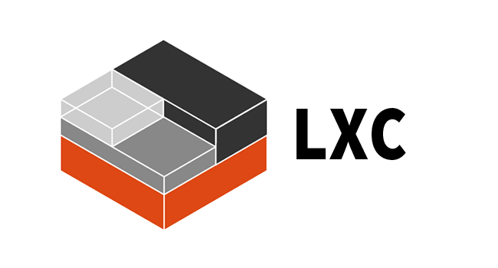
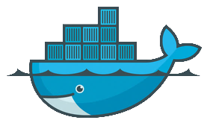


Container engines There is more than just Docker…
LXC / LXD
VM Containers in Linux kernel eventually enhanced by Ubuntu
Docker
That’s what we are talking about, since 2013
rkt [ˈr(ɒ)kit]
Container engine by CoreOS to replace Docker
cri-o
New lightweight container runtime to implements Kubernetes' container runtime interface

Slide 4
Linux Features
Chroot
Changes the root directory for a process to any given directory
Namespaces
Isolation of resources per process
7 different namespaces
netfilter
Firewall and packet manipulation
cgroups
Manage resource allocation
Netlink
Interprocess communication between containers
SELinux/AppArmor
Security profiles to govern access to resources
capabilities
Granular control of privileges
seccomp
Limitation of syscalls to processes
Docker Runtime
dockerd
Container
Container
Container
Container
Linux
namespaces
Netlink
SELinux
netfilter
seccomp
capabilities
cgroups
AppArmor
Hardware

Slide 5




Filesystem isolation with chroot
/
Chroot makes any directory the topmost/root directory of a process
New process can only see files and directories under that special root directory
Provides file system isolation
bin
home
foo
/
container101
chroot
bin
container
lib
bin
usr
lib
usr
usr

Slide 6
Process (and more) isolation with namespaces
Linux process tree
Namespaces give a process a limited view on the process table
Only processes in the same namespace can see each other
Processes get new PIDs in namespace
Still visible with their original PID outside of namespace
Same principle applies to mount, uid, cgroup, …, namespaces
1
3
27
16
namespaced process tree
1 (31)
49
51
31
4 (62)
7 (12)
62
12

Slide 7
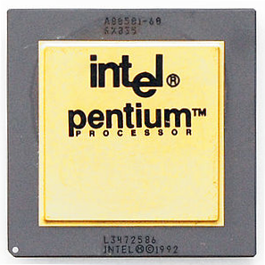
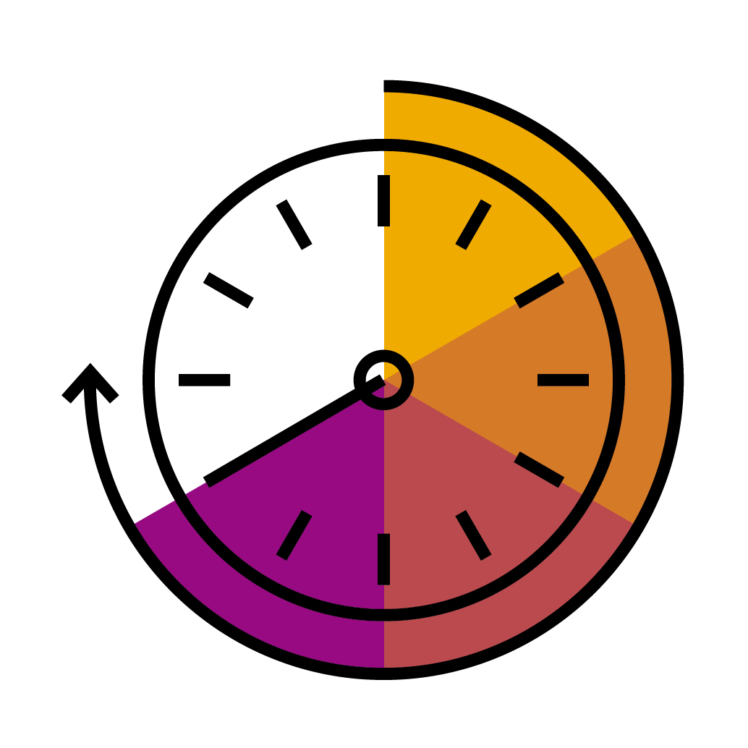
Resource limitations with cgroups
cgroups limit access of a process to system resources
Several processes can be in the same cgroup they all share the resource limit
cgroups offer resource control for
CPU
memory
block I/O
and others
cgroup
Process
Process
Process
Process

Slide 8

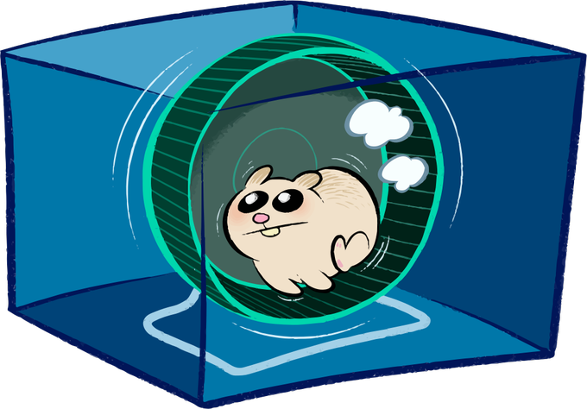
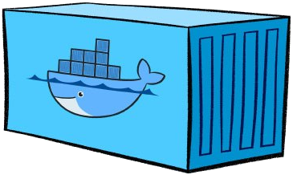
A look into the docker engine
Docker daemon is the central entry point for all API requests
dockerd
Container runtime to handle container lifecycle based on OCI specs
containerd
shim process which takes over parent ownership of a running container
containerd-shim
containerd-shim
containerd-shim
runc
runc
runc
runc actually starts the container

