Slide 1
NoSQL databases
“Not Only SQL”

Slide 2
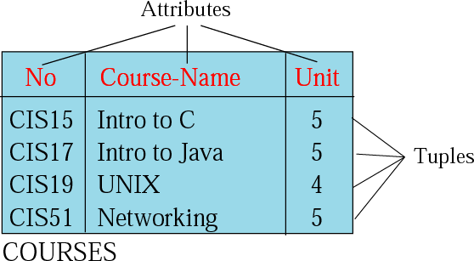
What is RDBMS
2
RDBMS: the relational database management system.
Relation: a relation is a 2D table which has the following features:
Name
Attributes
Tuples
Name

Slide 3
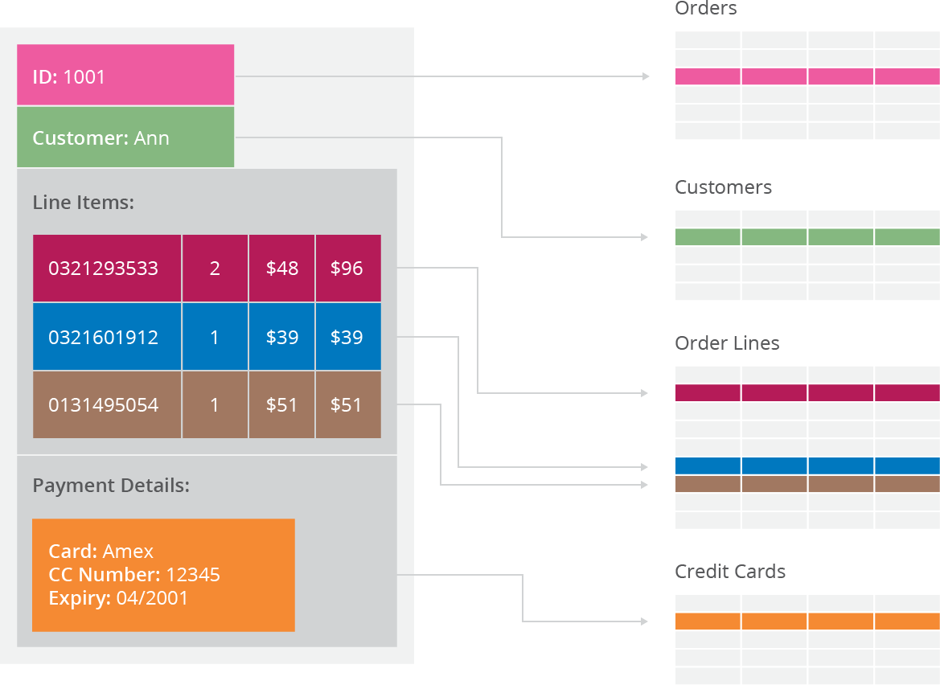
Issues with RDBMS- Scalability
3
Issues with scaling up when the dataset is just too big e.g. Big Data.
Not designed to be distributed.
Looking at multi-node database solutions. Known as ‘horizontal scaling’.
Different approaches include:
Master-slave
Sharding

Slide 4
What is NoSQL
5
Stands for Not Only SQL. Term was redefined by Eric Evans after Carlo Strozzi.
Class of non-relational data storage systems.
Do not require a fixed table schema nor do they use the concept of joins.
Relaxation for one or more of the ACID properties (Atomicity, Consistency, Isolation, Durability) using CAP theorem.

Slide 5
NoSQL Types
7
NoSQL database are classified into four types:
Key Value pair based
Column based
Document based
Graph based

Slide 6
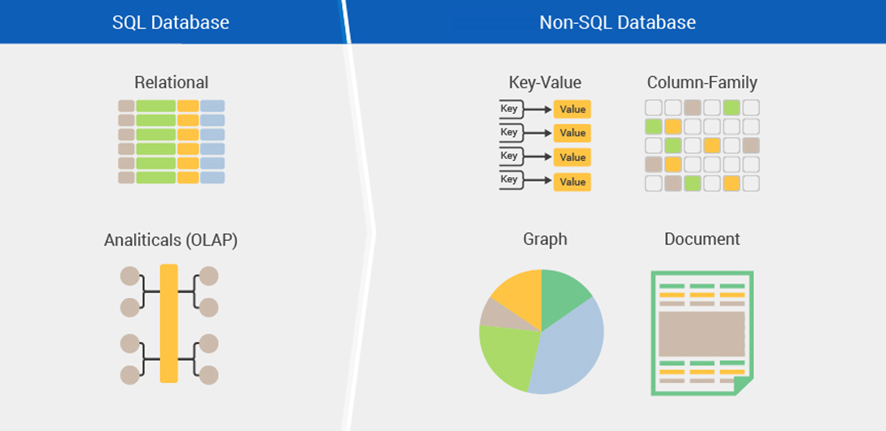

Slide 7
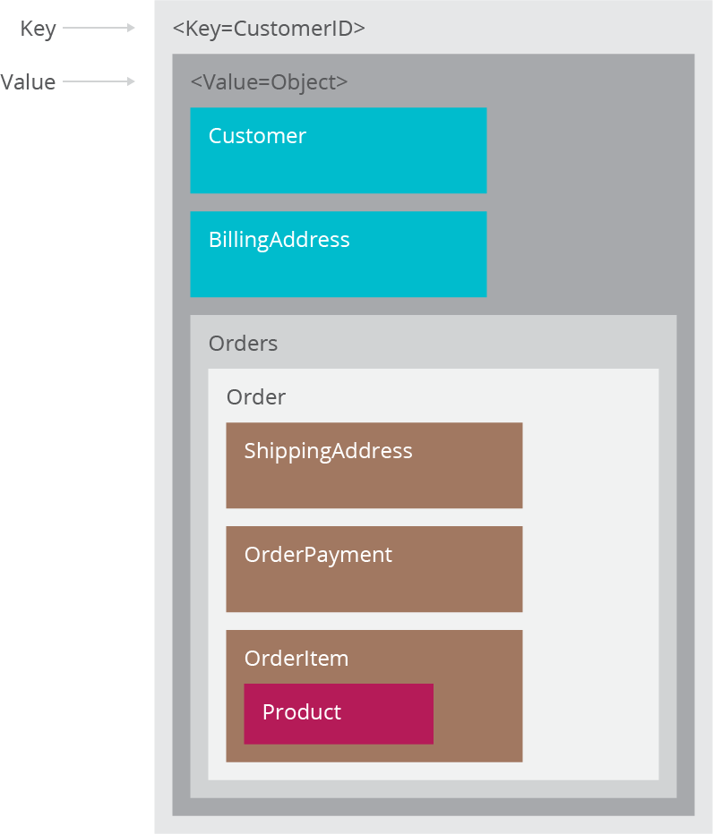
Key Value Pair Based
8
Designed for processing dictionary. Dictionaries contain a collection of records having fields containing data.
Records are stored and retrieved using a key that uniquely identifies the record, and is used to quickly find the data within the database.
Example: CouchDB, Oracle NoSQL Database, STSDb etc.
We use it for storing session information, Stock exchange (Forex), Big data analysis.
We would avoid it when we need to query data having relationships between entities.

Slide 8
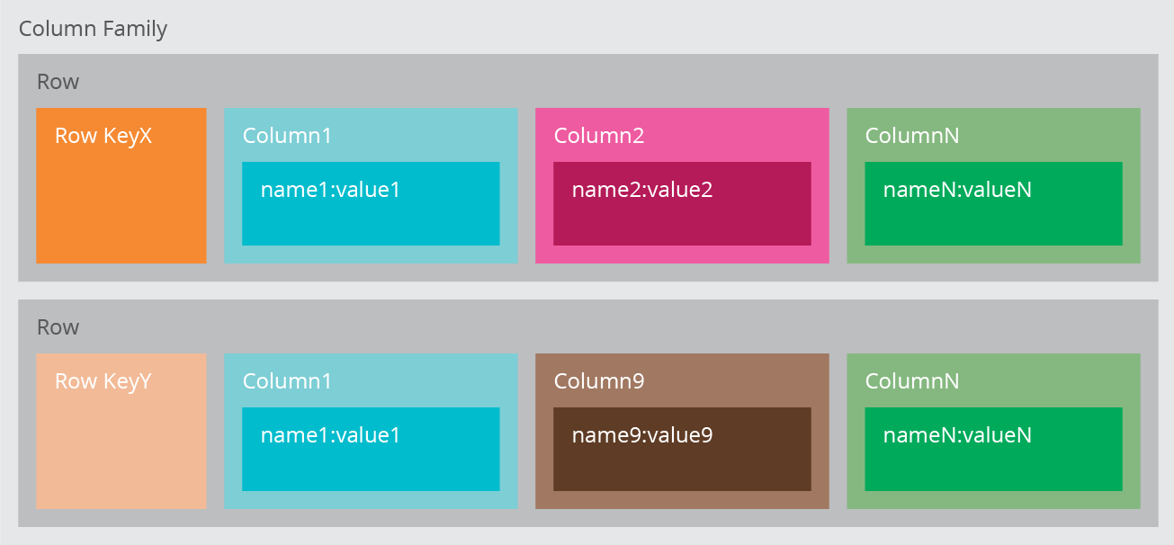
Column based
It store data as Column families containing
rows that have many columns associated with
a row key. Each row can have different columns.
Column families are groups of related data that
is accessed together.
Example: Cassandra, HBase, Hypertable
and Amazon DynamoDB.
We use it for content management systems, blogging platforms, log aggregation.
We would avoid it for systems that are in early development, changing query patterns.
9

Slide 9
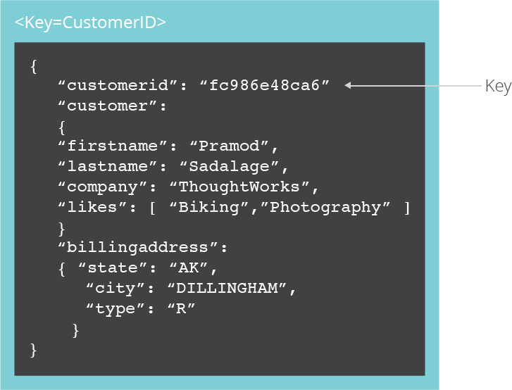
Document Based
The database stores and retrieves documents. It stores documents in the value part of the key-value store.
Self- describing, hierarchical tree data structures consisting
of maps, collections, and scalar values.
Example: Lotus Notes, MongoDB, Couch DB, Orient DB,
Raven DB.
We use it schemaless systems, real-time analytics, e- commerce applications.
We would avoid it for systems that need complex transactions spanning multiple operations or queries against varying aggregate structures.
10

Slide 10
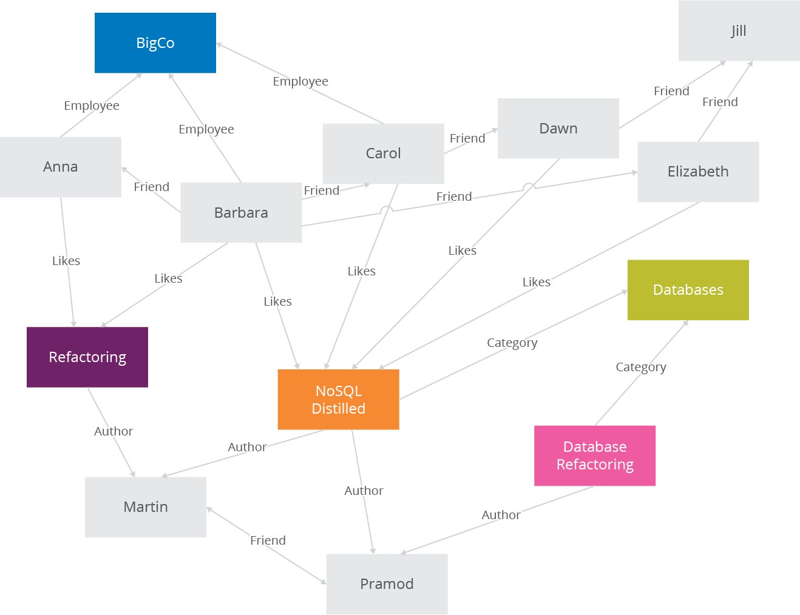
Graph Based
Store entities and relationships between these entities as nodes and edges of a graph respectively. Entities have properties.
Traversing the relationships is very fast as
relationship between nodes is not calculated at
query time but is actually persisted as a relationship.
Example: Neo4J, GraphDB, Infinite Graph, OrientDB.
It is well suited for connected data, such as social
networks, spatial data, routing information for goods
and supply.
11

Slide 11
CAP Theorem
12
According to Eric Brewer a distributed system has 3 properties :
Consistency
Availability
Partitions
We can have at most two of these three properties for any shared-data system
To scale out, we have to partition. It leaves a choice between consistency and availability. ( In almost all cases, we would choose availability over consistency)

Slide 12
MongoDB– Key Features
Scale horizontally over commodity hardware
RDBMSs great so keep what works
Rich data models
Adhoc queries
Fully featured indexes
What doesn’t distribute well?
Long running multi-row transactions
Joins
Both artifacts of the relational data model
Do not homogenize programming interfaces
Local storage first class citizen for DB storage

Slide 13
Data stored as documents (JSON)
Schema free
CRUD operations – (Create Read Update Delete)
Atomic document operations
Ad hoc Queries like SQL
Equality
Regular expression searches
Ranges
Geospatial
Secondary indexes
Sharding (sometimes called partitioning) for scalability
Replication – HA and read scalability

Slide 14
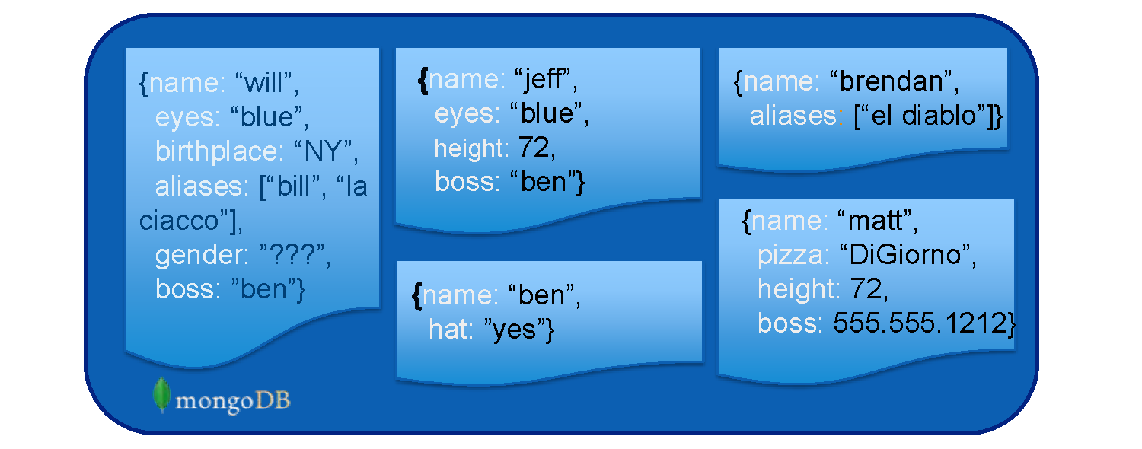
Schema Free
MongoDB does not need any defined data schema.
Every document could have different data!

Slide 15
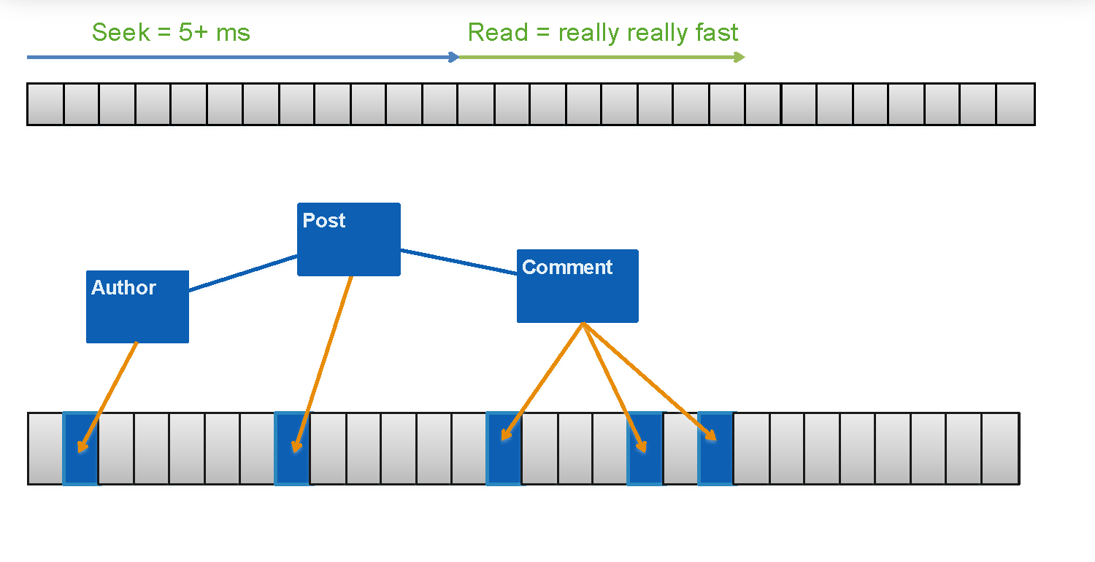
Data Storage

Slide 16
Graph database - Neo4j Examples
Open and Log in - https://neo4j.com/sandbox-v2/
Create new account or use this
User name
Password

Slide 17
Cypher language - basic operations
Create new object
CREATE (n:Person { name: 'Andres', title: 'Developer' })
Node/Collection name
Label name / property name
Value
Create relationships
MATCH (a:Person),(b:Person) WHERE a.name = 'A' AND b.name = 'B' CREATE (a)-[r:RELTYPE]->(b) RETURN type(r)
Select object
MATCH (movie:Movie) RETURN movie.title

Slide 18
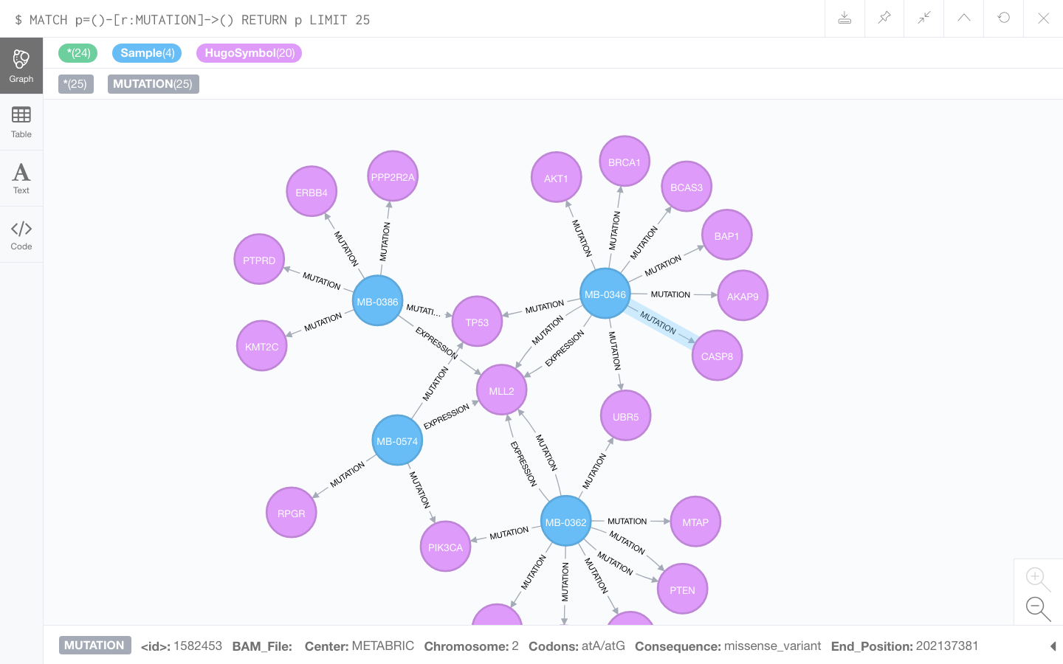
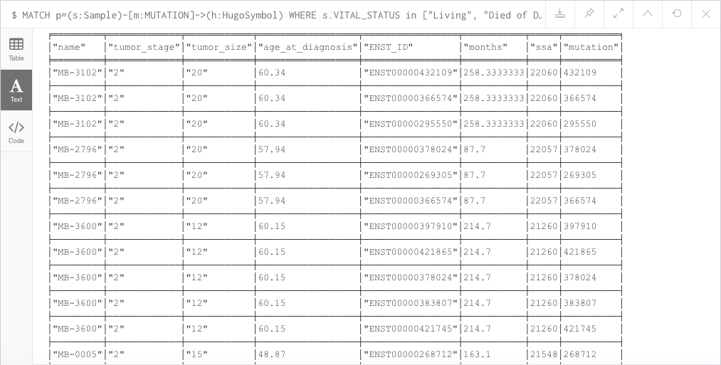
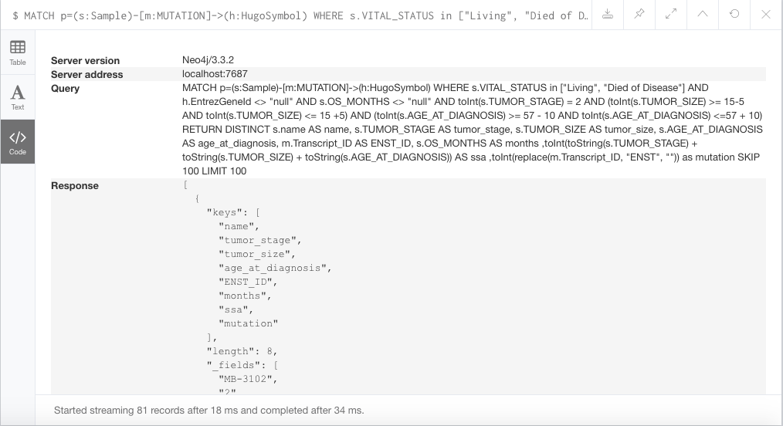
Views

Slide 19
Python - example
#--------------- INITIALIZE DRIVER ----------------------- def __init__(self, uri, user, password):
self._driver = GraphDatabase.driver(uri, auth=(user, password))
def print_greeting(self, message):
with self._driver.session() as session:
greeting = session.write_transaction(self._create_and_return_greeting, message)
print(greeting)
#----------------EXECUTE QUERY---------------------------
def _create_and_return_greeting(tx, message):
result = tx.run("CREATE (a:Greeting) "
"SET a.message = $message "
"RETURN a.message + ', from node ' + id(a)", message=message)
return result.single()[0]

