Slide 1
H-PaGe
(Home Page Generator)
Svetoslav Nikolov
(http://svetoslavnikolov.wordpress.com)

Slide 2
Background (why)
The structure of the DTU web pages is quite complicated (http://www.oersted.dtu.dk)
The designer must replicate the menu for each web page.
The idea – keep them separate. The designer just writes the content.

Slide 3
What is H-PaGe
H-PaGe is a program for generating dynamic web pages.
Written in PHP.
Pages do not exist physically.
Created on the fly from a specification.

Slide 4
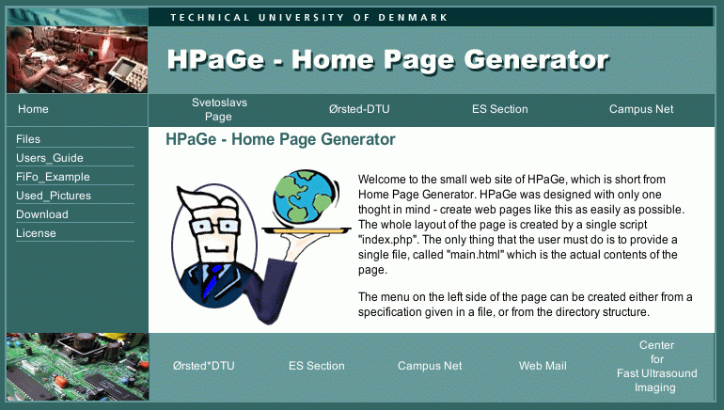
Structure of Ørsted’s Pages
Pictures:
  Upper left and right
  Middle left and right
  Lower left.
Menus:
  Top.
  Left.
  Bottom.
Contents

Slide 5
Structure Of a Web Site
Here ”web site” means a place to which we return when we click on a button ”home”. For example Ørsted’s site.
The personal web sites are located at:
http://www.oersted.dtu.dk/personal/$USER

Slide 6
Directory Structure
Each web site has one ROOT DIRECTORY and a number of sub-directories
root_dir
sub_dir_1
sub_dir_2
sub_dir_3
The ”root_dir” for the personal pages is on the web server under: /home/$USER/2www/

Slide 7
Create Web Page With H-PaGe
Obtain the distribution of H-PaGe.
Copy ”index.php” to the root directory, for example in ”/home/$user/2www/”.
Specify your web site in the file ”web.config”. Give color scheme, names of pictures, etc.
”web.config” is in the same directory as ”index.php”
Create the files with the contents for each of the web pages in your web site.

Slide 8
What Is ”web.config”?
”web.config” is a file with commands to the server defining the looks and the structure of the web site.
”web.config” is created with a text editor. For example Word Pad or NEdit.
The file looks like this:
<?
// This is a comment
# This is also a comment
/*This is also a comment*/
set_style(’green.css’); // This is a command.
?>

Slide 9
Define Color Scheme
The color scheme is defined with a command set_style
<?
set_style(’name_of_style.css’);
?>
Possible options are:
green.css, red.css, blue.css,
lila.css, cyan.css, brown.css
These files define not only the colors, but also the font names, sizes, etc.

Slide 10
Specify Images
Images are added by the command add_image.
<?
//add_image(’position’,’file’,’descript’,’link’);
add_image(’upperright’,’dtu_logo_ur_green.gif’,
’DTU’, ’http://www.dtu.dk’);
add_image(’middleright’,’~/pictures/sn_name.png’,
’SN’);
add_image(’menu_line’,’.pictures/line_blue.gif’);
?>

Slide 11
The Images
upperleft
upperright (600 x 20)
middleleft
(151 x 72)
middleright
(600 x 72)
menu_line (130 x 3) or (130 x 1)
lowerleft
(151 x 72)

Slide 12

Create Menus
H-PaGe was initially developed to create the menus automatically from the directory structure.
/31000 --+-- /Slides
+-- /Notes
+-- /Exam
Home
Slides
Notes
../31000 contains:
index.php,
web.config
Exam

Slide 13
Expected Files
In the root directory, say, 31000, it is expected to have ”index.php”, ”web.config”.
In the rest ot the directories, ”index.php” expects to find a file with a name ”main.html”, or ”main.htm” or ”main.txt”.
If you make sub-directories, they will appear as sub-menus.
Only the menu on the left can be created like this.

Slide 14
Other Menus
left
top
bottom

Slide 15
Specifying Menus In web.config
Items in the mennu can be added to the web site from web.config using the command add_menu.
<?
//add_menu(’position’,’text’,’directory’,’file’)
// Absolute web address
add_menu(’top’, ’DTU’, ’http://www.dtu.dk’);
// Specify only directory
add_menu(’bottom’, ’Pictures’,’./pictures’);
// Specify directory and file
add_menu(’left’,’Links’, ’./’, ’links.html’);
?>

Slide 16
Other Commands
show_updated(’true’);
set_substitute(’true’ | ’false’);
add_bottom_text(’Some text instead of menu’);
set_title(’Some title for the page’);
Some Browser – Title of page
http://www.oersted.dtu.dk
bottom_text
Last updated: 1 Jan 1970

Slide 17
The Contents
The contents are simple html files.
Usually their name is ”main.html” if you work with directory structure.
contents
These files can be created with any editor – text or web editor. They can even be simple text files without any HTML formatting.

Slide 18
Things To Remember
All links are relative to the root directory, not to the current file with contents.
Do not use any formatting on the page like ”background color”, ”text color”, etc. The CSS files take care of it.
Make pages as simple as possible.

Slide 19

Let’s Do It !

Slide 20
Simple HTML
Header1 (title)
<h1> Some text </h1>
Header2 (section)
<h2> Section name</h2>
Header3 (sub-section)
<h3>Sub-section name</h3>

Slide 21
Simple HTML
Link:
<a href=”http://www.dtu.dk”> DTU </a>
Itemized list (with bullets):
<ul>
<li> Item text </li>
<li> Item text </li>
</ul>

Slide 22
Simple HTML
Enumerated list:
<ol>
<li> First item </li>
<li> Second item </li>
</ol>
New paragraph:
<p> Some text

