Slide 1
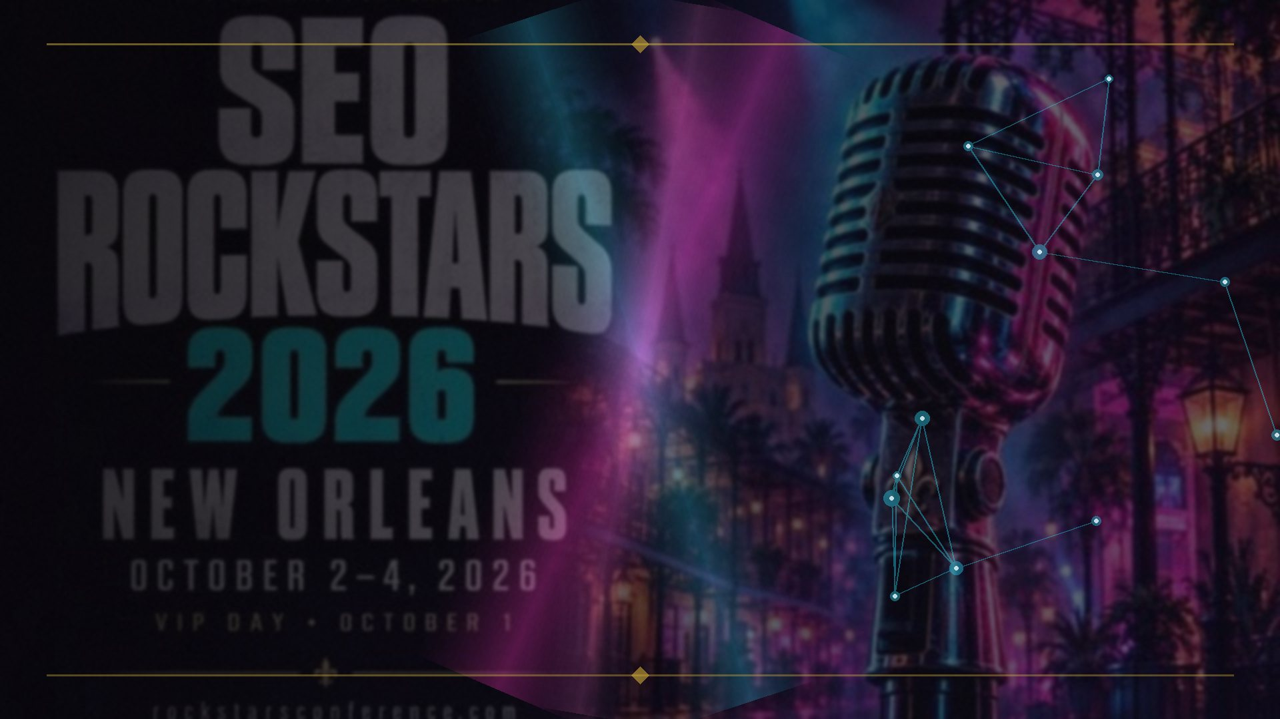
SEO ROCKSTARS 2026 · NEW ORLEANS
EIGHT GRAPHS,
ONE RANKING
How overlapping graphs determine prominence, authority, and trust — in search engines and AI alike.
BRIAN KATO · OCTOBER 2026
EIGHT GRAPHS, ONE RANKING · Brian Kato · SEO Rockstars 2026
1

Slide 2
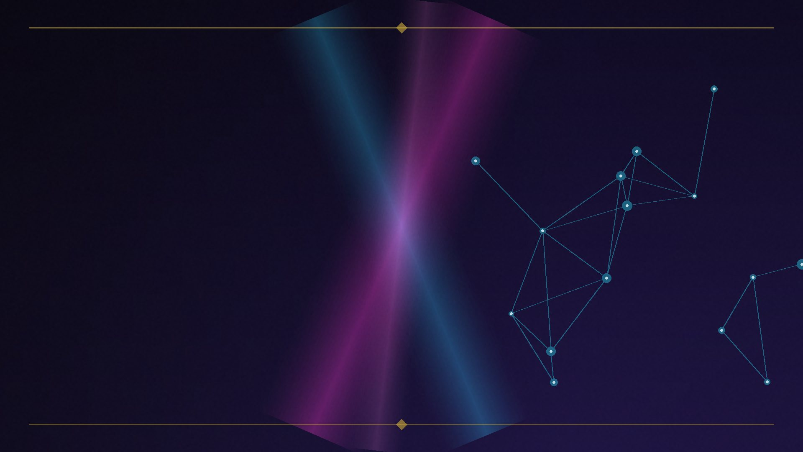
THE PROVOCATION
How many graphs does Google use to rank a page?
▸ Most people say one. (PageRank.)
▸ Some say two. (Links + entities.)
▸ The real answer: at least eight.
▸ And the math that fuses them was published a decade ago — in a biology journal.
EIGHT GRAPHS, ONE RANKING · Brian Kato · SEO Rockstars 2026
2
Notes:
Poll the room. Pause. Most will say one, some will say two.

Slide 3
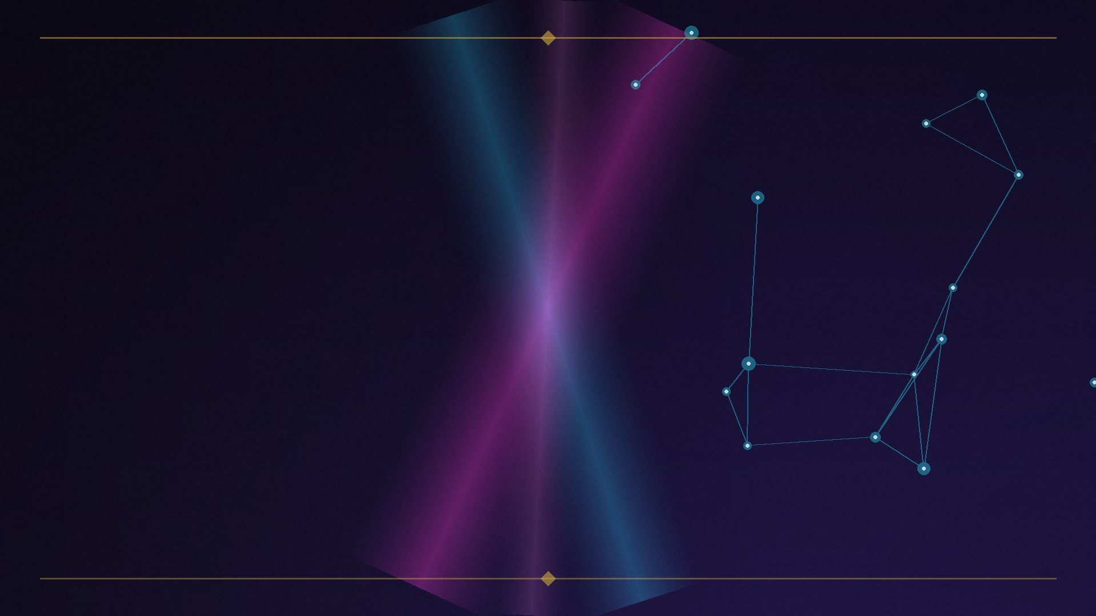
THE THESIS
One trick. Every system.
▸ Nearly all modern retrieval runs the same multi-graph playbook —
▸ Google • Bing • Perplexity • ChatGPT Search • every serious RAG pipeline
▸ Rankings are the interference pattern of overlapping graphs.
▸ Three acts: the graphs → the fusion math → the same pattern in AI.
EIGHT GRAPHS, ONE RANKING · Brian Kato · SEO Rockstars 2026
3
Notes:
Thesis statement. Preview the three acts.

Slide 4
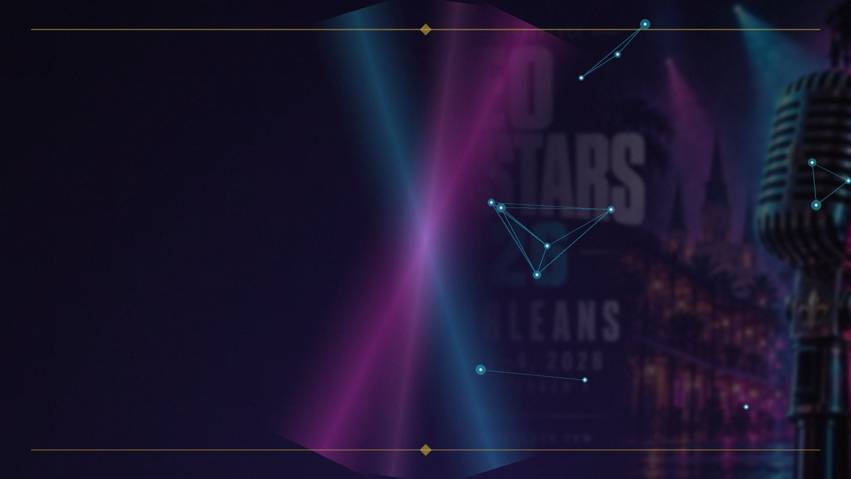
ACT I — THE SINGLE-GRAPH MYTH
The graph we all know
▸ 1998: the web as a directed graph of pages and links — the random surfer.
▸ Original PageRank patent (Stanford) expired January 2019.
▸ But Google never stopped patenting the link graph:
▸ US9165040B1 — distance-based PageRank, valid to 2027
▸ US8972329B2 — random-surfer ranking on graphs
Patents: US9165040B1 • US8972329B2
EIGHT GRAPHS, ONE RANKING · Brian Kato · SEO Rockstars 2026
4
Notes:
The link graph is still actively patented.

Slide 5
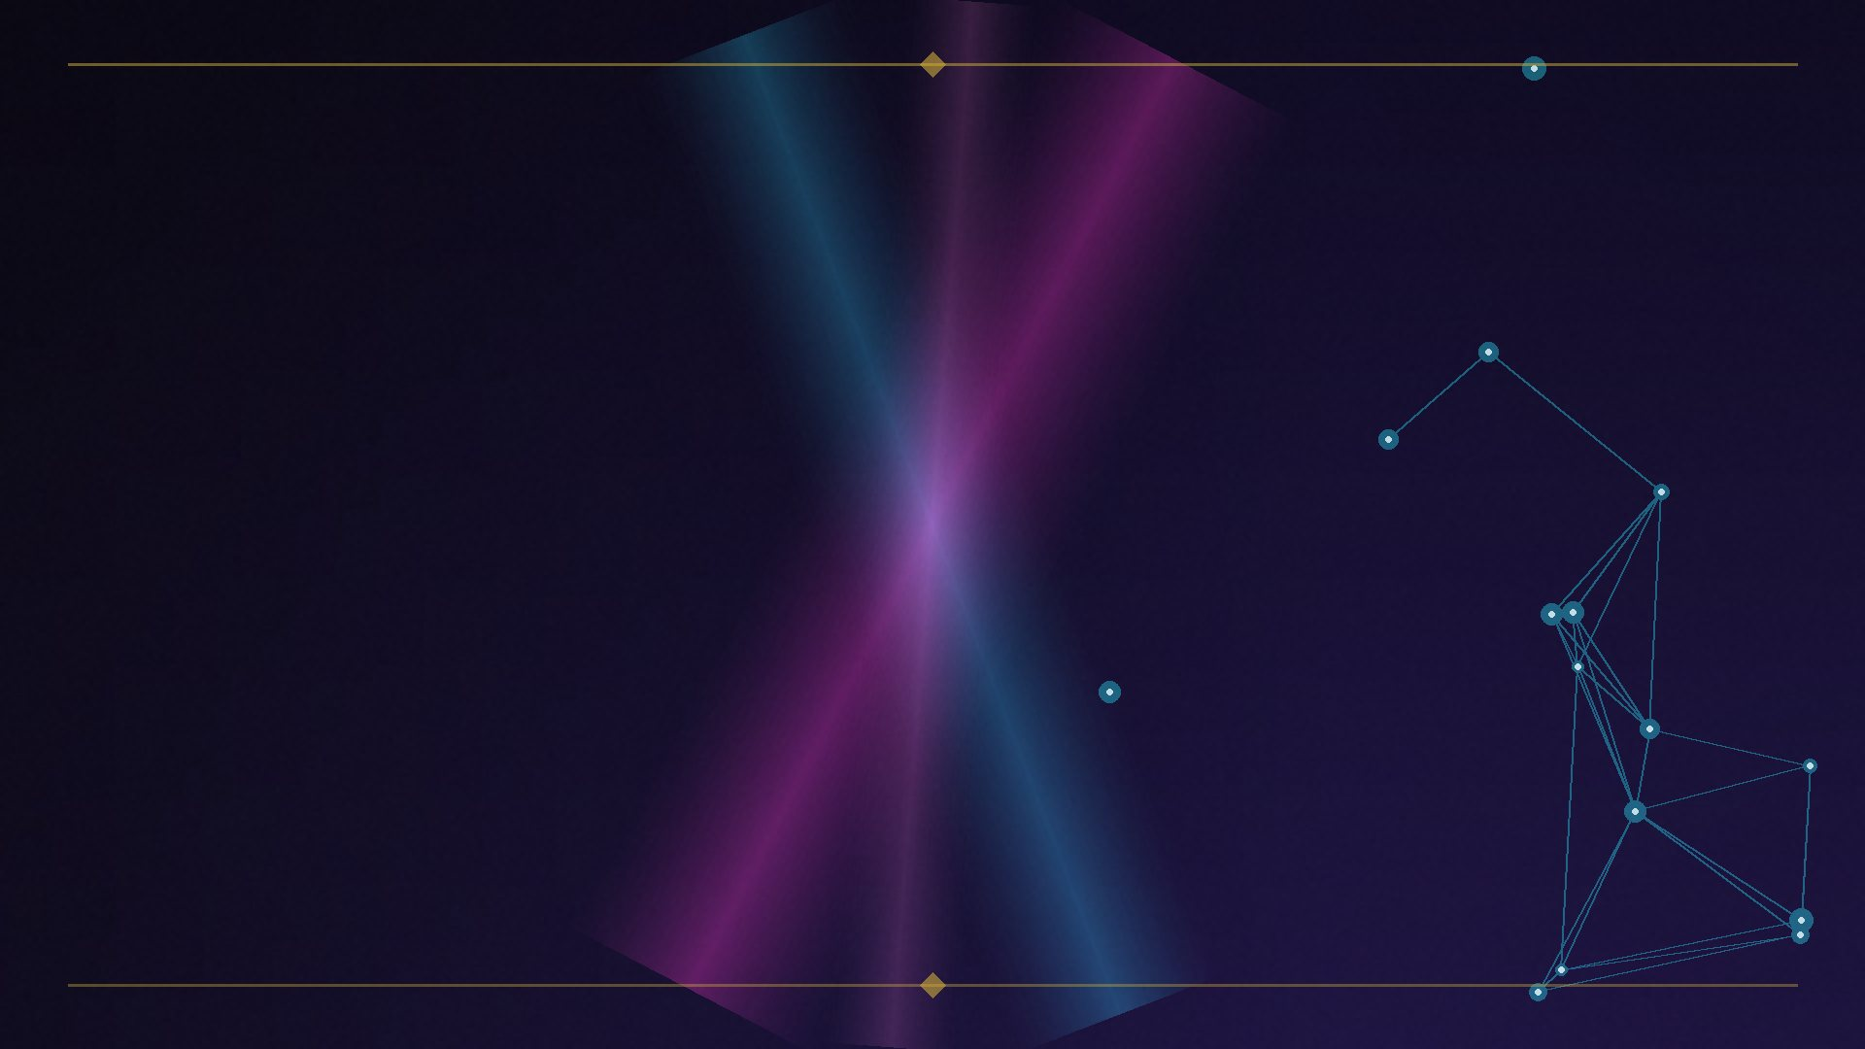
2012
“We’ve been working on an intelligent model — in geek-speak, a ‘graph’ — that understands real-world entities and their relationships to one another: things, not strings.”
Amit Singhal, SVP Engineering, Google — launching the Knowledge Graph, May 16, 2012
• 500M objects • 3.5B facts at launch (last official count)
• The moment the web stopped being one graph.
EIGHT GRAPHS, ONE RANKING · Brian Kato · SEO Rockstars 2026
5

Slide 6
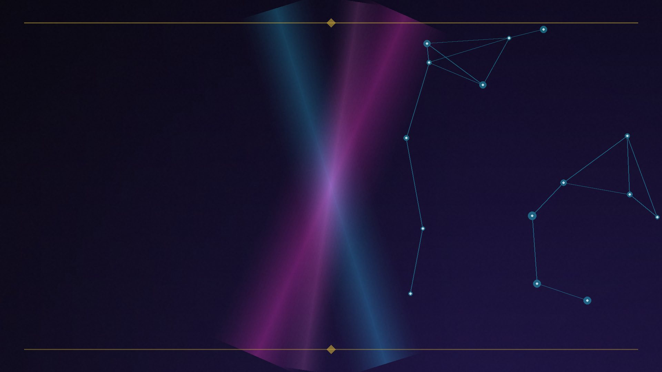
ACT I — THE SINGLE-GRAPH MYTH
The mental model most SEOs still run
▸ One axis: more links = more authority.
▸ Links are one layer.
▸ The ranking you see is the interference pattern of eight graphs overlapping —
▸ like moiré patterns. Like frequencies in a Fourier transform.
EIGHT GRAPHS, ONE RANKING · Brian Kato · SEO Rockstars 2026
6
Notes:
The pivot line of Act I.

Slide 7
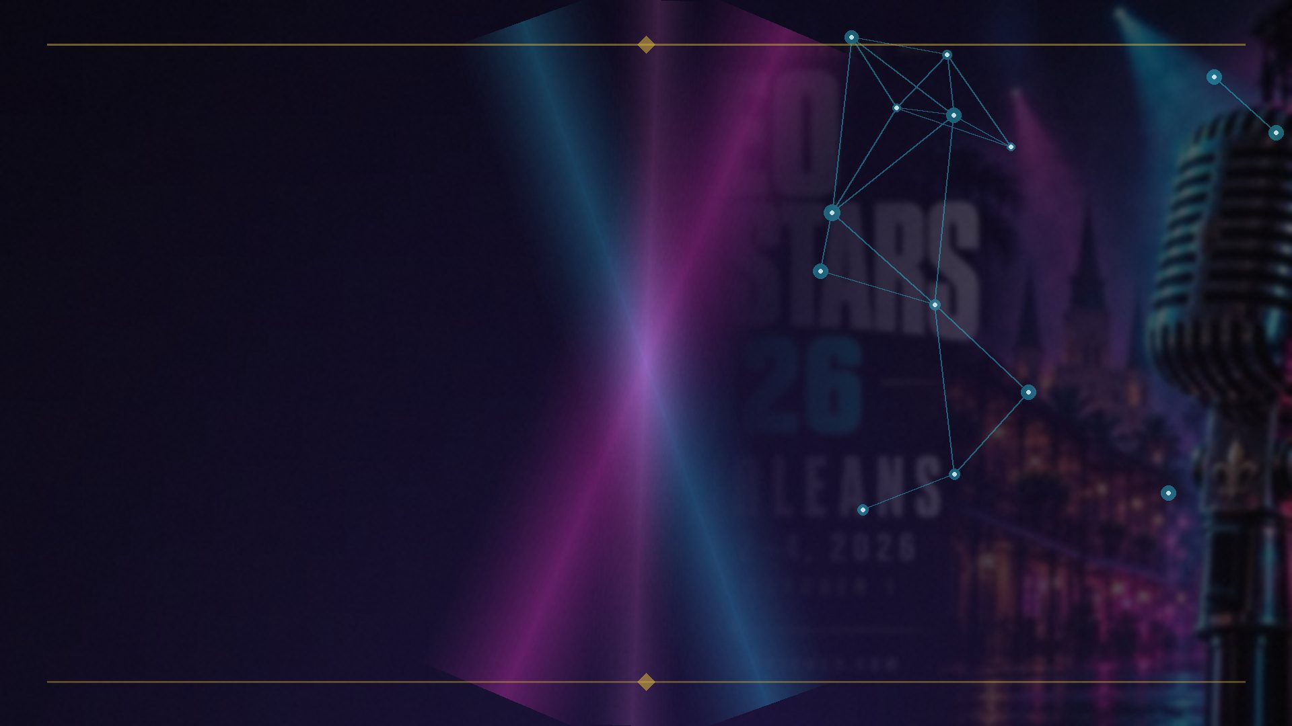
ACT II — THE EIGHT GRAPHS • GRAPH 01 / 08
The Link Graph
SCORES: AUTHORITY
▸ Nodes: pages. Edges: hyperlinks. Scored by PageRank-family random walks.
▸ DOJ trial: the ‘Quality’ signal = PageRank + link distance from trusted seed sites.
US9165040B1 • US8972329B2 • DOJ v. Google testimony
EIGHT GRAPHS, ONE RANKING · Brian Kato · SEO Rockstars 2026
7

Slide 8
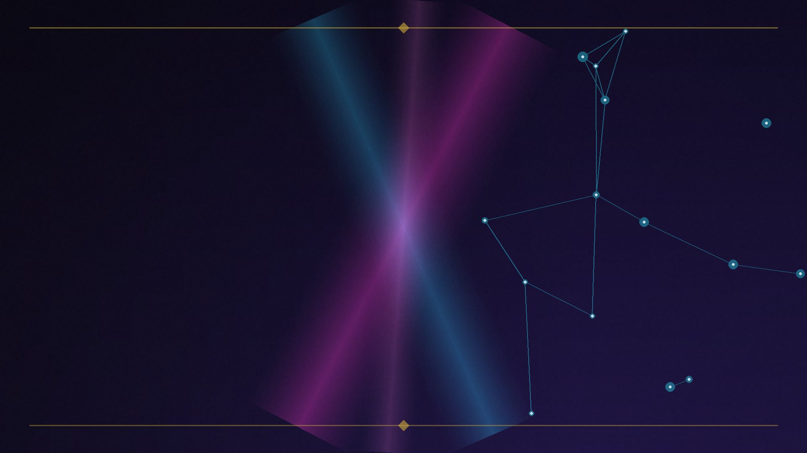
ACT II — THE EIGHT GRAPHS • GRAPH 02 / 08
The Entity / Knowledge Graph
SCORES: UNDERSTANDING
▸ Nodes: real-world things. Edges: typed relationships.
▸ US11762933B2 (2023): the query ‘pinpoints nodes within a knowledge graph’ — before document scoring.
▸ US11256866: the KG sits in the answering path.
US11762933B2 • US11256866 • Singhal 2012
EIGHT GRAPHS, ONE RANKING · Brian Kato · SEO Rockstars 2026
8

Slide 9
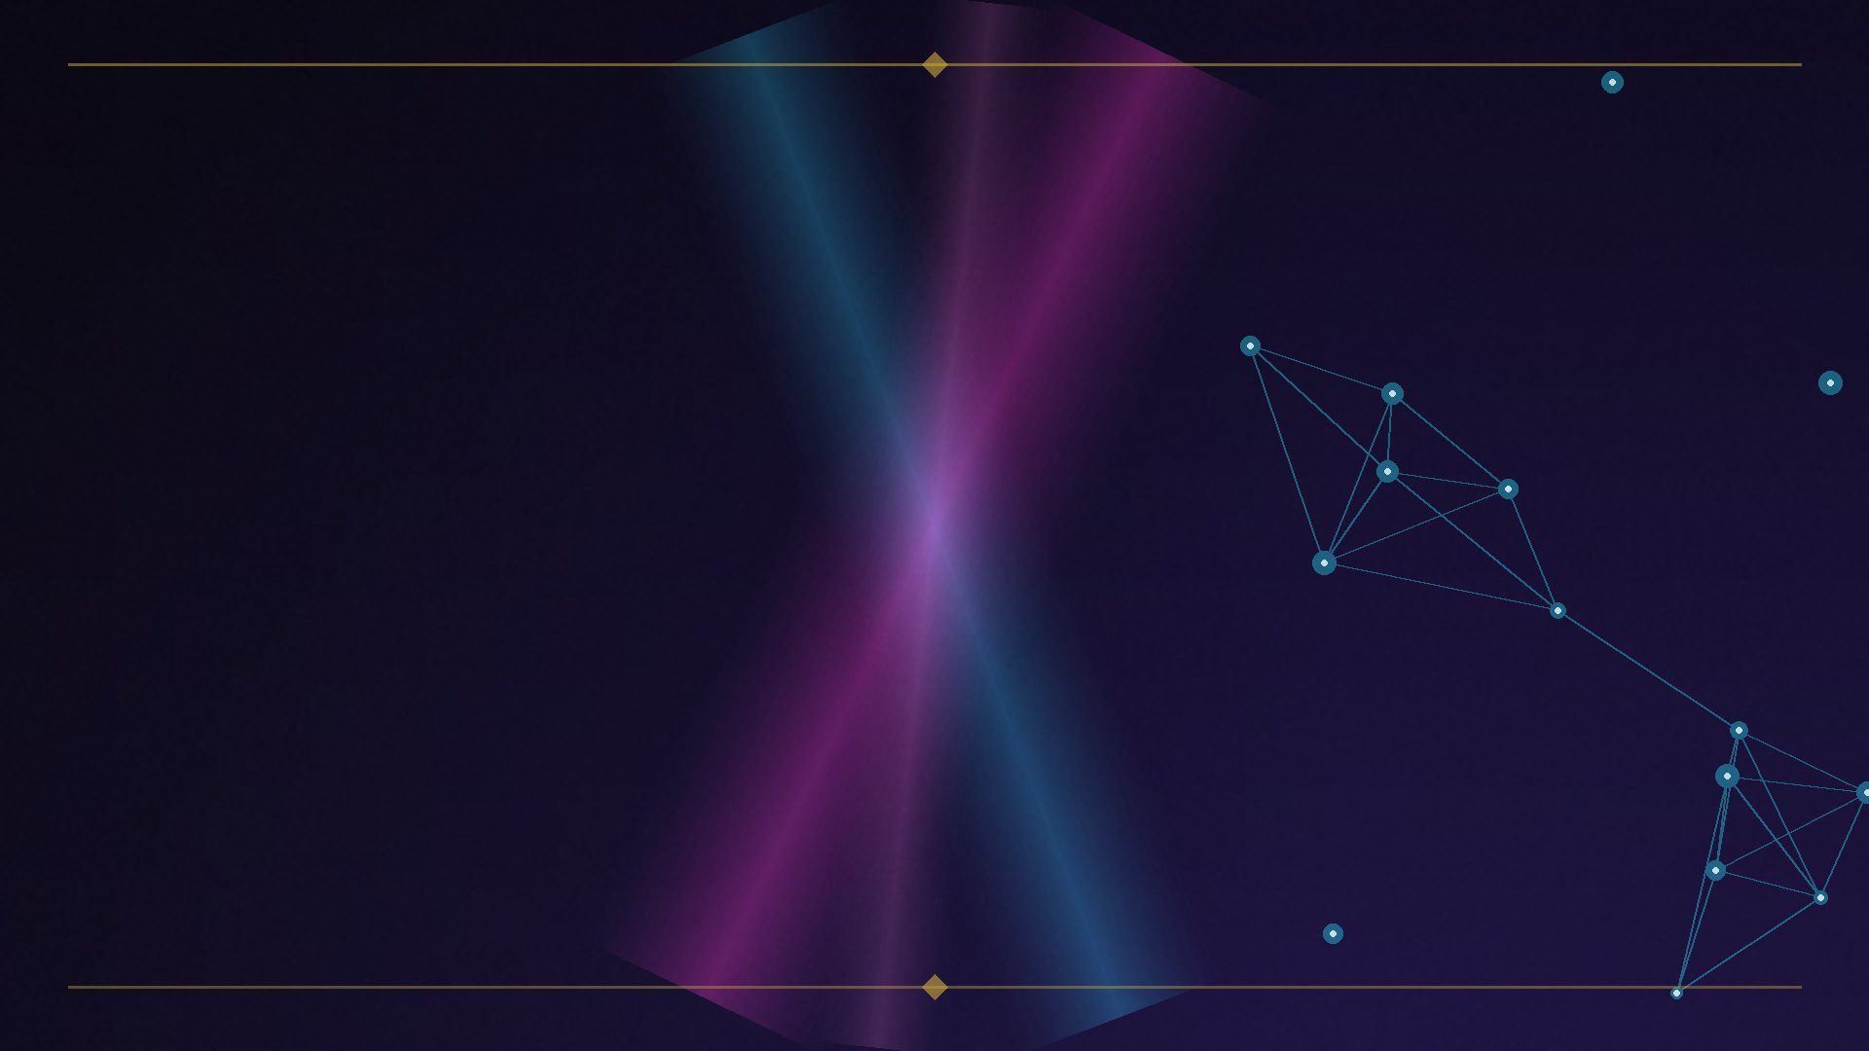
ACT II — THE EIGHT GRAPHS • GRAPH 03 / 08
The Topical Salience Graph
SCORES: DEPTH
▸ Bipartite document↔entity edges, weighted by salience — how central an entity is to a document.
▸ Cloud NL API analyzeEntities returns salience + a Knowledge Graph mid for every entity — a live window into the mechanism.
▸ DOJ ‘ABC’ signals: Anchors / Body / Clicks → Topicality.
Cloud Natural Language API docs • SEL on ABC signals
EIGHT GRAPHS, ONE RANKING · Brian Kato · SEO Rockstars 2026
9

Slide 10
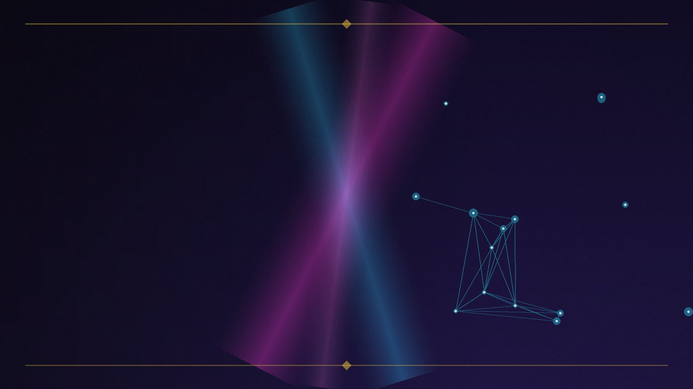
ACT II — THE EIGHT GRAPHS • GRAPH 04 / 08
The Behavioral Graph
SCORES: SATISFACTION
▸ Bipartite user↔document edges: clicks, dwell, Chrome visits.
▸ Navboost running since ~2005 on 13 months of click data (Glue underneath).
▸ 2024 leak: goodClicks • badClicks • lastLongestClicks.
▸ “Pretty much everyone knows we’re using clicks in rankings.” — Eric Lehman, sworn DOJ testimony, 2023
DOJ testimony (Nayak, Lehman) • 2024 Content Warehouse leak
EIGHT GRAPHS, ONE RANKING · Brian Kato · SEO Rockstars 2026
10
Notes:
The graph most SEOs deny — confirmed under oath. A wow beat.

Slide 11
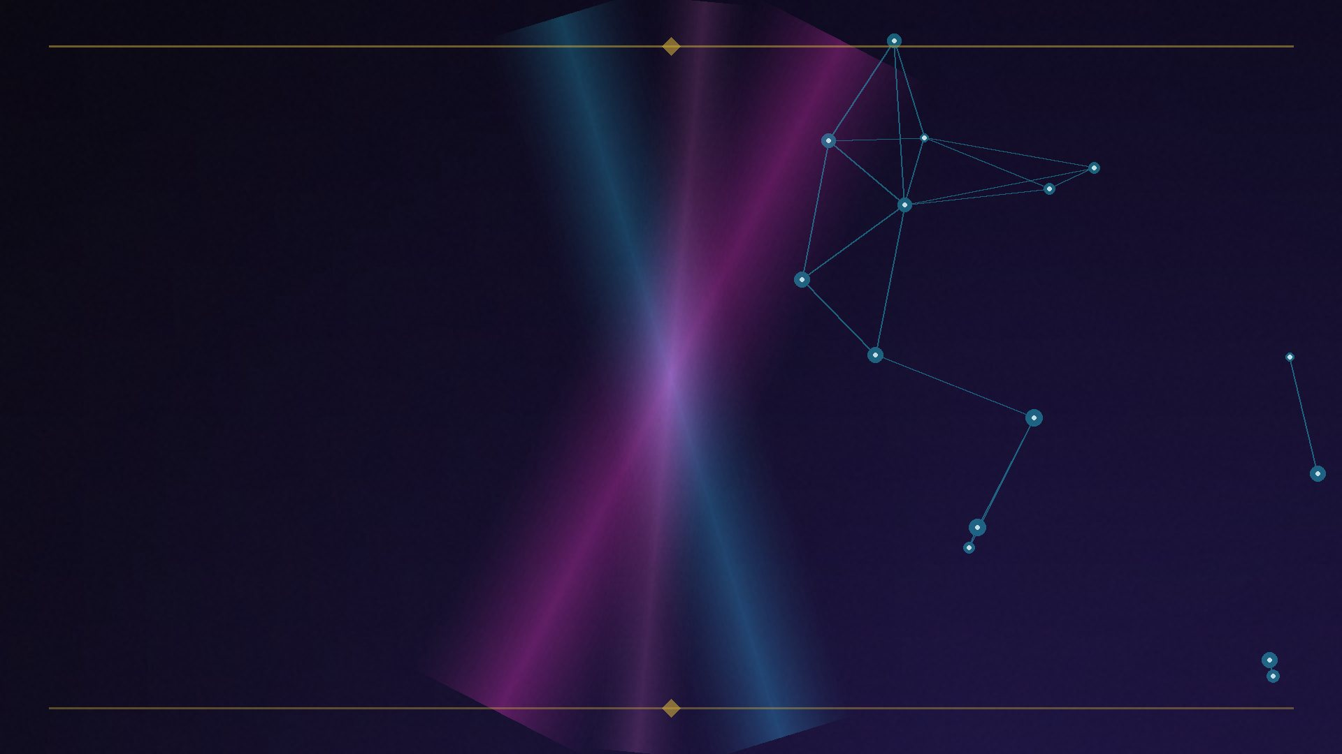
ACT II — THE EIGHT GRAPHS • GRAPH 05 / 08
The Authorship / Identity Graph
SCORES: PROVENANCE
▸ Person nodes → document edges.
▸ 2007: Agent Rank patent — author ‘digital signatures’ as a ranking signal.
▸ 2011: rel=author → 2014: dropped → 2020: ‘Author Vectors’ patent — algorithmic author ID from writing + behavior.
▸ The arc: explicit markup → inferred identity. E-E-A-T is this graph with a human-readable name.
Agent Rank (2007) • Author Vectors (2020) • QRG E-E-A-T
EIGHT GRAPHS, ONE RANKING · Brian Kato · SEO Rockstars 2026
11

Slide 12
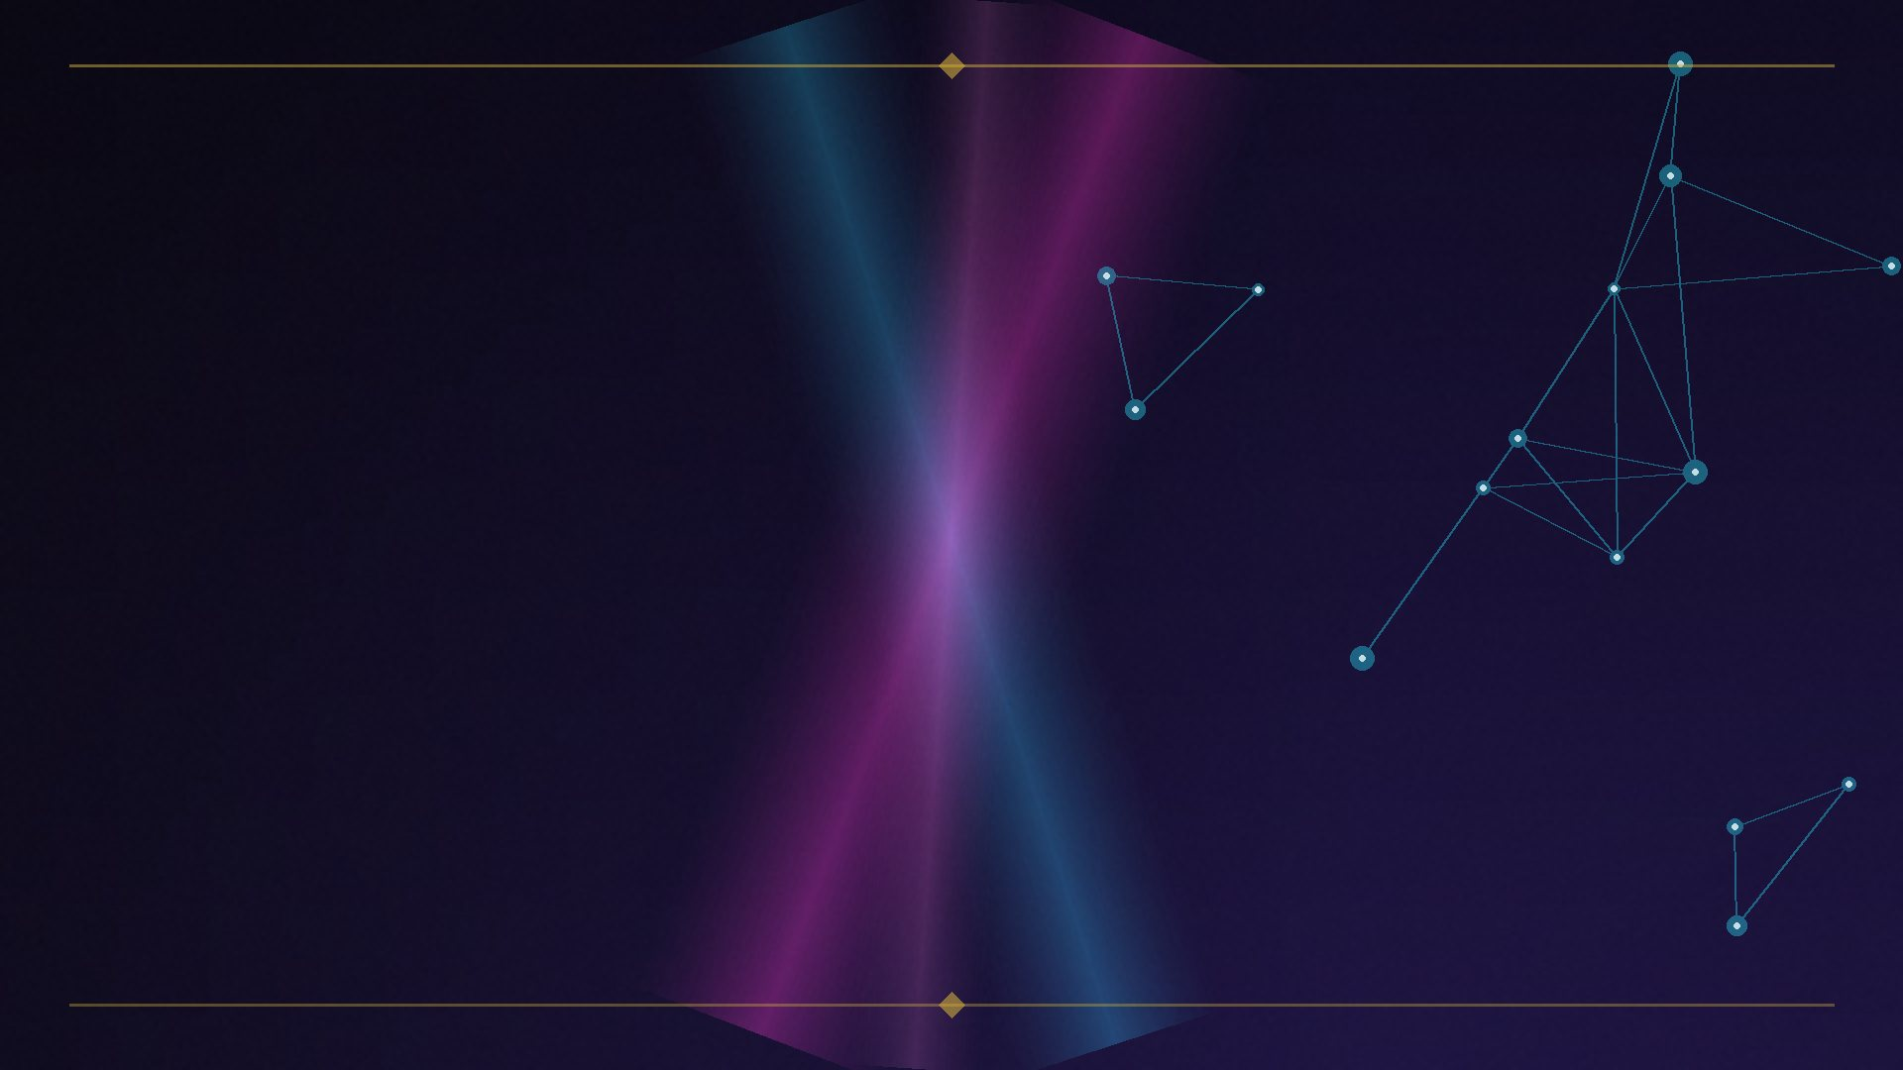
ACT II — THE EIGHT GRAPHS • GRAPH 06 / 08
The Local / Review Graph
SCORES: PROMINENCE
▸ Business↔place↔reviewer edges.
▸ Google’s official trio: Relevance • Distance • Prominence.
▸ Search Atlas, 3,269 businesses (Sept 2025): review-count influence rises 19% → 26% in top-ten local results — the review graph differentiates at the top.
Google local ranking docs • Search Atlas, Sept 2025
EIGHT GRAPHS, ONE RANKING · Brian Kato · SEO Rockstars 2026
12

Slide 13
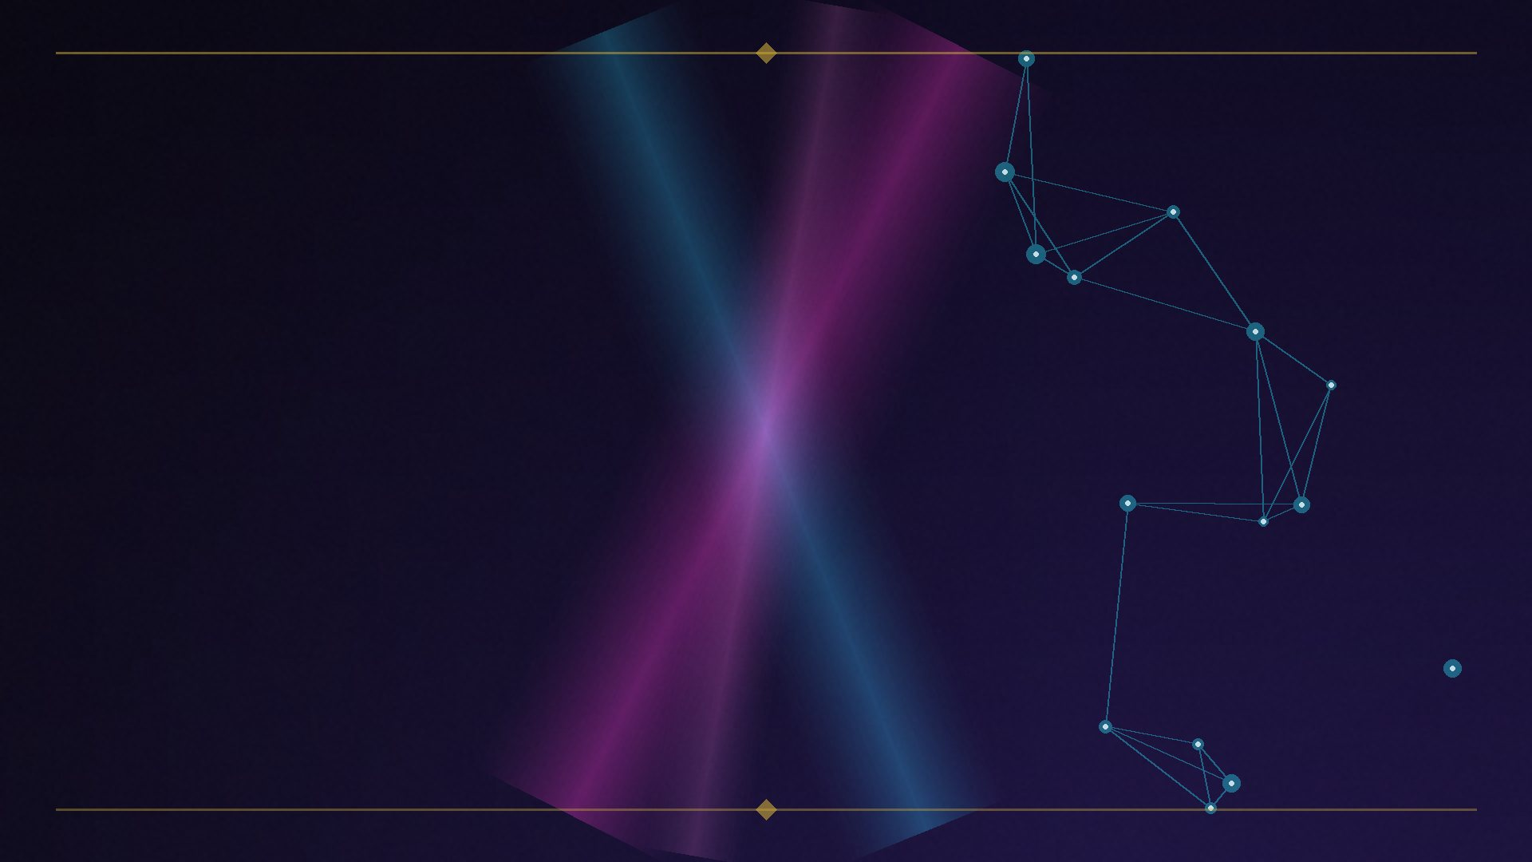
ACT II — THE EIGHT GRAPHS • GRAPH 07 / 08
The Trust / Spam Graph
SCORES: TRUST
▸ The link graph re-walked — teleportation restricted to human-verified seed sets.
▸ TrustRank: reliability decays with graph distance from seeds. Anti-Trust Rank runs in reverse from spam seeds.
▸ ‘PageRank and TrustRank are the same graph with different teleportation distributions.’
US7603350B1 • US7533092B2 • Gyöngyi et al. 2004
EIGHT GRAPHS, ONE RANKING · Brian Kato · SEO Rockstars 2026
13

Slide 14
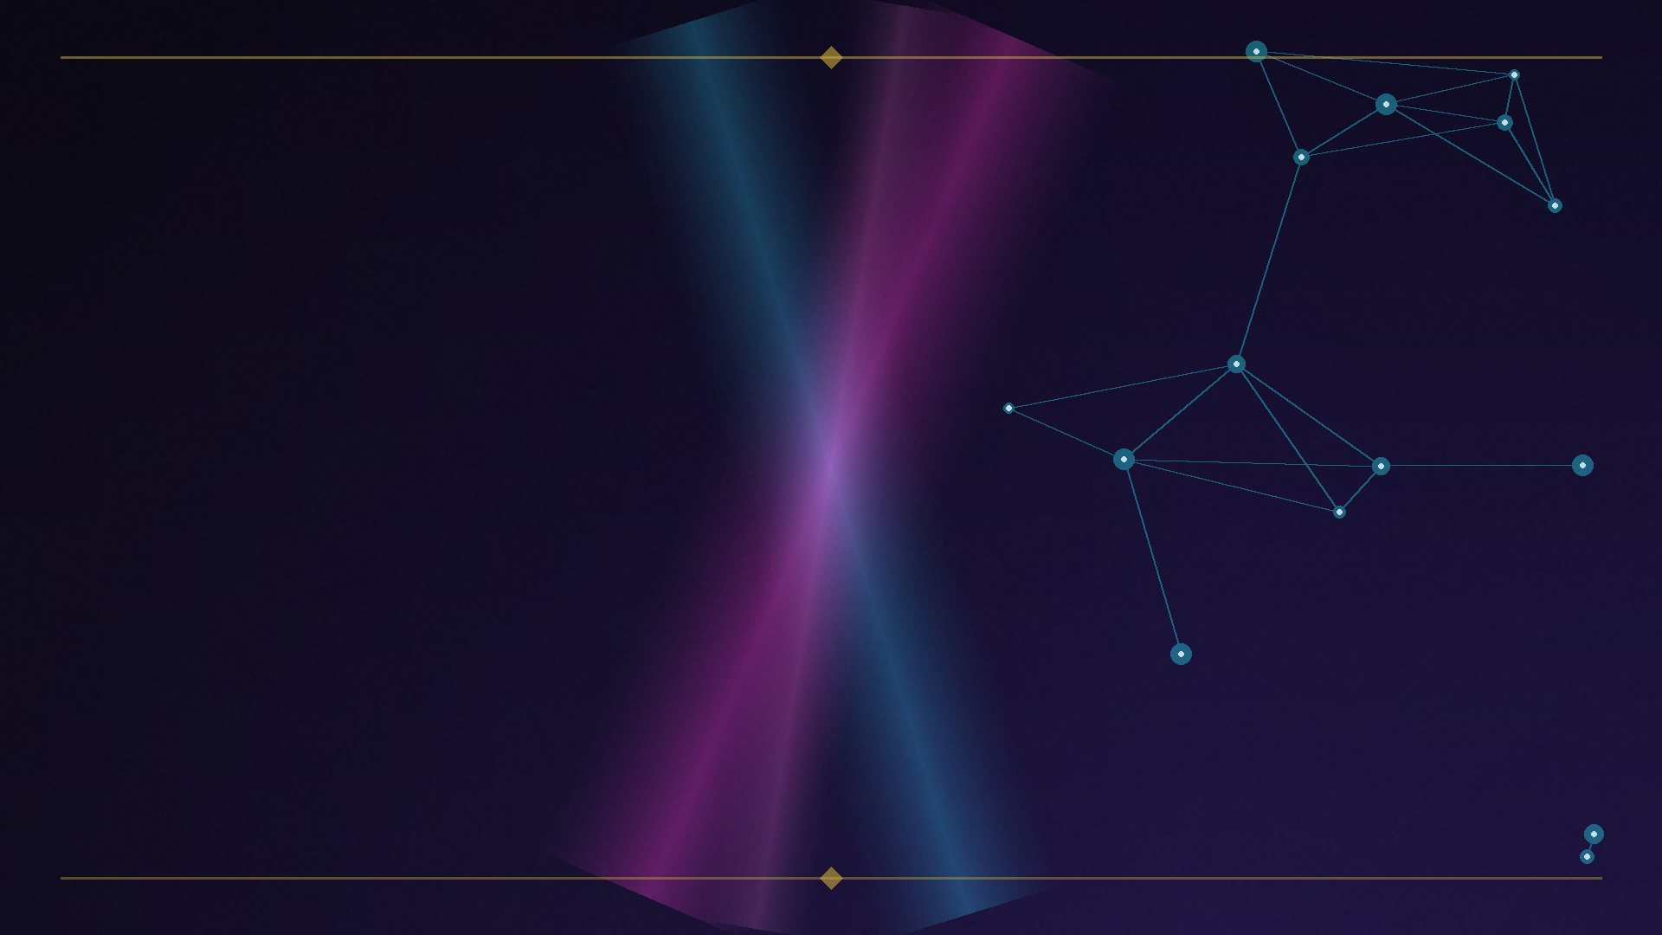
ACT II — THE EIGHT GRAPHS • GRAPH 08 / 08
The Citation Graph
SCORES: SCHOLARLY ECHO
▸ Garfield’s citation analysis → PageRank → Google Scholar.
▸ The scholarly sibling of the link graph — same random-surfer machinery, formal citations as edges.
PageRank patent history • Google Scholar
EIGHT GRAPHS, ONE RANKING · Brian Kato · SEO Rockstars 2026
14

Slide 15
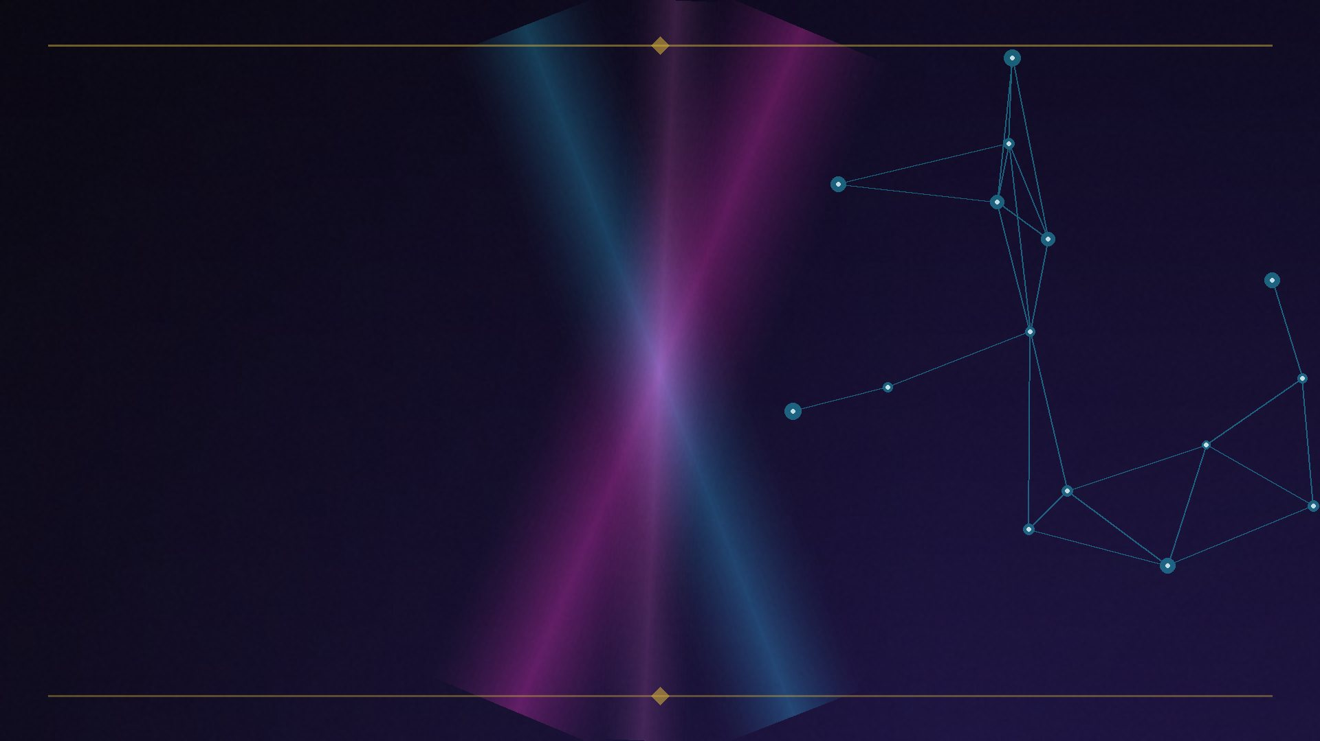
ACT II — RECAP
The map — eight graphs, one ranking
GRAPH | WHAT IT SCORES
Link graph | Authority
Entity / Knowledge graph | Understanding
Topical salience graph | Depth
Behavioral graph | Satisfaction
Authorship / Identity graph | Provenance
Local / Review graph | Prominence
Trust / Spam graph | Safety
Citation graph | Scholarly echo
EIGHT GRAPHS, ONE RANKING · Brian Kato · SEO Rockstars 2026
15
Notes:
The slide people will photograph.

Slide 16
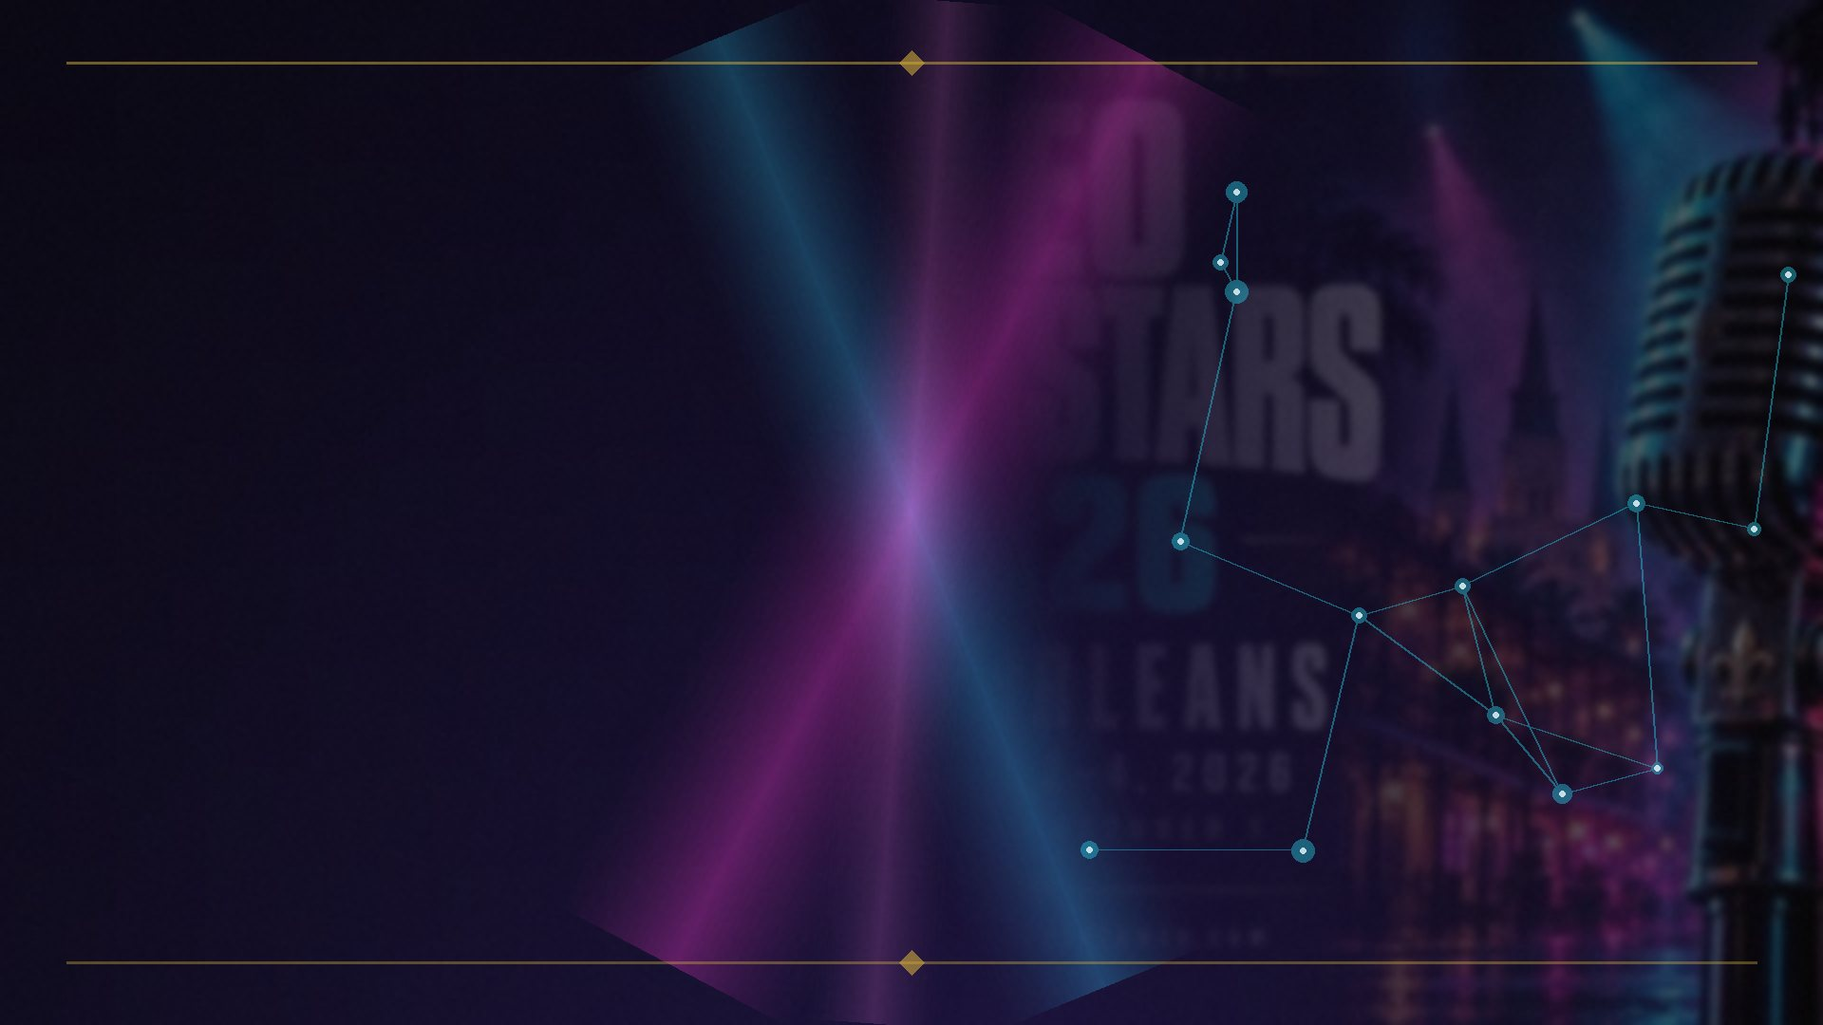
ACT III — HOW THE GRAPHS FUSE
The production pipeline: Superroot
▸ 1 • Candidate retrieval — web index + Knowledge Graph + specialist indexes
▸ 2 • First-pass scoring — PageRank, Q*, BM25-style
▸ 3 • Navboost / Glue re-rank — the behavioral graph
▸ 4 • DeepRank / RankBrain / RankEmbed re-rank
▸ 5 • Twiddlers → 6 • AI Overview generation (RAG over the ranked set)
▸ Early fusion → late fusion → ML fusion. Each stage is a different graph’s signal.
Antitrust disclosure analysis (Superroot orchestrator)
EIGHT GRAPHS, ONE RANKING · Brian Kato · SEO Rockstars 2026
16

Slide 17
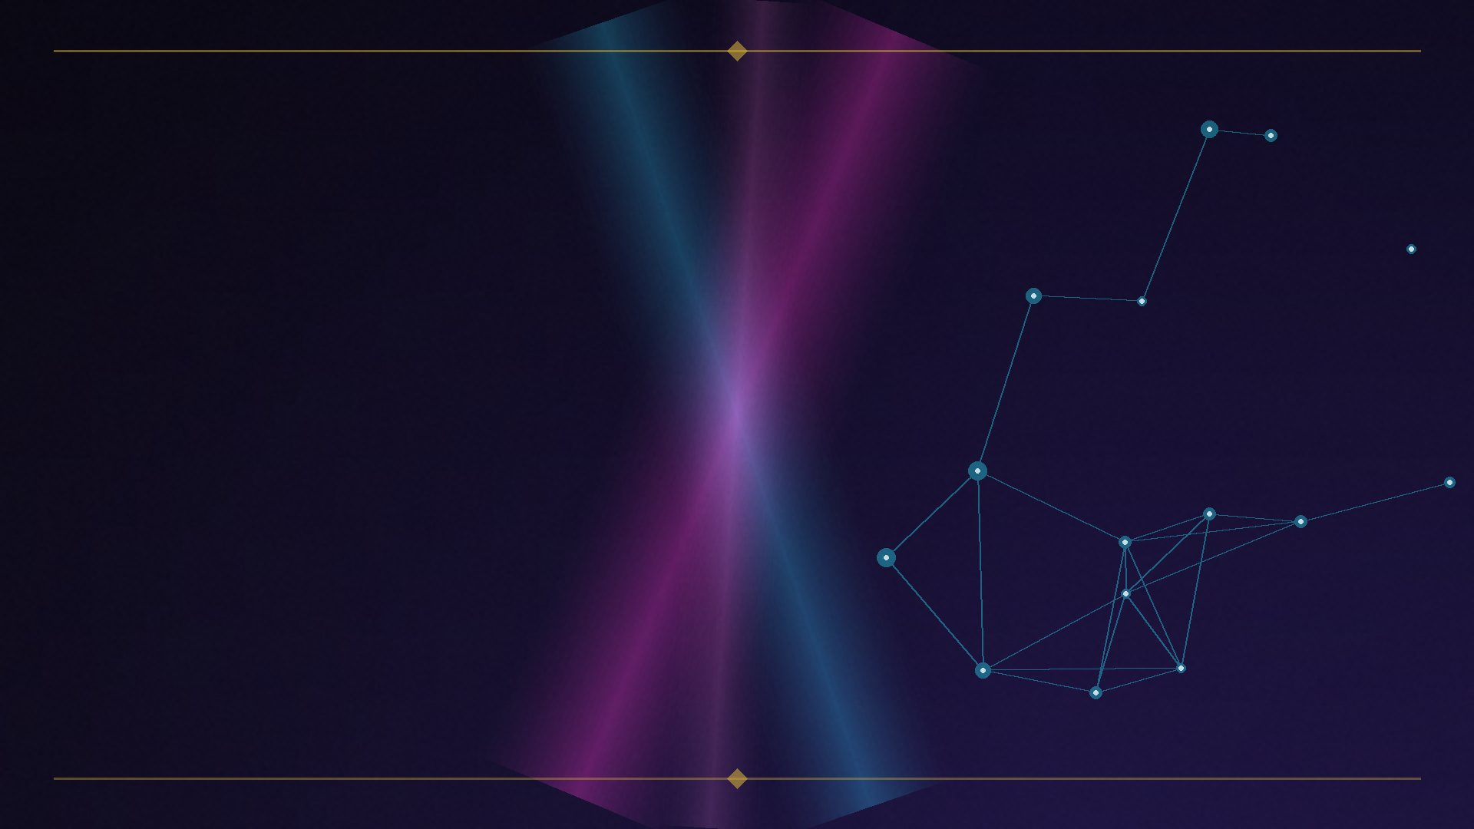
ACT III — THE FORMAL STATEMENT
“The centrality a node has in one layer affects the centrality the node can obtain in another layer.”
Multiplex PageRank — Halcão, Gómez, Arenas, Boccaletti, PLOS ONE 2013
• One layer’s scores bias the random jumps in another layer.
• This sentence is the thesis of this talk, in math form.
EIGHT GRAPHS, ONE RANKING · Brian Kato · SEO Rockstars 2026
17
Notes:
Slow down here. This is the intellectual peak.

Slide 18
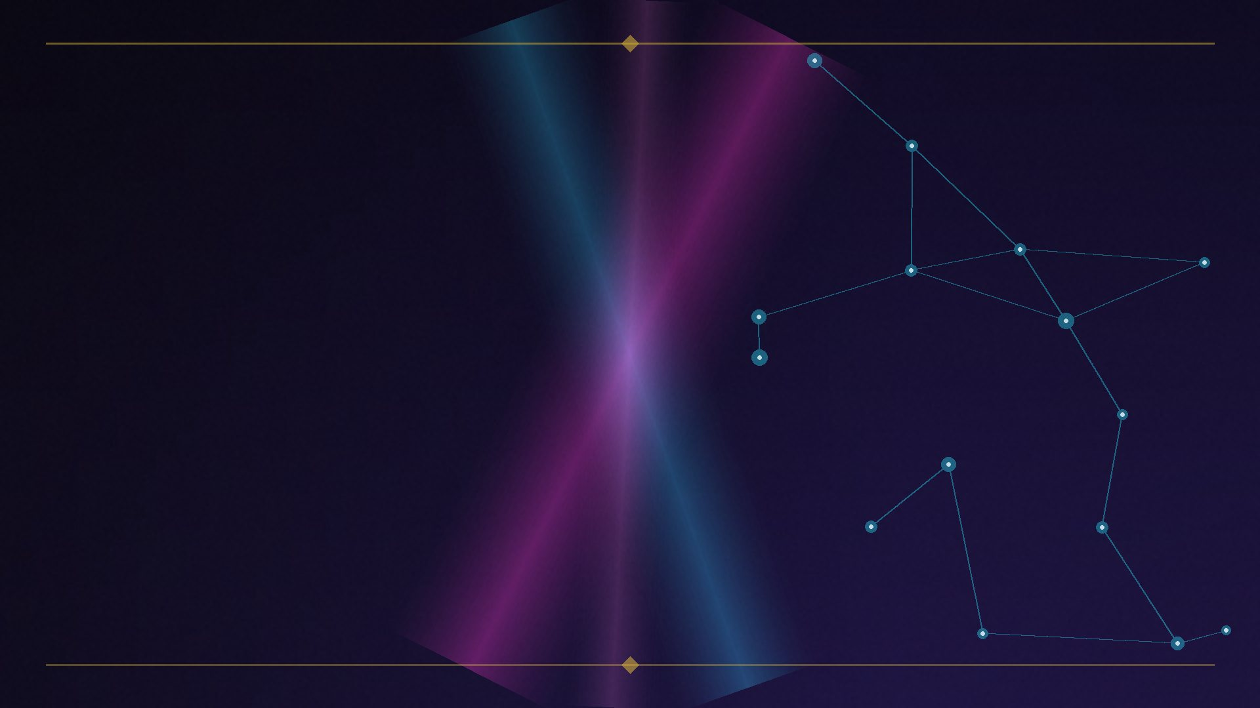
ACT III — HOW THE GRAPHS FUSE
Why fusion beats any single graph
▸ Chen (2022): global search on the multiplex beats any single layer in isolation.
▸ Translation for SEOs:
▸ A site strong on 5 graphs at 70% beats a site strong on 1 graph at 100%.
▸ That’s why ‘great links, mediocre everything else’ keeps losing.
arXiv:2207.08425 — Random walks on multiplex networks
EIGHT GRAPHS, ONE RANKING · Brian Kato · SEO Rockstars 2026
18

Slide 19
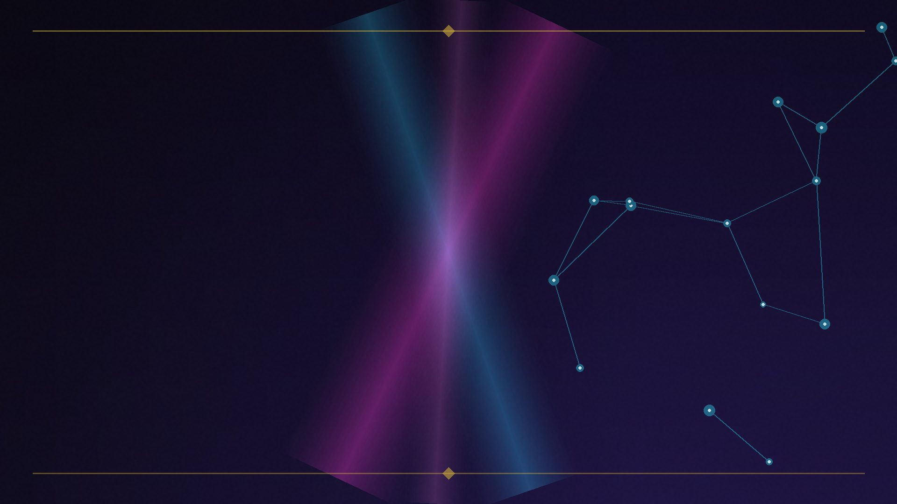
ACT III — HOW THE GRAPHS FUSE
Heterogeneous Information Networks
▸ Sun & Han: typed nodes, typed links.
▸ Meta-paths — e.g. author→paper→venue→paper — compose layers into similarity and ranking measures.
▸ In Google terms: PageRank/TrustRank = same layer, different walks; Navboost = a walk on the user–document bipartite graph; the KG is traversed at query time; learning-to-rank fuses late.
Sun & Han, Mining Heterogeneous Information Networks (Springer)
EIGHT GRAPHS, ONE RANKING · Brian Kato · SEO Rockstars 2026
19

Slide 20
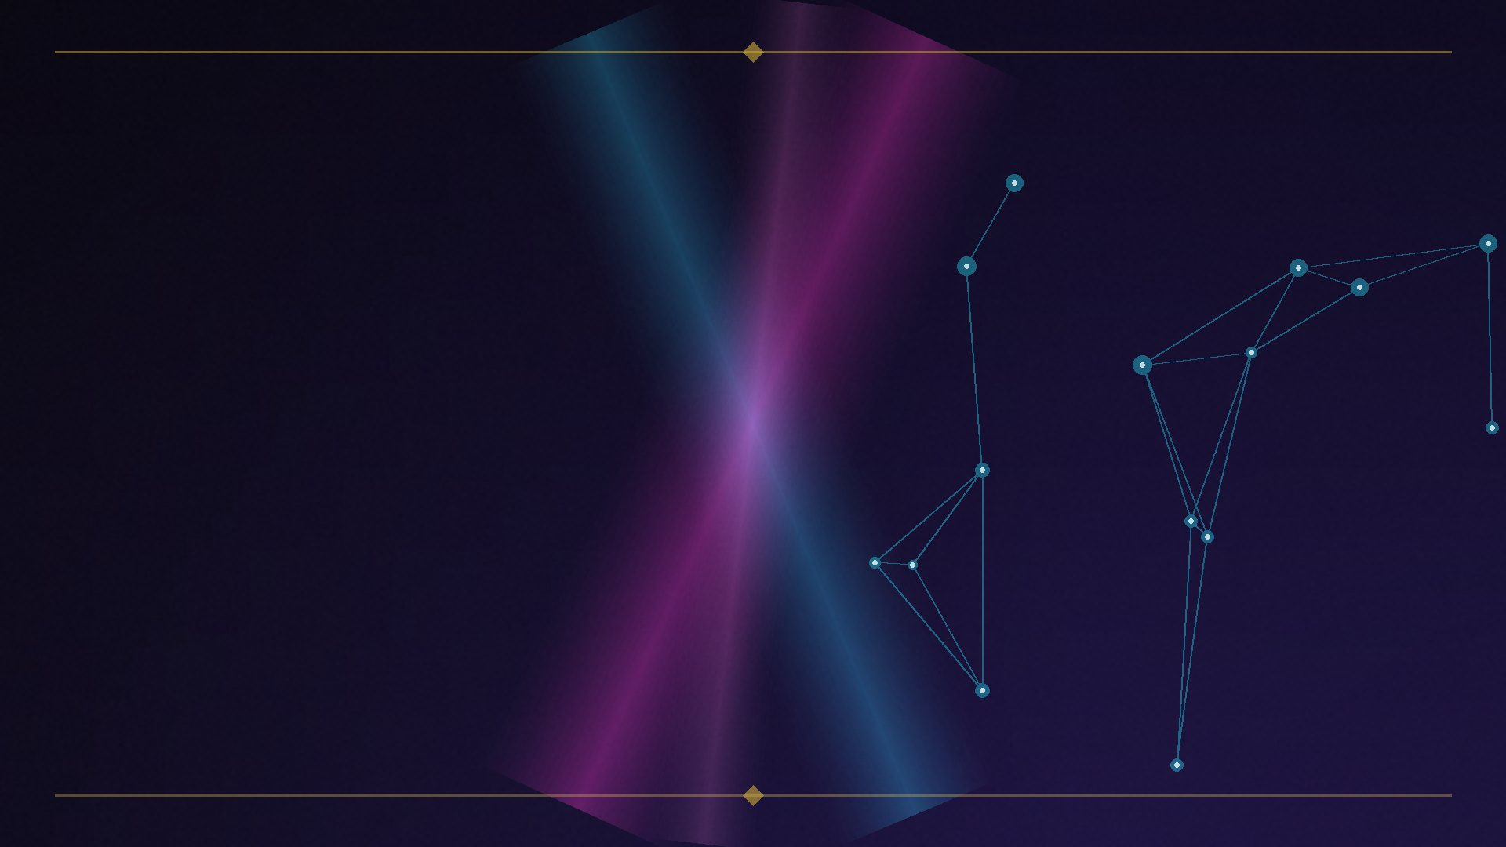
ACT III
False Precision
▸ The fusion weights are not public.
▸ The 2024 leak shows which attributes exist — not how they’re weighted.
▸ “Anyone who tells you ‘links are 23% of the algorithm’ is selling you a number they cannot have.”
▸ The graphs are real. The weights are not. Build for all eight; don’t optimize for a number.
EIGHT GRAPHS, ONE RANKING · Brian Kato · SEO Rockstars 2026
20
Notes:
Ties directly to the ‘False Precision’ UK SEO Summit talk. Second wow beat.

Slide 21
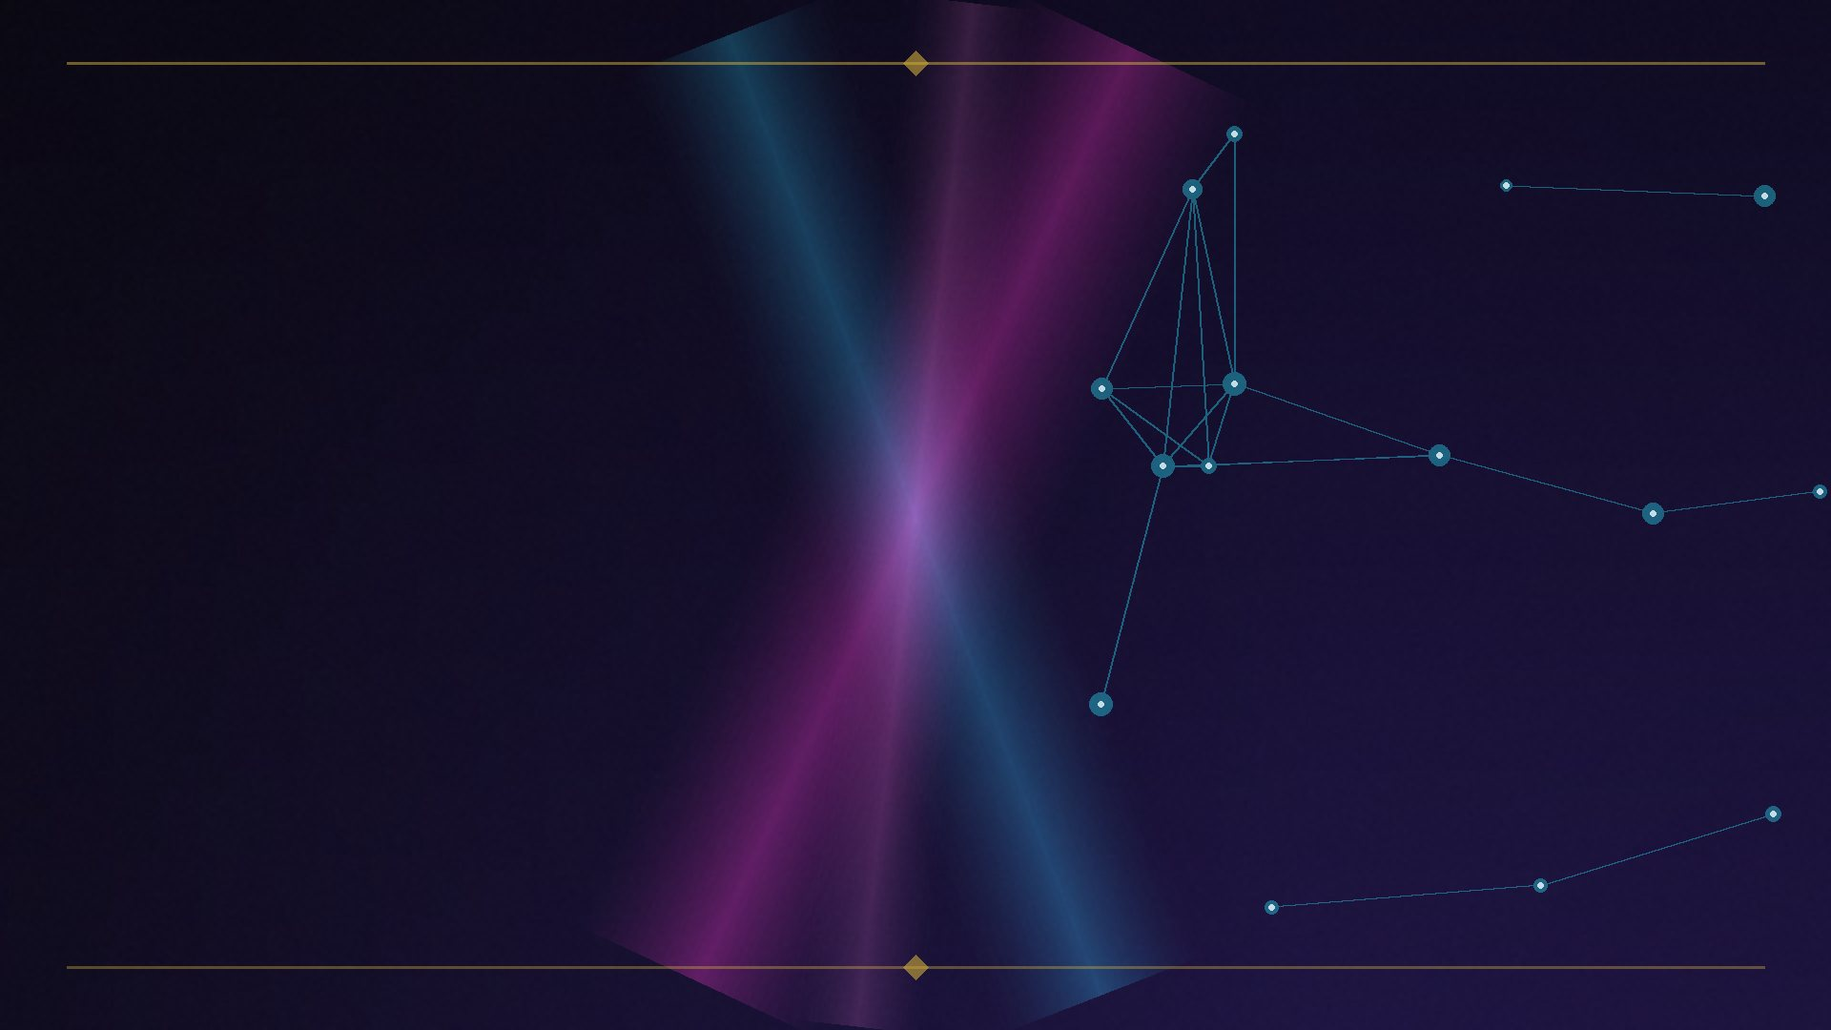
ACT III — RECAP
Proven machinery, not speculation
▸ Rankings = the interference pattern of eight overlapping graphs, fused in a cascade.
▸ Patents, sworn testimony, and the math all agree.
EIGHT GRAPHS, ONE RANKING · Brian Kato · SEO Rockstars 2026
21
Notes:
Close Act III.

Slide 22
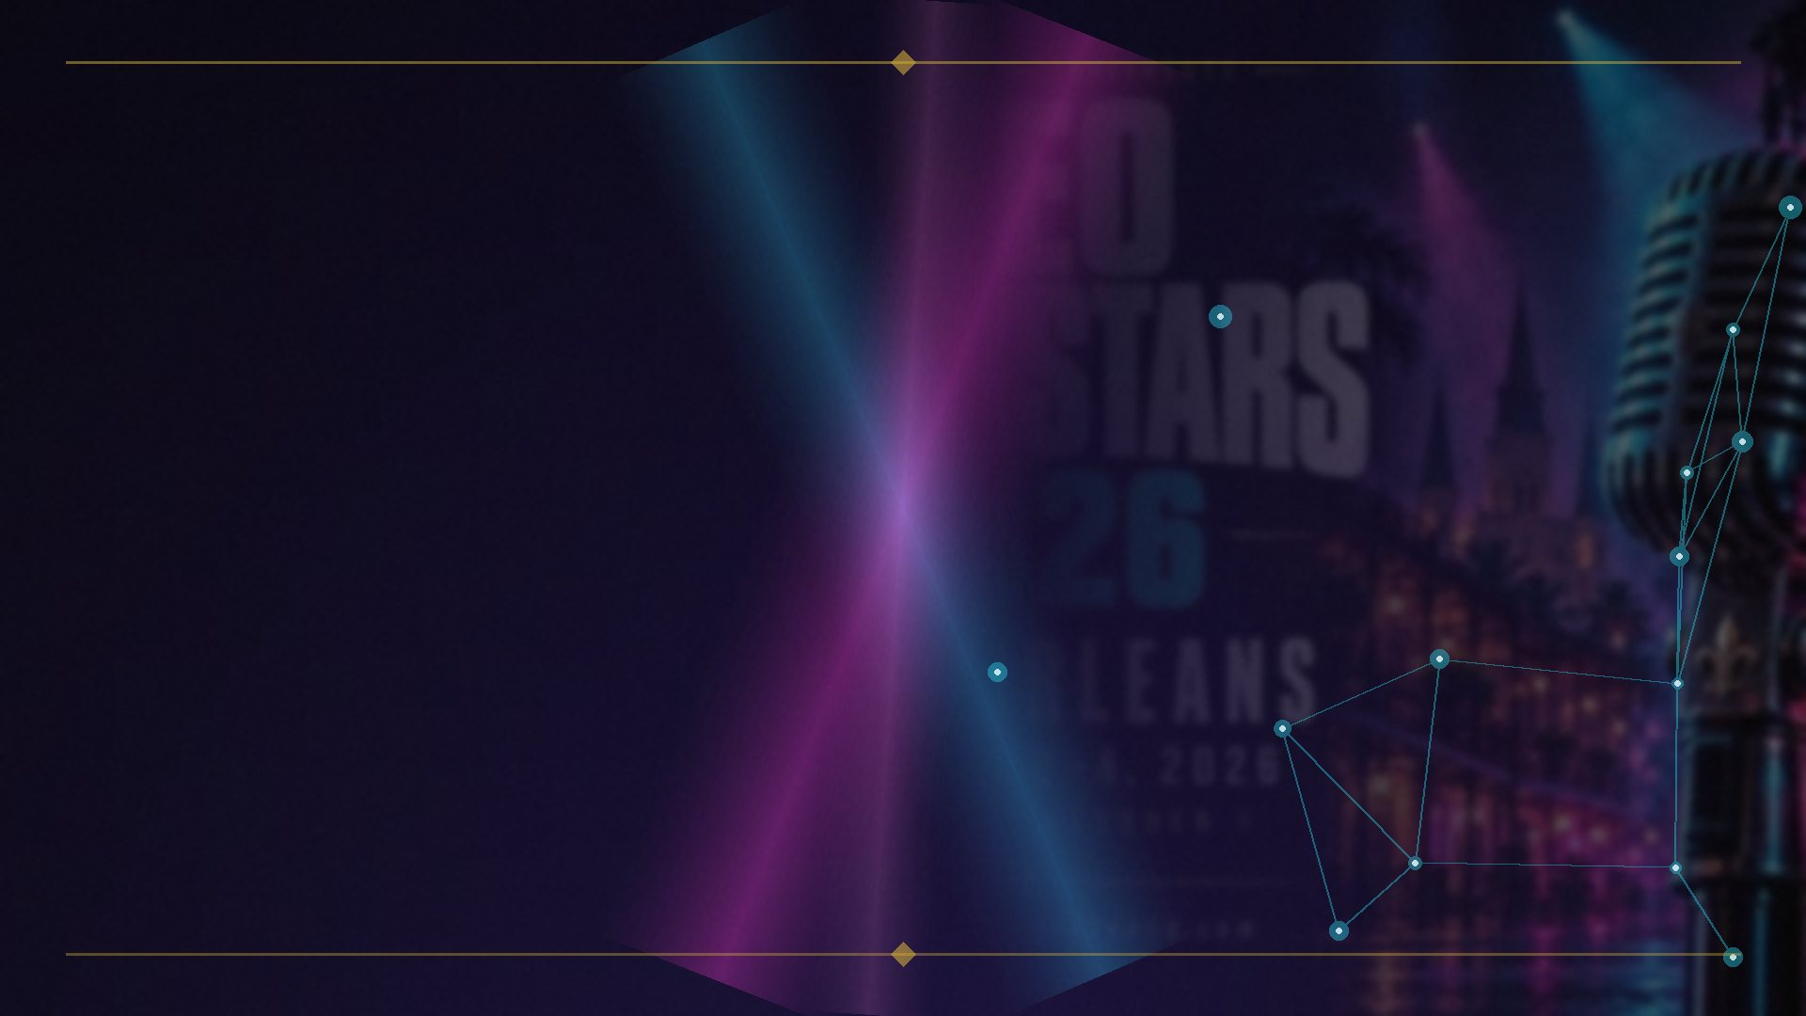
ACT IV — AI USES THE SAME TRICK
RAG’s founding pattern
▸ Lewis et al. (2020): generator + non-parametric memory.
▸ A dense vector index over ~21M Wikipedia passages.
▸ The vector index is itself a similarity graph — nearest-neighbor edges.
arXiv:2005.11401 (NeurIPS 2020)
EIGHT GRAPHS, ONE RANKING · Brian Kato · SEO Rockstars 2026
22

Slide 23
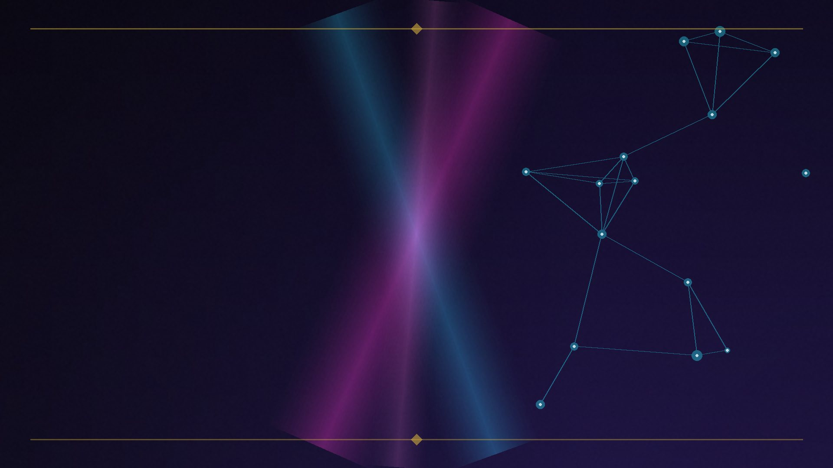
ACT IV — AI USES THE SAME TRICK
GraphRAG: the KG gets layered on
▸ Microsoft GraphRAG (Edge et al. 2024): LLM builds an entity KG → Leiden communities → local / global search.
▸ LightRAG (2024): dual-level retrieval fusing graph structure + vector representations.
▸ ACM TOIS 2025 survey: graph-based indexing → graph-guided retrieval → graph-enhanced generation.
arXiv:2404.16130 • arXiv:2410.05779 • ACM TOIS 2025
EIGHT GRAPHS, ONE RANKING · Brian Kato · SEO Rockstars 2026
23

Slide 24
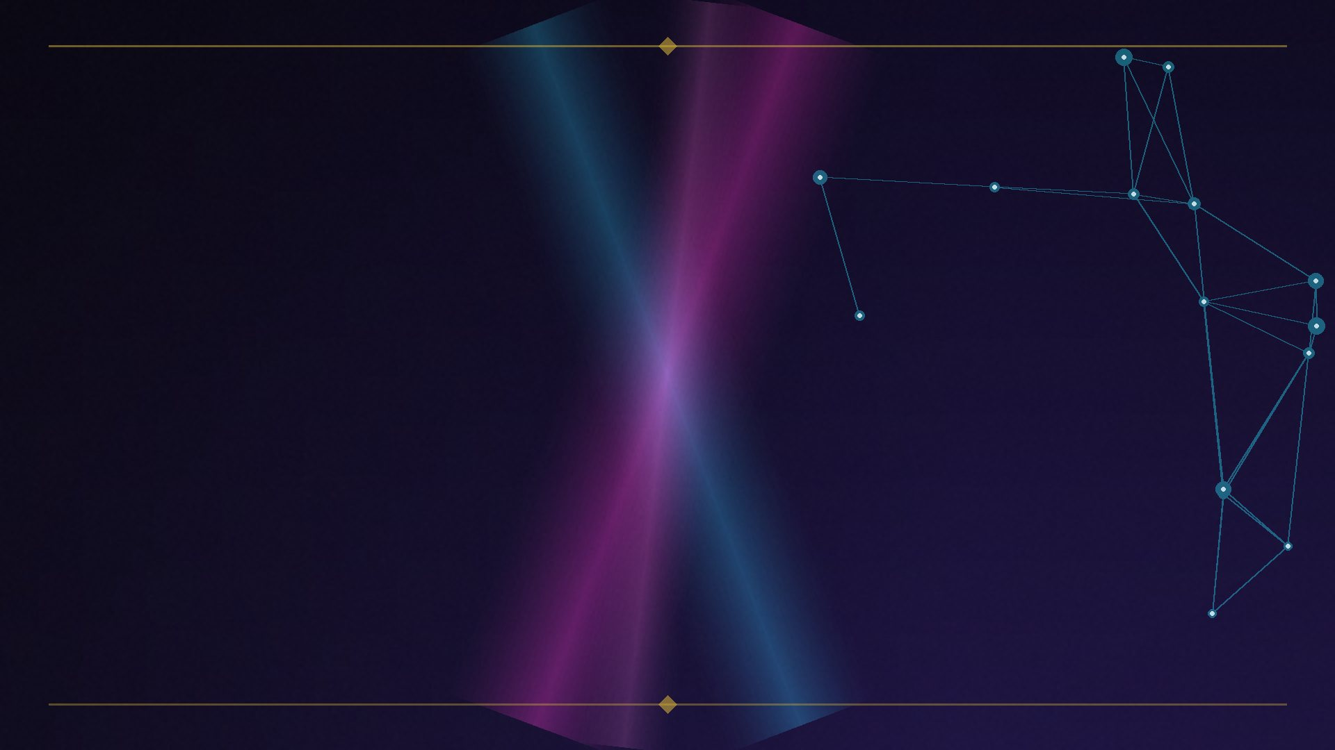
ACT IV — AI USES THE SAME TRICK
Every pipeline fuses the same three graphs
▸ (a) vector-similarity graph
▸ (b) entity / knowledge graph
▸ (c) document / citation graph
▸ Same three-layer shape as Google’s index / KG / behavioral stack.
▸ Different century. Same math.
EIGHT GRAPHS, ONE RANKING · Brian Kato · SEO Rockstars 2026
24

Slide 25
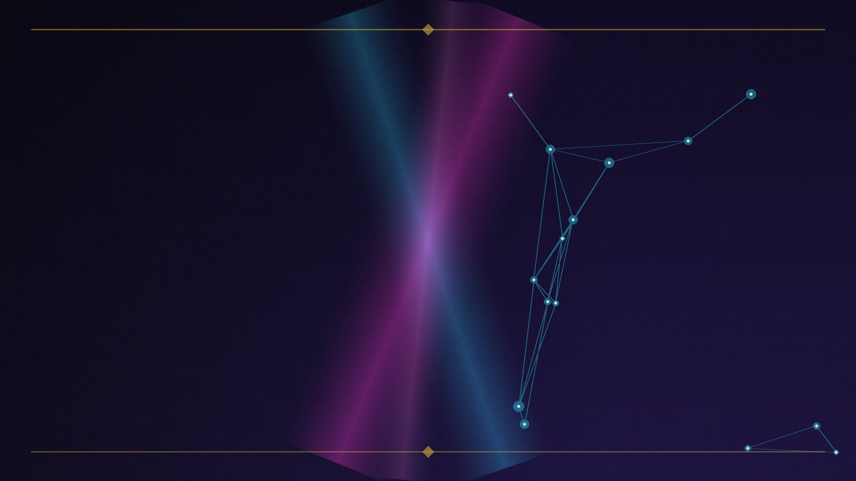
ACT IV — AI USES THE SAME TRICK
The answer engines run multi-graph retrieval too
▸ Perplexity: 5-stage intent→retrieval→rerank pipeline + an engagement feedback loop — its own behavioral graph. (Reverse-engineered.)
▸ ChatGPT Search: Bing-powered retrieval + hidden cached index + query fan-out. Only ~15% of retrieved pages get cited — retrieval gate, then citation gate.
▸ Bing Satori: RDF/SPARQL entity engine; fuses search-log behavior with the entity graph.
▸ Gemini grounding: Google Search + Google Maps + Vertex AI Search RAG, combinable.
ziptie.ai • attrifast, Sept 2026 • Satori docs • Cloud grounding docs
EIGHT GRAPHS, ONE RANKING · Brian Kato · SEO Rockstars 2026
25

Slide 26
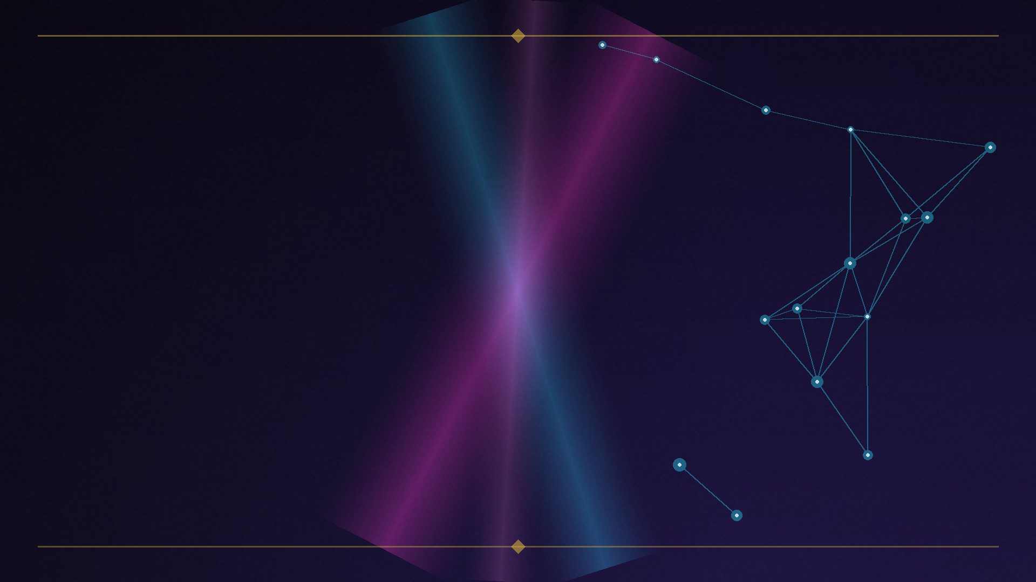
ACT IV — WHAT THIS MEANS
‘SEO’ and ‘AI visibility’ are not two disciplines.
▸ Same multi-graph game — different final stage:
▸ a ranked list vs. a generated answer with citations.
▸ The 8-graph playbook applies to both.
EIGHT GRAPHS, ONE RANKING · Brian Kato · SEO Rockstars 2026
26

Slide 27
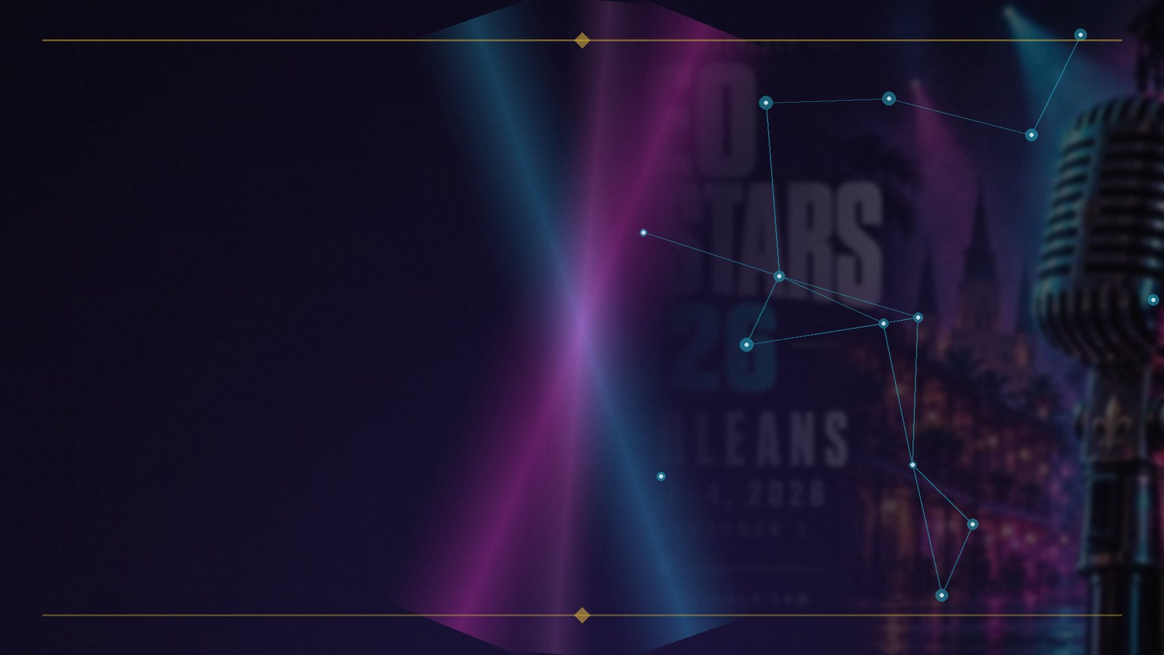
ACT V — THE MULTI-GRAPH PLAYBOOK
Authority engineering
FEEDS: LINK + TRUST GRAPHS
▸ Build links from seed-adjacent, editorially real sources.
▸ Proximity to trusted seeds beats raw volume.
▸ siteAuthority (2024 leak) = quality metrics + content signals + link diversity — not just counts.
EIGHT GRAPHS, ONE RANKING · Brian Kato · SEO Rockstars 2026
27

Slide 28
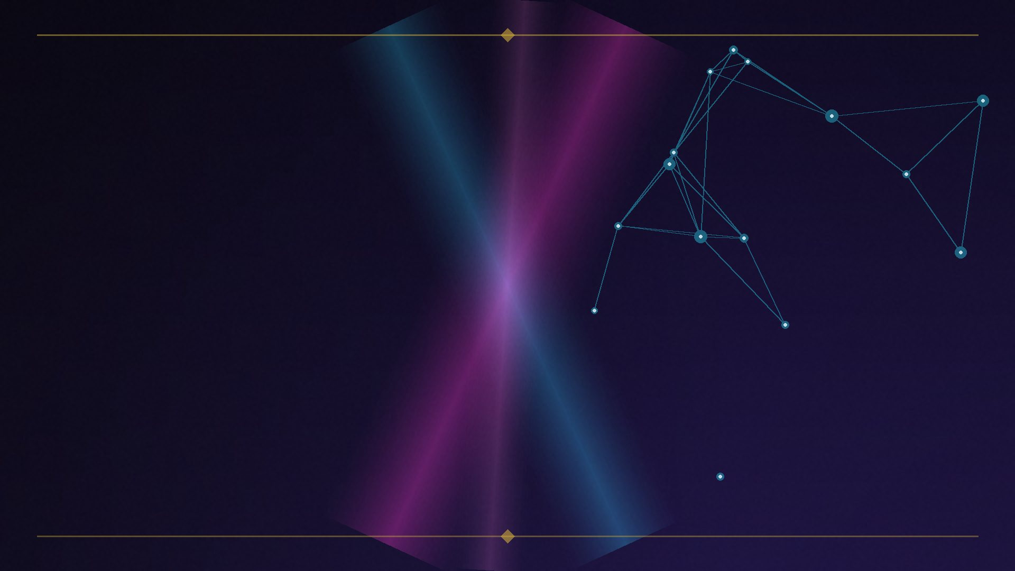
ACT V — THE MULTI-GRAPH PLAYBOOK
Entity establishment
FEEDS: KNOWLEDGE GRAPH
▸ Become a resolvable entity: Wikipedia / Wikidata presence.
▸ Consistent naming + NAP; schema.org Organization / Person with sameAs.
▸ Aliases resolve to canonical /m/ IDs — consistency across sources IS the mechanism of recognition.
EIGHT GRAPHS, ONE RANKING · Brian Kato · SEO Rockstars 2026
28

Slide 29
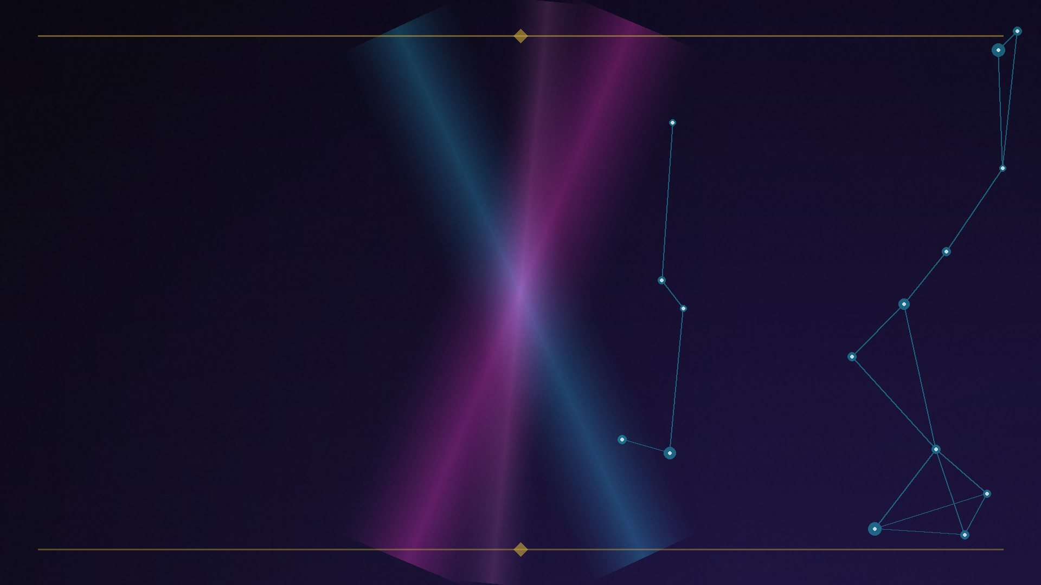
ACT V — THE MULTI-GRAPH PLAYBOOK
Entity-dense topical content
FEEDS: SALIENCE GRAPH
▸ Mention target entities as central to the document — not passing mentions.
▸ Topical clusters reinforce which entities a site ‘owns.’
▸ Write extractable, definition-led sentences — built for AI citation.
EIGHT GRAPHS, ONE RANKING · Brian Kato · SEO Rockstars 2026
29

Slide 30
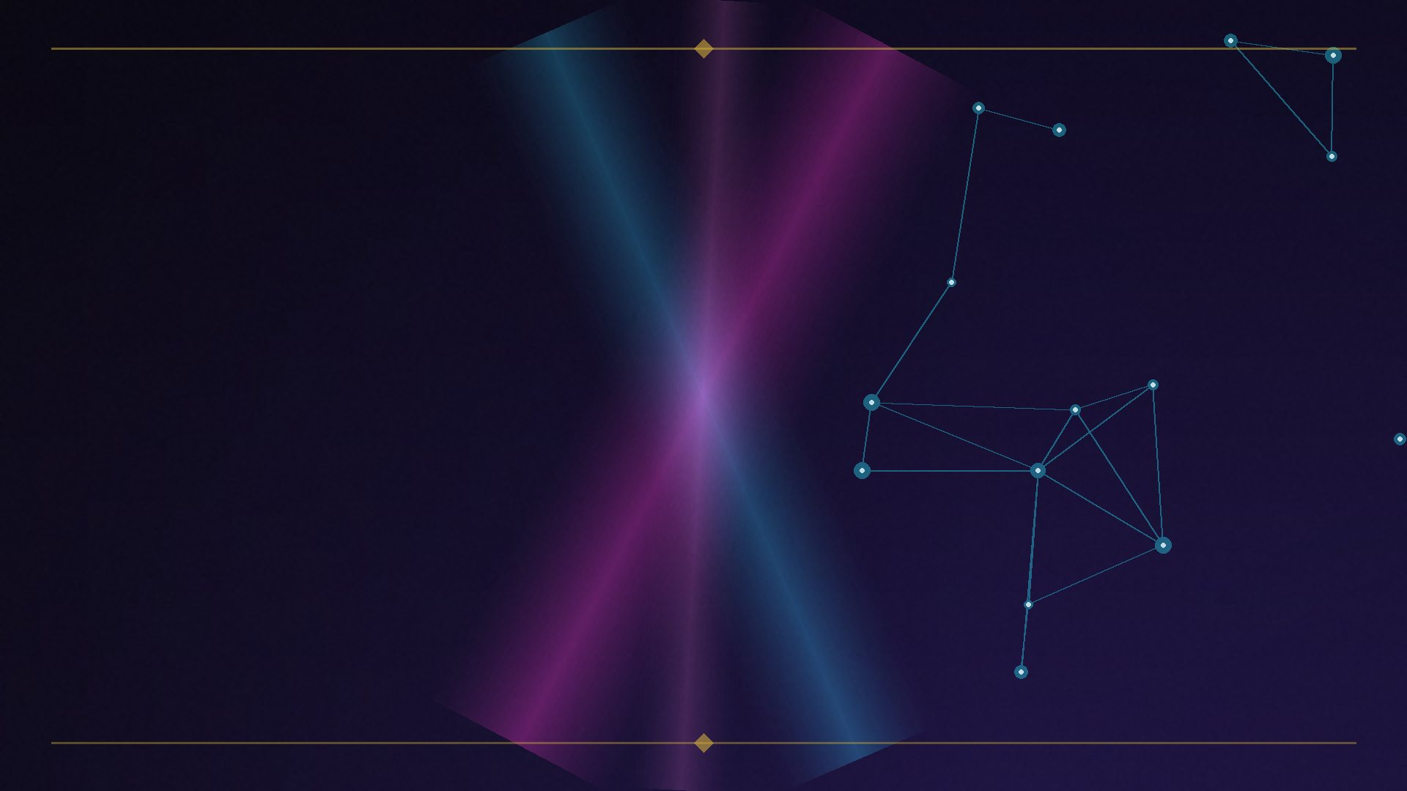
ACT V — THE MULTI-GRAPH PLAYBOOK
Earn the click and the stay
FEEDS: BEHAVIORAL GRAPH
▸ Navboost learns from 13 months of clicks and dwell.
▸ Title/meta craft, SERP-feature capture, genuinely satisfying content.
▸ Brand and navigational search behavior feed the same system.
EIGHT GRAPHS, ONE RANKING · Brian Kato · SEO Rockstars 2026
30

Slide 31
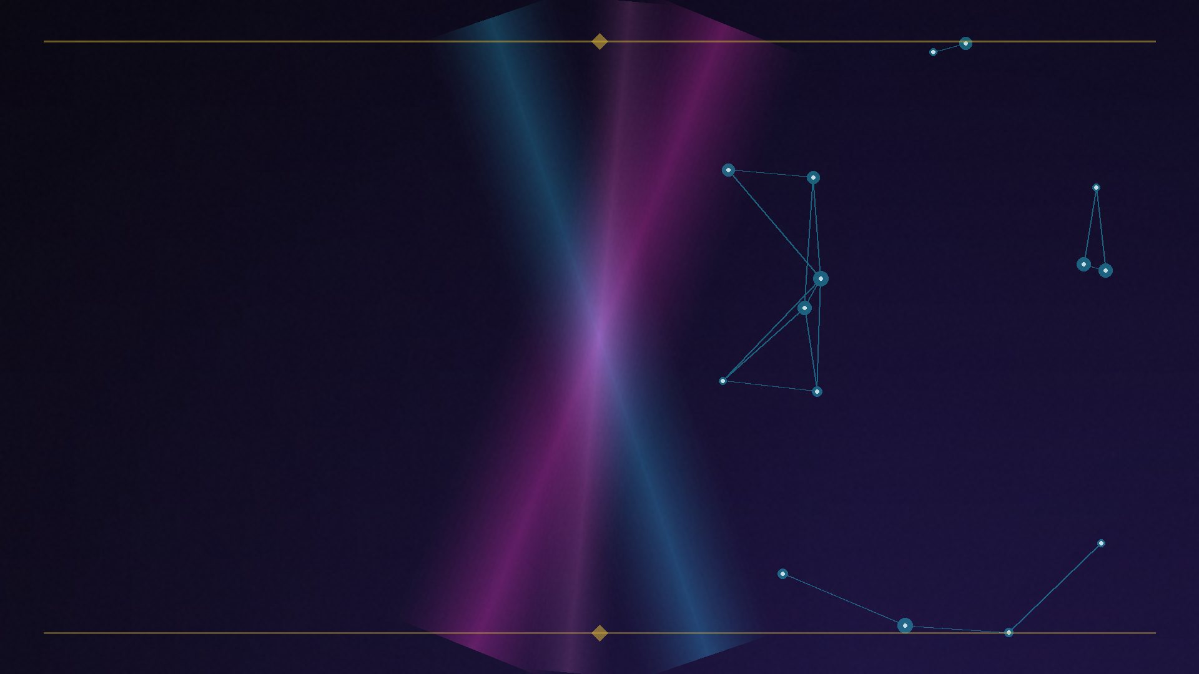
ACT V — THE MULTI-GRAPH PLAYBOOK
Consistent, verifiable authorship
FEEDS: IDENTITY GRAPH
▸ Named bylines + credentialed author pages.
▸ The same author identity across domains — the modern rel=author.
▸ Multi-domain publication histories and byline+expertise pages earn higher AI citation rates.
EIGHT GRAPHS, ONE RANKING · Brian Kato · SEO Rockstars 2026
31

Slide 32
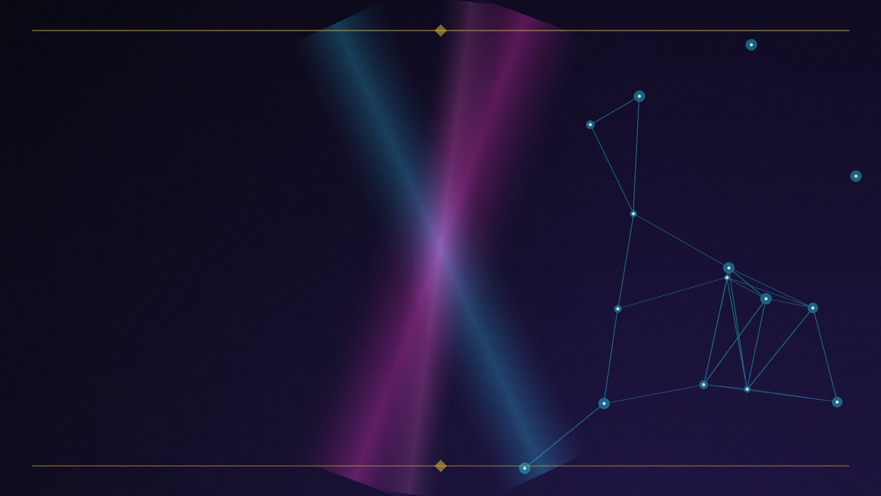
ACT V — THE MULTI-GRAPH PLAYBOOK
Prominence as a campaign
FEEDS: REVIEW + MENTION GRAPHS
▸ Reviews: quantity, recency, keyword relevance, responses. Citations + NAP consistency.
▸ Entity chains across the web: brands are ~6.5× more likely to be cited via third-party mentions than from their own domain.
▸ (Practitioner data — treat as directional.)
EIGHT GRAPHS, ONE RANKING · Brian Kato · SEO Rockstars 2026
32

Slide 33
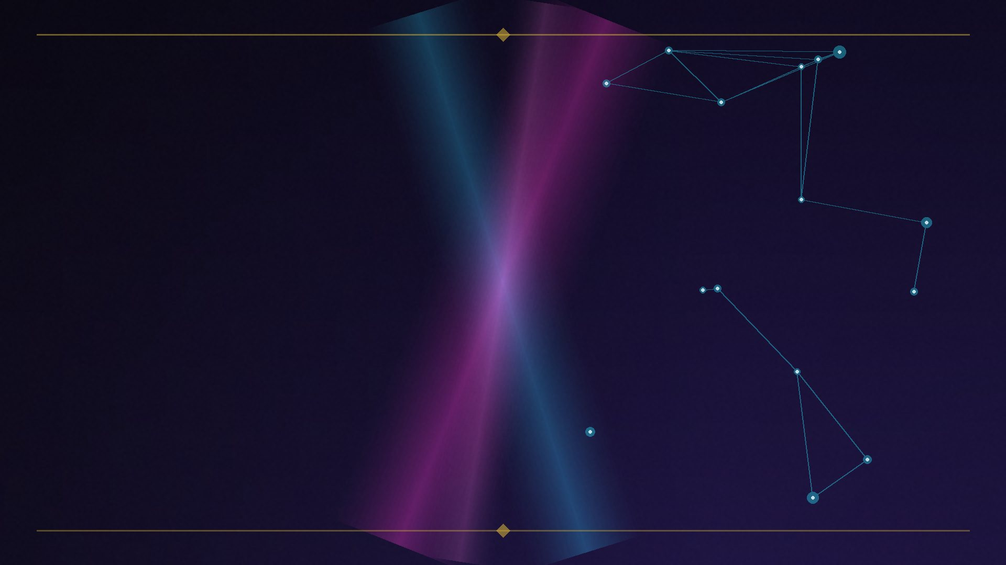
ACT V — THE MULTI-GRAPH PLAYBOOK
Pass the AI gates
FEEDS: CITATION GRAPH
▸ Technical gates first: Bing indexation, crawler access (OAI-SearchBot / ChatGPT-User), recency.
▸ 53% of AI-cited content was updated within 6 months. (Practitioner data — directional.)
▸ Then the citation gate: extractable evidence, freshness, per-engine formats.
EIGHT GRAPHS, ONE RANKING · Brian Kato · SEO Rockstars 2026
33

Slide 34
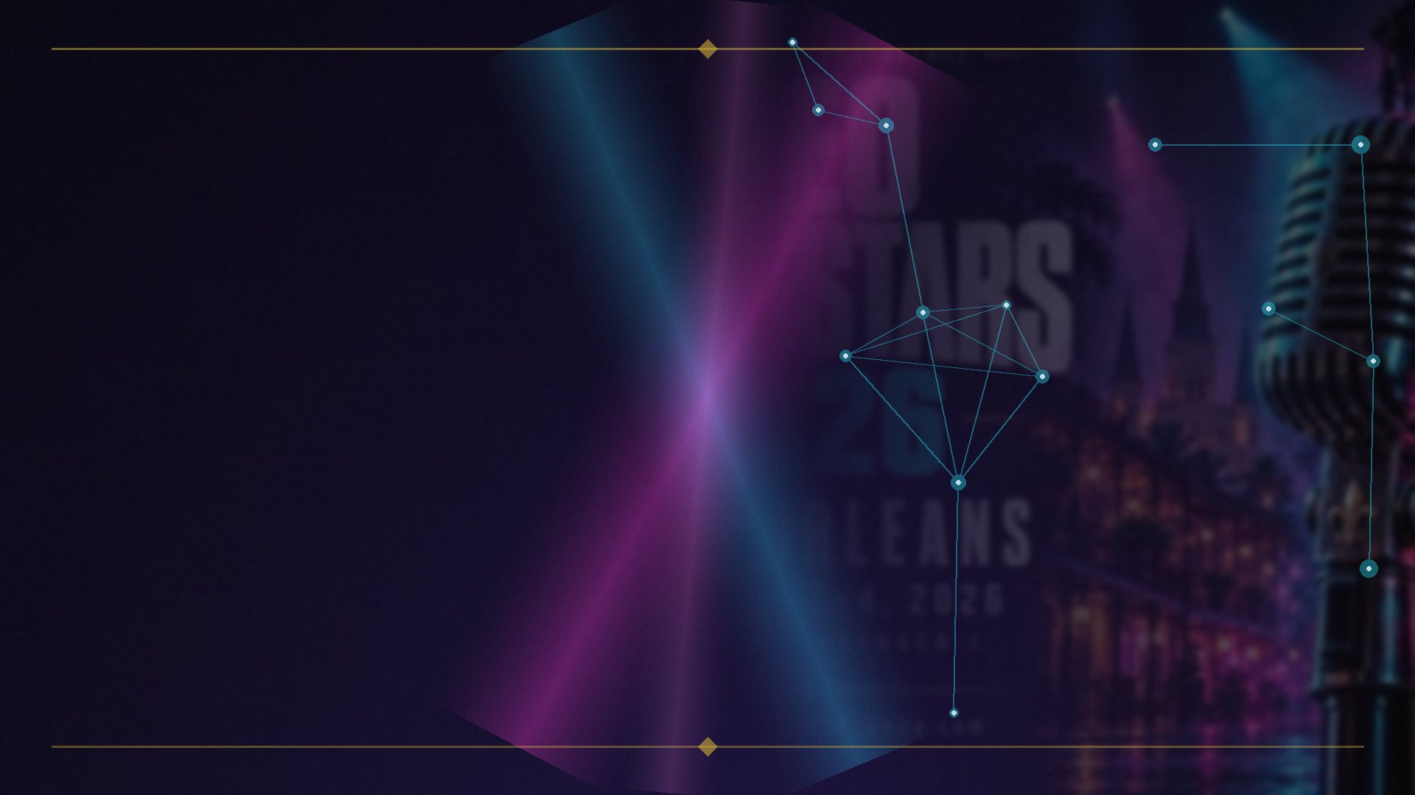
THE TAKEAWAY
Stop asking which graph matters most.
☐ Link graph — are your links seed-adjacent?
☐ Entity graph — are you a resolvable entity?
☐ Salience graph — are your entities central, not just mentioned?
☐ Behavioral graph — do searchers stay?
☐ Identity graph — is your authorship verifiable?
☐ Review graph — are you prominent off-site?
☐ Trust graph — how far are you from the seeds?
☐ Citation graph — can AI cite you?
Start asking which graph you’re neglecting.
EIGHT GRAPHS, ONE RANKING · Brian Kato · SEO Rockstars 2026
34
Notes:
Audience interaction: which graph are YOU neglecting?

Slide 35
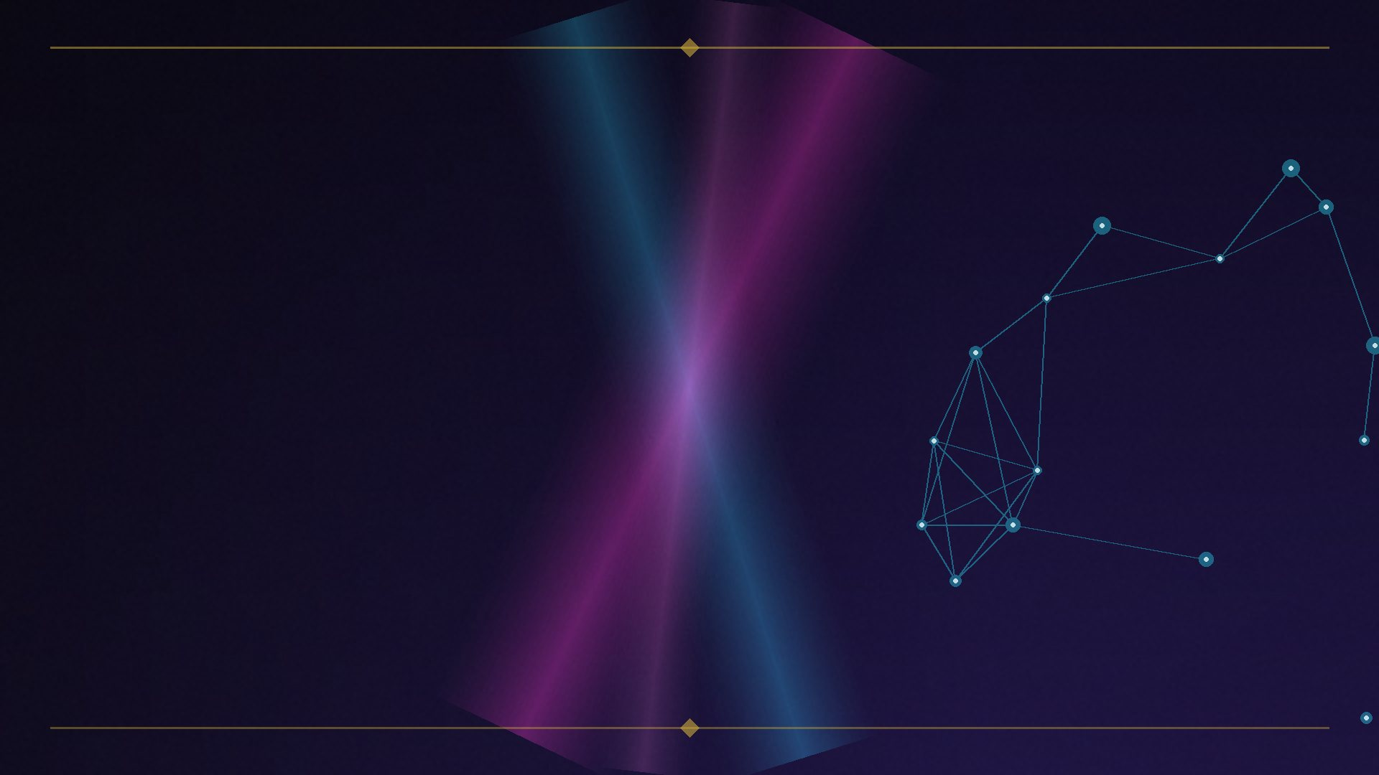
SEO ROCKSTARS 2026 — NEW ORLEANS
“The centrality a node has in one layer affects the centrality the node can obtain in another layer.”
— Multiplex PageRank, Halcão et al., 2013
• Your brand is a node in eight graphs. Act like it.
Brian Kato • Fusion Vine
EIGHT GRAPHS, ONE RANKING · Brian Kato · SEO Rockstars 2026
35

