Slide 1
Dynamic Programming-2
Srikanth.V.Goutham

Slide 2
Agenda
Knapsack and Subset Sum problems
Single source shortest path problem

Slide 3
Knapsack and subset sum problems (Section 6.4, K&T)

Slide 4
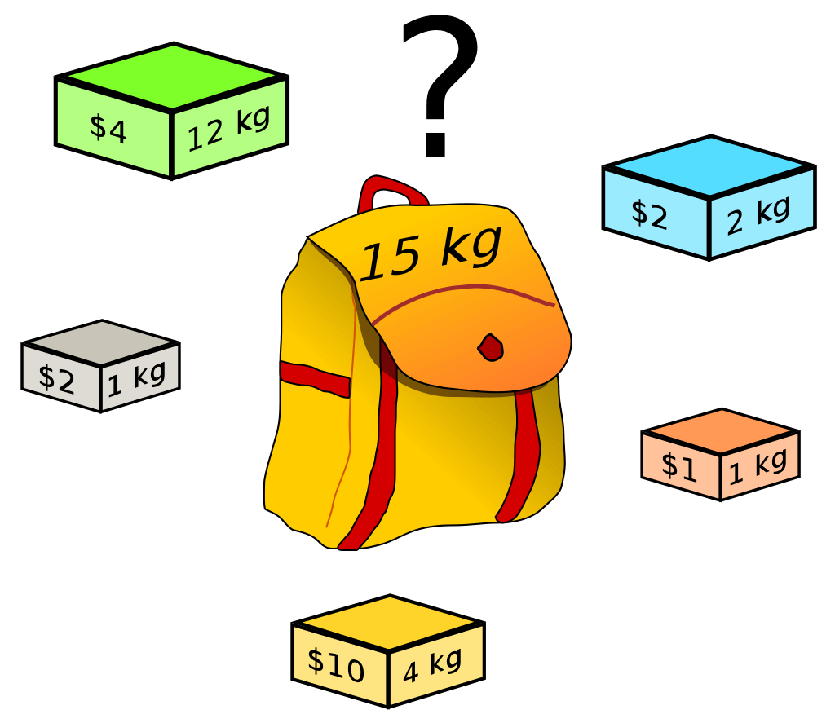

Knapsack Problem
Given:
There are $n$ items in a set $S$, where item$i$has value v_{i} and size $wi$ . You have a knapsack of size $W$, and you want to choose a subset of the items subject to certain conditions
Goal:
$\sum_{i ∈ S}{vi}is maximised$
• $\sum_{i ∈ S}{wi<W}$

Slide 5

Greedy failure
Works for fractional knapsack
Strategy sort by $pi =\frac{vi}{wi}$
Fails for 0/1 Knapsack
Example:
$Items = [0,1,2,3]$
$Values= [30, 40, 45, 100]$
$Weights = [1, 2, 3, 4]$
$P = [30, 20, 15, 25];$
$Greedy choice = Take items 1 and 4 = [30, 100] = 130$
$Optimal choice = Take items 2 and 4 = [40, 100] = 140$

Slide 6
Recall
Subproblems
Recurrence
Topological ordering
Base cases
Original problem
Time complexity

Slide 7
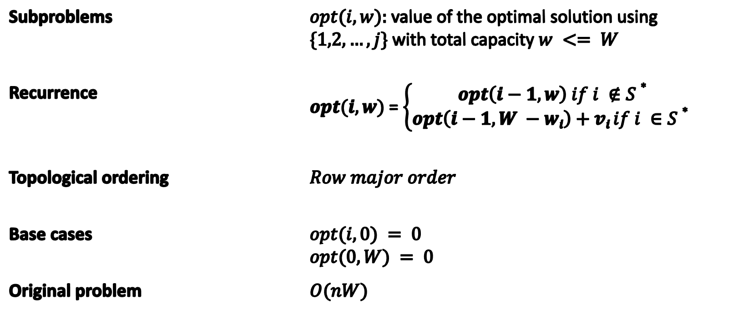
Applying SRTBOT
Subproblems | $opt(i, w):$value of the optimal solution using $\{1,2,…, j\}$with total capacity $w <= W$
Recurrence | $opt(i, w)$= $\left\{\begin{aligned}opt\left(i−1, w\right) if i ∉S∗ \\ opt\left(i−1, W −wi\right)+vi if i ∈S∗ \end{aligned}\right.$
Topological ordering | $$Row major order$$
Base cases | $$opt(i,0) = 0$$ $$opt(0, W) = 0$$
Original problem | $$O(nW)$$

Slide 8
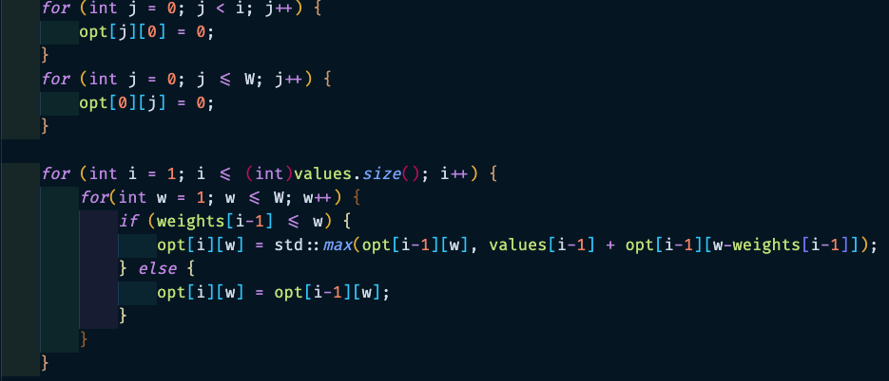
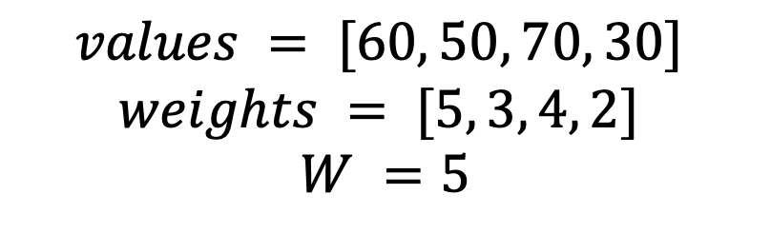
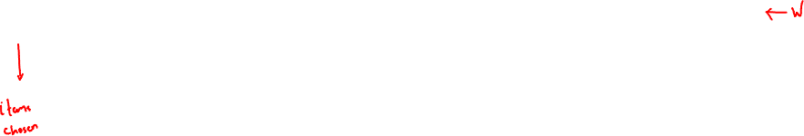
Example
$$values = [60, 50, 70, 30]$$
$$weights = [5, 3, 4, 2]$$
$$W =5$$
 | 0 | 1 | 2 | 3 | 4 | 5
[] | 0 | 0 | 0 | 0 | 0 | 0
[60] | 0 | 0 | 0 | 0 | 0 | 60
[60, 50] | 0 | 0 | 0 | 50 | 50 | 60
[60,50,70] | 0 | 0 | 0 | 50 | 70 | 70
[60,50,70,30] | 0 | 0 | 30 | 50 | 70 | 80

Slide 9
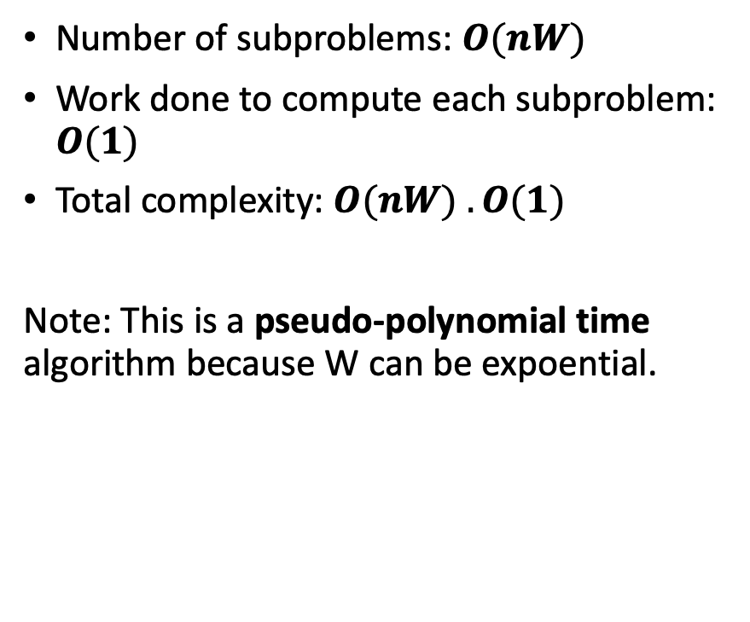
Time complexity
Number of subproblems: $O(nW)$
Work done to compute each subproblem: $O(1)$
Total complexity: $O(nW) . O(1)$
Note: This is a pseudo-polynomial time algorithm because W can be expoential.

Slide 10
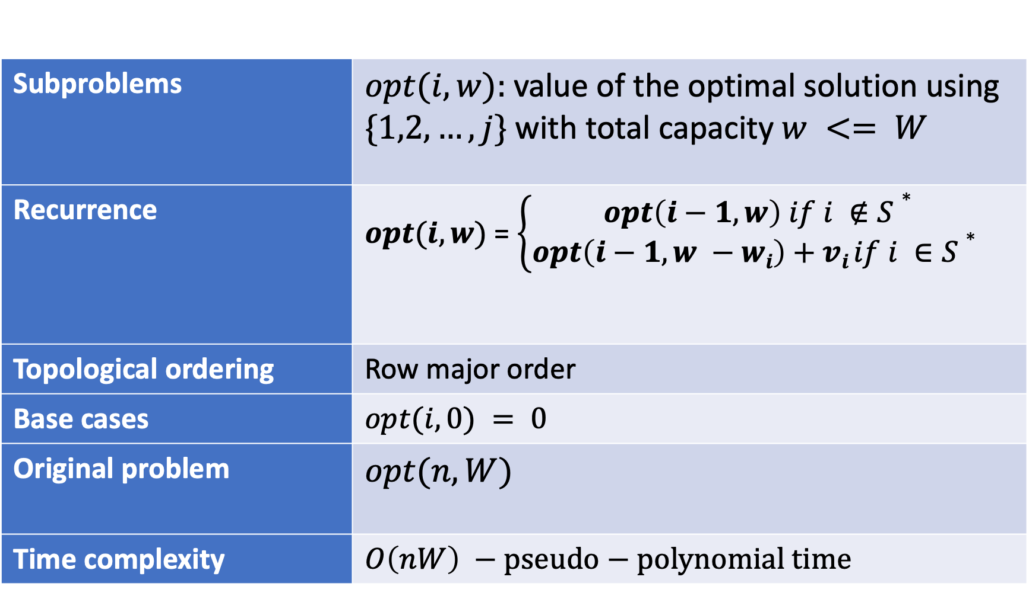
Summary
Subproblems | $opt(i, w):$value of the optimal solution using $\{1,2,…, j\}$with total capacity $w <= W$
Recurrence | $opt(i, w)$= $\left\{\begin{aligned}opt\left(i−1, w\right) if i ∉S∗ \\ opt\left(i−1, w −wi\right)+vi if i ∈S∗ \end{aligned}\right.$
Topological ordering | Row major order
Base cases | $$opt(i,0) = 0$$
Original problem | $$opt(n, W)$$
Time complexity | $$O\left(nW\right) −pseudo−polynomial time$$

Slide 11

Problem
Given:
An integer bound $W$.
$n$ items in a set $S$, each with a positive integer weight, $wi$
Goal:
Find $S∗ ⊆S such that \sum_{i ∈ S}{wi} is maximized subject to \sum_{i ∈ S}{wi≤W}$

Slide 12

Exploring Greedy Strategies
Strategy 1: Pick the smallest elements.
Eg: $S = \{1, 2, 3, 5\}, W=5$
Greedy answer = {1,2} -> not optimal
Strategy 2: Pick the largest elements
Eg: $S = \{1, 2, 3\}, W = 4$
Greedy answer = {3} -> not optimal
Conclusion: Greedy strategies don’t work. Let’s try DP.

Slide 13
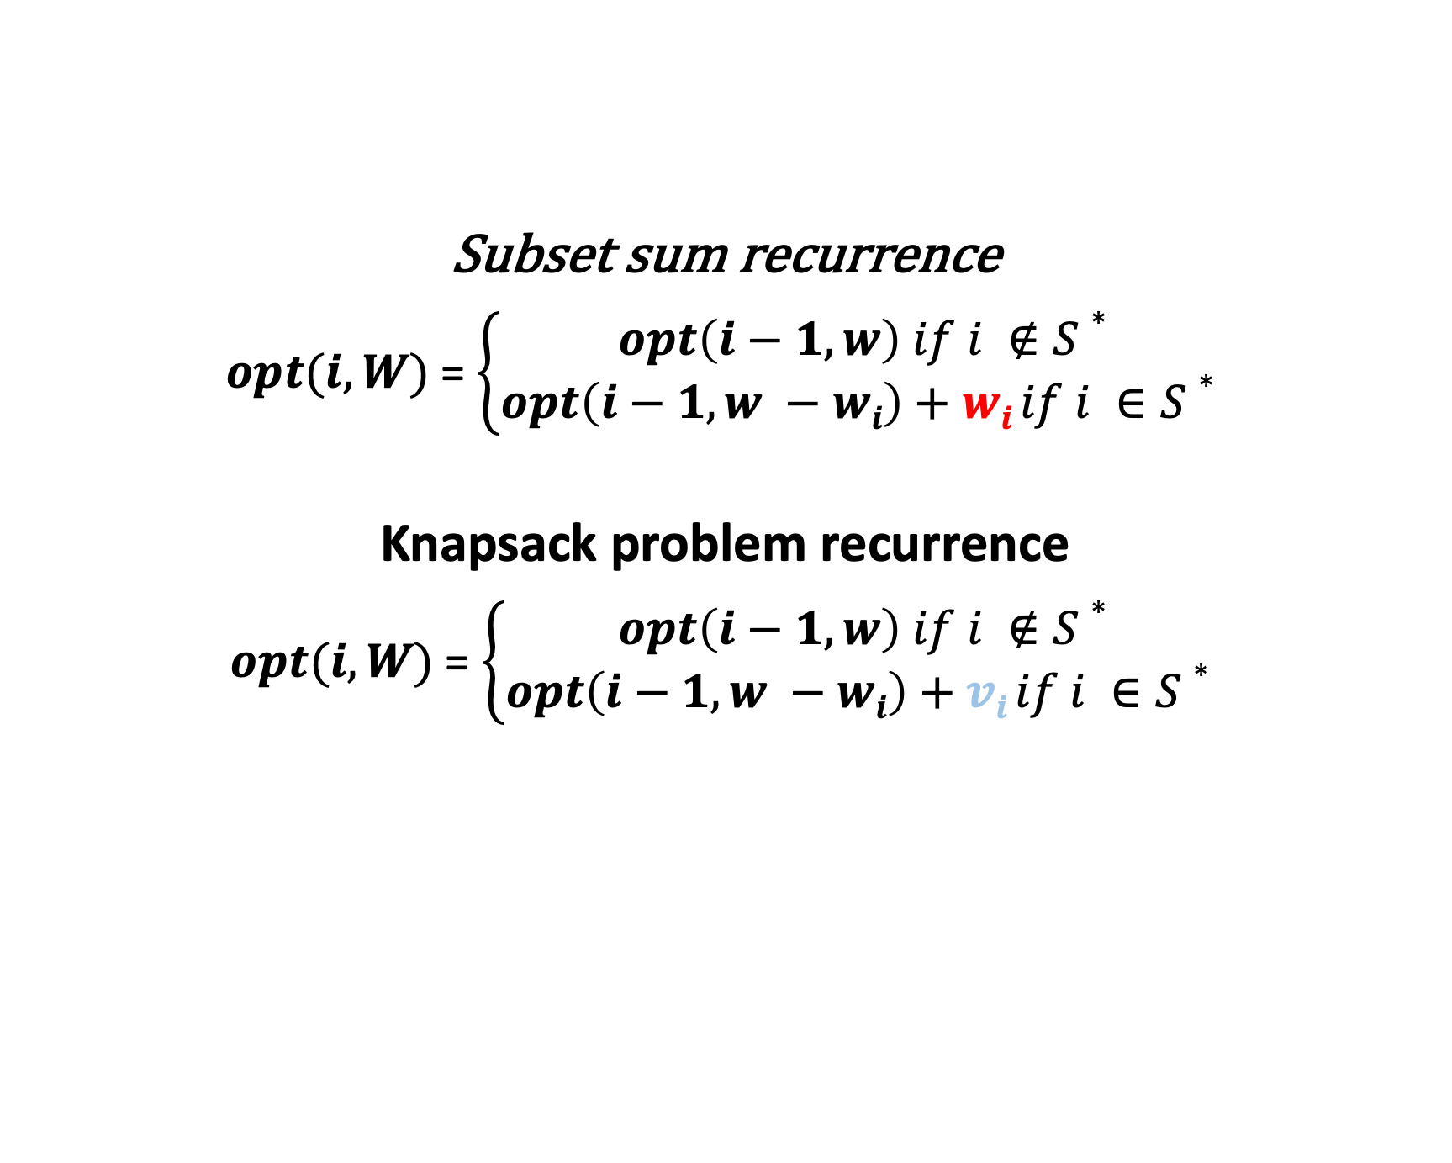
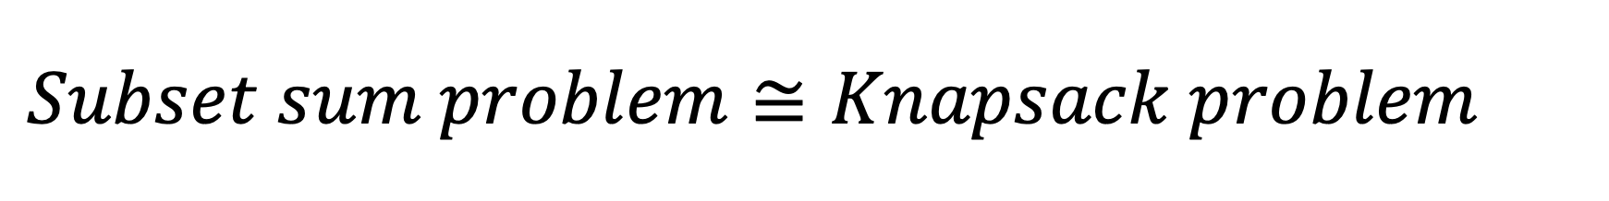
$$Subset sum problem≅Knapsack problem$$
Subset sum recurrence
$opt(i, W)$= $\left\{\begin{aligned}opt\left(i−1, w\right) if i ∉S∗ \\ opt\left(i−1, w −wi\right)+wi if i ∈S∗ \end{aligned}\right.$
Knapsack problem recurrence
$opt(i, W)$= $\left\{\begin{aligned}opt\left(i−1, w\right) if i ∉S∗ \\ opt\left(i−1, w −wi\right)+vi if i ∈S∗ \end{aligned}\right.$

Slide 14
Single source shortest path problem (Section 6.8, K&T)

Slide 15

Problem
Given:
A directed graph $G = \left(V, E\right)$, without negative weight cycles and with edge weights $cvw$.
Goal:
Find the shortest path from node $s$ to node $t$.

Slide 16
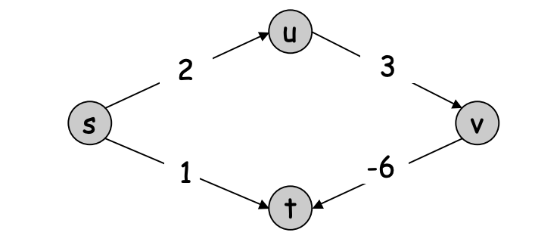
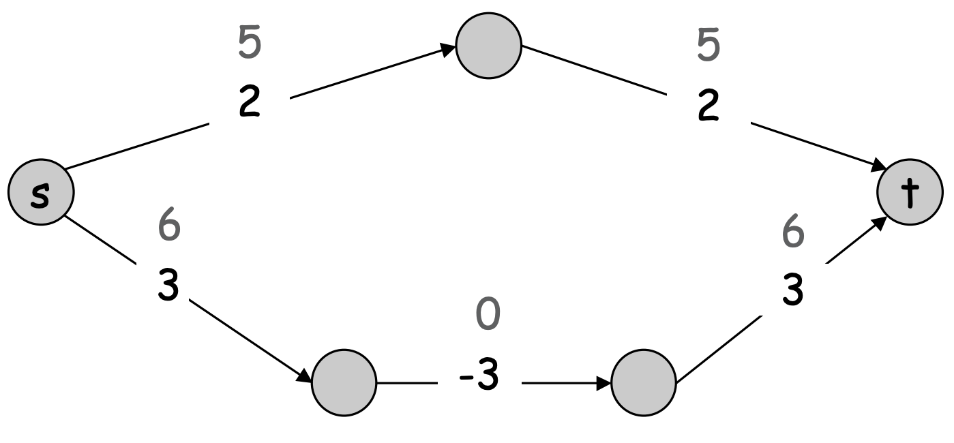
Failed attempts (Dijkstra)
Negative edge weights
Re-weighting

Slide 17

Key observations
If G has no negative cycles, then there is a shortest path from $s$ to $t$ that is simple (i.e., does not repeat nodes), and hence has at most $n − 1$edges.
Sub-paths of shortest paths are also shortest paths -- optimal substructure

Slide 18
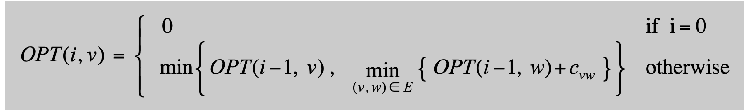
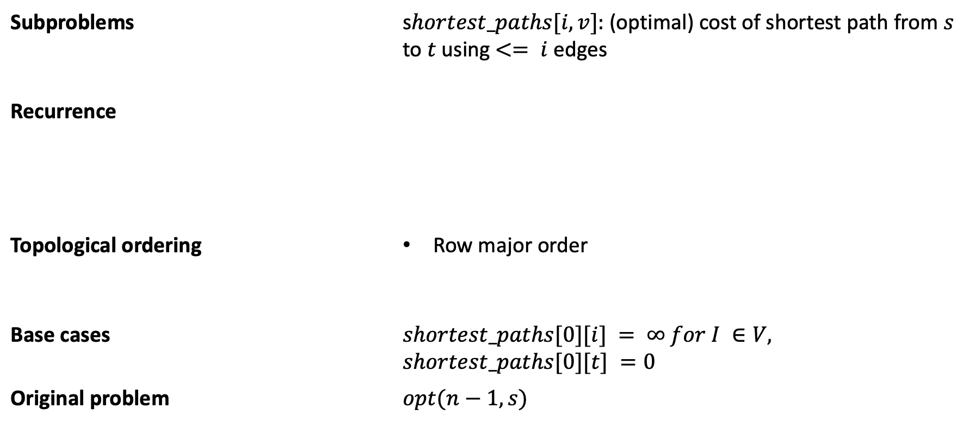
Applying SRTBOT
Subproblems | s$hortest_paths[i,v]:$(optimal) cost of shortest path from $s$ to $t$ using $<= i$edges
Recurrence
Topological ordering | Row major order
Base cases | $$shortest_paths[0][i] = ∞ for I ∈V,$$ $$shortest_paths[0][t] =0$$
Original problem | $$opt(n−1, s)$$

Slide 19
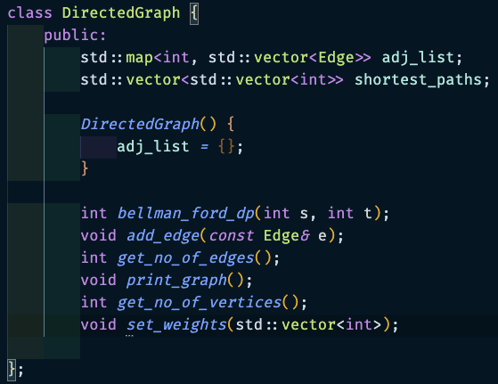
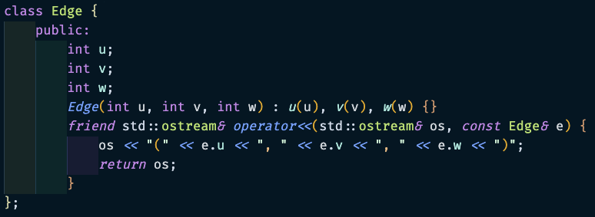
Implementation (Bellman-Ford-Moore algorithm)
Exercise: Write code to print the shortest paths

Slide 20
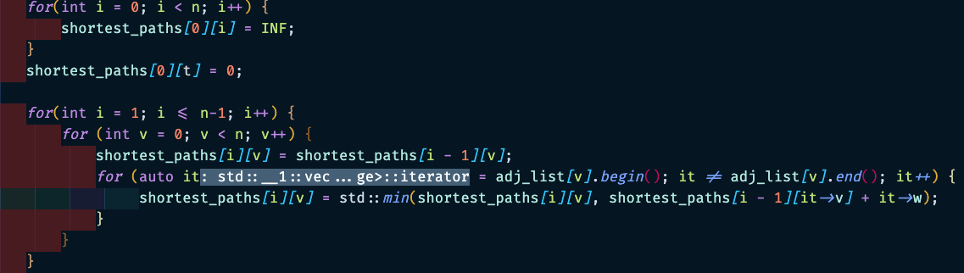
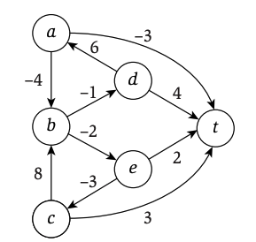
Example
 | 0 | 1 | 2 | 3 | 4 | 5
0 | INF | INF | INF | INF | INF | 0
1 | -3 | INF | 3 | 4 | 2 | 0
2 | -3 | 0 | 3 | 3 | 0 | 0
3 | -4 | -2 | 3 | 3 | 0 | 0
4 | -6 | -2 | 3 | 2 | 0 | 0
5 | -6 | -2 | 3 | 0 | 0 | 0
0
3
1
5
4
2

Slide 21
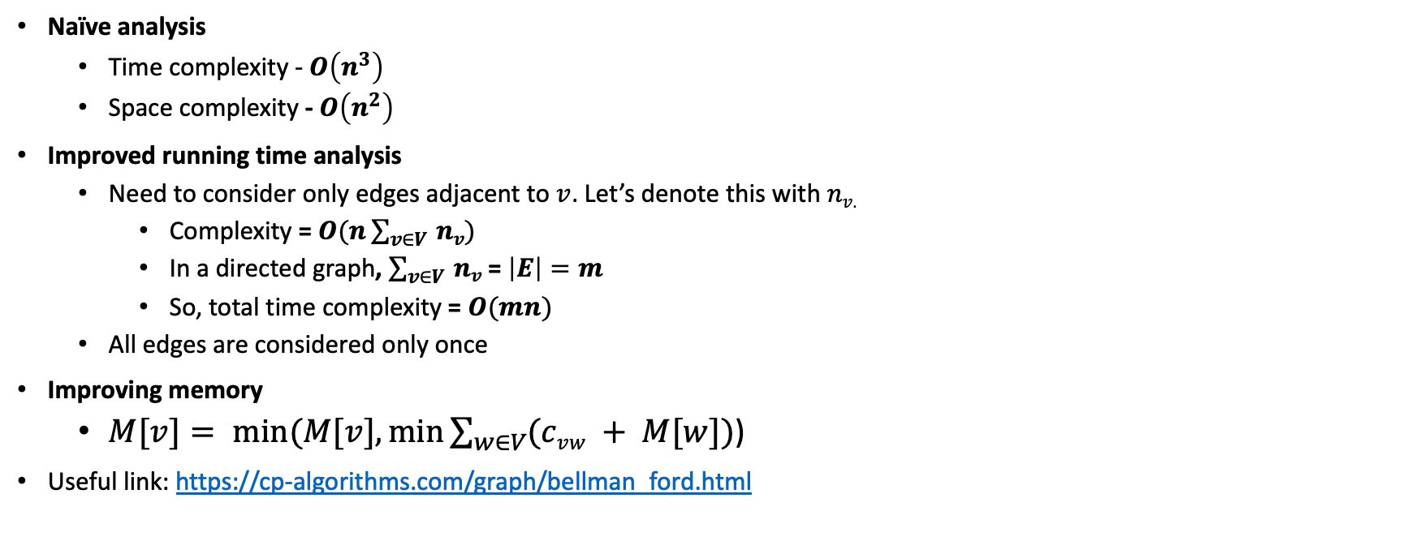
Analysis
Naïve analysis
Time complexity - $O\left(n^{3}\right)$
Space complexity - $O\left(n^{2}\right)$
Improved running time analysis
Need to consider only edges adjacent to $v$. Let’s denote this with $nv$.
Complexity =$O(n\sum_{v∈V }{nv})$
In a directed graph, $\sum_{v∈V }{nv}$ = $\left|E\right|=m$
So, total time complexity = $O(mn)$
All edges are considered only once
Improving memory
$M[v]= min⁡(M[v], min⁡\sum_{w∈V}{(cvw + M[w])}$)
Useful link: https://cp-algorithms.com/graph/bellman_ford.html

Slide 22
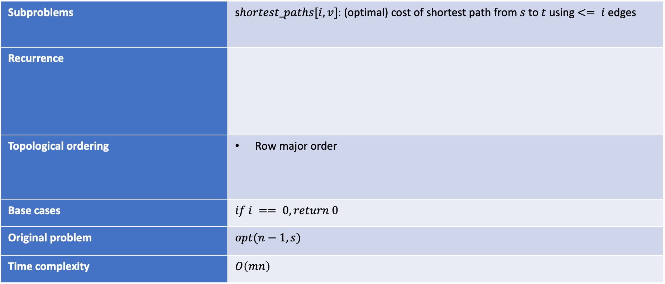
Summary
Subproblems | s$hortest_paths[i,v]:$(optimal) cost of shortest path from $s$ to $t$ using $<= i$edges
Recurrence
Topological ordering | Row major order
Base cases | $$if i == 0, return 0$$
Original problem | $$opt(n−1, s)$$
Time complexity | $$O\left(mn\right)$$

Slide 23
Next Steps
Solve all problems from: https://atcoder.jp/contests/dp/tasks
MIT OCW 6.006, MIT 6.046
Tim Roughgarden’s Coursera course on DP for a more theoretical treatment.
UC Davis’ algorithms lectures if you want K&T lectures.

