Slide 1

Dynamic Programming (DP)
Srikanth. V. Goutham
1MS071S101
13-July-2023

Slide 2
What to expect in this session?
Introduction to Dynamic Programming
Lots of interaction!
Some coding.
Some analysis of algorithms.

Slide 3
Setup
https://discord.gg/3T4CnCSa
Signup on leetcode.

Slide 4
Problem 1 from Liber Abaci (1202)
A single newly born pair of rabbits (one male, one female) are put in a field.
Rabbits can mate at the age of one month so that at the end of its second month, a female can produce another pair of rabbits.
Rabbits never die, and a mating pair always produces one new pair (one male, one female) every month from the second month on.
How many rabbit pairs are present at the end of ’n’ months?

Slide 5
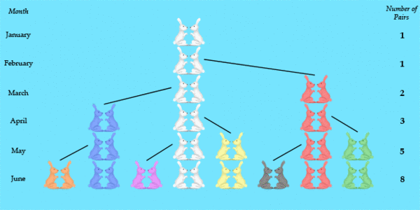
Solution

Slide 6
Fibonacci
F_{n} = F_{n-1} + F_{n-2}
_{F(0) = 0}
_{F(1) = 1}

Slide 7
Visualize the recursion
https://recursion.vercel.app/

Slide 8
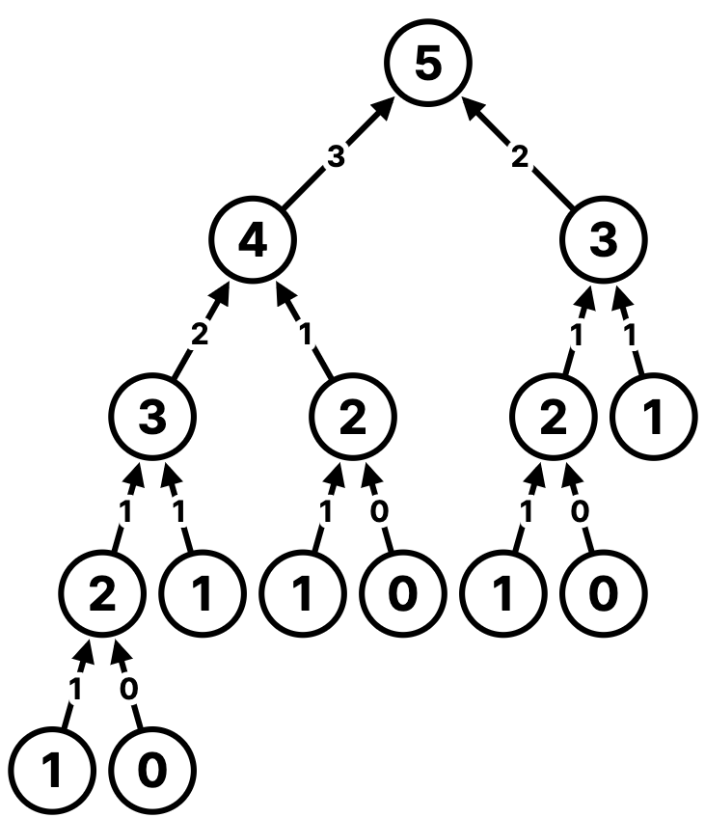
Inefficiencies

Slide 9
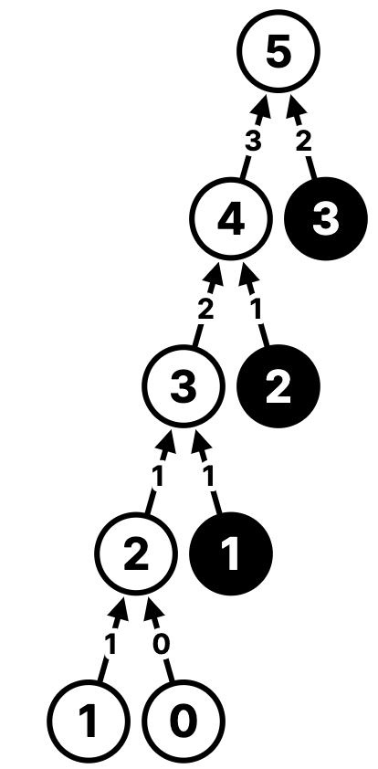
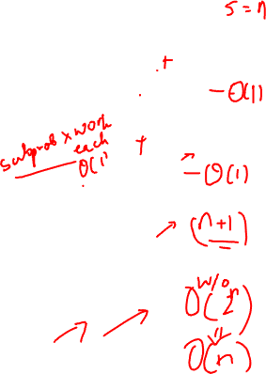
Solution – remember the past

Slide 10
Code!

Slide 11
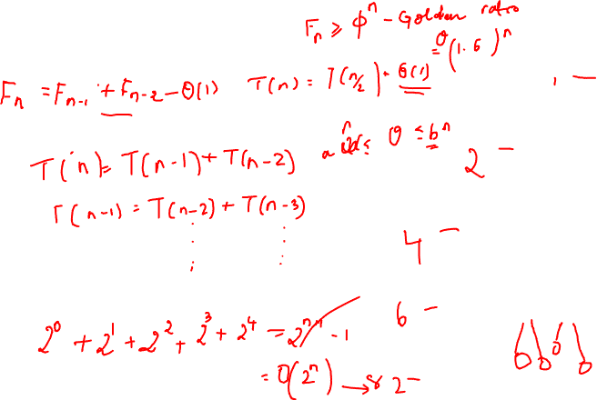
Analysis

Slide 12
Solve!
https://leetcode.com/problems/climbing-stairs/

Slide 13

Dynamic Programming

Slide 14
"I spent the Fall quarter (of 1950) at RAND. My first task was to find a name for multistage decision processes. An interesting question is, ‘Where did the name, dynamic programming, come from?’ The 1950s were not good years for mathematical research. We had a very interesting gentleman in Washington named Wilson. He was Secretary of Defense, and he actually had a pathological fear and hatred of the word, research. I’m not using the term lightly; I’m using it precisely. His face would suffuse, he would turn red, and he would get violent if people used the term, research, in his presence. You can imagine how he felt, then, about the term, mathematical. The RAND Corporation was employed by the Air Force, and the Air Force had Wilson as its boss, essentially. Hence, I felt I had to do something to shield Wilson and the Air Force from the fact that I was really doing mathematics inside the RAND Corporation. What title, what name, could I choose? In the first place I was interested in planning, in decision making, in thinking. But planning, is not a good word for various reasons. I decided therefore to use the word, ‘programming.’ I wanted to get across the idea that this was dynamic, this was multistage, this was time-varying—I thought, let’s kill two birds with one stone. Let’s take a word that has an absolutely precise meaning, namely dynamic, in the classical physical sense. It also has a very interesting property as an adjective, and that is it’s impossible to use the word, dynamic, in a pejorative sense. Try thinking of some combination that will possibly give it a pejorative meaning. It’s impossible. Thus, I thought dynamic programming was a good name. It was something not even a Congressman could object to. So I used it as an umbrella for my activities”.

Slide 15

Applications
Application areas.
Computer science: AI, compilers, systems, graphics, theory, ….
Operations research.
Information theory.
Control theory.
Bioinformatics.
Some famous dynamic programming algorithms.
Avidan–Shamir for seam carving.
Unix diff for comparing two files.
Viterbi for hidden Markov models.
De Boor for evaluating spline curves.
Bellman–Ford–Moore for shortest path.
Cocke–Kasami–Younger for parsing context-free grammars.
Needleman–Wunsch/Smith–Waterman for sequence alignment.
Knuth–Plass for word wrapping text in .

Slide 16

Applications 2.0
It gives you superpowers!
Often asked in coding interviews in reputed companies.
Shows up in competitive exams

Slide 17
Types of DP
Top down (memoization)
Bottom up (iterative)

Slide 18
Framework for thinking about DP problems (MIT 6.006)
Subproblems
Recurrences
Topological ordering
Base cases
Original problem
Time complexity

Slide 19
Key idea 1: Overlapping subproblems

Slide 20
Key idea 2: Optimal substructure

Slide 21
Problem 2
You’re preparing for an exam.
Goal: Secure high marks.
What is your preparation strategy?

Slide 22
Strategies

Slide 23
Weighted interval scheduling (Section 6.1, K&T)

Slide 24
Weighted interval scheduling
Job j starts at s_{j}, finishes at f_{j}, and has weight w_{j} > 0.
Two jobs are compatible if they don’t overlap.
Goal: find max-weight subset of mutually compatible jobs.

Slide 25
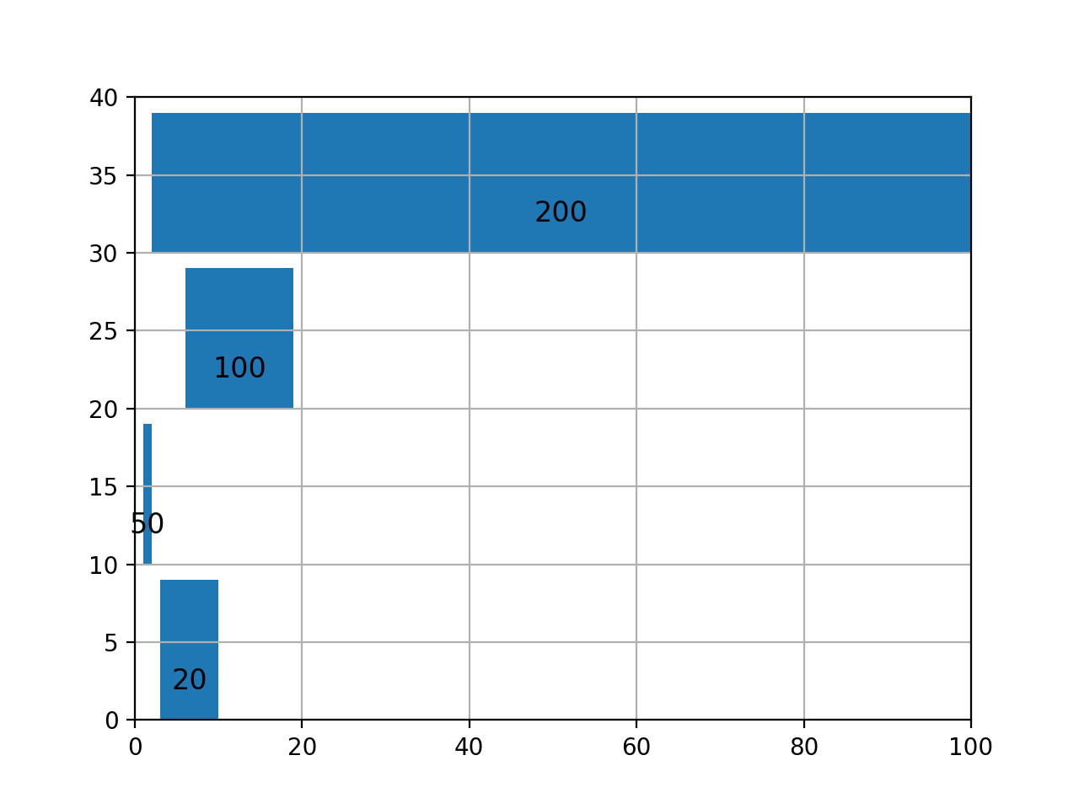
Intuition
 | start | end | weight
Job-1 | 3 | 10 | 20
Job-2 | 1 | 2 | 50
Job-3 | 6 | 19 | 100
Job-4 | 2 | 100 | 200

Slide 26
Solution strategies

Slide 27
Greed(y) doesn’t work
Sort by weight
Sort by end time

Slide 28
Subproblems
Notation. OPT(j) = value of the optimal solution to the problem consisting of job requests 1, 2, ..., j.
Case 1: OPT selects job j.
Collect profit v_{j}.
Can't use incompatible jobs { p(j) + 1, p(j) + 2, ..., j – 1 }.
Must include optimal solution to problem consisting of remaining compatible jobs 1, 2, ..., p(j).
Case 2: OPT does not select job j.
Must include optimal solution to problem consisting of remaining compatible jobs 1, 2, ..., j – 1.

Slide 30
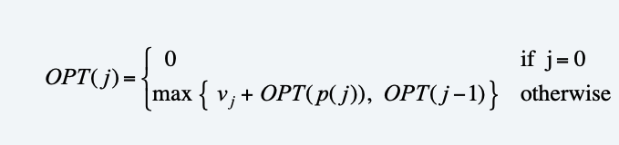
Recurrence

Slide 31
Code!

Slide 32
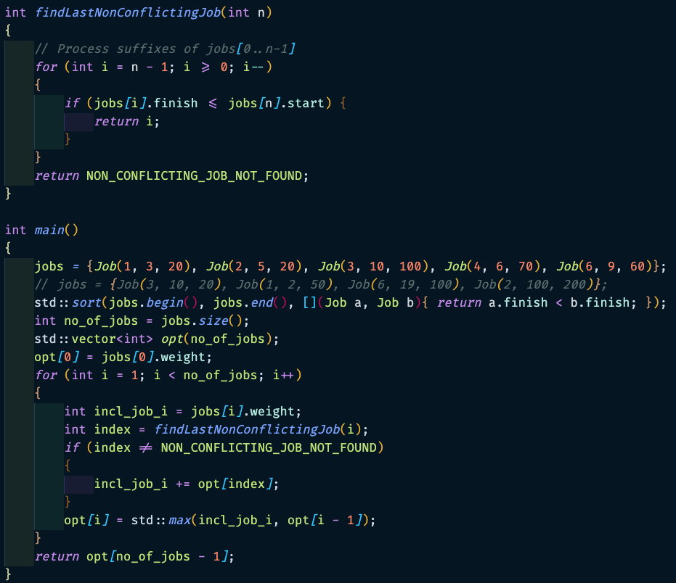
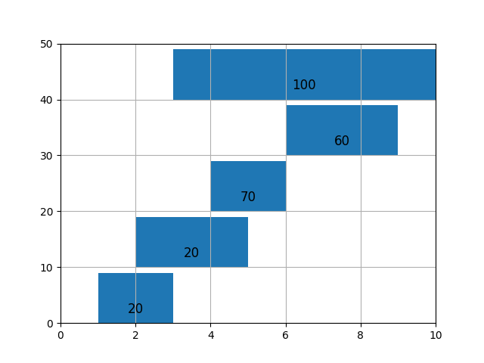
Exercise: Trace the code

Slide 33
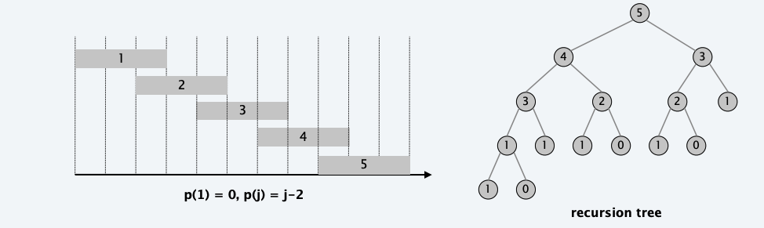
Running time analysis - recursion

Slide 34
Running time analysis – memoized implementation
Memoized version of algorithm takes O(n log n) time.
Sort by finish time: O(n log n).
Computing p[:] : O(n²)
weighted_interval_scheduling_memo(j): each invocation takes O(1) time and either
returns an existing value from the memo table
fills in one new entry in the memo table and makes two recursive calls
Progress measure Φ = # nonempty entries of memo table
initially Φ = 0, throughout Φ ≤ n
increases Φ by 1 ⇒ at most 2n recursive calls.
Overall running time of weighted_interval_scheduling_memo(j): is O(n).

Slide 35
Solve!
https://leetcode.com/problems/maximum-profit-in-job-scheduling/

Slide 36
Life lessons
“Those who cannot remember the past are condemned to repeat it.” – George Santayana
Greed(y) does not always work.

Slide 37
Key takeaways
Polynomial time GOOD!
Exponential time BAD!
Infinite time gets you FIRED!
SRTBOT
PRACTICE!

Slide 38
Assignment ☹
Can we do better than O(n^2) to compute in p(j) previous example?
2
Can the weighted interval scheduling problem be solved by start times?
3
Write code to trace the recursion in an indented manner
1

