Slide 1
Bike Sharing Application
Sergiu Vicol
Gheorghe ursu

Slide 2
Agenda
Description
User stories
Database structure
Technologies used
Demo
Key takeaways
Future improvements

Slide 3
Description
The aim of the application is:
Enabling bike owners to share their bikes for renting
Offering a platform for biking fans to search, book, and rent bikes
Encouraging healthy and environment-friendly habits of the population

Slide 4
Planning – user stories
All users can:
register an account;
login into the application.

Slide 5
Planning – user stories
A bike owner can:
register a bike so others can rent it by providing bike model and its location;
change the availability of his bikes for renting without deleting bikes from the database;
view and edit the data relating to his bikes;
permanently delete a bike;
view contact information of a renter for an opened renting order;
leave feedback to a renter when the renting order is closed.

Slide 6
Planning – user stories
A bike renter can:
rent an available bike ;
modify or cancel an opened order;
leave feedback to a bike owner when the renting order is closed.

Slide 7
Planning – user stories
The system (business logic of the app):
validates new users;
validates and generates new renting orders – orders must be in the future and they cannot overlap with other opened orders for the same bike;
validates modifications of renting orders;
generates comprehensive messages to users when validations fail;
does not allow renting own bikes.

Slide 8
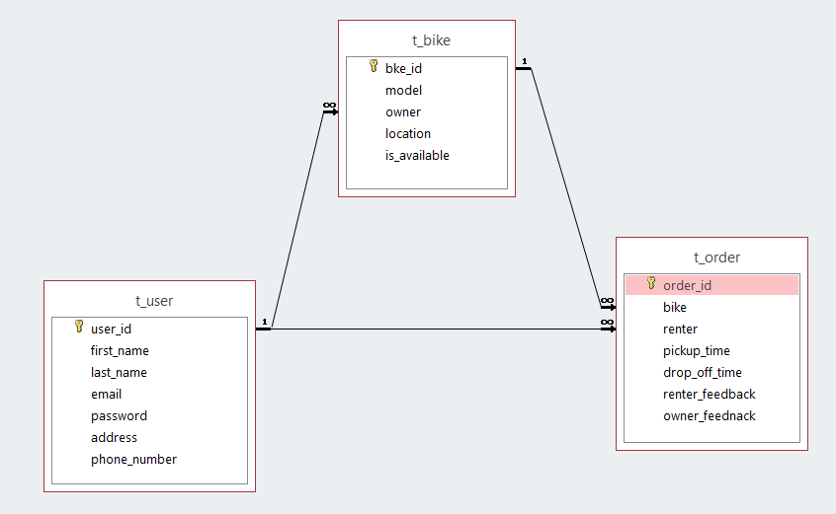
Planning – database

Slide 9












Technologies

Slide 10
Demo

Slide 11
What we learned?
Better understanding of JAVA
Maven
Git
Spring framework
JPA
SQL
Model View Controller (MVC) architecture
Testing
Working in teams

Slide 12
What is next?
Improve the UI
Add costs for renting
Enable users to change their account data (email, password, address, phone number)
Incorporate already existing online payment systems
Eventually deploy the application

Slide 13
Questions?

