Slide 1

Technology Trends
Kateryna Svidovska
December 2024

Slide 2

OUTLINE
Executive Summary
Introduction
Methodology
Results
Visualization – Charts
Dashboard
Discussion
Findings & Implications
Conclusion
Appendix

Slide 3

EXECUTIVE SUMMARY
Programming Languages and Database Trends
Survey on demographics
Technological disparities across nations
Gender disparities in employment opportunities

Slide 4

INTRODUCTION
About:
Examining trends in software development
Purpose:
Determine future skill requirements
Identify the most in-demand programming languages
Highlight the top database skills sought after in the industry
Explore the most popular Integrated Development Environments (IDEs)
Audience:
Human Resources and IT Leaders

Slide 5

METHODOLOGY
Data Collection Sources:
Stack Overflow Developer Survey 2019
GitHub Job Listings
Programming Languages and Annual Salary Data
Data Exploration
Data Cleaning
Data Visualization
Final Presentation

Slide 6
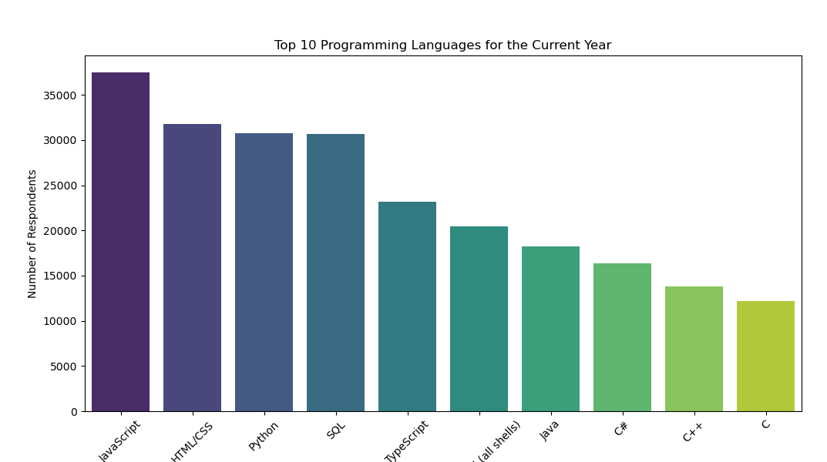
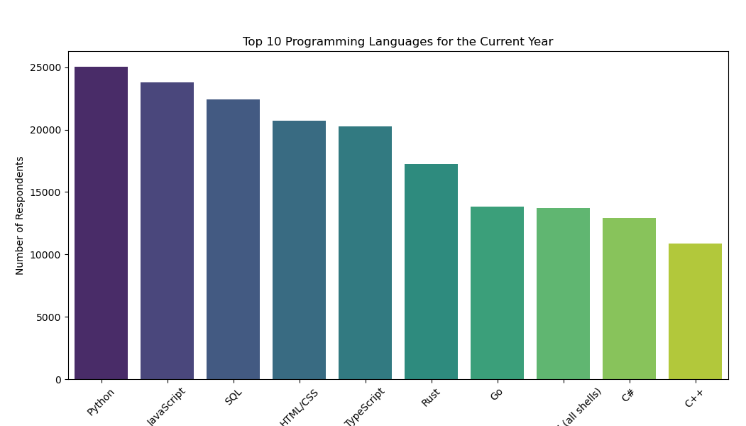
PROGRAMMING LANGUAGE TRENDS
Current Year
Next Year
<Bar chart of top 10 programming languages for the current year goes here.>
< Bar chart of top 10 programming languages for the next year goes here.>

Slide 7
PROGRAMMING LANGUAGE TRENDS - FINDINGS & IMPLICATIONS
Findings
The visualizations show which programming languages are most popular now and which are expected to grow in the future.
Implications
High current usage indicates strong job market demand, while languages with expected growth may present career opportunities for learning and specialization.

Slide 8
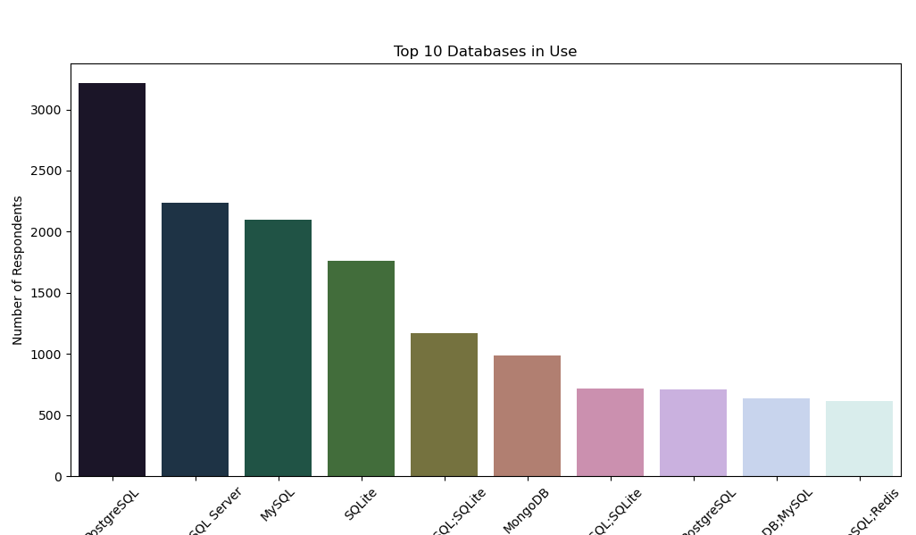
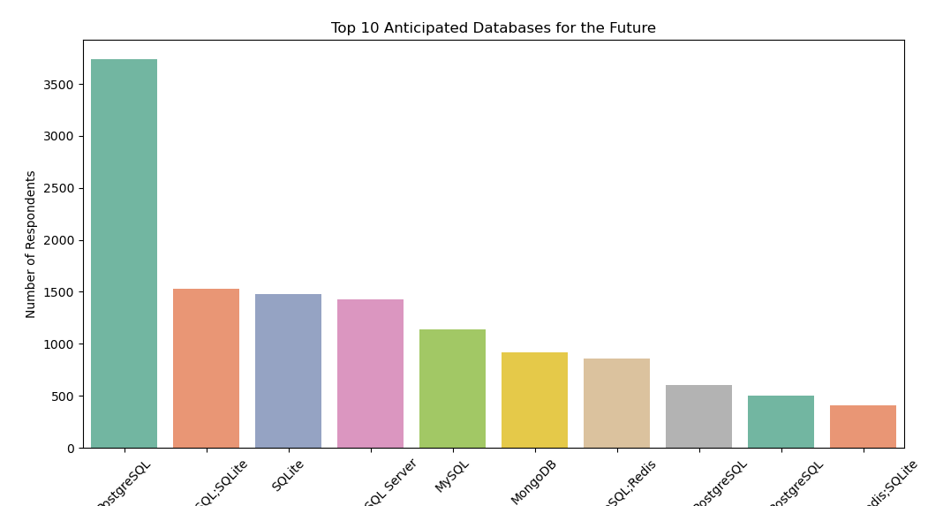
DATABASE TRENDS
Current Year
Next Year
< Bar chart of top 10 databases for the current year goes here >
< Bar chart of top 10 databases for the next year goes here.>

Slide 9
DATABASE TRENDS - FINDINGS & IMPLICATIONS
Implications
Current Trends:
Databases that are already popular (e.g., SQL Server and MySQL) are critical for professionals in the field, suggesting strong job prospects and continued relevance.
Future Outlook:
The projected growth in demand for databases like PostgreSQL and NoSQL solutions indicates that learning these technologies could be advantageous for long-term career growth.
Professional Development:
Staying updated with these trends can help developers align their skills with industry needs, enhancing employability and opening opportunities in high-demand areas.
Findings
Top 10 Databases in Use:
The bar chart for the current year indicates that certain databases like SQL Server, MySQL, PostgreSQL, and MongoDB are widely adopted.
SQL Server and MySQL show the highest number of respondents, signifying their strong market presence.
Top 10 Anticipated Databases for the Future:
The bar chart for anticipated future use suggests that databases such as PostgreSQL, MongoDB, and NoSQL databases are expected to gain more traction.
A noticeable trend shows that some currently less popular databases are projected to become more in-demand.

Slide 10

DASHBOARD
https://lookerstudio.google.com/reporting/ce13ad25-439f-47ac-ba77-e9ef7199cd2b

Slide 11
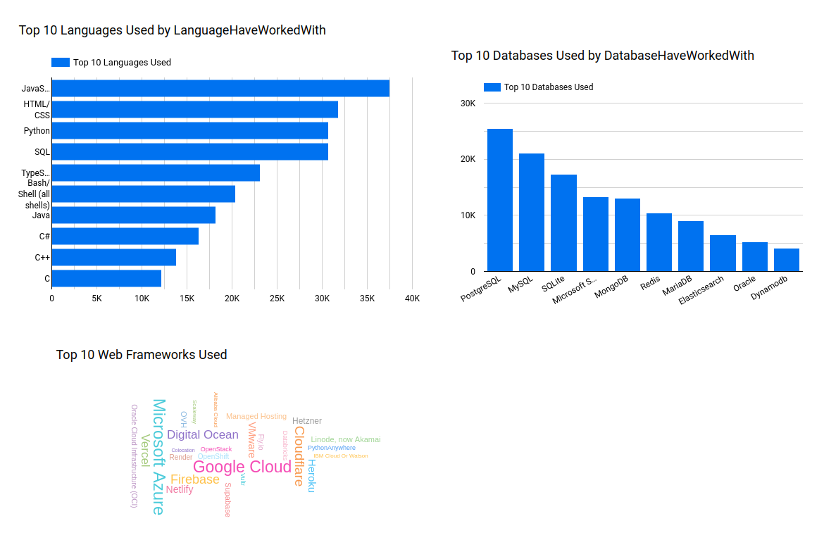
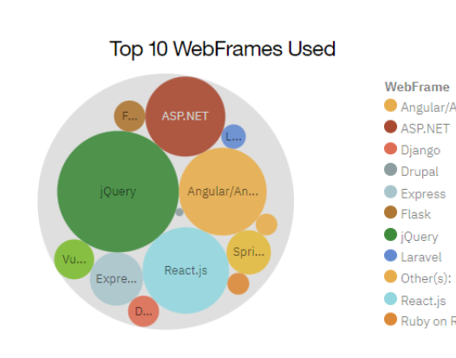
DASHBOARD TAB 1

Slide 12
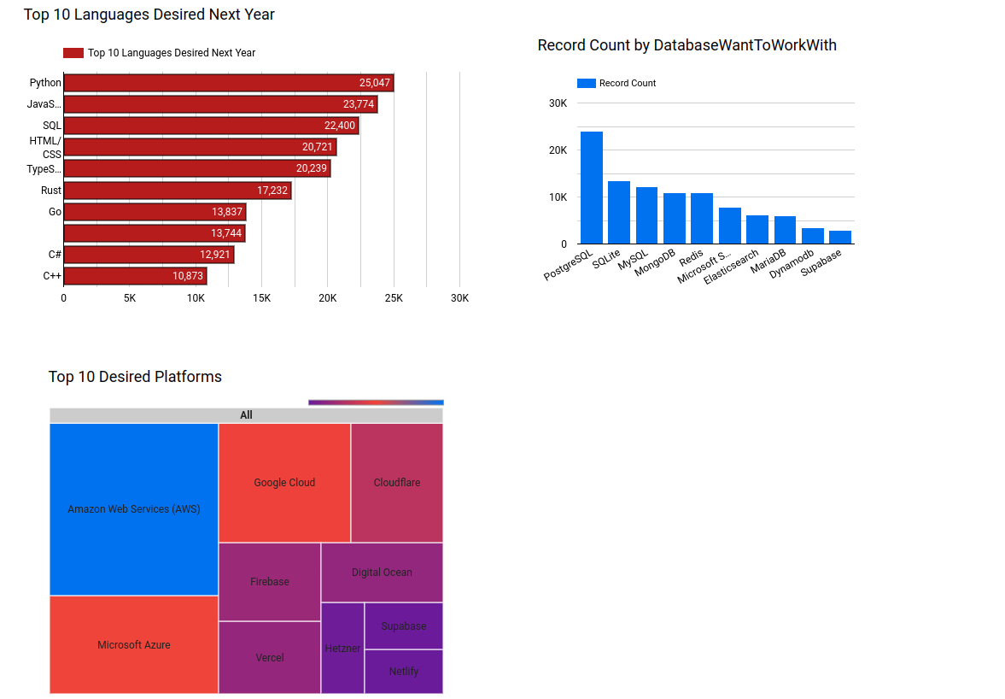
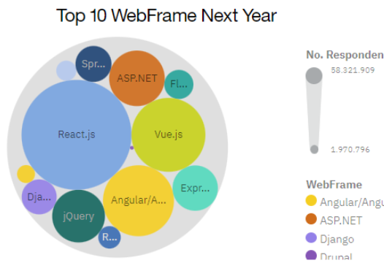
DASHBOARD TAB 2

Slide 13
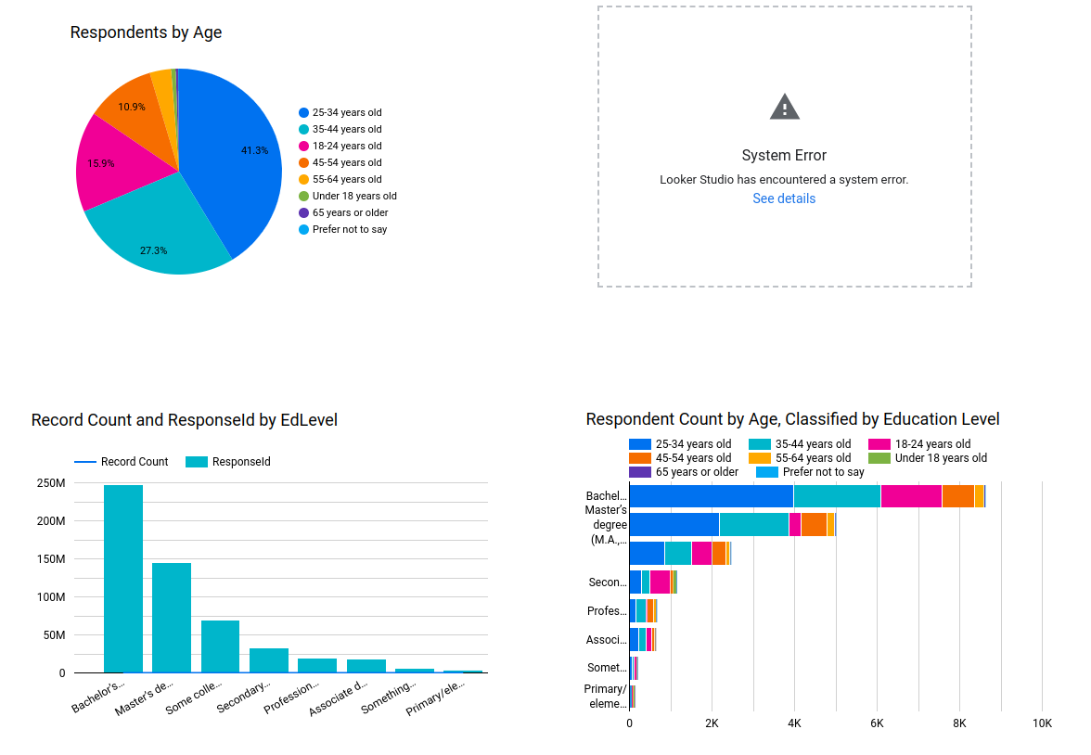
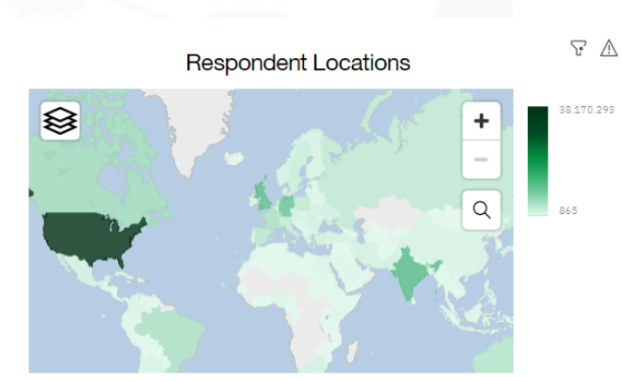
DASHBOARD TAB 3

Slide 14
DISCUSSION
Data Insights: Highlighted trends reveal opportunities in emerging programming languages and databases.
Challenges: Rapid tech evolution and regional disparities in adoption create skill gaps.
Opportunities: Upskilling in trending technologies and fostering diversity can address workforce needs.
Future Outlook: Ongoing trend analysis and collaboration among stakeholders are vital for aligning skills with market demands.

Slide 15
OVERALL FINDINGS & IMPLICATIONS
Findings
Current Trends: SQL Server, MySQL, PostgreSQL, and MongoDB are widely adopted databases.
Future Trends: PostgreSQL, MongoDB, and NoSQL databases are projected to grow in demand.
Implications
Current popular databases indicate strong job market relevance.
Learning emerging databases like NoSQL could benefit long-term career growth.
Keeping skills updated with these trends enhances employability.

Slide 16

CONCLUSION
Key Insights:
Programming languages and databases with strong current adoption offer immediate career opportunities.
Emerging technologies like NoSQL databases and growing programming languages present avenues for specialization and long-term growth.
Industry Trends:
Continuous learning and adaptation to market shifts are essential for career advancement.
Emphasizing in-demand skills aligns professionals with industry needs, enhancing employability.
Strategic Recommendations:
For organizations: Invest in upskilling employees in trending technologies to stay competitive.
For professionals: Focus on learning technologies with projected growth to future-proof careers.
Looking Ahead:
By staying informed of these trends, both professionals and organizations can make data-driven decisions to navigate the evolving technology landscape successfully.

Slide 17
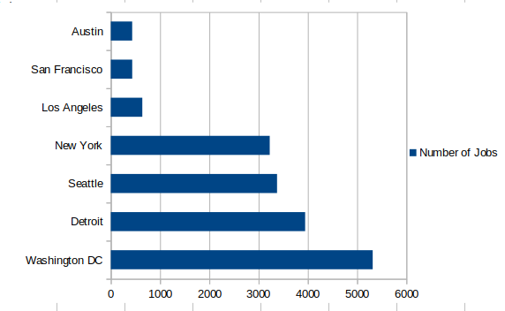
JOB POSTINGS
In Module 1 you have collected the job posting data using Job API in a file named “job-postings.xlsx”. Present that data using a bar chart here. Order the bar chart in the descending order of the number of job postings.

Slide 18
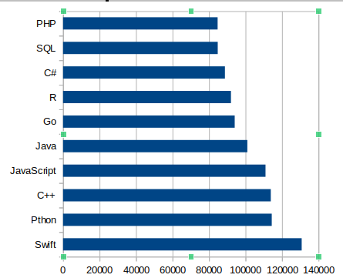
POPULAR LANGUAGES
In Module 1 you have collected the job postings data using web scraping in a file named “popular-languages.csv”. Present that data using a bar chart here. Order the bar chart in the descending order of salary.

