Slide 1

PEEK: A Proactive Producer Mobility Management Scheme for ICN
Vignesh Sivaraman
Department of Electrical and Computer Engineering

Slide 2
Motivation
Increase in mobile traffic
CISCO forecasts eightfold increase between 2015-2020^{[1]}
Consumer mobility is supported in NDN
Mobile producers
Smartphones
Vehicles
Support for producer mobility
[1] CISCO, “White paper: Cisco VNI Forecast and Methodology, 2015-2020,” Tech. Rep., July 2016.
Notes:
Supporting mobility has become a basic requirement for any internet architecture

Slide 3
Objectives
Support for producer mobility
A distributed approach
Respecting the principles of NDN
Notes:
First and foremost objective is to enable producer mobility.
There are a few solutions proposed in the literature like rendezvous server, indirection server and so on. In contrast to these proposal, this work address the producer mobility in a distributed manner.
And finally, we would like to take care that our approach respects the core principles of NDN like hierarchical naming schemes, content-location decoupling, interest aggregation and so on.
To this end, we propose a forwarding strategy to support producer mobility.
A forwarding strategy is characteristically distributed in nature and the proposed approach only requires a minimal addition to the interest header.

Slide 4




Producer Mobility Problem
R₁
R₂
Consumer
R₄
R₃
AP₂
AP₃
AP₄
AP₁

Slide 5
Proposed forwarding strategy
Exploits the following properties
Spatial locality
Interest and data traverse the same path
Introduce “Hopcount Threshold” field in Interest header
Interest Format
Content Name
Selectors
Nonce
Guiders
Hopcount
Hopcount Threshold

Slide 6
Proposed forwarding strategy
Interest generation (at the consumer)
Interest forwarding (at the router)
Data forwarding (at the router)

Slide 7
Interest generation
Initialize the threshold to a default value
On timeout, decrease the threshold value
On receiving the data, set threshold to the default value

Slide 8
Interest forwarding
At the router (when no match in CS nor in PIT)
Case 1: Hopcount less than threshold
Forward interest to the best face using FIB
Case 2: Hopcount greater than threshold
Probe interest to all neighbors
Case 3: Hopcount greater than TTL
Drop interest

Slide 9
Data forwarding
Forward the data using PIT
Update the FIB for the data with incoming face
R
AP₁
AP₂

Slide 10

An Example (Threshold=2 and No timeout)
R₁
R₂
Consumer
R₄
R₃
FIB Updated
AP₂
AP₃
AP₄
AP₁

Slide 11
An Example (Threshold=2 and timeout)
Consumer
R₁
R₂
Threshold=1
FIB Update
Threshold=2
R₄
R₃
Timeout
AP₂
AP₃
AP₄
AP₁

Slide 12
Determining the threshold
Formulation of the optimization problem
Decision variable: Hopcount threshold
Objective: Minimize the cost incurred (in terms of packets generated)
Constraint: Bound on consumer experienced delay
Cost of flooding: Number of neighbors at a distance of k or less

Slide 13
Simulation Results
Setup
A tree network
Leaves are the APs for the producer
Randomly moving producer
Simulating a human walk to a vehicle movement
Probabilistic flooding to compare the performance^{[2]}
[2] Y.-T. Yu, R. B. Dilmaghani, S. Calo, M. Sanadidi, and M. Gerla, “Interest propagation in named data manets” in IEEE CNC’13, January 2013, pp. 1118–1122.

Slide 14
Simulation Results
Notes:
4.54
5.47

Slide 15
Simulation Results
Notes:
4.54
5.47

Slide 16
Simulation Results
Notes:
4.54
5.47

Slide 17
Simulation Results
Notes:
4.54
5.47

Slide 18
Conclusion
Addressed producer mobility problem
Hopcount based forwarding
Spatial locality
Data traverses the same path as interest
Router forwards the interest based on the hopcount

Slide 19
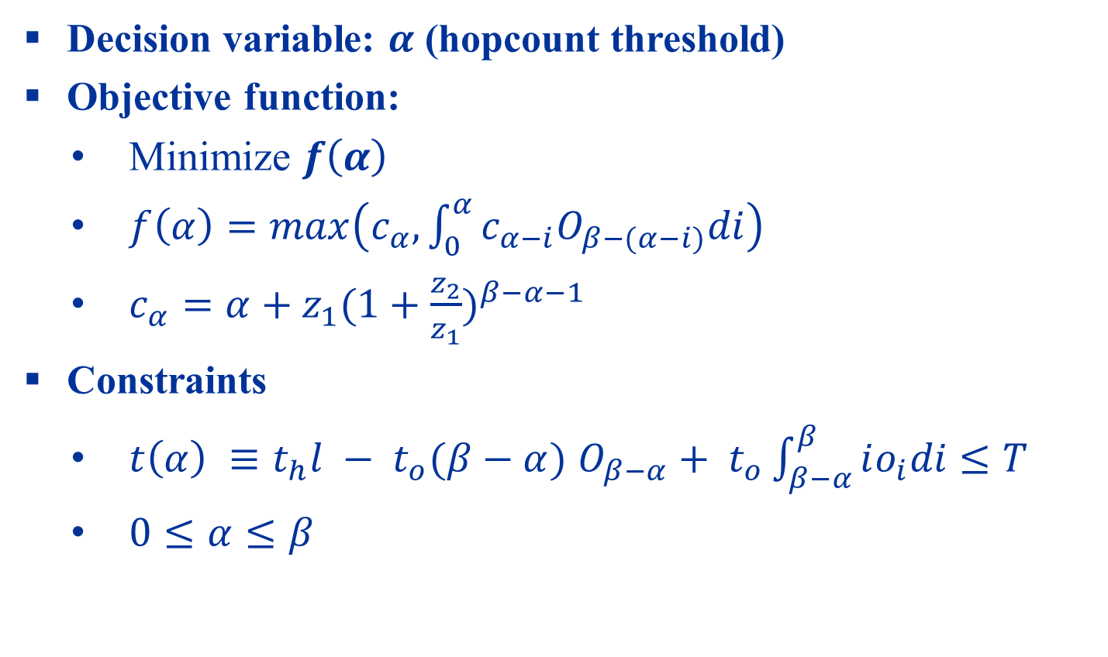
Mathematical expressions
Decision variable: $α$ (hopcount threshold)
Objective function:
Minimize $f\left(α\right)$
$f\left(α\right)=max\left(c_{α},\int_{0}^{α}{c_{α−i}O_{β−(α−i)}di}\right)$
$c_{α}=α+z_{1}{(1+\frac{z_{2}}{z_{1}})}^{β−α−1}$
Constraints
$t\left(α\right) ≡t_{h}l − t_{o}(β−α)$ $O_{β−α}+ t_{o}\int_{β−α}^{β}{io_{i}di}$ $≤T$
$0≤α≤β$

Slide 20
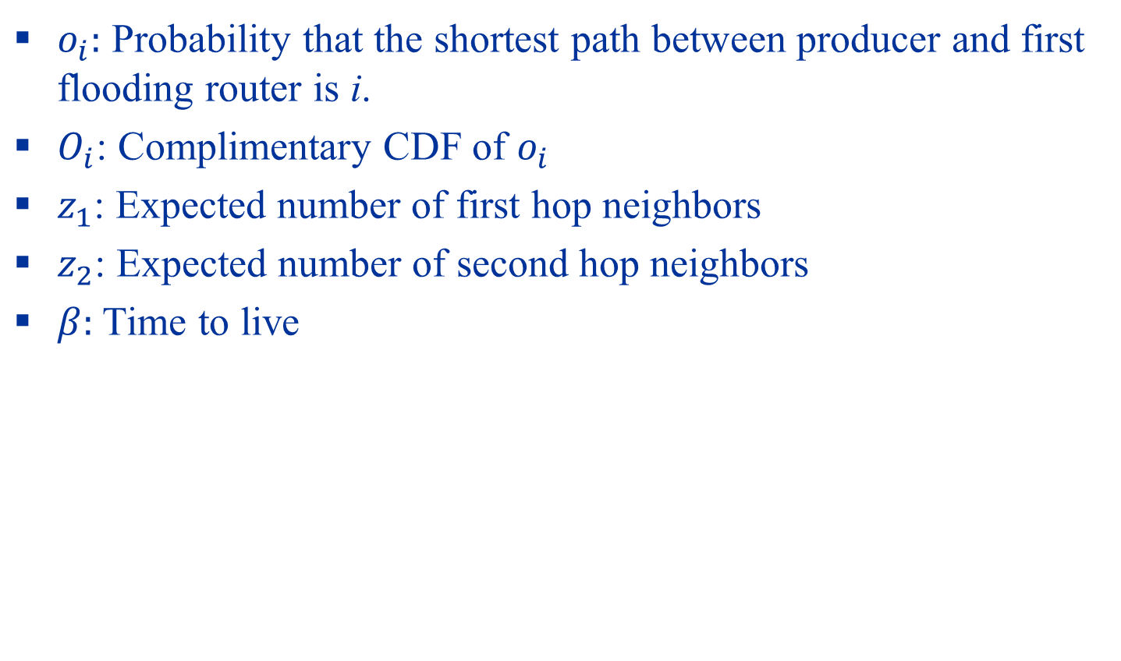
Mathematical expressions
$o_{i}:$ Probability that the shortest path between producer and first flooding router is i.
$O_{i}$: Complimentary CDF of $o_{i}$
$z_{1}$: Expected number of first hop neighbors
$z_{2}$: Expected number of second hop neighbors
$β:$Time to live

Slide 21

Mathematical expressions
Power law graphs
$z_{1}= \frac{{Li}_{τ−1}(e^{{−1}/k})}{Li_{τ}(e^{{−1}/k})}$
$z_{2}= \frac{{Li}_{τ−2}\left(e^{{−1}/k}\right)−{Li}_{τ−1}(e^{{−1}/k})}{Li_{τ}(e^{{−1}/k})}$
$o\left(i | θ,η\right)= \frac{t^{η−1}e^{−tθ}}{θ^{η}Γ(η)}$

