Slide 1
Differential Privacy Against Timing attacks in Information Centric Networks
Vignesh Sivaraman
Dept of Electrical and Computer Engineering
National University of Singapore

Slide 2
Information Centric Networks
Content is the primary entity
What rather than where
Content decoupled from host
Stateful routing
In-network caching
Router
PIT
Content store (cache)
Forwarder
Notes:
Why to cache?
Save bandwidth and reduce delay

Slide 3







System model
Every router has a cache to store the forwarded content
Whenever a request arrives, the cache is looked up first
Hit: serve the request
Miss: forward the request to the next router
Server
$$r_{c}$$
$$R_{1}$$
$$R_{2}$$
$$R_{3}$$
U₁
C
W
X
Y
M
N
O
C
X
Y
C
N
O
C
T
U
S
T
U
Notes:
Why to cache?
Save bandwidth and reduce delay

Slide 4




System model
Every router has a cache to store the forwarded content
Whenever a request arrives, the cache is looked up first
Hit: serve the request
Miss: forward the request to the next router
$$r_{c}$$
C
$$R_{1}$$
$$R_{2}$$
$$R_{3}$$
U₁
C
X
Y
C
N
O
C
T
U

Slide 5



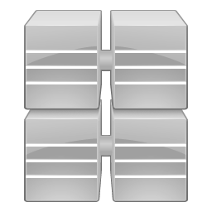





What is a Timing attack?
Try to identify the origin of a content by measuring the time taken to serve it
Server 2
Server 3
$$d_{3}$$
$$d_{2}$$
$$d_{1}$$
$$d_{4}$$
Server 4
Server 1

Slide 6
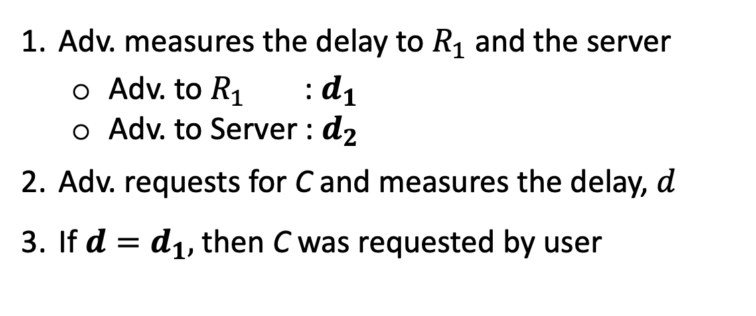




Breaching data privacy
Adv. measures the delay to $R_{1}$ and the server
Adv. to $R_{1}$: $d_{1}$
Adv. to Server : $d_{2}$
Adv. requests for C and measures the delay, $d$
If $d=d_{1},$ then C was requested by user
$$r_{c}$$
C
$$R_{1}$$
$$R_{2}$$
$$R_{3}$$
U₁
C
X
Y
C
N
O
C
T
U
Notes:
This type of attack does not require the adv to compromise any nodes as well.

Slide 7




Leveraging Off-path Caching
De-coupling users and (on-path) caches
Adv. Observes a delay of d₂ for C
$$r_{c}$$
C
$$R_{2}$$
U₁ ?
C
$$R_{3}$$
$$R_{4}$$
C
N
O
C
T
U
$$R_{1}$$
U₁ ?
D

Slide 8



Off-path Caching- Advantages
Efficient usage of resources
Reduces the load at the core network
$$R_{2}$$
$$R_{3}$$
$$R_{4}$$
$$R_{1}$$
U₁ ?

Slide 9



Off-path Caching: Idea
Probabilistically choosing R to cache C
Aim: Increasing the uncertainty of the Adv.
0.5
$$R_{2}$$
0.2
$$R_{3}$$
$$R_{4}$$
0.2
0.1
$$R_{1}$$
U₁ ?

Slide 10




Off-path Caching: Tradeoff
Tradeoff between privacy and performance
$$R_{3}$$
$$R_{4}$$

Slide 11
Off-path Caching: Approach
Computing a probability distribution for the set of routers which
Optimizes performance metrics
satisfies the privacy requirements

Slide 12
Optimization Problem
Objective: minimize the cost in terms of performance loss
Constraints: privacy constraints in terms of
Mutual information
Differential privacy
Decision variable: the probability vector on the set of routers

Slide 13

Optimization Problem: Cost function
Cost of caching at a router:
Cache utilization
Distance from user
Cost = $c^{T}p$
$c_{i}=a_{i}+b_{i}$
$a_{i}=\hat{a_{i}}q_{i}$

Slide 14
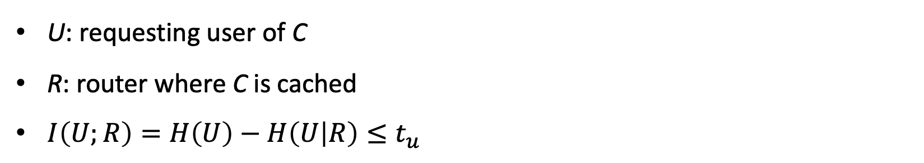
Optimization Problem: Mutual Information
U: requesting user of C
R: router where C is cached
$I\left(U;R\right)=H\left(U\right)−H\left(U | R\right)≤t_{u}$
H(U,R)
H(U|R)
I(U;R)
H(R|U)
H(U)
H(R)

Slide 15

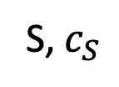
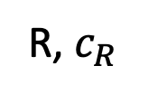
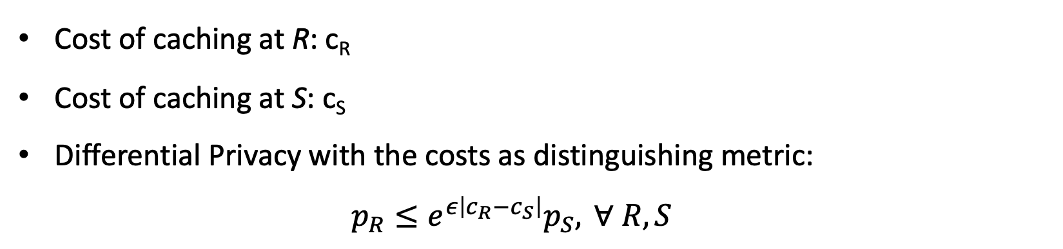
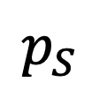
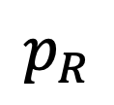
Optimization Problem: Differential Privacy
Cost of caching at R: c_{R}
Cost of caching at S: c_{S}
Differential Privacy with the costs as distinguishing metric:
$$p_{R}≤e^{ε\left|c_{R}−c_{S}\right|}p_{S}, ∀ R,S$$
$$p_{R}$$
R, $c_{R}$
$$p_{S}$$
S, $c_{S}$

Slide 16
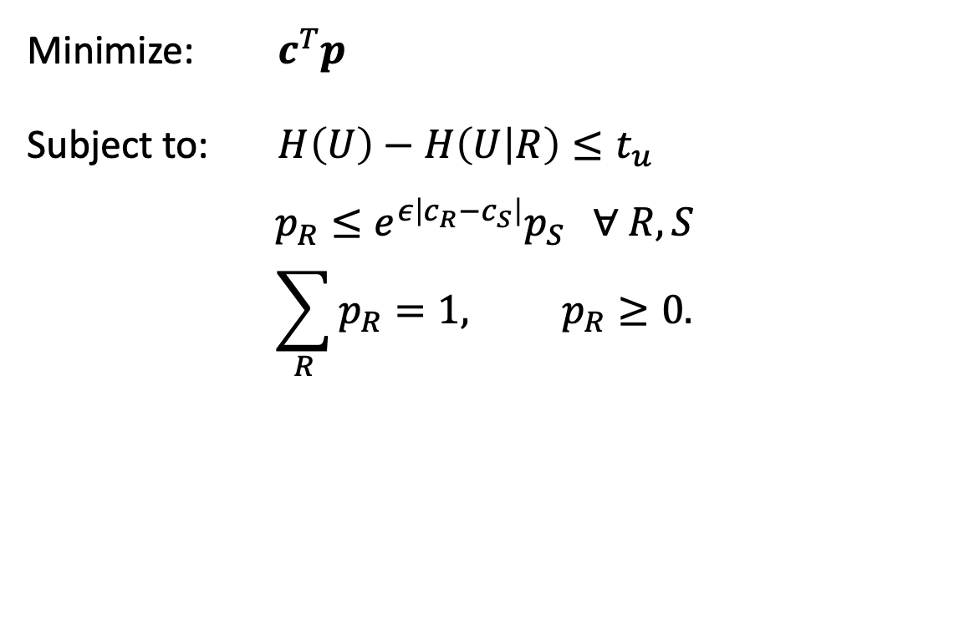

Optimization Problems
P1
P2
Minimize: $c^{T}p$
Subject to: $H\left(U\right)−H\left(U | R\right)≤t_{u}$
$$\sum_{R}{p_{R}=1, p_{R}≥0.}$$
Minimize: $c^{T}p$
Subject to: $H\left(U\right)−H\left(U | R\right)≤t_{u}$
$$p_{R}≤e^{ε\left|c_{R}−c_{S}\right|}p_{S} ∀ R,S$$
$$\sum_{R}{p_{R}=1, p_{R}≥0.}$$

Slide 17
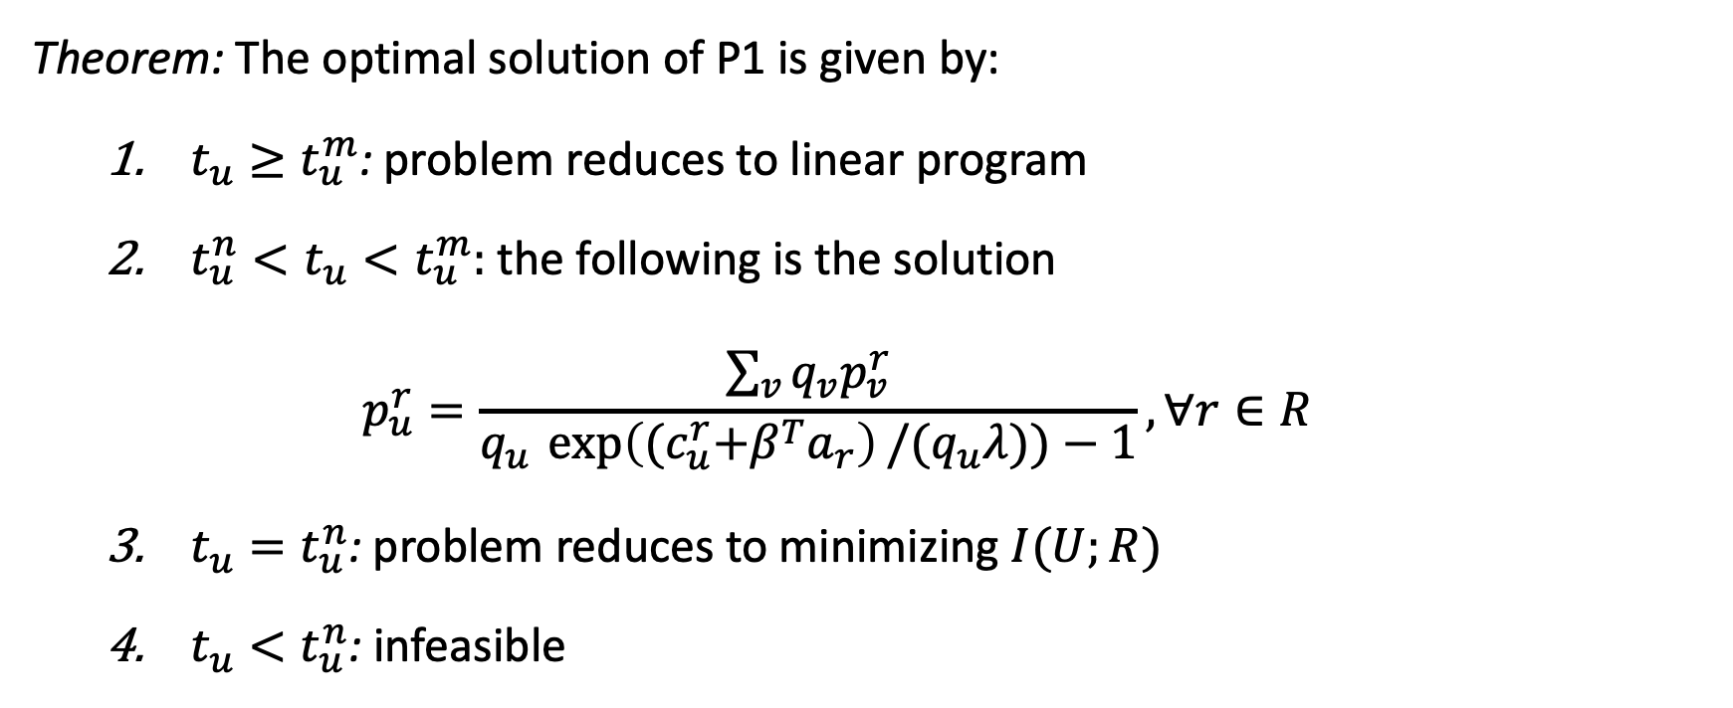
Solving P1
Theorem: The optimal solution of P1 is given by:
$t_{u}≥t_{u}^{m}$: problem reduces to linear program
$t_{u}^{n}<t_{u}<t_{u}^{m}:$the following is the solution $p_{u}^{r}=\frac{\sum_{v}{q_{v}p_{v}^{r}}}{q_{u }\exp\left({(c}_{u}^{r}+β^{T}a_{r}\right)/{(q}_{u}λ))−1}, ∀r∈R$
$t_{u}=t_{u}^{n}$: problem reduces to minimizing $I(U;R)$
$t_{u}<t_{u}^{n}$: infeasible

Slide 18
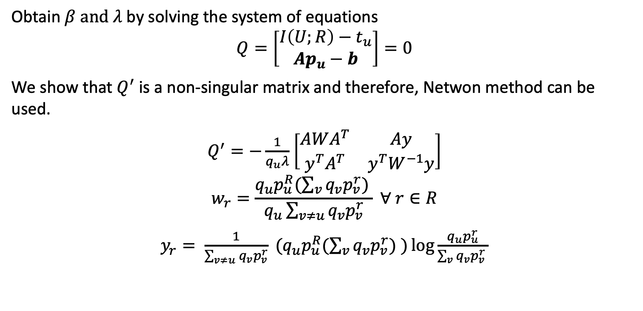
Solving P1
Obtain $β \text{and} λ$by solving the system of equations
$$Q=\left[\begin{matrix}I\left(U;R\right)−t_{u} \\ Ap_{u}−b\end{matrix}\right]=0$$
We show that $Q^{′}$ is a non-singular matrix and therefore, Netwon method can be used.
$Q^{′}=−\frac{1}{q_{u}λ}$ $\left[\begin{matrix}AWA^{T} & Ay \\ y^{T}A^{T} & y^{T}W^{−1}y\end{matrix}\right]$ $$w_{r}=\frac{q_{u}p_{u}^{R}(\sum_{v}{q_{v}p_{v}^{r}) }}{q_{u}\sum_{v≠u}{q_{v}p_{v}^{r}}} ∀ r∈R$$
$y_{r}= \frac{1}{\sum_{v≠u}{q_{v}p_{v}^{r}}} (q_{u}p_{u}^{R}(\sum_{v}{q_{v}p_{v}^{r}) )\log{\frac{q_{u}p_{u}^{r}}{\sum_{v}{q_{v}p_{v}^{r} }}}}$

Slide 19
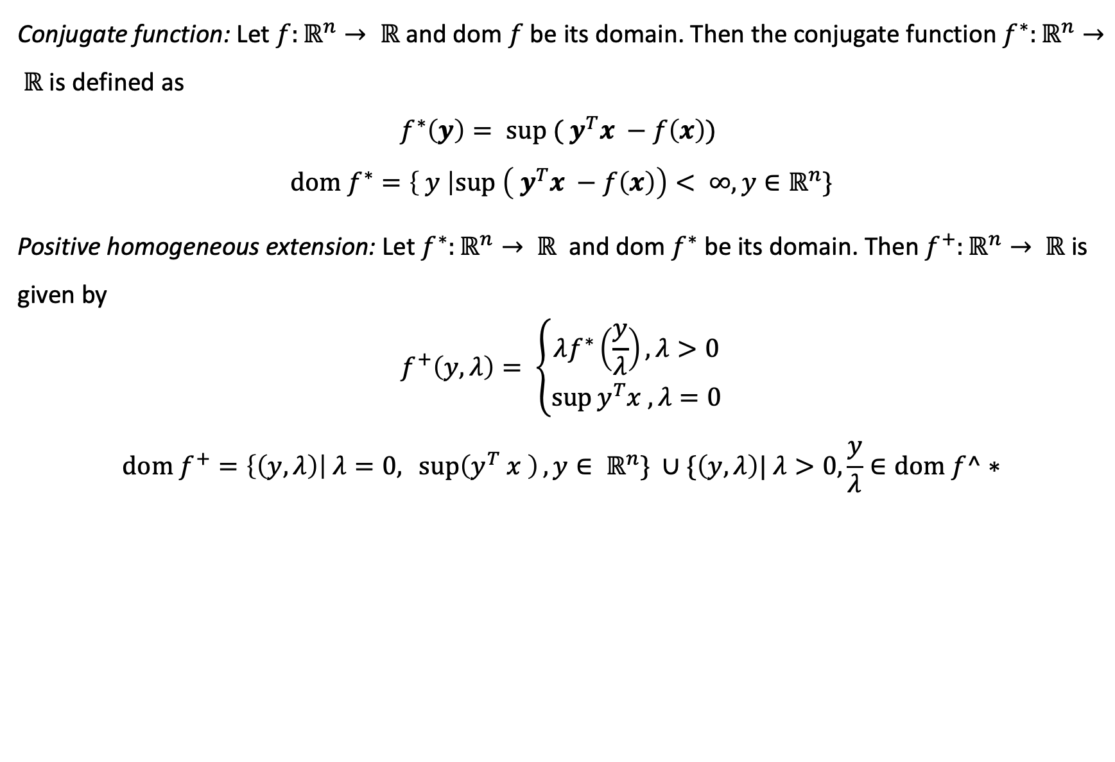
Solving P2: Conjugate function
Conjugate function: Let $f:ℝ^{n}→ ℝ$ and dom $f$ be its domain. Then the conjugate function $f^{∗}:ℝ^{n}→ ℝ$ is defined as
$$f^{∗}\left(y\right)= \text{sup} ( y^{T}x −f\left(x\right))$$
$$\text{dom} f^{∗}=\left\{ y \right|\text{sup} \left( y^{T}x −f\left(x\right)\right)< ∞, y∈ℝ^{n}\}$$
Positive homogeneous extension: Let $f^{∗}:ℝ^{n}→ ℝ$ and dom $f^{∗}$ be its domain. Then $f^{+}:ℝ^{n}→ ℝ$ is given by
$$f^{+}\left(y,λ\right)= \left\{\begin{aligned}λf^{∗}\left(\frac{y}{λ}\right), λ>0 \\ \sup{y^{T}x , λ=0}\end{aligned}\right.$$
$$\text{dom} f^{+}=\left\{\left(y,λ\right)\right| λ=0,\sup\left(y^{T} x \right), y∈ ℝ^{n}\} ∪\{\left(y, λ\right)| λ>0,\frac{y}{λ}∈\text{dom} f^∗$$

Slide 20
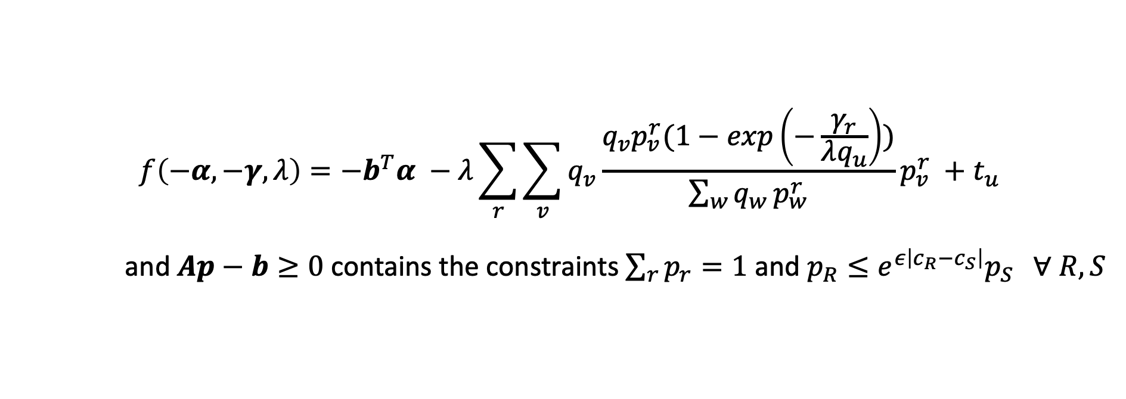
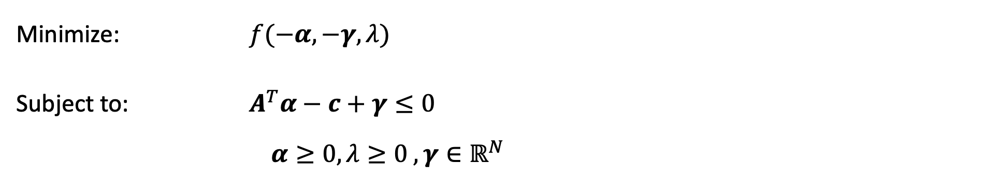
Solving P2: Conjugate dual problem
Minimize: ${f(−α, −γ, λ)}^{}$
Subject to: $A^{T}α−c+γ≤0$
$$α≥0, λ≥0 ,γ∈ℝ^{N}$$
$$f\left(−α, −γ, λ\right)={−b}^{T}α −λ\sum_{r}{\sum_{v}{q_{v}\frac{q_{v}p_{v}^{r}(1−exp\left(−\frac{γ_{r}}{λq_{u}}\right))}{\sum_{w}{q_{w }^{}p_{w}^{r}}}p_{v}^{r} }}+t_{u}$$
and $Ap−b≥0$contains the constraints $\sum_{r}{p_{r}=1}$ and $p_{R}≤e^{ε\left|c_{R}−c_{S}\right|}p_{S} ∀ R,S$
Here:

Slide 21
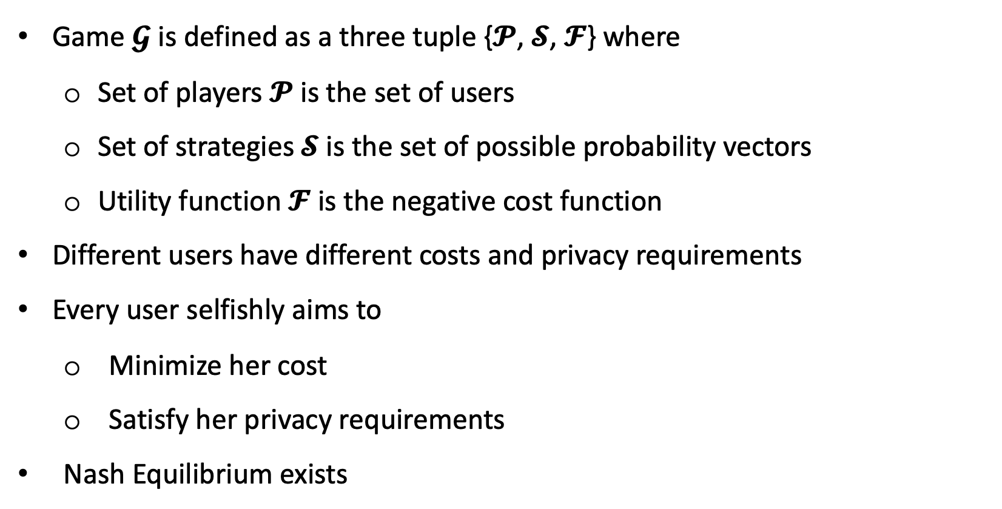
Non-cooperative game among users
Game $𝓖$ is defined as a three tuple {𝓟, 𝓢, 𝓕} where
Set of players 𝓟 is the set of users
Set of strategies 𝓢 is the set of possible probability vectors
Utility function 𝓕 is the negative cost function
Different users have different costs and privacy requirements
Every user selfishly aims to
Minimize her cost
Satisfy her privacy requirements
Nash Equilibrium exists

Slide 22
Performance Study
Cost comparison
Cache utilization

Slide 23





Breaching location privacy
Adv. Has knowledge of U₁ requesting C
Adv. requests C and measures the delay, d
U₁ is connected to
R₁, if d = d₁
R₂, if d = d₂
$$r_{c}$$
C
$$R_{2}$$
U₁ ?
C
$$R_{3}$$
$$R_{4}$$
C
N
O
C
T
U
$$R_{1}$$
U₁ ?
D
Notes:
This type of attack does not require the adv to compromise any nodes as well.

