Slide 1
Socket Programming Assignment
EE4204-EE4204E/TEE4204 Computer Networks

Slide 2
Example 1
Develop a socket program in UNIX/Linux that uses (i) TCP as the transport protocol and (ii) UDP as the transport protocol for transferring a short message between a client and server. The client sends a string (input by the user) to the server and the server prints the string on the screen after receiving it.

Slide 3
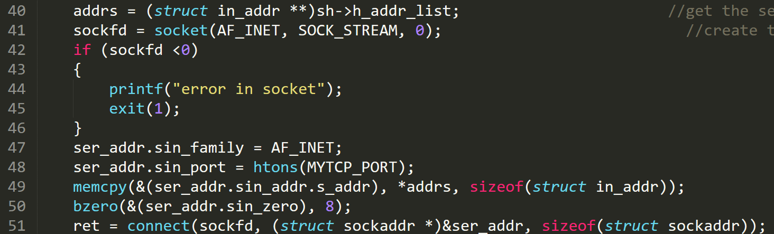
Example 1 (TCP): Client
Server address (from command line)
Creating a socket and connecting to it

Slide 4
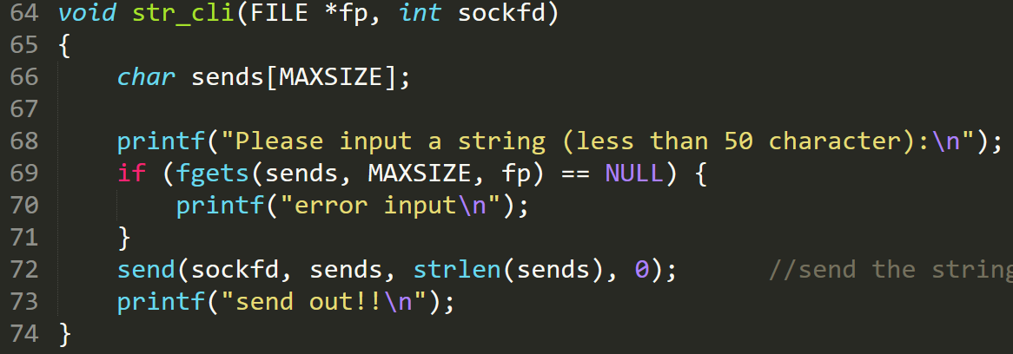
Example 1 (TCP): Client
Client application to send a string to the server

Slide 5
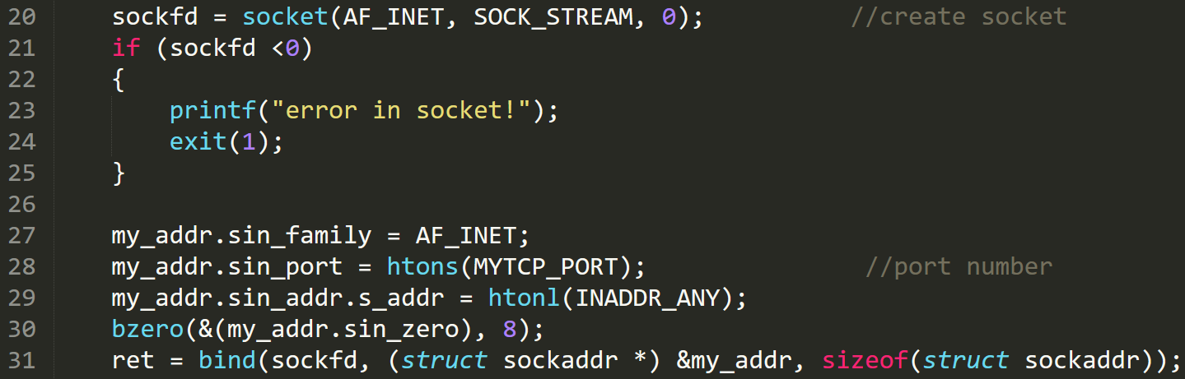
Example 1 (TCP): Server
Create a socket at the server

Slide 6
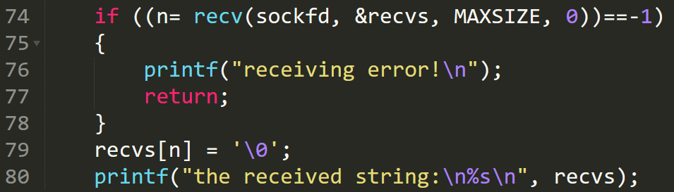
Example 1 (TCP): Server
Informs the OS, that socket is ready for requests
Connect to an incoming request
Server application to receive a string from a client

Slide 7
Example 2
Develop a TCP-based client-server socket program for transferring a large message. Here, the message transmitted from the client to server is read from a large file. The entire message is sent by the client as a single data-unit. After receiving the file, the server sends an ACK message to the receiver. Verify if the file has been sent completely and correctly by comparing the received file with the original file (“diff” command could be used). Measure the message transfer time and throughput.

Slide 8
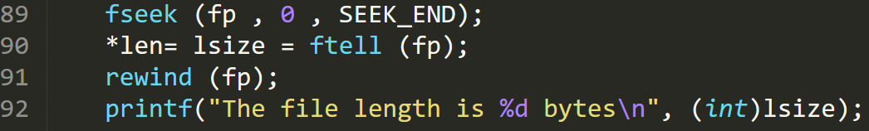
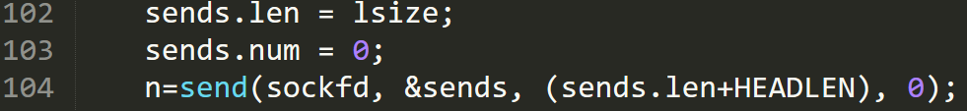
Example 2: Client
The TCP connection process is same as Example 1
Open the file in read mode
Determine the length of the file
Read the file into the buffer
Send the file to the server

Slide 9
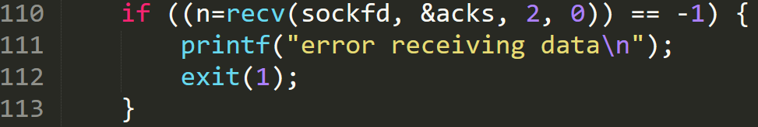
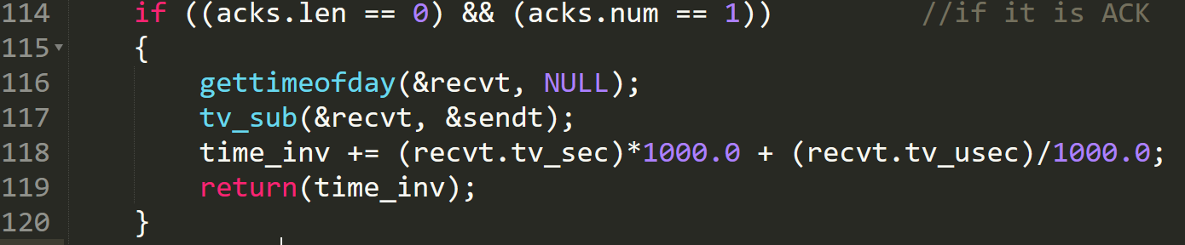
Example 2: Client
Wait for the ack
Check if it is an Ack and calculate the time taken

Slide 10
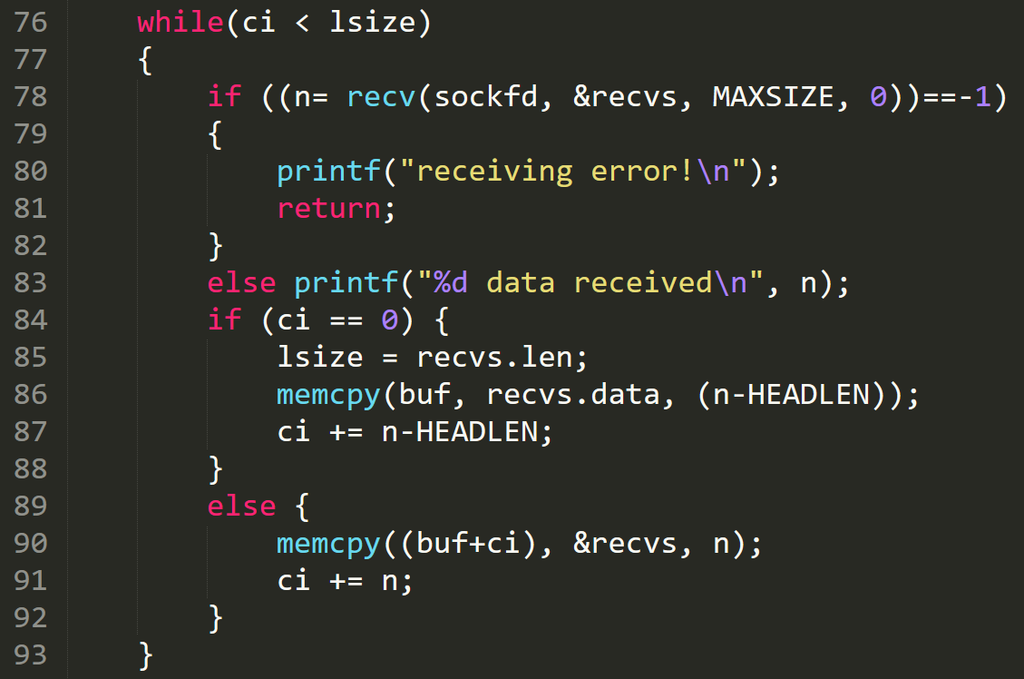
Example 2: Server
Receive the whole file from client

Slide 11
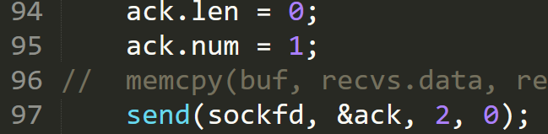

Example 2: Server
Send ack to client after receiving the whole file
Save the file from buffer to a file

Slide 12
Example 3
Develop a TCP-based client-server socket program for transferring a large message. Here, the message transmitted from the client to server is read from a large file. The message is split into short data-units which are sent one by one without waiting for any acknowledgement between transmissions of two successive data-units. Verify if the file has been sent completely and correctly by comparing the received file with the original file. Measure the message transfer time and throughput for various sizes of data-units.

Slide 13
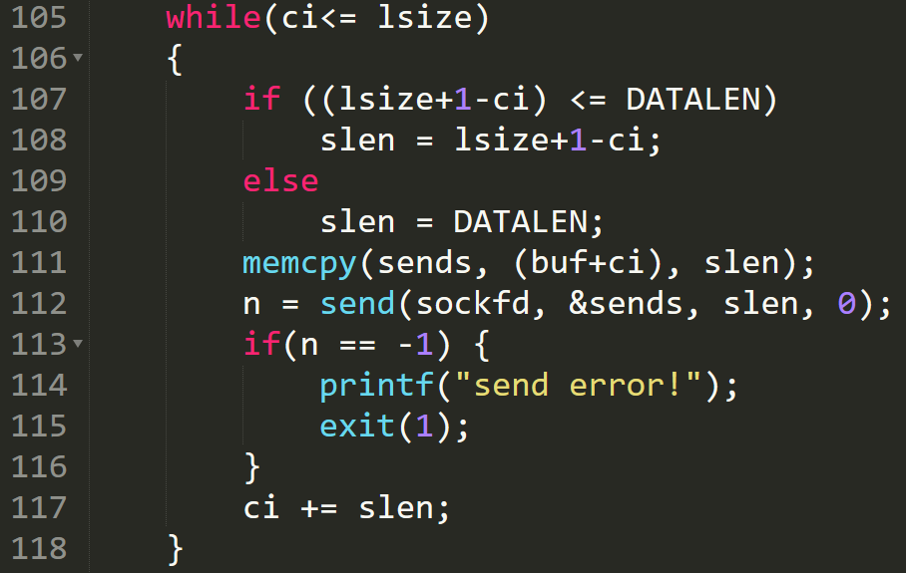
Example 3: Client
Sending file in data units of size DATALEN

Slide 14
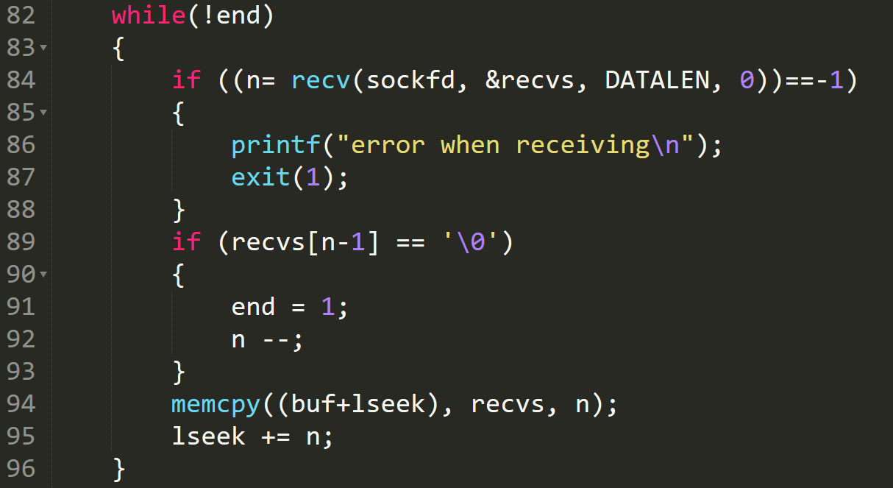
Example 3: Server
Receiving file in data units of size DATALEN

Slide 15
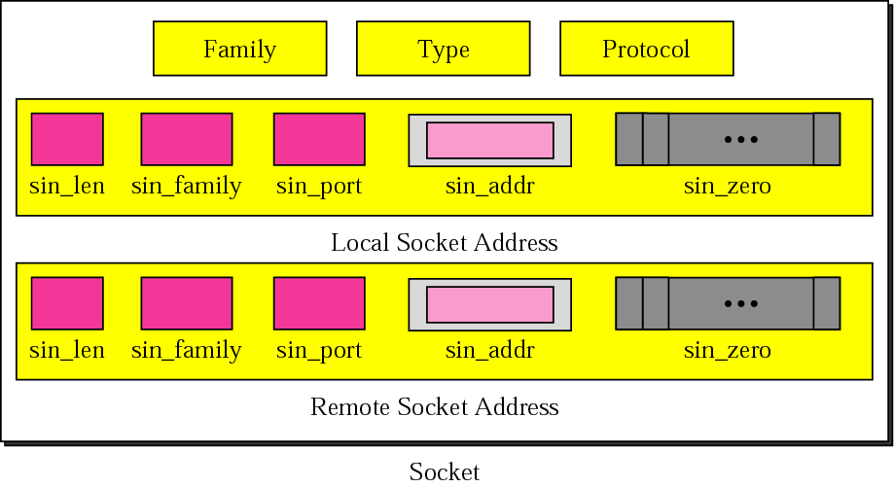
Socket structure
© The McGraw-Hill Companies, Inc., 2000

Slide 16
UDP Client
Create a socket
Chosen by the system
© The McGraw-Hill Companies, Inc., 2000

Slide 17
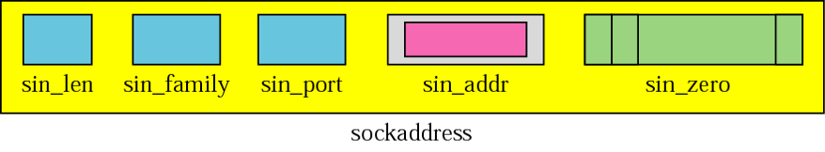
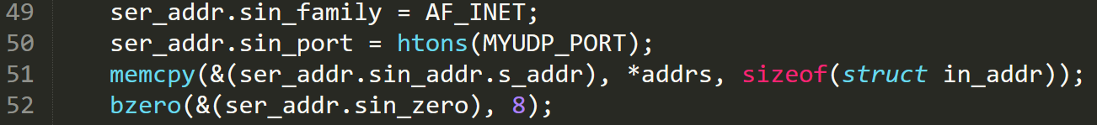
UDP Client
Has information like name, aliases, address type etc
Get the server address
© The McGraw-Hill Companies, Inc., 2000
Send data to the server
Server address

Slide 18
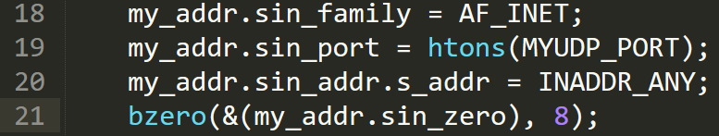
UDP Server
Creating socket is same as the client
Values of the other tuples
In case the system has multiple IPs
© The McGraw-Hill Companies, Inc., 2000

Slide 19
UDP Server
Bind function: To wait for incoming connections on a certain port
Receive from client
Client (source) address
Close the socket (both at server and client)

Slide 20
Assignment problem
Develop a UDP-based client-server socket program for transferring a large message. Here, the message transmitted from the client to server is read from a large file. The message is split into short data-units (DUs) which are sent and acknowledged in alternating batches of size 1 and 2 DUs. The sender sends one DU, waits for an acknowledgment (ACK); sends two DUs, waits for an acknowledgement; and repeats the above procedure until the entire file is sent. The receiver sends an ACK after receiving a DU; sends next ACK after receiving two DUs; and repeats the above procedure.

Slide 21
Assignment problem
Verify if the file has been sent completely and correctly by comparing the received file with the original file. Measure the message transfer time and throughput for various sizes of data-units and compare it with the stop-and-wait protocol where the batch size is always fixed to be 1. Choose appropriate values for “data unit size” and measure the performance. Repeat the experiment several times and plot the average values in a report with a brief description of results, assumptions made, etc.

Slide 22
Assignment problem
Send a file from client to server using UDP.
Server acks the data units in alternating batches of 1 and 2 data units.
Compare the performance with Stop and Wait.
Send 1
Ack
Rcv 1
Ack
Ack
Send 2
Ack
Rcv 2
Client states
Server states

Slide 23
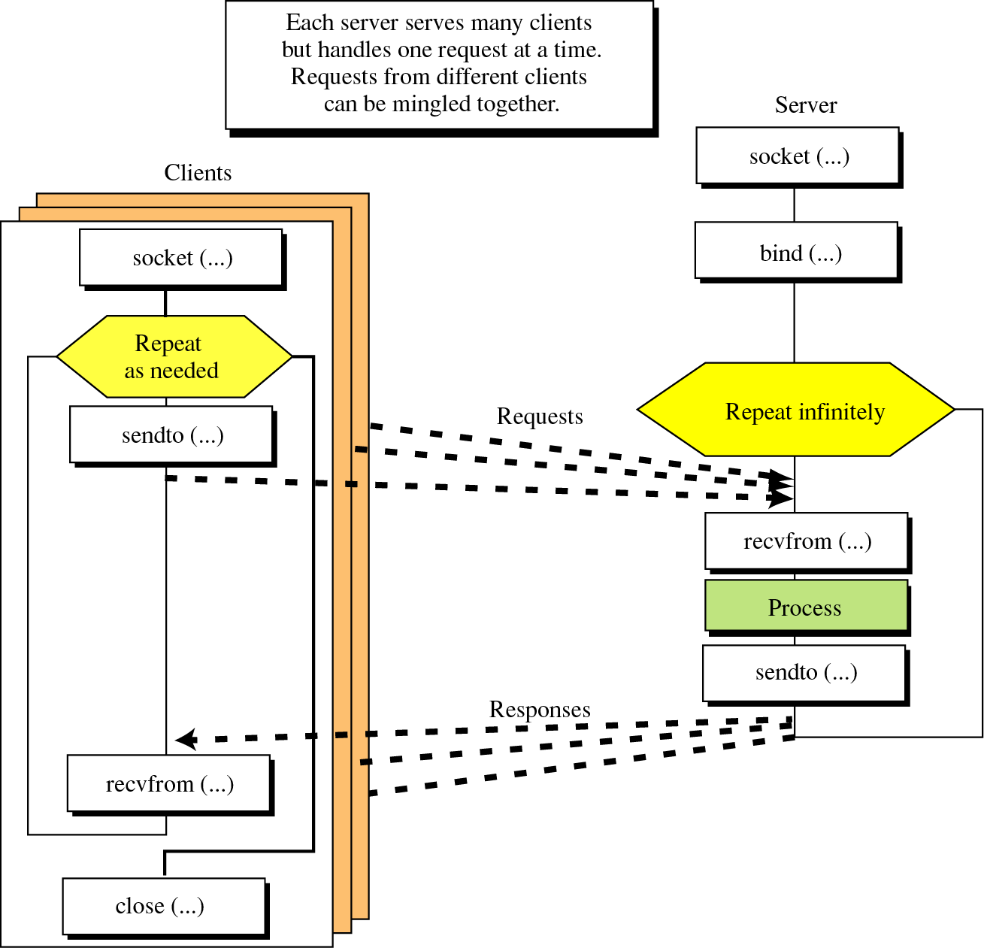
Connectionless iterative communication using UDP
© The McGraw-Hill Companies, Inc., 2000

Slide 24
Sending file in data units (TCP)
Sending file in data units of size DATALEN

Slide 25
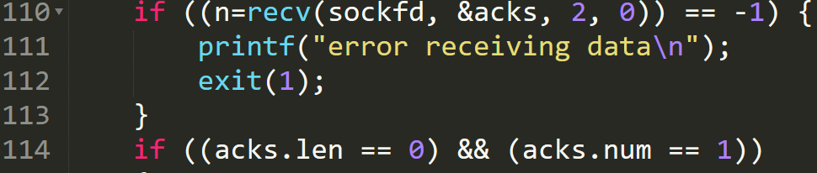
Client waits for Ack (TCP)

Slide 26
Receiving file in data units (TCP)
Receiving file in data units of size DATALEN

Slide 27
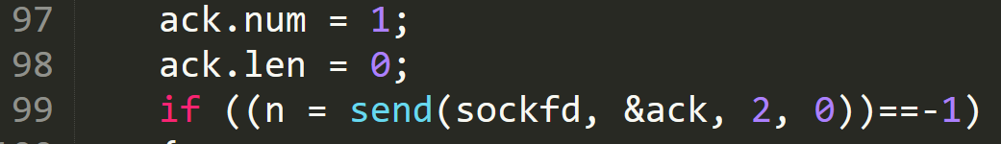

Sending Ack and saving the file (TCP)
Send ack to client
Save the file from buffer to a file
NOTE: The last few code excerpts are for TCP based connection, you need to make NECESSARY CHANGES for UDP based file transfer

Slide 28
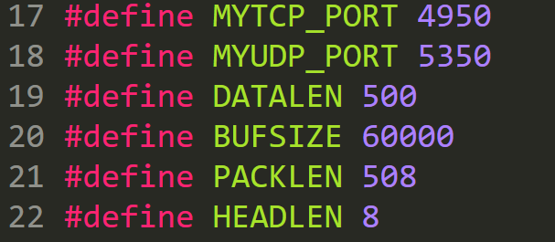
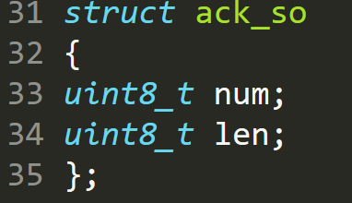
headsock.h (Ex 3)

