Slide 1
Quick learnings

Slide 2
Hadoop Basics
(Distributed Storage & Processing)

Slide 3




Distributed Storage & Processing Architecture (Master Slave Architecture)
200mb/128mb
Tool
Client
BM Hardware
OS, RTE, MWE
Hadoop & Spark
Name-node
(Metadata & Cluster admin)
MYSQL
200mb
B1- 128mb
B2- 72mb
BM Hardware
OS, RTE, MWE
Hadoop & Spark
Datanode
(Data as Blocks, Responding Namenode & Client)
BM Hardware
OS, RTE, MWE
Hadoop & Spark
Data-node
(Data as Blocks, Responding Namenode & Client)
B1- 128mb

Slide 4

1. Hadoop Architectures (High level)
Hadoop Storage (HDFS)
Hadoop Cluster (Architecture)
Client
Edge node
Name Node
Spark
Spark
Hadoop
Hadoop

Slide 5
2. Hadoop Architectures (High level)
Hadoop YARN
Hadoop Cluster (Architecture)
Client
Edge node
Resource Manager
Spark
Spark
Hadoop
Hadoop

Slide 6
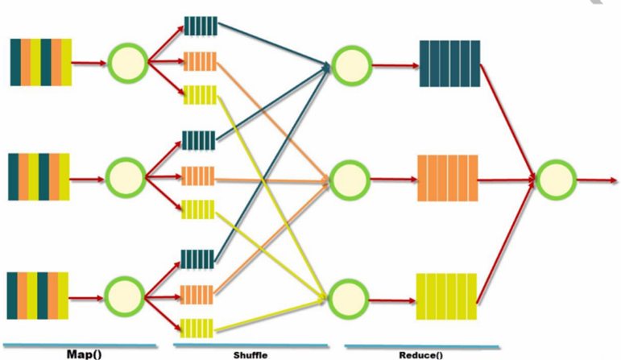
3. Hadoop Architectures (High level)
Hadoop Processing Framework (MR)

Slide 7
Apache Spark

Slide 8
4. Spark Terminologies & Architecture

Slide 9
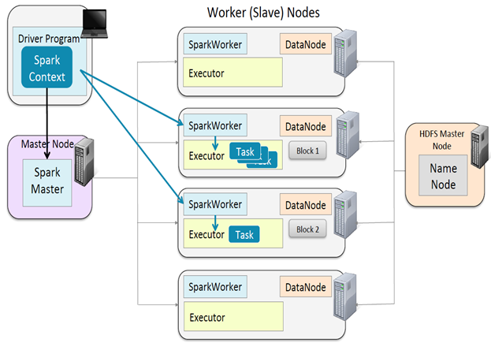
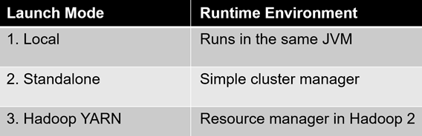
Terminologies
Driver Program (AM)
JVM allocated where Spark Context is created.
Spark Session
Objet created that tells how to access the cluster
(internally uses SparkContext)
Cluster Manager
Services to manage resources on the cluster
Deploy Mode (Only applicable for YARN, for other CMs we have only client mode)
Cluster : Driver inside the cluster along with AM
Client : Driver run in the edgenode

Slide 10
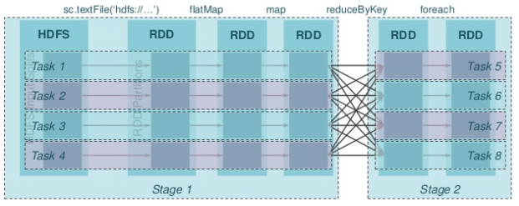
Terminologies (Contd.)
Master (RM) : Resource manager
Spark Worker (NM) : Node where resources are allocated
Executor (Container) : Memory where program runs on data
Job : Single job submitted consists of multiple tasks,
Created based on a Action
Stage : Job is divided into a smaller set of tasks
called Stages, stages are sequential and depend on each other (when shuffle happens stage split will happen) (stg2 depends on stg1)
Task : Jobs are divided into tasks, Task is A unit of work that will be sent to executor run in parallel. (t1, t2,t3,t4 can run in parallel)
Partitions: Memory Data unit that will be handled parallel, Same as blocks in HDFS.

Slide 11
Narrow & Wide Dependent Transformations

Slide 12
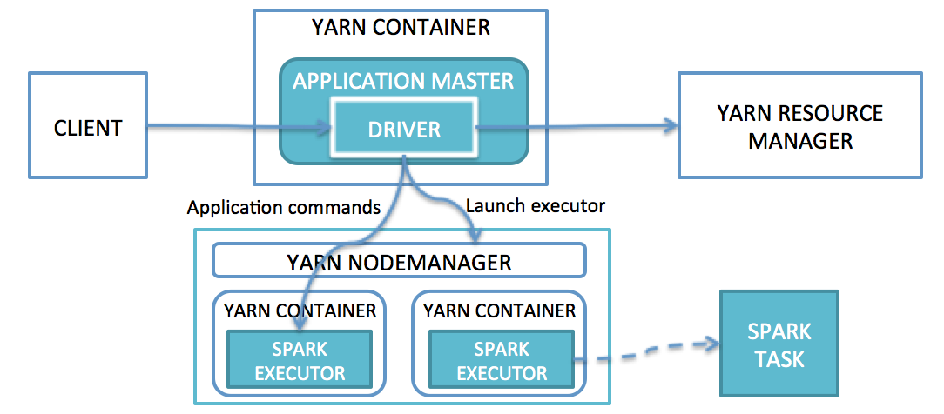
Spark on YARN
Spark Cluster Deployment
Standalone Spark

Slide 13
4.1. Performance Optimization (Core)

Slide 14
Partitioning in Spark
In Databricks, data partitioning means organizing large datasets into directory structures based on column values so that Spark can
read only what it needs instead of scanning everything.
A data partition is a subdirectory of your dataset created based on the distinct values of a column.
Spark uses these folders to skip irrelevant data when you query with filter (known as partition pruning).
Key Benefits of Partitioning
/Volumes/inceptez_catalog/outputdb/customerdata/
profession=Pilot/
profession=Teacher/
profession=Lawyer/
profession=Firefighter/
...
Faster queries – Spark reads only relevant partitions instead of scanning the entire dataset.
Reduced I/O – Minimizes data read from storage, saving time and resources.
Faster incremental loads – Enables quick updates or inserts for specific partitions.
Better parallelism – Allows Spark to process partitions independently for faster execution.
Optimized filtering – Queries with partition column filters become highly efficient.
Best Practices in Partitioning
Use low-cardinality columns – Partition on columns with relatively few unique values (e.g., year, region).
Keep partition size balanced – Aim for 100 MB to 1 GB per partition file for optimal performance.
Limit the number of partitions – Too many partitions can increase metadata overhead and slow queries.
Use dynamic partition overwrite – Overwrite only affected partitions during incremental loads.
Optimize and vacuum regularly – Compact small files and clean up old data in Delta tables.
Partition based on query patterns – Choose columns that are frequently used in filters.
Avoid over-partitioning small datasets – Small datasets do not benefit from heavy partitioning.

Slide 15
Databricks – ORC vs Parquet vs Delta
Feature | ORC | Parquet | Delta
Type | Columnar file format | Columnar file format | Transactional layer on Parquet
Ecosystem | Hive, Presto | Spark, Databricks | Spark, Databricks
Read Performance | Very fast (Hive) | Fast | Fast + optimized
Write Performance | Slower | Faster | Slightly slower (logs)
File Size | Larger | Smaller | Slightly larger
Schema Evolution | Limited | Good | Excellent
Predicate Pushdown | Yes | Yes | Yes
ACID Transactions | No | No | Yes
Time Travel | No | No | Yes
Merge/Upsert | No | No | Yes
Use Case | Hive batch queries | General Spark ETL | Lakehouse, real-time, analytics

Slide 16
Reparition (internally calls coalesce(shuffle=True)
Driver
512mb
2core
1gb
2core
1gb
Executor1
Executor2
Txns File (8mb)
txns (1 to 100000)

Slide 17
Coalesce (internally calls coalesce(shuffle=False)
2
2
2partitions
| (coalesce)
4 partitions
2partitions
| (coalesce)
3 partitions
Coalesce
Range Partitioning
Shuffle (optionally)
Linux File (7blocks)
Customer (1 to 20000)

Slide 18
Controlling Number of Partitions
At RDD Creation time
Linux - <32mb – default ? 2
Linux - >32mb – default ? Per 32mb 1 partition
Linux - <32mb – customize ? Any number <>2
Linux - >32mb – customize ? Any number > Per 32mb 1 partition
linux
HDFS - <128mb – default ? 2
HDFS - >128mb – default ? Per 128mb 1 partition
HDFS - <128mb – customize ? Any number <>2
HDFS - >128mb – customize ? Any number > Per 128mb 1 partition
hdfs
Programatic rdd- sc.parllelize(range(1,1000))
sc.parallelize([1,2,3,4,5,10,20])
Default # of partitions = No. of Cores allocated to this spark application
Customize # of partitions = second parameter (numslices) passed to the parallize function
Programatic rdd

Slide 19
Rdd1=sc.textFile(“hdfs:///user/hduser/txns_big2”)
Print(Rdd1.count())
Rdd1 (cleaned by GC)
Rdd2=Rdd1.filter(lambda x:’error’ in x)
Print(Rdd2.count())#(cleaned by GC)
Print(Rdd2.collect())#Run the entire inmem computation from Rdd1
Memory Management
60k
+40k
=1Lakh
count()
Driver
512mb
5k
+3k
=8000
60k
40k
2core
1gb
2core
1gb
Rdd1-part1 (128mb)
60k
GC()
Rdd1-part2 (74mb)
40k
GC()
count()
count()
Rdd1-part1 (128mb)
60k
Rdd1-part2 (74mb)
40k
filter(lambda x:’error’ in x)
filter(lambda x:’error’ in x)
Rdd2-part1 (10mb)
5k
Rdd2-part2 (7mb)
3k
count()
count()
Executor1
Executor2
Txns_big2 File (202mb)
txns (1 to 100000)

Slide 20
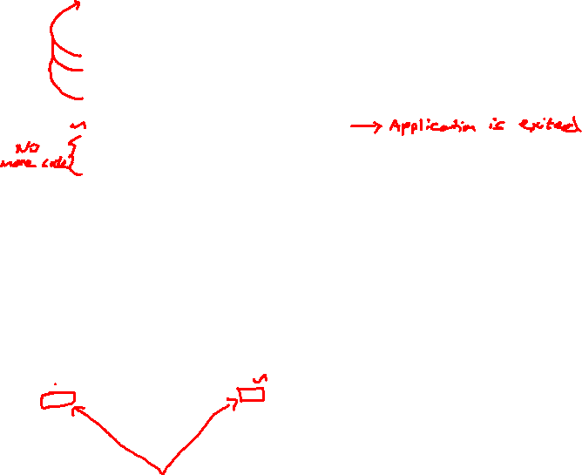
Rdd1=sc.textFile(“hdfs:///user/hduser/txns_big2”)
Rdd1.cache() #(GC pls don’t clean)
Print(Rdd1.count()) #RDD1 will be loaded from disk to memory
Rdd1 (GC pls don’t clean)
Rdd2=Rdd1.filter(lambda x:’error’ in x)
Print(Rdd2.count())#(cleaned by GC)
Rdd2 will be recomputed again taking data from Rdd1 (cache)
Print(Rdd2.collect())#Run the entire inmem computation from Rdd2
Rdd2 #(cleaned by GC)
#Rdd1.unpersist() #(Asking GC to clean the memory)
#I am not going to use Rdd1 further in my app?
Rdd3=sc.textFile(someotherdata)
#Application completed
Memory Management
60k
+40k
=1Lakh
count()
Driver
512mb
5k
+3k
=8000
60k
40k
2core
1gb
2core
1gb
Rdd1-part1 (128mb)
60k
GC()
Rdd1-part2 (74mb)
40k
GC()
count()
count()
Rdd1-part1 (128mb)
60k
Rdd1-part2 (74mb)
40k
filter(lambda x:’error’ in x)
filter(lambda x:’error’ in x)
Rdd2-part1 (10mb)
5k
Rdd2-part2 (7mb)
3k
count()
count()
Executor1
Executor2
Txns_big2 File (202mb)
txns (1 to 100000)

Slide 21
Pyspark Different Storage Levels

Slide 22
Pyspark Different Storage Levels
Storage Level | Memory | Disk | Serialized | Replication | Realtime usecases
MEMORY_ONLY | Yes | No | Yes | No | Fastest (if data fits in memory)
MEMORY_ONLY_2 | Yes | No | Yes | Yes (2x) | In-memory & replication for fault tolerance
MEMORY_AND_DISK | Yes | Yes | Yes | No | Falls back to disk if memory overflows
MEMORY_AND_DISK_2 | Yes | Yes | Yes | Yes (2x) | Memory + disk with replication
MEMORY_AND_DISK_DESER | Yes | Yes | No | Yes (2x) | Memory + disk with replication & Deserialized
DISK_ONLY | No | Yes | Yes | No | When memory is used very limitedly
DISK_ONLY_2 | No | Yes | Yes | Yes (2x) | When memory is used very limitedly & replication for fault tolerance
DISK_ONLY_3 | No | Yes | No | Yes (3x) | When memory is used very limitedly & replication for fault tolerance
OFF_HEAP | Yes | Yes | No | No | To leverage off heap memory space if on heap is not sufficient (Experimental)

Slide 23
JVM - Heap Memory Concept (High Level)
Executor/JVM/Cache/Heap/Container
Eden -> Young Generation (Survivor) -> Old Generation Memory
Permanent Generation
Security Credentials
Configs
OS Variables
Code objects
Local Variables
Broadcast variables
Accumulators etc
Garbage
Collector
RDD
(Java Serializer)
(Kryo Serializer)
Garbage
Collector
On-Heap (70% to 90%)
Off-Heap (30% to 10%)

Slide 24
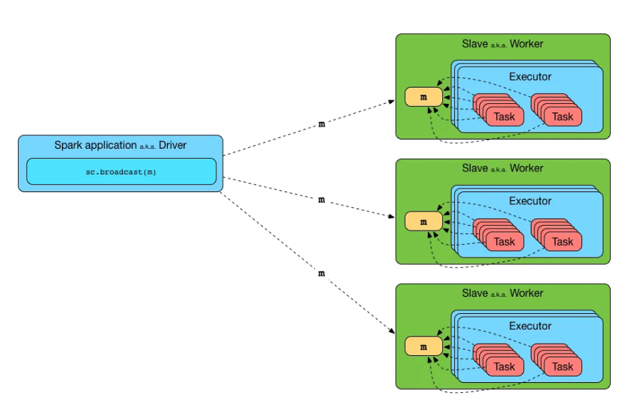
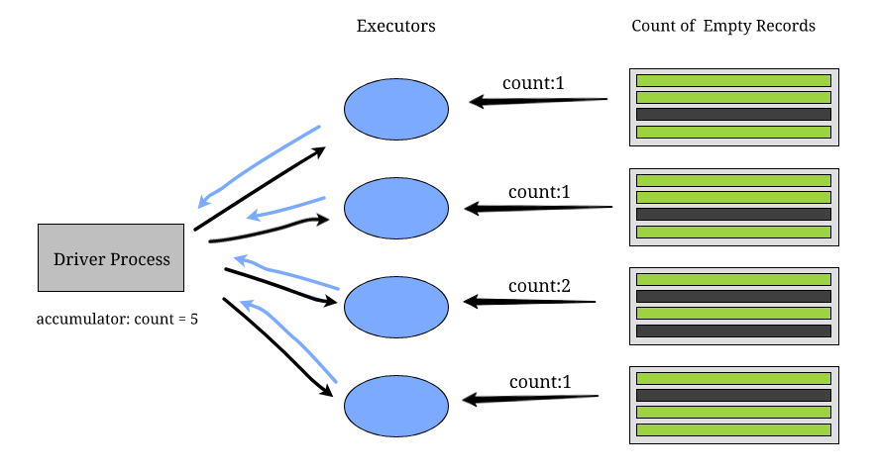
Broadcast Accumulator

