Slide 1

Intelligence digitalized
Video Link:
In this Document we are going to see how to …
Setup Git
Setup Databricks
Integrate Databricks with Git

Slide 2
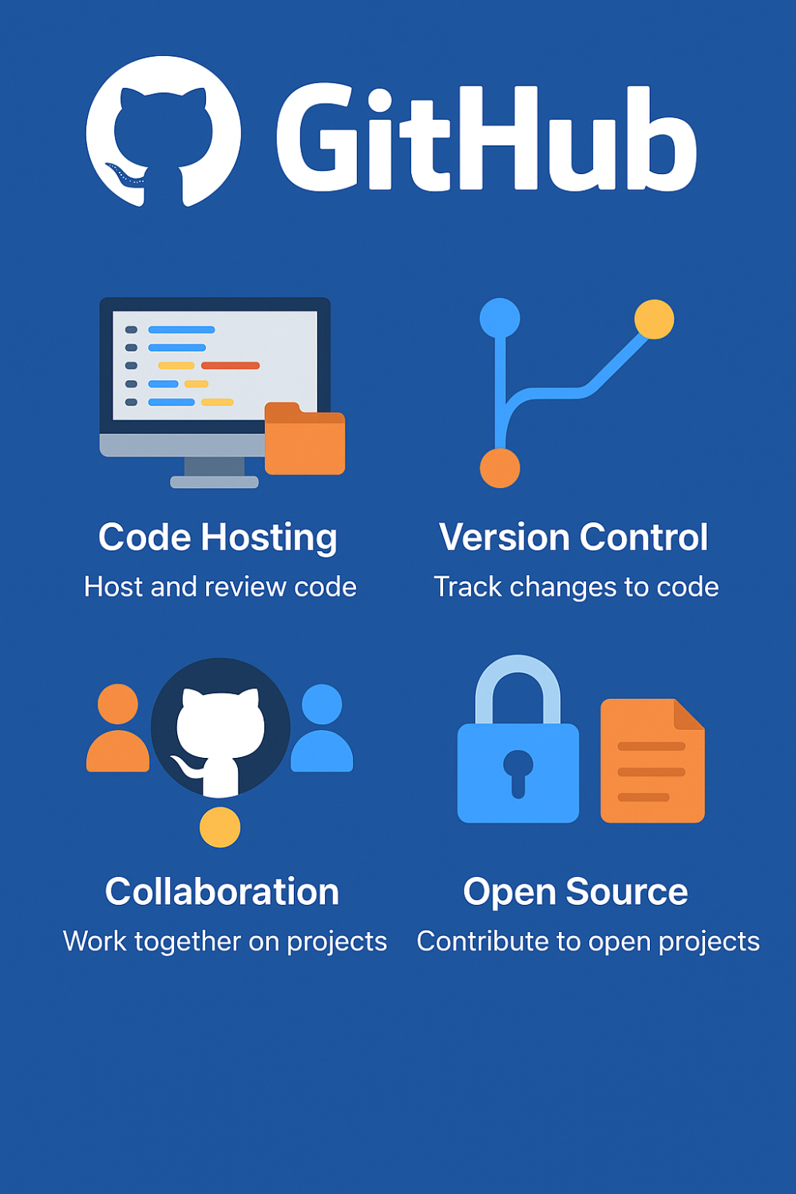
Github Account Creation – Free forever
Intelligence digitalized

Slide 3
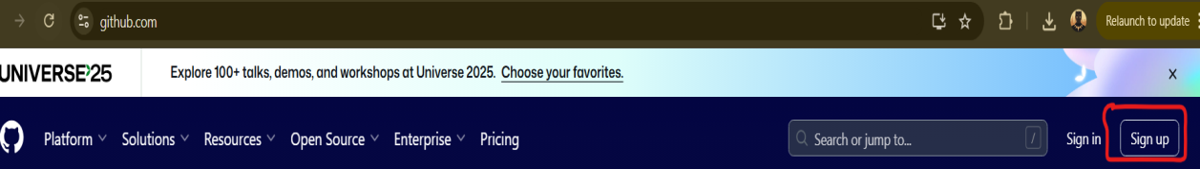
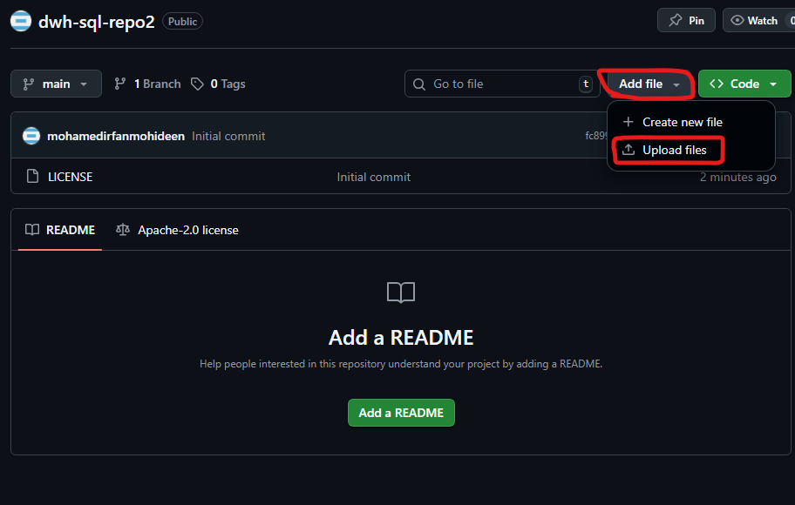
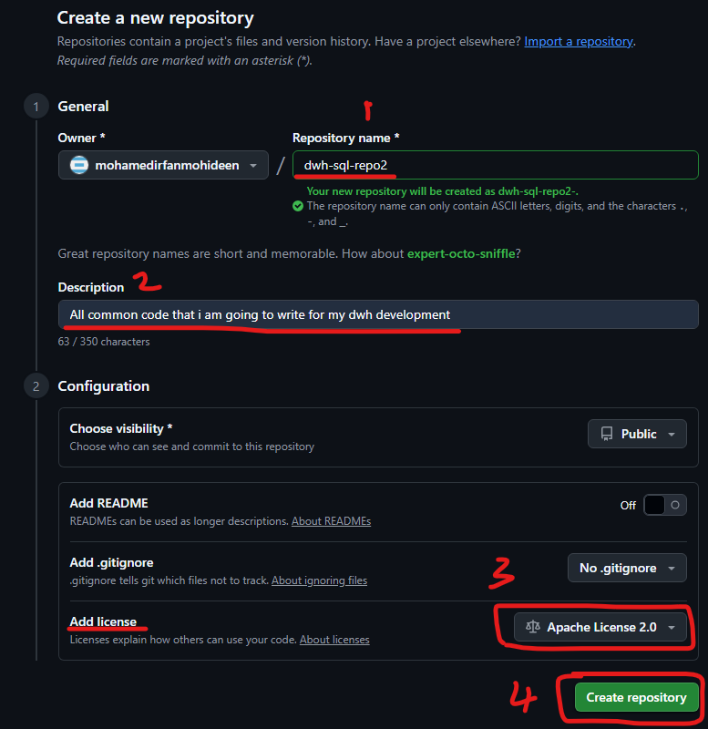
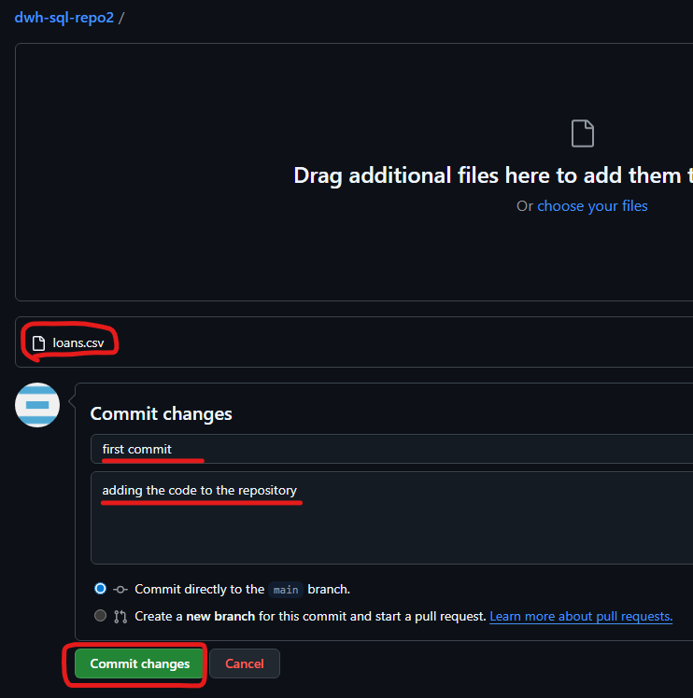
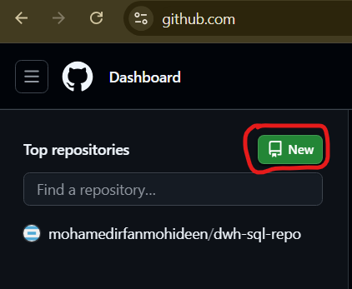
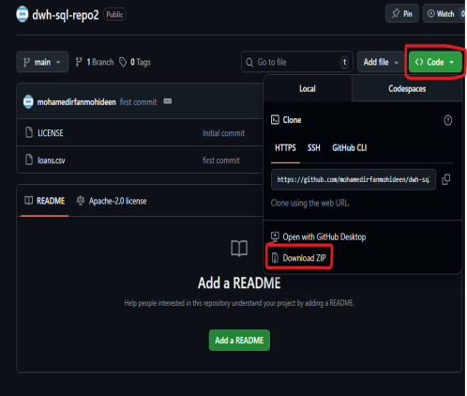
Github Account Creation Steps:
Setting up the code repo and version control system
Create a gmail account or use yours.
Goto https://github.com/
Signup for an account (continue with Google)
Create a repository
Choose repository name
Give some description
Add license Apache License 2.0
4. Add your first sample code
5. Commit ur first code
6. Clone (download/pull) your code
1
4
3
6
2
5

Slide 4
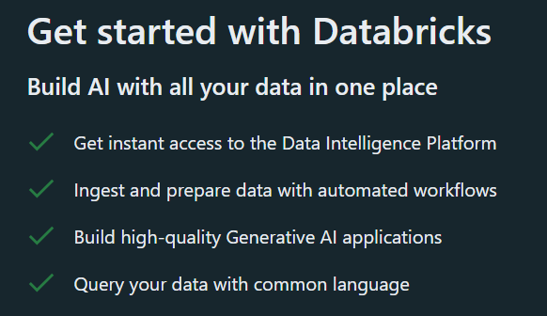
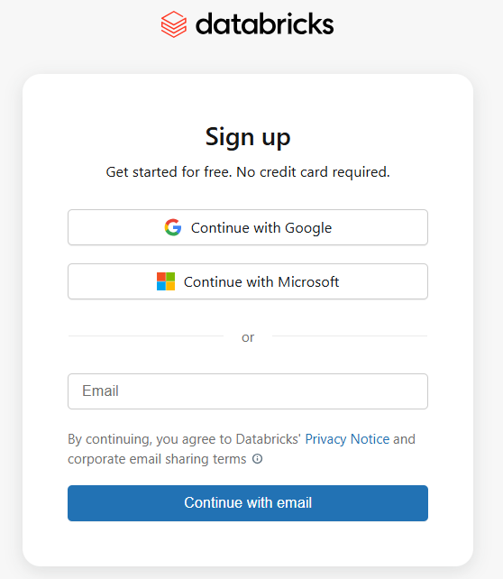
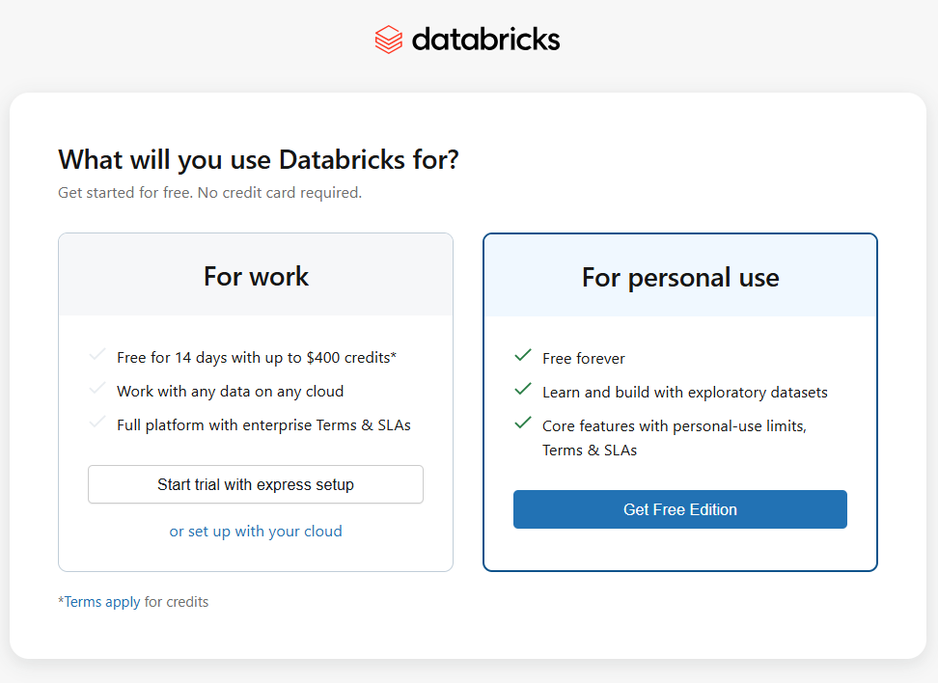
Databricks Account Creation – Free forever
Create a gmail account or use yours.
Goto https://login.databricks.com/signup
Signup for an account (continue with Google)
Click For personal use - “Get Free Edition”
Goto Workspace -> Create a notebook
Going forward login to https://accounts.cloud.databricks.com/login
Intelligence digitalized

Slide 5
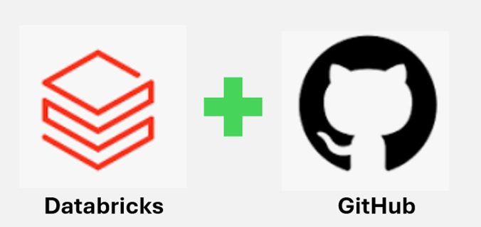
Databricks – Github integration for Collaboration & Code Commit
How to Link Databricks with your Github account?
Step 1: Link GitHub in Databricks
1. Open your Databricks workspace (portal) https://accounts.cloud.databricks.com/login
2. Click your user profile icon (top right).
3. Select Settings.
4. Go to Settings -> Linked Accounts.
5. Click the button "Add Git credential"
6. There are 2 options. Link Git Account & Using personal access token you created in GitHub.
Click on the Link Git Account -> Authorize Databricks -> Configure in Github
Step 2: Create New Repository (ignore if already done)
Goto the webssite https://github.com and login into your account
Create New Repository by selecting README.md file
Or
Step 3: Install the github databricks app
1. Open the github app in the https://github.com/apps/databricks
2. Click install/configure button
3. Enter the password to verify the account
4. Choose "Only select repositories" and add the new created repo then save it -> Install
Step 4: Creating Git Repo in databricks
1. Goto databricks account https://github.com/apps/databricks
2. Under workspace, right click then create -> Git Folder. It will popup a window that ask the url.
3. Copy the newly created github http url and paste into the databricks git repo url and give the repo name -> create git folder
4. Done

