Slide 1
Cloud Computing
Stage1
Py,SQL,DWH
Stage2
PySpark
Databricks
DE/AI/BI
Stage3
Multi-Cloud +
DE + AIE + BIE
First Azure -> +Databricks, +ADF, Learning (-1 month trial, -Cloud Hierachy Complex)
Second GCP -> +Databricks/+Dataproc, +Bigquery (SQL/PLSQL), Learning (+3 months trial, +Cloud Hierachy Simple)

Slide 2
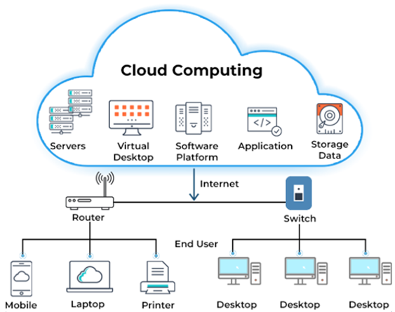
All about Cloud Computing
What is Cloud Computing?
Computers I am going to rent from some companies
IT Resources in a form of Service (APIs & Web Service)
IPS (Infra/Platform/Softwares) – cloud engineer
Cloud Name?
To access anytime by anyone from anywhere.
Types of Cloud ?
Private (Indegeneous/Soverign Cloud)
Security, Cost effectiveness,
Intensive AI Workloads/DE workloads
Public – Azure, AWS, GCP, Alibaba, Oracle, IBM…
Hybrid – Private & Public
(Private on Public or Public on Private)

Slide 3

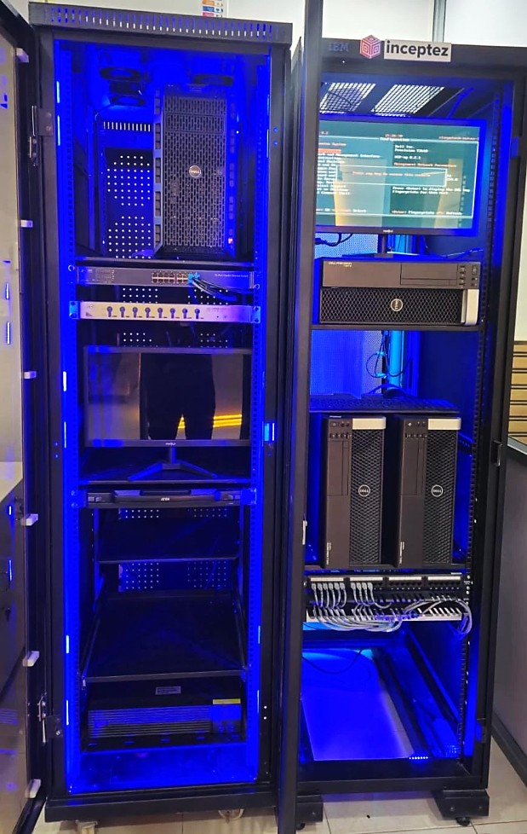
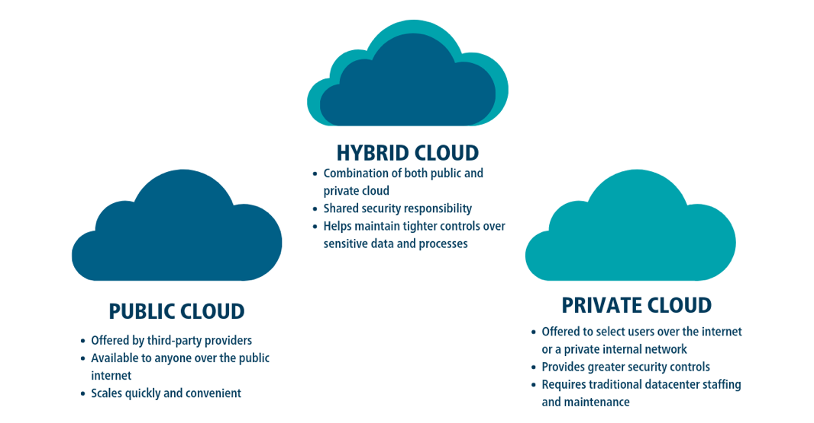


What is Cloud?
Hybrid Cloud (Pothys)
Cloud Computing is an on-demand availability of Computer system resources such as Infrastructure ,Platform, Software, OS, Database, Computation, Storage, anything etc., over the Internet/Intranet.
It is maturing at the level of providing any services at anytime, from anywhere by anyone for any need with high availability, high security, better features and cost effectiveness.
gcs
PC
Sto
Source
Chennai (Region)
PC
Compute
Private Cloud
Types of Cloud
Zone1 (Velachery)
Zone2 (Chengalpattu)
Dedicated
Network
VPC
Company/Home
Dedicated
Network
VPN
Datacenter Staffs
Infra/Platform maintenance

Slide 4
Public vs Private Cloud
 | PRIVATE CLOUD (Internal –on prem / hosted private cloud) | PUBLIC CLOUD
Infrastructure | Dedicated hardware and network for your business managed by an in-house technical team. | Multi-Tenant: Shared network hosted off site resources, managed by your service provider AWS/Az/GCP.
Business requirement | High performance and customization | Affordable solutions that provide room for growth
Scalability | Limited | Linear Scalable
Support and maintenance | Org administrators. | Service Provider
Cost | High -> Capital Expenditure (CapEx) + High -> Operational Expenditure (OpEx) | Low/No CapEx + Low to High OpEx
Security | Isolated network environment. Enhanced security to meet data protection legislation. | Security compliant
Performance | High performance from dedicated server. | Competing users can reduce performance levels from shared resources.

Slide 5
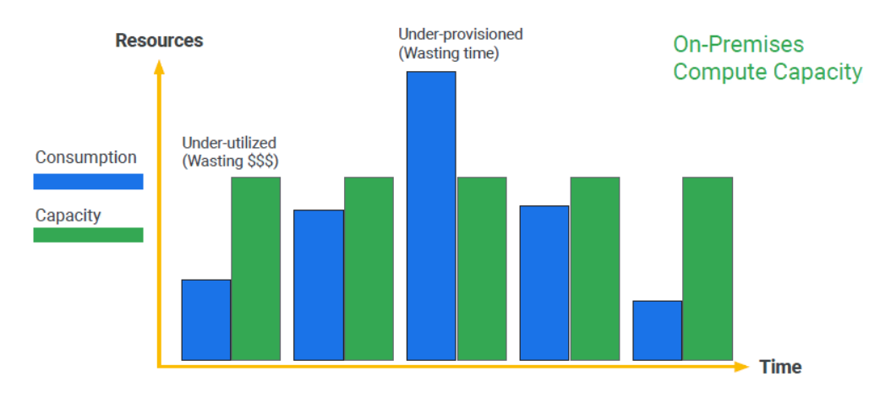
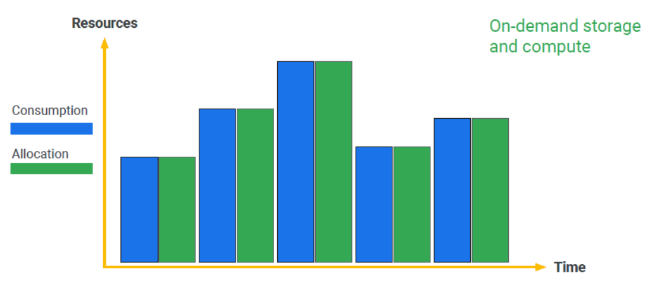
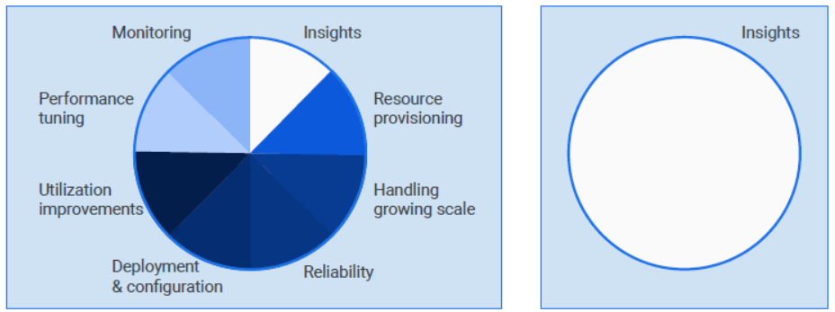
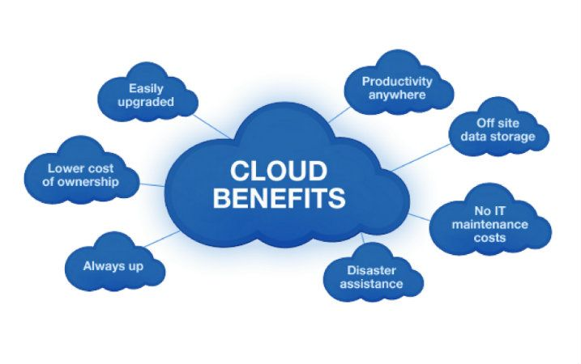
Why Cloud (Public)
Onprem (Private Cloud)
Public Cloud

Slide 6
Major Cloud Providers
AWS comprises over 200+ products and services including computing, storage, networking, database, analytics, application services, deployment, management, mobile, developer tools, and tools for the Internet of Things.
History –
Jeff Bezos - 1994
Started – 2000, Launched – 2002,
EC2 – 2003, SQS – 2004, S3 – 2006 ……..
Market Stake:
30+ ,Small level companies, Common Matured Ecosystems..
GCP is a public cloud vendor that offers a suite of 100+ services to do everything from data management (Engineering & Analytics) to delivering web and image/video over the web to AI and machine learning tools.
History –
In April 2008,
Google announced a preview release of App Engine
Market Stake:
10+ , Small scale to Enterprise (Data Analytics, Data Engineering & AIML Services).
Azure is a cloud computing service over nearly 200 operated by Microsoft, provides software as a service (SaaS), platform as a service (PaaS) and infrastructure as a service (IaaS) and supports many different programming languages, tools, and frameworks, including both Microsoft-specific and third-party software and systems
History -
Azure, announced at Microsoft's Professional Developers Conference (PDC) in October 2008, went by the internal project codename "Project Red Dog", and formally released in February 2010, as Windows Azure before being renamed to Microsoft Azure on March 25, 2014
Market Stake:
20+ , Small scale Enterprise (Microsoft flavored), Data Engineering (Databricks)..

Slide 7
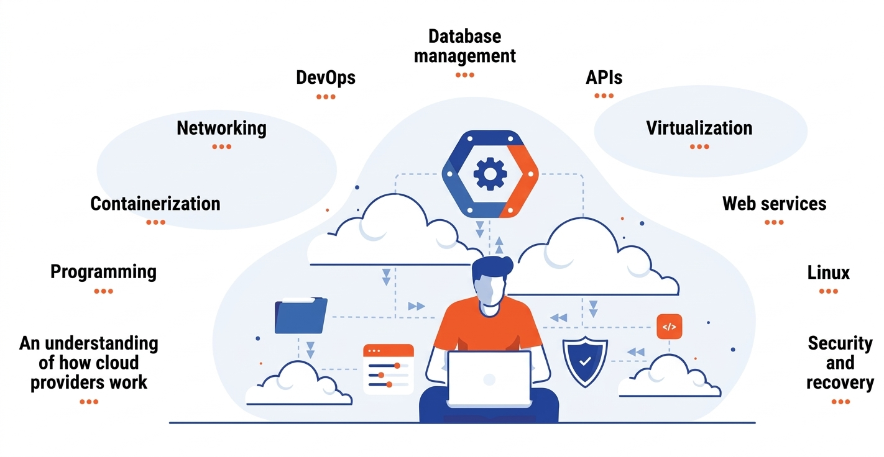
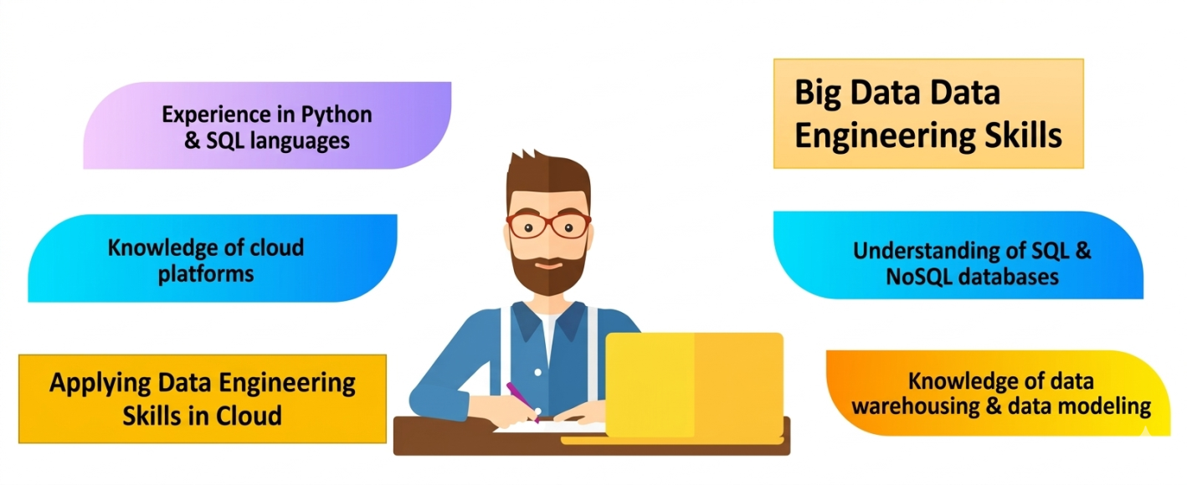
Assumptions & Scope of Learning Cloud
Cloud Data/AI/BI Engineer (IPS) (Second)
Cloud Engineer (IP) (First)
Caveat:
Try to learn about minimum one specific cloud, specific cloud components and the security features (only name varies but performs same operations and works in a same architecture).
Try to understand the Scope of the cloud Services particularly for a Data Engineering + AI + BI (Don’t get diluted).
Keep in mind Features/Options used can be changed by the providers.
Think how to make use of the infra/platform/software for my BigData components.
5. How can I smartly create some Business use cases to show my cloud proficiency integrated with Bigdata + AI + BI components

Slide 8
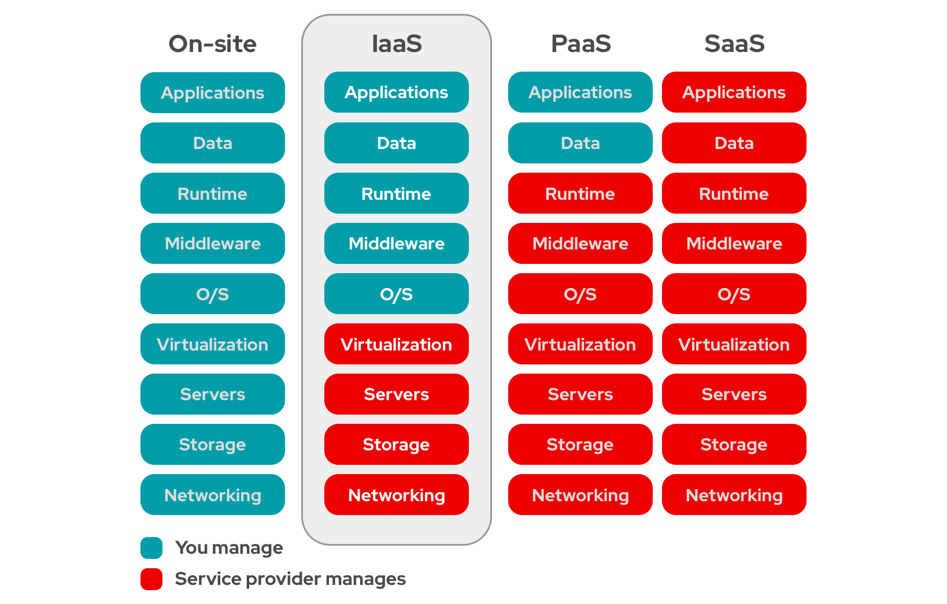
Cloud Services
OnPrem:
Capex: Defined workload with near recent changes expected in the Infra. (Capital Expenditure)
Cloud:
Opex: Variable workload with frequent changes expected in the Infra. (Operational Expenditure – Pay as you go/Pay per use)
IaaS: cloud-based services, pay-as-you-go for services such as storage, networking, and virtualization.
PaaS: Software tools like middleware, OS available over the internet.
SaaS: Software like applications, DB servers, Clusters that's available via a third-party over the internet.
Hybrid:
Features of CapEx of On Prem & OpEx of Cloud

Slide 9
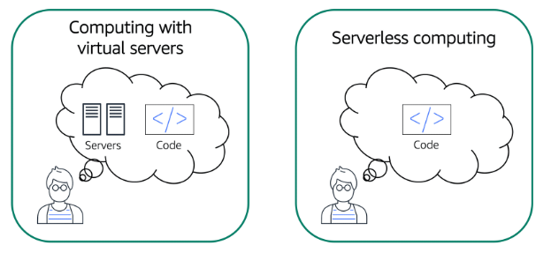
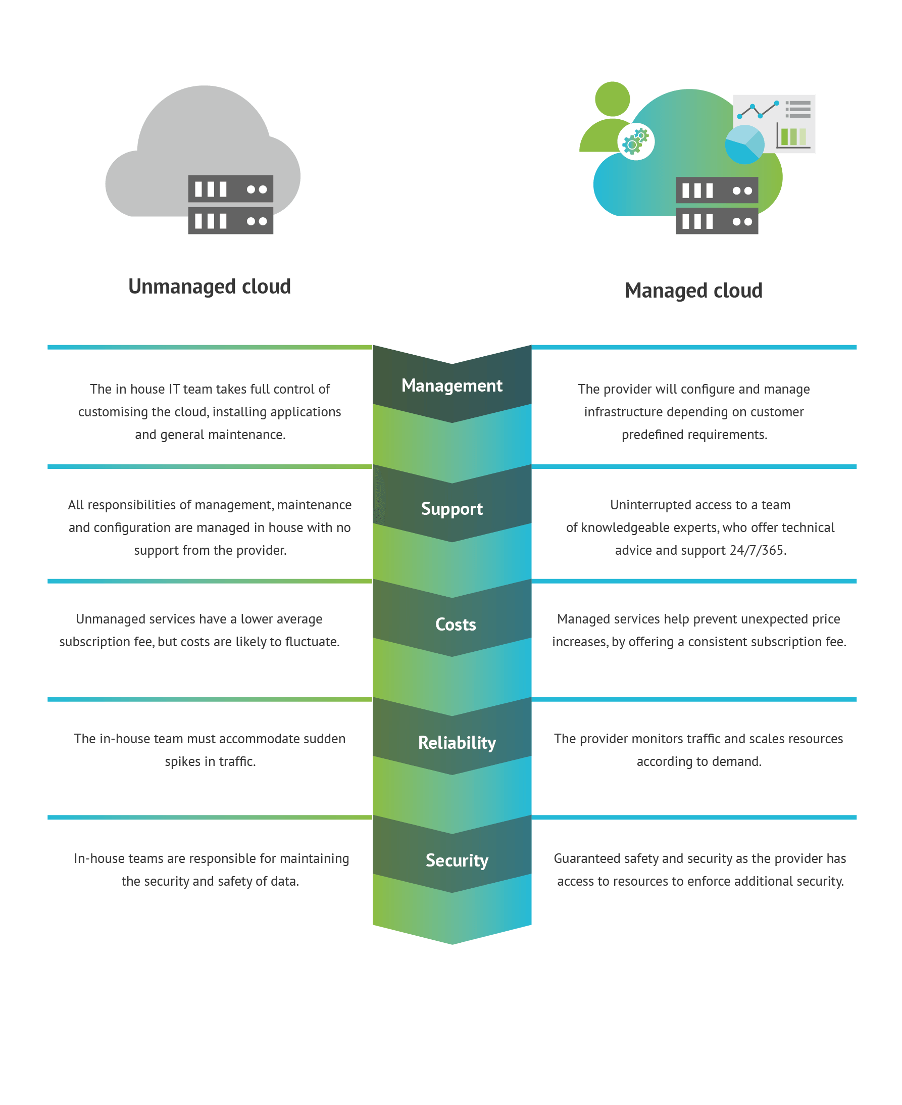
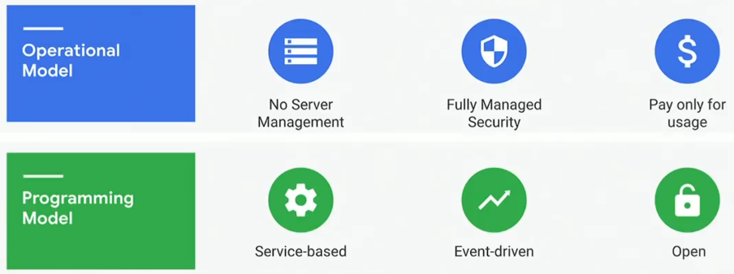
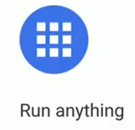
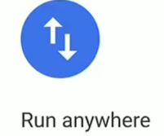
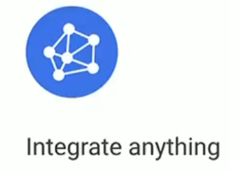
Server ful vs Server less Computing
Cloud Computing Solutions – Unmanaged vs Managed vs Serverless
Infra Platform
Infra Platform Software
Software
Vm/os/
Apps
HDInsight
Vm/os/
Apps
Server less Computing Benefits

Slide 10
BigData components Comparison of Different Cloud Providers https://comparecloud.in/
Service Category | Service Type | OnPrem | AWS | MS Azure | GCP | Description
Storage | Object storage | HDFS | AWS Simple Storage Service (S3) | Azure Blob Storage Azure Data Lake Service Gen2 | Cloud Storage | Store any amount of data and retrieve it as often as you'd like, using Google Cloud's object storage offering.
Storage | Block Storage | HDD/SSD | Amazon Elastic Block Store (EBS) | Azure Managed Disks | Persistent Disk | Reliable, high-performance block storage for VM instances.
Compute | Core compute | Physical Node/VM | Amazon Elastic Compute Cloud (EC2) | Azure Virtual Machines | Compute Engine | Accelerate your digital transformation with high-performance VMs.
Database | RDBMS | MYSQL/Derby | Amazon Aurora | Azure SQL Database | Cloud Spanner | Manage relational data with massive scale, strong consistency worldwide, and up to 99.999% availability.
Database | RDBMS | Postgres/MYSQL | Amazon Relational Database Service (RDS), Amazon Aurora | Azure Database for MySQL and Azure Database for PostgreSQL | Cloud SQL | Manage relational data for MySQL, PostgreSQL, and SQL Server for workloads under 30TB.
Data analytics | Business intelligence | Kibana/Grafana/Tableau.. | Amazon QuickSight | Microsoft Power BI | Looker | Explore, share, and visualize your company's data so that you can make better business decisions.
Data analytics | Data warehouse | Hive/Presto/Impala | Amazon Athena, Amazon Redshift | Azure Synapse Analytics Databricks SQL Analytics | BigQuery | Serverless, highly scalable, and cost-effective multi-cloud data warehouse designed for business agility.
Data analytics | Stream data ingest | Kafka | Amazon Kinesis | Azure Event Hubs | Pub/Sub | Create scalable messaging and ingestion for event-driven systems and streaming analytics.
Data analytics | Open source processing | IZ/Hortonworks/Cloudera/DB Community Distributions | Amazon Elastic MapReduce (EMR), AWS Batch, AWS Glue, DataBricks | Azure DataBricks, HDInsight | Dataproc, DataBricks | Deploy open-source data and analytics processing services (Apache Hadoop, Apache Spark, etc.) with improved efficiency and security.
Data analytics | Workflow orchestration | Oozie/Cron | Amazon Data Pipeline, AWS Glue, Managed Workflows for Apache Airflow | Azure Data Factory | Cloud Composer | Author, schedule, and monitor pipelines that span across hybrid and multi-cloud environments using this fully managed workflow orchestration service built on Apache Airflow.
Networking | Virtual networks | VPN | Amazon Virtual Private Cloud (VPC) | Azure Virtual Network | Virtual Private Cloud | Provide managed networking functionality for your cloud-based services running on Compute Engine VM instances, Google Kubernetes Engine, App Engine flexible environment instances, and other Google Cloud products built on Compute Engine VMs.
Operations | Monitoring | Ganglia/Nagios/Ambari/Cloudera Manager | Amazon CloudWatch | Azure Monitor | Cloud Monitoring | Monitor the performance, availability, and health of your applications and infrastructure.
Security & identity | IAM | SSL/LDAP/SSO | Amazon Identity and Access Management | Azure Identity Management | Identity and Access Management | Provide fine-grained access control and visibility for centrally managing resources.
Realtime Streaming | IAM | Nifi | Amazon Kinesis Stream | Azure Stream Analytics/ Databricks DLT/Spark Struct Streaming | Dataflow | Event Based/Micro batch based Streaming solution.

Slide 11
Azure – Account Creation
Notes:
TODO – List(1, 2) co se presne vola? Scala.List

Slide 12
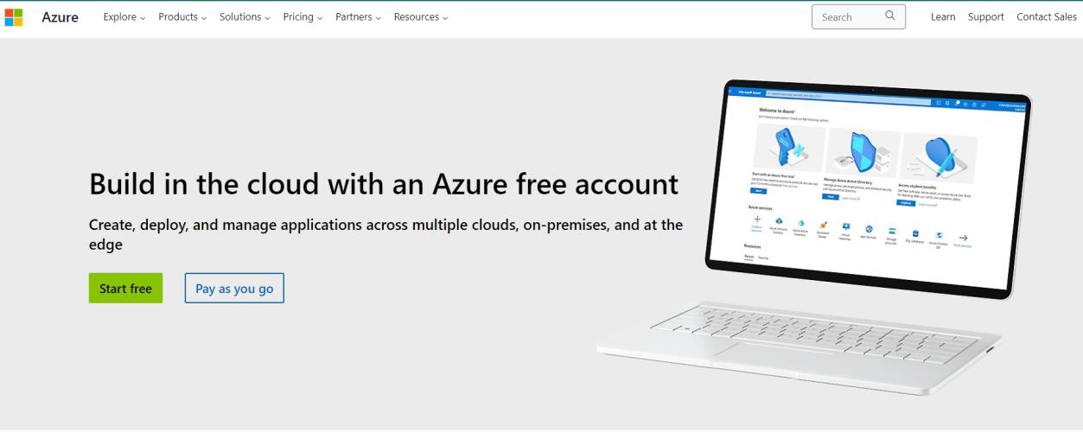
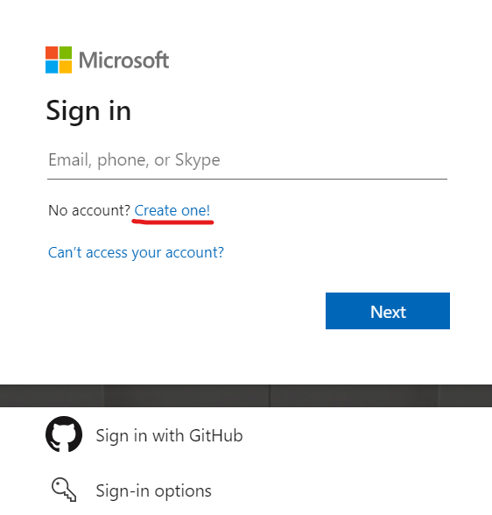
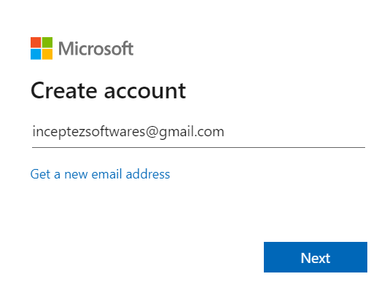
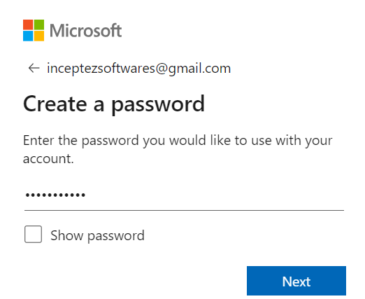

Creating Microsoft Cloud Free Account
1
https://azure.microsoft.com/en-in/free
2
3
4
Notes:
TODO – List(1, 2) co se presne vola? Scala.List

Slide 13
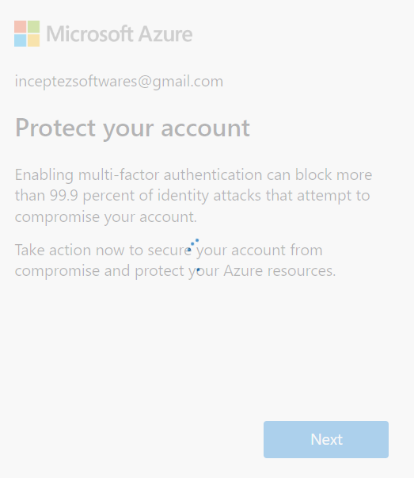
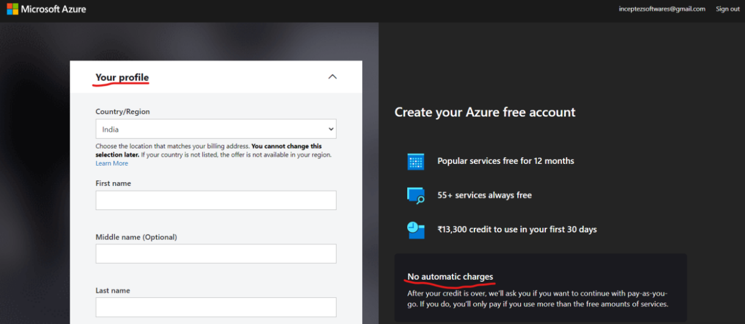
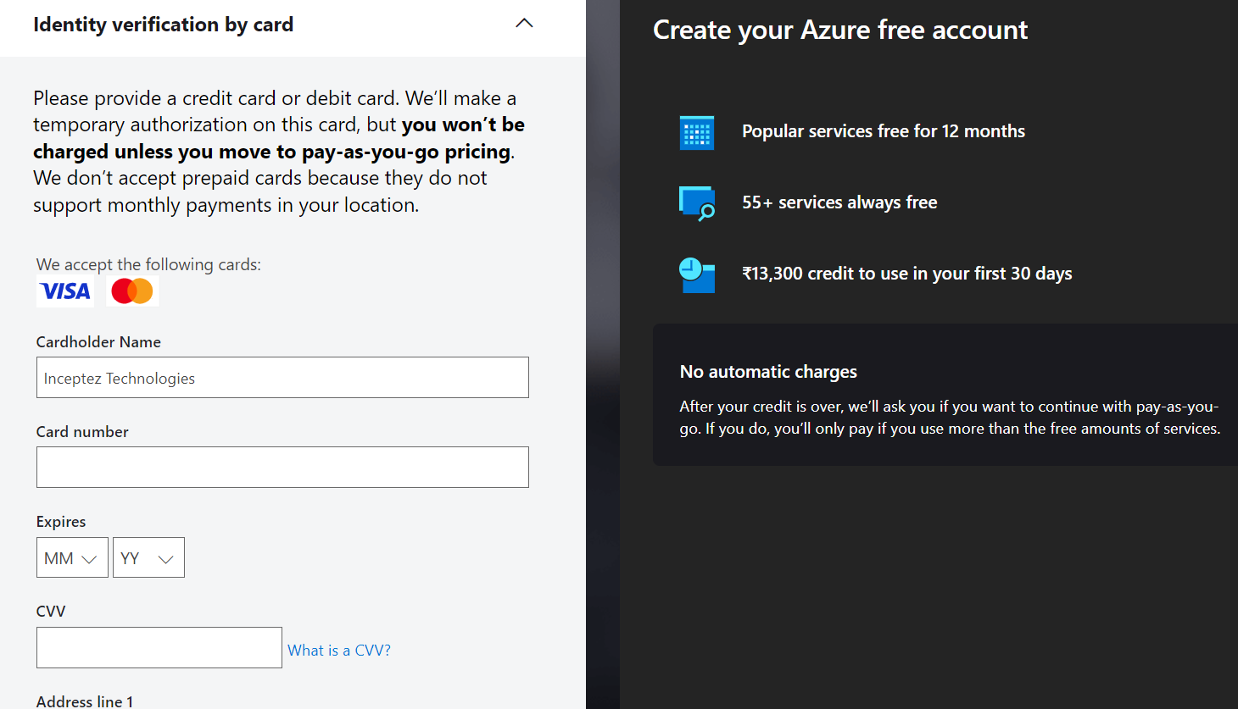
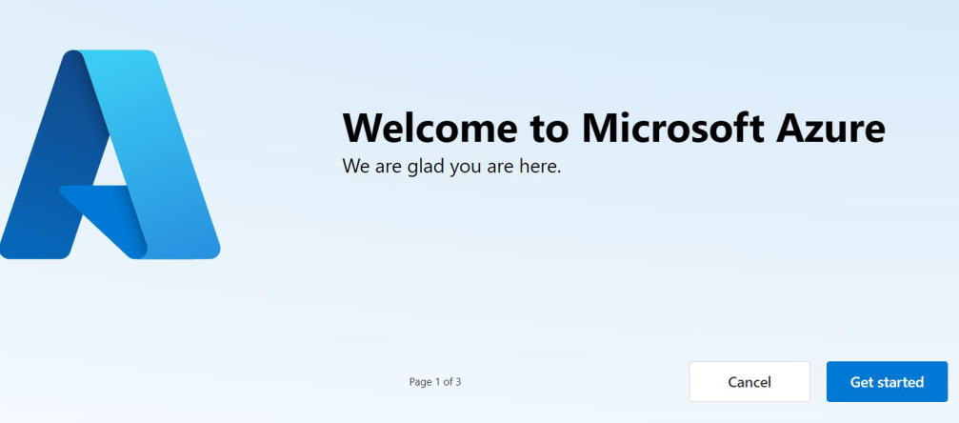
Creating Microsoft Cloud Free Account
7
5
6
https://portal.azure.com/#home
8
Notes:
TODO – List(1, 2) co se presne vola? Scala.List

Slide 14
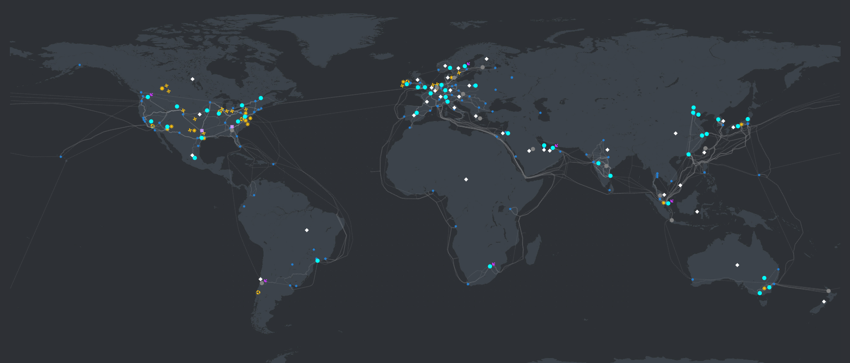
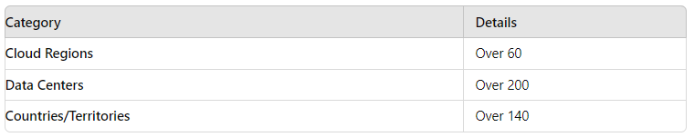
About Azure
Microsoft Azure is a public cloud vendor — like competitors Amazon Web Services (AWS) and GCP and other cloud vendors, customers are able to access computer resources housed in Microsoft data centers around the world for free or on a pay-per-use basis.
https://datacenters.microsoft.com/globe/explore/
https://azure.microsoft.com/en-us/explore/global-infrastructure/

Slide 15
Azure Data Engineering/AI/BI Services (Software)
Azure Core Services (Infra & Platform)
Access Pattern & Connectivity
Hierarchy & CLI/UI
Security
IAM & RBAC
Storage
Compute
Network
Datalake
ADLS/BLOB
Databricks
Data Factory
Azure Synapse
Power BI
EventHub
Function App
Stream Analytics
Purview
OpenAI & Foundry

Slide 16
Azure – Resource Hierarchy
PC/Computer Resource Hierarchy
My Computer (Authentication) -> Drive (Partitions) -> Main/Sub Folder (Grouping) -> Files/App (Resource)
Azure Resource Hierarchy
Azure Entra/AD/Tenant (Authentication) -> Management Group (Divisions) -> Subscription (Cost management) -> Resource Group (Logical Container Grouping)
-> Databricks/DF/ADLS/Virtual Machine/OpenAI (Resource/Services)
GCP Resource Hierarchy
Organization (Authentication) -> Folders (Divisions) -> Project (Cost management) & Resource Group (Logical Container Grouping)
-> Databricks/DFlow/GCS/Compute Engine/Gemini (Resource/Services)
Notes:
TODO – List(1, 2) co se presne vola? Scala.List

Slide 17
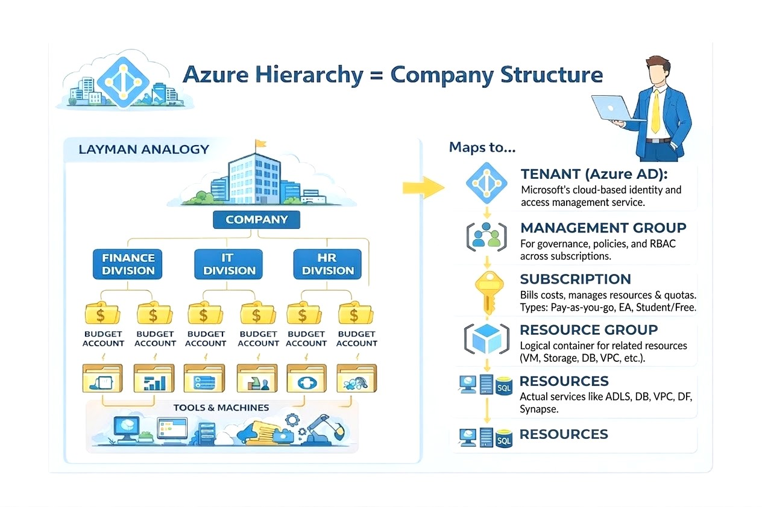
AZURE Fundamental Organization Hierarchy
Tenant, Management group, Subscription, Resource Group, Resources
Organization
Entra/Tenant
Management
Group
Folders
Subscription
Project
Resource
Group
Services/Resources
BQ/DP/DB/DF/CR…
Resources
ADF/ADLS/DB..
Notes:
TODO – List(1, 2) co se presne vola? Scala.List

Slide 18
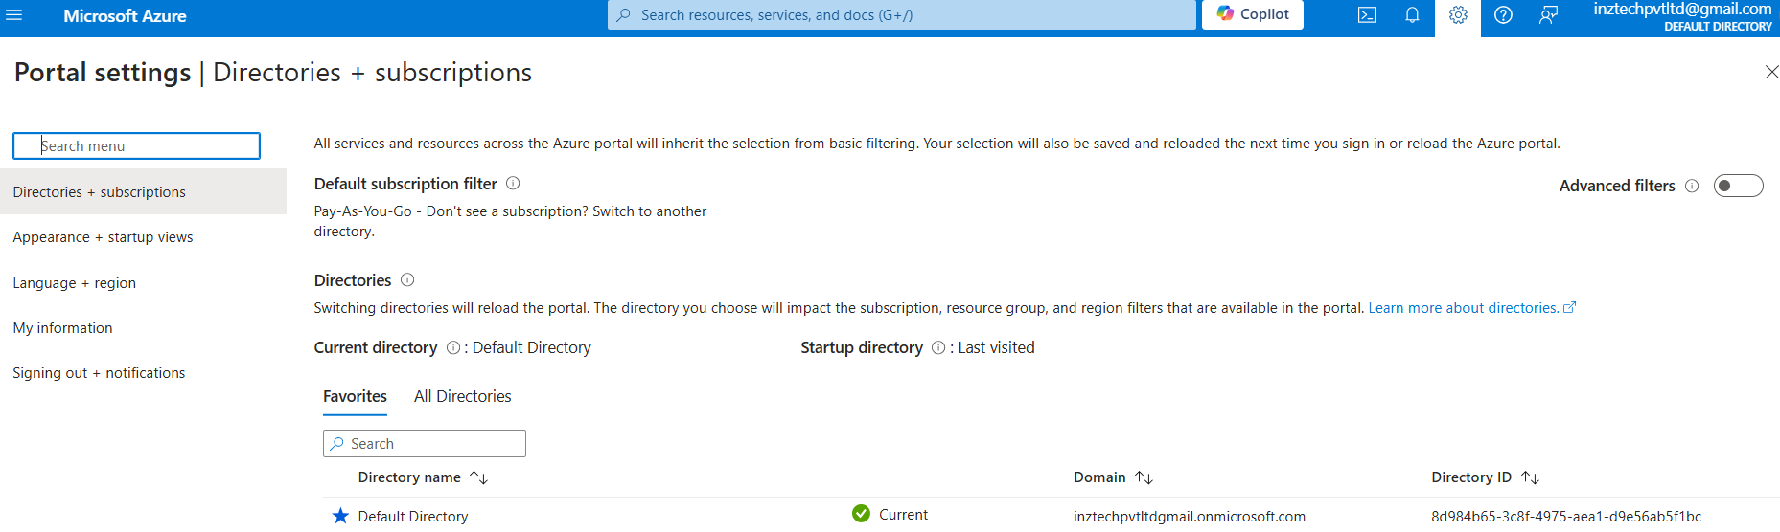
AZURE Fundamental Organization Hierarchy
1. Tenant/Directory (AD) (Organization) – Created by default (Admin).
Notes:
TODO – List(1, 2) co se presne vola? Scala.List

Slide 19
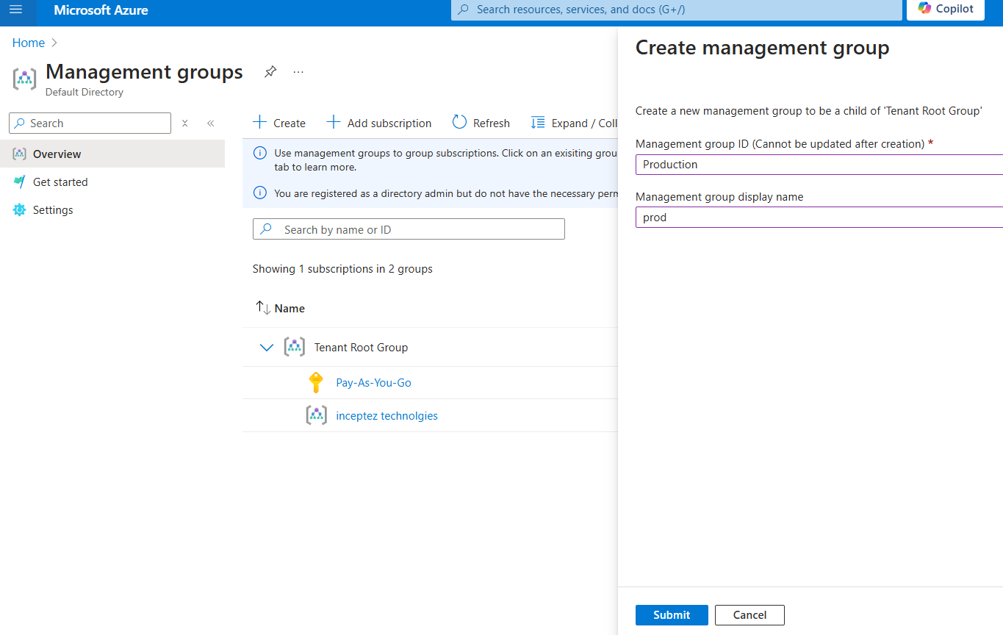
AZURE Fundamental Organization Hierarchy
2. Create a Management group (Folder) under (Tenant/Directory) – Search for “Management Group” in the search
Notes:
TODO – List(1, 2) co se presne vola? Scala.List

Slide 20
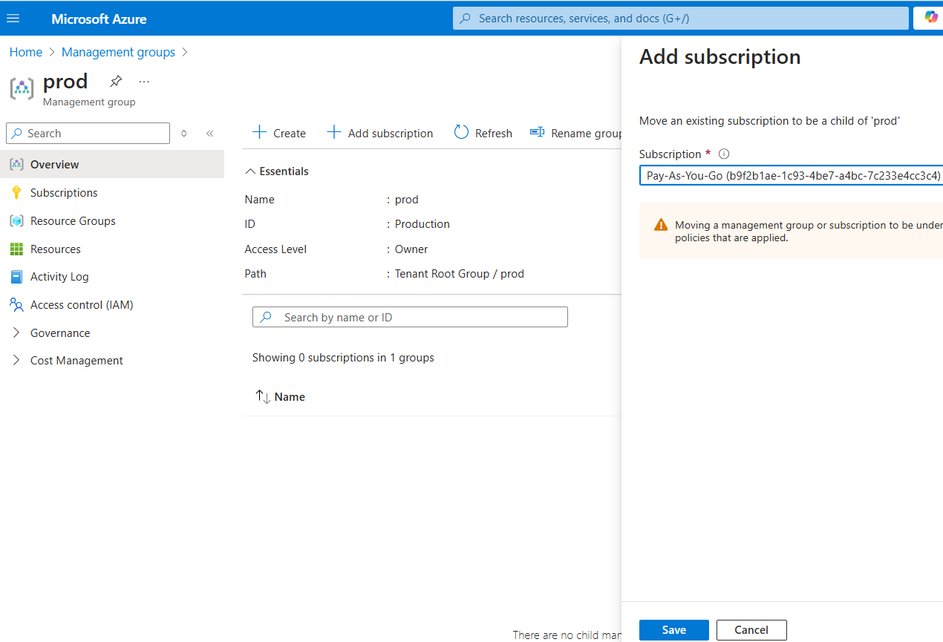
AZURE Fundamental Organization Hierarchy
3. Create a Subscription (Project) under (Management Group)
Notes:
TODO – List(1, 2) co se presne vola? Scala.List

Slide 21
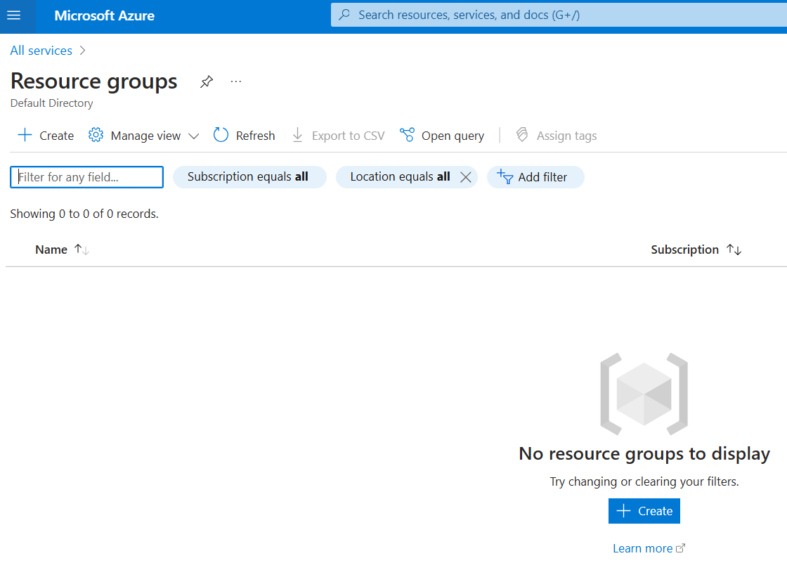
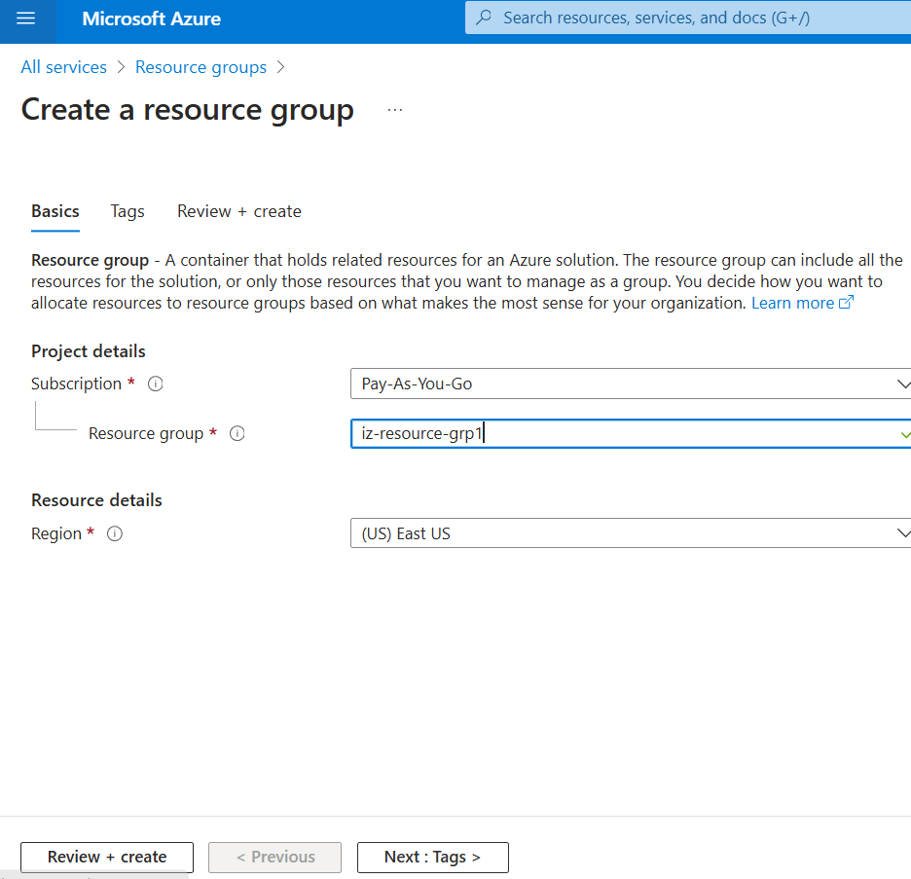
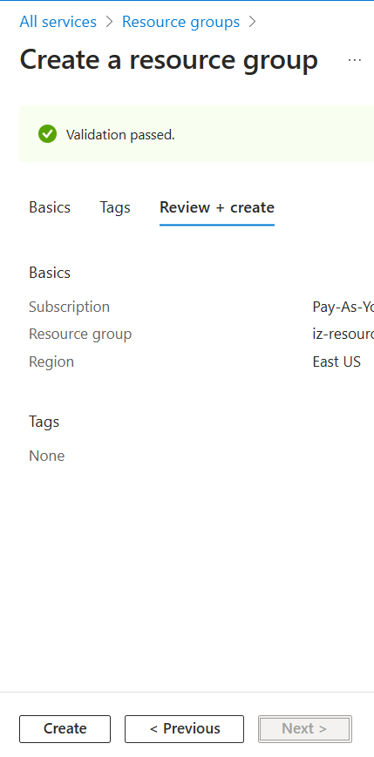
AZURE Fundamental Organization Hierarchy
4. Create a Resource group under (Subscription)
Search for the Resource Group -> Create -> Resource group name -> Review + Create
1
2
3
Notes:
TODO – List(1, 2) co se presne vola? Scala.List

Slide 22
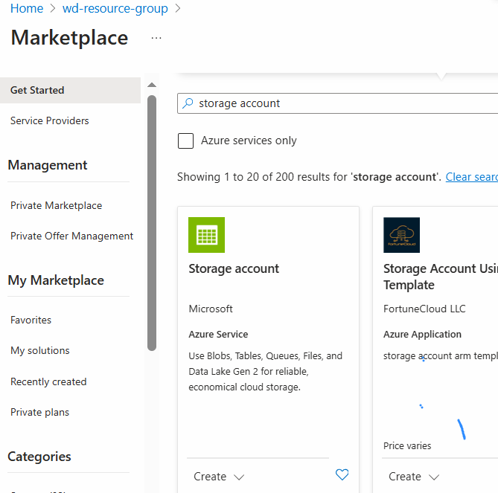
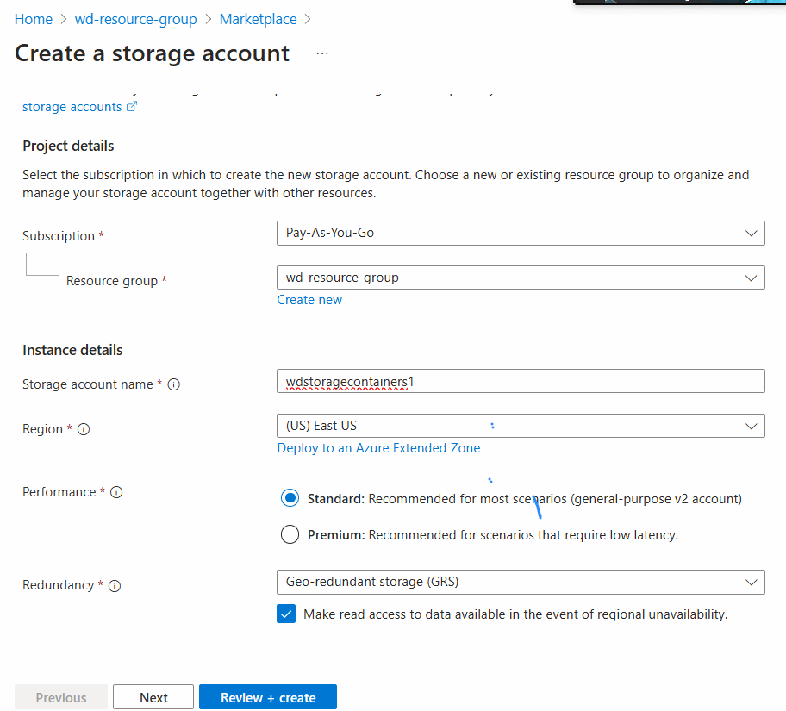
AZURE Fundamental Organization Hierarchy
5. Create a Resource under (Resource Group)
Once the resource group is created -> Create -> resource Account -> Market place -> Azure services only -> search for Databricks/storage account
1
2
Notes:
TODO – List(1, 2) co se presne vola? Scala.List

Slide 23
Azure – Connectivity
Notes:
TODO – List(1, 2) co se presne vola? Scala.List

Slide 24
Core Cloud Security Concept
User
Singapore
Azure Cloud
Chennai
AD/Entra->MG->Sub->RG->Res
CLI
User
US
UI
Notes:
TODO – List(1, 2) co se presne vola? Scala.List

Slide 25




US Cloud
Cloud Admin Role
SDK/CLI Connectivity
from Edgenode to Cloud
Download & Install SDK in Edgenode for CLI connectivity to Cloud for using Utils
Download and Install Cloud SDK
Enable Cloud login
Test sample utils commands (az)
Cmd prompt (India)
Cloud Shell (US)
Notes:
TODO – List(1, 2) co se presne vola? Scala.List

Slide 26
Cloud SDK & CLIs
Azure Cloud SDK:
Azure Cloud CLI (az) lets you manage resources and services from the command line (Only if I programmatic access).
Cloud Shell (online) lets you code or use a terminal directly in the web-browser rather than using an onprem linux/windows box (provided if you have the UI user access).
What is the az CLI?
Command line interface to interact with Azure cloud resources
You can use these tools to perform many common platform tasks from the command line or through scripts and other automation.
Most azure services are managed by the admin from CLI using az rather than going into the console.
We can create/delete/update/read existing resources and perform actions like deployment as well using the az/cloud utils
For example, you can use the az CLI to create and manage the following services:
Compute Engine virtual machine instances and other resources
Azure SQL instances
HDInsight clusters and jobs

Slide 27
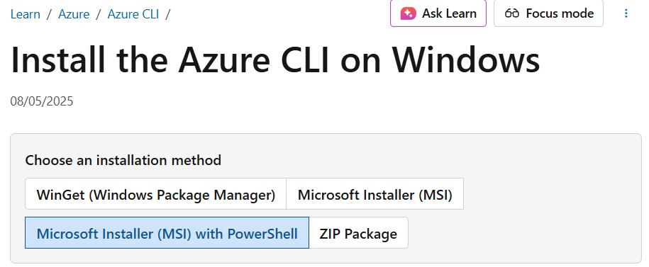
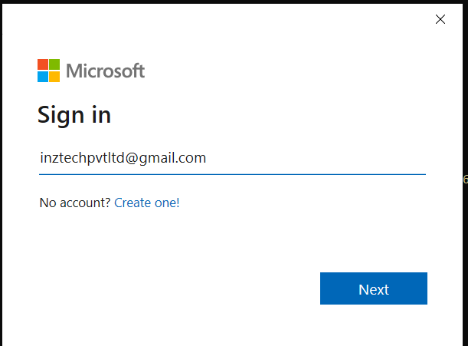
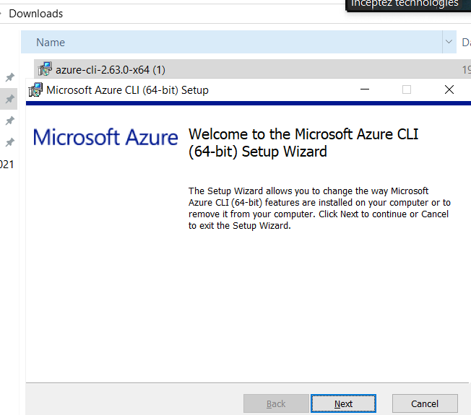
1. Download & Install az SDK - Classroom - Practice
Go to the below URL
https://aka.ms/installazurecliwindowsx64
brew update && brew install azure-cli
Cloud Admin Role
Select a subscription and tenant (Type a number or Enter for no changes): 1

Slide 28
3. Az Commands list - Classroom - Practice
GCP | Azure
Organization | Tenant/Directory
Folders | Management Groups
Projects | Resource Group > Subscriptions
Resources | Resources
Only for the first time to initialize az access, define the user, project, configuration
B. To login into a given/different user account
az login
#Get the directory id by clicking the settings button in the top right corner
az login --tenant dc0ce96f-6b44-4a0c-b4eb-5cacfff7dd94
#To List which account we have logged in? gcloud config list
az account show
#To List available subscriptions gcloud auth list
az account list --output table
B. To login into a given/different user account (capture the subscription id from the above output)
#To Set the subscription: gcloud config set project “wd32-proj-1234”
az account set --subscription "445b9ed0-3121-4340-bd7f-8935df4be9f0"
#To logout of the given user/principals account gcloud auth revoke
az account clear
#To list available resource groups (We use these resource group later to create resources/access resources)
az group list --output table
#Copy the resource group listed above
#To activate the ad’s (entra) service principal (Service Account) (IAM authenticating) for RBAC - gcloud auth activate-service-account --key-file=/home/hduser/weekday-32-proj-427802-a6-fd822f730117.json
#Generate a Private Key
openssl genrsa -out sp_private.pem 2048
#Create a self-signed certificate (valid 1 year)
openssl req -new -x509 -key sp_private.pem -out sp_cert.pem -days 365 -subj "/CN=MySPNCert"
#Create a Service Principal(Service account) in Azure with the Certificate
az ad sp create-for-rbac --name "my-certificate-spn" --cert "@sp_cert.pem" --role Contributor --scopes /subscriptions/7b676d44-6580-4871-8821-52ad8aef4a14
#Combine Key + Certificate into One .pem (for login)
cat sp_private.pem sp_cert.pem > azure_sp.pem
#Login Using the Certificate (username is appId)
az login --service-principal --username "d1df90e1-8e06-4fa6-8870-b3a46b12c086" --tenant "dc0ce96f-6b44-4a0c-b4eb-5cacfff7dd94" --certificate "azure_sp.pem"
Cloud Admin Role

Slide 29
Az – SECURITY
Notes:
TODO – List(1, 2) co se presne vola? Scala.List

Slide 30
Core Cloud Security Concept
Identity & Access Management - IAM
Identity (Who)
(Authentication)
User@Entra
Role Based Access Control - RBAC
Role (What)
-> Reader/Contributor/Owner
Access Management
(What on Where)
(Authorization)
MG->Sub->RG->Res
Scope (Where)
-> Level of Hierarchy
Notes:
TODO – List(1, 2) co se presne vola? Scala.List

Slide 31
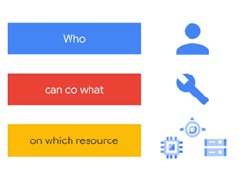
IAM (RBAC) – Ms Entra/Ms AD
IT DH - IAM
Accountant - IAM
CEO - IAM
JSE - IAM
IAM
IAM – Identity(Authentication) & Access Management (RBAC-Authorization)
RBAC – Role Based Access Control (Authorization)
CEO - RBAC
IAM
RBAC
RBAC
RBAC
Databricks
Notes:
TODO – List(1, 2) co se presne vola? Scala.List

Slide 32
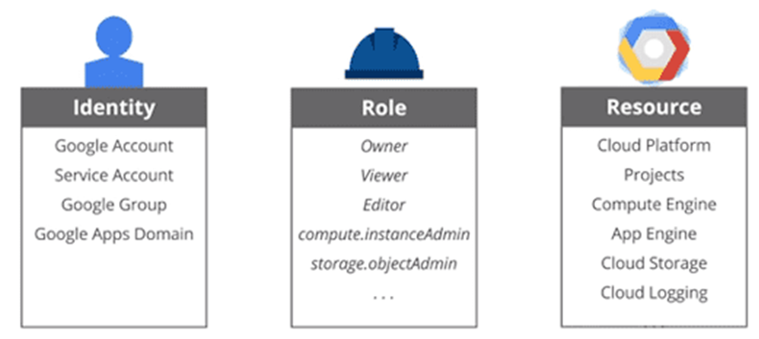
IAM (RBAC) – Ms Entra/Ms AD
For an Organization
(Org account (Managed Identity))
Groups
For A User create an Account (Users)
What is IAM (Identity and Access Management)
Who >> What >> Which
IAM help the admin provide
Authentication (Who can Sign in to Az account/project)
Authorization (What can be done on Which resources) at project level
For a Service we create Account (Service Principal)
For A User create an Account (User)
What we are learning here:
(Identity)- Define Users/Roles/Service Principals – Can be created by the admin using Active Directory/Microsoft Entra Id (creating Single Sign On)
Users=Principal, Group=Group, Service Principal=Service Account, Managed Identity=GCP Owner User
2. (Access Management) We are learning about What access can be given for Which Resource at what level of hierarchy -
Every level we can control the access
IAM
Key Components of Azure RBAC – Role Based Access Control (IAM Roles):
Roles (RBAC):
Built-in Roles (Privileged Admin Roles) 4 : Primitive/Basic roles that cover common access scenarios.
Eg: Owner, Contributor, Reader, and User Access Administrator. (GCP: Owner, Editor, Reader/Browser, Owner (with only user creation/deletion access))
Built-in Roles (Job function Roles) 570+ : Curated Roles specific to the given resources.
Eg: Storage account Contributor, Storage blob reader …
Custom Roles: You can create custom roles tailored to specific needs.
User (Principals): 4
Users: Individual accounts within Azure AD.
Groups: Collections of users that can be managed together.
Service Principals: Security identities for applications or automation tools that need to access Azure resources.
Managed Identities: A type of service principal that Azure automatically manages, providing secure access without requiring explicit credentials.
Permissions: 15k +
Permissions in Azure are actions (like read, write, delete) that can be assigned to roles.
Scope: Roles Can be defined at any level (Tenant/MG/Subscription/RG/Resource).
Azure RBAC (IAM) Workflow:
Define a Role: Select a built-in role or create a custom role with specific permissions.
Assign the :Role Assign the role to a principal (user, group, service principal, or managed identity).
Manage Access: Review and manage access to control the roles(principals) to use the respective subscription -> Resource Group -> Resources
Authorization

Slide 33

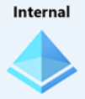
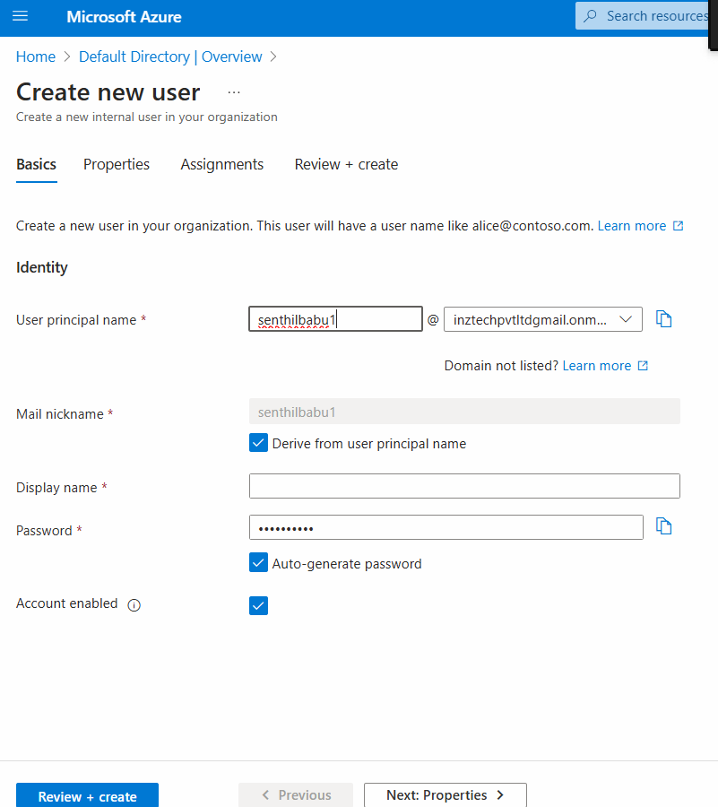
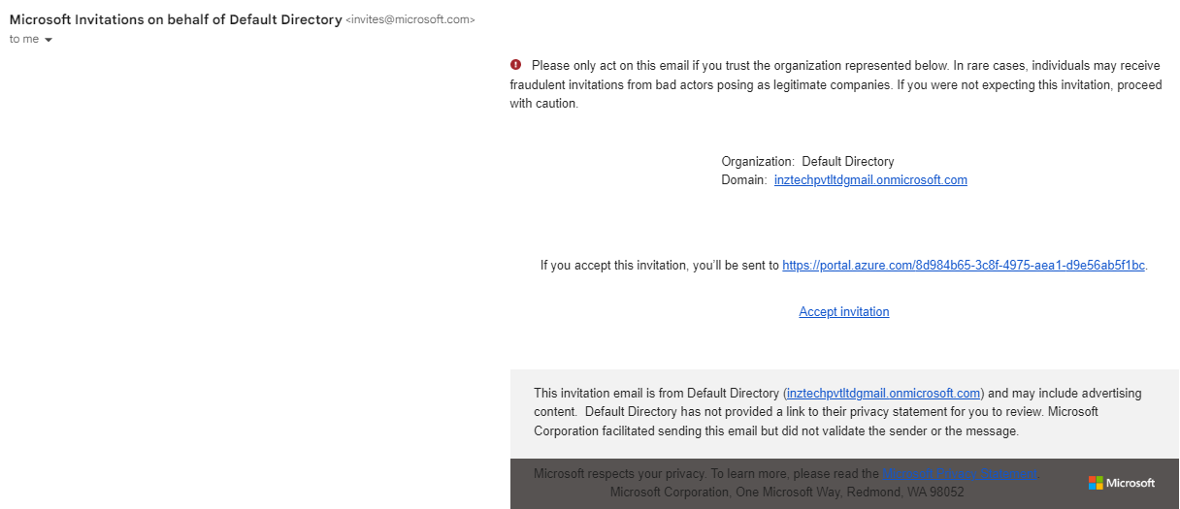
RBAC – IAM (Identity) (User/group/role management)
To add a new user search for active directory -> Add users/groups (done by Admin)
Go to the Azure Active Directory -> select Users under the "Manage" section
Invite external guest user or add a internal member user.
1

Slide 34
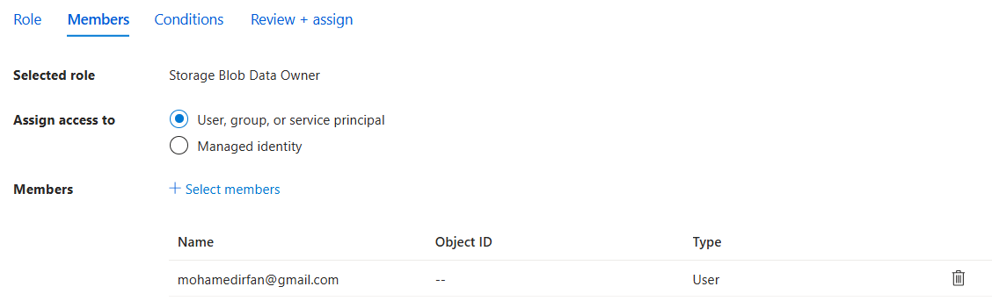
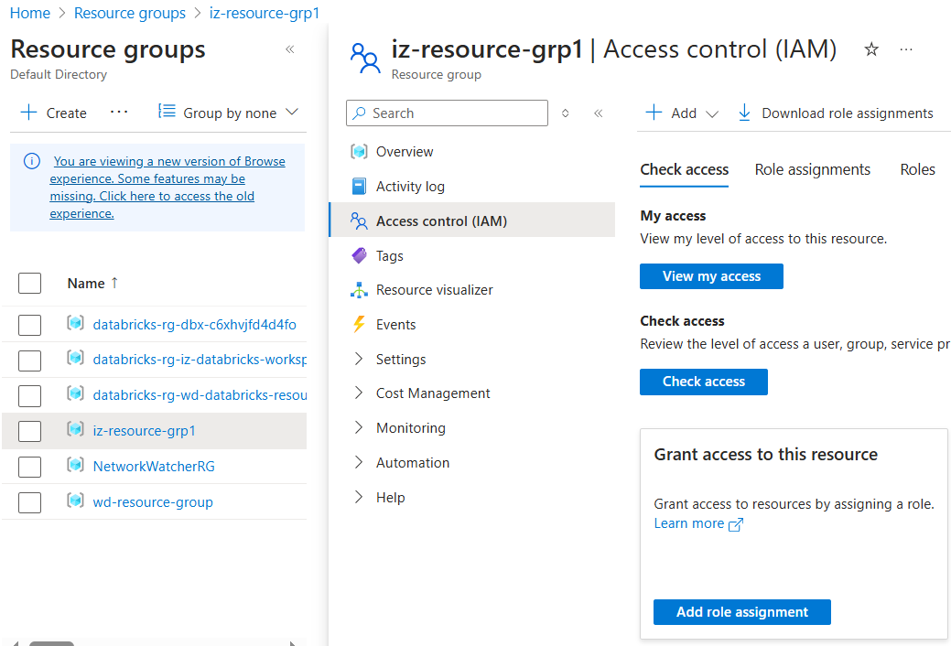

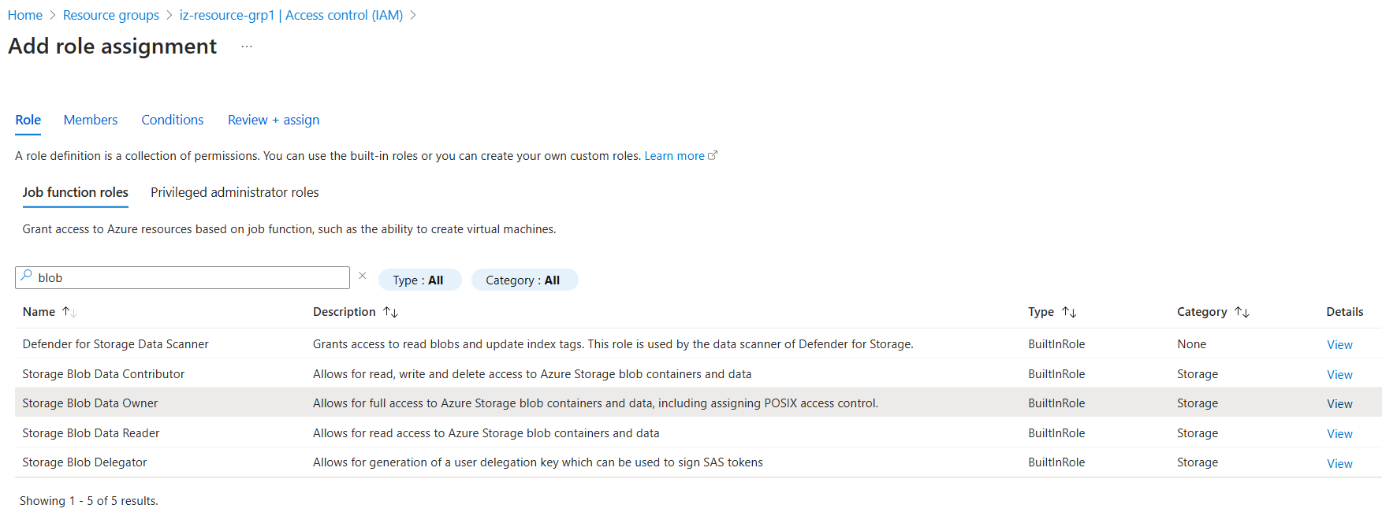
RBAC – IAM (Access) (Role Assignment)
3
To Assign roles to the new user, we can directly click on the tenant/management group/
Resource Group/Resource directly
(Access Management) We are learning about What access can be given for Which Resource at what level of hierarchy - Every level we can control the access
1
2

Slide 35
Azure Data Lake (Cloud Engg./Platform Engg.) BLOB/ADLS Gen2
Notes:
TODO – List(1, 2) co se presne vola? Scala.List

Slide 36
Cloud Storage Concept
Core Types of Storages in this world
Block Type (Onprem)
Chunks/pieces -> 1Node(Windows/Linux) /
nNodes(Distributed Storage WORM)
Azure Object Types - (BLOB & ADLS) - WORM
BLOB (Bin Large Object)
Only Flat File, No Atomic Directory Operations, only IAM(RBAC) Access Control, Used only for Legacy & Not optimized for Bigdata
Object Type (Cloud)
Single Entity(Attr, MD, Data)
File 1GB -> 1 Object in 1 HDD
File 190TB -> 1 Object in 1 HDD
ADLS Gen2 (Az Data Lake Storage)
Hierarchical Folder & File, Atomic Directory Operations, Both IAM(RBAC) & ACLs Access Control, Optimized for Bigdata ecosystems
Src
Blob
Ingestion
DBFS
Brz
DBFS
Silver
DBFS
Gold
Notes:
TODO – List(1, 2) co se presne vola? Scala.List

Slide 37
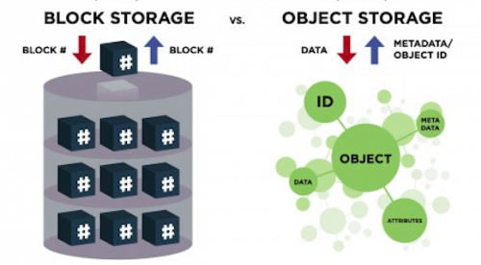
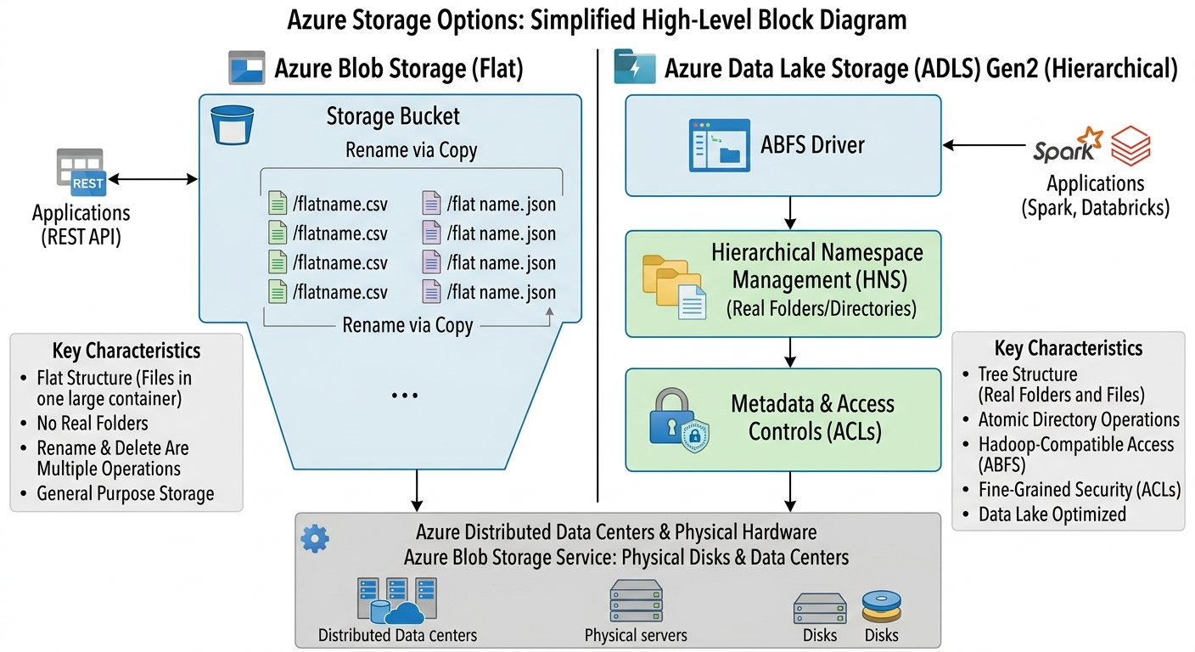
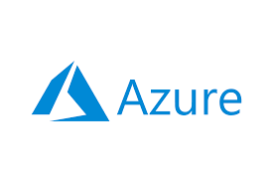

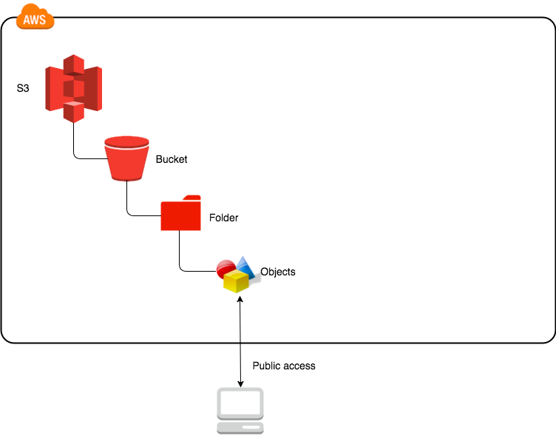




GCS/ADLS/S3 – Architecture & Comparison
Types of Storage Available
Chn
CLI
Blocks in Regular Storage Systems
Eg. HDFS/Windows/Linux/MAC
Objects in Cloud Storage Systems
Eg. AWS/Az/GCP
Azure Storage Hierarchy
BLOB
ADLS
Container
Container
(File
Behind the scene)
Directory
(Real Directory)
Folder3/file1=san1/blob1
Files
BLOB/ADLS all are
Stored as objects
behind the scene
blob

Slide 38
Azure Storage Container Basic Characteristics
Azure Storage | Description
Container | The logical unit/name for holding related Objects.
Naming Rules | Name must be lowercase, 3–63 characters, and can only contain letters, numbers, and dashes (-).
Unlimited Scale | You can create an unlimited number of containers within a single Storage Account.
Blob Service API | The service for storing any type of data—from simple text files to massive unstructured videos—accessible via REST API.
Immutability (WORM) | Supports Immutable Storage (Write Once Read Many)
Access Control | Container level: Managed via RBAC (Roles) (applicable for both BLOB & ADLS)
 | Object level: Managed via SAS tokens or ACLs (if ADLS Gen2 is enabled).
Max Object Size | A single Block Blob/object can be up to 190.7 TB (from year 2023 onwards) (significantly larger than the 5 TB limit in other clouds).
Costing: Data Storage Cost | Based on the Access Tier (Hot, Cool/Cold, Archive) and how many GBs you store per month.
Data Processing(Read/Write) Cost | Includes Transaction fees (Read/Write operations) and Geo-Replication (LRS, ZRS, GRS, GZRS).
Network Usage | Charges apply for Egress (data leaving the Azure region). Data coming in (Ingress) is free.

Slide 39


Storage Tiers (Storage Classes in GCP Standard/Nearline(30d)/Coldline(90d)/Archival(365d))

Slide 40






Redundancy (Location) Types
Zone (Velachery/Tambaram)
Upto 100KMs
Geo (US/Asia)
Datacenters
(Rack1/Rack2)

Slide 41

AZ Storage Account & Containers
Classroom - Practice
Open Cloud Shell to practice az container commands
1. Create a Storage Account first
az storage account create --name izdatalakegen2 --resource-group we45-resourcegroup --location eastus --kind StorageV2
Make Bucket Commands:
gsutil mb gs://com-inceptez-data-learn1-we43
Project Specific:
gsutil mb -p singular-elixir-425117-q0 gs://com-inceptez-data-learn1-we43_proj
Location Types (regional, dual, multi) – costing, usability(availability), performance
#regional (replicated across upto 3 zones-clusters) 99.999999999% availability
gsutil mb -l us-east1 gs://com-inceptez-data-learn1-we43_2
gsutil mb -l asia-south1 gs://com-inceptez-data-learn1-we43_2
#dual region(replicated across upto 3+3 zones-clusters) – better availability, reachability and fault tolerance
gsutil mb -l us --placement us-west1,us-west2 gs://com-inceptez-data-learn1-we43_3
#DEFAULT MULTI region - accross the country all/any regions
gsutil mb -l asia gs://com-inceptez-data-learn1-we43_4
Storage Classes – costing, usability(availability), performance
gsutil mb -c nearline gs://com-inceptez-data-learn1-we43_5
gsutil mb -c coldline -l us-east1 gs://com-inceptez-data-learn1-we43_6
#depends upon the frequency of access and period of storage
gsutil mb --autoclass gs://com-inceptez-data-learn1-we43_7
gsutil autoclass set on gs://com-inceptez-data-learn1-we43_7
gsutil autoclass get gs://com-inceptez-data-learn1-we43_7
gsutil defstorageclass get gs://com-inceptez-data-learn1-we43_7
gsutil defstorageclass get gs://com-inceptez-data-learn1-we43_5#Getting the type of class used
gsutil defstorageclass set archive gs://com-inceptez-data-learn1-we43_5#Move from nearline class to archive manually
Retention Period (How long we are going to protect the data from deletion/overwriting)
gsutil mb --retention 60s gs://com-inceptez-data-learn1-we43_8
gsutil cp samplefile.txt gs://com-inceptez-data-learn1-we43_8
gsutil cp samplefile.txt gs://com-inceptez-data-learn1-we43_8
ADLS/Blob Account creation/management Commands
In Azure is to create a storage account, which is a higher-level resource that can contain multiple storage containers (buckets)
1. First list available resource groups
az group list --output table
2. Setting Environment - Subscription Specific Container /Bucket creation (Project Specific in azure):
az account list --output table
az account set --subscription "445b9ed0-3121-4340-bd7f-8935df4be9f0"
2. Create a Storage Account (One level higher than the container/bucket)
BLOB Storage Account Creation: (Check the account kind and hierarchical namespace)
az storage account create \
--name izblobwe \
--resource-group we45-resourcegroup \
--location eastus \
--sku Standard_LRS \
--kind BlobStorage \
--access-tier Hot
Notes:
TODO – List(1, 2) co se presne vola? Scala.List

Slide 42
ADLS Gen2 Storage Account Creation:
Location Type (Regional/Dual/Multi) GCP = Location + SKU – Stock Keeping Unit (LRS/ZRS/GRS/GZRS)
az storage account create --name izadlswe --resource-group we45-resourcegroup --location eastus --sku Standard_GRS \
--access-tier Cool --kind StorageV2 --enable-hierarchical-namespace true
3. Check for the kind and hierarchical namespace enablement
az storage account show --name izblobwe --resource-group we45-resourcegroup --output table
az storage account show --name izadlswe --resource-group we45-resourcegroup --query "kind" --output table
#Check whether it is an blob or adls with hierarchical namespace enabled?
az storage account show --name izblobwe --resource-group we45-resourcegroup \
--query "{kind: kind, isHnsEnabled: isHnsEnabled}" --output table
az storage account show --name izadlswe --resource-group we45-resourcegroup \
--query "{kind: kind, isHnsEnabled: isHnsEnabled}" --output table
4. Delete the Storage Account
az storage account delete --name izdatalakegen2 --resource-group we45-resourcegroup --yes
Container creation/management Commands
5. Create containers = Make Bucket Commands:
az storage fs create --name container1 --account-name izblobwe
az storage fs create --name container2 --account-name izadlswe
az storage account show --name izblobwe --resource-group we45-resourcegroup --output table
az storage fs list --account-name izadlswe --output table
Notes:
TODO – List(1, 2) co se presne vola? Scala.List

Slide 43
AZ Storage Account & Containers
Classroom - Practice
# Create a Directory in Data Lake Storage Gen2
Note:In the blob container the below directory will be created as an object of zerobyte, whereas in the adls it is literally created as directory since it is adls with hierarchical namespace enabled.
az storage fs directory create -n sampledir --file-system container1 --account-name izblobwe
az storage fs directory create -n sampledir --file-system container2 --account-name izadlswe
az storage fs list --account-name izblobwe --output table
az storage fs list --account-name izadlswe --output table
# Copy a Directory into Data Lake Storage Gen2 container
mkdir localdir
echo sampledata>localdir/samplefile
#copy file
az storage copy -s localdir/samplefile --account-name izblobwe --destination-container container1/sampledir/
az storage copy -s localdir/samplefile --account-name izblobwe --destination-container container1/dir1
az storage copy -s localdir/samplefile --account-name izadlswe --destination-container container2/sampledir/
#Copy directory recursively
echo sampledata>localdir/samplefile1
az storage copy -s localdir --account-name izblobwe --destination-container container1/sampledir/ --recursive
az storage copy -s localdir --account-name izadlswe --destination-container container2/sampledir --recursive
# List the files and folders
az storage blob list --account-name izadlswe --container-name container2 --prefix "sampledir/" --output table
az storage blob list --account-name izblobwe --container-name container1 --prefix "sampledir/" --output table
Storage Tiers Classes – costing, usability(availability), performance
# Upload the blob/file with access tier to Hot (where as the storage account is in Cold tier)
az storage blob upload --container-name container2 --file localdir/samplefile --name sampledir/localdir/samplefilehot --account-name izadlswe --tier Hot
# Change a blob access tier to Hot
az storage blob set-tier --account-name izadlswe --container-name container2 --name sampledir/localdir/samplefile --tier Hot
Notes:
TODO – List(1, 2) co se presne vola? Scala.List

Slide 44
AZ Storage Account & Containers
Classroom - Practice
#How to use access/account key to access the storage account/container/dirs/files
#To collect the account key list for future need to access the given container
az group list --output table
az storage account keys list --resource-group we45-resourcegroup --account-name izadlswe --output table
#To use the account key to perform container operations
#Upload files
az storage blob upload --container-name container2 --file mobile_trans.csv --name sampledir/localdir/gcpfile.csv --account-name izadlswe --tier Hot --overwrite --account-key "2WRJhCS5de3FQkBuKYJFPufmwtH5aZBJ2DHgKLC9BAYwPm40WyOge4wq12Zyxneb9zBbs2ld47HF+ASteHVZDg=="
#Download files
az storage blob download --container-name container2 --name sampledir/localdir/samplefile1 --file samplefile3 --account-name izadlswe --account-key "2WRJhCS5de3FQkBuKYJFPufmwtH5aZBJ2DHgKLC9BAYwPm40WyOge4wq12Zyxneb9zBbs2ld47HF+ASteHVZDg=="
Performance improvement & misc commands
Multi threaded & recursive copy: – Performance factor gsutil -m cp -r /home/hduser/hive/data/custs gs://source1-weblog-bucket-we43/datadir
az storage blob upload-batch --source localdir --destination container2/sampledir/localdir/targetdir --account-name izadlswe --account-key "2WRJhCS5de3FQkBuKYJFPufmwtH5aZBJ2DHgKLC9BAYwPm40WyOge4wq12Zyxneb9zBbs2ld47HF+ASteHVZDg=="
Remove Command
#Remove an object/file
az storage blob delete --container-name container2 --name sampledir/localdir/samplefile1 --account-name izadlswe --account-key "2WRJhCS5de3FQkBuKYJFPufmwtH5aZBJ2DHgKLC9BAYwPm40WyOge4wq12Zyxneb9zBbs2ld47HF+ASteHVZDg=="
# List and delete all blobs in the container
az storage blob list --account-name izadlswe --container-name container2 --output table
az storage blob delete-batch --source container2 --account-name izadlswe --account-key "2WRJhCS5de3FQkBuKYJFPufmwtH5aZBJ2DHgKLC9BAYwPm40WyOge4wq12Zyxneb9zBbs2ld47HF+ASteHVZDg=="
# Delete the container itself
az storage container delete --name container1 --account-name izadlswe --account-key "9uKGi3d0CcRMw5WdHHUmoBGot2+VUICJBZFp4BqRwx/q8wUK38YyRru892602EUG7d2d9i+G7MEE+AStp4MmXA=="
Notes:
TODO – List(1, 2) co se presne vola? Scala.List

Slide 45
Azure Cloud Storage (Security) (gsutil commands)
Classroom - Practice
Security Commands (Access Controls) – Group -> Users -> Service Principals -> RBAC (IAM) -> Open to internal resource Acct key/ Open to outside SAS(ACLs)
Access Controls:
Create Shared Access Signature (SAS) Tokens (For granting temporary access directly on the directories/files for a time being for external users) - ACLs
az storage blob generate-sas --account-name izadlswe --container-name container2 --name sampledir/samplefile1 --permissions r --expiry 2025-08-31T23:59:59Z --output table
#se=2024-08-31T23%3A59%3A59Z&sp=r&sv=2022-11-02&sr=b&sig=cf6xI1y4pwBsnwt2ogwT7dQ%2FKB8SGk8wdAlHnTgTCug%3D
Usage of Access/Account keys (For using internally in a closed project environment for nearly a month across the resources like datafactory -> adls -> Databricks)
az storage account keys list --resource-group we45-resourcegroup --account-name izadlswe --output table
Preferred - Create Azure AD and RBAC (IAM) - For more permanent and managed access control at the storage container level (not at the dir/file level)
az role assignment create --assignee principal_mailid@gmail.com/principalid --role "Storage Blob Data Reader" --scope /subscriptions/<subscription-id>/resourceGroups/<resource-group>/providers/Microsoft.Storage/storageAccounts/<storage-account-name>/blobServices/default/containers/<container-name>
az account list --output table
#Change the container IAM (RBAC) access (copy the assigne principal from the active dir) – SPECIFIC TO THE USER
az role assignment create --assignee vjbalaece11_gmail.com#EXT#@inctech2015gmail.onmicrosoft.com --role "Storage Blob Data Contributor" --scope /subscriptions/445b9ed0-3121-4340-bd7f-8935df4be9f0/resourceGroups/we45-resourcegroup/providers/Microsoft.Storage/storageAccounts/izadlswe/blobServices/default/containers/container2
Public Access: Check for PAP is on/off:
az storage account show --name izadlswe --resource-group we45-resourcegroup --query "allowBlobPublicAccess"
az storage account update --name izadlswe --resource-group we45-resourcegroup --allow-blob-public-access true
az storage container set-permission --name container2 --account-name izadlswe --public-access blob
Cloud Admin Role
Security Model | Azure Blob Storage | ADLS Gen2 | When to Use
Account Keys (Shared Key) | Supported | Supported | Legacy/testing, internal connection between other resources (datafactory/databricks), avoid in production (too much privilege).
SAS Tokens (Shared Access Signature) | Supported (Service SAS, Account SAS, User Delegation SAS) | Supported | Fine grained access for Temporary, limited access (read/list/delete) for apps/users; external sharing.
RBAC (Role-Based Access Control) | Supported (at storage account/container level) | Supported | Important access control used widely - High-level access control (e.g., Blob Data Reader).
ACLs (SAS) | Not supported | Supported | Fine-grained, folder/file-level control in data lake scenarios.
Notes:
TODO – List(1, 2) co se presne vola? Scala.List

Slide 46
Azure Cloud Storage - Handson
Container
What is a Container?
Objects
What is an Object/File? Data transferring or online transferring into the bucket/folder
Storage Tiers & Pricing Models
Identify and fill here the different storage tiers available in az container creation?
Handson
Practice az Commands provided (https://inceptezlabs.com/cloudengg)
Az commands – create container
Create a Container with proper naming convention eg. inceptez-core-learnings - Yes
Cli commands
What are the Two types of core access controls & Additional Storage level access controls?
Practice PySpark Programs in databricks notebook
Notes:
TODO – List(1, 2) co se presne vola? Scala.List

Slide 47
Azure Virtual (Pvt) Network (GCP - VPC)
Virtual Network (Ips)
Subnetwork (Ips)
NSG

Slide 48












Azure – Infra & Network Hierarchy
Subscription– Billing Management for Resources
VNet (Log)– Virtual Network is the private isolated networking partition (Global) - NW
Region(Phy) – Geo location identifier that comprised of zones - Infra
Subnet(Log) – Subnetwork with the range of IP addresses to isolate the cloud resources GCEs (Regional) inside VPN- NW
Availability Zone(Phy)– Deployment area of Az resources that provides high availability (spread across Few KMs radius) - Infra
Scaled Units(Phy)– A Scaledunits represents a distinct physical infrastructure ie data center. Each zone is hosted in one or more clusters - Infra
Resources (Phy/Log) – Any cloud resources like VM, Storage, VPN…
Cloud Platform
Azure Subscription -> RG
Virtual Network (Broader Network)
Region South Ind
Region US-East1
Subnet3 10.0.2.0/27
10.0.2.0 -> 10.0.2.32
Physical (Infra)
Logical (Network)
Subnet1 10.0.0.0/28
10.0.0.0 -> 10.0.0.16
Subnet2 10.0.1.0/28
10.0.1.0 -> 10.0.1.16
Security
NSG
Avl Zone Chen-Tamb
Avl Zone Chen-Velachery
Az Scale Units (DC)
Az Scale Units
Rack
Host
Az (Internet) Gateway
VM1 10.0.0.5
VM1 10.0.0.6
Cluster
UDR
User Def
Routes
Virtual Machine

Slide 49

Azure Virtual Network
Scaled Units

Slide 50




Azure Virtual Network

Slide 51
Azure VM

Slide 52
Azure VNs, Subnet & Compute Engine - Handson
Create a VN
Create Subnet & assign inside a Region
Create NSG/Firewall Rules
Define CIDR
IP addresses
Create a VM Instance
Define the Region & Zone
Identify the Machine type
Identify the VM Provisioning Model
Define Advanced Options
Networking – Network Interface
Security– Manage Access
A Region in Microsoft Azure is a specific geographical area that contains one or more datacenters where Azure resources are hosted.
Each region is made up of multiple availability zones for high availability and disaster recovery.
A Virtual Network (VNet) in Azure is a logically isolated network within Azure that allows Azure resources such as virtual machines to securely communicate with each other,
the internet, and on-premises networks.
An Availability Zone in Azure is a physically separate datacenter within a region.
A Subnet is a segmented IP address range within an Azure VNet.
A Cluster in Azure generally refers to a group of servers or nodes working together
CIDR stands for Classless Inter-Domain Routing. It is used in Azure to define IP address ranges for VNets and subnets, such as 10.0.0.0/16 or 10.0.1.0/24.
Network Security Groups (NSGs) in Azure act like firewall rules will allow or deny inbound (ingress) and outbound (egress) traffic to Azure resources such as
virtual machines and subnets.
Route Tables in Azure define how network traffic is directed between subnets, VNets, on-premises networks, and the internet.
An Internet Gateway equivalent in Azure is provided through the default system route that allows Azure resources with public IPs to communicate with the internet.
Notes:
TODO – List(1, 2) co se presne vola? Scala.List

Slide 53



Virtual Machine
Host Types
Azure Virtual Machine is a virtual machine (VM) service that allows users to create and run VMS on Azure infrastructure (IAAS -> PAAS)
Azure VMs can be understood as a digital version of the physical computer.
Each virtual machine consists of a complete operating system and a set of virtualized hardware resources, including CPU, memory, storage, and network interfaces. The operating system running inside the virtual machine is isolated from the host operating system/hypervisor and other virtual machines running on the same physical machine.
Virtual machines run on a physical machine controlled by a software which is known as a hypervisor.
Placement types – Standard/spot –
Standard Whether we need the VM for a long time (Azure can’t take this VM out)
Preemtable/spot instances - Whether we need the VM for a short time
Committed Use Discounts (Reservations) : Commitments provide discounts for VMs and software licensing in return for 1-3 year purchase agreements. Can be a good option if your workloads have predictable resource needs.
Capacity Reservation: To make sure that Compute Engine resources are available when you need them, use reservations. Reservations provide a very high level of assurance in obtaining capacity for Compute Engine zonal resources.
Fleets:
Proximity Services:
24cores
48gb ram
96gb hdd
VMs(12)
2cores
4gb ram
8gb hdd
Machine Types (Predefined/Custom)

Slide 54
Azure Virtual Machine
az vm create \
--resource-group wd36-rg1 \
--name MyUbuntuVM \
--image Ubuntu2204 \
--size Standard_L2aos_v4 \
--admin-username azureuser \
--generate-ssh-keys \
--vnet-name wd36_vn \
--subnet wd36_sn1 \
--nsg wd36_nsg1 \
--public-ip-sku Standard
az vm list --output table
az vm stop --resource-group wd36-rg1 --name MyUbuntuVM
az vm start --resource-group wd36-rg1 --name MyUbuntuVM
az vm restart --resource-group wd36-rg1 --name MyUbuntuVM
az vm delete --resource-group wd36-rg1 --name MyUbuntuVM --yes
az ssh vm --resource-group we45-resourcegroup --vm-name vm2 --subscription b9f2b1ae-1c93-4be7-a4bc-7c233e4cc3c4

Slide 55


Azure Databricks
Creamy
Databricks & ADLS & Core Cloud
Mid Creamy
Creamy + ADF + Synapse + PowerBI + AI
Complete
Mid Creamy + Eventhub + Stream analytics + Functions
MS Fabric (Unified platform)
ADLS Gen2
ADF
HDInsight
Synapse
PowerBI
OpenAI/Foundry
Databricks (Unified platform)
DBFS
Lakeflow services
Spark
Delta tables (SQL serverless)
Dashboard & Genie
AI/ML services
+

Slide 56

Azure Databricks – Planes/Grounds
Webserver
Az VM
Orchestration
Az Functions
UC
ADLS, 2. DB
3. Az Security
Queries & Code
1. VM, 2. IPSaaS
DBFS

Slide 57

Azure Databricks – Hierarchy of resources
Databricks
Databricks - Workspace

Slide 58


Azure Databricks – Pricing Types & Workspace Types

Slide 59

Azure Databricks – Compute
Hybrid
On Prem
Inceptez
Cloudera
Buy own car
Self driven Rental car
Uber car booking
Spark Serverless
Only – Fixed Nodes
Cloud Migration:
Reservation
Type of Cluster
Costing model
Resource utilization
(auto linear scaling, photon,
Fixed/dynamic computes,
auto termination)

Slide 60



Azure Databricks – Compute
2022 – AZURE (XYZ)
SPINCO/RETAINCO
2014 – BM – PVH 12 NODES
2015 – BM – HW 12 NODES
2017 – OP – CDP 20 NODES
2018 – OP – AWS 30 NODES
2019 – OP – 600 YAHOO GRID
2021 – GCP (XYZ)
DB2/DATASTAGE/INFA/TD
2021 – EDL OP (1000)
Onprem (Private Cloud)
Public Cloud (All purpose/Job Cluster + Auto Scaling)
Public Cloud (Serverless)

Slide 61
Azure Databricks – Compute
Feature | All-Purpose Compute | Job Compute | Serverless Compute | SQL Serverless (Warehouse)
Primary Use | Interactive development, notebooks, long running/continuous resource intence jobs | Ondemand once in a while Scheduled jobs , pipelines | Ad-hoc execution without cluster management | BI dashboards, SQL analytics
Realtime Scenarios | 1. All jobs running in Teradata/DB2 migrated to Bigdata platform. 2. Project in Onprem Hadoop Cluster with Spark engine of 80 nodes , can be simply migrated to All purpose cluster of 50 nodes (regular hourly/daily/streaming jobs) | 1. Project in Onprem Hadoop Cluster with Spark engine (where the variable frequency of few jobs are weekly/monthly & workload is also variable use auto scaling (volume of data is variable)) can be simply migrated to Job compute cluster (30 nodes). | Identify the eligible small to medium jobs that runs for a short time, to run in serverless, hence reduce from 50 to 30 nodes of all purpose cluster by moving 20 nodes worth of jobs to serverless. | Identify the eligible Adhoc/Reporting/BI jobs that runs for a short time, to run in SQL serverless, hence reduce from balance 30 to 20 nodes of all purpose cluster by moving 10 nodes worth of jobs to SQL serverless.
Users | Data Engineers, Data Scientists | ETL pipelines | Analysts, Engineers | BI users, Analysts
Startup Time | Medium (2–5 minutes) | Medium (2–5 minutes - per job run) | Very fast (near instant) | Very fast (near instant)
Cluster Control | Full control | Full control (ephemeral clusters) | No control | No cluster access
Instance Pools | Yes | Yes | No | No
Multi-user Support | Yes | No | Yes | Yes
Cost Model | Pay for cluster uptime | Pay per job run | Pay per execution | Pay per query
Billing Unit | DBU + VM uptime | DBU + VM per job run | DBU only (serverless rate) | DBU per query
Idle Cost | High (charged even when idle) | None (auto-terminates after job) | None | None
Auto Termination | Manual config required | Automatic (after job completion) | Built-in | Built-in
Cost Efficiency (Dev) | Moderate | Low | High | High (for SQL only)
Cost Efficiency (Production) | Low | High | Moderate | High (BI workloads)
Best for Long Job (hour to few hours) | Yes | No | No | No
Best for Short Bursts (secs to mins) with variable data workload | No | Yes (Cluster start time of 2 to 3 minutes) | Yes (best) | Yes (best)
Cost Predictability | Medium | High | Medium (usage-based) | High (query-based)
Scaling Behavior | Manual / autoscale | Per job cluster | Fully auto-managed | Fully auto-managed
Resource Utilization | Often underutilized | Optimized per job | Highly optimized | Highly optimized
Optimization Effort Needed | High | Medium | Low (internal spark features are used automatically) | Low

Slide 62
Azure Databricks – Compute
Regarding Cluster Types – We may get lot of interview questions?
What is your daily data volume & Frequecy ?
1. Talk about your volume (800 GBs to 1.2 TB), Data processing happened in APC, JC, SL
2. Our jobs are categorized in these 3 clusters. Frequency is Streaming/Continuous, hourly, daily, weekly, monthly.
3. Continous, daily (regular legacy workloads) – APC
Weekly/Monthly/priority jobs – JC with autoscaling
Adhoc/Variable/priority jobs - Serverless

Slide 63

Azure Databricks – Compute Policies

Slide 64


Creating Databricks resource
1. Create a Resource under (Resource Group)
Once the resource group is created -> Create -> resource -> Market place -> Azure services only -> search for Databricks -> Click on Review & Create -> Validation Succeeded -> Create -> Wait for few minutes to launch the workspace
1
2
Notes:
TODO – List(1, 2) co se presne vola? Scala.List

Slide 65


Create a single node cluster
1. Choose Launch Workspace
2. Choose Compute -> All purpose Compute -> Create single node -> Auto terminate after 60 minutes (default 120 mins) -> Create Compute
2
1
Notes:
TODO – List(1, 2) co se presne vola? Scala.List

Slide 66

1. Creating DBFS Catalog & Volume for source data handling
Create a Catalog
Click on Catalog
Click the + button
Mention the catalog name as inceptezcatalog
Click Create
Create a Volume running the below command in the notebook
%sql
CREATE VOLUME IF NOT EXISTS inceptezcatalog.default.izdatavolume
COMMENT 'Managed volume for izdatavolume';

Slide 67


2. Upload sample data into Databricks DBFS Volume created in the previous slide
Create a dbfs Volume (Drive) (using magic command) and upload custsmodified.csv into it using upload option as given below.
Goto left top corner -> Click New -> Add or Upload Data -> Upload files to volume -> Click below All Catalogs ->
Choose your databricks catalog and volume created in the previous slide (/Volumes/inceptezcatalog/default/izdatavolume/) -> click upload file (Refer the below image)

Slide 68

Cluster Configurations (Compute -> New Compute)
Policy
Unrestricted: Shared cluster with no restrictions, where all users share the same credentials and have full access to resources and data.
Personal Compute: Single user - providing full control & isolation.
Power User Compute: Advanced users - custom configurations and elevated permissions with multi node cluster access.
Shared Compute: Multiple users - Share a cluster with credential with credentials isolation (separate credentials).
Legacy Shared Compute: An older shared cluster type with no credentials isolation, (all users share the same credentials)
The Photon Accelerator in Azure Databricks refers to a performance optimization feature that accelerates the execution of Apache Spark SQL workloads. Photon uses vectorized query execution and leverages advanced hardware capabilities, such as CPUs, GPUs
Worker Type
Memory Optimized
Compute Optimized
Storage Optimized
General Purpose
GPU Accelerated
Auto Scaling
User specifies the min and max work nodes
Auto scales between min and max based on the data workload
Not recommended for streaming workloads
Auto Termination
Terminates the cluster after X minutes of inactivity
Default value for Single Node and Standard clusters is 120 minutes
Users can specify a value between 10 and 10000 mins as the duration

Slide 69



Create a single node cluster using Cluster Pool
Cluster pool is a collection of pre-configured/pre-installed/pre-warmed virtual machines (VMs) that are shared among multiple clusters.
Ideal for dynamic environments where clusters are frequently created and destroyed (should happen without taking longer time)
Use Databricks Premium service
Choose Compute -> Pools -> Create a cluster pool with instance type “Standard_F4”
Choose Compute -> All purpose Compute -> Create single node -> Node type -> Pool1
1
3
2
Notes:
TODO – List(1, 2) co se presne vola? Scala.List

Slide 70





Databricks Pricing Calculation & Cluster Tiers
https://azure.microsoft.com/en-us/pricing/calculator/
Cost Effectiveness Considerations
Set budget alerts on subscription
Scheduling - Don’t forget to pause/delete the scheduling
Azure Databricks Cluster Pool - Delete the cluster pool once your practice is complete
Azure Databricks All Purpose Cluster - Set Auto Termination for an hour
Premium/Enterprise Tier
Standard Tier

Slide 71
Whats Next, post Core Cloud Engineer???
Performance Optimization & UI - Monitoring & Logging – We will see seperately
How to integrate/amalgamate Azure/anycloud & Databricks?
A. How databricks fit under Azure hierarchy? We know (Res group, res)
B. How databricks fit under Azure Compute + Network? We know (Workspace creation under network & VM types/pool/policies/configs)
C. How databricks works with Security? IAM/RBAC, ACLs, Managed Identity, SP, Access keys, SAS, AKV, Secret scope
D. How databricks works with Storage? BLOB & ADLS not by using DBFS.
3. How to integrate/amalgamate Azure/anycloud & Databricks?
A. Databricks Data engineering extended learning (was restricted in Databricks free edition)

Slide 72
Performance Optimization & UI - Monitoring & Logging ???

Slide 73
Databricks Pricing ???

Slide 74



Usecase1: Integrating Azure Storage & Security with Databricks
Reading BLOB using SAS & Writing ADLS data using access keys
Reading ADLS using other security methodologies
Create blob Container/sourcedir/
Import sample data inside the above dir. https://drive.google.com/file/d/1X-uAU9Pyyssge8M_UtsSzcYZEb_5LSva/view?usp=drive_link
Create adls Container/bronzedir/
Capture the SAS for blob & accesskeys for adls.
Setup the config with blob and adls accesskeys (as per the below code)
Read the above data from source blob and write into the abfss bronze location
#Read data from BLOB using SAS token
storage_account = "wd36blobstorageacct2"
container_name = "container1"
sas_token = "sv=2024-11-04&ss=b&srt=co&sp=rwdlaciyx&se=2026-04-06T01:24:57Z&st=2026-04-05T17:09:57Z&spr=https&sig=IBrByOt9w7%2BQvZC%2F%2FmJFDSfgjEQc8YMIM17L2%2FVJDjY%3D"
spark.conf.set(f"fs.azure.sas.{container_name}.{storage_account}.blob.core.windows.net",sas_token)
path = f"wasbs://{container_name}@{storage_account}.blob.core.windows.net/sourcedir/"
df = spark.read.csv(path,header=True)
display(df)
#Write data into ADLS using Access key
adlsacct='wd36blobstorageacct1'
containername='container11'
accesskey='eB248csrKyfpaJ4owuoLUAsMRin2G+p4KI8zgF2wnvdBX9icn73GnYUYVEbHjvOdfWMPgP9Uk99y+AStt5BO3Q=='
spark.conf.set(f"fs.azure.account.key.{adlsacct}.dfs.core.windows.net",accesskey)
path = f"abfss://{containername}@{adlsacct}.dfs.core.windows.net/targetdir/"
df.write.mode("overwrite").csv(path,header=True)
Vendor
Source
Azure Storage
Read Using SAS token
Write Using Access keys
Azure
Databricks
PySpark
Pull -> Push
Source push to BLOB
BLOB
DBFS
Bronze
ADLS
Gen2
DBFS
Databricks
Notebook
No
Security
Delta
Security
DBFS
S3/ADLS/GCS

Slide 75


Slide 76
Azure Databricks – CDC, CDF, SCD

Slide 77
Usecase2: Learning the Azure Databricks Additional Features/Differences
Feature | Purpose | Level
CDC | Bringing changes into Databricks from the outside world. | Source → Bronze
CDF | Exposing changes from a Delta table for downstream use. | Bronze → Silver → Gold
SCD | Determining how to store those changes (overwrite vs. history). | Target Table Logic
Concept | Definition | What It Does | Key Columns / Mechanics | Telecom Devices Example | When to Use
CDC (Change Data Capture) | Technique to capture changes (insert, update, delete) from source systems | Identifies what changed in source DB | Depends on source (logs, triggers, timestamps) | Device status changes from Active → Inactive captured as an update event | Real-time ingestion from OLTP systems
CDF (Change Data Feed) | Delta feature that records row-level changes in a table | Exposes incremental changes for downstream processing | _change_type → type of change_commit_version → version of transaction_commit_timestamp → time of change | Example rows:• insert → new device added• update_preimage → old value• update_postimage → new value | Incremental processing in Delta Lake pipelines
SCD Type 1 | Overwrites old data with new data | Maintains only latest snapshot | Uses latest records (typically update_postimage) | Device model updated → old model replaced | When history is NOT needed (current state reporting)
SCD Type 2 | Preserves historical versions of data | Tracks changes with validity period | Uses sequence column (e.g., timestamp/version) to manage history | Device model change → old row expired, new row inserted | When audit/history is required
Value | Meaning | Example
insert | New row inserted | New device added (device_id = 4)
update_preimage | Old value before update | Model = A2633 (before change)
update_postimage | New value after update | Model = A2633-Pro (after change)
delete | Row deleted | Device removed from inventory

Slide 78




Healthcare & Life Science Project (BLOB, Datalake(ADLS), Databricks (Delta)) Implementation Medallion (Parallel Pipeline1&2) & Understanding of Deltalake
Create a Databricks notebook (delta_lake_concepts_1)
1. Create medallionproject3 Storage account
2. Create 3 containers
3. Using the access/oauth/rbac SP access we are going
to access the data
4. Use Deltalake library to access the container data
Process
4. Use Deltalake library to access the container data
Source
3. Using mounts created on top
Of the containers, we are going
to access the data
1
Storage
1. medallionproject3
Storage account
2. Create 3 containers
Pipeline1:
Source
pushed drugs.csv data
into BLOB container
Parquet
ETL
Delta
Flatten
Joined
Patients
&
Drugs
BLOB
Azure ADLS
Gen2 Storage
parquet
Azure ADLS
Gen2 Storage
Delta
Azure ADLS
Gen2 Storage
Delta
Pipeline2:
pushed patients.csv data
into BLOB container
source-to-bronze-load1
Delta Tables

