Slide 1
Consumable Energy
Surge Detection
- Vijay Kailash S

Slide 2
Business Problem
Climate change is a dangerous predicament affecting the world’s population. Almost 80% of the overall world energy is produced by fossil fuels.
Residential buildings sectors consume more than 40% of the overall energy generated globally, which is equivalent to around 30% of the entire worldwide CO2 emission.
Hence, Reduction of power consumption in building environments could absolutely support the urgently needed diminutions in the world-wide power consumption and the related environmental interests.
Scope
The energy consumption log of a household for a period of 12 months, recorded at a regular interval of 15 minutes using Smart-meter.
Constraint: The geography of the household is not known. Knowing this, would further add value to our study in terms of learning the Energy consumption pattern during their holiday calendar, and other features etc..

Slide 3
Objective
The main objective is to detect and analyze the outlier itself (anomalies), which helps to detect anomalous consumption of energy and notify the users about the same.
In reference to the “Business Problem statement” mention, the Residential building sectors consume more than 40% of overall energy generated globally, We will develop a framework that can help to reduce the total energy consumption by 40%.
Action Items
Detection using Classification:
Construct a predictive model to “classify future data points”.
Set/Create Target variable based on
the contextual outliers observed in the
dataset. It says whether a data point is ‘anomalous’ or ‘not’.
Detection using Forecasting:
Using Forecasting, we make use of
historical data points, to generate forecast
for future. Use Regression Models
to “forecast future Energy Consumption”, which ushers the users to consume energy consciously and efficiently, in the future.

Slide 4

Feature Engineering
Available Information(Sample):
To explore data in depth, we created the following features out of the available information.
Detection using Classification:
Detection using Forecasting:
1 | Anamalous Consumption (New field/Target label)
2 | Energy Consumed(Existing)
3 | Day
4 | Month
5 | Hour
6 | Minute
7 | Dayofweek
8 | Weekofyear
9 | Weekend
10 | Monthstart
11 | Monthend
12 | Quarter
13 | LocalHoliday(For Future)
1 | Energy Consumed (Existing/ Target field)
2 | Day
3 | Month
4 | Hour
5 | Minute
6 | Dayofweek
7 | Weekofyear
8 | Weekend
9 | Monthstart
10 | Monthend
11 | Quarter
12 | LocalHoliday(For Future)

Slide 5
Set Cut-off for Energy Consumption
Looking at all the energy consumption distribution,
It can be learnt that there is a clear distinction in "energy consumption" between "weekdays" and "weekends"
Based on the "contextual outliers" in the observed cases, we set the following.
For "weekdays", any value greater than 75% percentile is "Anomalous Consumption“ i.e. Energy Consumption > 6.24 kWh/every 15 mins.
For "weekends", any value greater than 75% percentile is "Anomalous Consumption“ i.e. Energy Consumption > 3.06 kWh/every 15 mins.
Reasoning: Instead of setting a single cut-off value for anomalous energy consumption, we set different cut-offs for “Weekdays” and “Weekends”.
Example: A temperature observation of 45°C can behave as an outlier in the context of a “winter season”, but the same reading behaves like a normal data point in the context of a “summer season”.

Slide 6
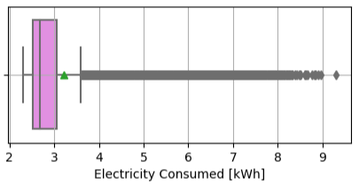
Data Distribution –
Consumption during Weekends
Mean Energy Consumption:
3.20 kWh/every 15 mins.
Median Energy Consumption:
2.67 kWh/every 15 mins.
25% of observations consume energy < 2.52 kWh/every 15 mins.
50% of observations consume energy between 2.52 and 3.06 kWh/every 15 mins.
25% of observations consume energy > 3.06 kWh/every 15 mins.

Slide 7
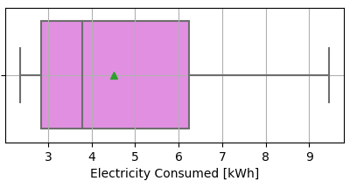
Data Distribution –
Consumption during Weekdays
Mean Energy Consumption:
4.51 kWh/every 15 mins.
Median Energy Consumption:
3.78 kWh/every 15 mins.
25% of observations consume energy < 2.85 kWh/every 15 mins.
50% of observations consume energy between 2.85 and 6.24 kWh/every 15 mins.
25% of observations consume energy > 6.24 kWh/every 15 mins.

Slide 8
Modelling Approach
Detection using Classification:
Detection using Forecasting:
Target variable/Label:
“Anomalous Consumption”
(Binary values: 1- Yes / 0 – No)
Train/Test split:
Taken as 80% and 20% respectively.
Model Building:
This being a classification problem, the dataset has been trained on following models.
Decision Tree Classifier (plus Tuning).
Random Forest Classifier(plus Tuning).
MLP Classifier.
KNN Classifier (plus Tuning).
Gradient Boosting Classifier.
Logistic Regression.
Linear Discriminant Analysis.
Target variable/Label:
“Energy Consumed”
(Continuous values)
Train/Test split:
Taken as 80% and 20% respectively.
Model Building:
This being a regression problem, the dataset has been trained on following models.
Decision Tree Regressor (plus Tuning)
Random Forest Regressor.
MLP Regressor
Linear Regression
Support Vector Regressor
KNN Regressor (plus Tuning).
Lasso Regressor.
Ridge Regressor.

Slide 9
Model Evaluation Metrics & Optimum Model
Detection using Classification:
Detection using Forecasting:
Metrics for Evaluation:
Precision.
Recall.
F1-score.
Confusion Matrix.
Time Taken to construct the Model.
Model Complexity
(i.e. Simple or Black-box).
Optimum Model:
Based on the above metrics and Out of the 10 models constructed, Decision Tree Classifier, Random Forest Classifier and KNN-Classifier were optimal.
These 3 models were further parameter tuned, to be evaluated on the Validation Dataset.
Metrics for Evaluation:
Mean Absolute Error(MAE).
Mean Squared Error(MSE).
Root Mean Squared Error(RMSE).
R-square Technique.
Time Taken to construct the Model.
Model Complexity
( i.e. Simple or Black-box).
Optimum Model:
Based on the above metrics and Out of the 10 models constructed, Decision Tree Regressor and KNN-Regressor were optimal.
These 2 models were further parameter tuned, and evaluated on the Validation Dataset.

Slide 10
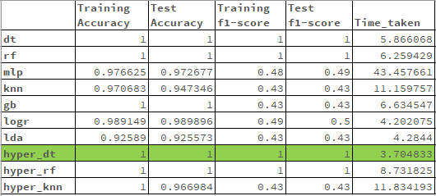
Model Performance
Detection using Classification:

Slide 11
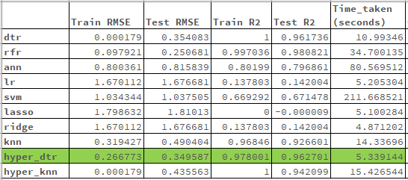
Model Performance
Detection using Forecasting:

Slide 12
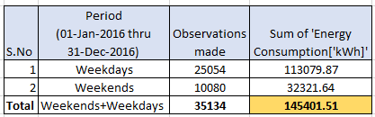
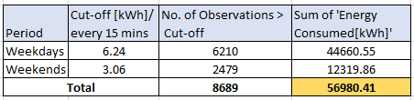
Conclusion
Table shows Total Energy Consumption
From the historical data,78% of Energy is consumed in weekdays and 22% during weekends.
When energy consumption[kWh] every 15 mins exceeds the defined cut-off on “weekends” and “weekdays”, it cumulates to 56,980.41 kWh every year.
In terms of percentage, this is 39.18 % of Total Energy Consumption
Table with Energy Consumed > Defined Cut-off
As per Problem Statement, Our Framework to detect Anomalous Energy Consumption will help to reduce energy consumption close to 40%.

Slide 13
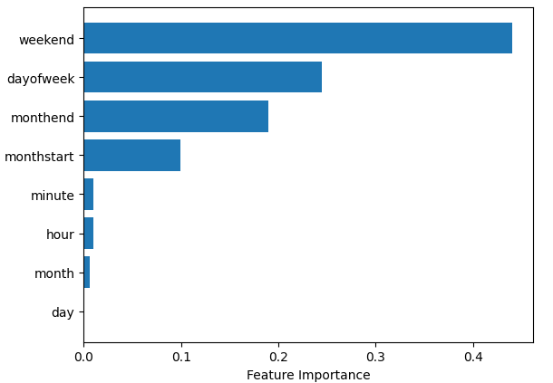
Feature Importance

Slide 14
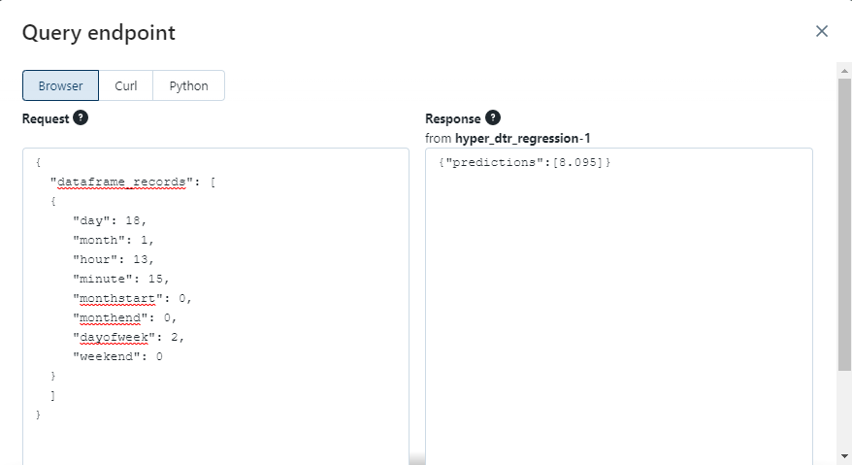
Testing : DataBricks Query Endpoint
Detection using Forecasting:
Via query endpoint, provided Inputs in JSON format in the “Request” section.
The “Response” section, predicted the “Energy consumption” from the registered Regression model.

Slide 15
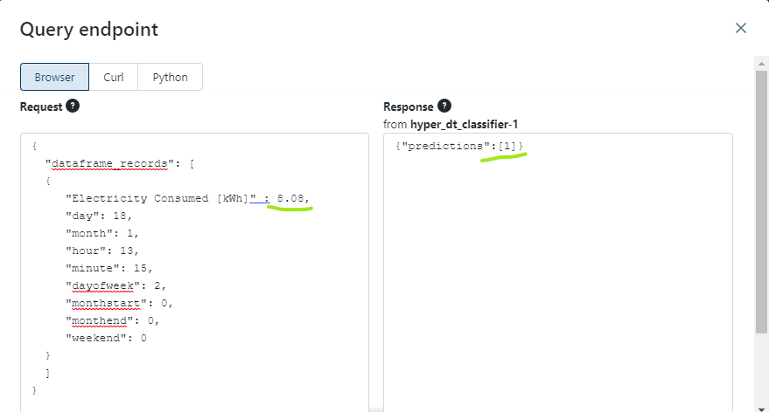
Testing : DataBricks Query Endpoint
Detection using Classification:
Via query endpoint, provided Inputs in JSON format in the “Request” section.
The “Response” section, classified the Energy Consumption as “1” from the registered Classification model.(“1” denotes Anamalous Consumption).

Slide 16
Thank you ☺

