Slide 1
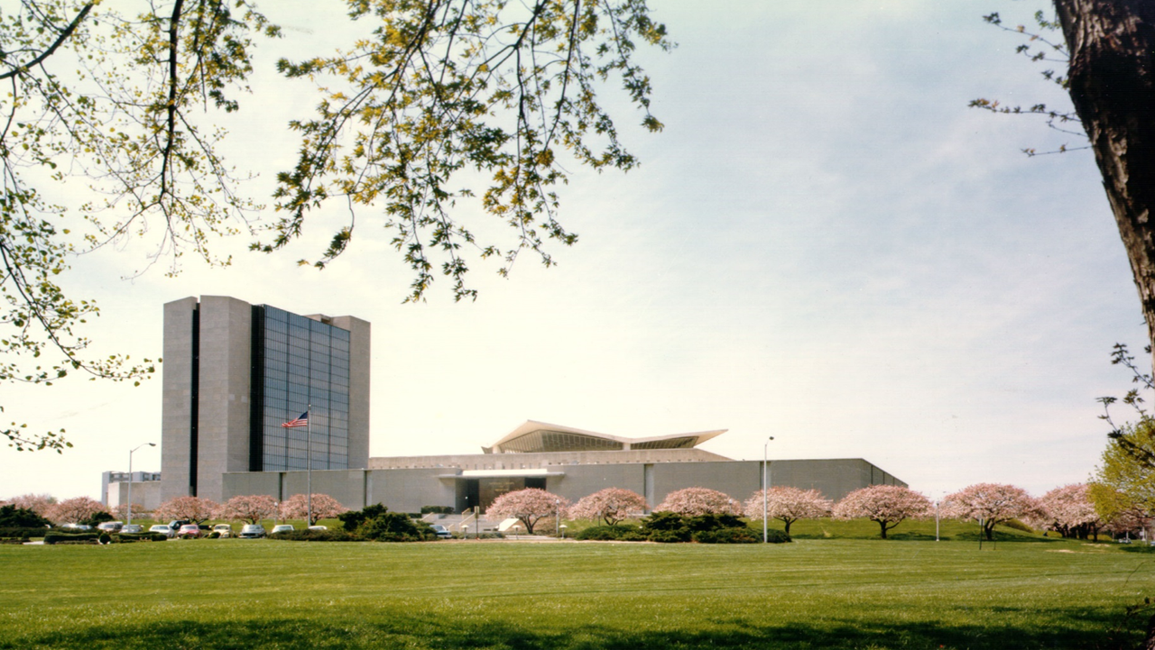
State of the Literature: ncRNA and lncRNA-miRNA Interactions (LMIs)
Vik Becker
National Library of Medicine (NIH)

Slide 2
Overview
Defining non-coding RNA (ncRNA) in context.
LncRNA-miRNA interactions (LMIs).
Existing LMI-associated computational methods.
Future directions.

Slide 3
Defining non-coding RNA (ncRNA) in context.

Slide 4
Non-Coding RNA (ncRNA)
= transcriptional products that do not encode proteins.
Only ~2% of human genome is protein coding!
ncRNA initially considered an RNA processing byproduct.
Regulatory ncRNA Discovery Timeline:
1984: micF RNA identified in E. coli.
1993: First regulatory miRNA (lin-4) found in C. elegans.
Early 2000s: Rapid miRNA pathway characterization.
2007: Encyclopedia of DNA Elements (ENCODE) project initiation.

Slide 5
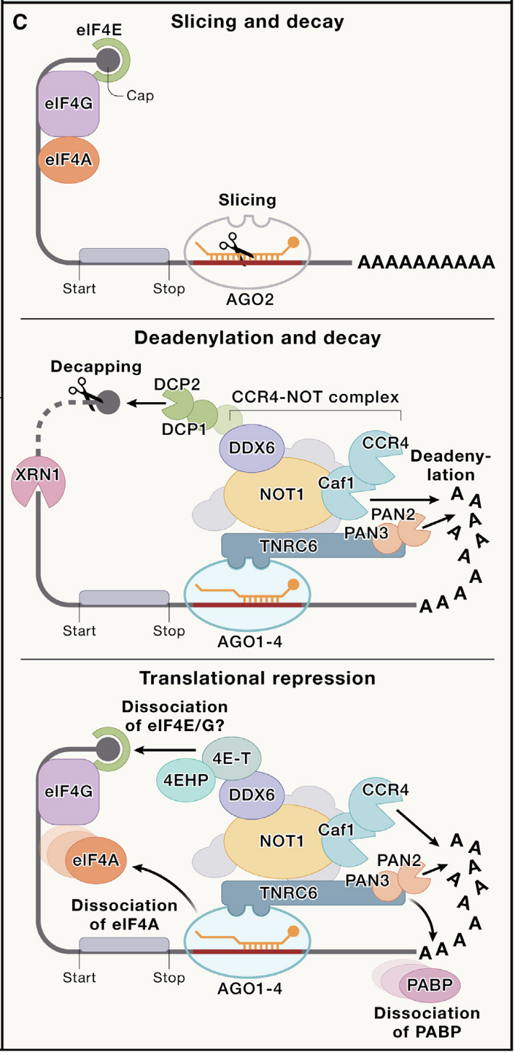
Micro RNA (miRNA)
= subset of small ncRNAs that are ~20-28 nucleotides long.
Primary function is RNA interference gene silencing.
Associate with Argonaute (Ago) proteins within RNA-induced silencing complexes (RISC).
Bind to miRNA Response Elements (MREs)
Located within 3′ untranslated regions of mRNAs.
Outcomes depend on complementarity:
Perfect → endonucleotide cleavage
Partial → deadenylation or translational repression
Relatively conserved and well-characterized biogenesis.
Chen et al. (2024) Small and long non-coding RNAs: Past, present, and future. Figure 4(c)

Slide 6
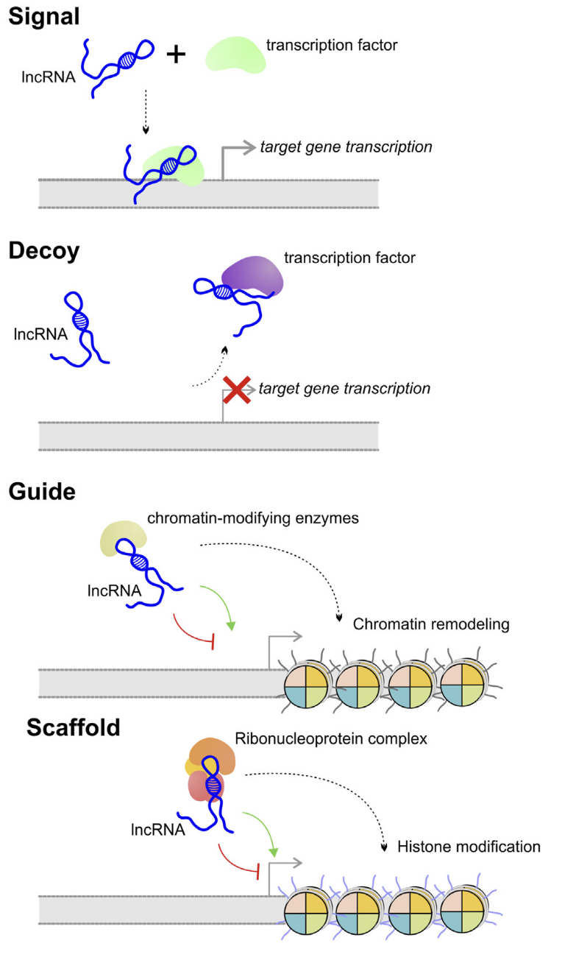
Long Non-Coding RNA (lncRNA)
= non-coding RNA transcripts greater than 200 nucleotides long.
Participates in diverse nuclear and cytoplasmic regulatory processes.
Major Functional Classes:
Signal = facilitate enhancer-promoter interactions through stabilizing chromatin loops.
Decoys = sequester miRNAs, mRNAs, or proteins.
Guides = recruit chromatin-modifying proteins to specific genomic loci in cis or in trans.
Scaffolds = assemble multiprotein regulatory complexes.
Highly diverse and context-specific biogenesis.
Poloni et al. (2024) Localization is the key to action: regulatory peculiarities of lncRNAs. Figure 1(b)

Slide 7
LncRNA-miRNA Interactions (LMIs).

Slide 8
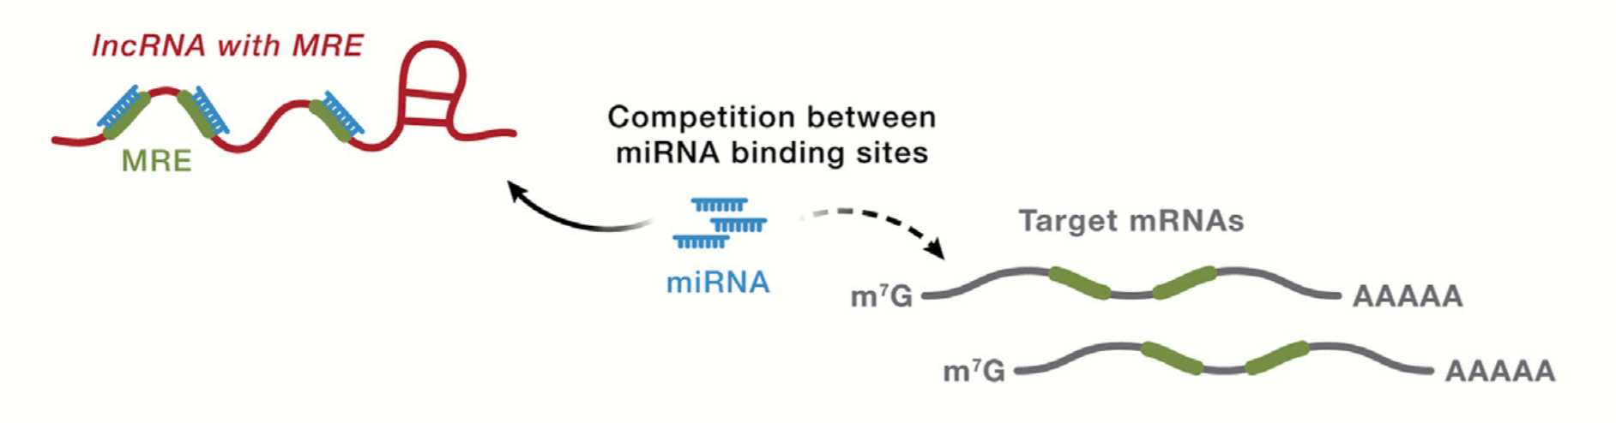
Competing Endogenous RNA (ceRNA) Hypothesis
= complex network where lncRNAs and mRNAs sharing common miRNA response elements (MREs) compete for a limited pool of miRNAs (Salmena et al., 2011).
Chen et al. (2024) Small and long non-coding RNAs: Past, present, and future. Figure 6(b)(i)

Slide 9
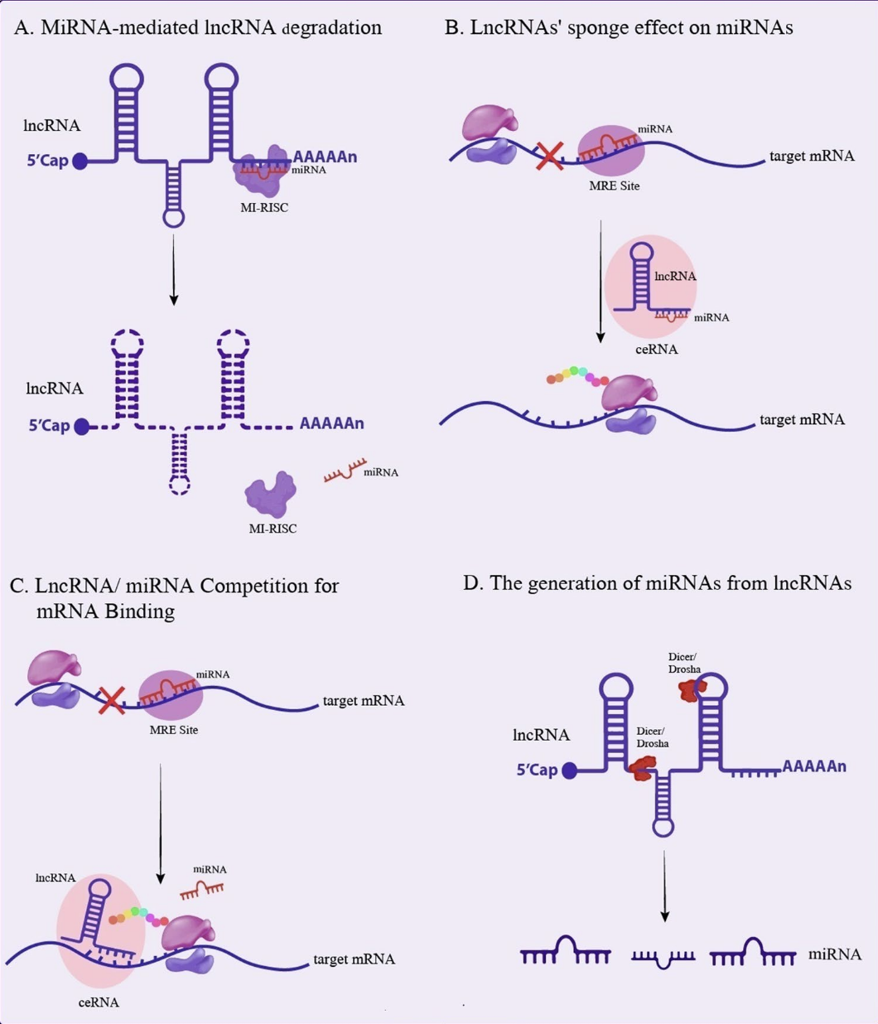
lncRNA-miRNA Interactions (LMIs)
Pooresmaeil et al. (2025) Pivotal Role of miRNA–lncRNA Interactions in Human Diseases. Figure 1

Slide 10
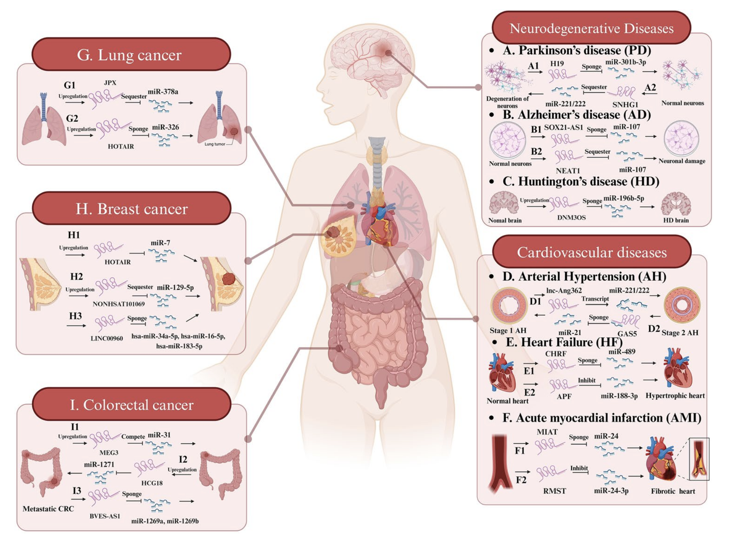
Reported LMIs in Disease
Pooresmaeil et al. (2025) Pivotal Role of miRNA–lncRNA Interactions in Human Diseases. Figure 2

Slide 11
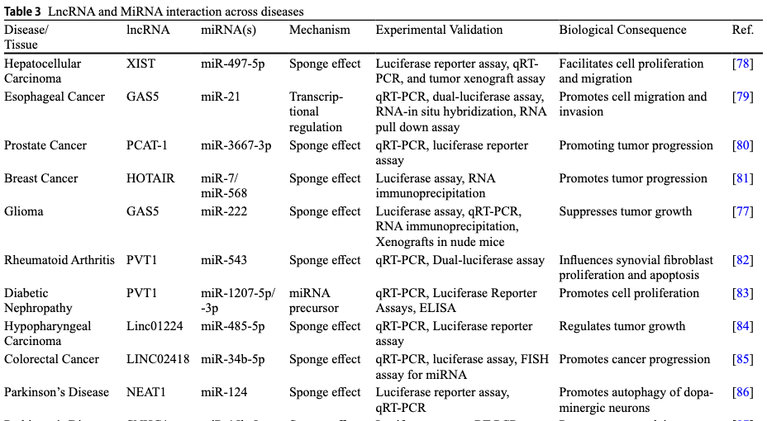
Reported LMIs in Disease (cont.)
Singh et al. (2025) Emerging landscape of lncRNA-miRNA interactions as architects of gene expression patterns. Table 3 (first 10 entries)

Slide 12
Existing LMI-associated computational methods.

Slide 13
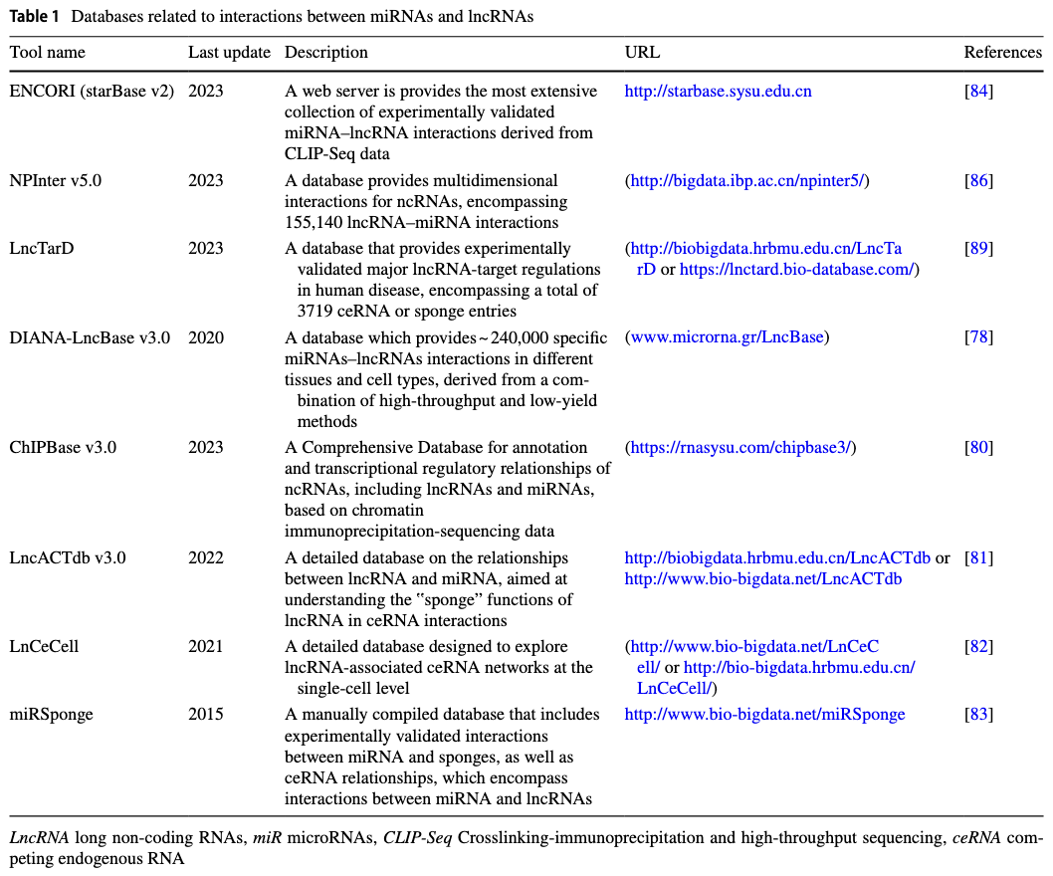
LMI Databases
Updated LnCeCell v2.0: lncRNA-associated ceRNA networks and web tools based on single-cell and spatial transcriptomics sequencing data
starBase v2.0: RNA-RNA and RNA-protein networks based on CLIP-seq datasets
And so many more…
Pooresmaeil et al. (2025) Pivotal Role of miRNA–lncRNA Interactions in Human Diseases. Table 1

Slide 14
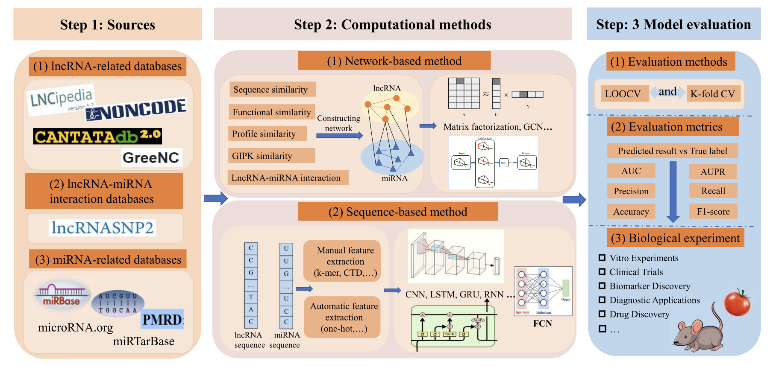
Interaction Prediction (EX: miRInter-Trans)
Goal: Predict novel lncRNA-miRNA interactions (LMIs)
Sheng et al. (2023) A Survey of Computational Methods and Databases for lncRNA-MiRNA Interaction Prediction. Figure 1

Slide 15
ceRNA Network Construction (EX: miRTarBase)
Goal: Infer physiologically associated full lncRNA-miRNA-mRNA regulatory networks.
Biomarker Discovery (EX: CERDA-HOSR)
Goal: Identify ncRNA that serve as biomarkers.
Patient Stratification (EX: Liu et al. Radiotherapy Model)
Goal: Predict prognosis, recurrence, therapeutic response, or disease subtype.

Slide 16
Future directions.

Slide 17
Future Directions
Current trends of computational ncRNA research:
Multi-omics integration.
De novo interaction prediction.
Begging for experimental validation :[
Hypothetical Projects:
Further investigate threshold patterns in ceRNA network expression.
NS-Forest implementation with ncRNA:
ceRNA network co-expression as biomarkers.
How effective is ncRNA (or specifically lncRNA) as biomarkers? Across organs? Across development?

Slide 18
Bibliography
Chai Z, Su Y, Tian X et al. Predicting disease associations based on the higher order structure of ceRNA networks. Brief Bioinform 2025;26(5):bbaf518. https://doi.org/10.1093/bib/bbaf518.
Chen LL, Kim VN. Small and long non-coding RNAs: Past, present, and future. Cell 2024;187(23):6451–85. https://doi.org/10.1016/j.cell.2024.10.024.
Cui S, Yu S, Huang HY et al. miRTarBase 2025: updates to the collection of experimentally validated microRNA–target interactions. Nucleic Acids Res 2025;53(D1):D147–56. https://doi.org/10.1093/nar/gkae1072.
Gao Y, Takenaka K, Xu SM et al. Recent advances in investigation of circRNA/lncRNA-miRNA-mRNA networks through RNA sequencing data analysis. Brief Funct Genomics 2025;24:elaf005. https://doi.org/10.1093/bfgp/elaf005.
Guo Q, Liu Q, He D et al. LnCeCell 2.0: an updated resource for lncRNA-associated ceRNA networks and web tools based on single-cell and spatial transcriptomics sequencing data. Nucleic Acids Res 2025;53(D1):D107–15. https://doi.org/10.1093/nar/gkae947.
Li JH, Liu S, Zhou H et al. starBase v2.0: decoding miRNA-ceRNA, miRNA-ncRNA and protein–RNA interaction networks from large-scale CLIP-Seq data. Nucleic Acids Res 2014;42(Database issue):D92–7. https://doi.org/10.1093/nar/gkt1248.
Liu A, Peng B, Pankajam AV et al. Discovery of optimal cell type classification marker genes from single cell RNA sequencing data. BMC Methods 2024;1:15. https://doi.org/10.1186/s44330-024-00015-2.
Liu W, Zhang Y, Yang Y et al. A prognostic model for head and neck squamous cell carcinoma based on a ceRNA network to predict radiotherapy response. Journal of Radiation Research and Applied Sciences 2025;18(2):101501. https://doi.org/10.1016/j.jrras.2025.101501.
Necsulea A, Soumillon M, Warnefors M et al. The evolution of lncRNA repertoires and expression patterns in tetrapods. Nature 2014;505(7485):635–40. https://doi.org/10.1038/nature12943.
Nicolini M, Stacchietti F, Molina FJ et al. MiRInter-Trans: a Transformer-Based Framework for microRNA Interaction Prediction. Bioinformatics Advances 9 Mar. 2026:vbag073. https://doi.org/10.1093/bioadv/vbag073.
Poloni J de F, Oliveira FHS de, Feltes BC. Localization is the key to action: regulatory peculiarities of lncRNAs. Front Genet 2024;15. https://doi.org/10.3389/fgene.2024.1478352.
Pooresmaeil F, Azadi S, Hasannejad-Asl B et al. Pivotal Role of miRNA–lncRNA Interactions in Human Diseases. Mol Biotechnol 2025;67(12):4363–85. https://doi.org/10.1007/s12033-024-01343-y.
Salmena L, Poliseno L, Tay Y et al. A ceRNA hypothesis: the Rosetta stone of a hidden RNA language? Cell 2011;146(3):353–8. https://doi.org/10.1016/j.cell.2011.07.014.
Sheng N, Huang L, Gao L et al. A Survey of Computational Methods and Databases for lncRNA-MiRNA Interaction Prediction. IEEE/ACM Transactions on Computational Biology and Bioinformatics 2023;20(5):2810–26. https://doi.org/10.1109/TCBB.2023.3264254.
Singh M, Priya K, Nagar A et al. Emerging landscape of lncRNA-miRNA interactions as architects of gene expression patterns. Mol Biol Rep 2025;52(1):810. https://doi.org/10.1007/s11033-025-10906-4.

Slide 19
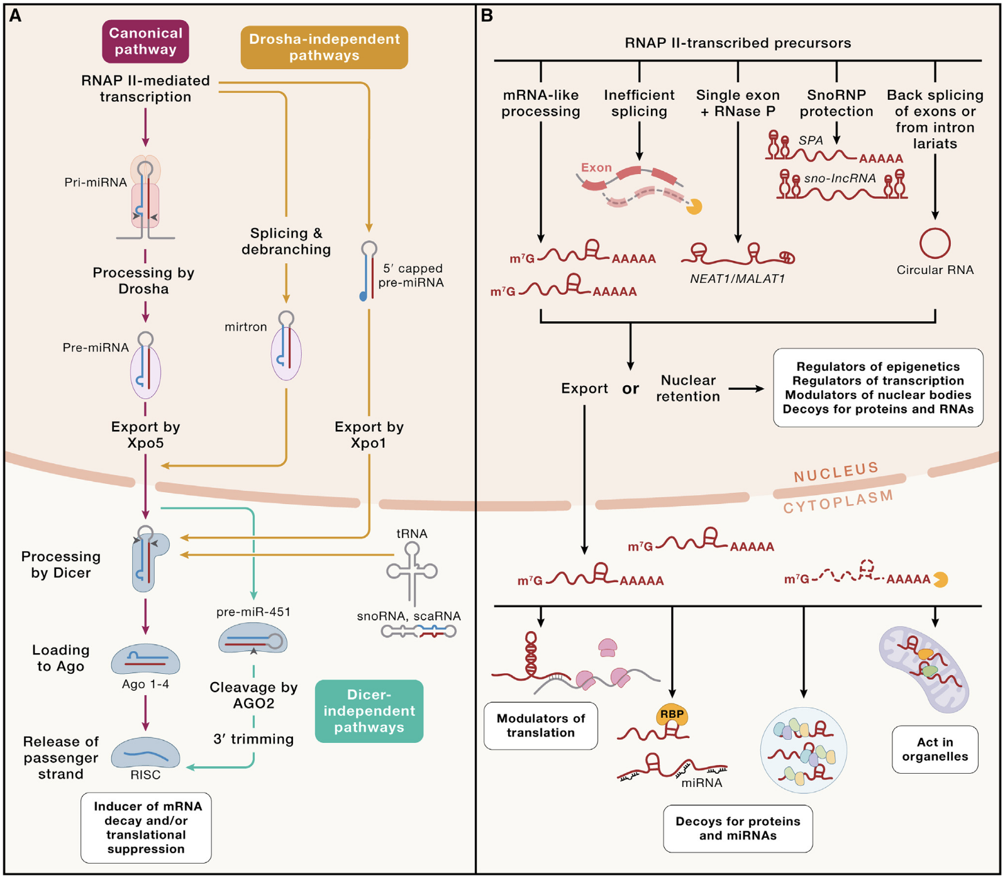
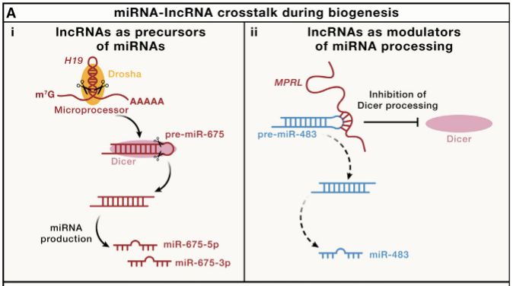
miRNA and lncRNA Biogenesis Pathways
Chen et al. (2024) Small and long non-coding RNAs: Past, present, and future. Figure 3 and Figure 6(a)

Slide 20
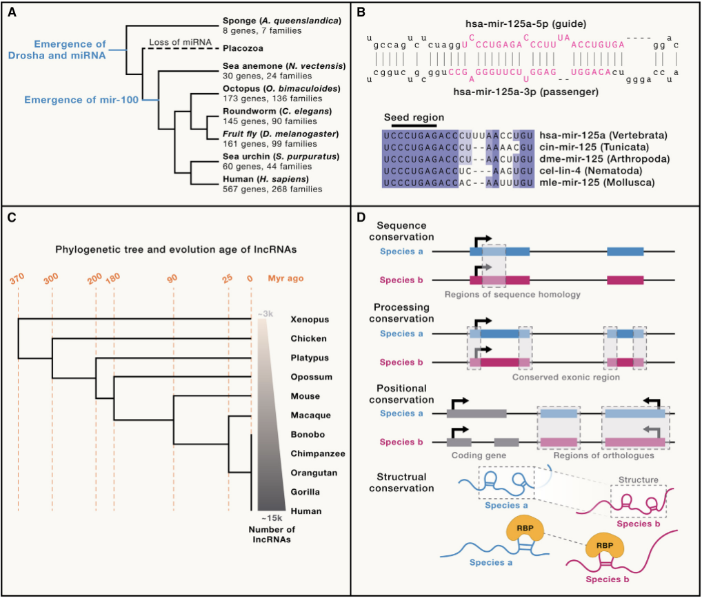
Evolutionary Conservation
Chen et al. (2024) Small and long non-coding RNAs: Past, present, and future. Figure 2

Slide 21
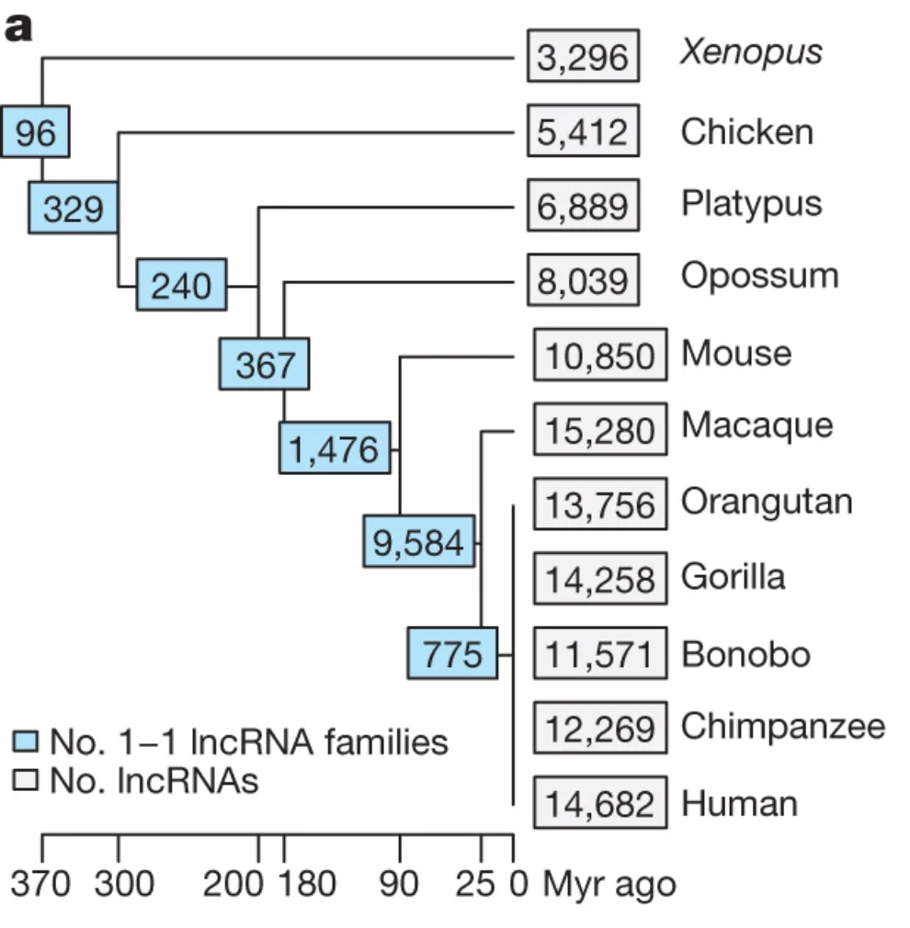
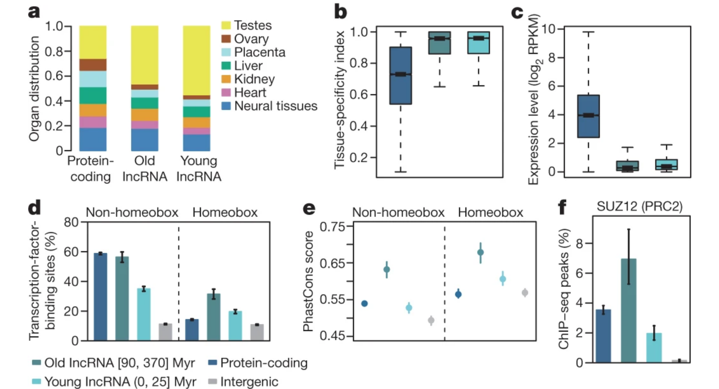
lncRNA Evolutionary Age (1) and Expression (2)
(1)
(2)
Necsulea et al. (2014) The evolution of lncRNA repertoires and expression patterns in tetrapods. Figure 1(a) and 2

Slide 22
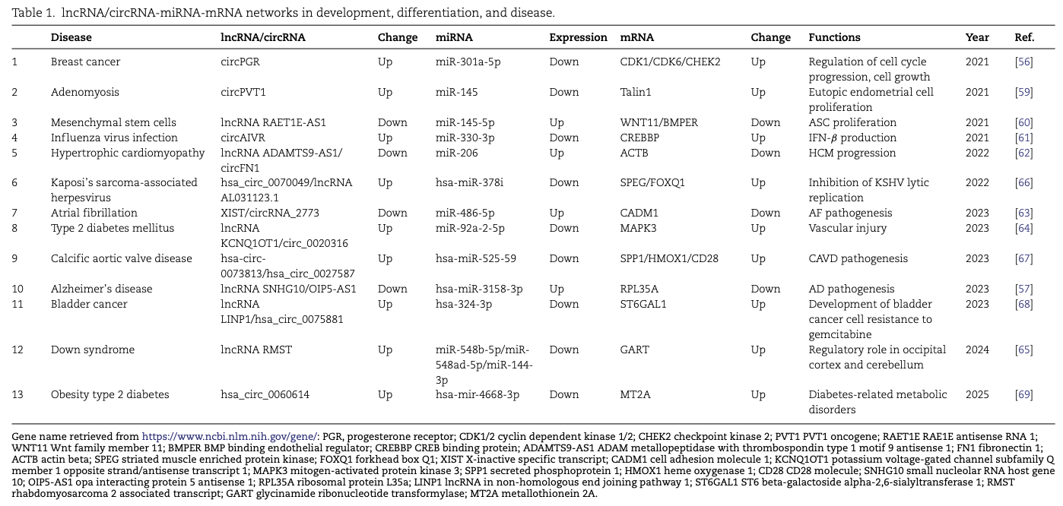
lncRNA-miRNA-mRNA Network in Disease
Gao et al. (2025) Recent advances in investigation of circRNA/lncRNA-miRNA-mRNA networks through RNA sequencing data analysis. Table 1

Slide 23
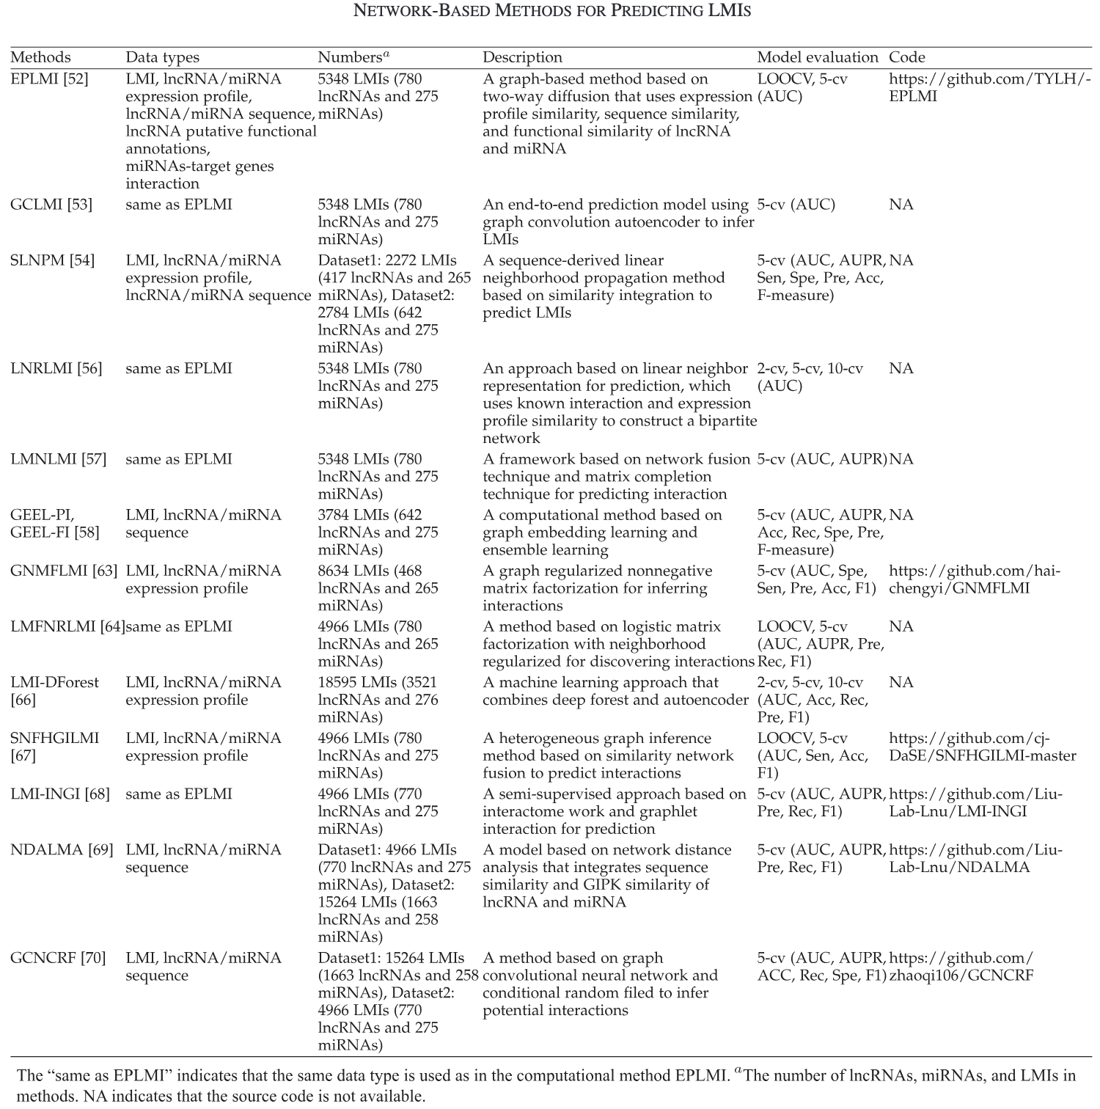
LMI Prediction:
Network-Based Models
Sheng et al. (2023) A Survey of Computational Methods and Databases for lncRNA-MiRNA Interaction Prediction. Table 2

Slide 24
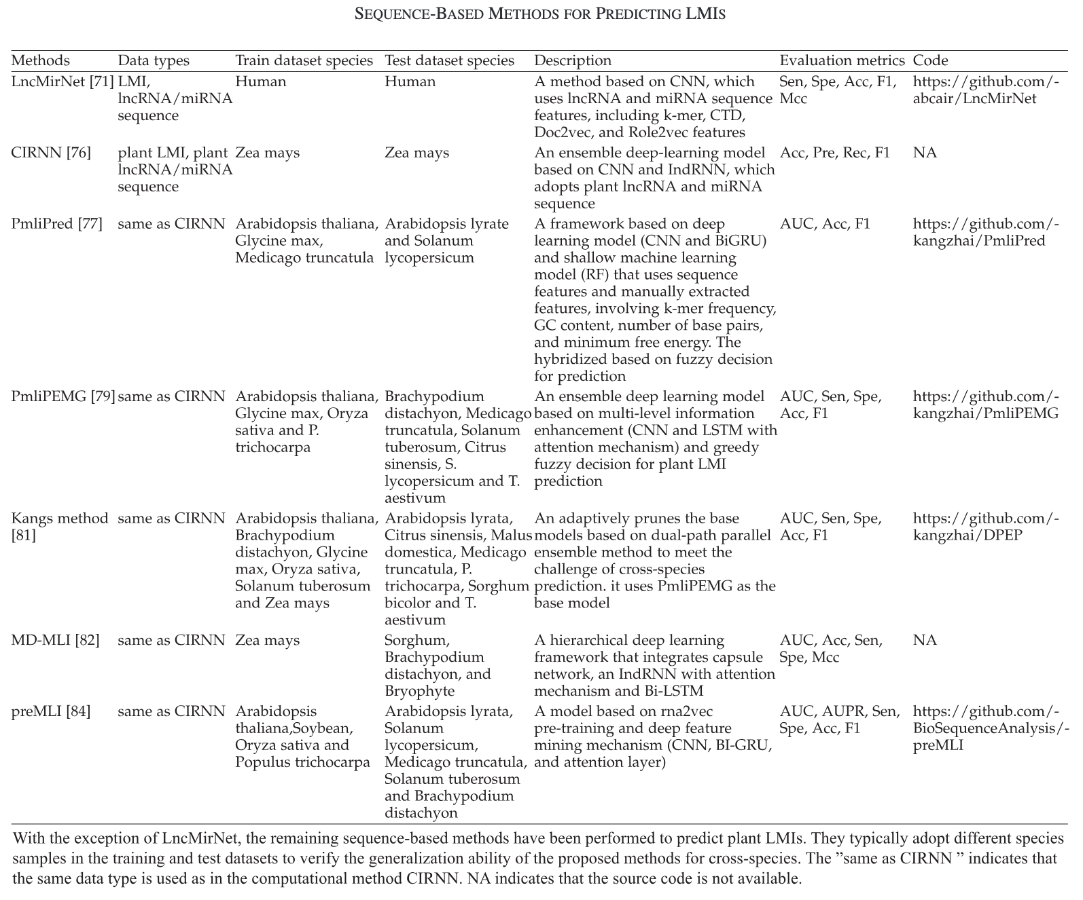
LMI Prediction:
Sequence-Based Models
Sheng et al. (2023) A Survey of Computational Methods and Databases for lncRNA-MiRNA Interaction Prediction. Table 3

