Slide 1
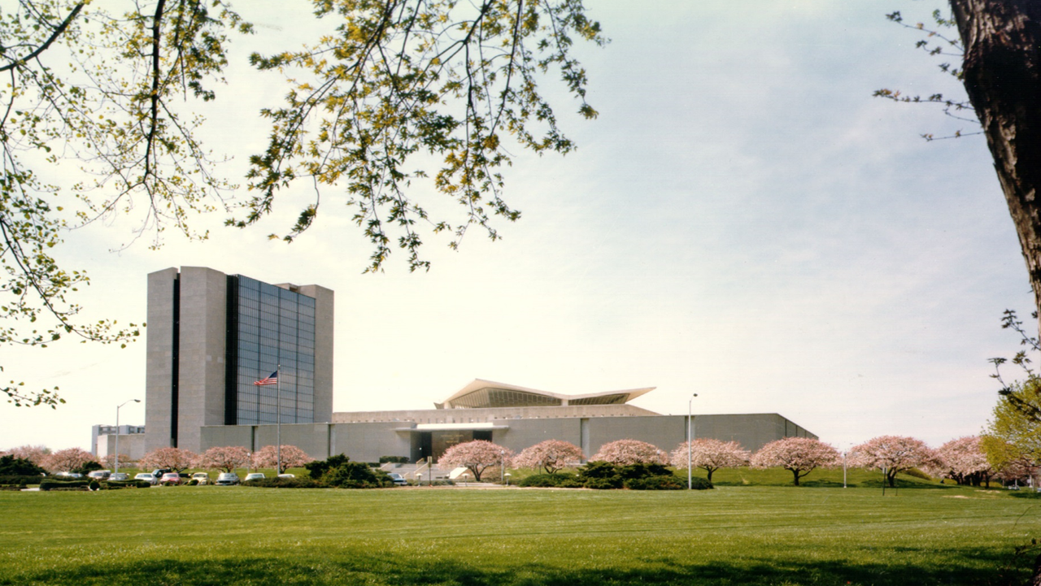
Preliminary Results for NS-Forest Comparison Runs on Retina and Kidney Data
Vik Becker
National Library of Medicine (NIH)

Slide 2
Overview
Summary of NS-Forest Comparison Pipeline.
Results on HCA Retina Data.
Results on HuBMAP Kidney Data.
Future Directions

Slide 3
Summary of NS-Forest Comparison Pipeline.

Slide 4
Basic Pipeline
Load raw sc/snRNA-seq Cell x Gene Data (scanpy).
Optional: Downsample by cell type (celltypist).
Obtain lncRNA subset from data (anndata).
Perform preprocessing on full and subset data:
Generate dendrograms (scanpy).
Calculate cluster medians per gene (nsforest).
Calculate binary scores per gene per cluster (nsforest).
Run NS-Forest on the full and subset data (nsforest).
Run visualization suite (nsforest).

Slide 5
Results on HCA Retina Data.

Slide 6
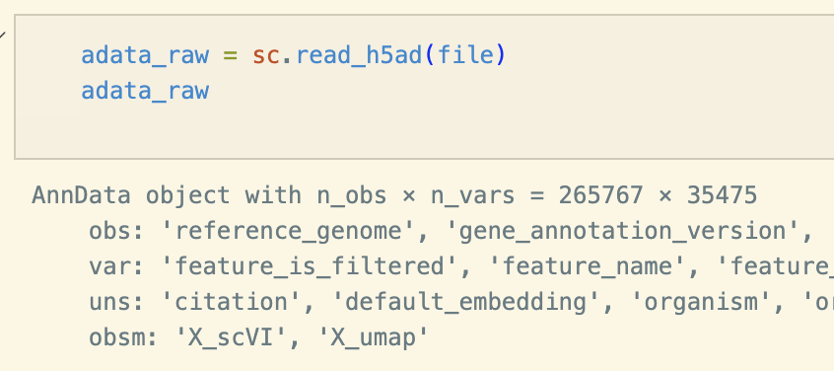
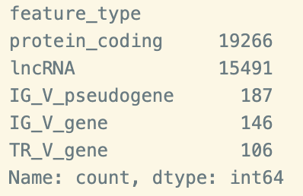
Raw Data and Gene Type Counts

Slide 7
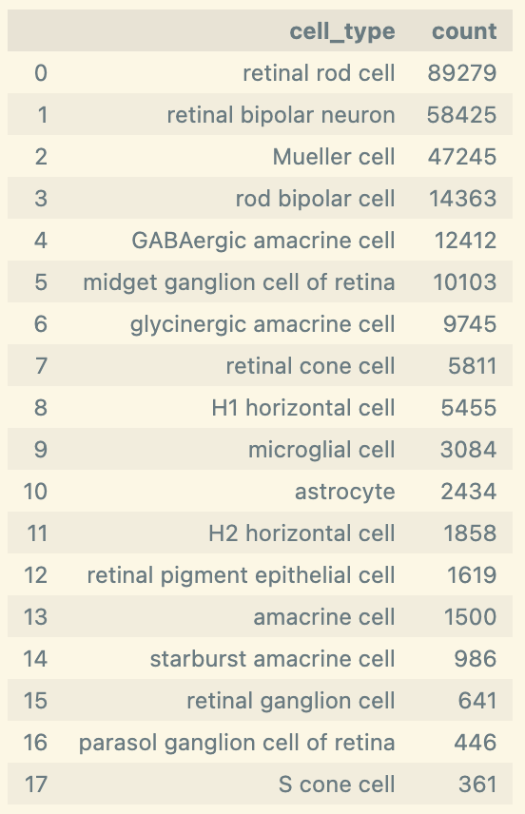
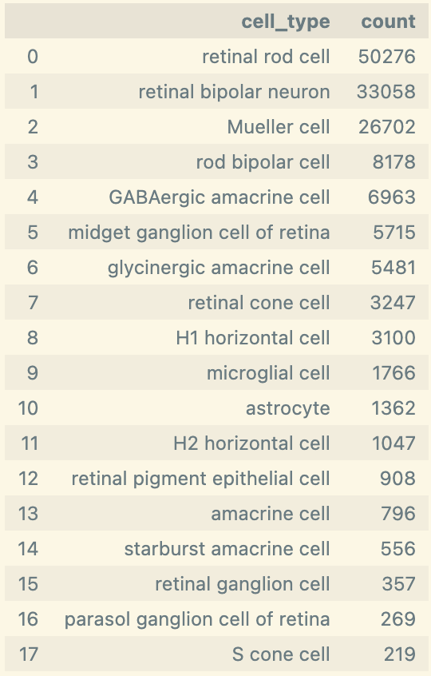
Cell Type Counts
n (cells) = 265,767
Downsample
n (cells) = 150,000

Slide 8
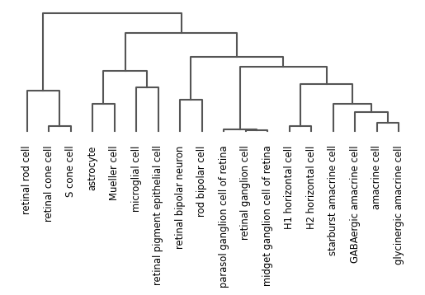
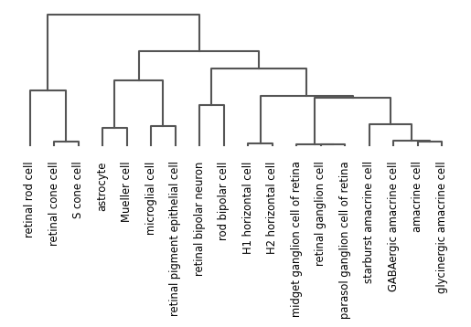
Dendrograms
All Genes
lncRNA

Slide 9
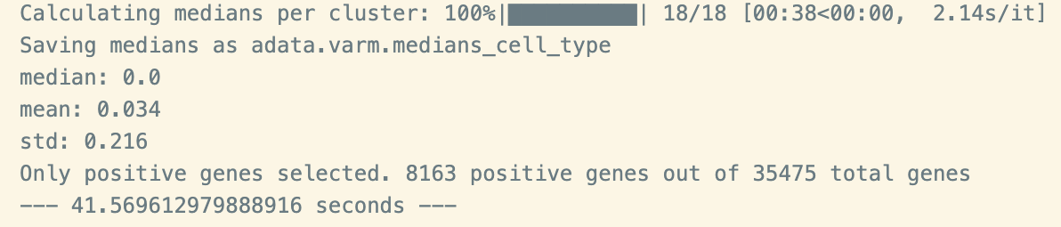
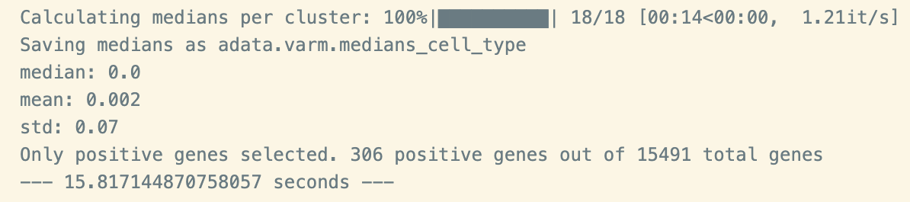
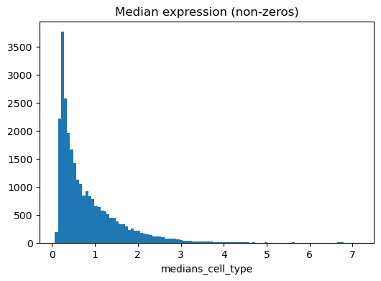
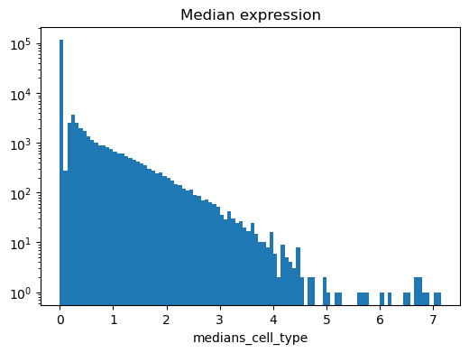
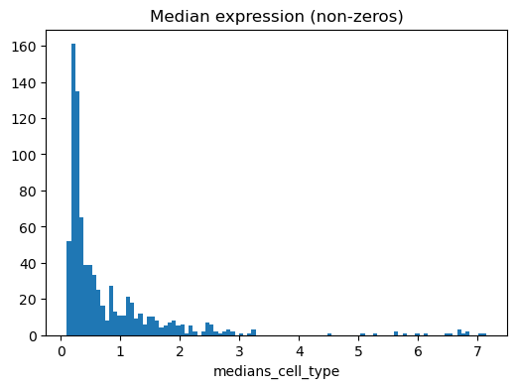
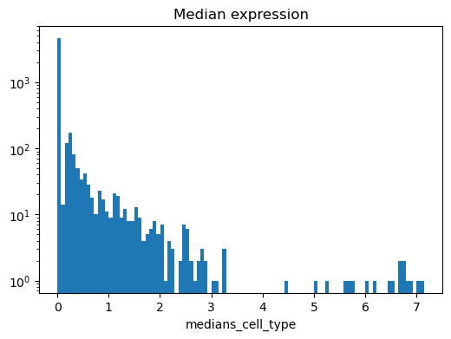
Cluster Medians
All Genes
lncRNA
Unscaled
Log
Unscaled
Log

Slide 10
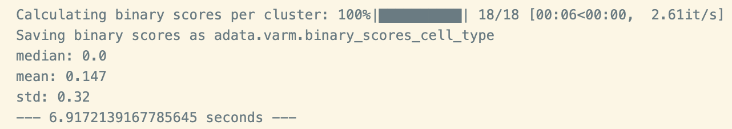
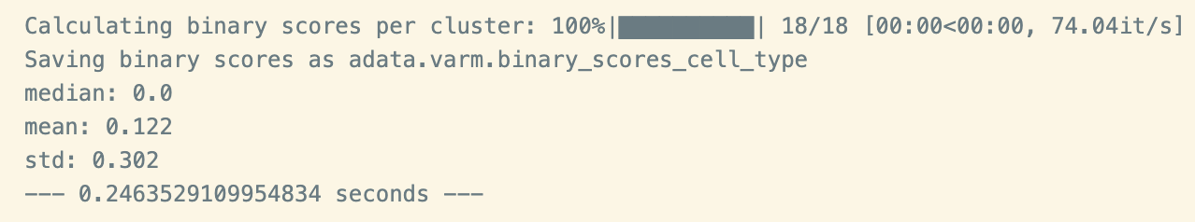
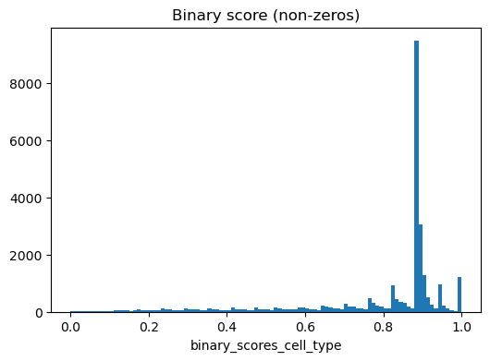
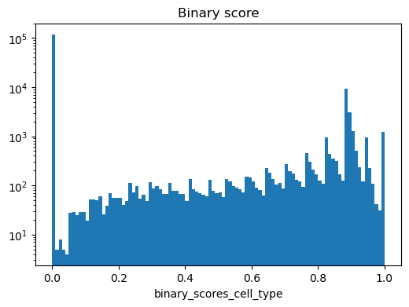
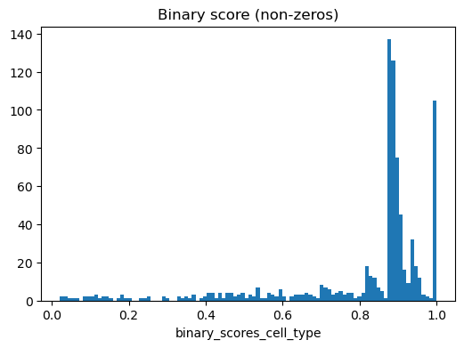
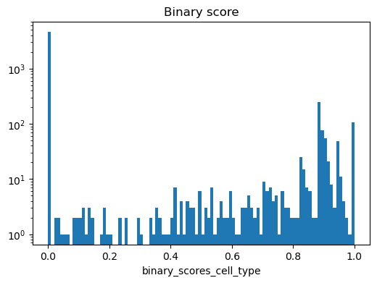
Binary Scores
All Genes
lncRNA
Unscaled
Log
Unscaled
Log

Slide 11
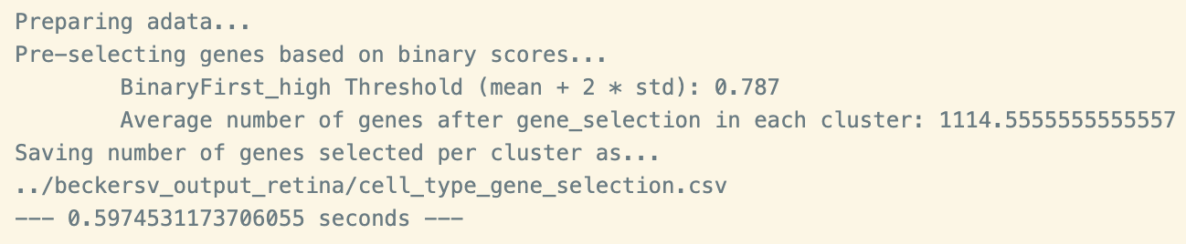
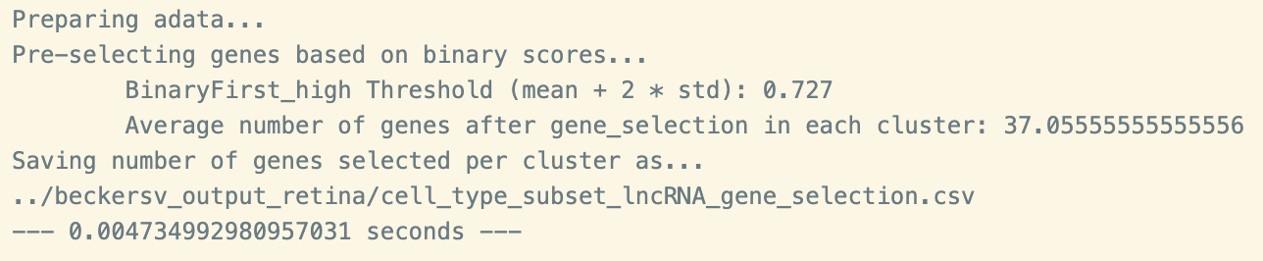
NS-Forest
All Genes
lncRNA

Slide 12
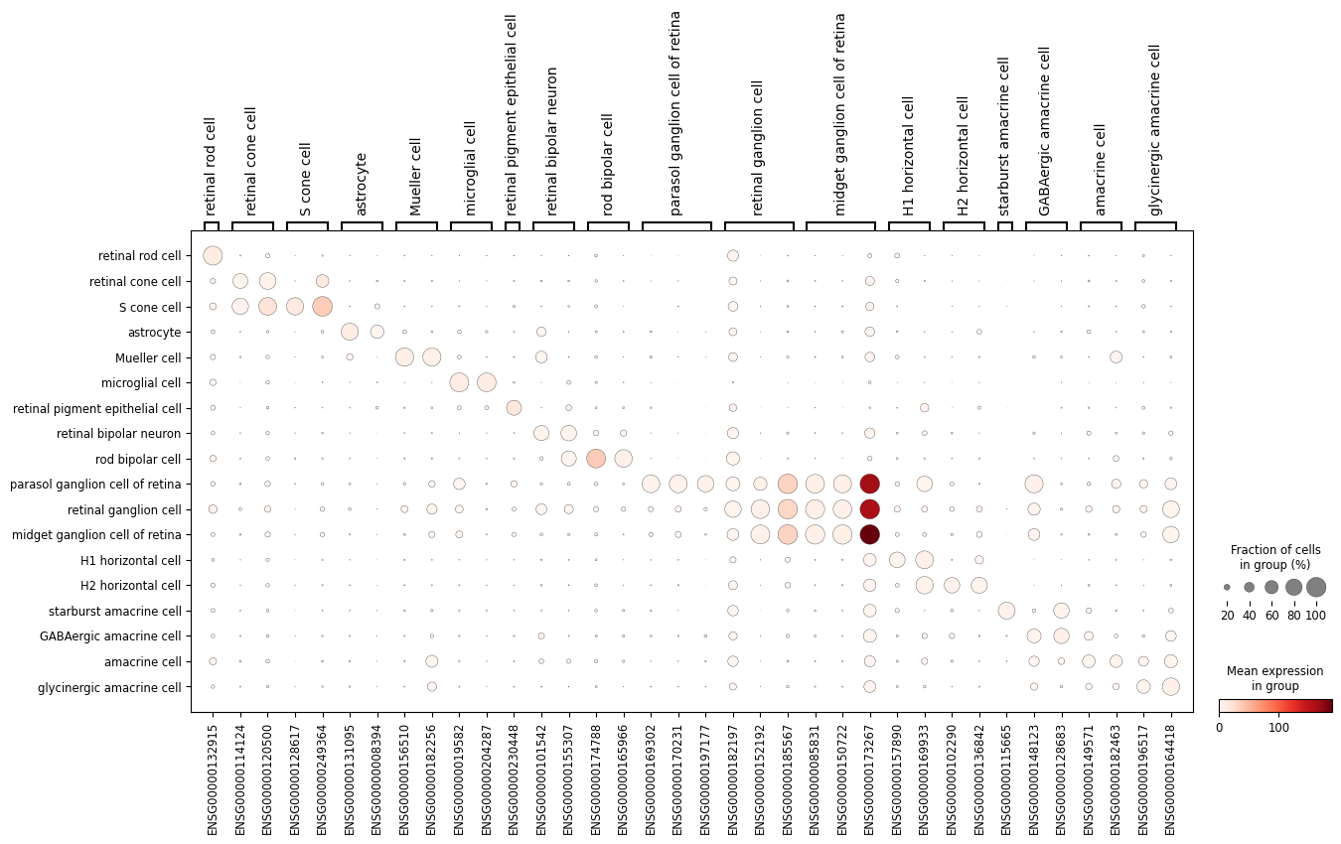
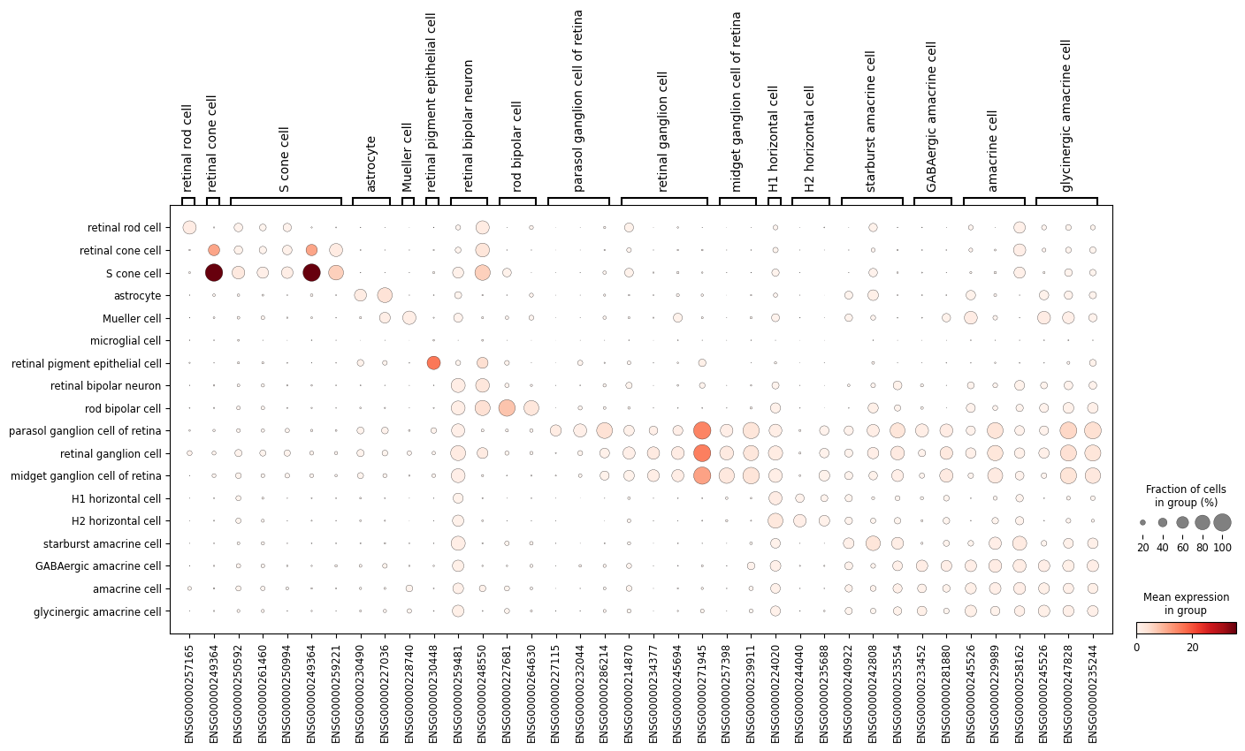
Dot Plot
All Genes
lncRNA

Slide 13
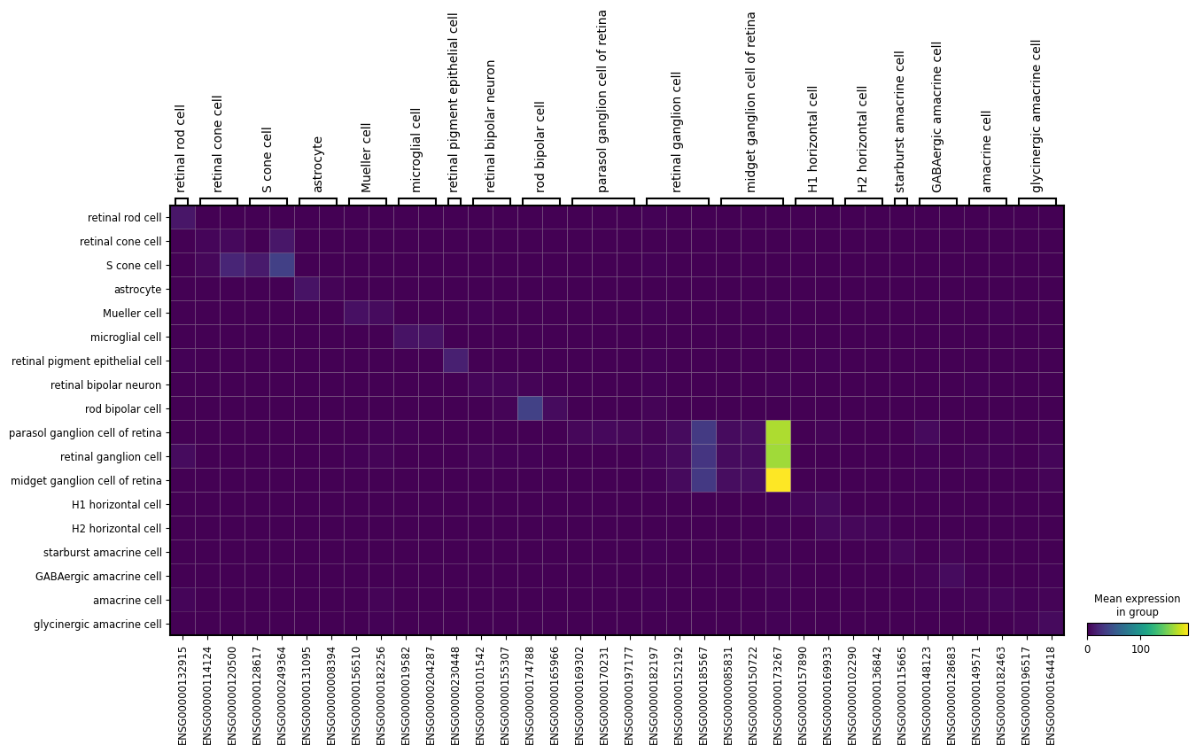
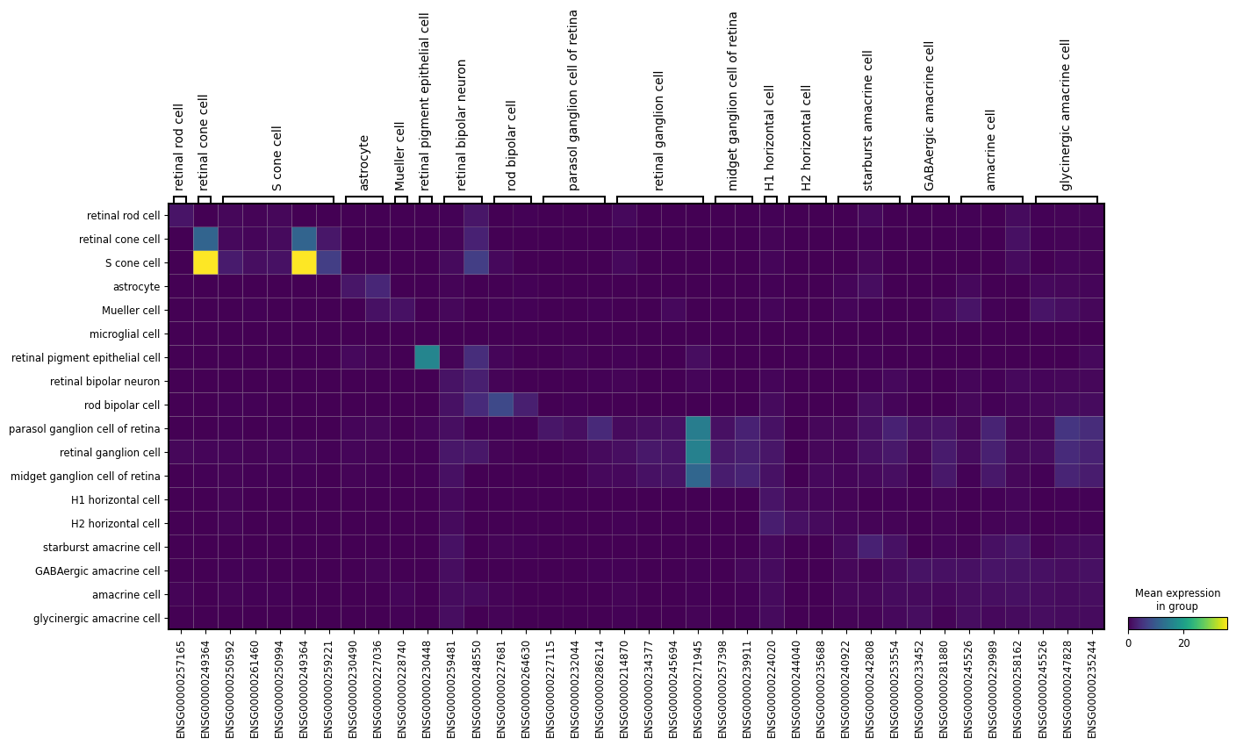
Heat Map
All Genes
lncRNA

Slide 14
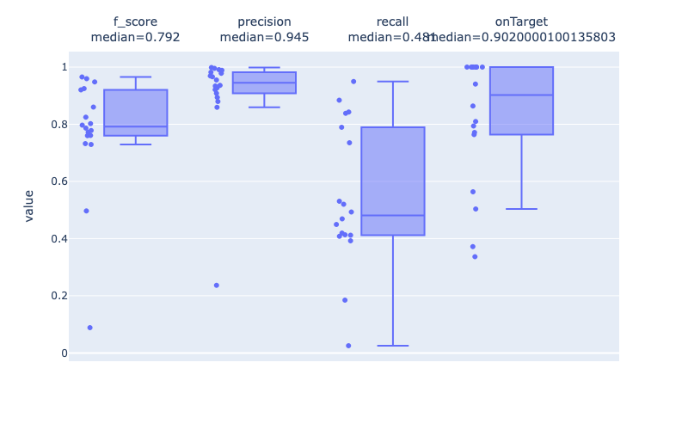
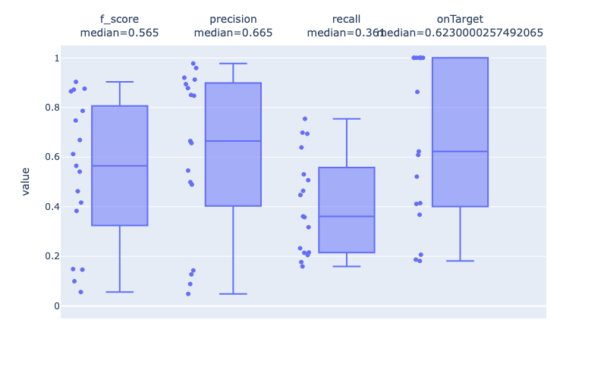
Box Plot
All Genes
lncRNA

Slide 15
Results on HuBMAP Kidney Data.

Slide 16
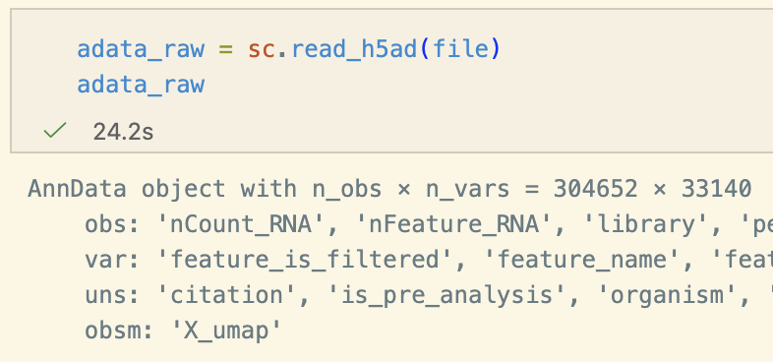
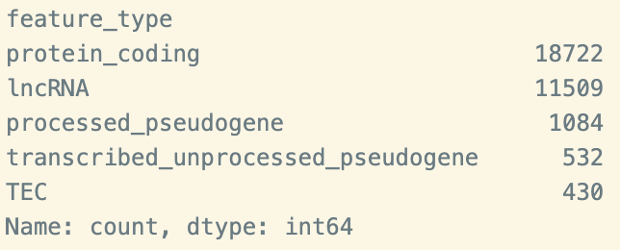
Raw Data and Gene Type Counts

Slide 17
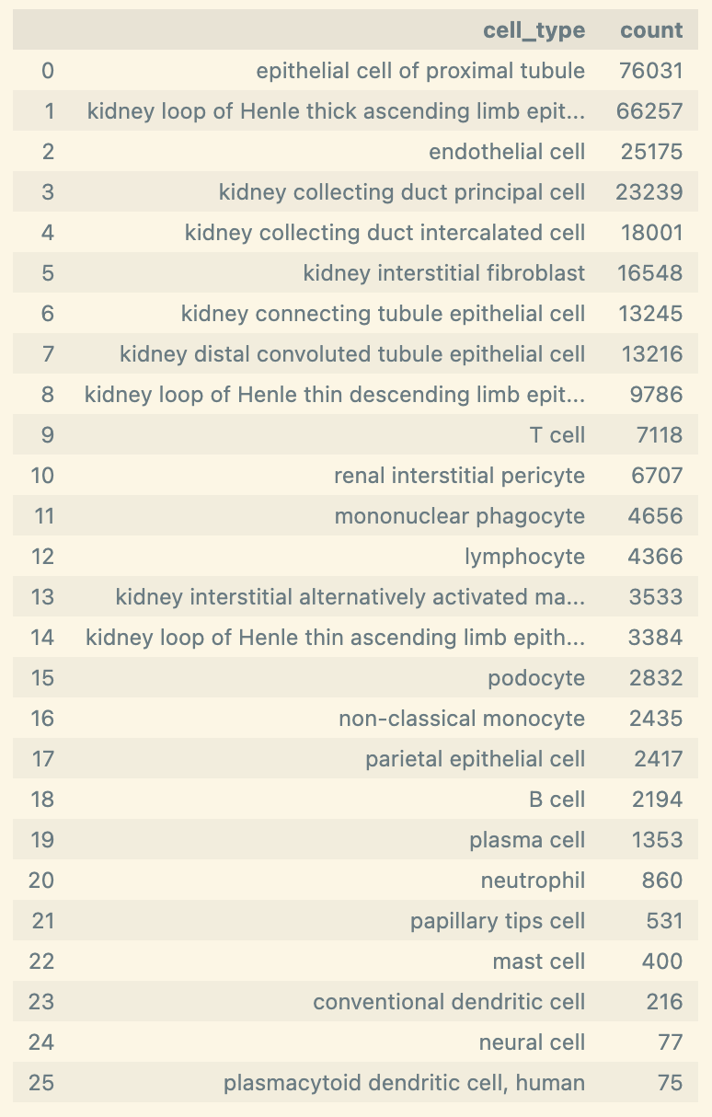
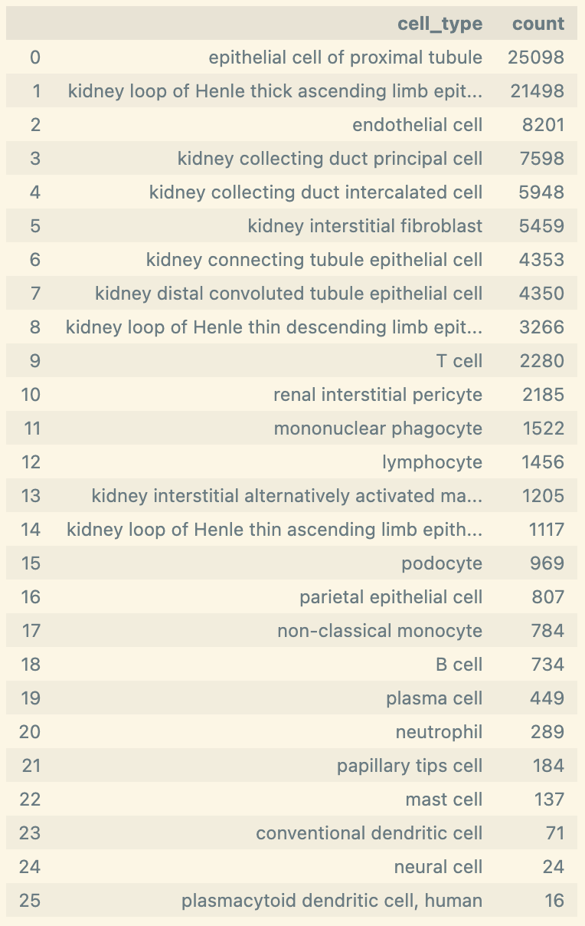
Cell Type Counts
n (cells) = 304,652
Downsample
n (cells) = 150,000

Slide 18
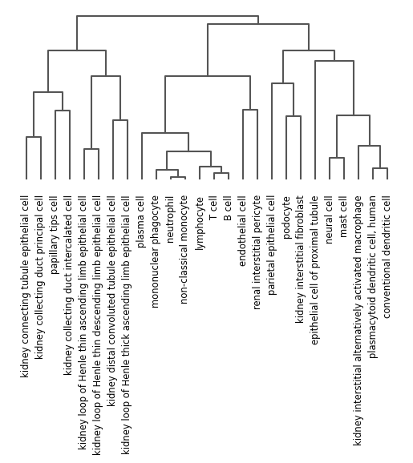
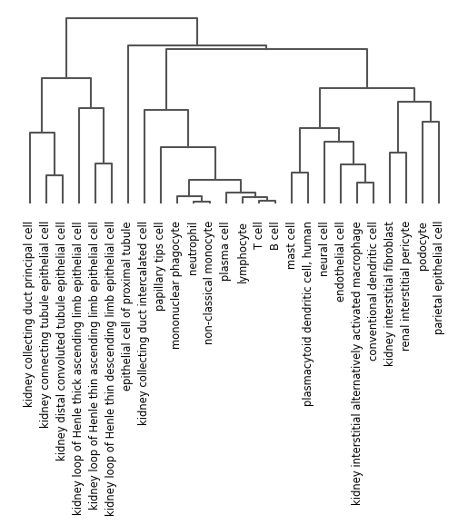
Dendrograms
All Genes
lncRNA

Slide 19
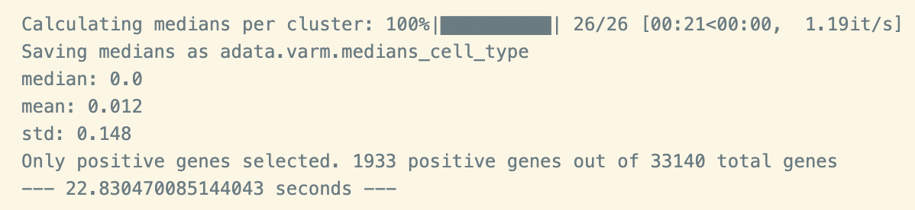
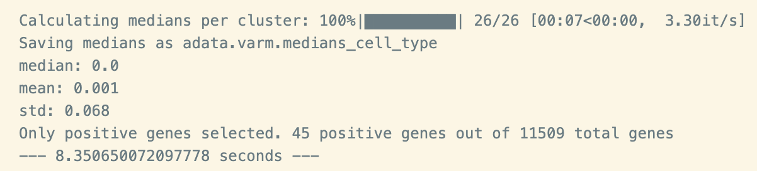
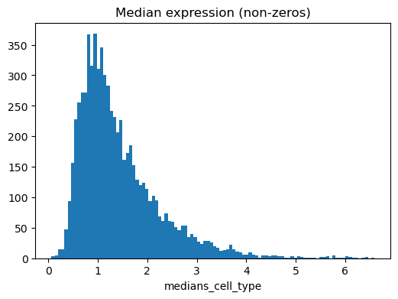
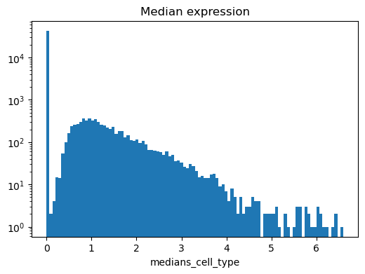
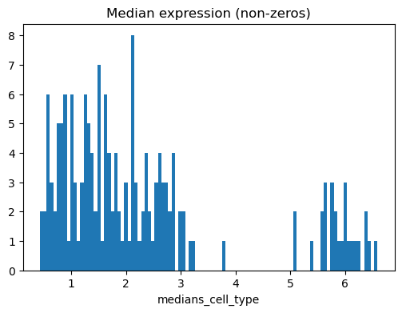
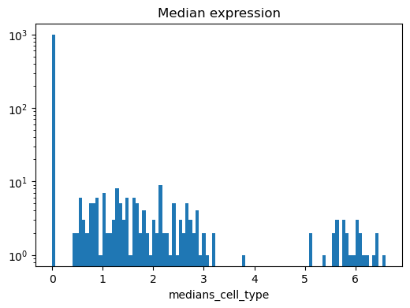
Cluster Medians
All Genes
lncRNA
Unscaled
Log
Unscaled
Log

Slide 20
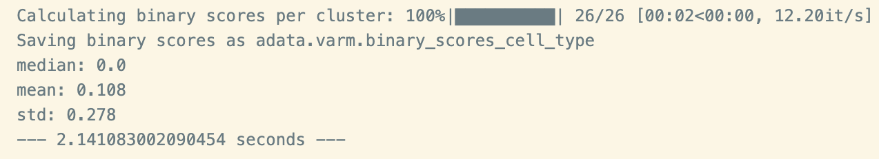
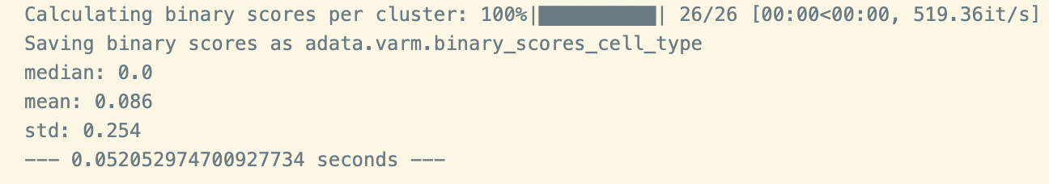
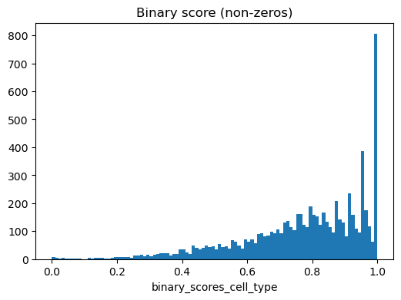
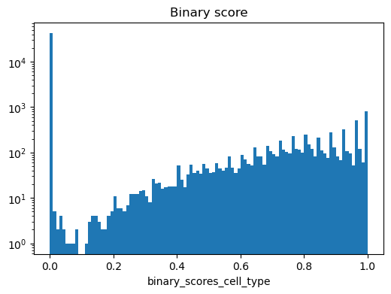
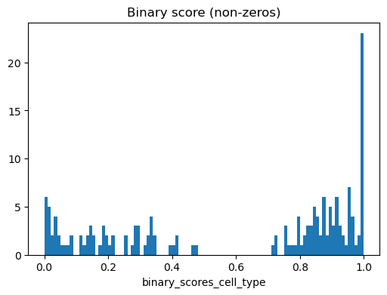
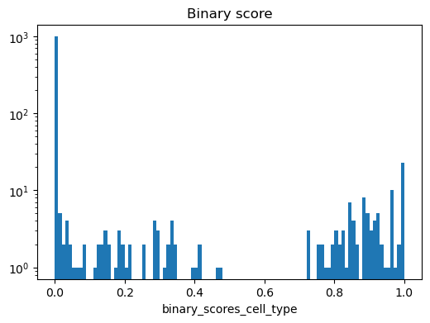
Binary Scores
All Genes
lncRNA
Unscaled
Log
Unscaled
Log

Slide 21

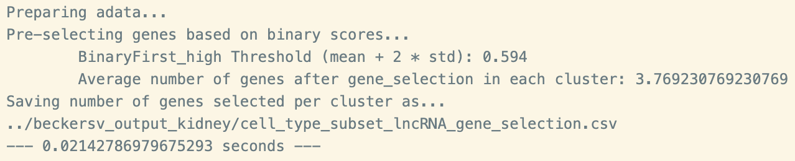
NS-Forest
All Genes
lncRNA

Slide 22
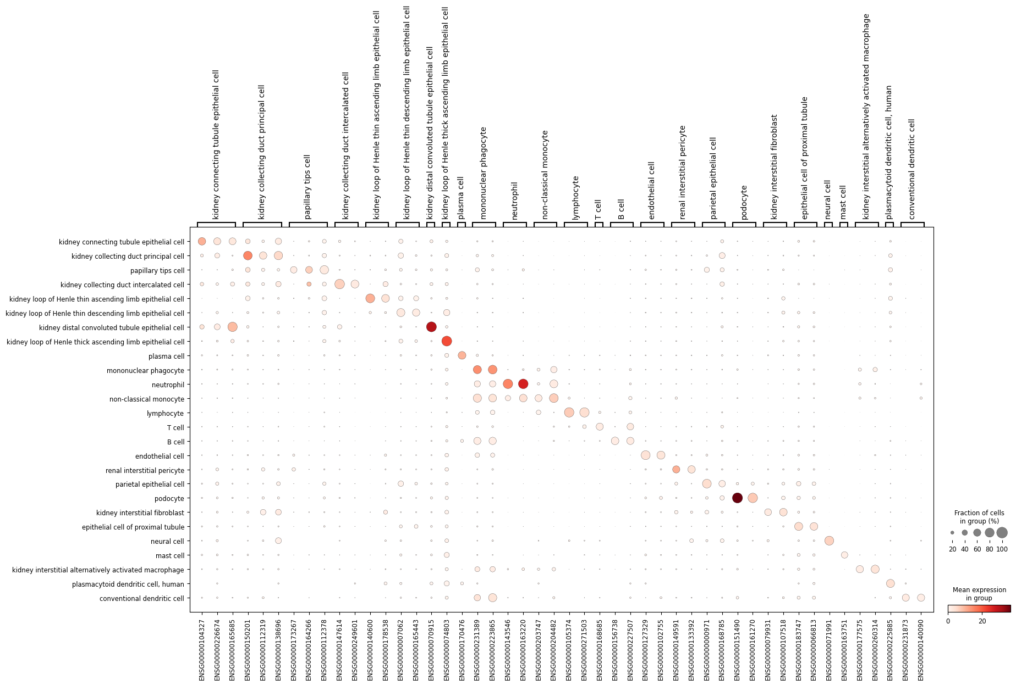
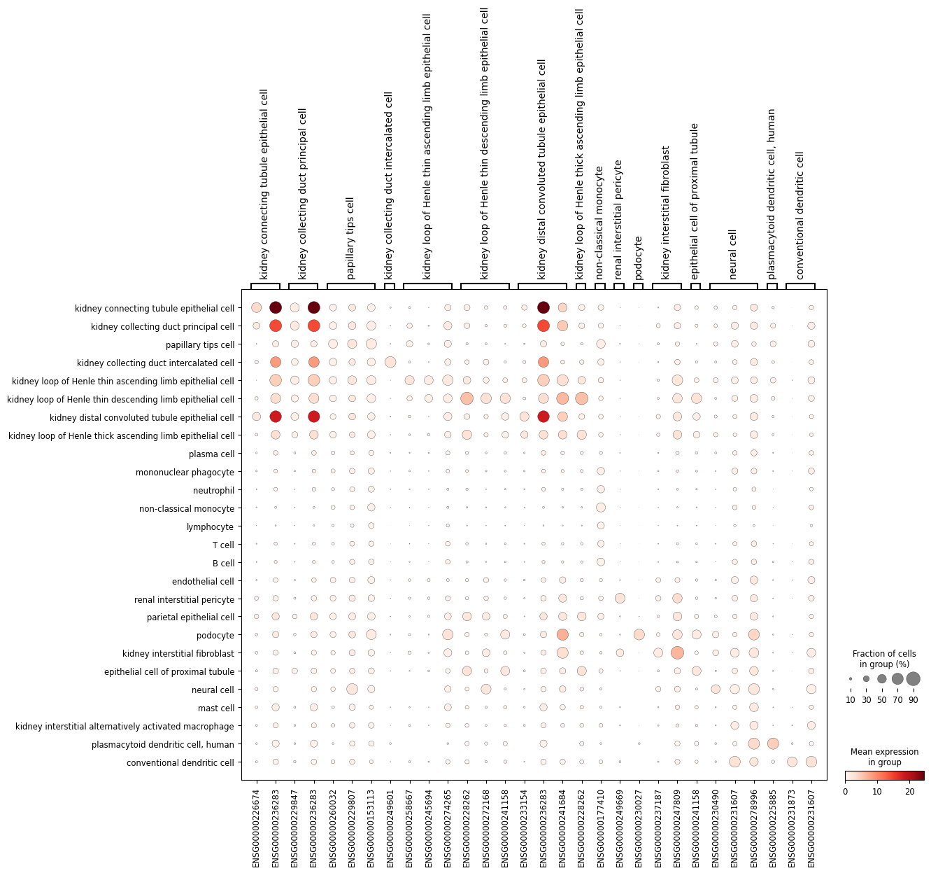
Dot Plot
All Genes
lncRNA

Slide 23
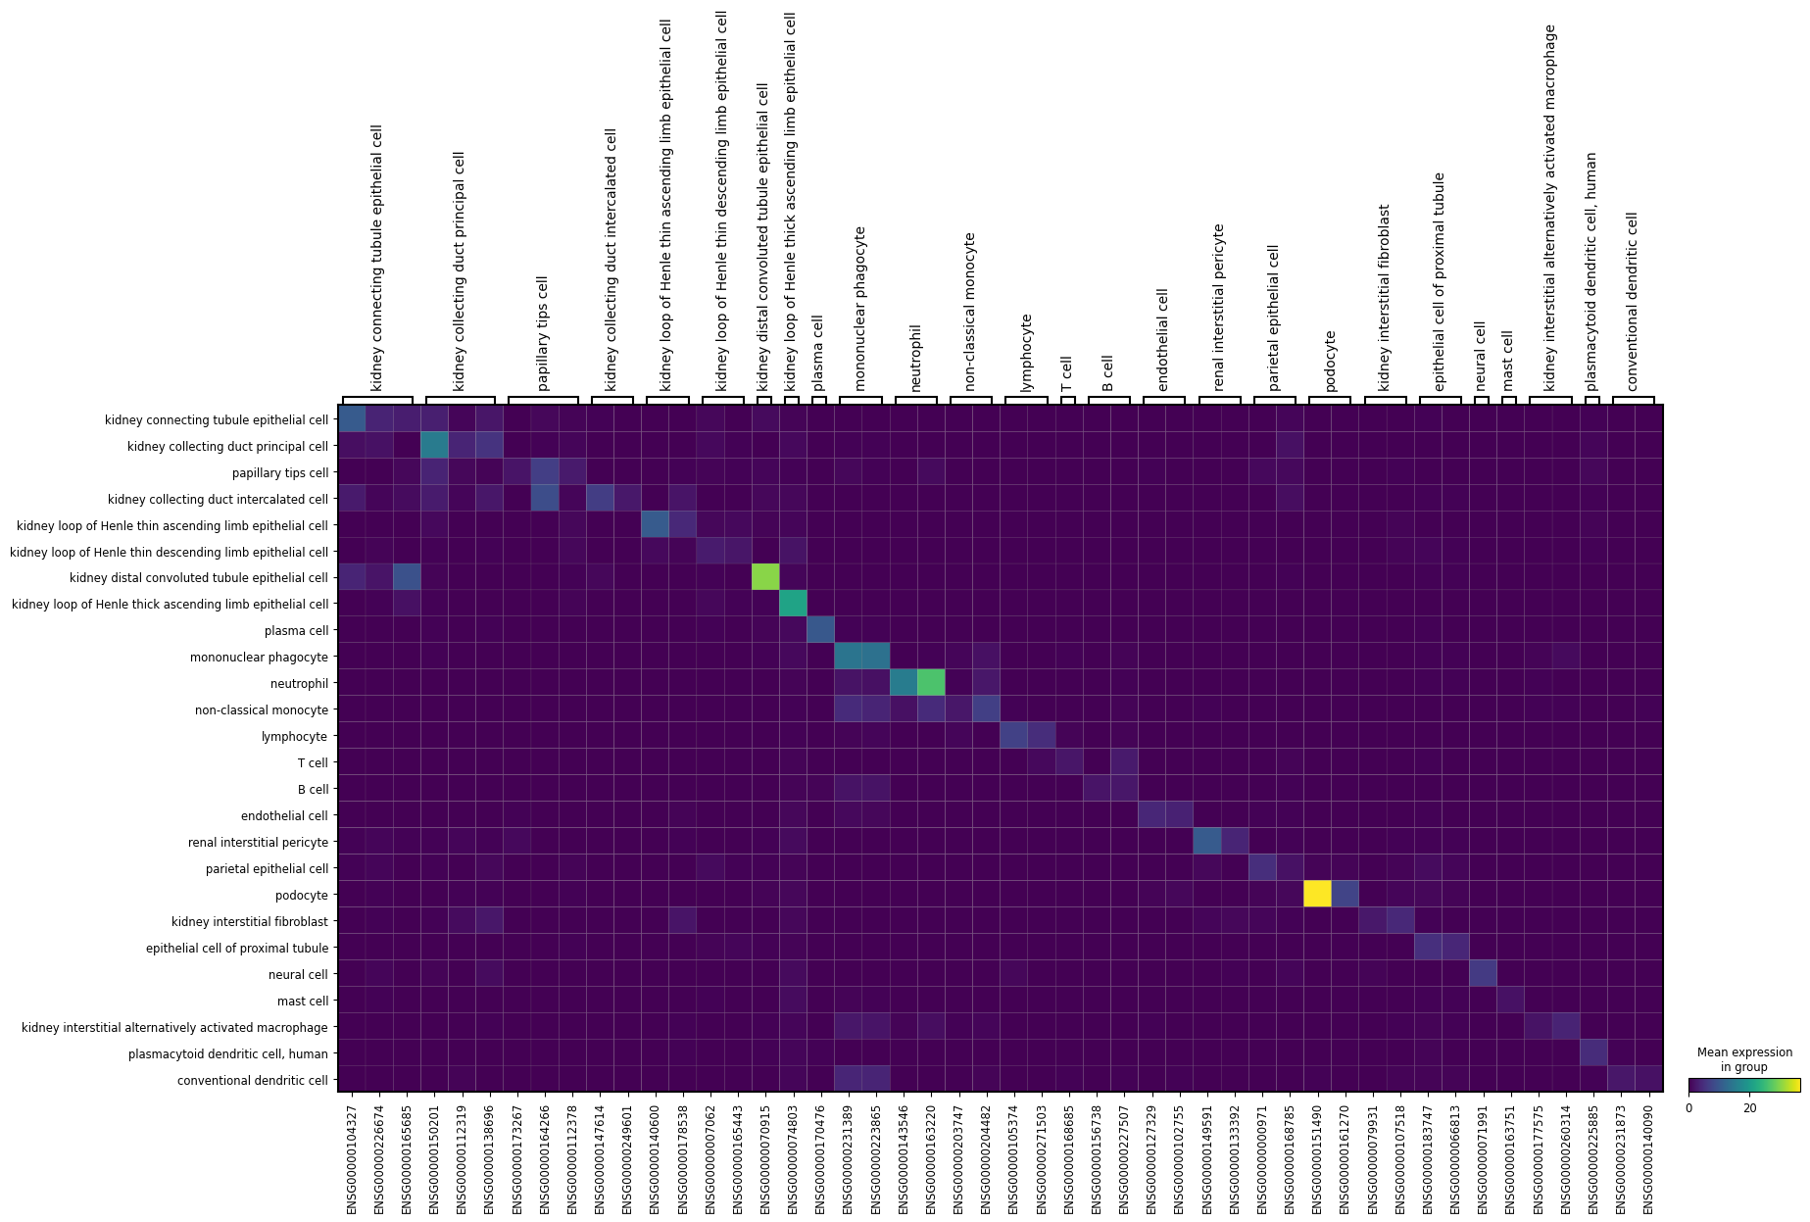
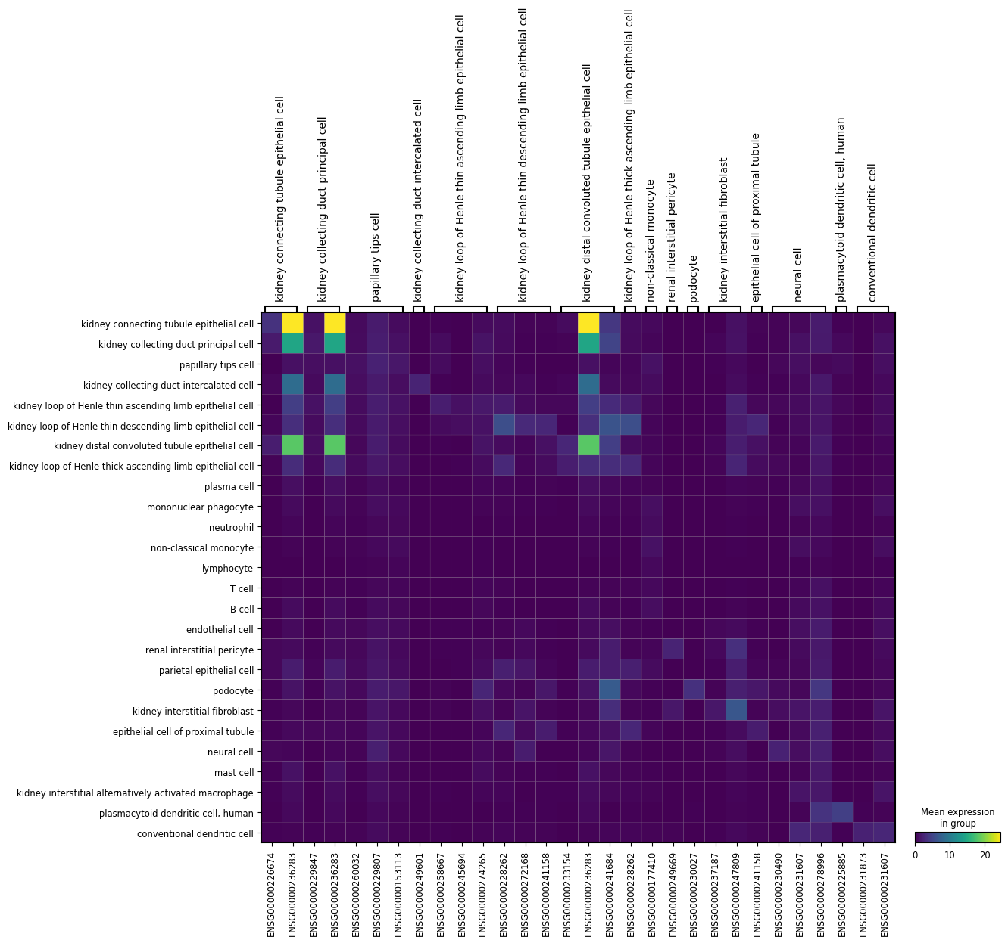
Heat Map
All Genes
lncRNA

Slide 24


Box Plot
All Genes
lncRNA

Slide 25
Future directions.

Slide 26
Run without down-sampling (likely need Biowulf).
Calculate ratio of the median number of passed genes per cluster from full to lncRNA subset for full and subset.
n (genes passed to NS forest) : N (all genes in data)
Examine clusters that had small amount or no lncRNAs pass the threshold versus those that did.
Run coding RNA or complement to lncRNA subset to see lncRNA contribution to full cluster median and binary score distributions.
Run on other neural and non-neural related organs.
See if any markers we found (or missed) are experimentally validated.
Test marker evaluation on experimentally validated markers for retinal cell types.
lncRNA biomarkers more commonly validated for disease :[

