Slide 1

Journal Club: "Redefining normal breast cell populations using lncRNAs” (Bitar et al., 2023)
Vik Becker
National Library of Medicine (NIH)

Slide 2
Overview
Why is “Transcriptional Waste” a Problem?
Key Background Information
Materials and Methods
Relevance of Key Results
What the Future Holds

Slide 3
Why is "Transcriptional Waste” a Problem?

Slide 4
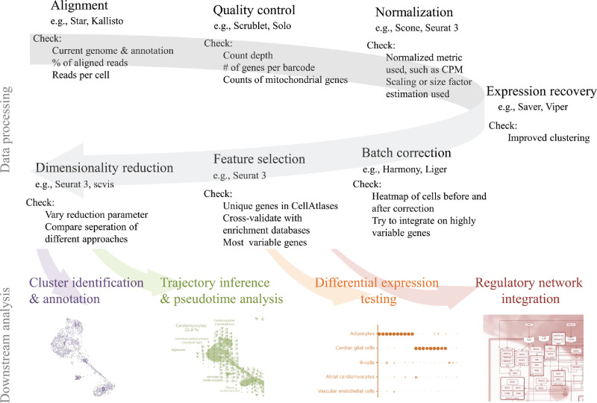
The Problem: scRNA-seq pipelines are built on a “protein-coding bias” where reads that don’t map to annotated regions are lost in analysis.
Massive loss of meaningful data!
EX: In this study., ~75% (over 13,600!) of the recovered lncRNAs were previously unannotated and would’ve been discarded in a standard run.
Annotations prioritize coding genes, which are generally more abundant and have clearer ORFs than the less-conserved lncRNAs.
Wolfien et al. (2021) Single-Cell RNA Sequencing Procedures and Data Analysis.
Notes:
Figure or prettier representation of the classic scRNA workflow
How much unannotated RNA is thrown away in scRNA-seq runs?
Are bulk- and/or scRNA-seq technologies biased towards protein coding genes? Why? How much?
Are annotation technologies biased towards protein coding genes? Why? How much?

Slide 5
Key Background Information
Notes:
* Noncoding RNA
* lncRNA
* breast cancer cell types

Slide 6
Non-Coding RNA (ncRNA)
= transcriptional products that do not encode proteins.
Though it's estimated that ~75% of the human genome is transcribed, only ~1-2% is protein coding!
ncRNA initially considered an RNA processing byproduct.
Regulatory ncRNA Discovery Timeline:
1990: First human regulatory lncRNA, H19, identified.
2007: Encyclopedia of DNA Elements (ENCODE) project initiation.
2019: First FDA-approved diagnostic lncRNA biomarker.
Djebali et al. (2024) Landscape of transcription in human cells.
Chen et al. (2024) Small and long non-coding RNAs: Past, present, and future.
Notes:
To date, the human ENCyclopedia Of DNA Elements (GENCODE) database has cataloged over 20,000 lncRNA genes while other databases have estimated the existence of more than 100,000 human lncRNAs.
Chen et al
Only about 500-1500 lncRNAs have been functionally characterized (Poloni et al)
The introduction of additional copies of the H19 gene into transgenic mice led to prenatal lethality, indicating its critical role in development

Slide 7
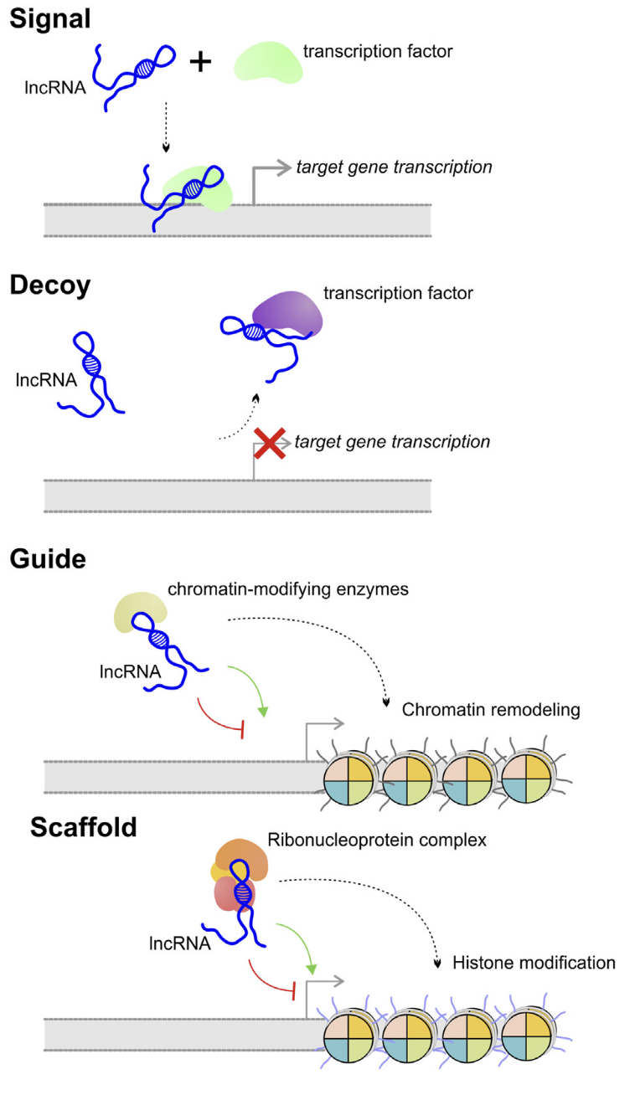
Long Non-Coding RNA (lncRNA)
= non-coding RNA transcripts greater than 200 nucleotides long.
Expression is often highly specific to context.
Major Functional Classes:
Signal = facilitate enhancer-promoter interactions through stabilizing chromatin loops.
Decoys = sequester miRNAs, mRNAs, or proteins.
Guides = recruit chromatin-modifying proteins to specific genomic loci in cis or in trans.
Scaffolds = assemble multiprotein regulatory complexes.
Difficult to annotate due to low sequence and evolutionary conservation and low expression levels.
Poloni et al. (2024) Localization is the key to action: regulatory peculiarities of lncRNAs. Figure 1(b). “Molecular function of lncRNAs.”
Notes:
Why is lncRNA difficult to annotate?

Slide 8
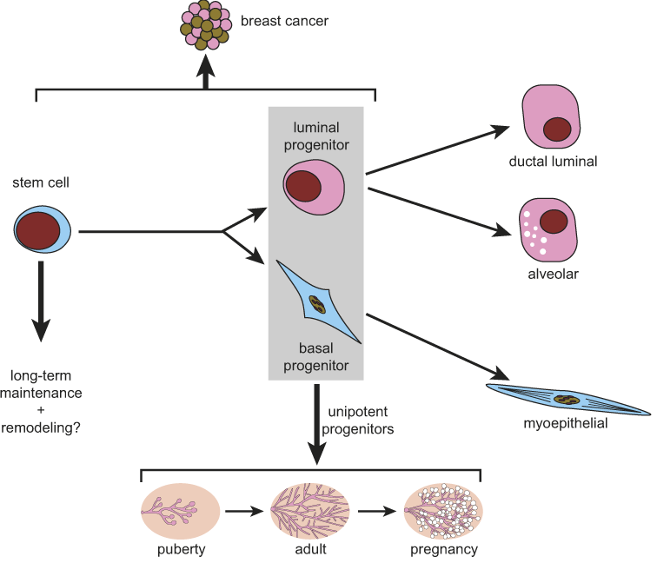
Human Breast Cells
EpCAM-hi CD49f-hi
3 main epithelial cell populations of the mammary gland:
Luminal Cells = secretory inner layer.
Generate (progenitor) milk secretory cells (mature).
Basal Cells = myoepithelial outer layer.
Contractile property enables milk expulsion.
Goal: Using lncRNAs to help resolve subpopulations that protein markers alone fail to distinguish.
EpCAM-hi CD49f-low
EpCAM-low CD49f-hi
Fu et al. (2024) Stem Cells and the Differentiation Hierarchy in Mammary Gland Development.
Graphical Abstract.
Notes:
Based on EpCAM and CD49f.
Humans have three distinct cell populations; mice have only two (basal and total luminal)
Basal are EpCAM-low, CD49f-hi
L. progenitor are EpCAM-hi, CD49f-hi
L. mature are EpCAM-hi, CD49f-low

Slide 9
Materials and Methods

Slide 10
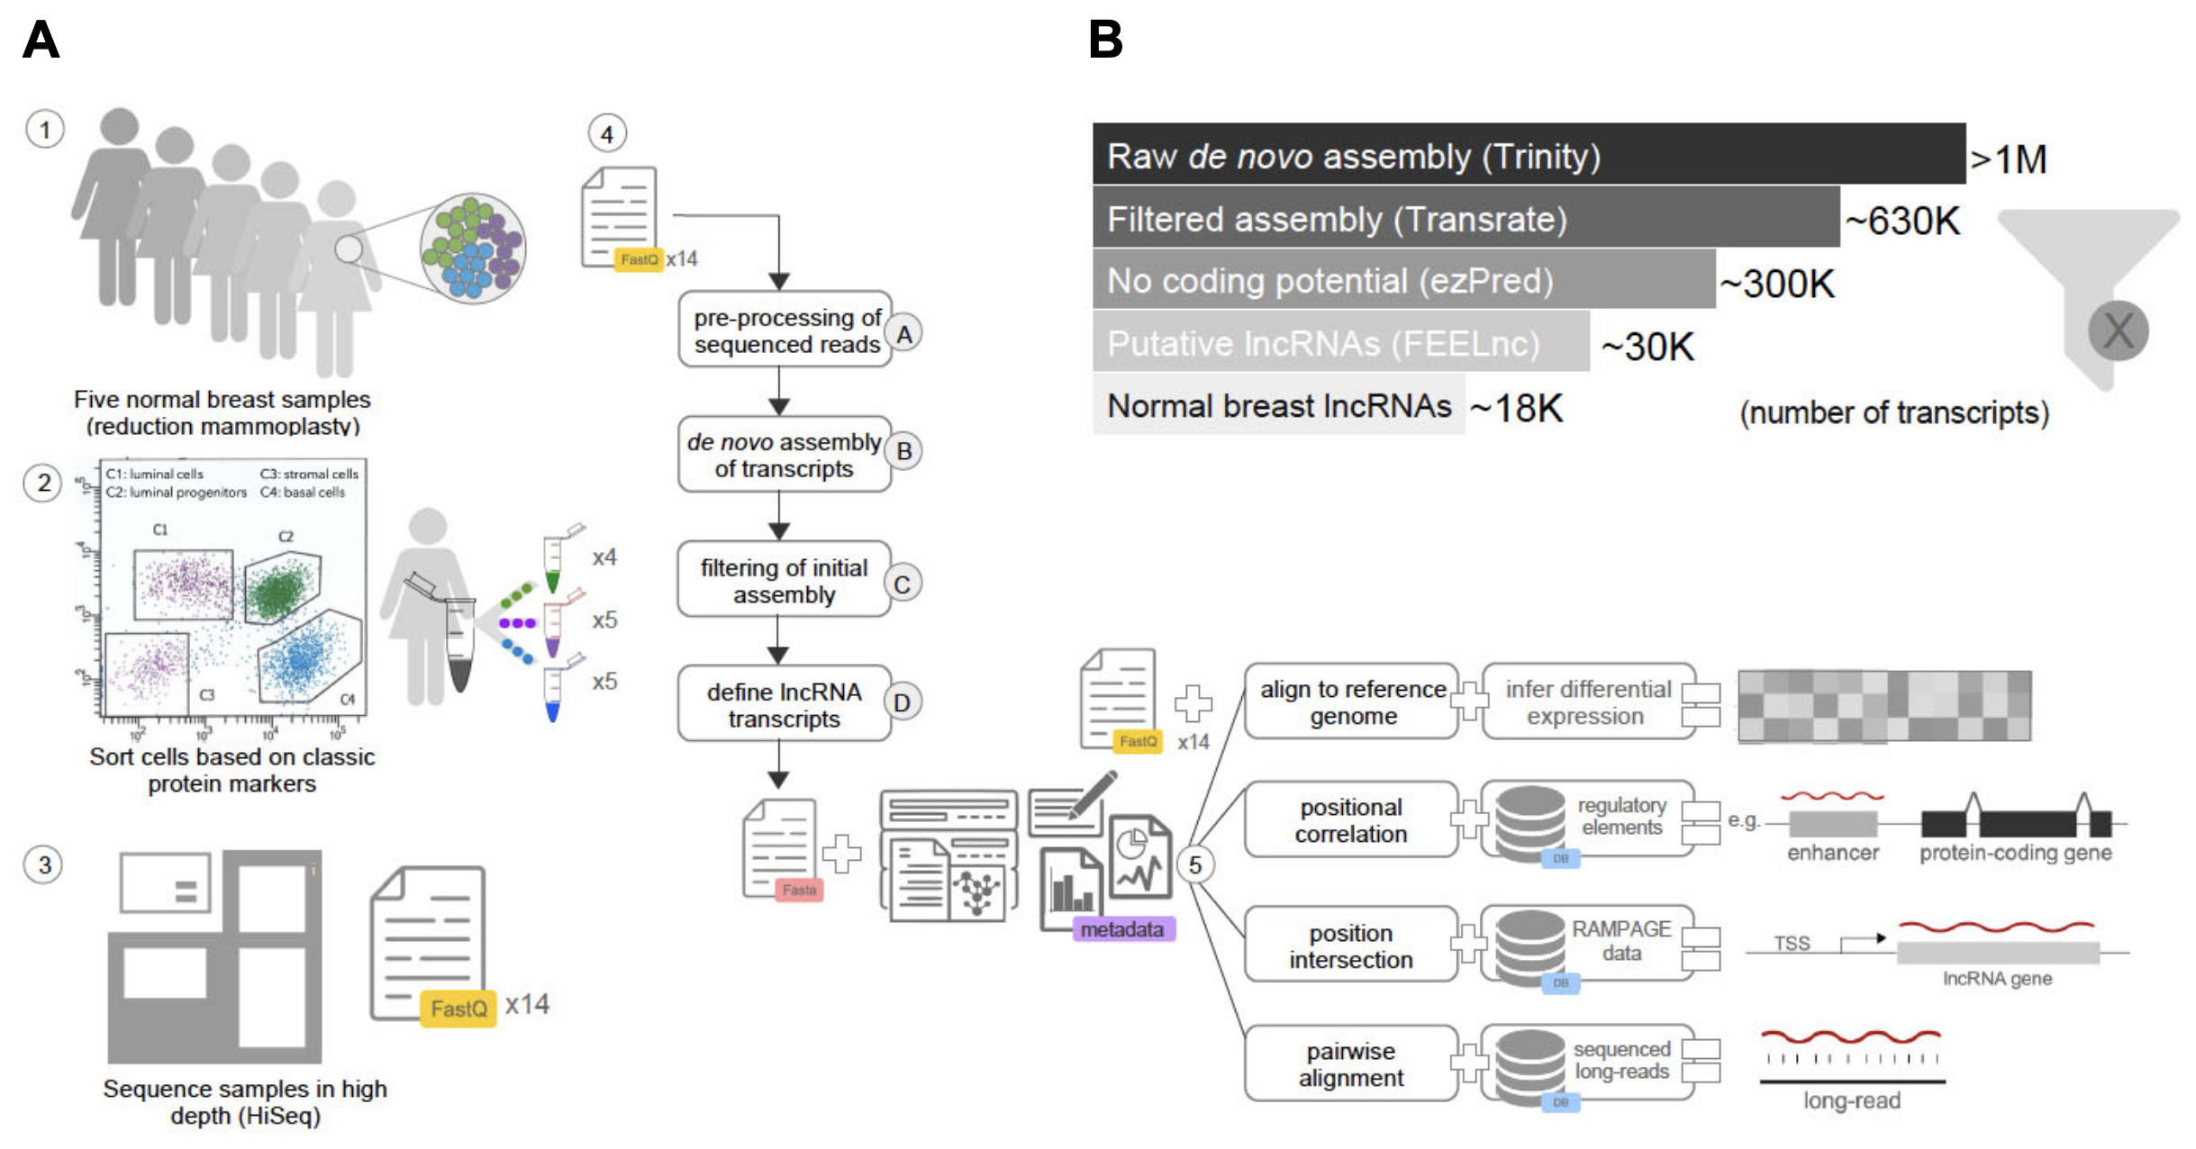
Identification of Normal Breast (NB) lncRNAs
Bitar et al. (2023) Redefining normal breast cell populations using long noncoding RNAs.
Figure 1(A-B). “Identification of NB-lncRNAs from human breast epithelium.”
Notes:
Samples collected and enriched for epithelial cell populations (exclude endothelial, hematopoietic, and leukocyte cells)
Sorted into the basal, luminal progenitor, and luminal mature cell types based on aforementioned EpCAM-CD49f markers
High depth sample sequencing on Illumina Novoseq 6000
Each sample yielded 30.6-67.3M read pairs (avg 49.9M)
Base call accuracy between 99.95% and 99.99%
Computational pipeline for lncRNA discovery from bulk RNA-seq based on de novo assembly (QC at each step)
Preprocess reads to remove containants (ex adapters/reads from ribosomal RNA) and asses low-freq k-mers correcting sequencing errors
De novo assembly of transcripts
High quality transcripts selected based on features like read support and base calling quality
Identification of non-coding transcripts and lncRNAs
4 programs run through ezLncPred v1.0 to predict coding potential of transcripts and FEELnc
Considered trasncripts with no doing potential detected by at least 2 different tools as positives
Transcripts aligned to GENCODE h38 reference genome with Minimap2 v2.16
Matches with minimumn overlap of 75% and on the same strand removed from final set of NB-lncRNAS, unless GENCODE transcript was annotated as a lncRNA. Same method used to intersect NB-lncRNAS with the in-house known lncRNA database.
Colocalized NB-lncRNAs with known enhancer elements, promoter regions, and terminal untranslated ends of annotated genes to provide first layer of functional annotation
According to metric defined in a 2019 benchmarking study, the pipeline performed >10% better than best-ranked assembly tool at the time. Didn’t have the time to look further into that.

Slide 11
Focus of predictive cell type improvement is on improving the quality/quantity of feature space, not algorithm development.
Assembly supported by validation steps (EX: Long-Read Sequencing and RAMPAGE data, RT-PCR) to reduce inclusion of invalid transcripts.
Constraints:
Cohort only consists of 5 individuals.
Identification of lncRNAs depends on transcript reconstruction, which is challenging given repetitive sequences prevalent in lncRNAs.
Used high-depth data from Fluidigm C1 (1.5M reads/cell); detection drops when transferred to 10x Genomics.
Notes:
Steps confirmed structural features for about 15% of total discovered lncRNAs, which the authors describe as consistent with other studies focusing on lncRNA systematic identification.
Validation for de novo assembly
RAMPAGE (RNA Annotation and Mapping of Promoters for the Analysis of Gene Expression) identifies TSSs. Study compared the 5’ ends of their assembled NB-lncRNAs against public RAMPAGE data from normal breast cells and in-house data from breast cancer cell lines.
RAMPAGE libraries aligned to reference genome supplemented with novel NB-lncRNA sequences
Confirmed TSS for 10% of discovered NB-lncRNAs
How it works: Long-reads allow researchers to see the entire exon-intron structure of a transcript in a single read, rather than relying on computational assembly to guess how short fragments connect.Bioinformatic process: Public long-read data from MCF7 and MCF10A cells, along with new data from SUM149 cells, were aligned to the NB-lncRNAs using BLAT. To account for the lower accuracy typical of long-reads, the authors required a minimum of 80% sequence identity and filtered for 70% reciprocal coverage.Validation Stat: This step confirmed the structural authenticity of 7% (1,310) of the NB-lncRNAs.
Reverse Transcription Polymerase Chain Reaction (RT-PCR) served as the final experimental "wet lab" confirmation to prove these transcripts existed in the actual tissue samples used in the study.
How it works: Total RNA was extracted from the same FACS-sorted populations (Basal, Luminal Progenitor, and Luminal Mature). This RNA was reverse-transcribed into cDNA, and primers specific to the novel NB-lncRNAs were used to amplify them.
Detection of low-abundance transcripts: Because lncRNAs are often expressed at very low levels, the authors performed 50 cycles of PCR to ensure even the rarest transcripts could be detected and visualized.
Validation Stat: The authors tested 30 candidate NB-lncRNAs, and 25 (83%) were successfully validated at their expected molecular sizes across the sorted cell populations.

Slide 12
Relevance of Key Results

Slide 13
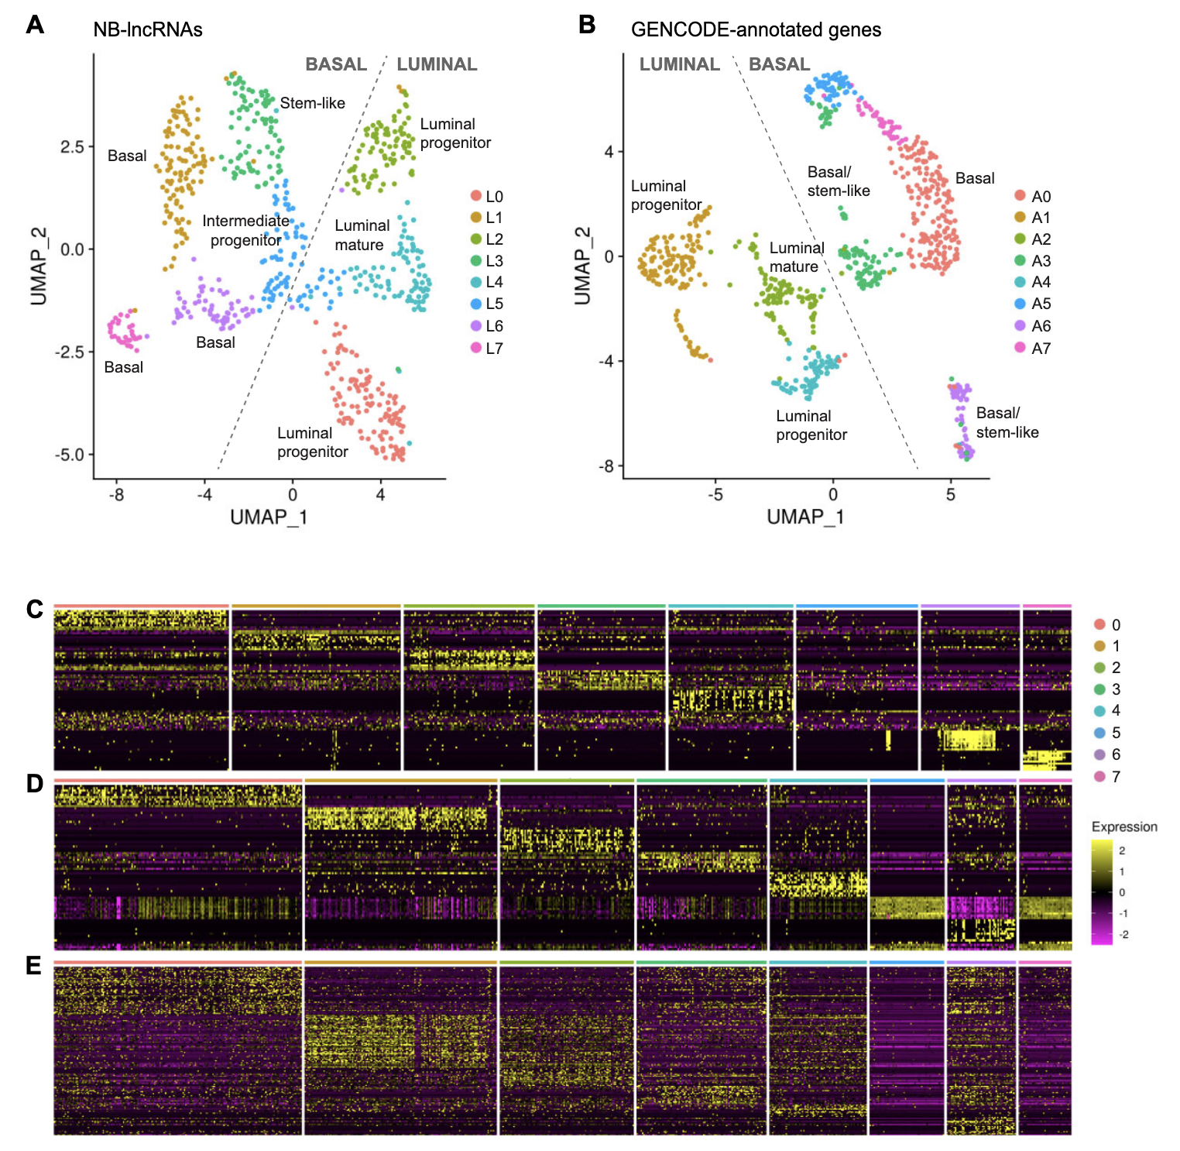
Population Resolution
UMAP of normal breast cells clustered by their NB-lncRNA expression (A) or GENCODE-annotated gene expression (B).
Heatmaps showing the top 10 assigned markers for each L-cluster (C) or A-Cluster (D).
Heatmap of assigned A-cluster markers previously reported in literature (E).
Bitar et al. (2023) Redefining normal breast cell populations using long noncoding RNAs.
Figure 3. “NB-lncRNAs and GENCODE-annotated genes can distinguish breast epithelial cell types.”
Notes:
To explore the ability of NB-lncRNAs to distinguish normal breast cell subpopulations, we quantified the expression of NB-lncRNAs using published scRNAseq data of 867 cells from three donors, with >1.5M reads per cell (6). Using flow cytometry, Nguyen et al. sorted cells from the luminal and basal populations before performing scRNAseq (File S4). On average, each cell expressed close to 900 NB-lncRNAs, with over one-third expressing at least 1000 NB-lncRNAs.
Figure Description:
NB-lncRNAs and GENCODE-annotated genes can distinguish breast epithelial cell types. (A) Uniform manifold approximation projection (UMAP) of normal breast cells, clustered based on NB-lncRNAs expression, quantified on Fluidigm scRNAseq data (L-clusters). Cells are color-coded for clusters, which are numbered according to cell counts. (B) UMAP of normal breast cells, clustered based on GENCODE-annotated gene expression, quantified on Fluidigm scRNAseq data (A-clusters). (C) Heatmap showing the top ten Seurat-assigned markers for each L-cluster. (D) Heatmap showing the top ten Seurat-assigned markers for each A-cluster. (E) Heatmap showing Seurat-assigned markers for A-clusters previously reported in the literature.
Cell set from published scRNAseq data of 867 cells from three donors, with >1.5M reads per cell (6). Using flow cytometry, Nguyen et al. sorted cells from the luminal and basal populations before performing scRNAseq (File S4). On average, each cell expressed close to 900 NB-lncRNAs, with over one-third expressing at least 1000 NB-lncRNAs
Eight clusters were obtained after filtering, normalizing and clustering cells with Seurat
Annotations from prior described biomarkers
Basal vs luminal cluster label given if >70% of cells in cluster having that label
L stands for lncRNA, A stands for Annotated
Clustering cells using only NB-lncRNA expression (L-clusters) successfully replicated the primary Basal and Luminal divisions.
L-clusters showed high correspondence with standard FACS labels and A-cluster identities.
Non-coding transcriptome alone contains sufficient signal to define tissue-level cell types.

Slide 14
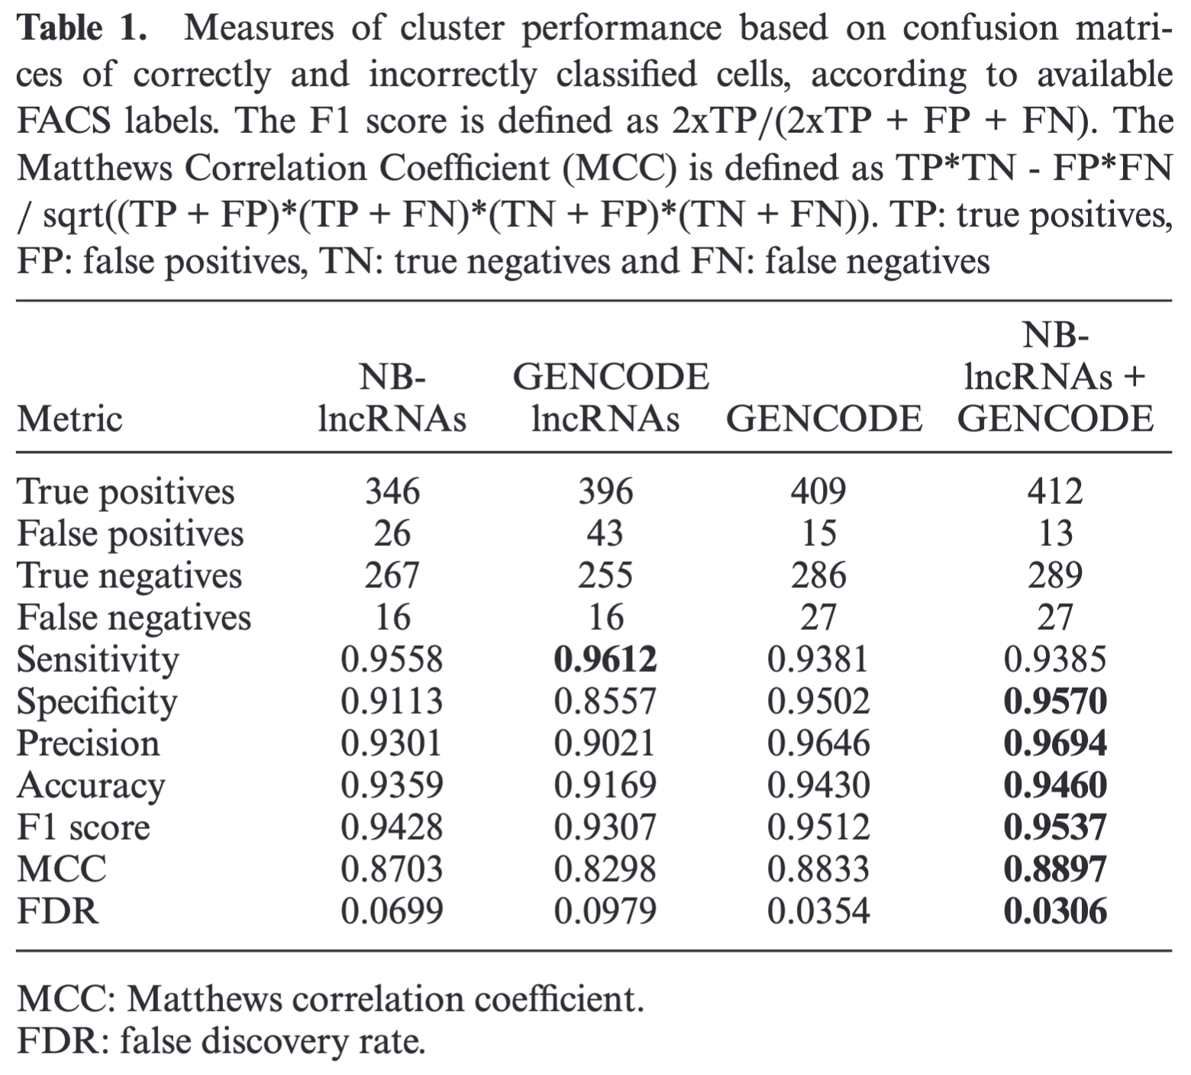
Predictive Cluster Performance
The NB-lncRNA set alone is effectively able to resolve the major breast epithelial cell types.
NB-lncRNA set outperformed GENCODE set in all metrics except sensitivity.
Combining NB-lncRNA with GENCODE set reached overall highest metrics.
Bitar et al. (2023) Redefining normal breast cell populations using long noncoding RNAs.
Table 1. “Measures of cluster performance.”
Notes:
The Metrics: NB-lncRNAs achieved 0.95 sensitivity and 0.91 specificity relative to FACS labels.
Comparison: NB-lncRNAs performed better at resolving cell types than previously annotated GENCODE lncRNAs (0.91 vs 0.85 specificity).
Why it matters: It validates the technical necessity of de novo annotation; standard "off-the-shelf" lncRNA databases are insufficient for high-resolution phenotyping.
NB-lncRNAs achieved a sensitivity of 0.9558 and a specificity of 0.9113 relative to standard FACS labels, effectively resolving the major breast epithelial cell types.
The novel NB-lncRNA set outperformed "off-the-shelf" GENCODE-annotated lncRNAs in nearly all metrics, including a higher Matthews Correlation Coefficient (0.87 vs 0.83), proving that tissue-specific discovery is required for high-resolution phenotyping.
Combining NB-lncRNAs with standard protein-coding genes reached the highest overall accuracy (0.9460) and precision (0.9694), suggesting that the non-coding transcriptome provides a complementary layer of biological information.

Slide 15
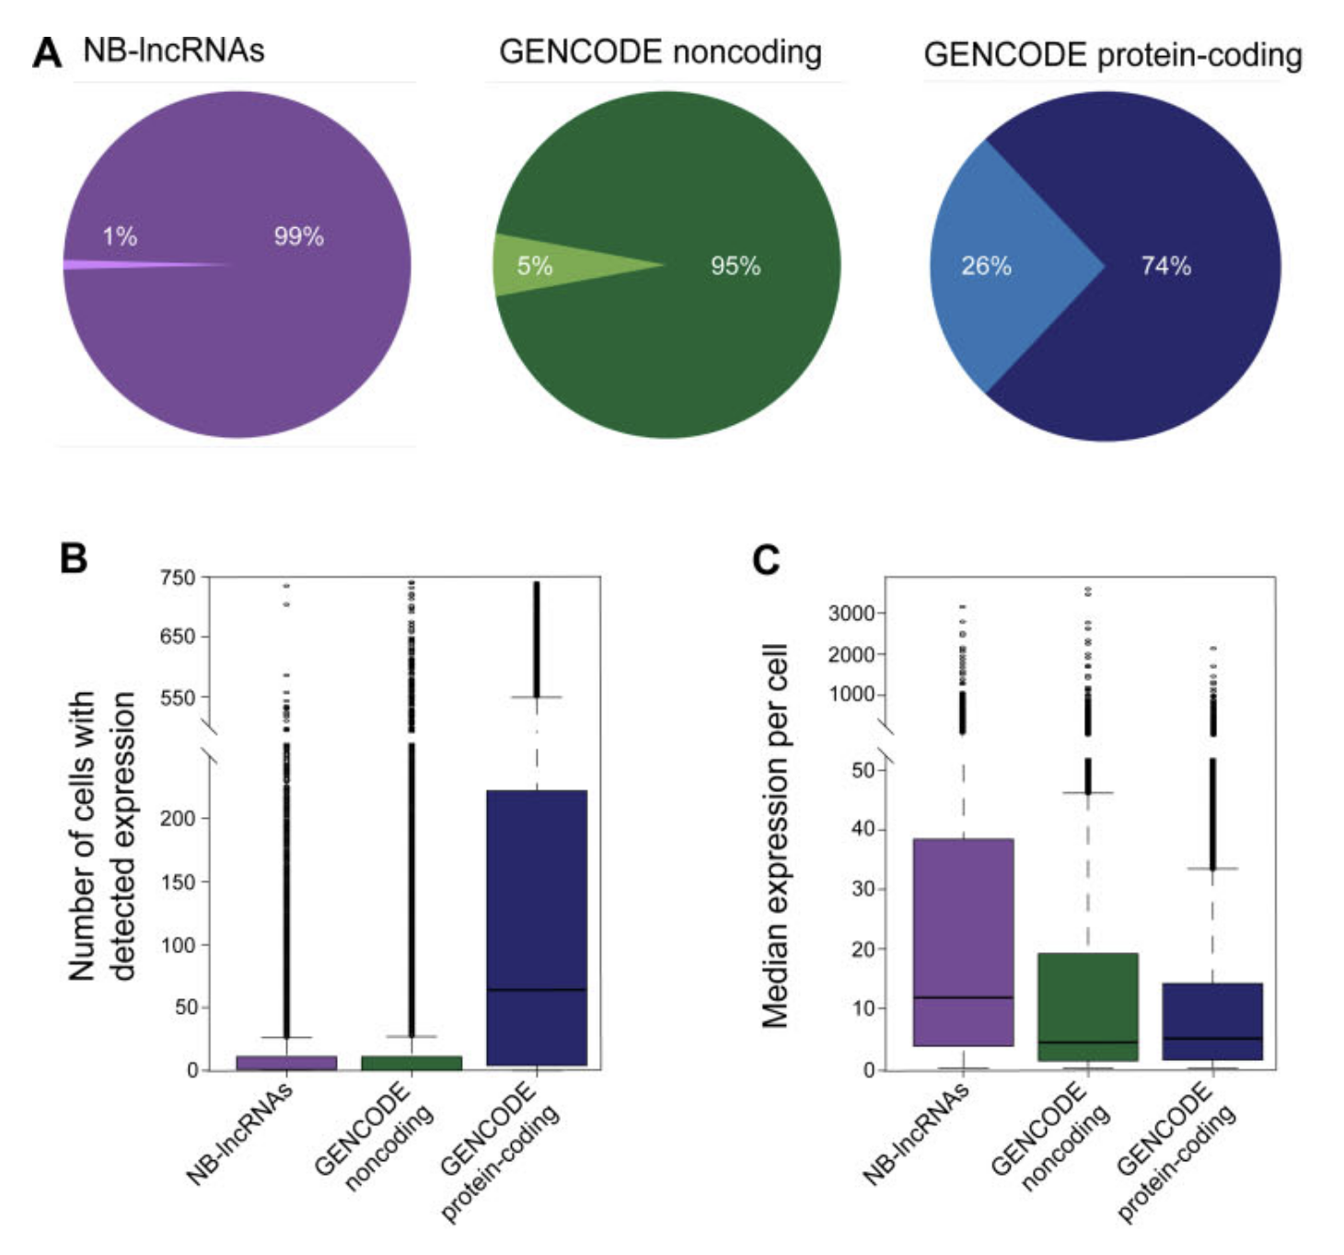
Compartmentalized Expression
(A): The proportion of genes with…
…restricted expression pattern (dark).
…widespread expression pattern (light).
(B): Number of cells where genes are expressed.
(C): Median expression of genes per cell when detected.
Bitar et al. (2023) Redefining normal breast cell populations using long noncoding RNAs.
Figure 5(A-C). “NB-lncRNAs have compartmentalized expression levels, which are higher at cell-level.”
Notes:
The Finding: NB-lncRNAs are "restricted but robust." Only <1% of NB-lncRNAs are widespread (in >1/3 of cells), compared to 26% of protein-coding genes.
Cellular Abundance: However, in the cells where they are detected, NB-lncRNAs have a median expression level nearly twice that of protein-coding genes (p < 1.9e−06).
Why it matters: This restricted/robust pattern makes them ideal "binary" markers for identifying rare or specific cell states.
NB-lncRNAs exhibit an "exquisite" restricted expression pattern; only <1% are widespread (detected in >1/3 of cells), compared to 26% of standard protein-coding genes.
On average, a specific NB-lncRNA is detected in only ~15 cells out of a 741-cell dataset, whereas protein-coding genes are detected in ~140 cells.
Despite being expressed in far fewer cells, NB-lncRNAs have a median expression level nearly twice that of protein-coding genes within those specific cells (p < 1.9e−06).
This "restricted but robust" profile makes tissue-specific lncRNAs ideal high-resolution, binary markers for identifying rare cell populations or specific states.

Slide 16
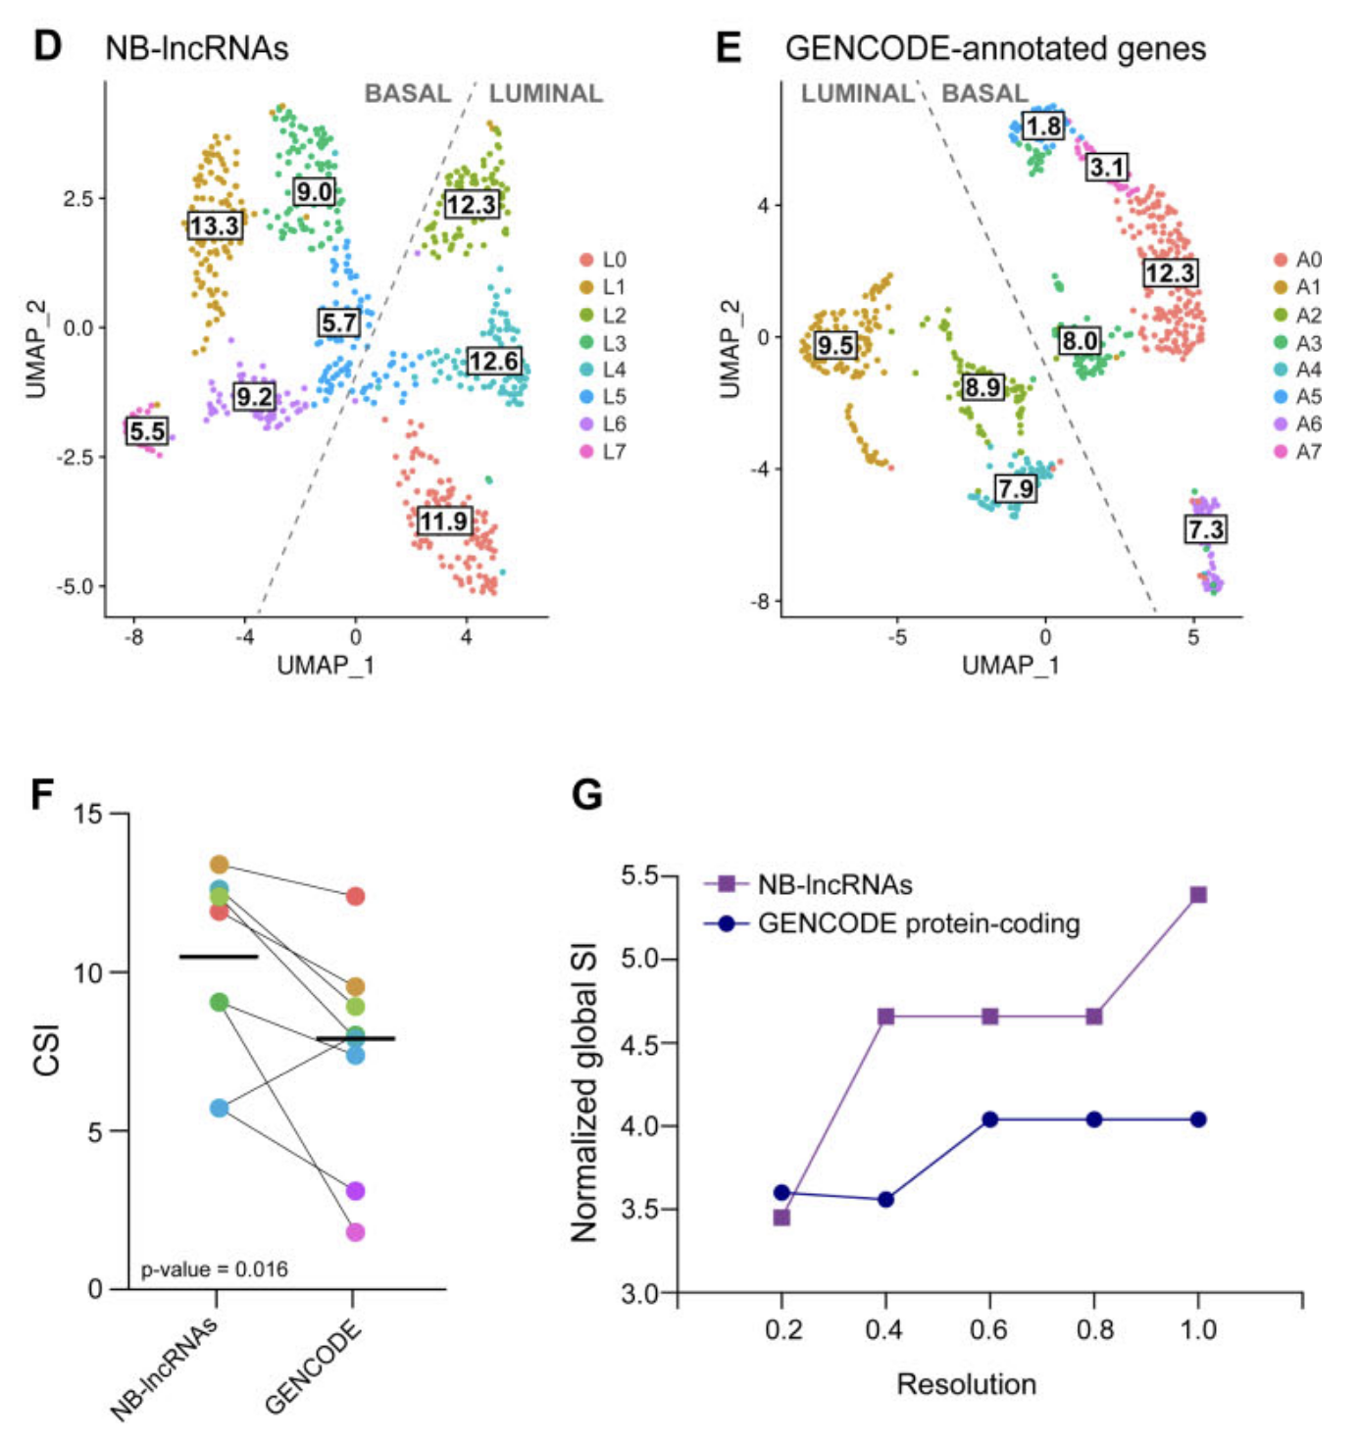
Superior CSI
UMAP with normal breast cell clusters based on NB-lncRNA (D) or GENCODE (E) with Cluster Specificity Index (CSI) labelled.
(F): CSI difference for the corresponding clusters in (D) and (E).
Bold horizontal lines mark the average CSI for each gene set.
(G): Increase in normalized global SI levels (averaged CSIs), as resolution parameter is increased.
Bitar et al. (2023) Redefining normal breast cell populations using long noncoding RNAs.
Figure 5(D-G). “NB-lncRNAs have compartmentalized expression levels, which are higher at cell-level.”
Notes:
The Cluster Specificity Index (CSI) for lncRNA-based clusters (L-clusters) was significantly higher than for protein-coding clusters (A-clusters) (p = 0.016).
As clustering resolution increases, the global specificity of NB-lncRNAs grows by 59%, while the specificity of protein-coding genes only improves by 11%.
Protein-coding markers tend to "wash out" at high resolutions, whereas lncRNAs allow researchers to subdivide the heterogeneous basal population into three distinct states (L1, L6, L7) that standard markers cannot resolve.
For resolution, higher values correspond to larger number of communities and vice cersa.
Figure 5. NB-lncRNAs have compartmentalized expression levels, which are higher at cell-level. (A) Proportion of NB-lncRNAs (purple) or GENCODEannotated noncoding (green) or protein-coding (blue) genes with restricted (darker) versus widespread (lighter) expression patterns. (B) Boxplot of the number of cells in which NB-lncRNAs (purple) or GENCODE-annotated noncoding (green) or protein-coding (blue) genes are expressed, from the total 741 cells. On average, NB-lncRNAs are expressed in ∼15 cells, GENCODE-annotated noncoding genes in ∼30 cells and GENCODE-annotated protein coding genes in ∼140 cells. (C) Boxplots of the median expression of NB-lncRNAs (purple) or GENCODE-annotated noncoding (green) or protein-coding (blue) genes per cell (in TPMs), showing NB-lncRNAs have higher cell-level expression. (D) UMAP showing normal breast cell clusters obtained based on NB-lncRNA gene expression (L-clusters), with their corresponding cluster specificity index (CSI). (E) UMAP showing normal breast cell clusters obtained based on GENCODE-annotated gene expression (A-clusters), with their corresponding CSI.
(F) Dotplots showing the difference in CSI for corresponding clusters in ‘D’ and ‘E’. Dots were colored according to the represented L-cluster or A-cluster, bold horizontal lines mark the average CSI for each gene set and the p-value (0.016; Fisher’s exact test) shows the difference was significant.
(G) Increase in normalized global SI levels, obtained as the normalized average of the CSIs of all clusters, as resolution is increased.

Slide 17
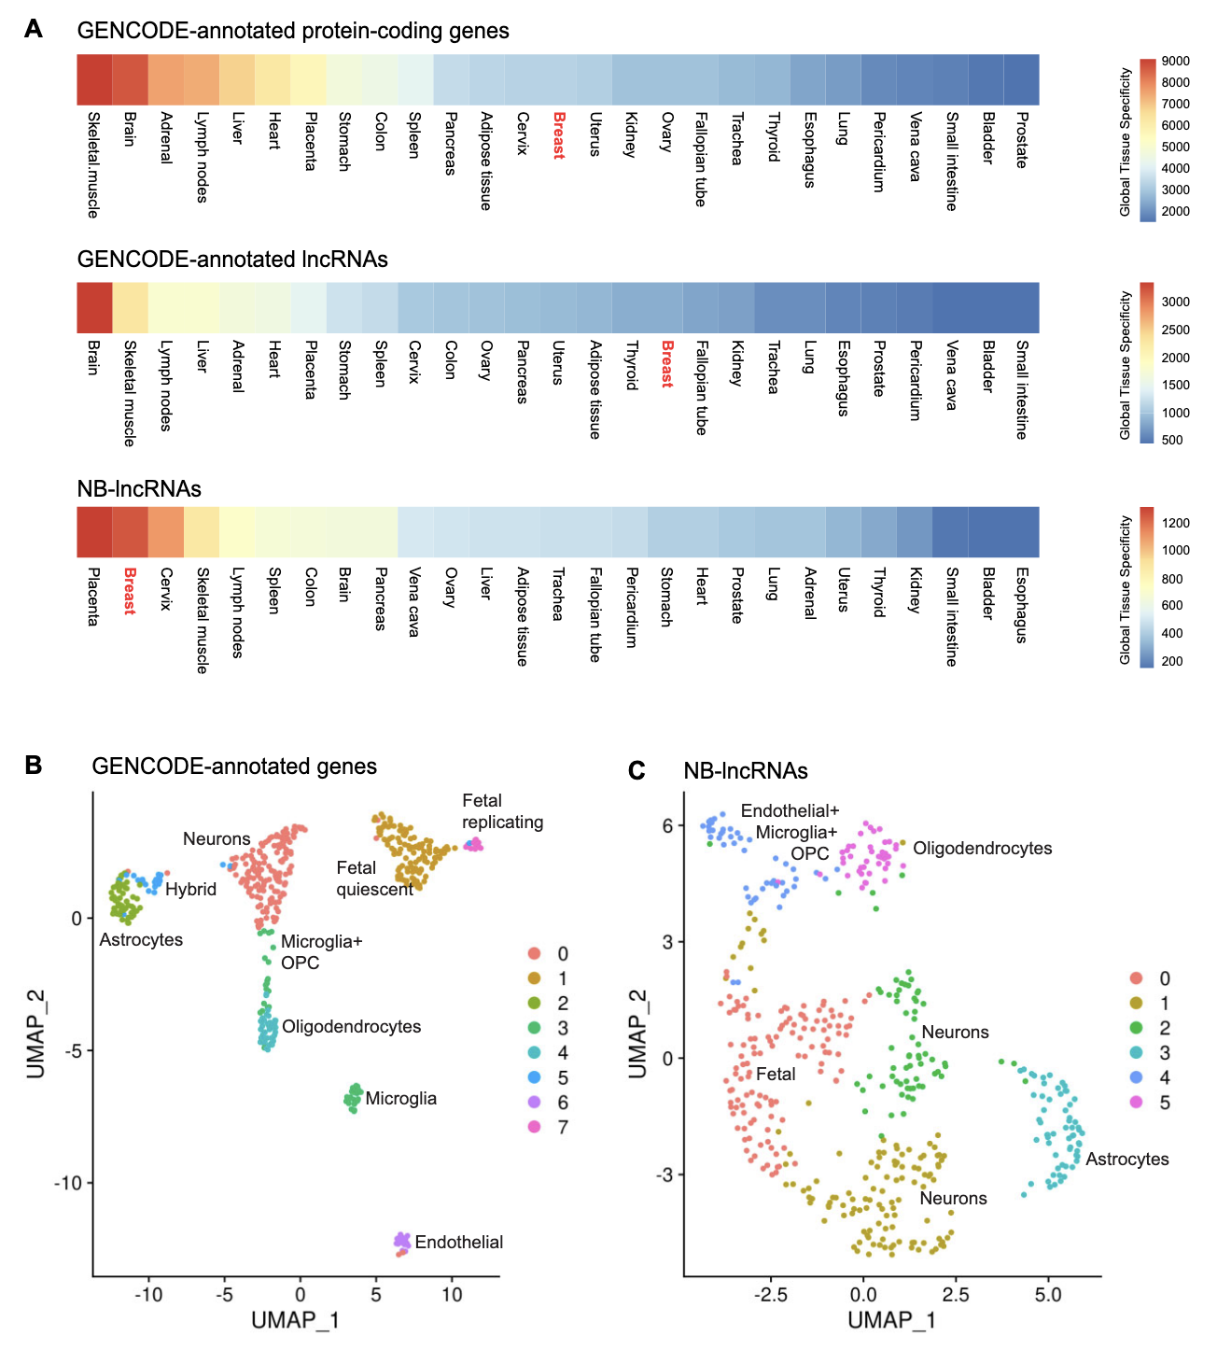
lncRNA Tissue Specificity
(A): Global tissue specificity of genes across 27 human tissues.
UMAP of cells from a healthy human brain based on GENCODE genes expression (B) or NB-lncRNAs (C).
Clusters labelled based on known biomarkers of the represented brain cell types.
LncRNAs (both GENCODE and NB-lncRNAs) demonstrate increased specificity in tissue type compared to coding genes.
Bitar et al. (2023) Redefining normal breast cell populations using long noncoding RNAs.
Figure 6. “NB-lncRNAs cannot identify human brain cell types.”
Notes:
The Findings: When breast-specific NB-lncRNAs were used to cluster healthy human brain cells, they failed to unambiguously discern microglia or OPCs.
Conclusion: lncRNA identity is exquisitely tissue-specific (Figure 6A).
Why it matters: This provides a warning for bioinformatics pipelines: you cannot use a universal lncRNA list for all scRNA-seq. Discovery must be performed a priori for each new tissue.
lncRNA identity is exquisitely tissue-specific; calculated tau indices show NB-lncRNAs have significantly higher global tissue specificity than protein-coding genes across 27 human tissues.
When breast-specific NB-lncRNAs were used to cluster cells from a healthy human brain, they failed to unambiguously discern standard brain cell types like microglia or oligodendrocyte precursors (OPCs).
The resulting brain UMAP shows mixed clusters that lack clear protein-marker correspondence, providing a critical warning that lncRNA discovery must be performed a priori for every new tissue type being studied.
Figure 6. NB-lncRNAs cannot identify human brain cell types. (A) Global tissue-specificity of annotated protein-coding genes (top), annotated lncRNAs (middle) and NB-lncRNAs (bottom) across 27 human tissues. The tissue-specificity was summarized by calculating the tau index of every transcript in each set and counting the number of occurrences where each tissue had the highest tau overall.
(B) UMAP of normal breast cells, clustered based on GENCODE-annotated gene expression, quantified on Fluidigm scRNAseq data. Cells are color-coded for clusters, which are numbered according to cell counts.
(C) UMAP of normal breast cells, clustered based on NB-lncRNAs expression, quantified on Fluidigm scRNAseq data. Clusters were labeled based on the information provided in (35) and known protein-coding markers of the represented brain cell types.

Slide 18
What the Future Holds

Slide 19
Progress Since Publication (2023-2026)
Recent expansion of lncRNA annotations through the GENCODE CLR sequencing project (Perteghella et al., 2026).
Rapid development of features and methods to identify lncRNA and their associated proteins/transcripts (Gao et al., 2025)
RNA-targeting CRISPR-Cas13 screens have identified 788 essential lncRNAs across five human cell lines (Liang et al., 2026).
Author et al. (xxxx) Title.
Notes:
Should have both general and specific to group’s interests (cell phenotyping, cell type representation, cell type biomarker discovery)

Slide 20
Future Directions (2026-)
Numerous lncRNAs still require annotation and validation.
Majority of studies emphasize lncRNAs as disease biomarkers, rather than their roles in healthy cell states or differentiation potential.
Rather than depending on fixed gene sets for cell-type exploration, scRNA-seq workflows should incorporate tissue-specific lncRNA identification as a preprocessing step.
Integration of tissue-specific lncRNA spatial analysis to see how localization effects tissue structure.
Author et al. (xxxx) Title.
Notes:
Standardizing the Pipeline: We need to incorporate tissue-specific lncRNA discovery as a pre-processing step for all scRNA-seq, rather than relying on static gene sets.
Healthy Cell Type Biomarkers: Most literature focuses on disease; there is a critical need for lncRNA biomarkers that define healthy cell states and differentiation roots.
Multi-omic Integration: The next step is integrating these lncRNA maps with spatial transcriptomics to see how non-coding localization drives tissue architecture (Poloni et al., 2024).

Slide 21
Thank you!

Slide 22
Bibliography
Bitar M, Rivera IS, Almeida I et al. Redefining normal breast cell populations using long noncoding RNAs. Nucleic Acids Res 2023;51(12):6389–410. https://doi.org/10.1093/nar/gkad339.
Chen LL, Kim VN. Small and long non-coding RNAs: Past, present, and future. Cell 2024;187(23):6451–85. https://doi.org/10.1016/j.cell.2024.10.024.
Djebali S, Davis CA, Merkel A et al. Landscape of transcription in human cells. Nature 2012;489(7414):101–8. https://doi.org/10.1038/nature11233.
Fu NY, Nolan E, Lindeman GJ et al. Stem Cells and the Differentiation Hierarchy in Mammary Gland Development. Physiological Reviews 2020;100(2):489–523. https://doi.org/10.1152/physrev.00040.2018.
Gao Y, Takenaka K, Xu SM et al. Recent advances in investigation of circRNA/lncRNA-miRNA-mRNA networks through RNA sequencing data analysis. Brief Funct Genomics 2025;24:elaf005. https://doi.org/10.1093/bfgp/elaf005.
Liang WW, Mueller SJ, Hart SK et al. Essential lncRNAs in the human transcriptome. Cell Genomics 2026;0(0). https://doi.org/10.1016/j.xgen.2026.101253.
Perteghella T, Kaur G, Carbonell-Sala S et al. The GENCODE CLS project: massively expanding the lncRNA catalog through capture long-read RNA sequencing. Preprint, bioRxiv, 21 Jan. 2026, 2024.10.29.620654. https://doi.org/10.1101/2024.10.29.620654.
Poloni J de F, Oliveira FHS de, Feltes BC. Localization is the key to action: regulatory peculiarities of lncRNAs. Front Genet 2024;15. https://doi.org/10.3389/fgene.2024.1478352.
Scherrer K. Is RNA the working genome in eukaryotes? The 60 year evolution of a conceptual challenge. Experimental Cell Research 2023;424(1):113493. https://doi.org/10.1016/j.yexcr.2023.113493.
Wolfien M, David R, Galow AM. Single-Cell RNA Sequencing Procedures and Data Analysis. In: Helder I. N (ed.), Bioinformatics. Brisbane (AU): Exon Publications, 2021. http://www.ncbi.nlm.nih.gov/books/NBK569559/ (30 June 2026, date last accessed).

Slide 23
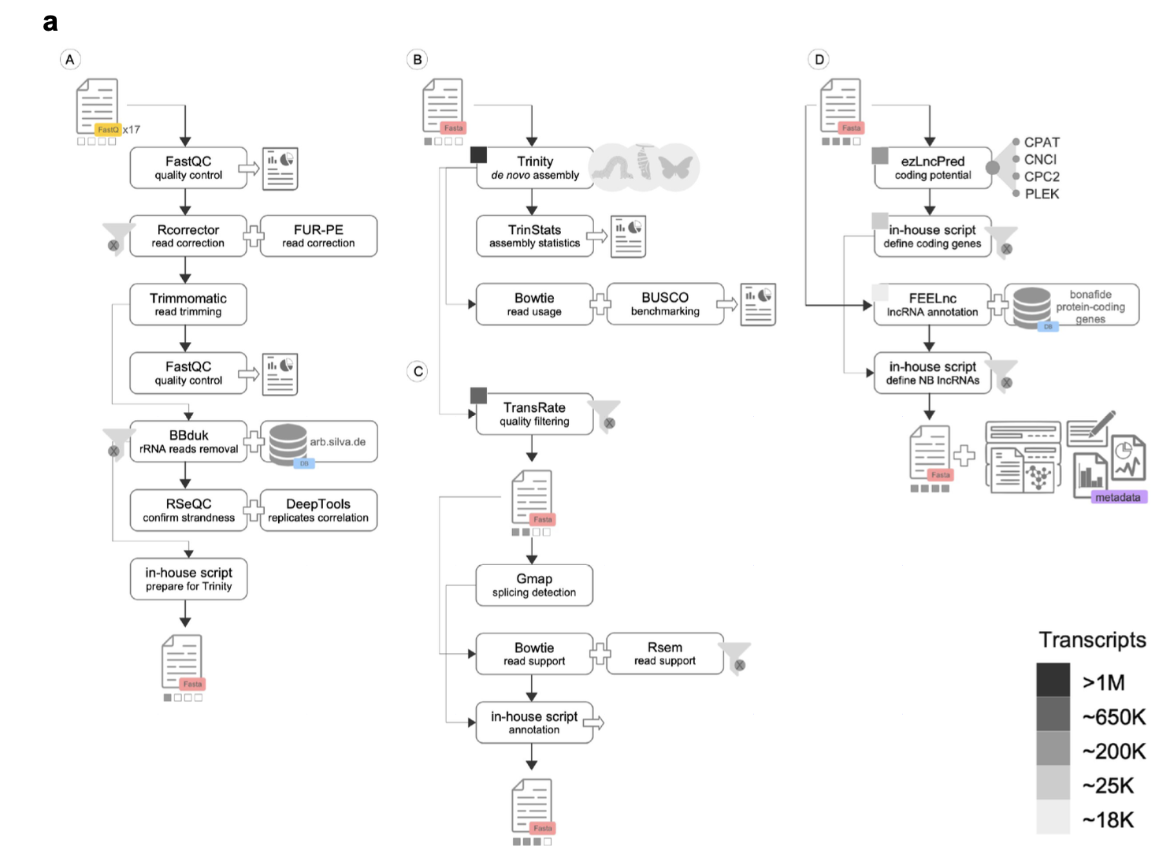
Computational pipeline for lncRNA discovery from bulk RNA-seq, based on de novo assembly
Bitar et al. (2023) Redefining normal breast cell populations using long noncoding RNAs.
Figure S1(A). “Computational pipeline for the identification of NB-lncRNAs.”
Notes:
Approximate number of transcripts left after each filtering routine shown as boxes in greyscale

Slide 24
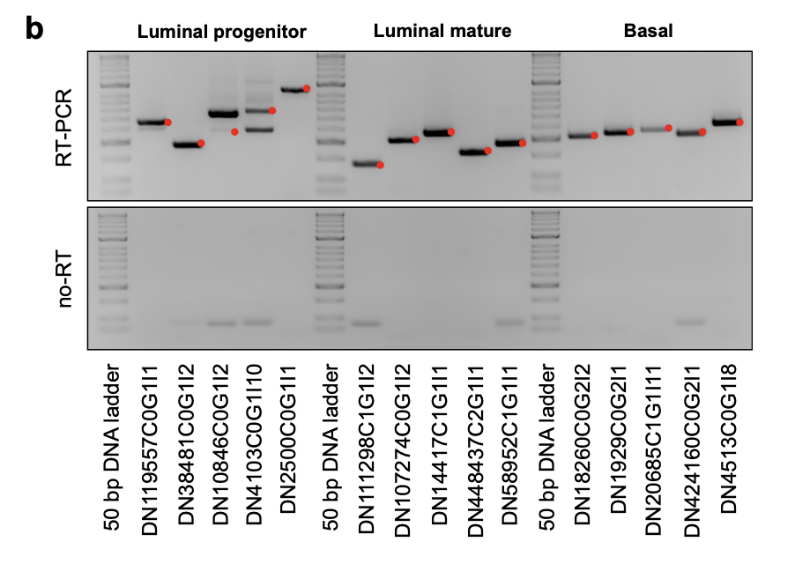
RT-PCR validation of representative NB-lncRNAs uniquely expressed in luminal progenitor, luminal mature or basal cells.
Bitar et al. (2023) Redefining normal breast cell populations using long noncoding RNAs.
Figure S1(B). “Computational pipeline for the identification of NB-lncRNAs.”
Notes:
Red dots are expected NB-lncRNA PCR fragment size

Slide 25
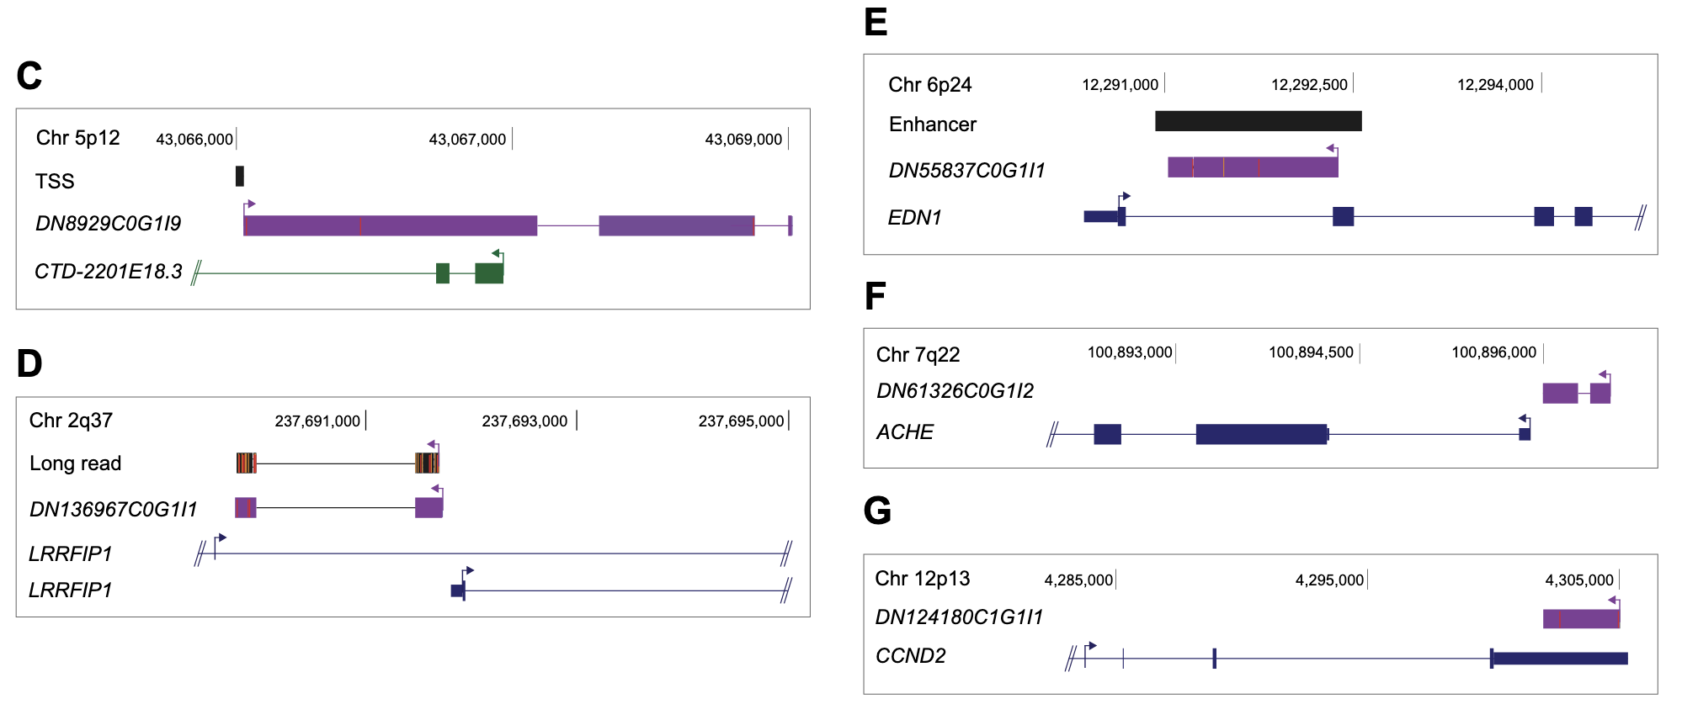
UCSC Genome Browser (hg38) Diagram
Purple: NB-lncRNAs
Blue: GENCODE-annotated protein-coding genes.
Green: GENCODE-annotated non-coding genes.
Black: TSSs and enhancer elements.
Bitar et al. (2023) Redefining normal breast cell populations using long noncoding RNAs.
Figure 1(C-G). “UCSC genome browser (hg38) diagram.”
Notes:
UCSC genome browser (hg38) diagram
Validation Modes: Confirmed Transcription Start Sites (TSS) for 10% (1,810) of NB-lncRNAs.
Nanopore Long-Read: Confirmed full-length exon structures for 7% (1,310).
RT-PCR: Experimentally validated 25 out of 30 tested transcripts at expected sizes in breast cell populations.

Slide 26
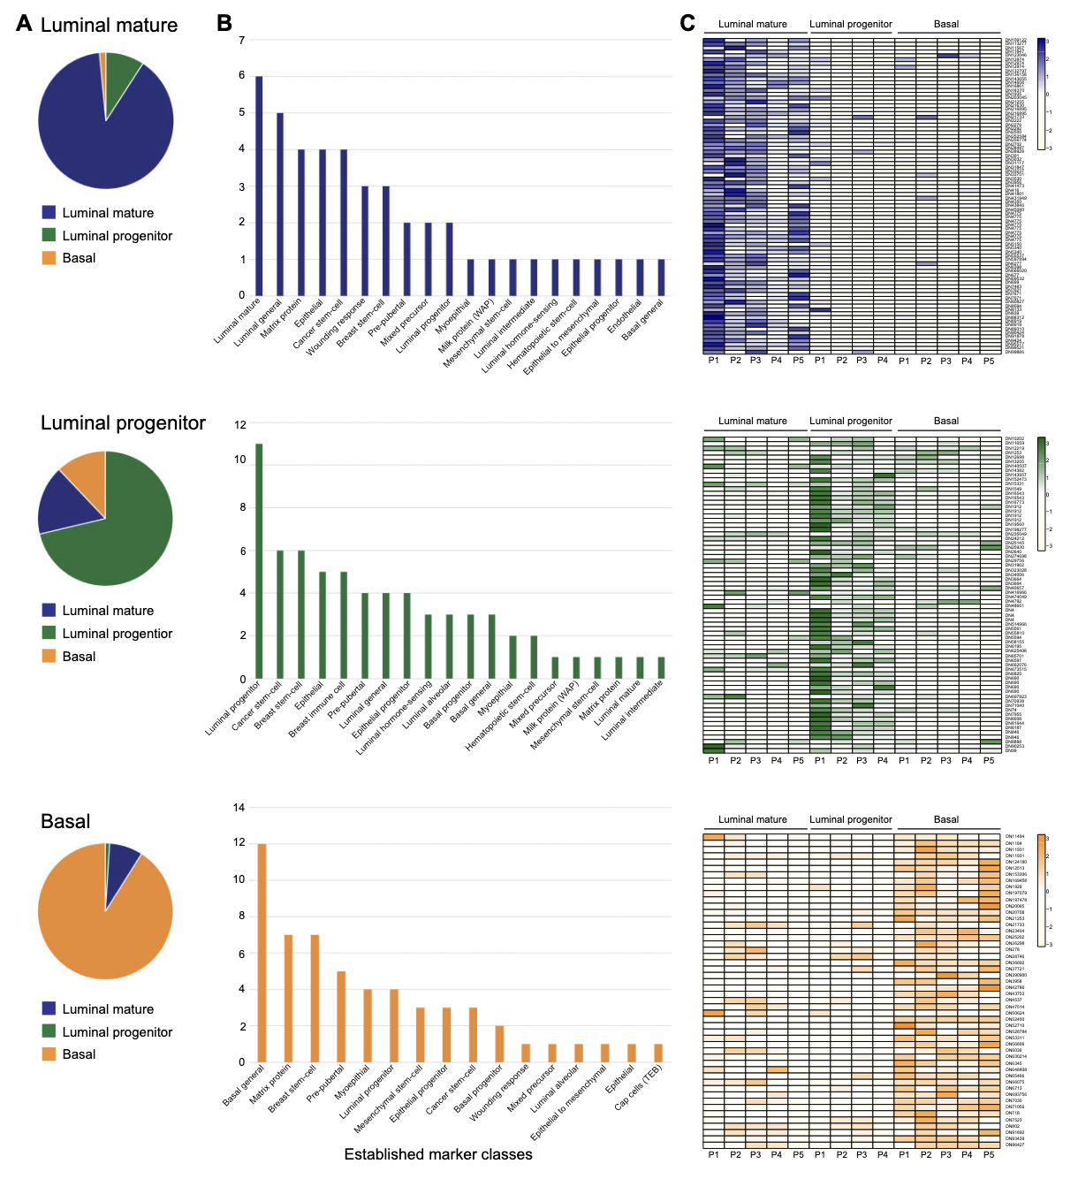
Bitar et al. (2023) Redefining normal breast cell populations using long noncoding RNAs.
Figure 2. “Cell population-specific NB-lncRNAs target protein-coding markers of the same cell type.”
Notes:
Figure 2. Cell population-specific NB-lncRNAs target protein-coding markers of the same cell type.
(A) FEELnc-assigned partners of NB-lncRNAs specifically expressed in each of the three main epithelial cell populations [i.e. luminal mature (top, blue), luminal progenitor (middle, green) and basal (bottom, orange)] were compared with previously reported markers of cell types, showing significant overrepresentation of the corresponding type. Enrichment was confirmed based on the p-value obtained for Fisher’s exact tests.
(B) Similar analyses were performed using an in-house dataset of known markers of several normal breast cell types, also showing a higher proportion of the population-specific NB-lncRNA partners are characteristic of the corresponding cell type.
(C) Heatmaps of gene expression confirm the NB-lncRNAs as population-specific.

Slide 27
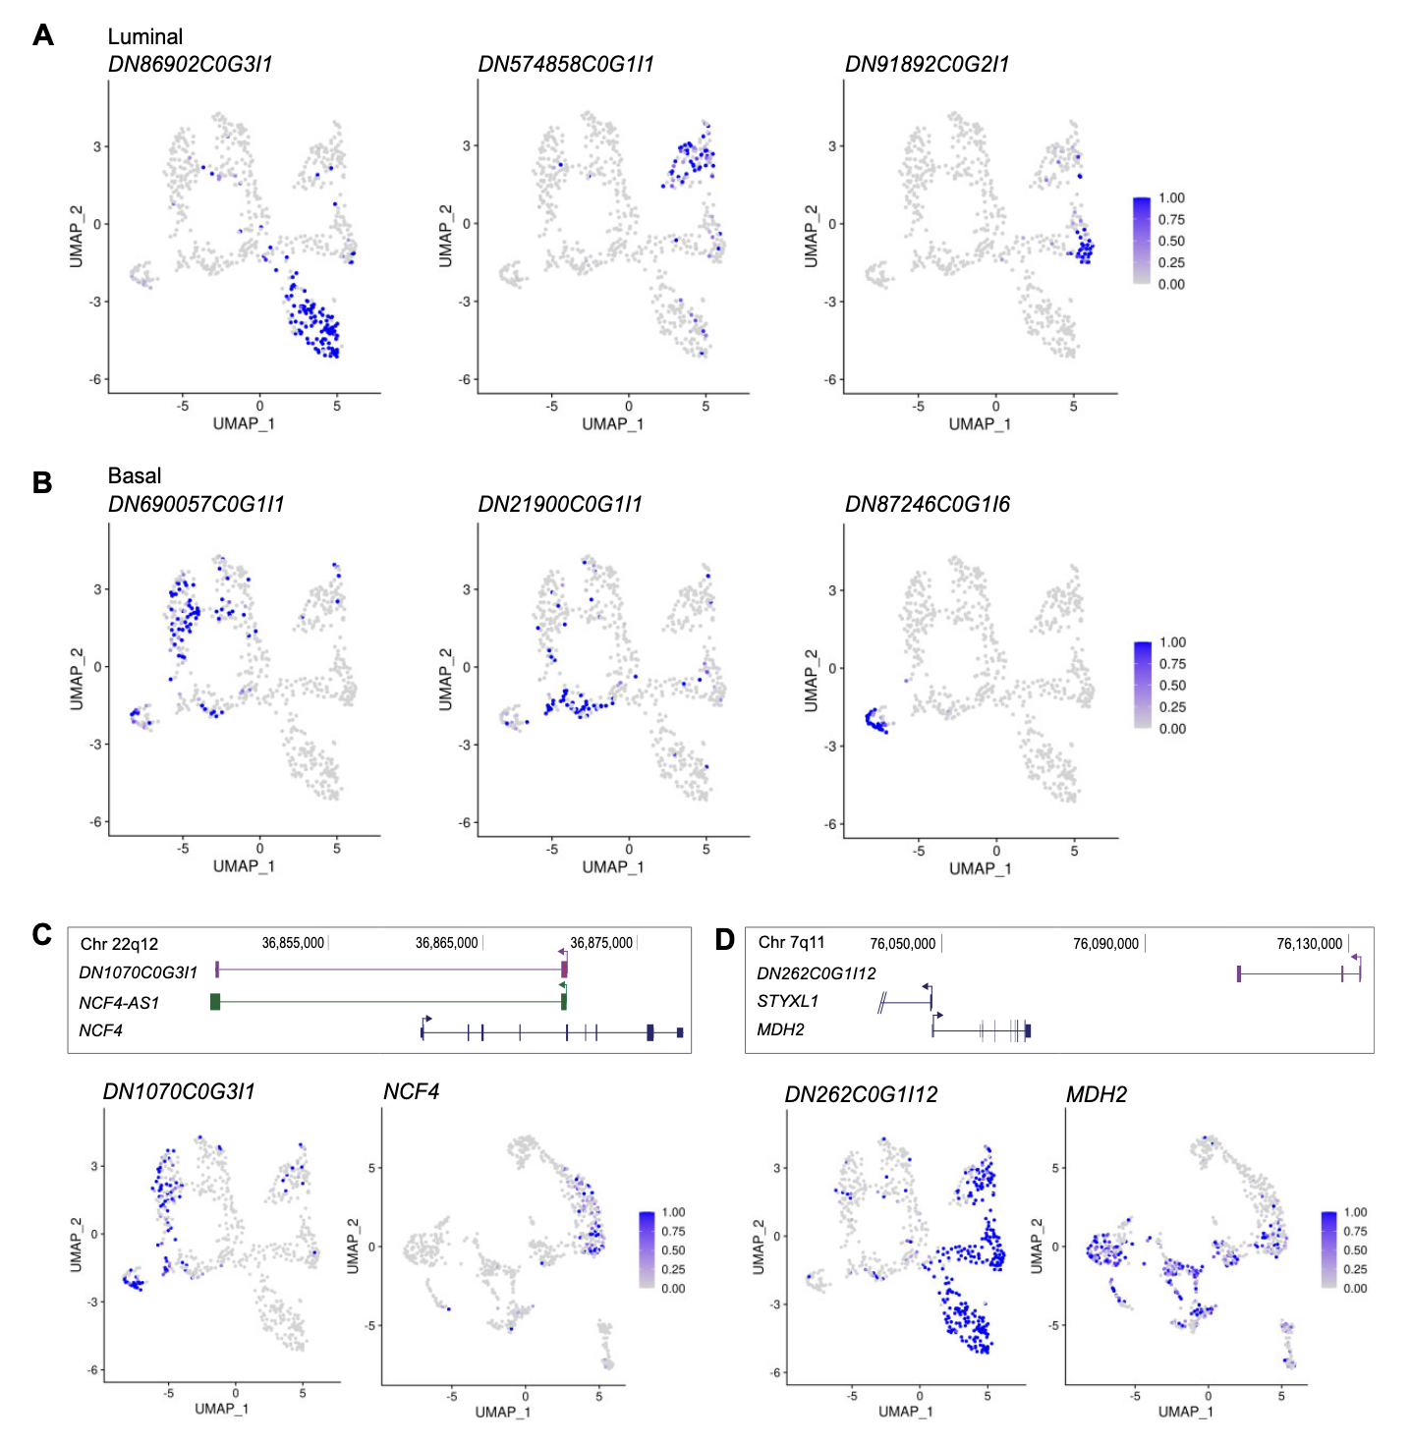
Bitar et al. (2023) Redefining normal breast cell populations using long noncoding RNAs.
Figure 4. “Seurat-assigned markers identified candidate NB-lncRNA biomarkers.”
Notes:
Figure 4. Seurat-assigned markers identified candidate NB-lncRNA biomarkers.
(A) Expression patterns of three identified NB-lncRNA luminal markers in L-clusters.
(B) Expression patterns of three identified NB-lncRNA basal markers in L-clusters.
(C, D) Upper panels: UCSC genome browser (hg38) diagrams showing NB-lncRNAs (purple), GENCODE-annotated protein-coding (blue) or noncoding genes (green). Lower panels: Expression patterns of NB-lncRNAs in L-clusters (left) and correlated protein-coding genes in A-clusters (right), showing examples of co-expression between coding and noncoding genes at single-cell level.

Slide 28
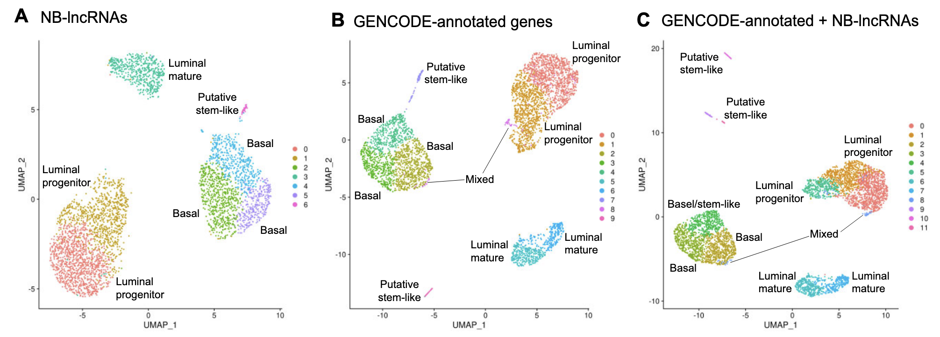
Bitar et al. (2023) Redefining normal breast cell populations using long noncoding RNAs.
Figure 8. “NB-lncRNAs discern normal breast cell subpopulations on 10x Genomics scRNA-seq.”
Notes:
The Findings: Although discovery was in Fluidigm (deep seq), the results replicated in 10x Genomics data.
Depth Sensitivity: Per-cell lncRNA detection dropped from ~900 to ~200 in 10x, but specific markers remained effective for subpopulation segregation.
Why it matters: Proves the biological signal is robust enough for standard, high-throughput single-cell platforms.
Figure 8. NB-lncRNAs discern normal breast cell subpopulations on 10x Genomics scRNAseq.
(A) UMAP of normal breast cells, clustered based on NB-lncRNAs expression, quantified on 10x Genomics scRNAseq data. Cells are color-coded for clusters, which are numbered according to cell counts.
(B) UMAP of normal breast cells, clustered based on GENCODE-annotated gene expression, quantified on 10x Genomics scRNAseq data. Cluster labels are based on the presence of known markers of cell subpopulations in the list of Seurat-assigned markers.
(C) UMAP of normal breast cells, clustered based on the expression of GENCODE-annotated genes and NB-lncRNAs, quantified on 10x Genomics scRNAseq data.

Slide 29
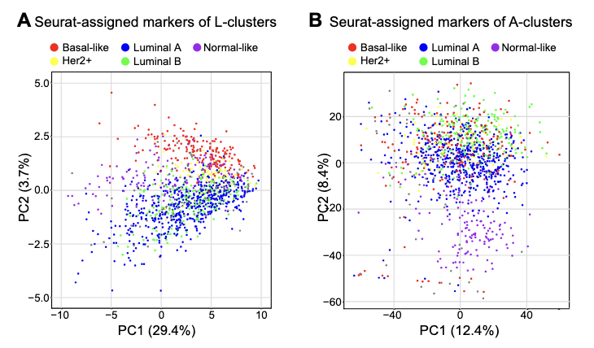
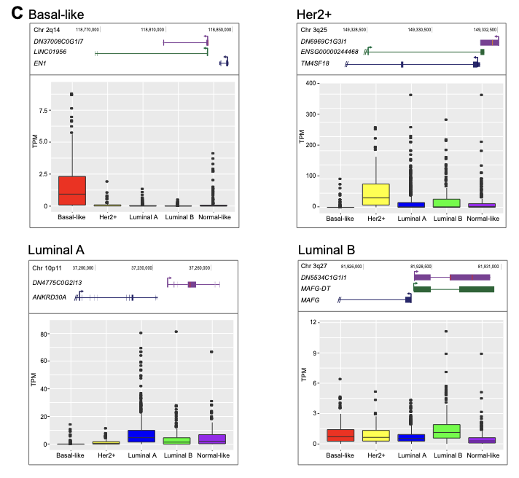
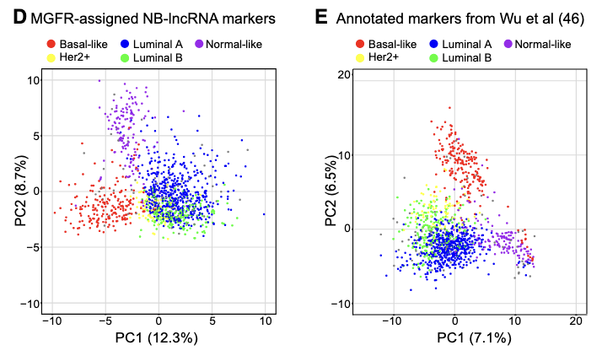
Bitar et al. (2023) Redefining normal breast cell populations using long noncoding RNAs.
Figure 9. “NB-lncRNA expression can differentiate between breast cancer subtypes in TCGA.”
Notes:
The Findings: Expression of NB-lncRNA markers stratified TCGA cancer samples into molecular subtypes better than standard clinical markers (Figure 9A vs 9B).
Precision: Her2+ and Luminal A subtypes were identified with significantly higher precision using the non-coding signature.
Why it matters: Identifies lncRNAs as an "untapped resource" for novel diagnostic biomarkers and therapeutic targets.
Figure 9. NB-lncRNA expression can differentiate between breast cancer subtypes in TCGA.
(A) The expression of Seurat-assigned NB-lncRNA markers of L-clusters separates the main subtypes of TCGA breast cancer tumors in a two-dimension PCA plot.
(B) To a lesser degree, the expression of Seuratassigned GENCODE-annotated markers of A-clusters separates different subtypes of TCGA breast cancer tumors in a two-dimension PCA plot.
(C) NB-lncRNAs are markers of specific breast cancer subtypes. Four selected NB-lncRNAs are shown with their genomic context (upper; UCSC genome browser diagram) and expression levels (lower; boxplots of TPMs in TCGA samples of each subtype).
(D) In-house NB-lncRNA markers of TCGA breast cancer subtypes can separate all subtypes of breast cancer in a two-dimensional PCA plot.
(E) For comparison, known breast cancer protein-coding markers separate subtypes with comparable performance.

Slide 30
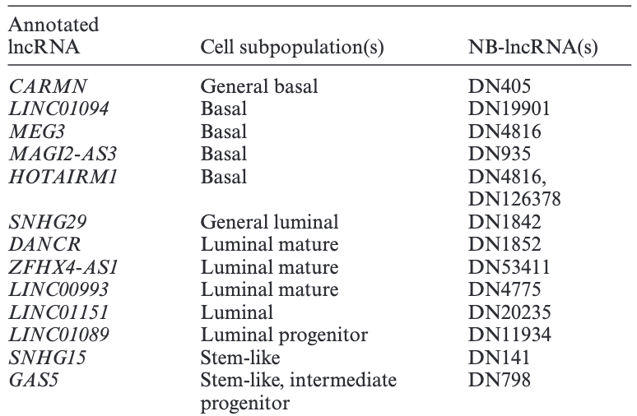
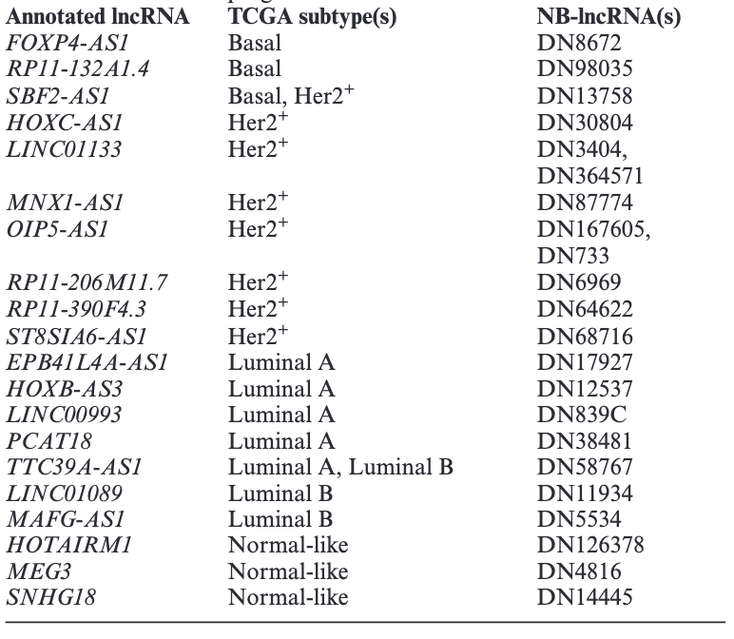
Bitar et al. (2023) Redefining normal breast cell populations using long noncoding RNAs.
Table 2. “Annotated NB-lncRNAs markers of breast cell subpopulations or breast cancer subtypes"
Notes:
The Findings: Compiled a list of NB-lncRNA markers with experimental evidence linked to cancer, such as TTC39A-AS1.
Validation Example: ASO-mediated knockdown of TTC39A-AS1 was shown to impair branch development in mammary organoids.
Why it matters: Transitions the paper from "computational discovery" to "biological relevance".
Table 2. Annotated NB-lncRNAs markers of normal breast cell subpopulations (top) or TCGA breast cancer subtypes (bottom).
Top: Seurat-assigned NB-lncRNA markers with previous annotation, experimental evidence and established links with breast cancer are listed with the corresponding normal breast cell subpopulation for which they are markers and short identifiers.
Bottom: MGFR-assigned NB-lncRNA markers with previous annotation, experimental evidence and established links with breast cancer are listed with the corresponding breast cancer subtype for which they are markers and short identifiers. Full identifiers are available in Supplementary Table S18

Slide 31
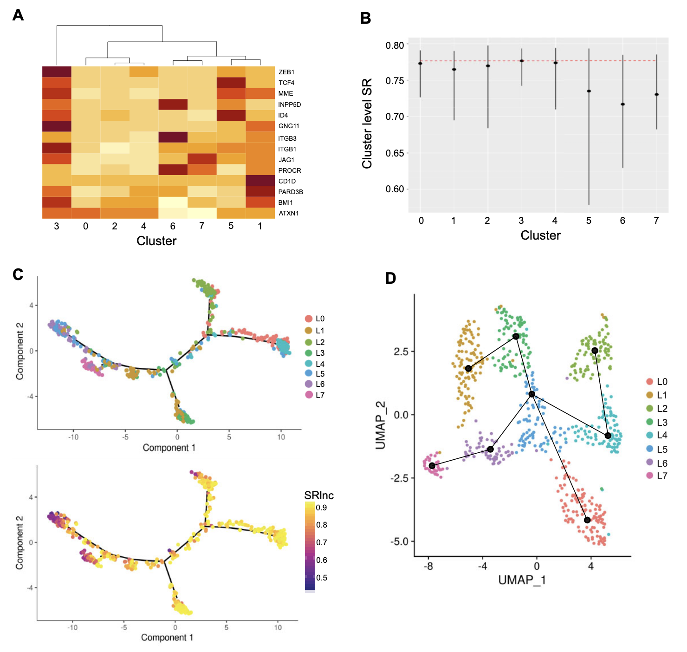
Bitar et al. (2023) Redefining normal breast cell populations using long noncoding RNAs.
Figure 7. “NB-lncRNAs define a stem-like cell subpopulation.”
Notes:
The Findings: Used SCENT (signaling entropy) and Slingshot to identify cluster L3 as the "root" state harboring the highest stemness.
Intermediate States: Differentiation trajectories revealed cluster L5 as a mixed intermediate progenitor between basal and luminal branches.
Why it matters: lncRNAs can reconstruct cell hierarchies and pinpoint "stem-like" states that appear heterogeneous when looking only at protein markers.
Figure 7. NB-lncRNAs define a stem-like cell subpopulation in the normal breast epithelium.
(A) Heatmap of the average expression of genes with experimentally confirmed stem-cell properties across the L-clusters. Genes were selected for their reported capacity of repopulating mammary fat pads, originating both basal and luminal compartments. Expression was measured at cell level and averaged across cells allocated to the same L-cluster.
(B) The SCENT method was used to calculate the signaling entropy level (SR value) of each cell. Cells in the same L-cluster were plotted together, with the average for each cluster represented by dots. The dashed red line was placed at the highest average (cluster L3).
(C) Monocle plots with cells distributed along a differentiation trajectory, with branch points representing cell lineages. Cells were colored either by Seurat-assigned L-clusters (upper) or by SR value (lower). (D) Slingshot trajectories showing the placement of lineages on top of the UMAP of L-clusters obtained with Seurat. Cluster L3 was defined as the root state, based on its higher stemness.

