Slide 1

2 July 2026 Progress Report
Vik Becker
National Library of Medicine (NIH)

Slide 2
Overview
Review of 6/30 Journal Club Presentation.
Collected Neural and Non-Neural Datasets.
The Special Case of Retina snRNA.
Writing a Downsampling/Stratification Script for Big .h5ad Data.
Neuron/Non-Neuron Runs.
Future Directions (and Poster Titles)

Slide 3
Review of 6/30 Journal Club Presentation.

Slide 4
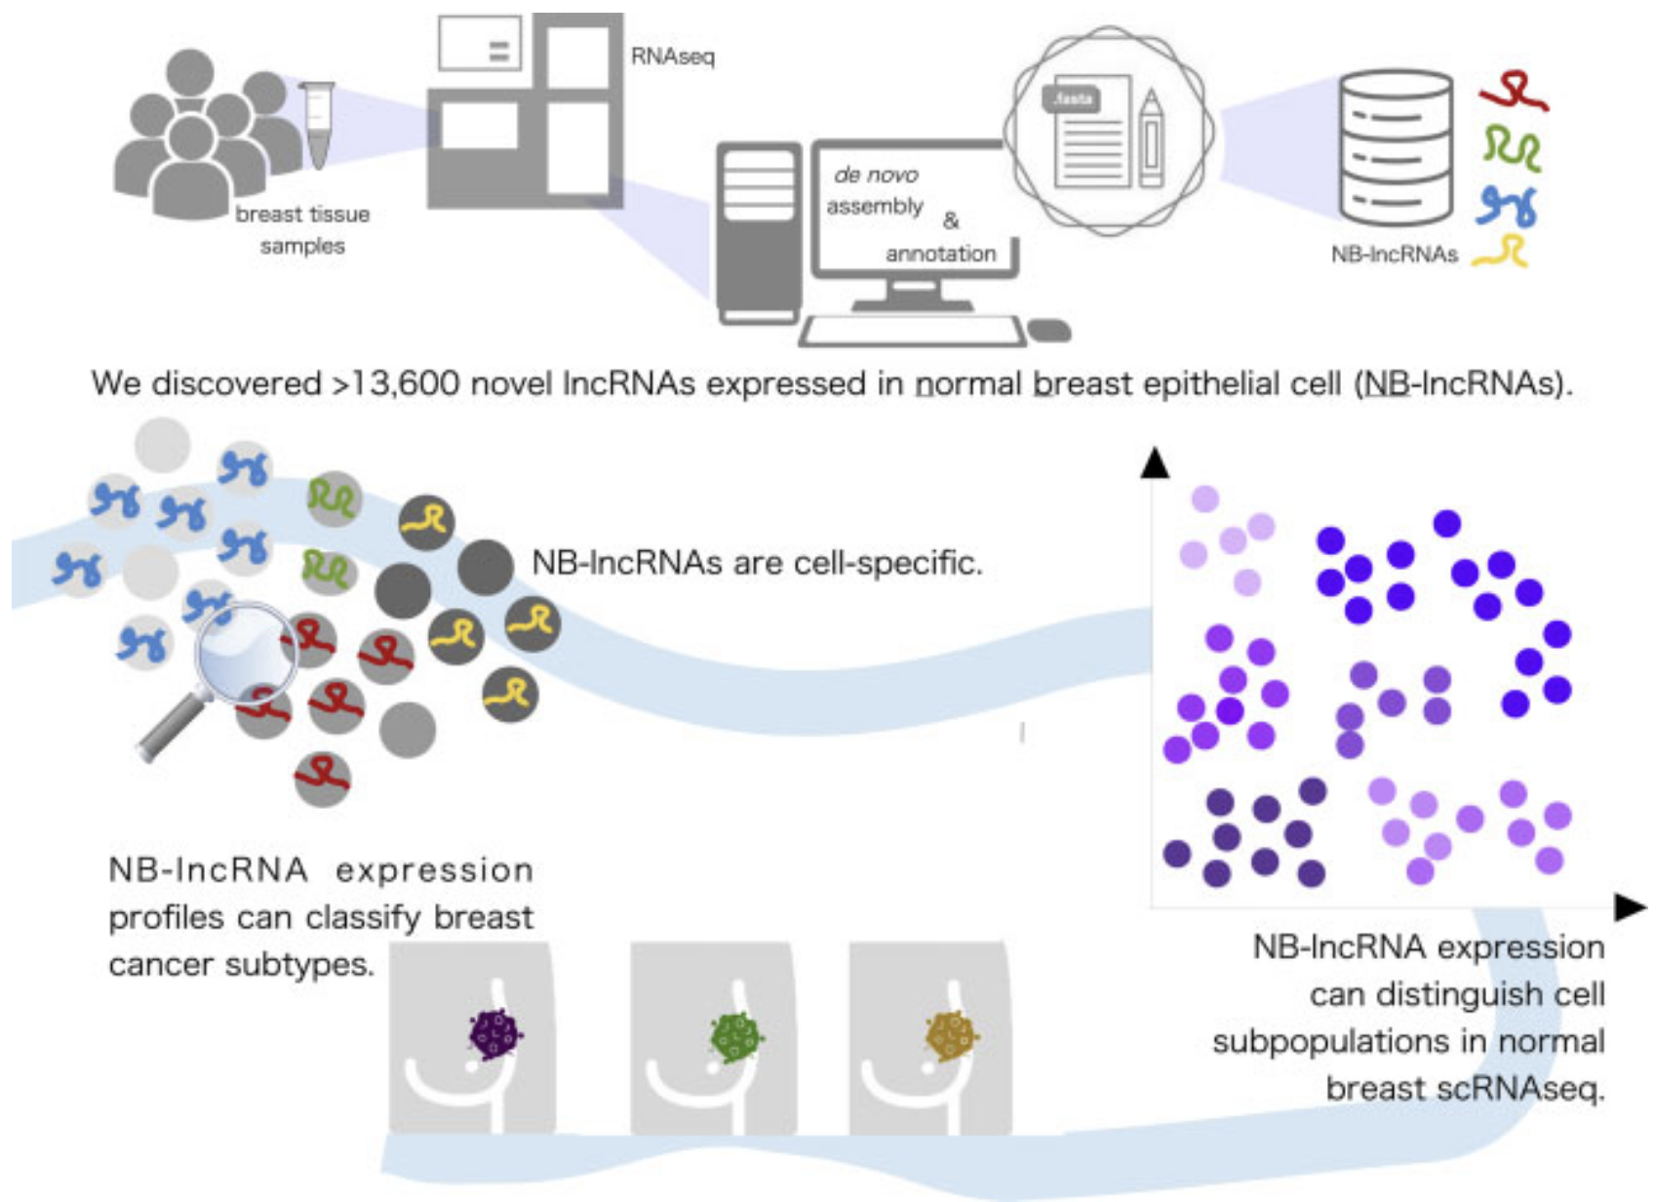
It went well!
The paper I presented was "Redefining normal breast cell populations using long noncoding RNAs" (2023) by Bitar et al.
Presented for approximately 45 minutes.
Started late due to the CellKN meeting running over.
Meeting was recorded.
Bitar et al. (2023) Redefining normal breast cell populations using long noncoding RNAs.
Graphical Abstract.

Slide 5
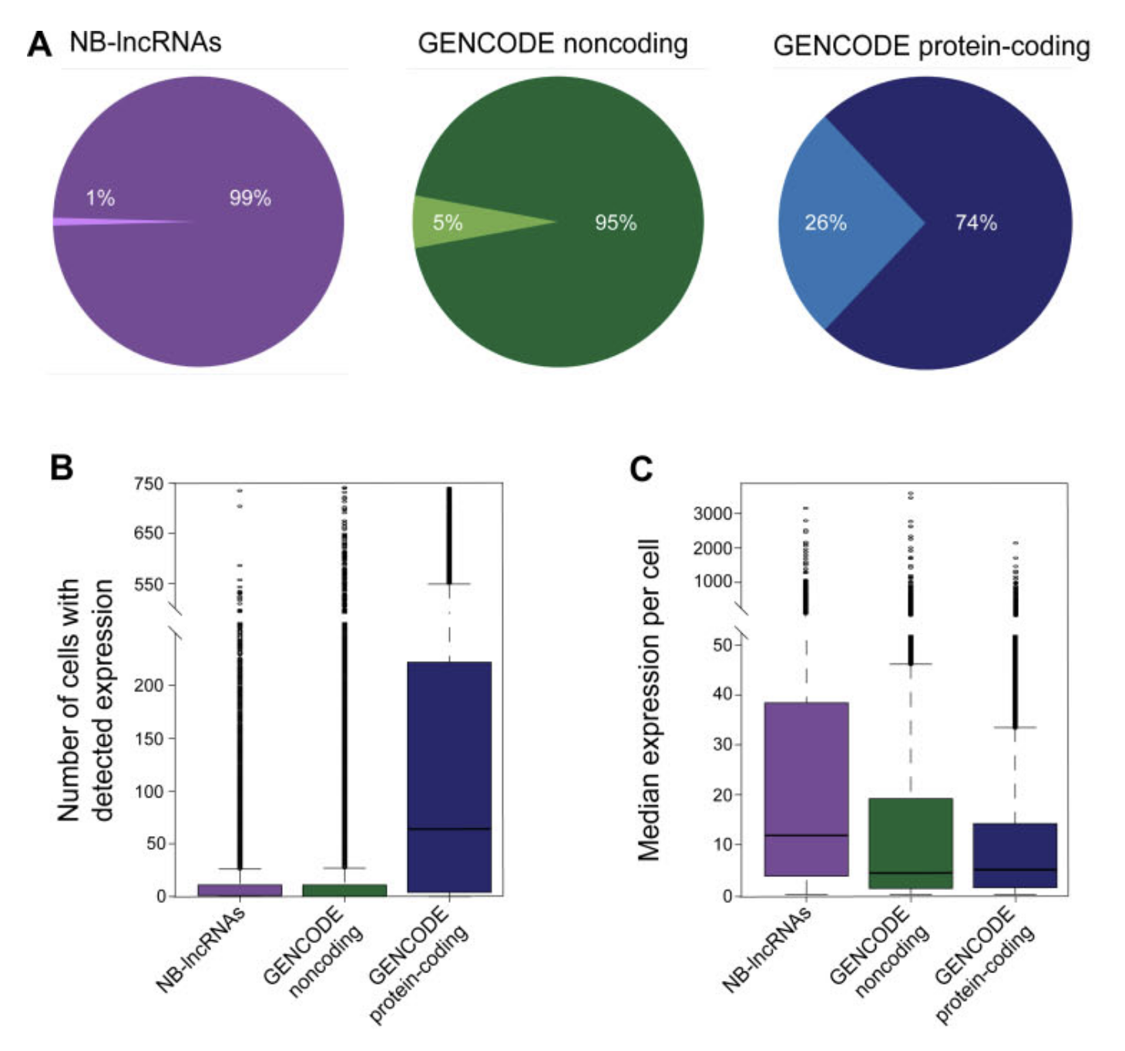
Compartmentalized Expression
(A): The proportion of genes with…
…restricted expression pattern (dark).
…widespread expression pattern (light).
(B): Number of cells where genes are expressed.
(C): Median expression of genes per cell when detected.
Bitar et al. (2023) Redefining normal breast cell populations using long noncoding RNAs.
Figure 5(A-C). “NB-lncRNAs have compartmentalized expression levels, which are higher at cell-level.”
Notes:
NB-lncRNAs exhibit restricted expression pattern; only <1% are widespread (detected in >1/3 of cells), compared to 26% of standard protein-coding genes.
On average, a specific NB-lncRNA is detected in only ~15 cells out of a 741-cell dataset, whereas protein-coding genes are detected in ~140 cells.
Despite being expressed in fewer cells, NB-lncRNAs have a median expression level nearly twice that of protein-coding genes within those specific cells (p < 1.9e−06).
Set of broadly expressed protein coding genes is enriched in known housekeeping genes (47%, P-value ∼ 0; Supplementary Table S15).
Protein-coding genes nearest or co-expressed with the 121 broadly expressed NB-lncRNAs were also enriched for known housekeeping genes (46% with P-value 5.4e−31 and 35% with P-value 9.6e−19; Supplementary Table S15) e.g. GAPDH, HSPA5, IAH1, MKLN1, PSMD7, SYNCRIP and TIMM44.

Slide 6
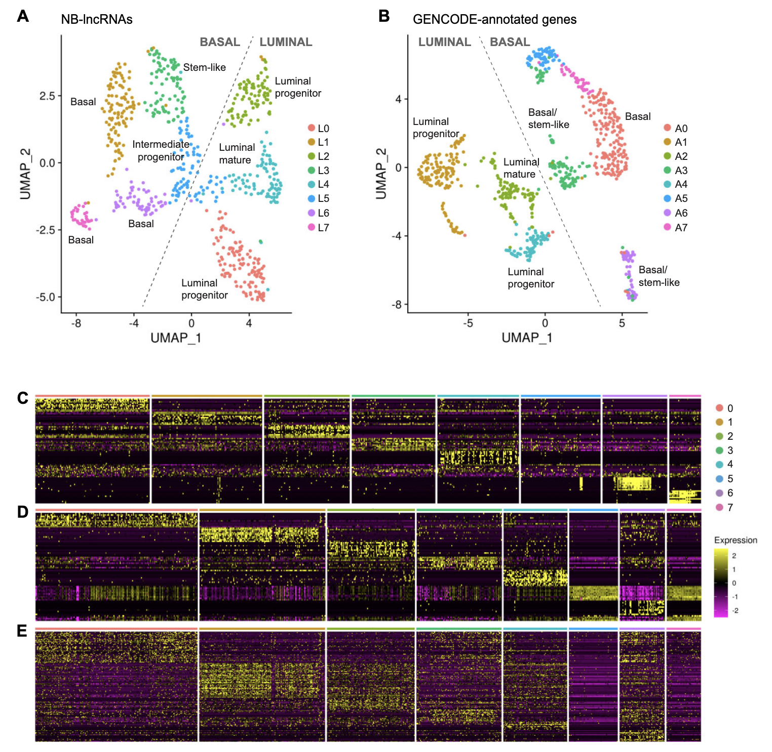
Population Resolution
UMAP of normal breast cells clustered by their NB-lncRNA expression (A) or GENCODE-annotated gene expression (B).
Heatmaps showing the top 10 assigned markers for each L-cluster (C) or A-Cluster (D).
Heatmap of assigned A-cluster markers previously reported in literature (E).
Bitar et al. (2023) Redefining normal breast cell populations using long noncoding RNAs.
Figure 3. “NB-lncRNAs and GENCODE-annotated genes can distinguish breast epithelial cell types.”
Notes:
To explore the ability of NB-lncRNAs to distinguish normal breast cell subpopulations, we quantified the expression of NB-lncRNAs using published scRNAseq data of 867 cells from three donors, with >1.5M reads per cell (6). Using flow cytometry, Nguyen et al. sorted cells from the luminal and basal populations before performing scRNAseq (File S4). On average, each cell expressed close to 900 NB-lncRNAs, with over one-third expressing at least 1000 NB-lncRNAs.
Figure Description:
NB-lncRNAs and GENCODE-annotated genes can distinguish breast epithelial cell types. (A) Uniform manifold approximation projection (UMAP) of normal breast cells, clustered based on NB-lncRNAs expression, quantified on Fluidigm scRNAseq data (L-clusters). Cells are color-coded for clusters, which are numbered according to cell counts. (B) UMAP of normal breast cells, clustered based on GENCODE-annotated gene expression, quantified on Fluidigm scRNAseq data (A-clusters). (C) Heatmap showing the top ten Seurat-assigned markers for each L-cluster. (D) Heatmap showing the top ten Seurat-assigned markers for each A-cluster. (E) Heatmap showing Seurat-assigned markers for A-clusters previously reported in the literature.
Cell set from published scRNAseq data of 867 cells from three donors, with >1.5M reads per cell (6). Using flow cytometry, Nguyen et al. sorted cells from the luminal and basal populations before performing scRNAseq (File S4). On average, each cell expressed close to 900 NB-lncRNAs, with over one-third expressing at least 1000 NB-lncRNAs
Eight clusters were obtained after filtering, normalizing and clustering cells with Seurat
Annotations from prior described biomarkers
Basal vs luminal cluster label given if >70% of cells in cluster having that label
L stands for lncRNA, A stands for Annotated
Clustering cells using only NB-lncRNA expression (L-clusters) successfully replicated the primary Basal and Luminal divisions.
L-clusters showed high correspondence with standard FACS labels and A-cluster identities.
Non-coding transcriptome alone contains sufficient signal to define tissue-level cell types.

Slide 7
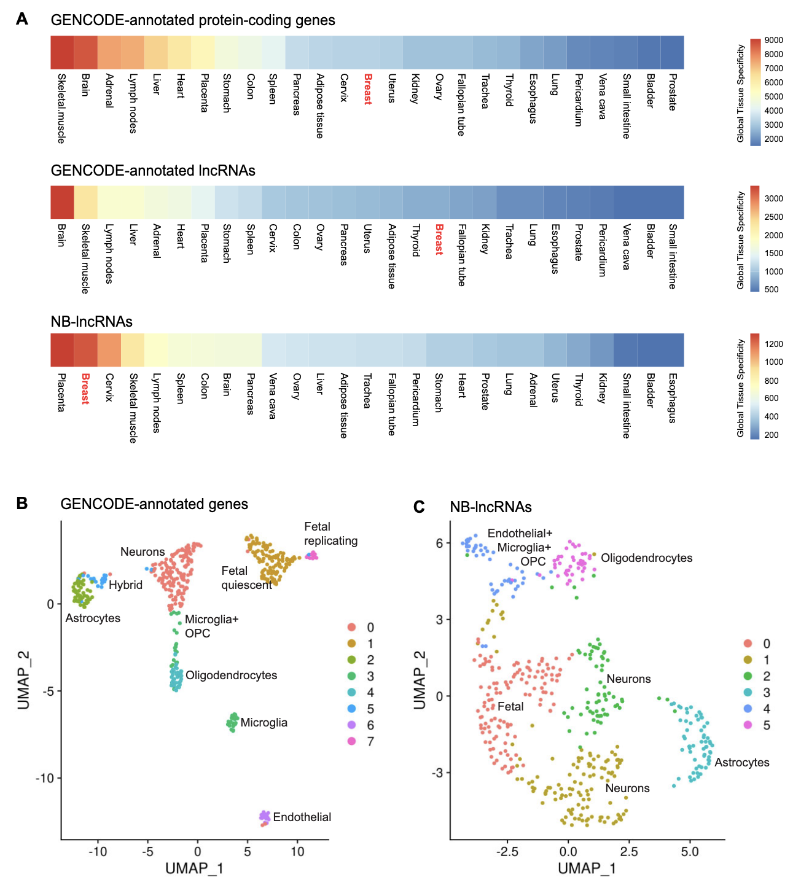
lncRNA Tissue Specificity
(A): Global tissue specificity of genes across 27 human tissues.
UMAP of cells from a healthy human brain based on GENCODE genes expression (B) or NB-lncRNAs (C).
Clusters labelled based on known biomarkers of the represented brain cell types.
LncRNAs (both GENCODE and NB-lncRNAs) demonstrate increased specificity in tissue type compared to coding genes.
Bitar et al. (2023) Redefining normal breast cell populations using long noncoding RNAs.
Figure 6. “NB-lncRNAs cannot identify human brain cell types.”
Notes:
When breast-specific NB-lncRNAs were used to cluster healthy human brain cells, they failed to unambiguously discern microglia or OPCs.
lncRNA identity is tissue-specific; calculated tau indices show NB-lncRNAs have significantly higher global tissue specificity than protein-coding genes across 27 human tissues.
When breast-specific NB-lncRNAs were used to cluster cells from a healthy human brain, they failed to unambiguously discern standard brain cell types like microglia or oligodendrocyte precursors (OPCs).
The resulting brain UMAP shows mixed clusters that lack clear protein-marker correspondence, providing a critical warning that lncRNA discovery must be performed a priori for every new tissue type being studied.
Figure 6. NB-lncRNAs cannot identify human brain cell types.
(A) Global tissue-specificity of annotated protein-coding genes (top), annotated lncRNAs (middle) and NB-lncRNAs (bottom) across 27 human tissues. The tissue-specificity was summarized by calculating the tau index of every transcript in each set and counting the number of occurrences where each tissue had the highest tau overall.
(B) UMAP of normal breast cells, clustered based on GENCODE-annotated gene expression, quantified on Fluidigm scRNAseq data. Cells are color-coded for clusters, which are numbered according to cell counts.
(C) UMAP of normal breast cells, clustered based on NB-lncRNAs expression, quantified on Fluidigm scRNAseq data. Clusters were labeled based on the information provided in (35) and known protein-coding markers of the represented brain cell types.

Slide 8
Collected Neural and Non-Neural Datasets.

Slide 9
Neural v Non-Neural | Tissue | File | Annotation Hierarchy (finest granularity) | Number of Cell Types (← in finest granularity) | Cells | File Size
Neural | Motor Cortex (M1) | Dissection: Cerebral cortex (Cx) - Precentral gyrus (PrCG) - Primary motor cortex - M1C | cell_type | 35 | 116.6k | 1.49 GB
 | Middle Temporal Gyrus (MTG) | Dissection: Cerebral cortex (Cx) - Middle Temporal Gyrus - MTG | cell_type | 28 | 107.3k | 1.32 GB
 | Retina (snRNA) | snRNA-seq of human retina - all cells | majorclass → cell_type → author_cell_type | 205 | 3.2M | 37.74 GB
 | Spinal Cord | (Dissection: Spinal cord - SpC) | cell_type | 22 | 24.2k | 154.4 MB
Non-Neural | Breast | (HBCA - global) | level0_global → level1_global → cell_type → level2 | 44 | 803.2k | 8.34 GB
 | Heart | (Heart) | cell_type → Curated_annotation | 26 | 931.0k | 6.45 GB
 | Kidney | (Integrated Single-nucleus and Single-cell RNA-seq of the Adult Human Kidney) | cell_type → subclass.full | 75 | 304.6k | 2.96 GB
 | Lung | (An integrated cell atlas of the human lung in health and disease (core) | cell_type → ann_finest_level | 61 | 584.9k | 5.87 GB

Slide 10
The Special Case of Retina snRNA.

Slide 11
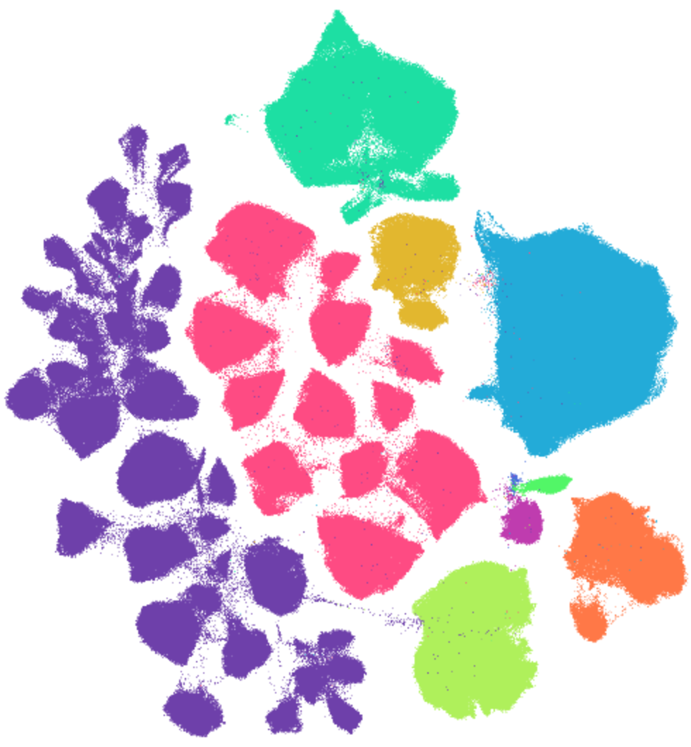
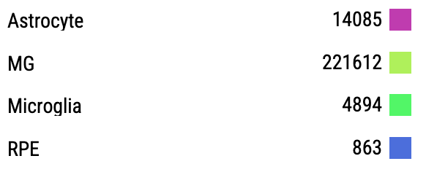

scRNA Retina Cell Types
(205 in total, with 119 neuronal and 4 non-neuronal)
RGC
Bipolar
Are there differences in lncRNA biomarker performance between neuronal and non-neuronal cells in the retina?
The numerous neuronal cell types drastically raises runtime without harsh down sampling.
At T = 500k (~85% reduction of 3.2M), out of the 10 clusters ran before manual interruption, avg runtime was ~7 mins / cluster.
For just the neuronal subset, that's ~14 hours to run NS-Forest on all 119 neuronal cell types :[
For T = 250k (~92%), its ~3 mins / cluster (~6 hours)
Horizontal
Rod
Cone
Amacrine
Notes:
89 of the 119 neuronal cell types (~75%) are amacrine cells
RGC = retinal ganglion cells

Slide 12
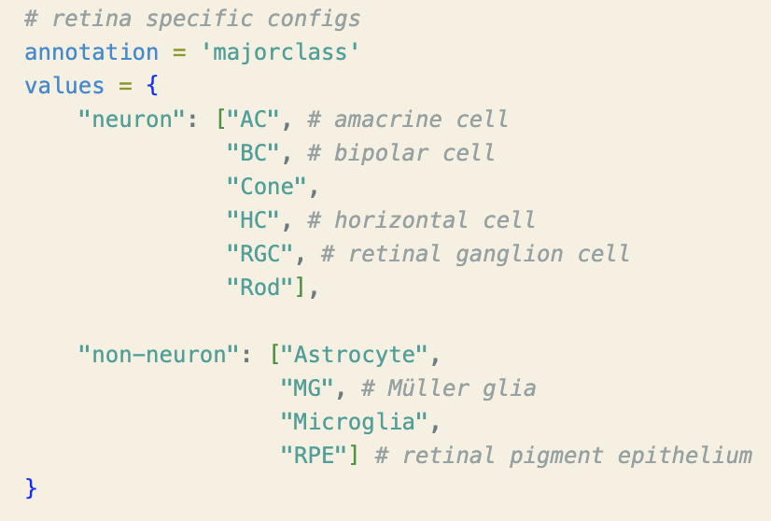
Neuron and Non-Neuron Cell Annotations
All cell types within high-level annotation majorclass.
Major Class → Number of Author Cell Types:
Amacrine (AC) → 86
Bipolar (BC) → 14
Cone → 2
Horizontal (HC) → 2
RGC → 11
Rod → 1
Non-neuronal classes from majorclass map 1-1 to associated author_cell_type.

Slide 13
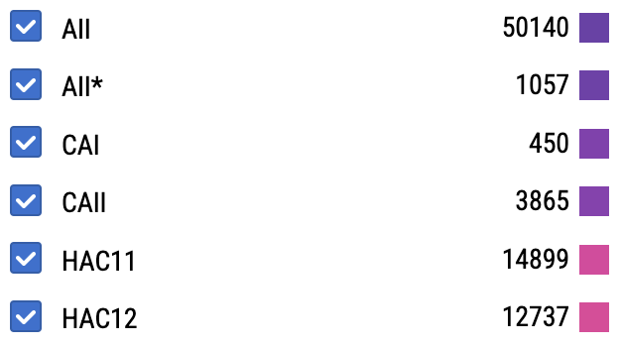
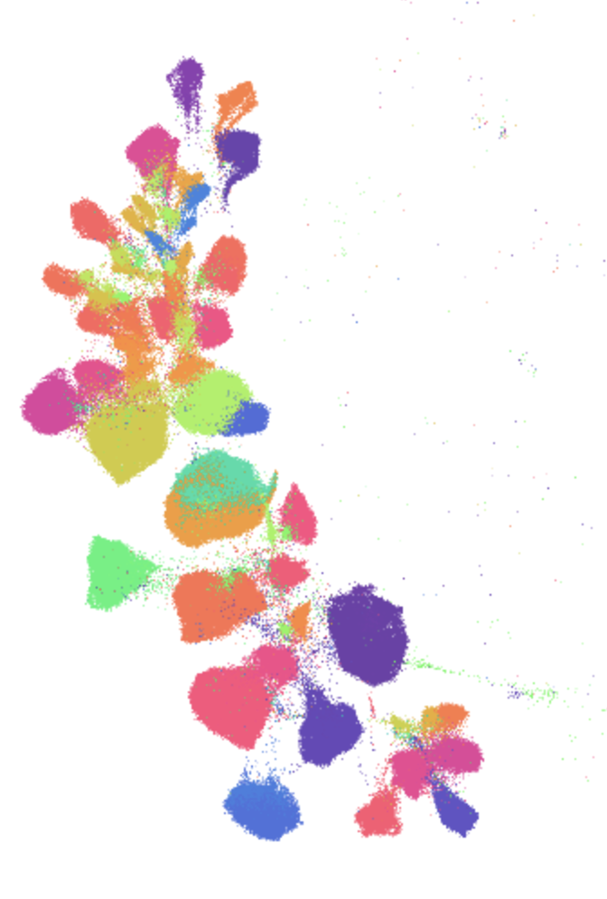
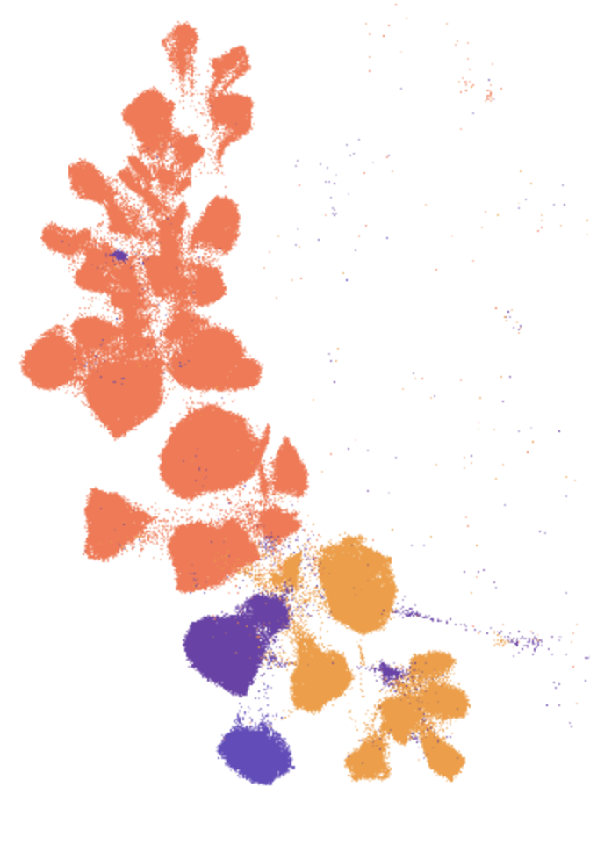
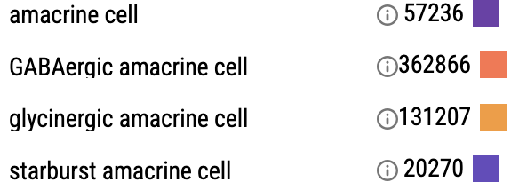
Amacrine Cell Type Annotations
80 more cell types unshown.
author_cell_type:
86 Clusters
cell_type:
4 Clusters
Notes:
89 amacrine cell types (author cell type) -> 4 (cell type)

Slide 14
Writing a Downsampling and Stratification Script for Big .h5ad Data.
Notes:
Part 2 of the issue:
Issue is that

Slide 15
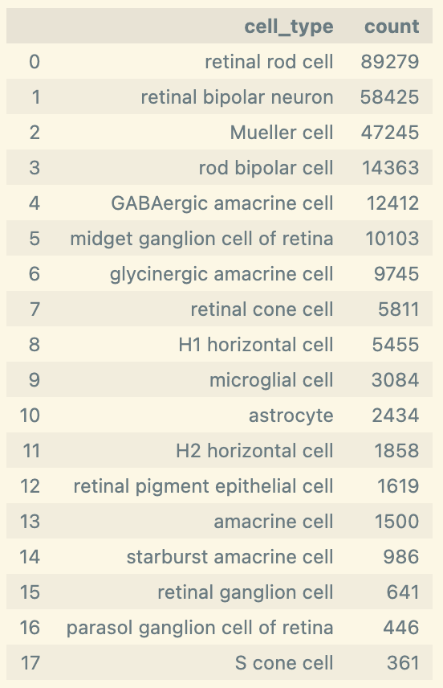
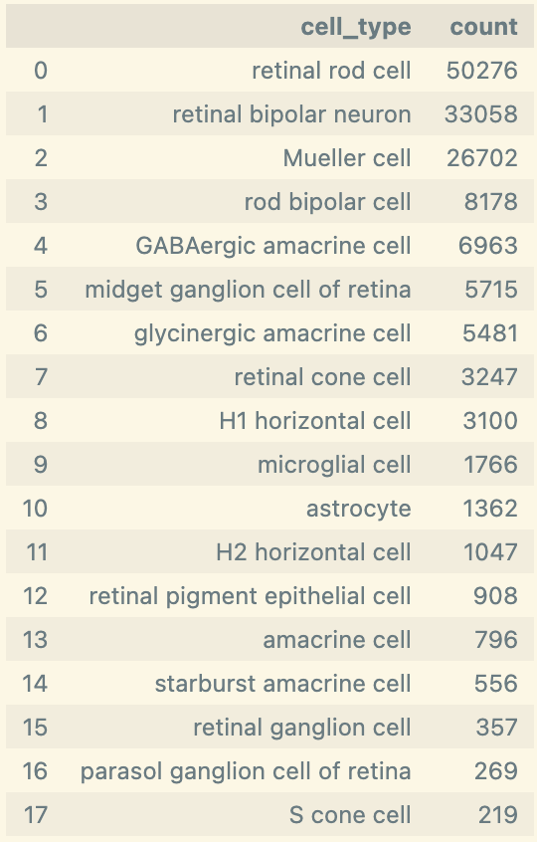
Original Downsampling Example (past data)
Downsample
N (cells) = 265,767
N (cells) = 150,000
All cell types reduced, regardless of size.

Slide 16
Loading a 3.2M cell CxG into memory is infeasible.
"Each" Downsampling Method
You set a threshold t as a "cluster cap" to act on the set of all cluster sizes n. Then examine the size of each cluster.
If less than t, keep all cells.
If greater than t, randomly sample t cells from the cluster to bring it down to the cap (all in n_downsampled <= t)
But for big data, we want to set an overall cap.
The total number of cells T we want to sample from N.
Implemented as the "Total" downsampling method, but as-written the method downsamples all clusters – even small ones.
If N > T, downsample from ALL clusters so N_downsampled <= T.
Notes:
Added stratification for kicks

Slide 17
Merging the Methods.
Goal: Find per-cluster cap t whose resulting N_downsampled on our optimal T.
EX: The retina scRNA data has N = 3.2M cells. My desired T = 250k cells. What's the "cluster cap" that brings the total number of cells closest to T?

Slide 18
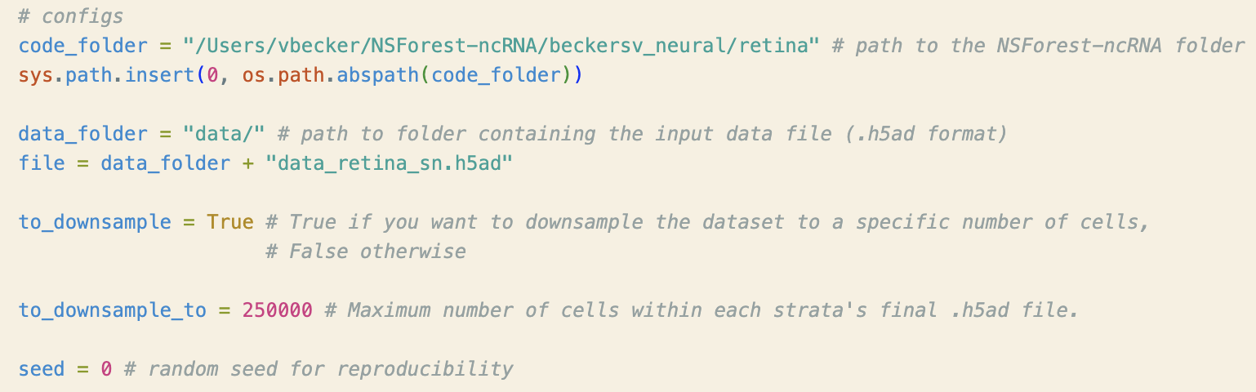
Setting Configs
Goal: Configuration of code/data folders and the desired number of cells in the downsampled data.

Slide 19
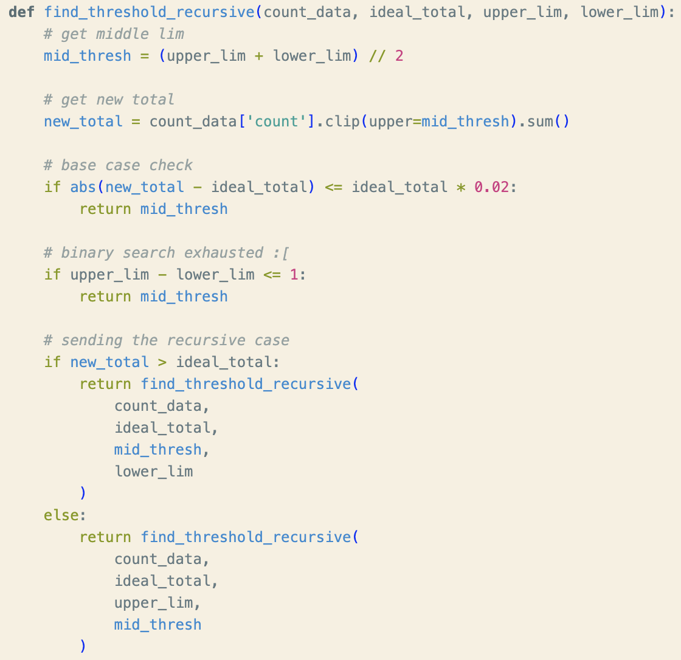
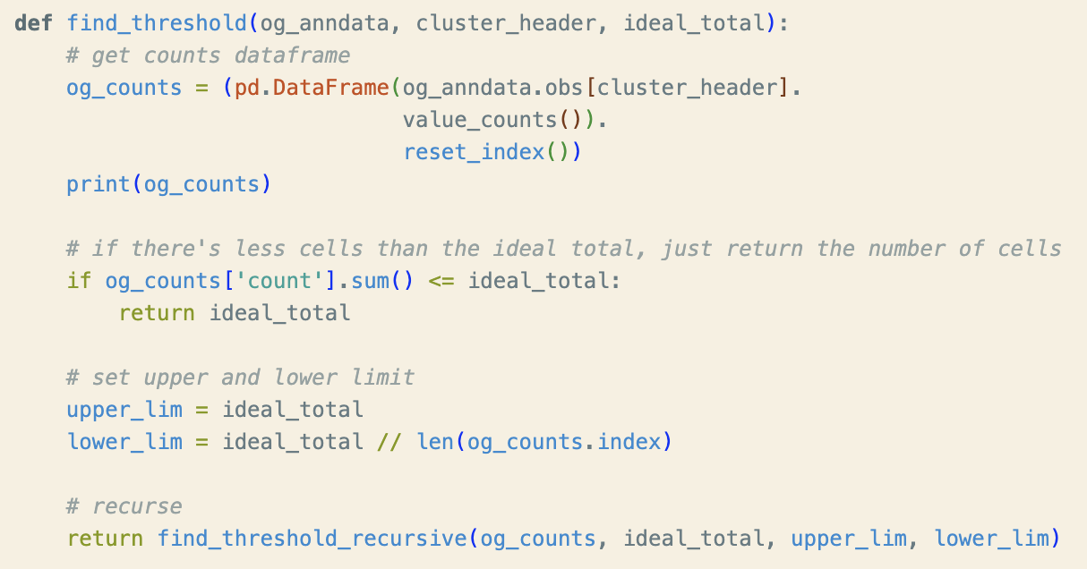
Threshold (n) Discovery
Upper Lim = Only 1 cluster or T < N
Lower Lim = Equally large clusters that must all be downsampled.
Notes:
What t gets us as close to T as feasible (within 2% is what I currently have set)

Slide 20
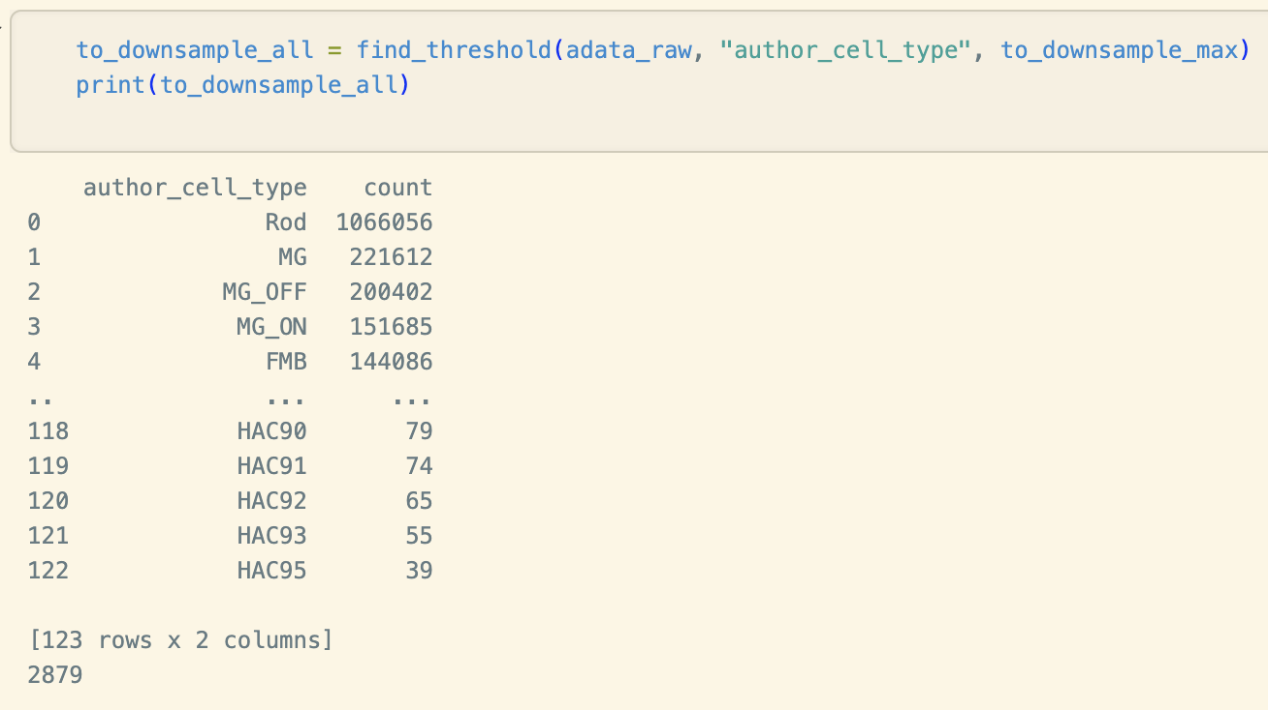
Returns n to pass to downsample_adata(each=)
Notes:
What n gets us as close to N as feasible?

Slide 21
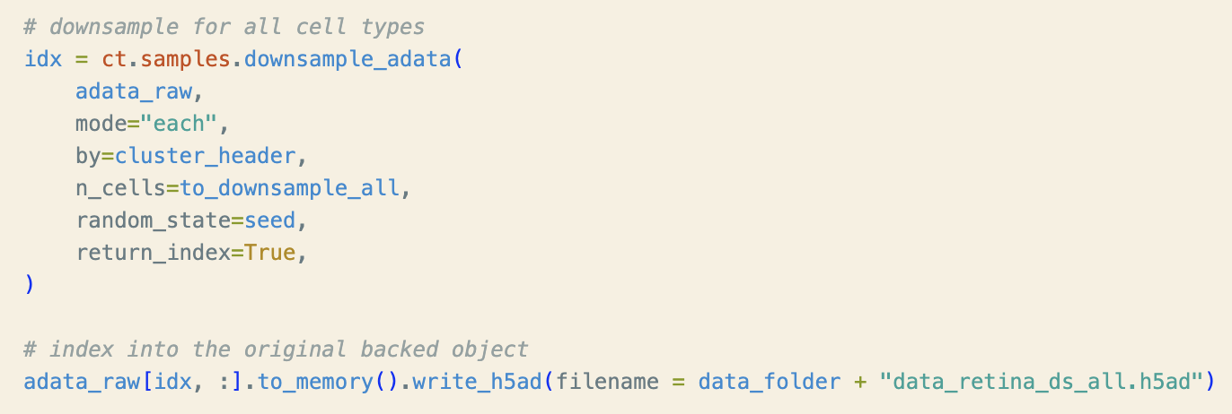
Downsample and write gathered indices.
Notes:
What n gets us as close to N as feasible?

Slide 22
Stratifying by Broad Retina Annotations
All cell types within high-level annotation "majorclass."
Major Class → Number of Author Cell Types:
AC → 86
BC → 14
Cone → 2
HC → 2
RGC → 11
Rod → 1
Non-neuronal classes map 1-1 to associated author cell type.

Slide 23
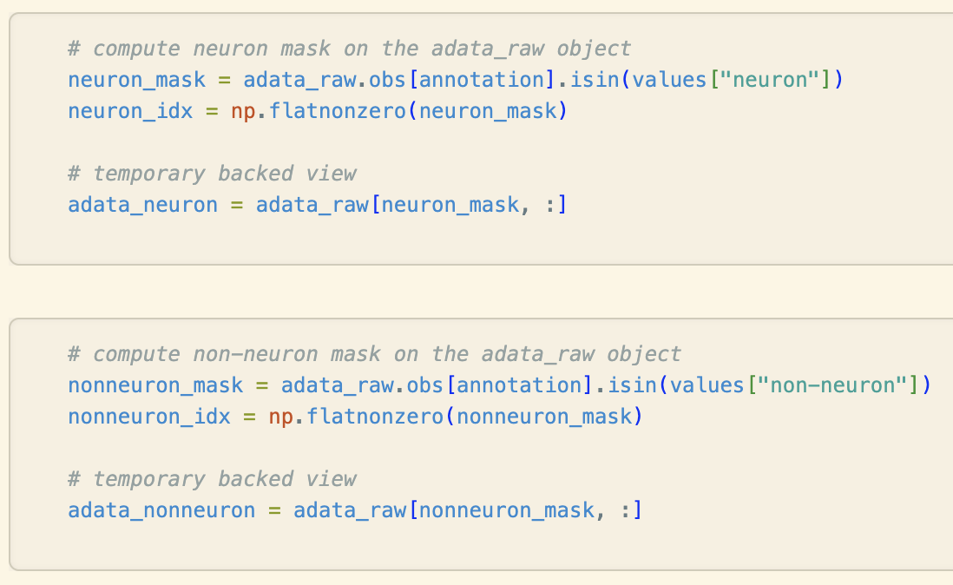
Compute Masks

Slide 24
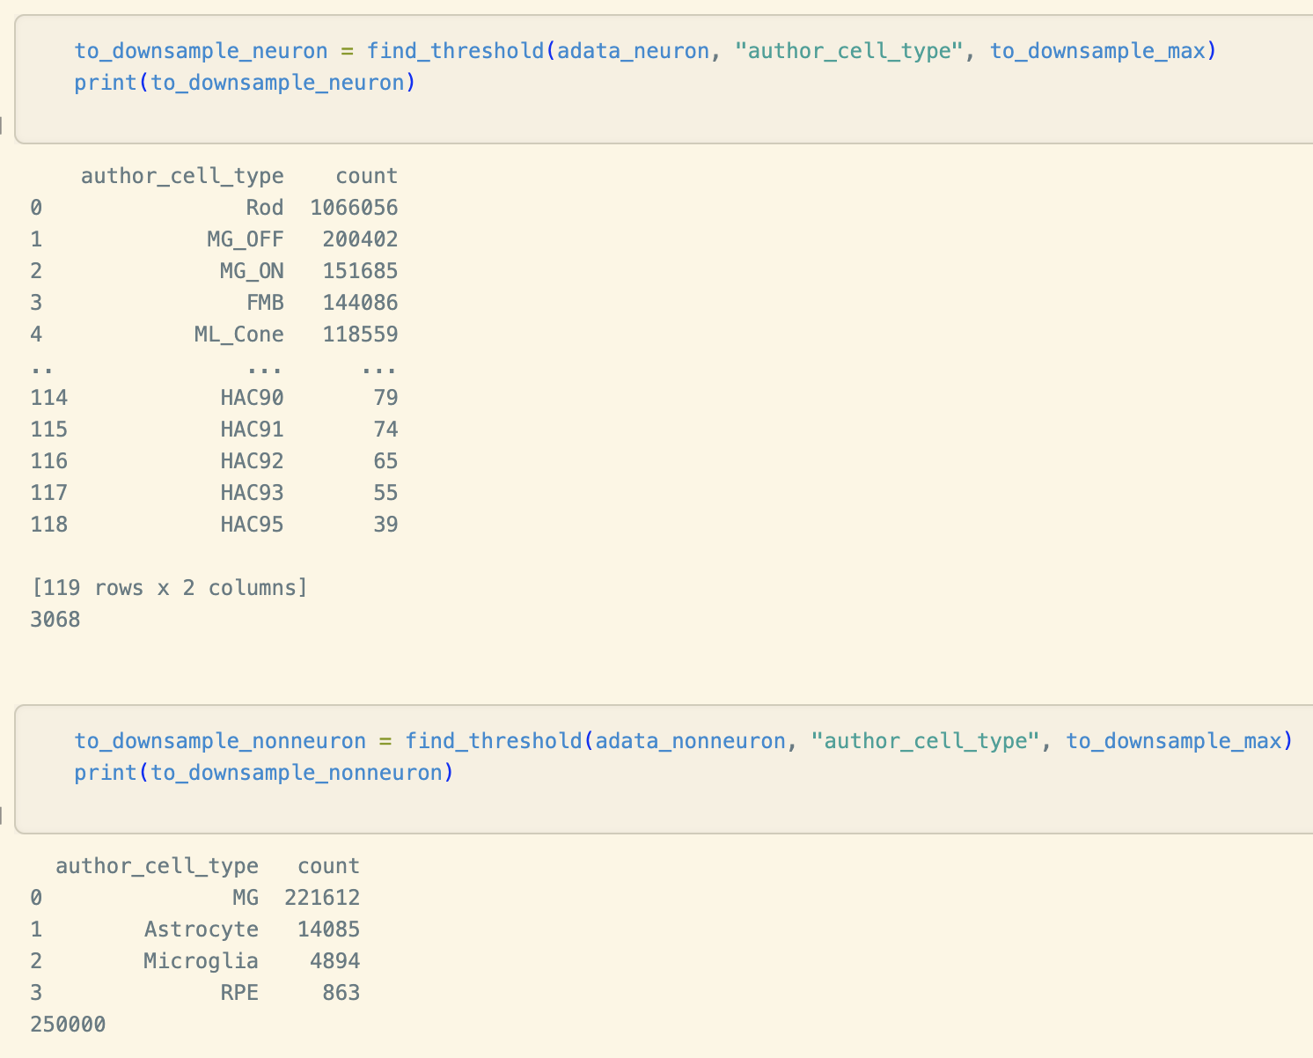
Discover Strata-Specific Thresholds

Slide 25
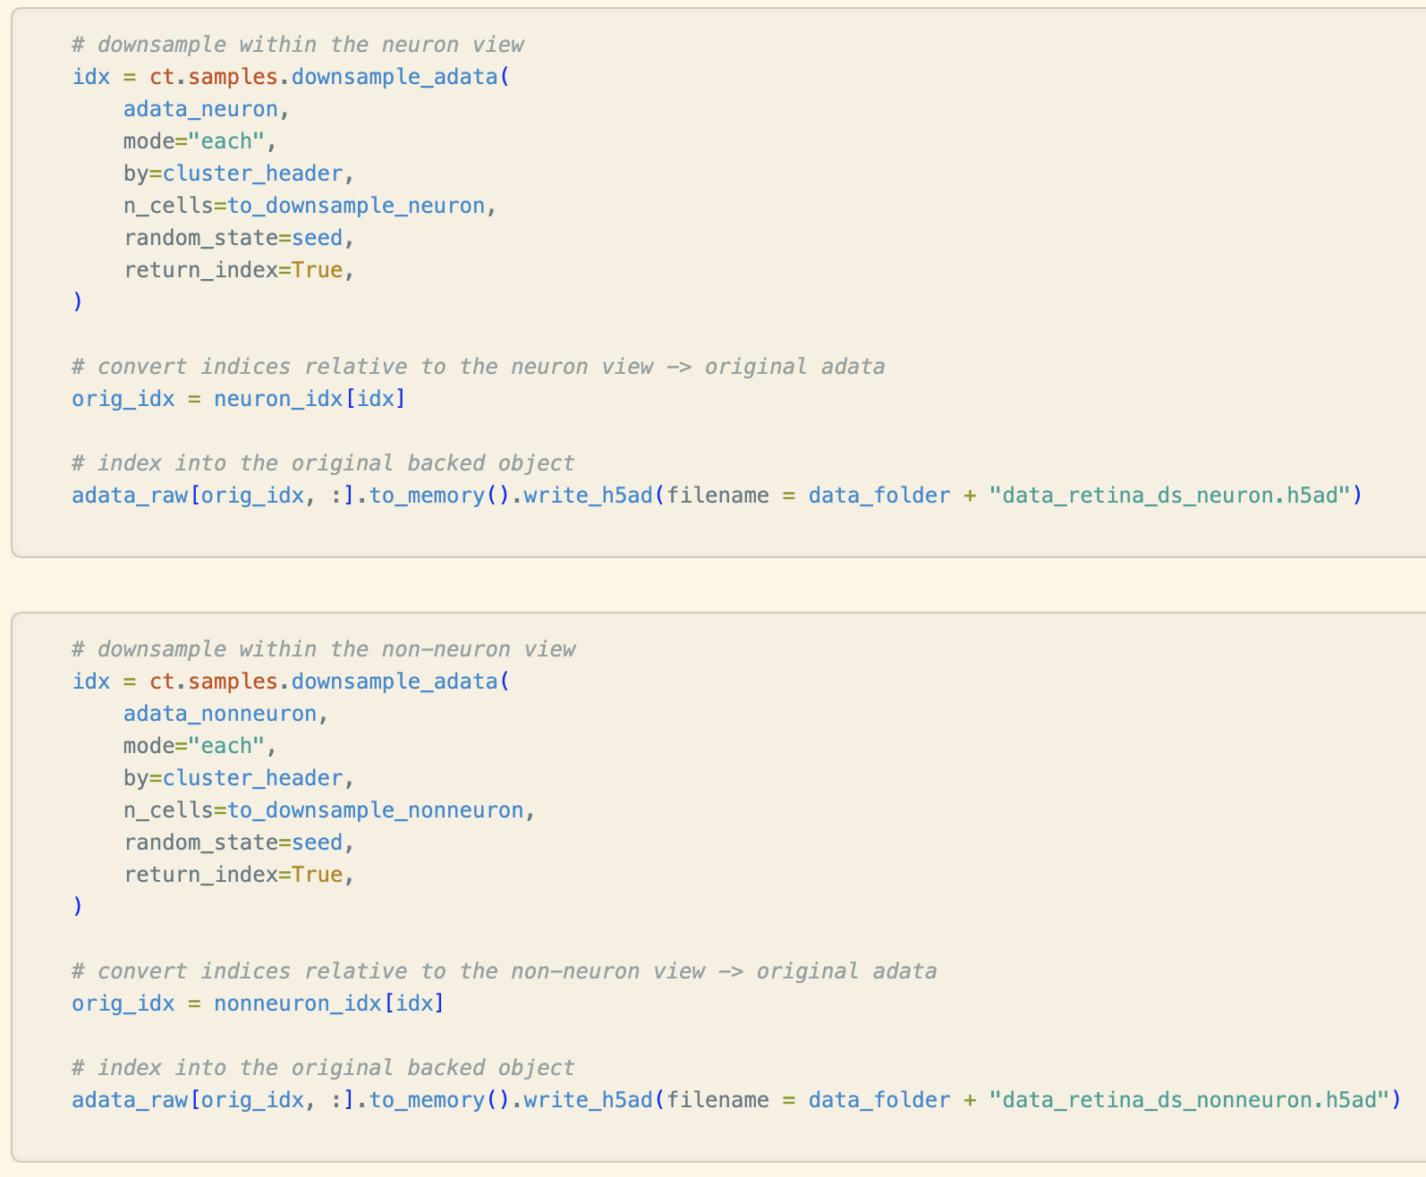
Run Downsampling on Masks

Slide 26
Neuron/Non-Neuron Runs (T = 500k).

Slide 27
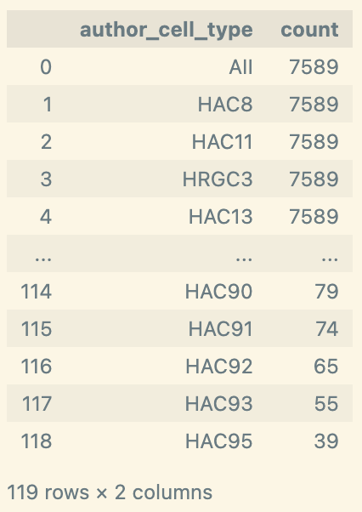
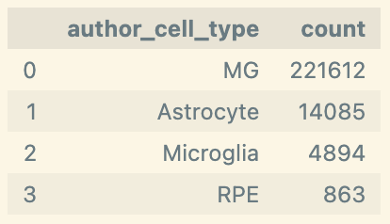
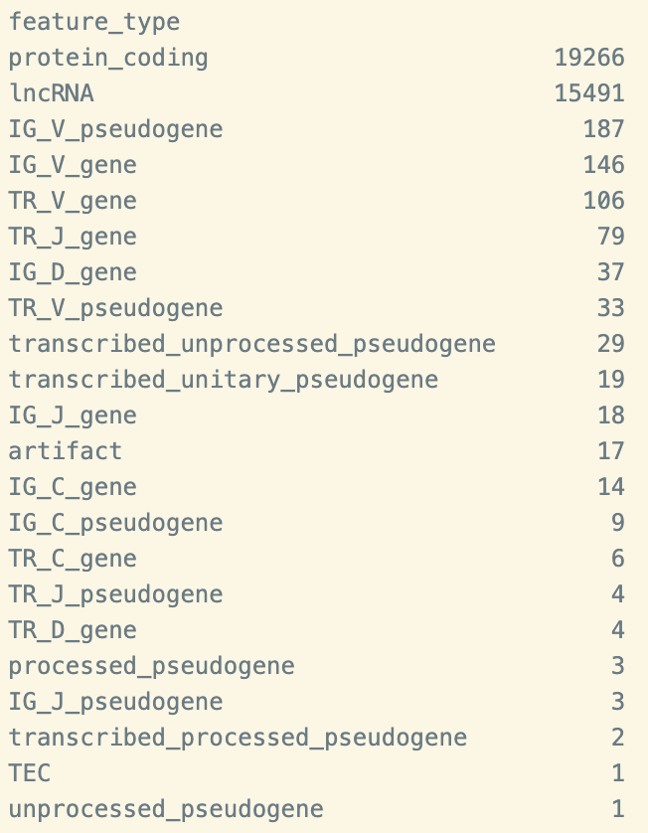
Neuron
Non-Neuron
Gene Type

Slide 28
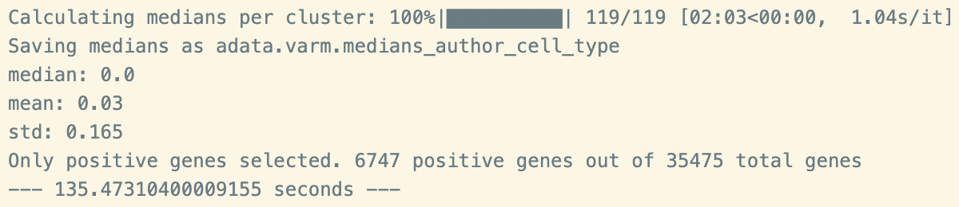
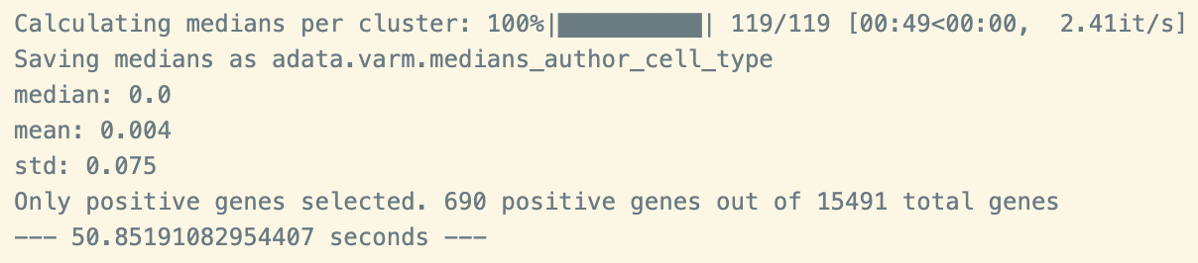
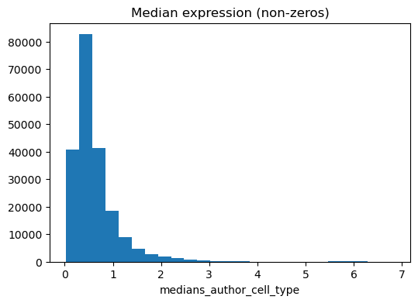
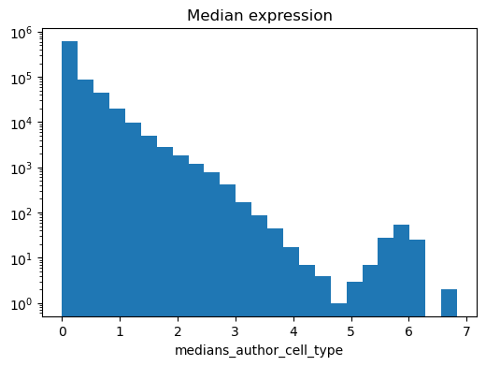
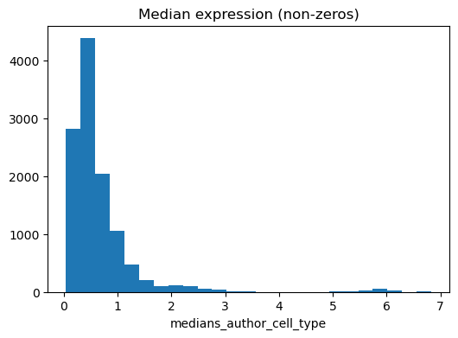
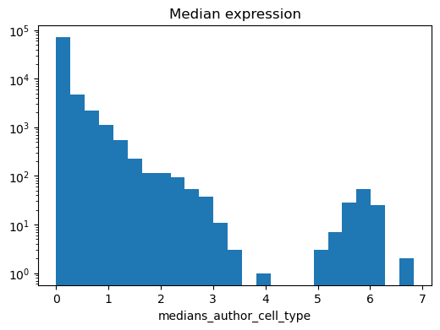
Cluster Medians (Neuron)
All Genes
lncRNA
Unscaled
Log
Unscaled
Log
Notes:
Approximately the same as in the scRNA dataset
REMINDER: x axis is median expression of gene in a cluster, y axis is number of gene-cluster pairs with that binned expression

Slide 29
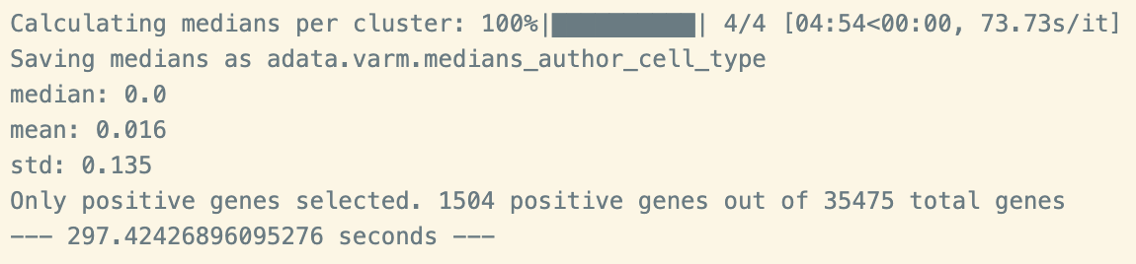
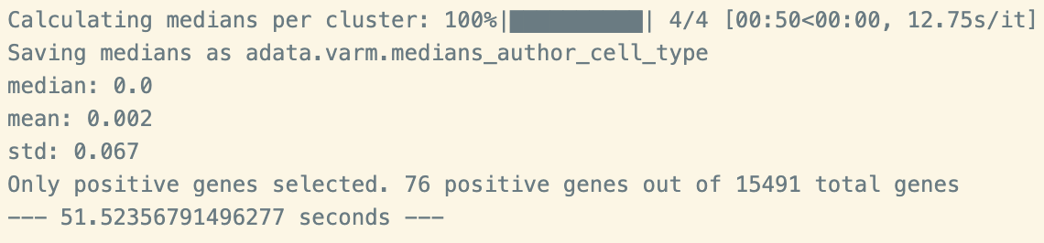
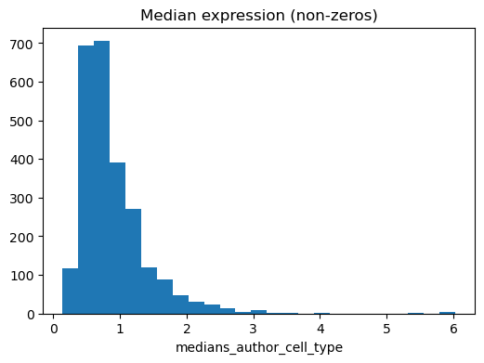
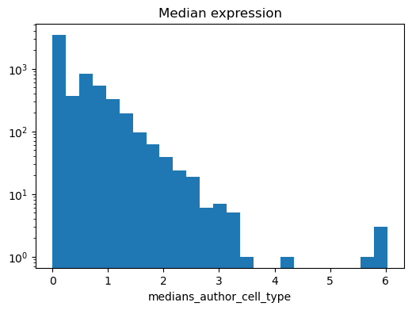
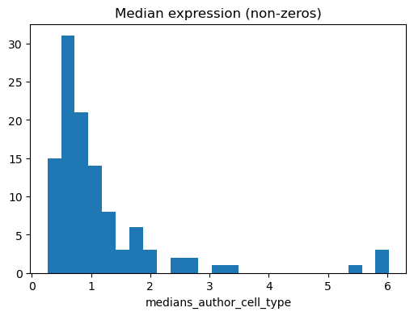
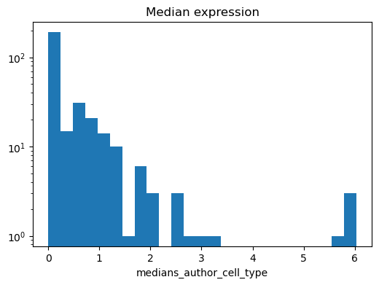
Cluster Medians (Non-Neuron)
All Genes
lncRNA
Unscaled
Log
Unscaled
Log
Notes:
Approximately the same as in the scRNA dataset
REMINDER: x axis is median expression of gene in a cluster, y axis is number of gene-cluster pairs with that binned expression

Slide 30
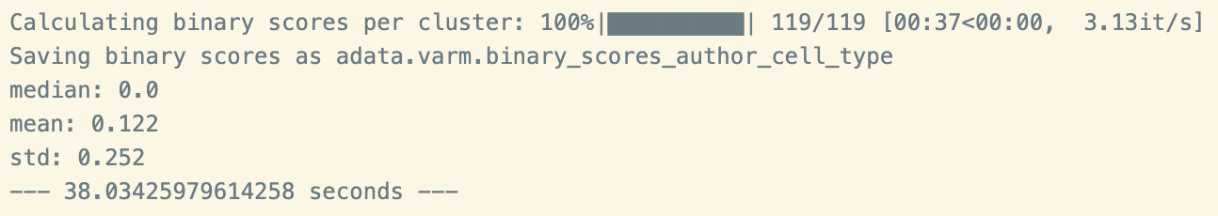
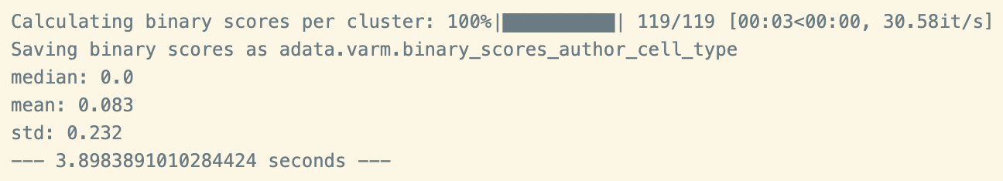
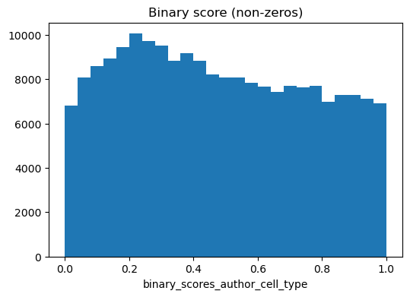
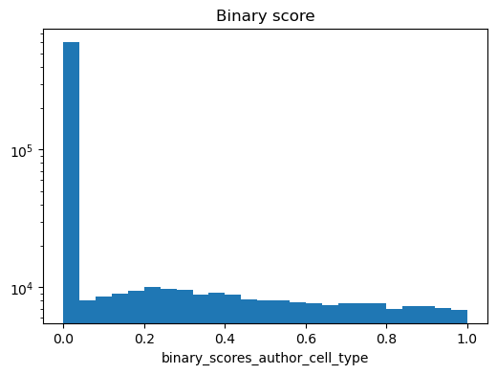
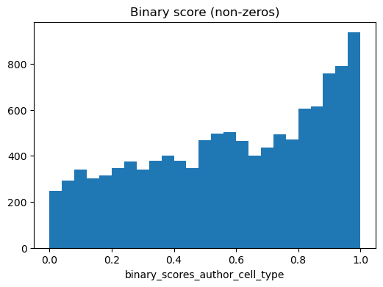
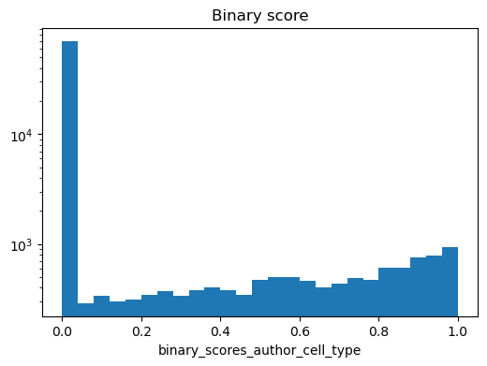
Binary Scores (Neuron)
All Genes
lncRNA
Unscaled
Log
Unscaled
Log
Notes:
Approximately the same as in the scRNA dataset
REMINDER: x axis is binary score of gene in a cluster, y axis is number of gene-cluster pairs with that binary score

Slide 31
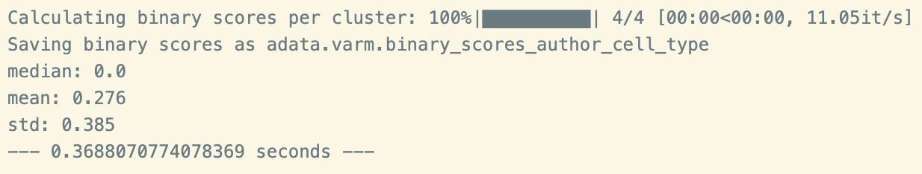
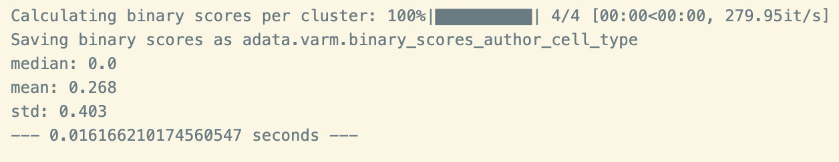
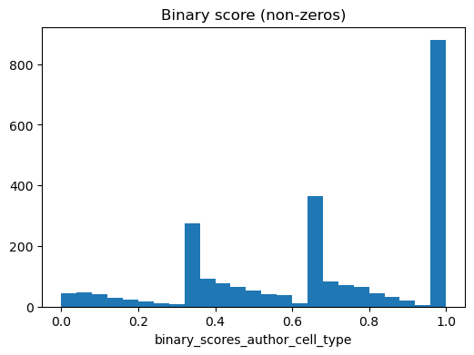
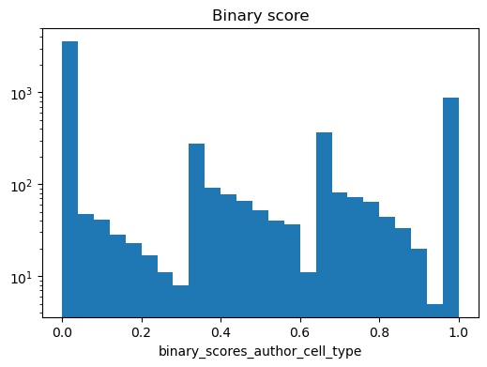
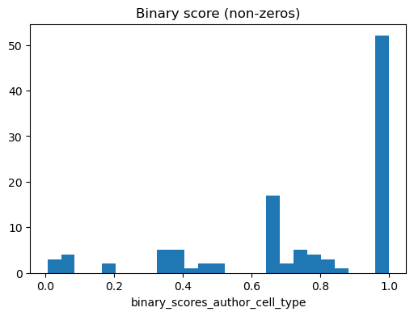
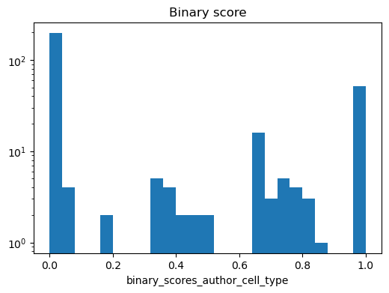
Binary Scores (Non-Neuron)
All Genes
lncRNA
Unscaled
Log
Unscaled
Log
Notes:
Approximately the same as in the scRNA datasets
REMINDER: x axis is binary score of gene in a cluster, y axis is number of gene-cluster pairs with that binary score

Slide 32
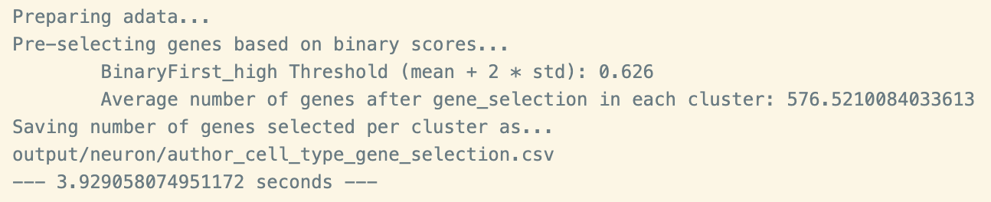
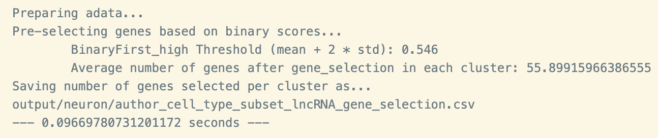
NS-Forest (Neuron)
All Genes
lncRNA

Slide 33


NS-Forest (Non-Neuron)
All Genes
lncRNA

Slide 34
Future Directions and Poster Titles

Slide 35
Decide upon retina cell type annotations.
Less amacrine granularity? Run on HPC?
Try to find annotations for higher non-neuronal granularity?
Just going to run on the full data and color based on neuron vs non-neuronal. Unsure that it's worth figuring out stratification if we're not focusing exclusively on retina.
Run on the rest of the tissues and assemble results.
Once I have that, I can compare cluster median/binary score/performance results across tissues and gene subsets.
Make personal visualization suite.
Poster title...
Comparative evaluation of lncRNA feature sets for cell type prediction across
Notes:
Added stratification for kicks

Slide 36
Don't want to get into results when there's still runs and analysis yet to completed.
Key elements are lncRNA, neural vs non-neural human tissue/structures, cell type biomarkers, etc.
Brainstorm:
Comparative evaluation of lncRNA feature sets for cell type prediction across neural and non-neural human tissues.
Evaluating lncRNA expression, specificity, and effect on biomarker selection across neural and non-neural human tissues.
Comparing whole transcriptome and lncRNA subset for cell type prediction in diverse tissue types.
Characterizing lncRNA expression and role in computationally predicted biomarker discovery for neural vs non-neural cell types.
Neural and non-neural tissue differences in lncRNA expression and cell type biomarker potential.
Notes:
Added stratification for kicks

Slide 37
Preliminary Results for NS-Forest Comparison Runs on Retina and Kidney Data
Vik Becker
National Library of Medicine (NIH)

Slide 38
Overview
Summary of NS-Forest Comparison Pipeline.
Results on HCA Retina Data.
Results on HuBMAP Kidney Data.
Future Directions

Slide 39
Summary of NS-Forest Comparison Pipeline.

Slide 40
Basic Pipeline
Load raw sc/snRNA-seq Cell x Gene Data (scanpy).
Optional: Downsample by cell type (celltypist).
Obtain lncRNA subset from data (anndata).
Perform preprocessing on full and subset data:
Generate dendrograms (scanpy).
Calculate cluster medians per gene (nsforest).
Calculate binary scores per gene per cluster (nsforest).
Run NS-Forest on the full and subset data (nsforest).
Run visualization suite (nsforest).

Slide 41
Results on HCA Retina Data.

Slide 42


Raw Data and Gene Type Counts

Slide 43
Cell Type Counts
n (cells) = 265,767
Downsample
n (cells) = 150,000

Slide 44


Dendrograms
All Genes
lncRNA

Slide 45






Cluster Medians
All Genes
lncRNA
Unscaled
Log
Unscaled
Log

Slide 46






Binary Scores
All Genes
lncRNA
Unscaled
Log
Unscaled
Log

Slide 47


NS-Forest
All Genes
lncRNA

Slide 48


Dot Plot
All Genes
lncRNA

Slide 49


Heat Map
All Genes
lncRNA

Slide 50


Box Plot
All Genes
lncRNA

Slide 51
Results on HuBMAP Kidney Data.

Slide 52


Raw Data and Gene Type Counts

Slide 53


Cell Type Counts
n (cells) = 304,652
Downsample
n (cells) = 150,000

Slide 54


Dendrograms
All Genes
lncRNA

Slide 55






Cluster Medians
All Genes
lncRNA
Unscaled
Log
Unscaled
Log

Slide 56






Binary Scores
All Genes
lncRNA
Unscaled
Log
Unscaled
Log

Slide 57


NS-Forest
All Genes
lncRNA

Slide 58


Dot Plot
All Genes
lncRNA

Slide 59


Heat Map
All Genes
lncRNA

Slide 60


Box Plot
All Genes
lncRNA

Slide 61
Future directions.

Slide 62
Run without down-sampling (likely need Biowulf).
Calculate ratio of the median number of passed genes per cluster from full to lncRNA subset for full and subset.
n (genes passed to NS forest) : N (all genes in data)
Examine clusters that had small amount or no lncRNAs pass the threshold versus those that did.
Run coding RNA or complement to lncRNA subset to see lncRNA contribution to full cluster median and binary score distributions.
Run on other neural and non-neural related organs.
See if any markers we found (or missed) are experimentally validated.
Test marker evaluation on experimentally validated markers for retinal cell types.
lncRNA biomarkers more commonly validated for disease :[

