Slide 1
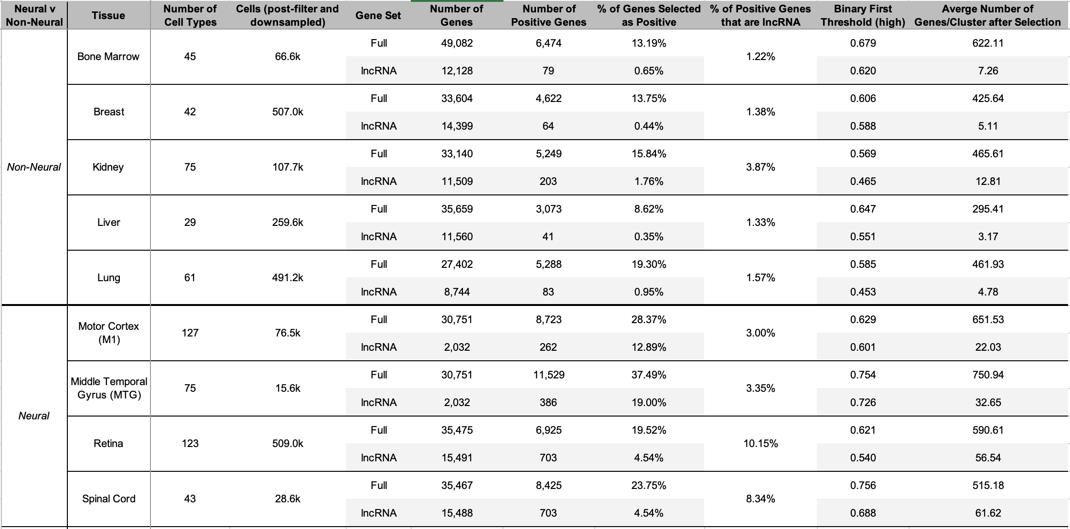
Notes:
Double check "positive gene"

Slide 2
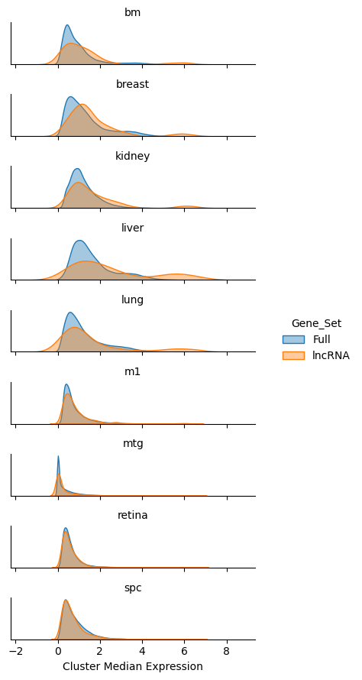
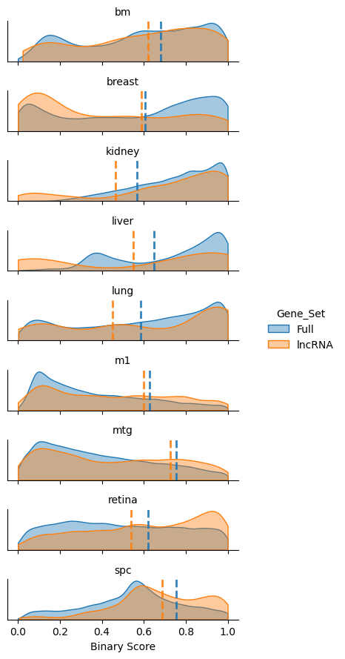
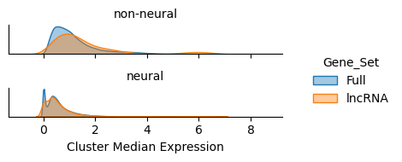
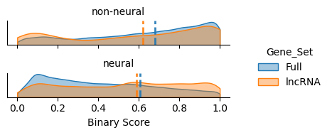
Cluster Median (gene-cluster pairs)
Binary Scores (gene-cluster pairs)

Slide 3
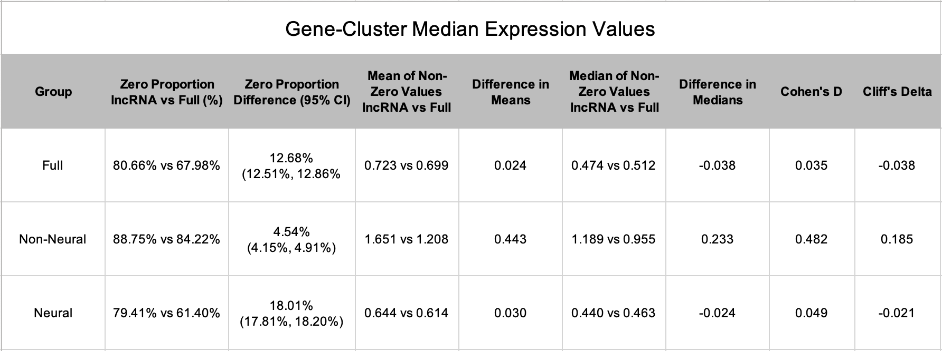
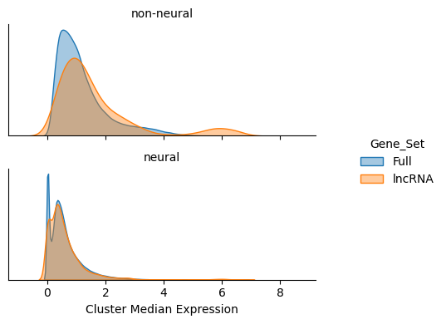
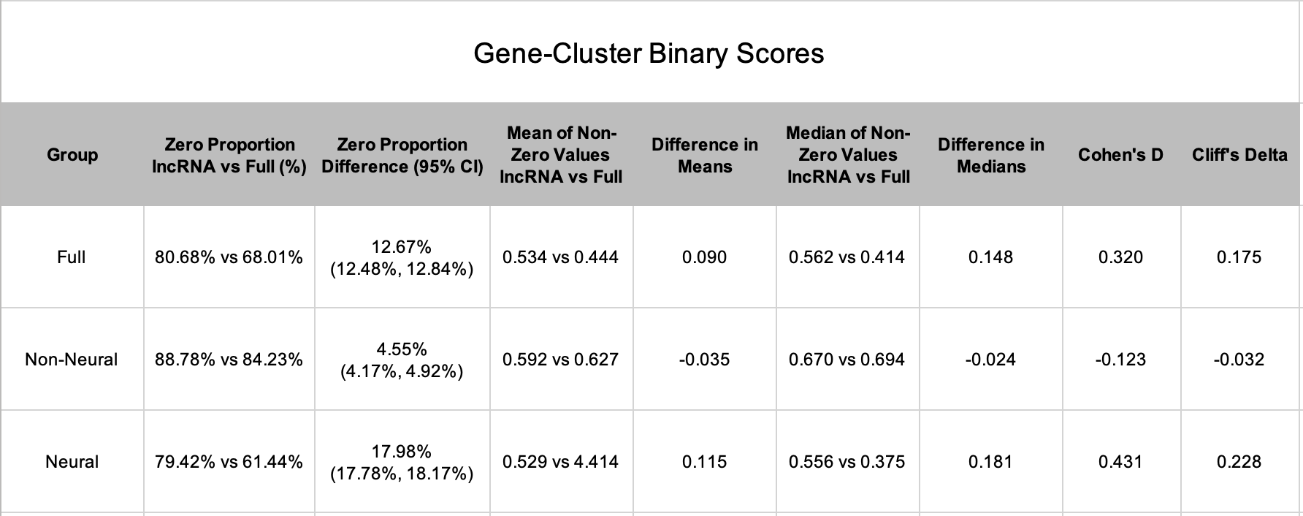
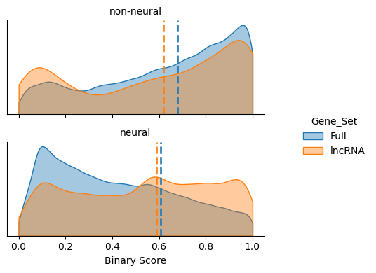
Notes:
Not sure that I want to keep the full group, but have regardless
Higher binary scores -> more cell type specific
Run on coding subset (don't worry about pseudogenes)
For cohen and cliff, it was group A lnc and group B full. Aka magnitude is strength, positive = lncRNA higher, negative = full higher
δ near 0: The two groups overlap substantially; one group does not tend to outperform the other.
δ near +1: Almost every observation in group A exceeds the corresponding observation in group B — strong stochastic dominance.
δ near −1: Group B dominates group A in nearly every pairwise comparison.
Confidence interval includes 0: The direction of the effect is uncertain; interpret the point estimate cautiously.
Medium effect (δ ≈ 0.40): In a clinical context this would suggest a practically meaningful difference worth reporting to stakeholders.

Slide 4
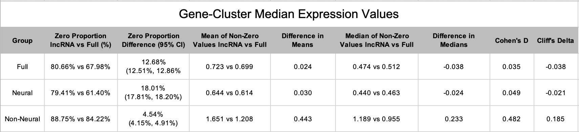
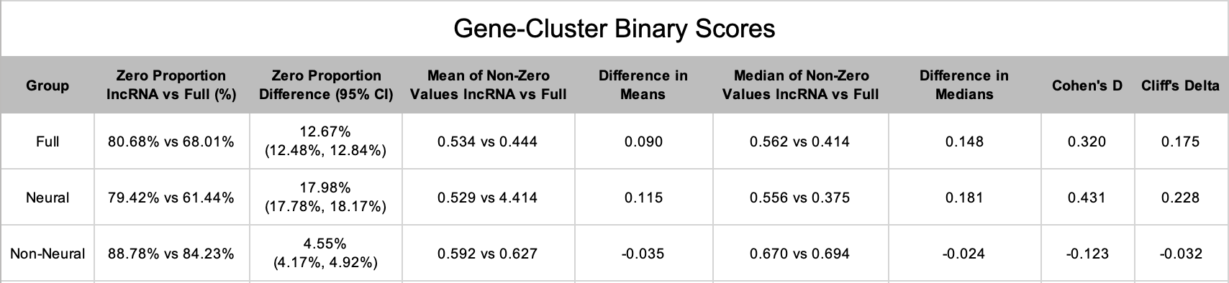
Notes:
Not sure that I want to keep the full group, but have regardless

Slide 5
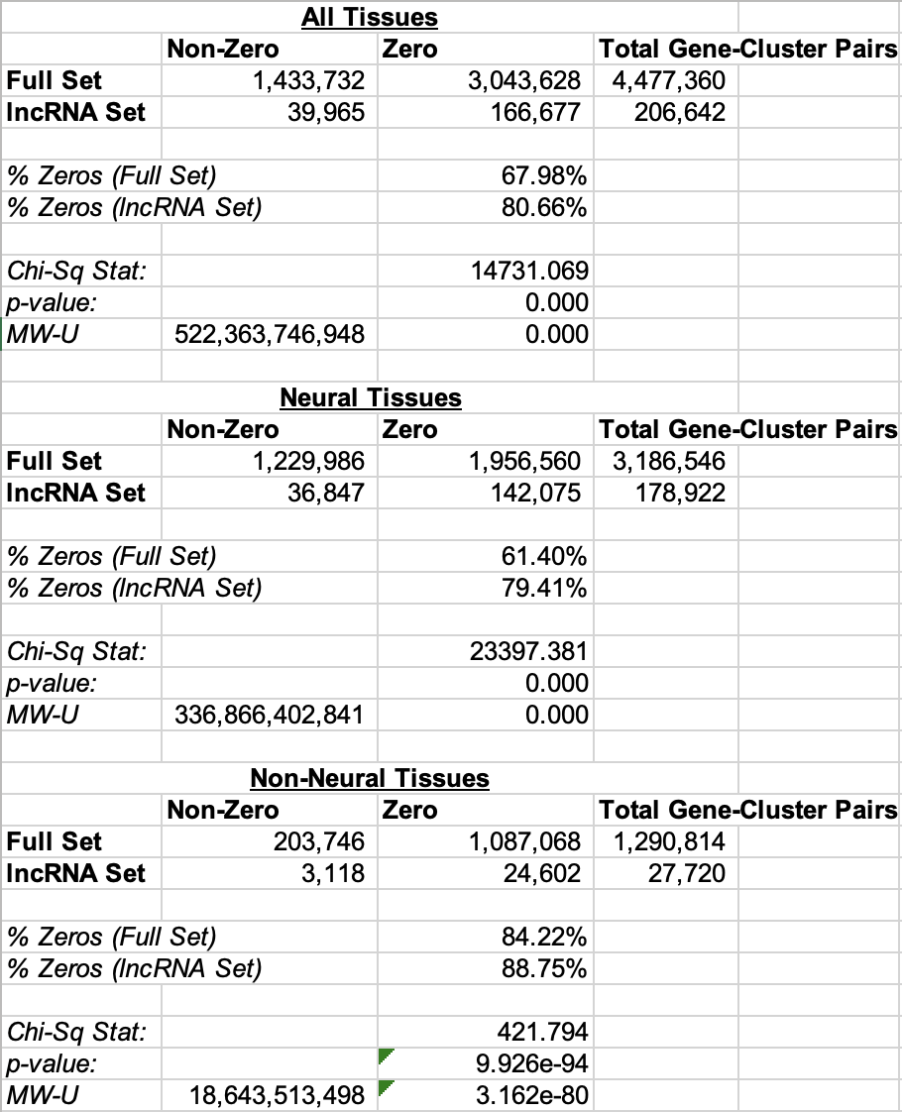
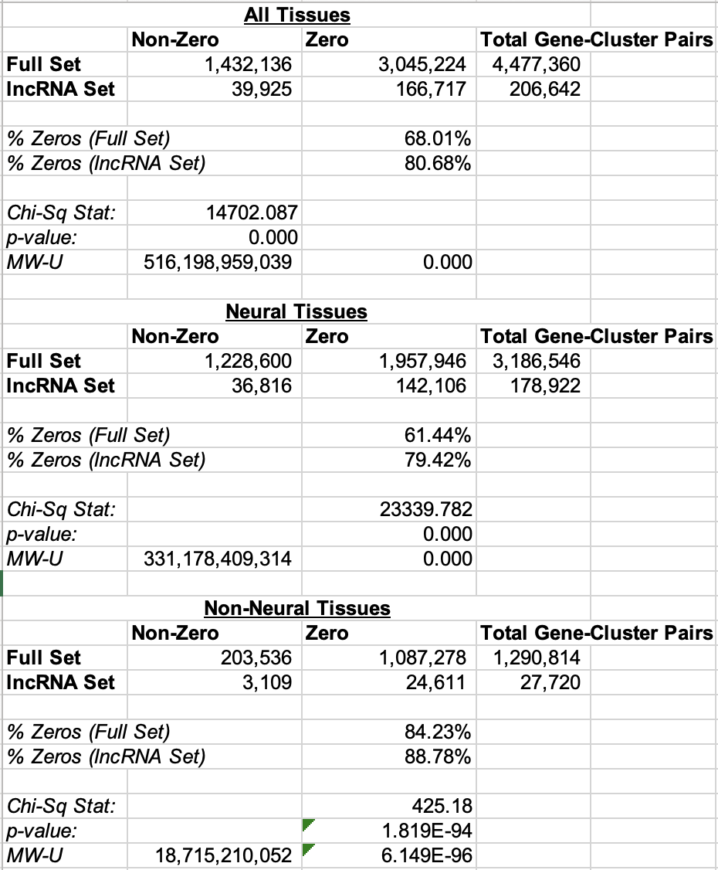
Cluster Median
Binary Scores
Notes:
Frequentist testing, not particularly descriptive since at this sample size basically any p-value will be significant.

Slide 6
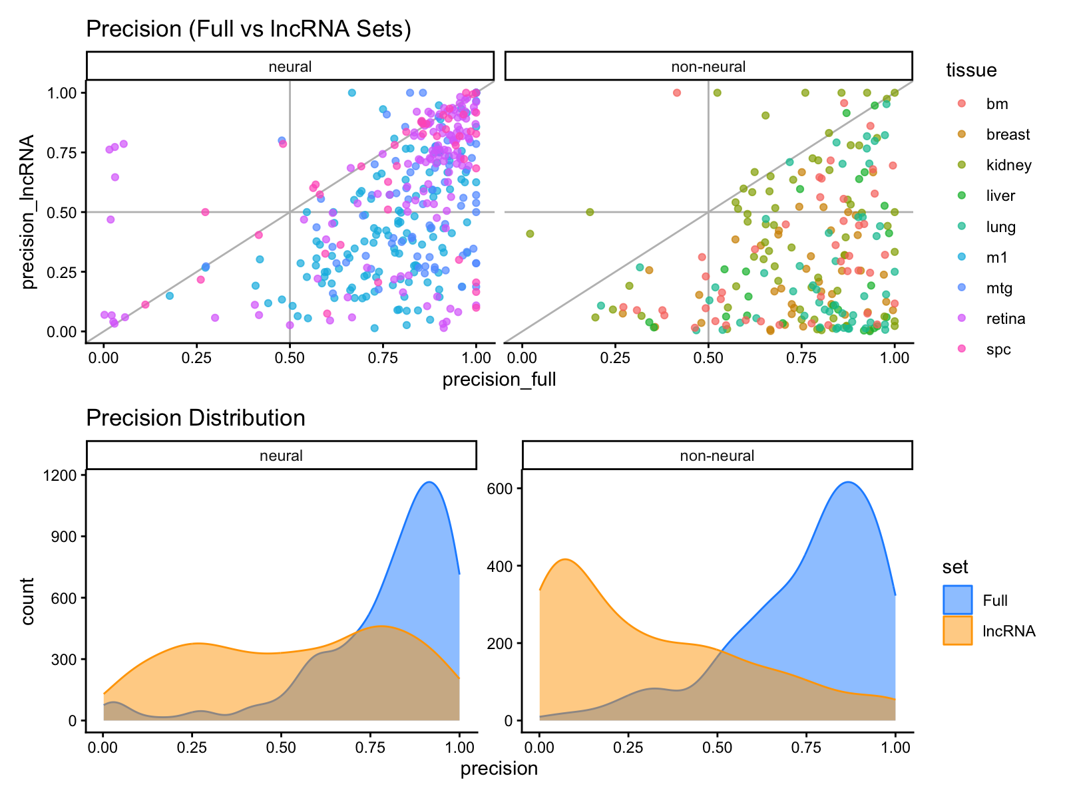
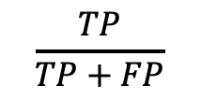
$$\frac{TP}{TP+FP}$$
Notes:
convert to 2d density plot
Look into importance metric
Downsample coding genes subset to lncRNA proportion (similar distribution)

Slide 7
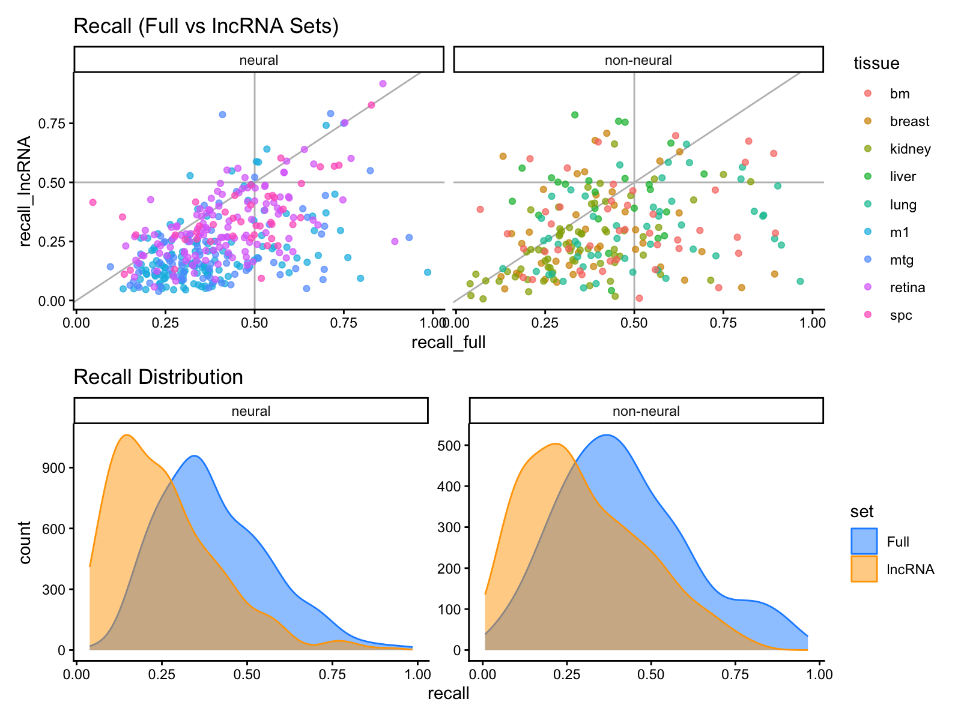
$$\frac{TP}{TP+FP}$$
Notes:
Improved recall -> cell types with high lncRNA expression

Slide 8
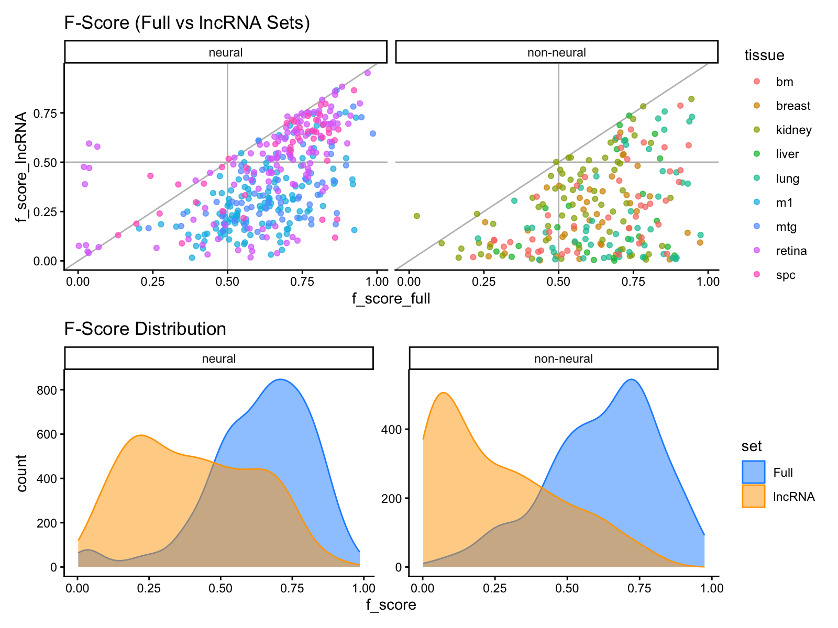

Slide 9
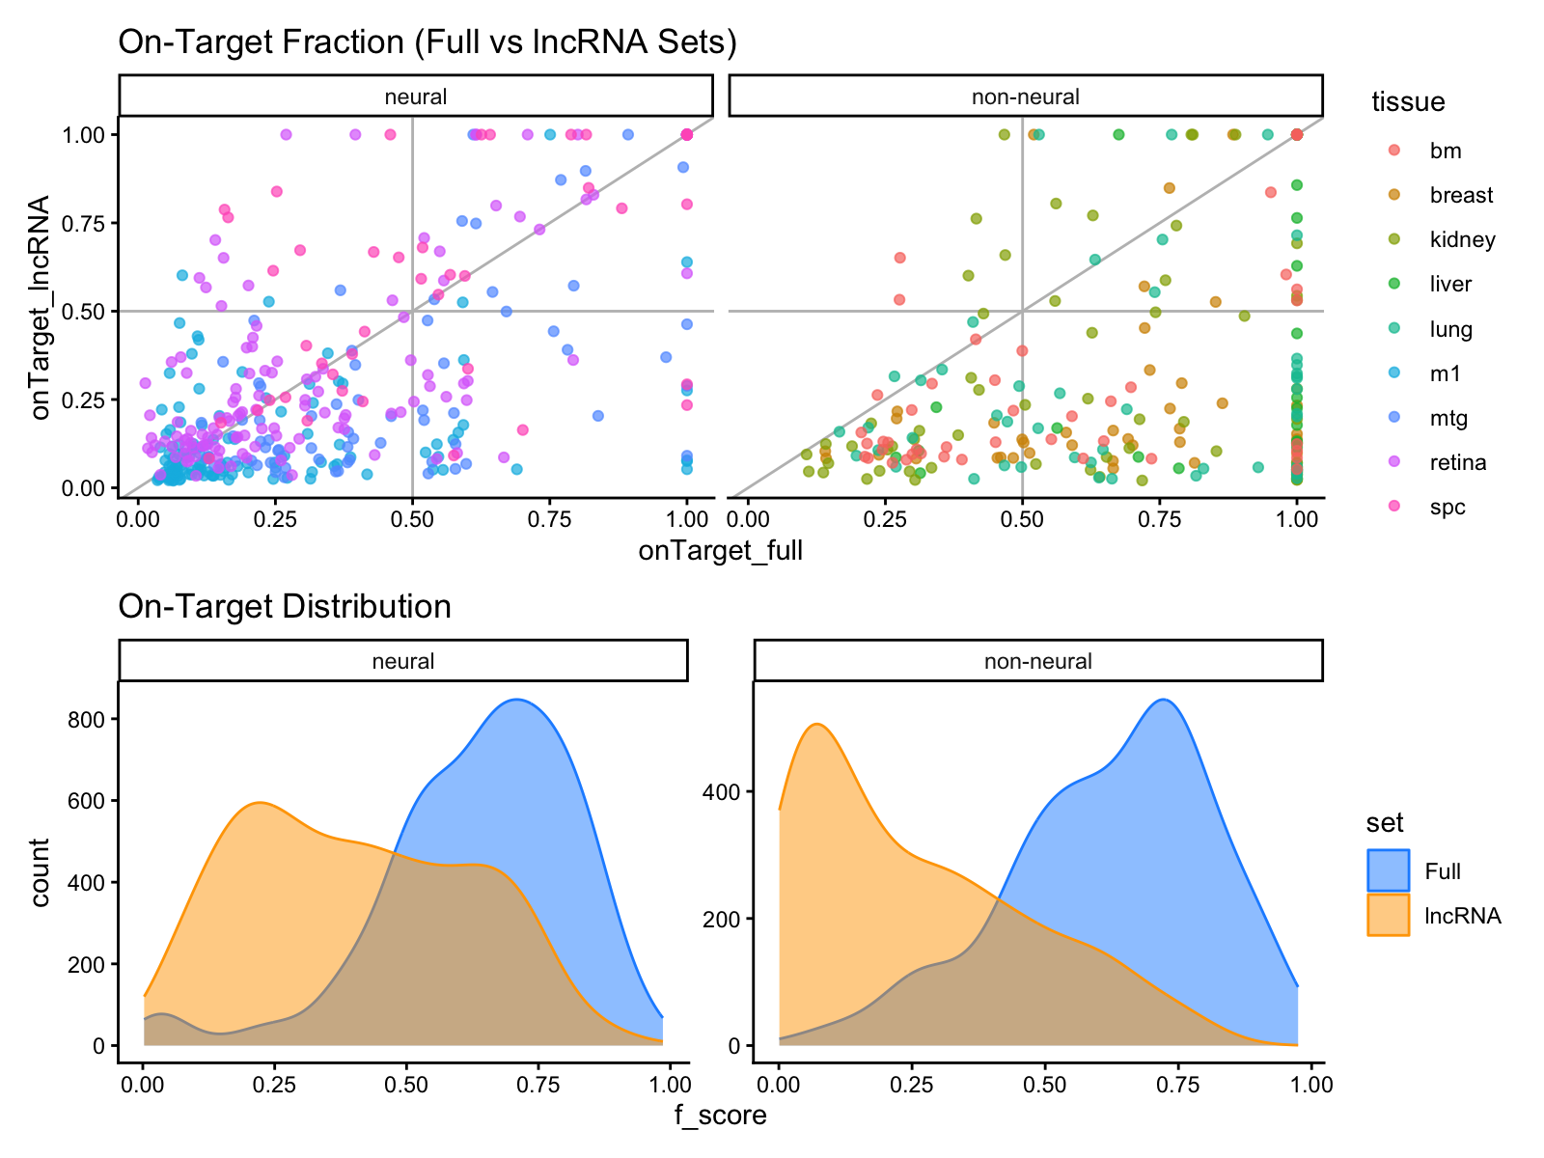
Notes:
Expression metric in comparison to other classification metrics
Measures how well NSForest achieves the ideal scenario of identifying markers for each cluster that are exclusively expressed in that cluster.
On Target Fraction (of gene g in cluster T) = median expression in target cluster / sum of median expression across all clusters
- focus on binary score but include on-target fraction

Slide 10
My Retention Demonstration Woes
Notes:
Expression metric in comparison to other classification metrics
Measures how well NSForest achieves the ideal scenario of identifying markers for each cluster that are exclusively expressed in that cluster.
On Target Fraction (of gene g in cluster T) = median expression in target cluster / sum of median expression across all clusters

Slide 11
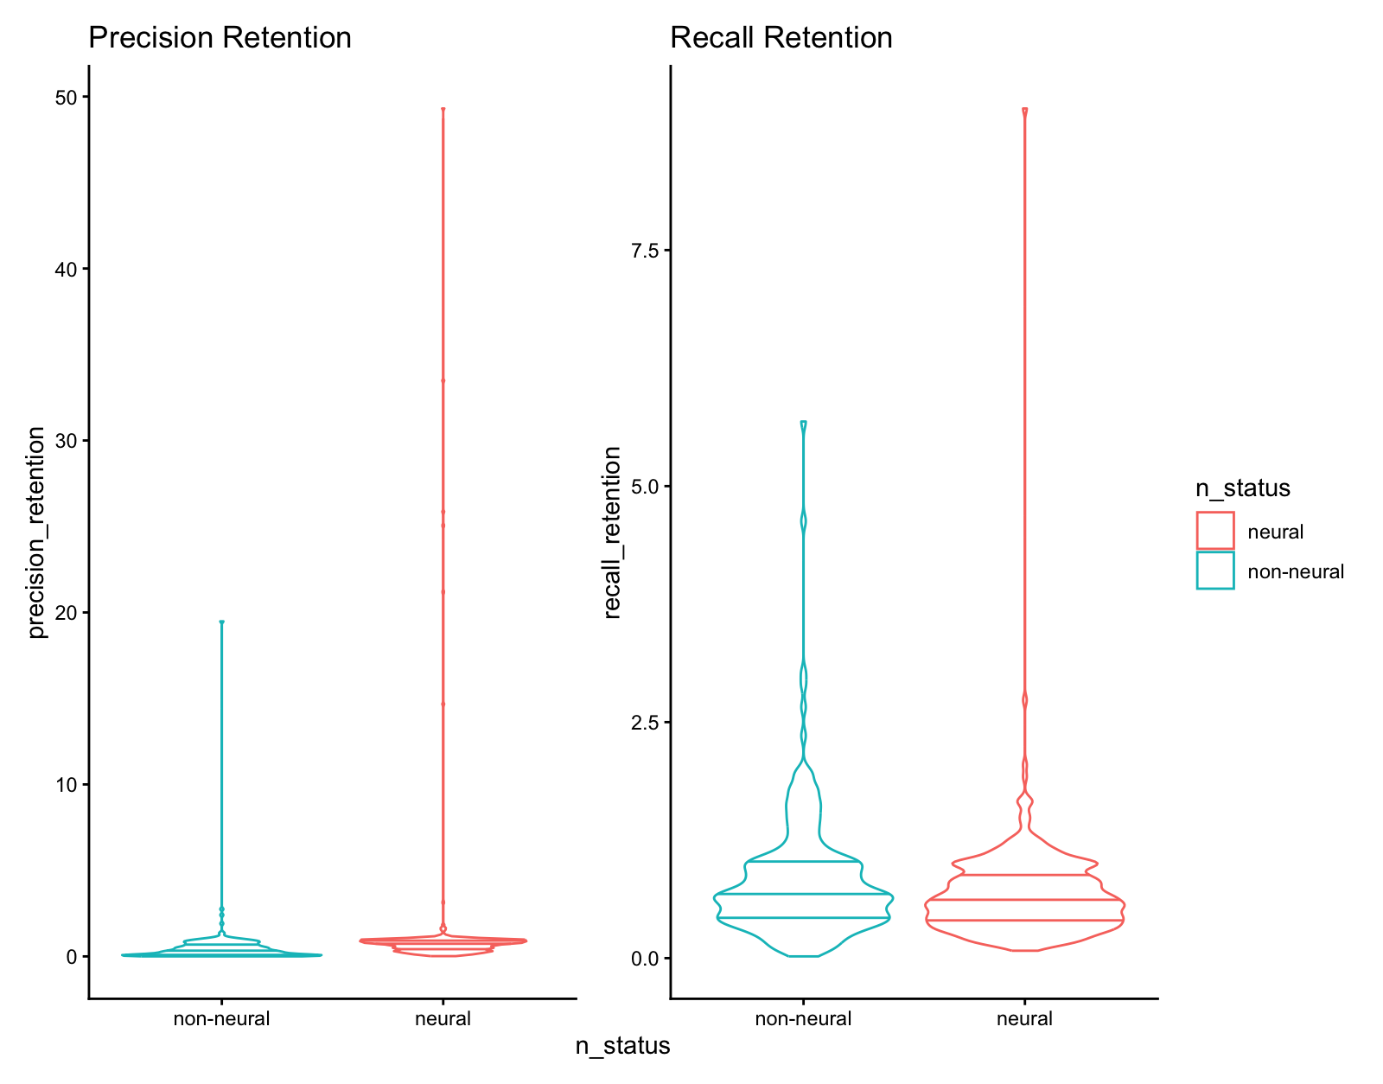
Raw Retention
Notes:
Don't think this visualization

Slide 12
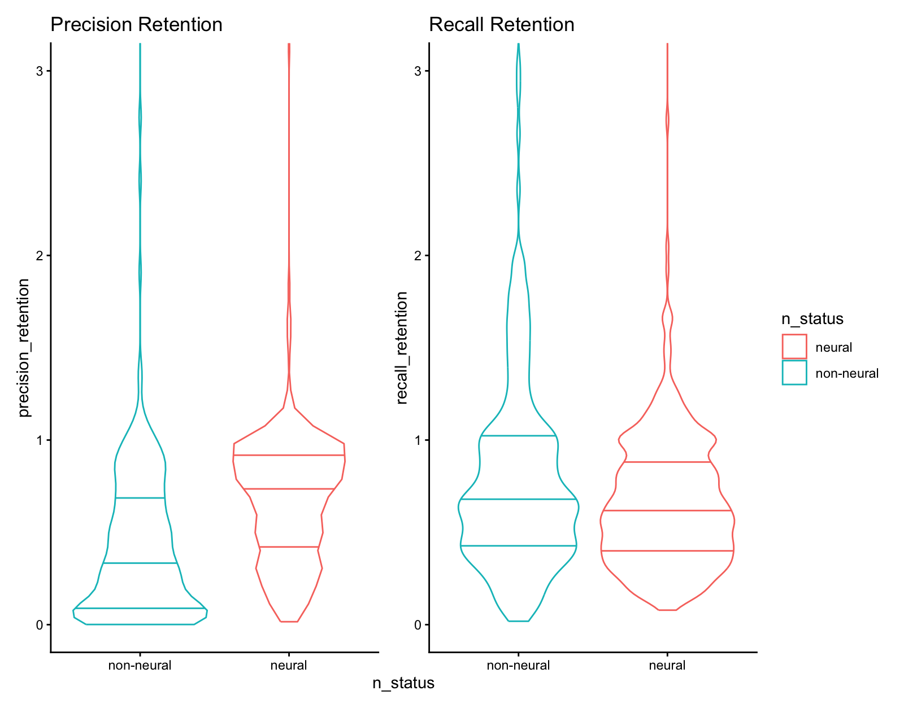
"Zoomed In" Retention
Notes:
Don't think this visualization

Slide 13
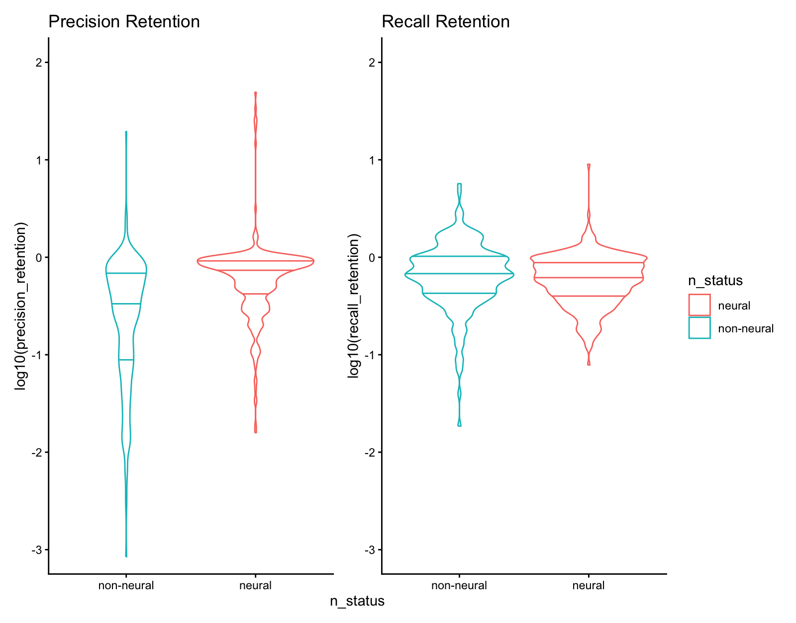
Log-Scale Retention
Notes:
Least favorite, emphasizes extremes over more pertinant differences within the log(retention) = -1 range
log2

Slide 14
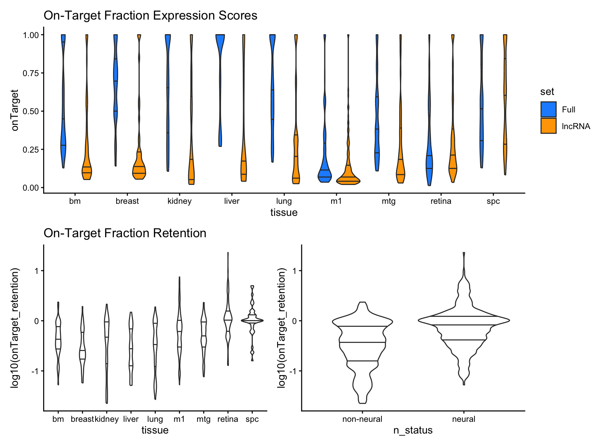
Notes:
Expression metric in comparison to other classification metrics
Measures how well NSForest achieves the ideal scenario of identifying markers for each cluster that are exclusively expressed in that cluster.
On Target Fraction (of gene g in cluster T) = median expression in target cluster / sum of median expression across all clusters

Slide 15
Notes:
lncRNA has higher precision than sim number of coding genes inneural prediction, non-neural has lower.
Coding protein performance relatively similar, lncRNA performance changes across tissues

