Slide 1
My First Powerpoint
Jan X
Department of Slides
January 2024
London
Notes:
Cover slide option #3

Slide 2
Introducing Dickinson United
Dickinson: From steeds to hens, we deliver
Family-owned since 1985
Quality equine and poultry in one place
Ethical and sustainable practices

Slide 3
Our Sales Went UP in the past!

Slide 4
Table of Sales – not bad, huh?
Product | 2009 | 2010 | 2011
Horses | 0.5 | 0.5 | 0
Chickens | 6.5 | 5.8 | 0
Cats | 0 | 0 | 0
Mice | 0 | 0 | 0
Frogs | 0 | 0 | 0
Snails | 0 | 0 | 0

Slide 5
Investment Opportunity
Dickinson is seeking $2.5 million in equity investment to fuel our expansion plans. We're offering a 20% ownership stake in our unique horse and chicken retail business. The minimum investment is set at $250,000. Funds will be allocated towards a new state-of-the-art facility, inventory expansion, and targeted marketing initiatives. We project a 15% annual return on investment over the next 5 years. Our exit strategy includes potential buyout options or an IPO within 7-10 years.
Interested investors are invited to contact CEO Sarah Dickinson directly for access to detailed financials and our comprehensive business plan.

Slide 6
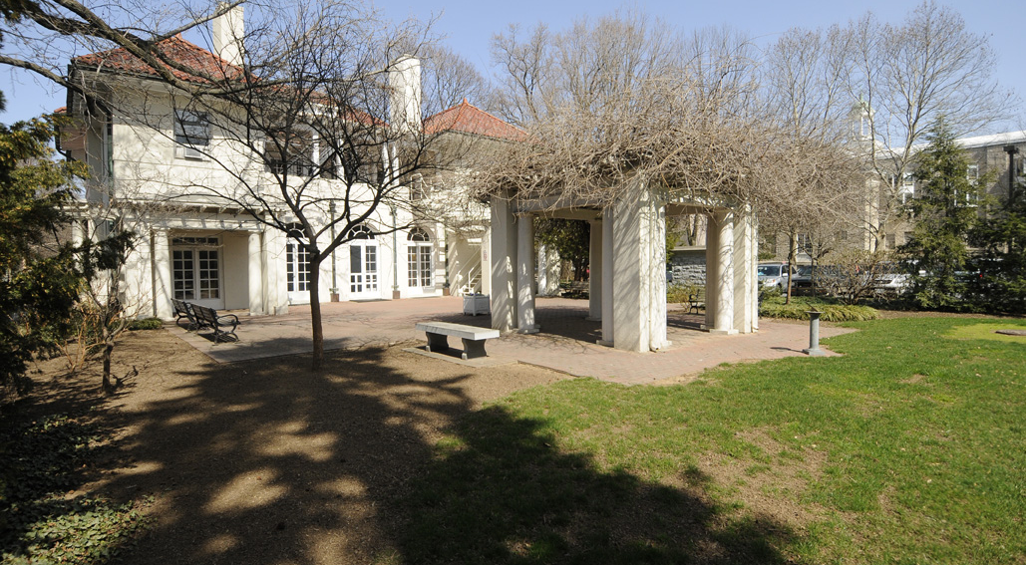
This is our headquarters
Type image caption here.

Slide 7
Thank you!
Notes:
Blank slide

