Slide 1

Group Members – Sohail Inamdar (220343120037)
Aditya Nair (220343120003)
Sadanand Gobade (220343120036)
Sujeet Shinde (220343120102)
Project Guide – Mrs. Harshita Maheshwari

Slide 2
Contents
Introduction
Choice of topic
Proposed System
Methodology
Proposed System Model
Proposed Approach
Screenshot
System Requirements
Applications
Advantages & Limitations
Conclusion
Future Scopes
References

Slide 3
Introduction
HouseHelpers is the website which will provide direct communication between the Helpers and the Customers.
The main objective of our project is to develop a platform that will help people in Metro-cities to directly find and hire helpers according to their needs such as Nanny, Maid, Gardener, Pet Care, etc.
As these Helpers were exploited by brokers which meant they are not getting their hard-earned money completely.
To overcome these drawbacks we came up with this idea..

Slide 4
Choice of topic
Through this project Helpers ensure great profitability.
Easy & Fast
Helper Differentiation

Slide 5
Proposed System
AIM:
1. It will help helpers to earn their hard earned money completely.
Proposed System:
1. Digitalize House services
2. Communication can take place even through mobile
3. Eliminate Intermediates

Slide 6
Methodology
The objective is to create a website that can perform the following:-
Opening the relevant HTML page using HTTPS POST & GET methods.
Read the data logically into Helper, Customer and Admin.
Creating a local database.

Slide 7
Proposed System Model
There are three main modules:
Admin Helper Customer
1 Home 1 Home 1 Home
2 Product Category 2 Helper Services 2 All Services
3 Add customers & Helpers 3 Notification 3 Hire Helpers

Slide 8
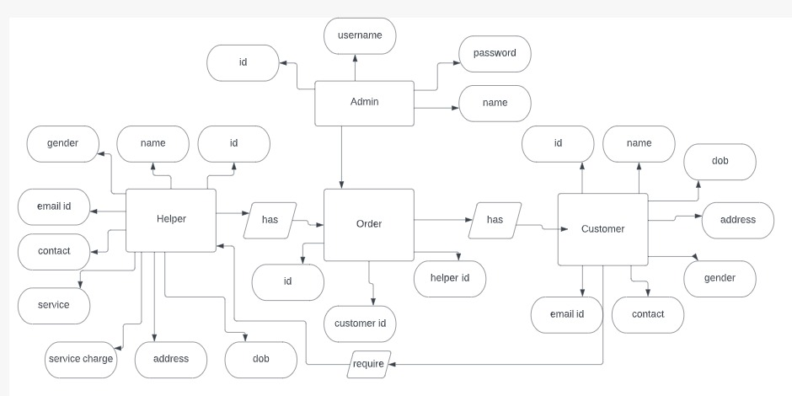
Proposed Approach

Slide 9
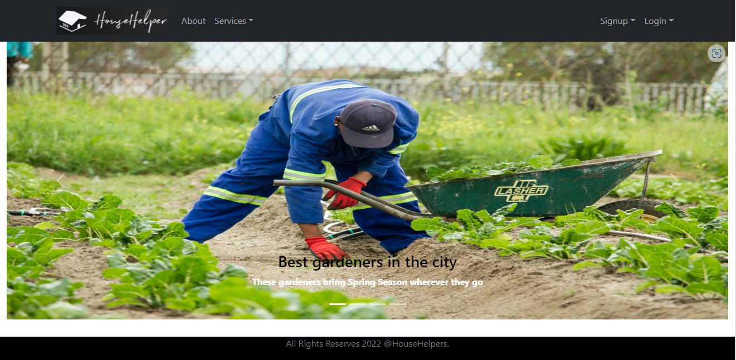
Screenshots

Slide 10
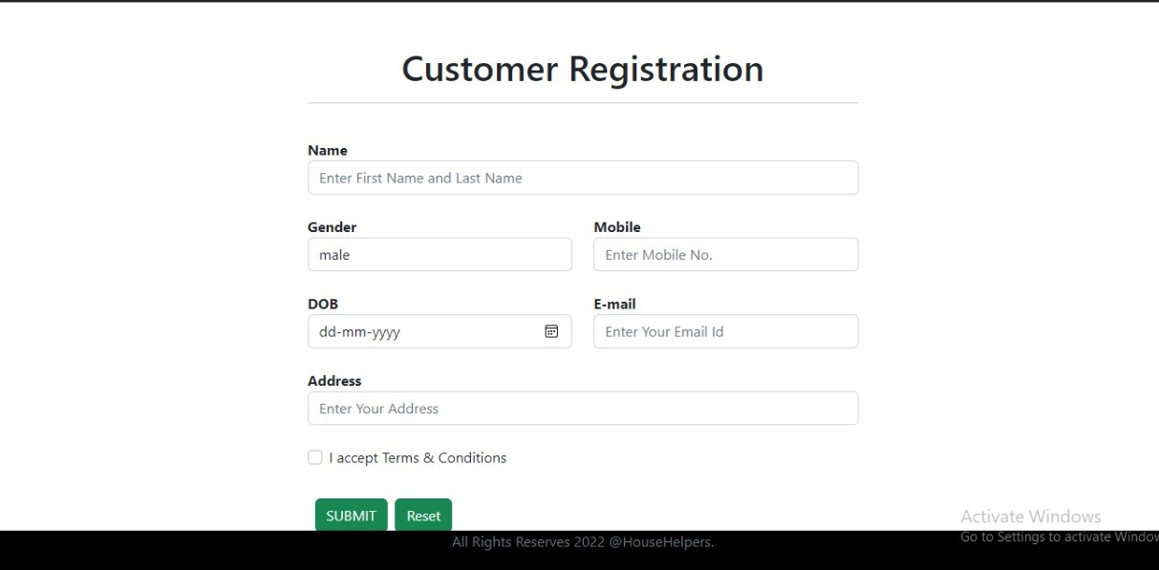

Slide 11
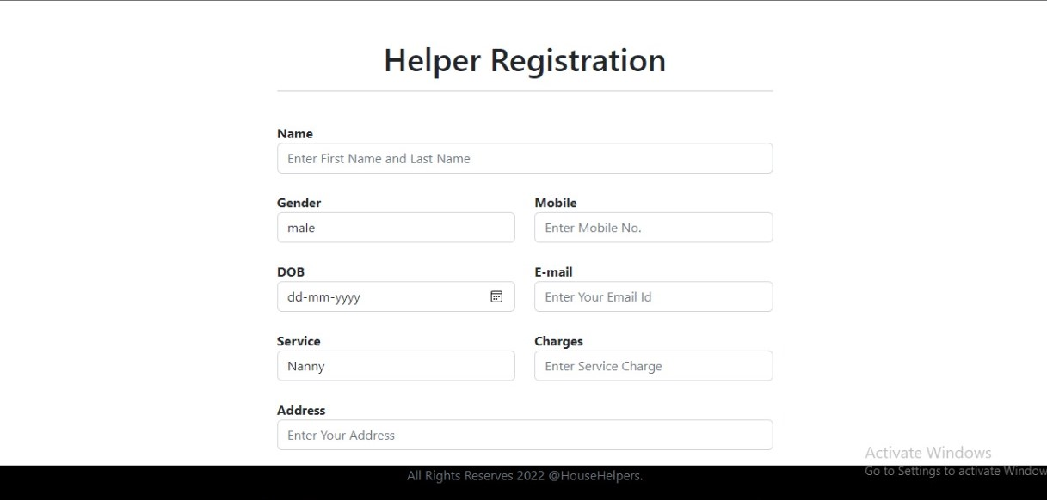

Slide 12
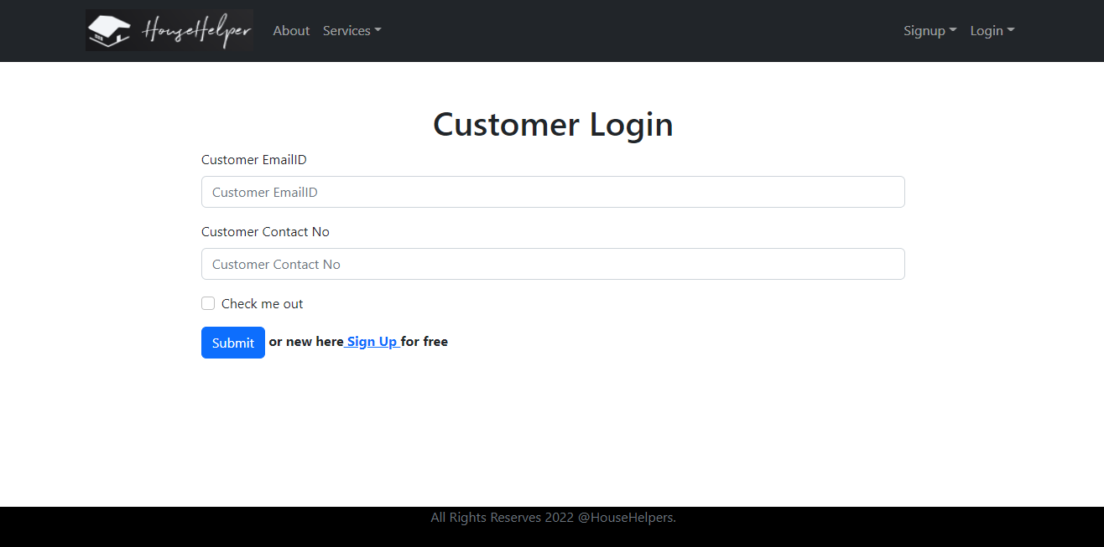

Slide 13
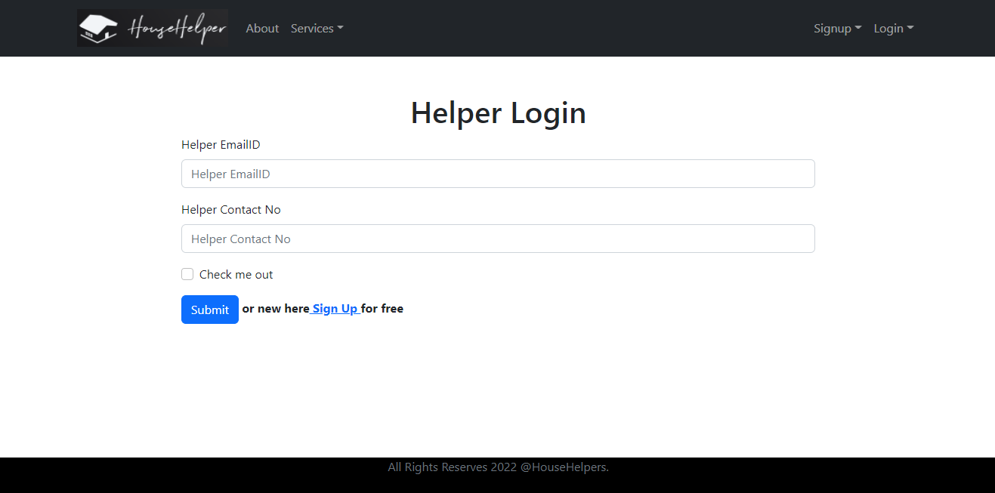

Slide 14
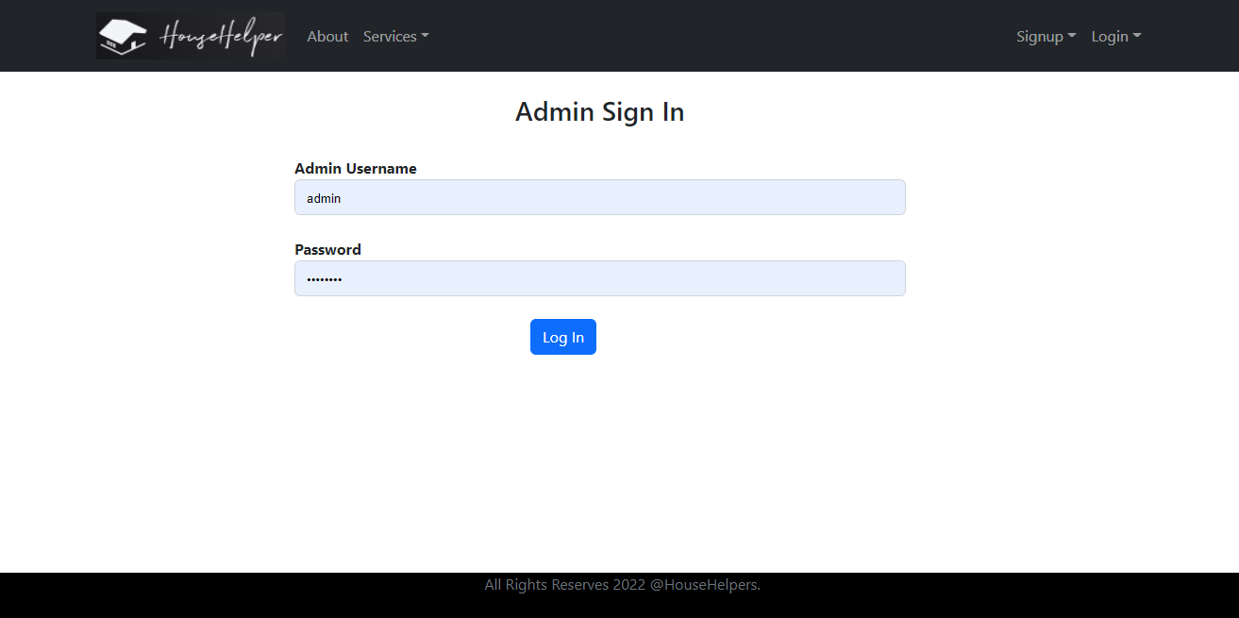

Slide 15
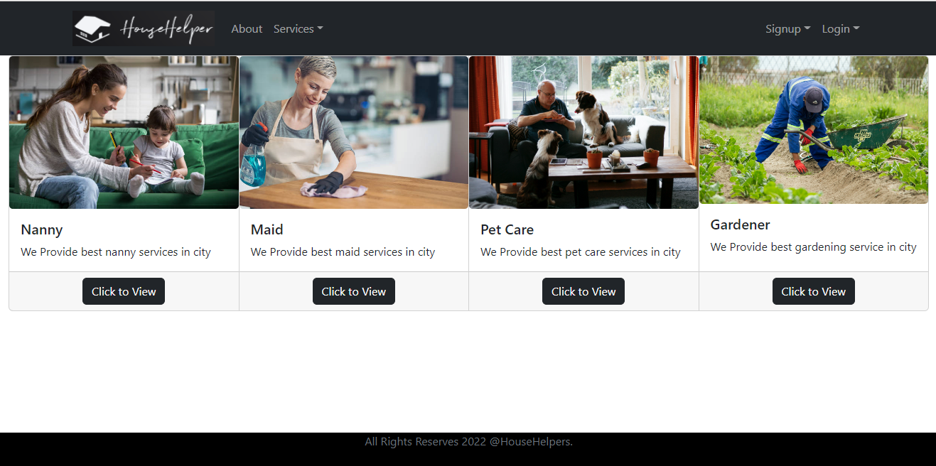

Slide 16
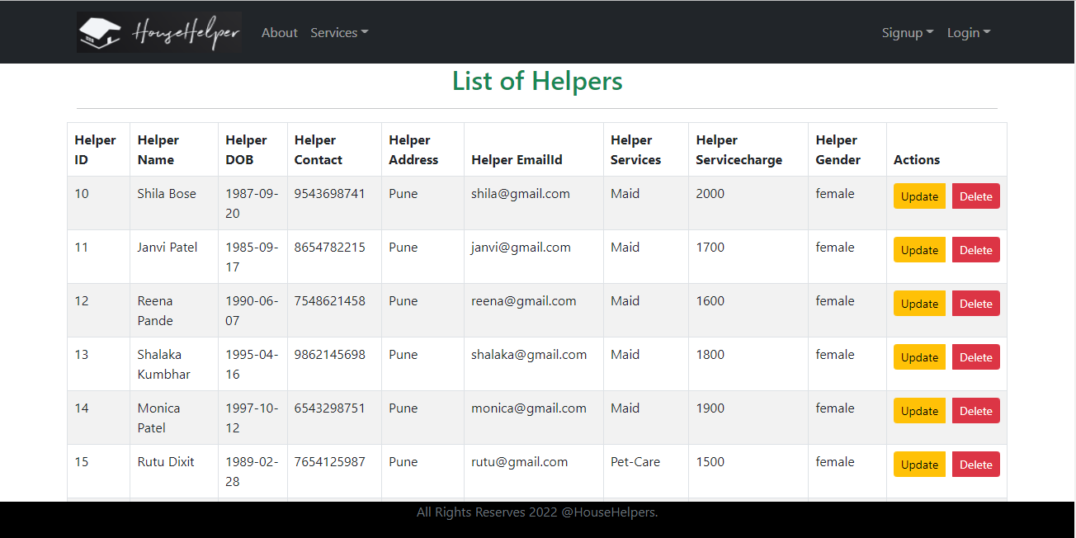

Slide 17
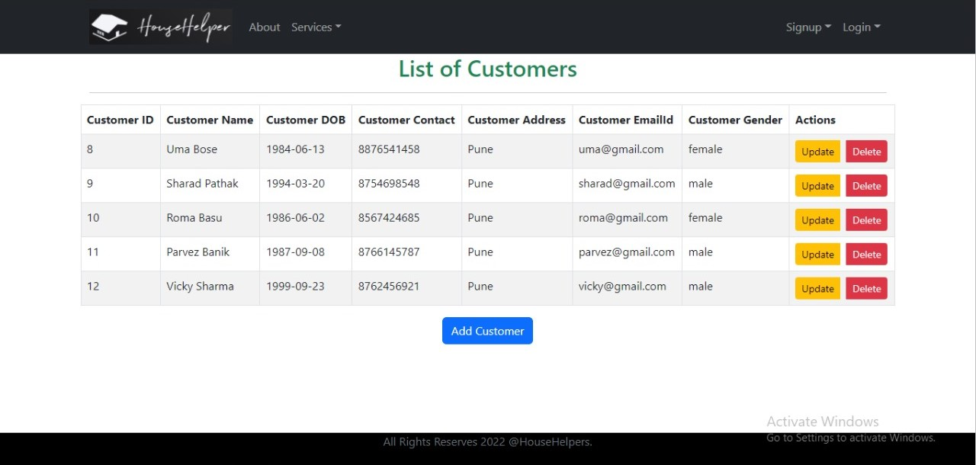

Slide 18
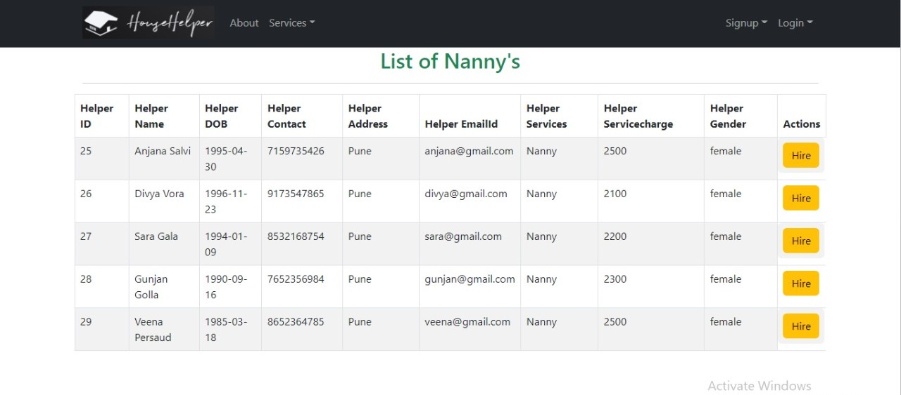

Slide 19
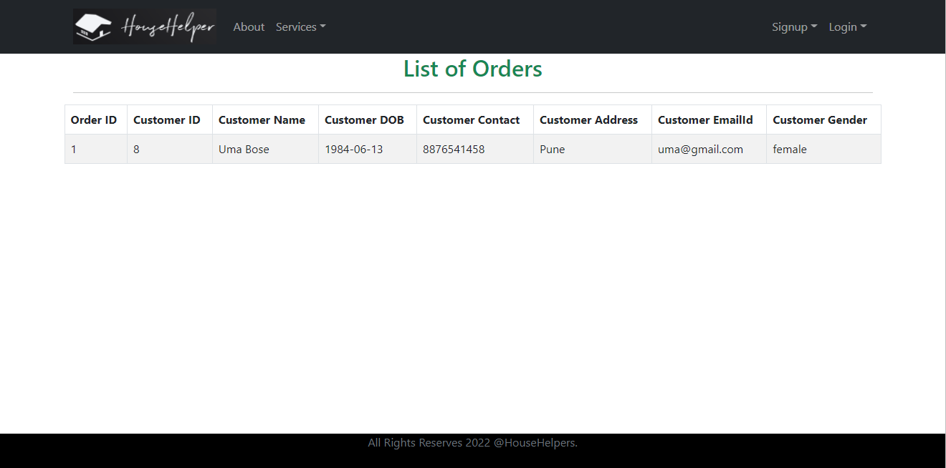

Slide 20
System Requirements
Software Requirements:
• Windows
• Eclipse, MySQL, Google Chrome, Visual Studio Code
Hardware Components:
• Processor – i5, Ryzen 5
• SSD– 256 GB
• Memory – 4GB RAM

Slide 21
Technologies Used
HTML : Page Layout has been designed in HTML.
CSS : Used for all designing part.
JavaScript : All Validation task and animations has been developed by JS.
JAVA : All the business logic has been written in JAVA.
MySQL : MySQL database has been used as database.
Spring Boot : Backend will run using Spring Boot server.
React JS : Frontend is written in React JS .

Slide 22
Applications
Digital House Services
Can be used in other countries
House Services Industry

Slide 23
Advantages
Transparency in the system.
Saves Time, cost and energy.
Helpers can get notifications of any new orders.

Slide 24
Limitations
Accurate verification of the users cannot be done online.
It requires an extensive database and memory.

Slide 25
Conclusion
The House Helpers service will be designed and developed to overcome the drawbacks of old manual system and meet the requirement of modern age.
This system will digitalize the House Services industry and give more profit to Helpers. It will bring transparency between Customers and Helpers by removing intermediates.
It will save time & energy of everyone using this portal.
Lastly it can be improved in future according to rising demand of users.

Slide 26
Future Scope
For time being our project is limited to Pune City only but as our success grow we are going to explore in other metro cities as well.
Furthermore will be adding more services as per users demands.

Slide 27
References
Mr. Saleel Bagde for Database.
Mrs. Harshita Maheshwari for HTML JS & CSS also she was our project guide.
Mrs. Mayuri Fakirpure for Java, Spring boot.
YouTube Tutorials
Udemy Platform
A special thanks to Infoway Management.

Slide 28
THANK YOU

