Slide 1
Williams-Sonoma Coding Challenge
Implementation of Code Challenge by Sunil Kumar

Slide 2
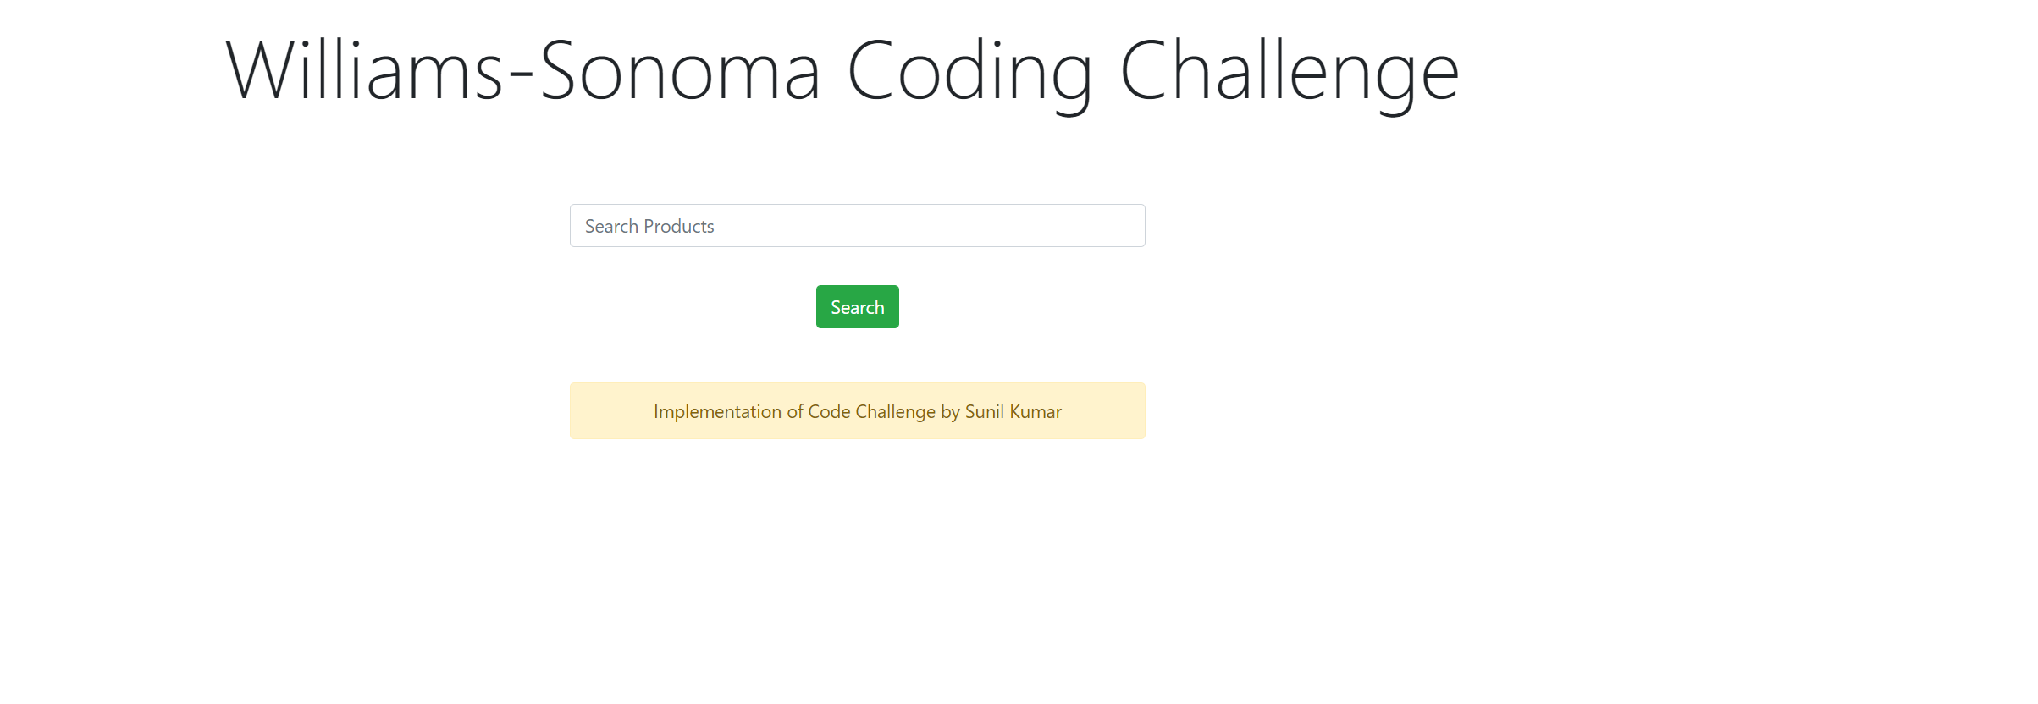
Home Page

Slide 3

After Search

Slide 4

On Iphone

Slide 5
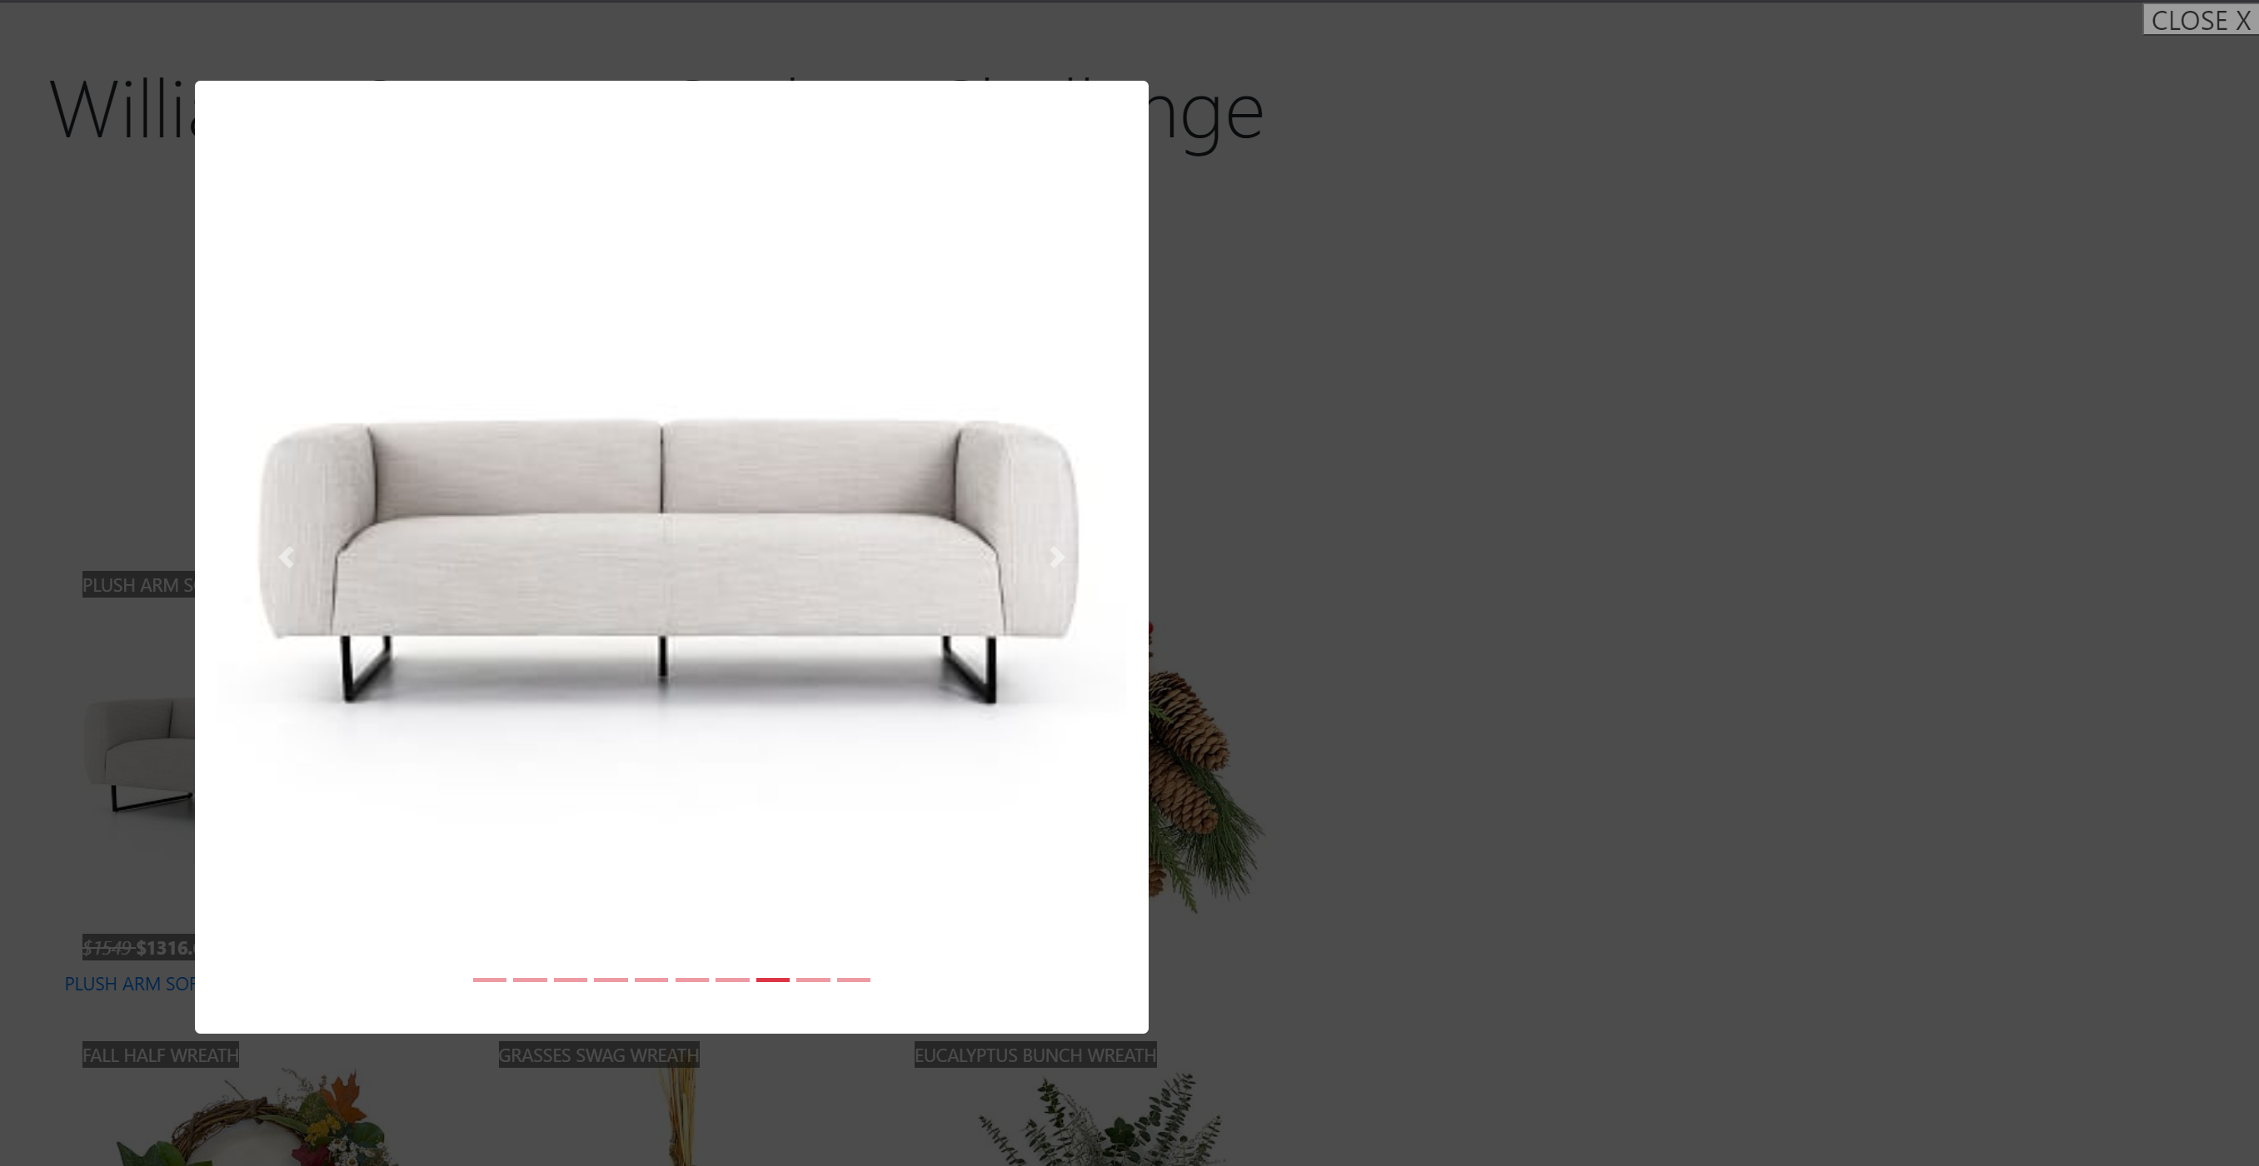
Overlays
Close button

