Slide 1
Project-8 Decision Tree and Neural Networks on Crop Recommendation Dataset
Vinay Achanta and James Sanford-Luevano

Slide 2

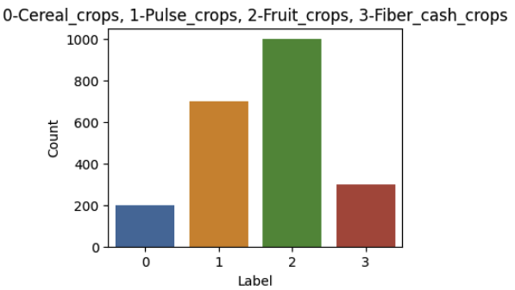
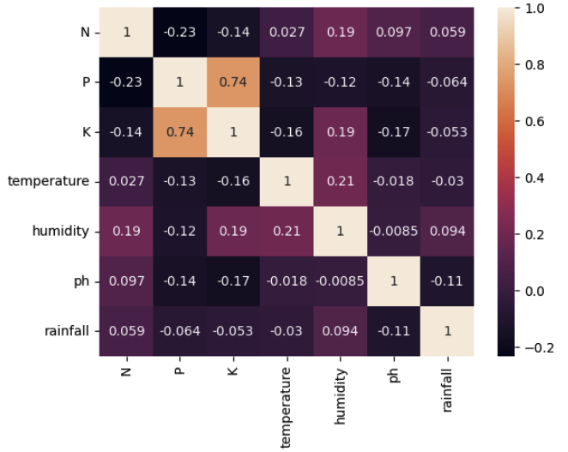
Introduction and Dataset
In this project, we analyze Crop Recommendation Dataset using decision trees and neural networks.
Crop recommendation helps farmers choose the optimal crop to grow in their fields, taking into account various environmental factors includes attributes like nitrogen(N), phosphorus(P), and potassium(K), temperature, humidity, pH, rainfall, and the label for the crop type that corresponds to a given set of attributes.
The dataset has been preprocessed and any missing values have been dropped and standardized attributes. The correlation between the attributes has been analyzed and the potassium attribute has been dropped as it was found to be highly correlated with phosphorus.
The crop names have been categorized into four categories - cereal crops, pulse crops, fruit crops, and fiber cash crops which helps to provide better insights.

Slide 3
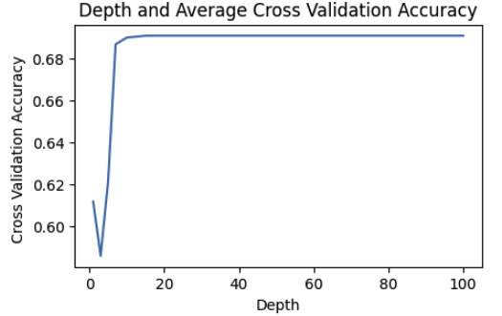
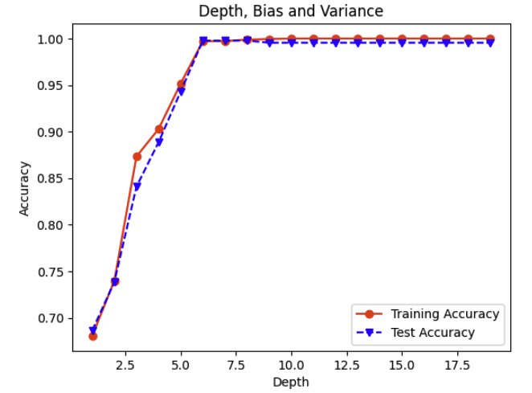
Decision Tree
First, cross-validation was used to train a decision tree classifier for different depths, and the average cross-validation accuracy was computed for each depth.
The results show that the accuracy initially improves with the increase in depth, reaching a maximum of 69.09% at depth 10. However, beyond that, the accuracy flattens out, indicating overfitting of the training data.
Second, the decision tree was plotted at different depths.
The results showed that increasing the depth of the decision tree can reduce bias and increase accuracy up to a certain point, but beyond that point, it leads to overfitting and high variance.
We can get a balance between bias and variance by selecting an appropriate depth for the decision tree model. Also, keeping the depth too low leads to high bias, while increasing the depth beyond a certain point leads to overfitting and high variance.

Slide 4
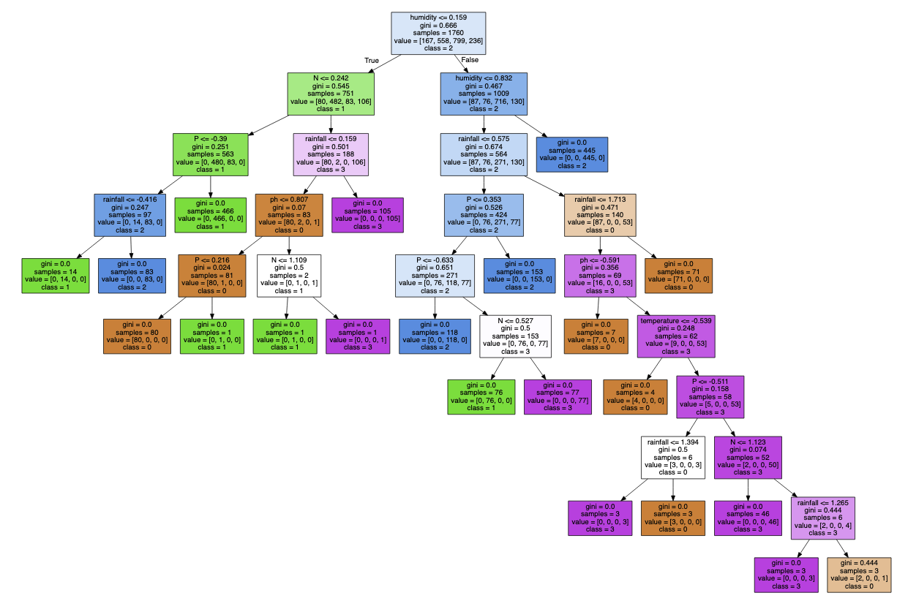
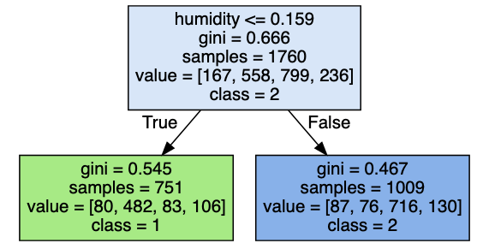
Decision Tree
Decision tree visualization for Depth 9:
Decision tree visualization for Depth 1:

Slide 5
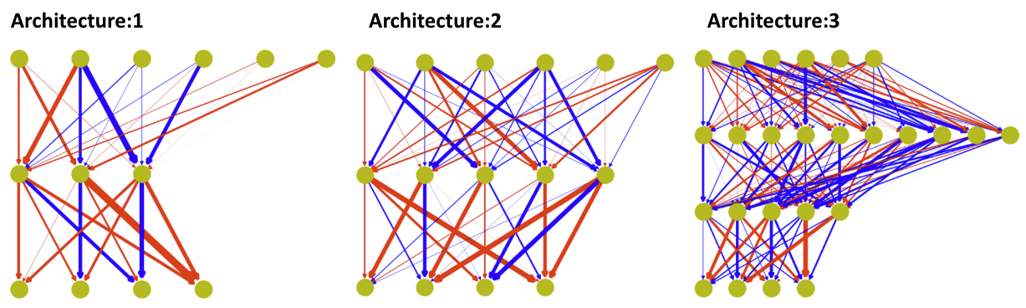
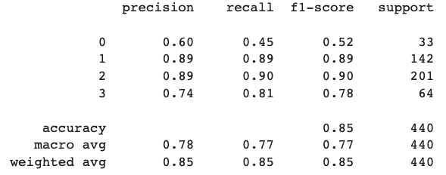
Neural Networks
We tried three different architectures, each with different numbers of hidden layers and nodes in each layer. We used the MLPClassifier class from scikit-learn to create the neural network models. We found that the performance of the models improved with the increasing complexity of the architecture.
Architecture 1: The first architecture used only one hidden layer with 3 nodes. The accuracy was 0.85. The model performed well for classes 1, 2, and 3 but poorly for class 0.

Slide 6
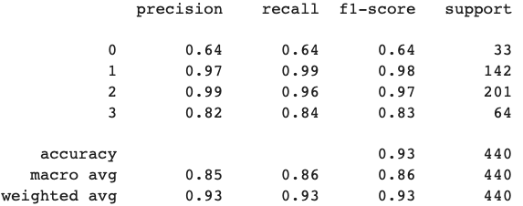
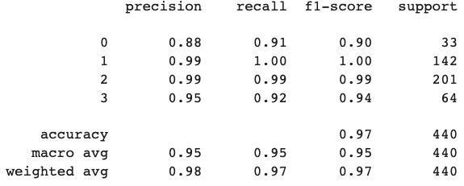
Neural Networks
Architecture 2: The second architecture used only one hidden layer with 5 nodes. The accuracy score was 0.93. The model performed well for all classes, and the second architecture outperformed the first architecture in terms of precision, recall, and accuracy for all classes.
Architecture 3: The third architecture used two hidden layers with 10 and 5 nodes, respectively. The accuracy score was 0.97. The model performed the best among all the architectures in terms of precision, recall, and accuracy for all classes.
Architecture:2
Architecture:3

Slide 7
Conclusion
The main findings of our analysis show that both decision trees and neural networks are effective in classifying the crop recommendation dataset.
We have analyzed the performance of decision trees with different depths, and the results show that increasing the depth of the decision tree can increase accuracy up to a certain point, but beyond that point, it leads to overfitting. The decision tree with a depth of 9 performed the best among all the decision tree models.
For neural networks, the third architecture, which used two hidden layers with 10 and 5 nodes, respectively, outperformed the other architectures in terms of precision, recall, and accuracy for all classes.
These machine learning algorithms can assist in making recommendations for crops, which can be beneficial for farmers in increasing their crop yield.

Slide 8
Thank you

