Slide 1
CS6830 Project -1 Baseball Data Analysis
Aswani Yaramala
Vinay Achanta

Slide 2
Overview
Baseball dataset analysis can give us valuable data insights.
We analyzed any trends or correlations in the data using some plotting tools.
We looked into the causes of any dips or spikes in the data.
MLB may use these analyses to enhance player performance, design winning strategies, or make other important decisions.

Slide 3
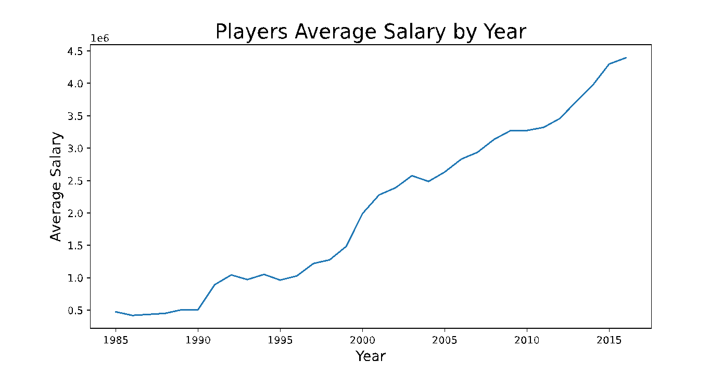
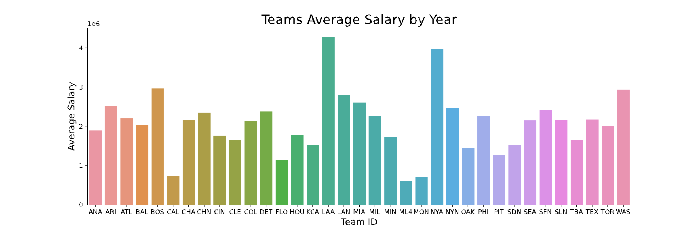
Analysis - 1
There is no salary increase in 1994 (baseball strike).
Salary declines were visible in 2004 (sponsorship issue due to attendance problem).
LAA is the top team by average salary (team name changes many times and highest win percentage).
The NYA team is ranked second (won the worldseries 27 times).

Slide 4
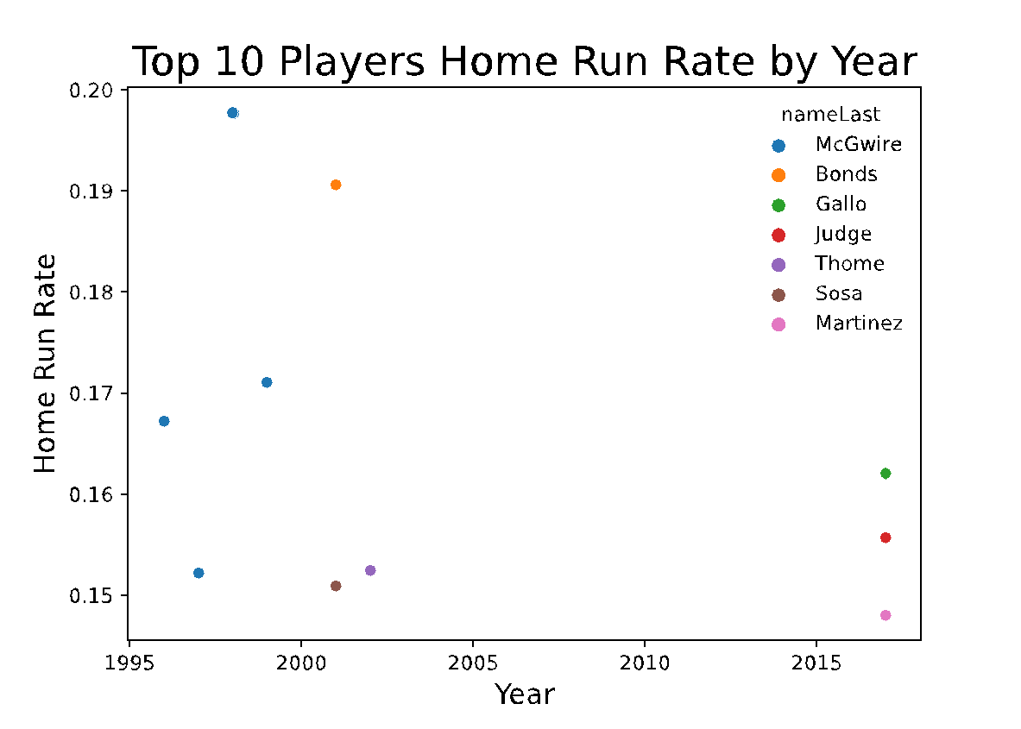
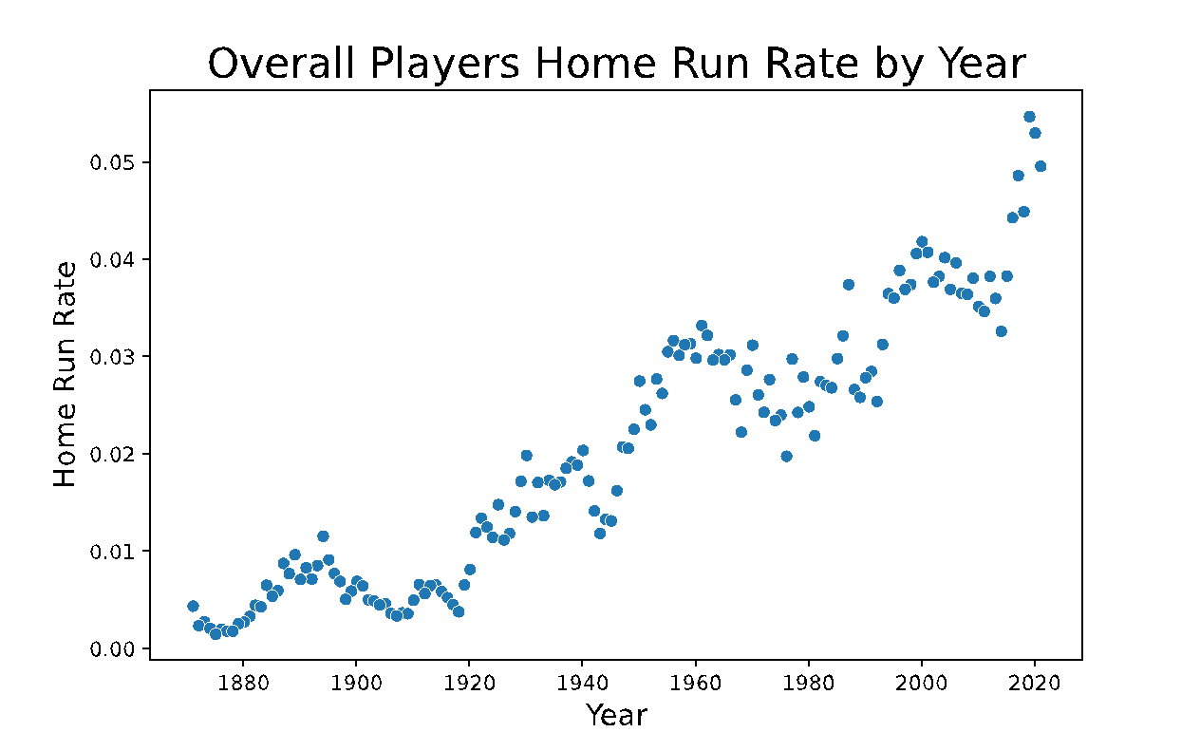
Analysis - 2
Top player by home run rate is McGwire
Highest home run rates recorded from 1996 to 2003(steroids era).

Slide 5
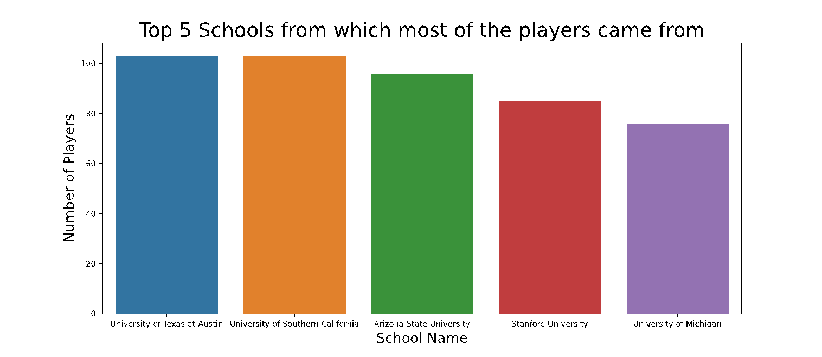
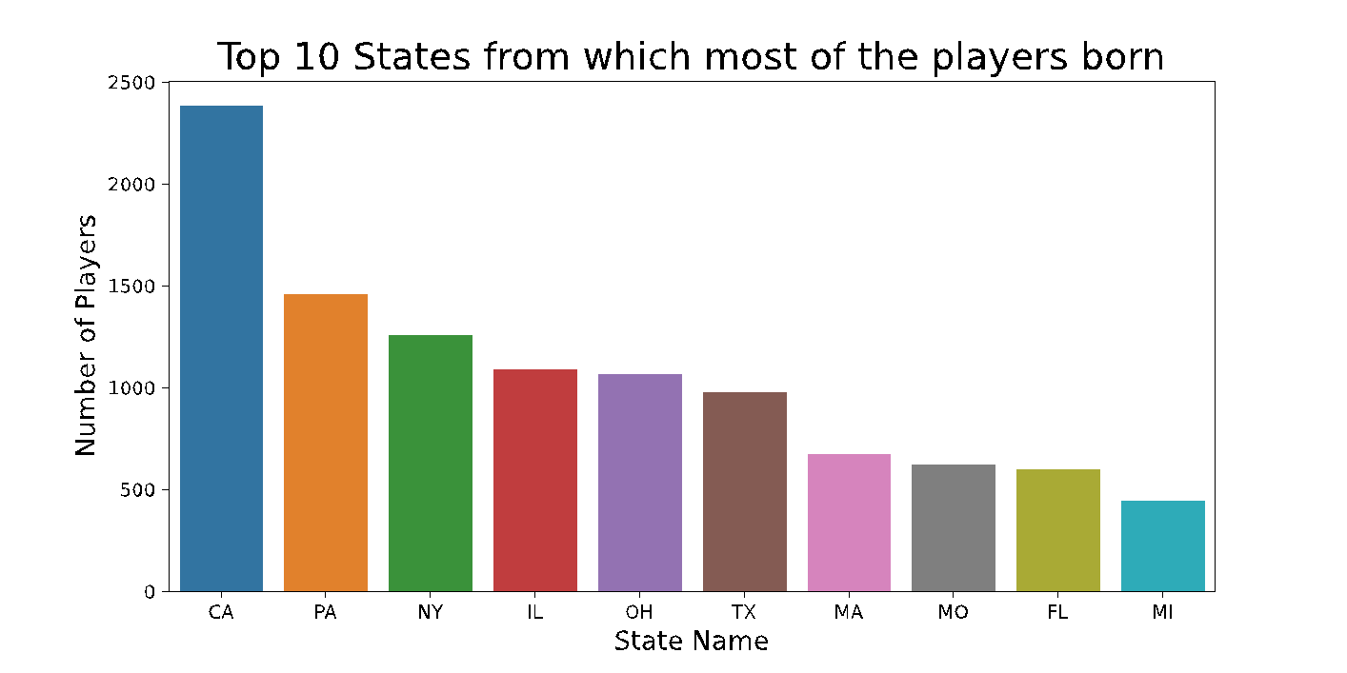
Analysis - 3
School where highest number of players attended- is University of texas Austin(34% of student athletes get scholarships)
Second highest is USC(won many baseball titles)
Many players born in CA(accounts for 21.8% of US player births )

Slide 6
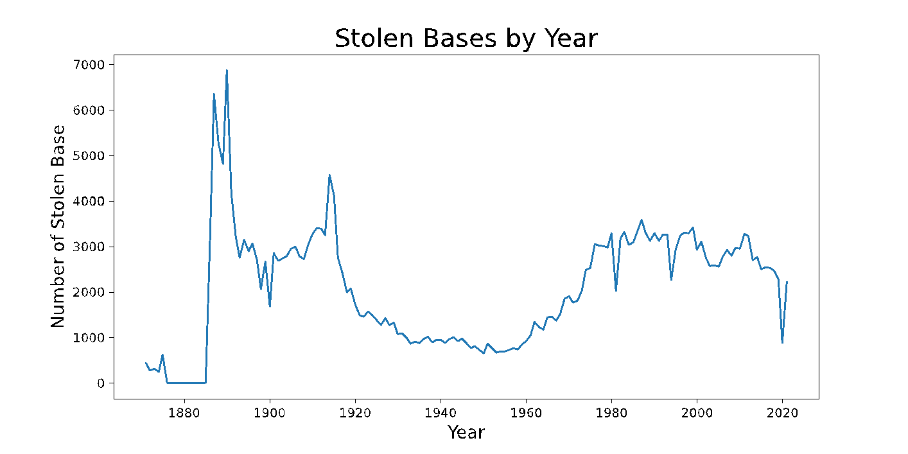
Analysis - 4
We can observe a significant decline in the curve from 1920(game rule changes).
It starts to rise again in 1960(rule got revoked)

Slide 7
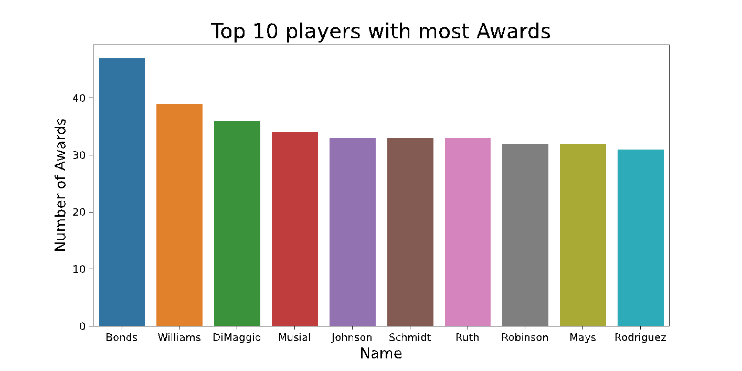
Analysis - 5
Bonds received most awards(#1 on the list of all-time MLB lifetime home runs with 762)

Slide 8
Conclusion
Usefulness of insights
Helps young players who want to go professional in baseball to choose their schools.
MLB can use these statistics and data analysis to enhance player performance.
Future player salaries can be forecasted by analyzing historical salary information.
Analysis of stolen bases or home runs can provide future baseball players with benchmarks.

