Slide 1
CS6830 Project -2 Austin Crime Data 2015 Analysis
Brad Leavitt
Vinay Achanta

Slide 2
Overview
Crime and housing dataset can help identify correlations and find possible influences on crime
Distributions can help identify similarities or differences between features.
T-tests can provide numerical evidence for claims about datasets.
Crime may be influenced by many factors

Slide 3
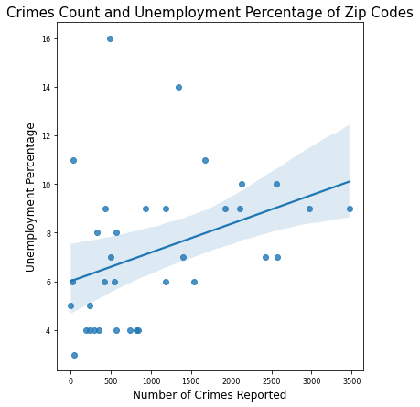
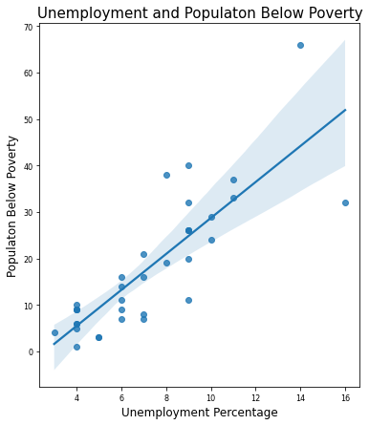
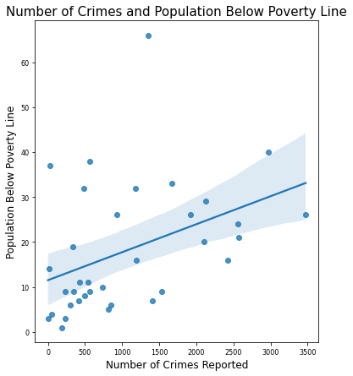
Analysis - 1
where there is higher unemployment there is also more crime
poverty may also influence crime rate
supported by poverty and unemployment are very strongly positively correlated (r = .827)
1-R:0.36, P:0.029

Slide 4
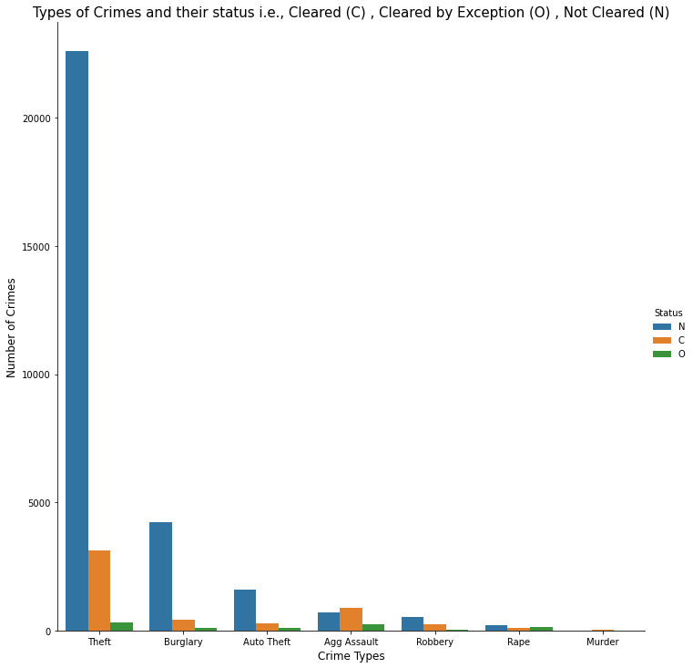
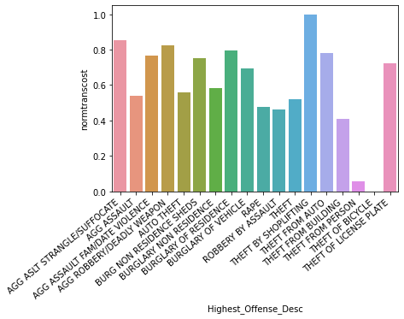
Analysis - 2
Theft is a big problem in Austin Texas.
there may be a focus on theft prevention (looking at how many clears there are)
transportation costs may have unexpected influence on certain crime types

Slide 5
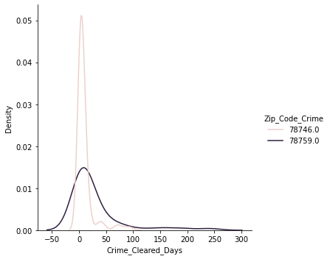
Analysis - 3
The police may be better in zip code 78746
t-test shows that the average time to clear crimes (catch and arrest) is different between the two distribution
p-val = .0000189

Slide 6
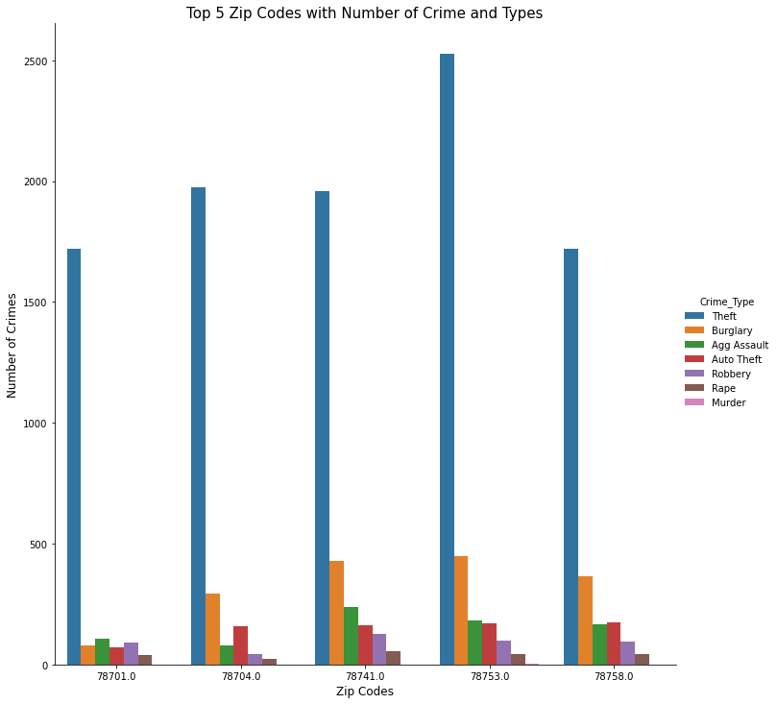
Analysis - 4
Theft and burglary are most prevalent.
zip codes to left in figure have less violent crimes than most (aggravated assault)

Slide 7
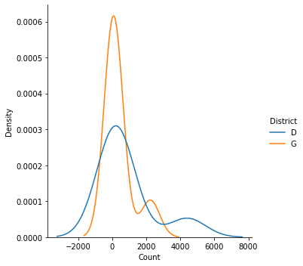
Analysis - 5
districts have similar crime type distributions
t-test shows statistic = .626, p val = .543 (large)
crime type may be similar across Austin TX

Slide 8
Conclusion
These findings could help identify other problems that affect and are affected by crime
focus on theft/burglary prevention
t-tests can help identify distributions
data cleaning can be difficult

