Slide 1
Detecting SMS Spam Messages using Naive Bayes
Supriyo Sandhya and Vinay Achanta

Slide 2
Introduction:
Welcome to our presentation on fighting spam messages using machine learning.
Spam messages have become a significant problem in modern communication, as they can be sometimes harmful, leading to financial loss or identity theft.
In this project, we will explore how machine learning techniques can be used to automatically detect and classify spam messages.
Our goal is to train a Naive Bayes classifier using the SMS Spam Collection dataset, from UCI Machine Learning Repository and evaluate its performance in detecting spam messages.

Slide 3
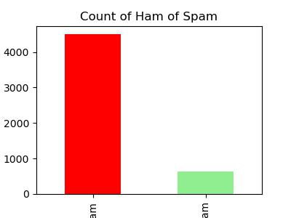
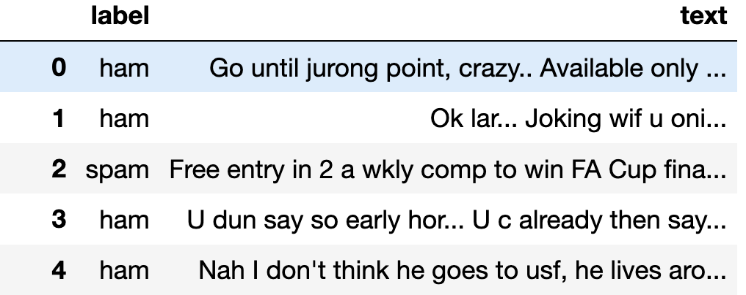
Dataset:
The SMS Spam Collection dataset contains a collection of SMS messages that have been classified as either ham or spam.
The dataset consists of 5,574 messages, with 4,827 ham messages and 747 spam messages.
The messages are pre-labeled, which means that we can use them to train our machine learning model to automatically classify new messages as either ham or spam.

Slide 4
Text Preprocessing:
Tokenization: Process of splitting text into individual words
‘Hello World’ —> ['Hello', 'World']
Lowercase Conversion: Converting all words to lowercase
'Hello' and 'hello'
Stop Word Removal: Removing common words that do not carry much meaning like 'the', 'and', 'is', etc.
Stemming: Reducing words to their base form
'walking' –-> walk
Bag of Words Representation: A method for displaying text as a list of words and their frequencies. A vector of word frequencies is used to represent each message. The classifier is trained using this vector.

Slide 5
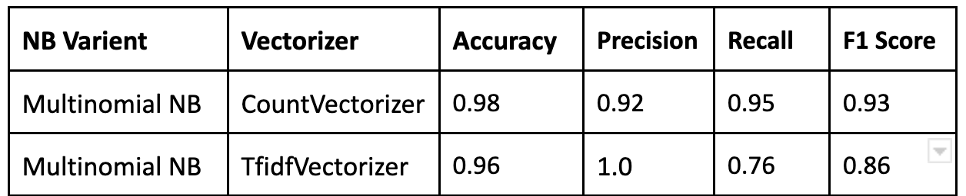
Classifier Training and Results:
Preprocessing technique used: CountVectorizer and TF-IDF Vectorizer.
Models trained and performed using Multinomial Naive Bayes classifiers on both representations with an accuracy of 0.98 and 0.96 respectively.
Multinomial Naive Bayes classifier is more suitable for text classification tasks, as it considers the frequency of words, while the Gaussian Naive Bayes classifier assumes a normal distribution of features, which is not appropriate for text data.
The reason why CountVectorizer outperformed TfidfVectorizer here is that CountVectorizer only considers the count of each word in a document, whereas TfidfVectorizer also takes into account the importance of each word in the entire dataset. In the context of spam detection, count-based approach of CountVectorizer is more suitable which resulted in higher accuracy compared to TfidfVectorizer.

Slide 6
Messages Classified Wrong:
Upon analyzing misclassified messages, we found that some spam messages contained words that are in with legitimate messages. This suggests that spammers are using more sophisticated techniques to make their messages appear less spammy.
Some of the messages like “Thank you for your purchase! You can claim your free gift by replying YES.”, “Sorry, your account has been suspended. Contact us to reactivate your account.” was misclassified as non spam because of the presence of the words 'thank you' and 'purchase', ‘sorry, which are often linked with legitimate messages.
One of the solution to this problem is to use deep learning models that uses neural network, to detect relation between words in spam message making them more effective at detecting spam messages.

Slide 7
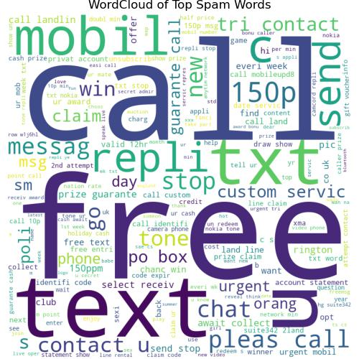
Word Cloud of Spam Words

Slide 8
THANK YOU

