Slide 1
Fraud Detection in E-commerce
Group 11 :
Satyanarayana Vinay Achanta
Hari Chandana Kotnani
Venkata Shiva Sai Dheeraj Kotte

Slide 2
Introduction and Motivation:
Project objective: use machine learning to detect fraudulent transactions in e-commerce.
Problem addressed: increasing risk of fraud in e-commerce causing financial losses and poor customer experience.
Significance: we would like to build models that enhances security, improves customer experience, and reduces costs for e-commerce companies.
Excitement: opportunity to explore visualization, machine learning techniques and apply them to a practical problem.

Slide 3
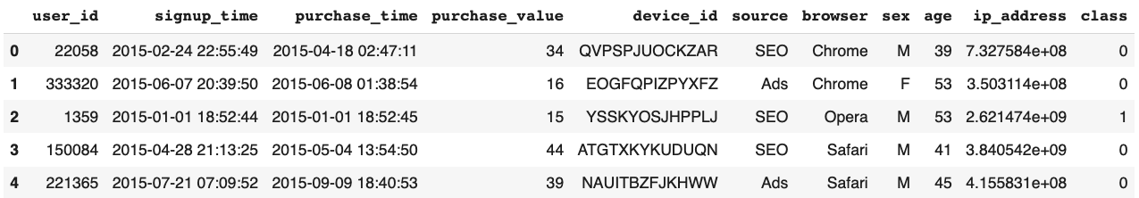
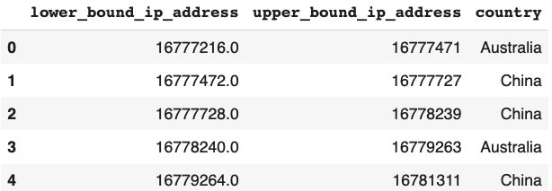
Dataset
Overview of the dataset: Our project will be using a combination of three datasets to train our machine learning model first two obtained from kaggle and third from IP Addresses Live Database Real-time website.
Dataset 1: The first dataset contains 151,112 rows of user and transaction information, like user's age, gender, and transaction history, such as the purchase date and amount.
Dataset 2: The second dataset contains a list of country names and the lower and upper bounds of IP addresses, which is essential for mapping IP addresses to their respective countries.

Slide 4
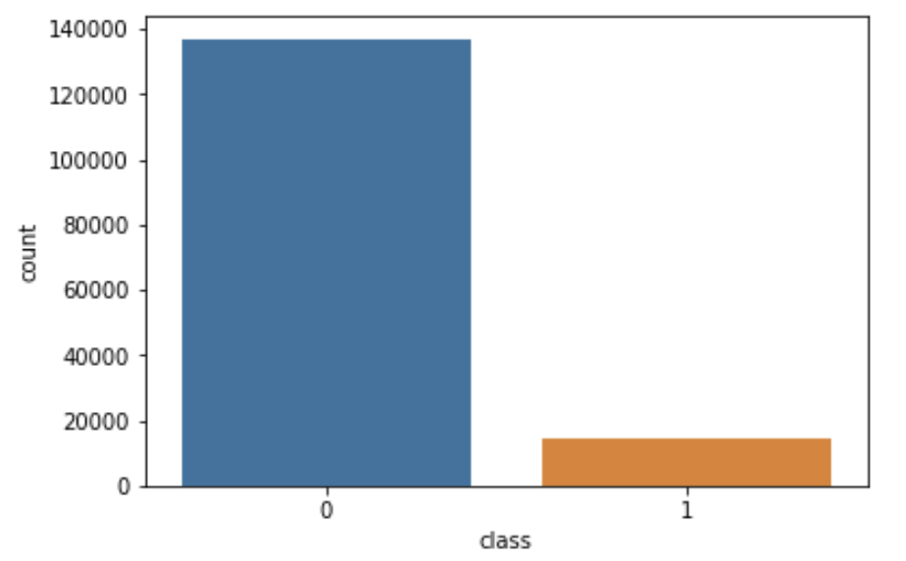
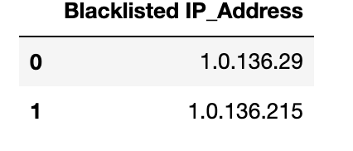
Dataset
Dataset 3: We added the third dataset, 'Blacklisted_IP.csv', which contains a list of IP addresses associated with fraudulent activities in the real world.
Preprocessing steps: To prepare the datasets, we merged the first two datasets and converted IP addresses to quad-dot format to match the other datasets. Additionally, we checked if the IP addresses in the first dataset were blacklisted by referencing the third dataset.
Potential Problem: Highly imbalanced dataset.

Slide 5
Exploratory Data Analysis (EDA) and Preprocessing:
To understand the relation in the data and extract valuable insights we performed EDA.
Checked for missing and null values.
Distribution of Categorical Variables: browser, sex, country, and source.
Feature Engineering: time difference, total purchase, purchase weekday/week, unique device_id/IP address per user, correlation matrix.
Distribution of Numerical Variables: time diff, purchase value, age.
Standardize the numerical features.
Label Encoding and Encoding of categorical variables using one hot encoding are performed.

Slide 6
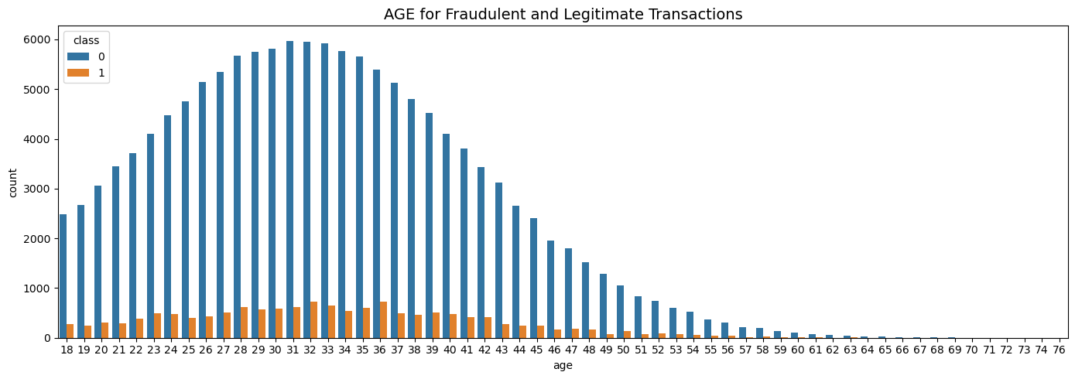
Analyze trends of age and fraud count
Financial Pressure
Attitude Towards Risk

Slide 7
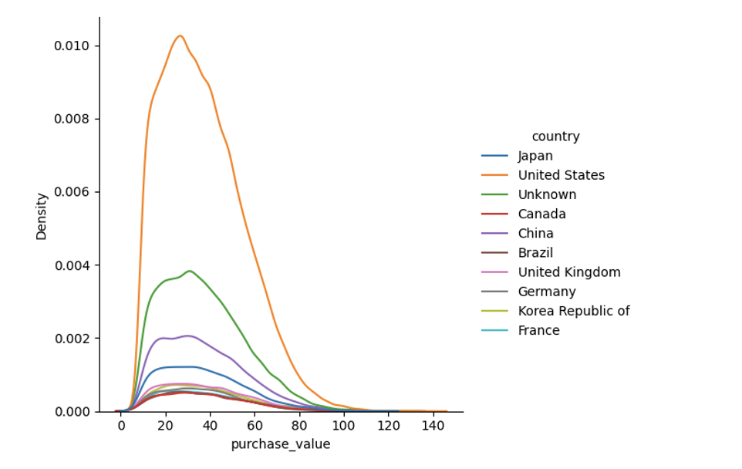
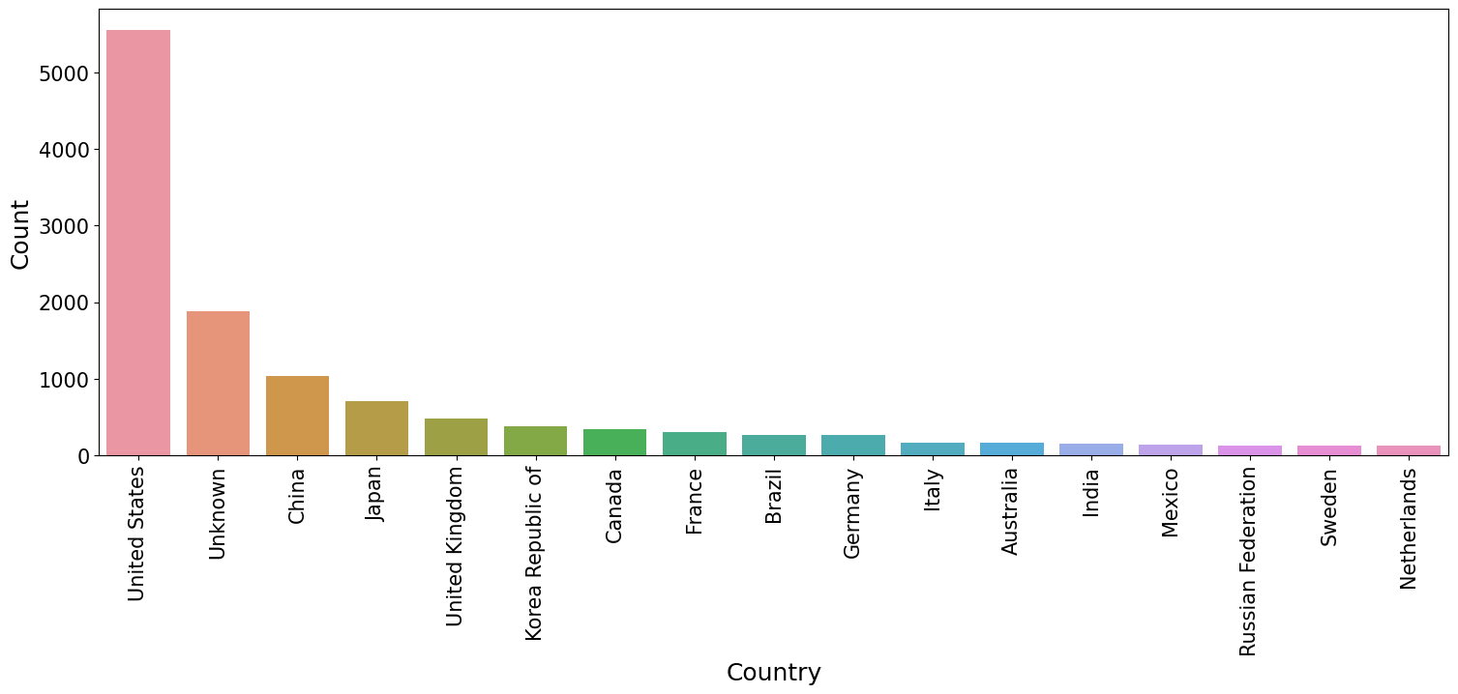
Which countries does fraud happening more?
Fraudulent transactions are happening more in United States
Economic power
Technology

Slide 8
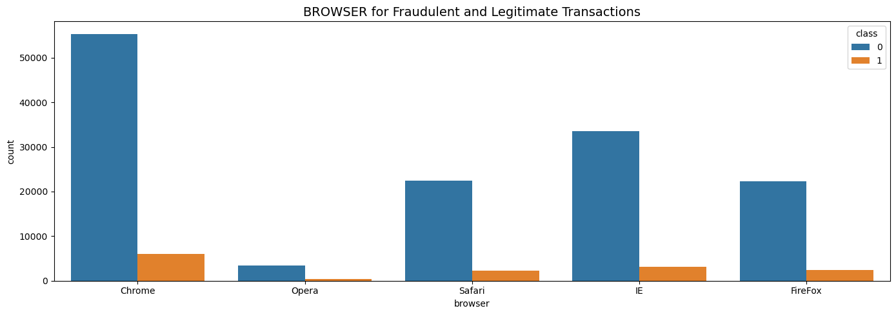
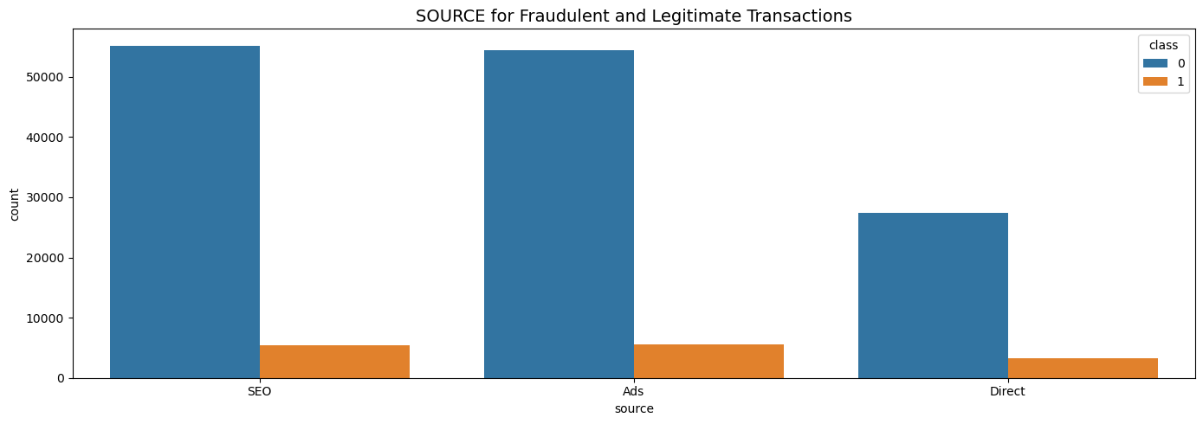
Browser and Source for fraudulent Transactions:
Chrome
Pop-up ads
Extensions
SEO(Search Engine Optimization) and Ads
Click fraud
Botnets
Fake websites - SEO

Slide 9
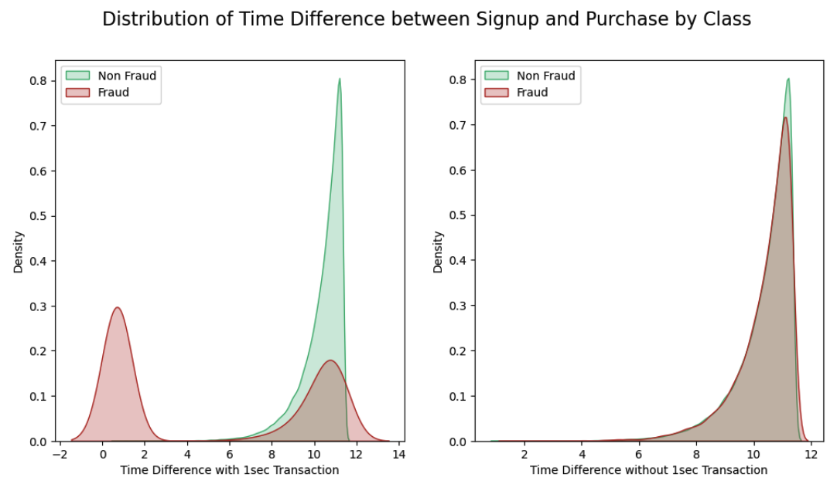
Feature Engineering:
Added a new column for time difference between ‘signup’ and ‘purchase’ time
Discovered that all transactions with a time difference of 1 second were fraudulent.

Slide 10
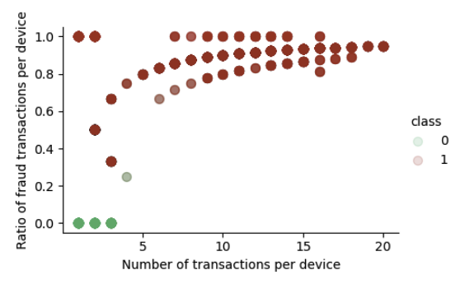
Feature Engineering findings:
Also, Found that the repeating IP addresses with different user ids concludes as fraud.
On Further research, we found if repeated transactions are made from a single device with different used id, there is a higher incidence of fraudulent activity among those transactions.

Slide 11
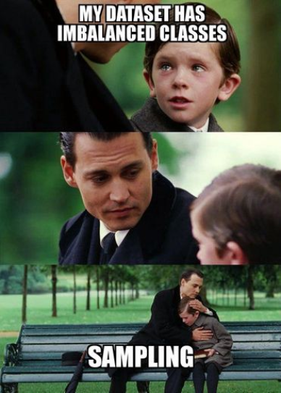
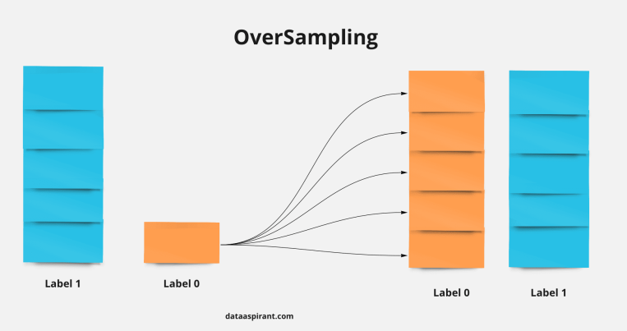
Handling Imbalanced Dataset by Oversampling:
We mentioned that our data is imbalanced, meaning that non-fraudulent samples are the majority class, and fraudulent samples are the minority class. To address this issue, we utilized a common data sampling technique called SMOTE (Synthetic Minority Over-sampling Technique) to balance the data.
SMOTE creates more synthetic sample of minority class that are similar to the existing minority class
This process is repeated until the classes are balance.

Slide 12
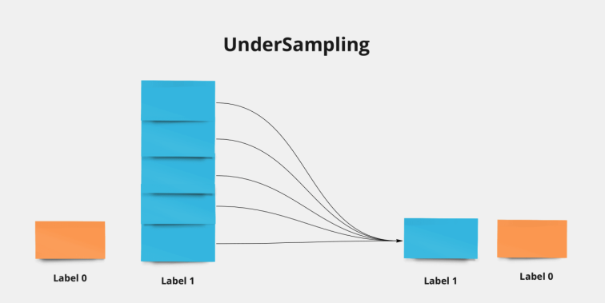
Handling Imbalanced Dataset by Undersampling:
Under Sampling: Undersampling is a technique to balance imbalanced data by reducing the number of samples from the majority class to match the number of samples in the minority class.
We used the Random Sampler Technique to undersample, which randomly selects a few samples from the majority class to remove and balance the dataset.

Slide 13

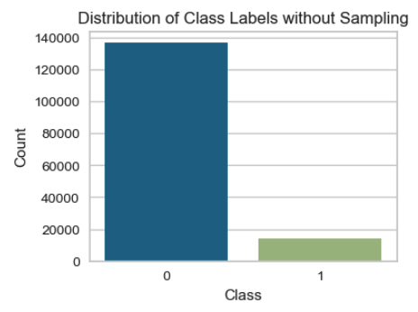
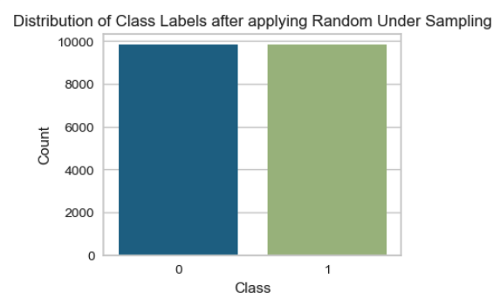
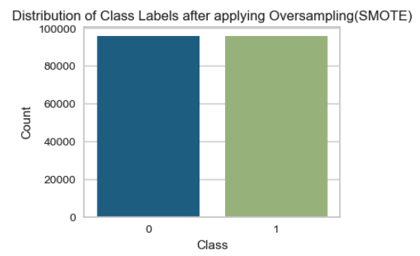
Data:
(Imbalanced)Original data:
Under Sampled data: Over Sampled data:

Slide 14
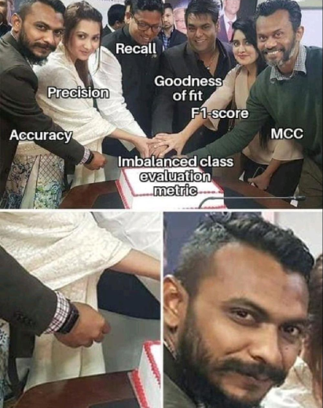
Models:
We evaluated the performance of machine learning models on the original, oversampled, and undersampled datasets using various metrics.
We also implemented GridSearchCV to select the best hyperparameters for our models.

Slide 15
Scores of Dataset without Sampling
Models | Accuracy | Precision | Recall | F1-Score | Best Hyperparameters
Decision Tree Classifier | 0.95 | 0.95 | 0.77 | 0.83 | Best max_depth: 6
MLP Classifier | 0.91 | 0.95 | 0.50 | 0.48 | hidden_layer_sizes=(3), (20, 10, 5)
K Neighbors Classifier | 0.88 | 0.51 | 0.50 | 0.50 | Best n_neighbors: 3
Random Forest Classifier | 0.95 | 0.95 | 0.77 | 0.83 | Best parameters: {'max_depth': 8, 'n_estimators': 100}
Light Gradient Boosting | 0.95 | 0.95 | 0.77 | 0.83 | Best hyperparameters: {'learning_rate': 0.1, 'max_depth': 10, 'num_leaves': 10}
Gradient Boosting Classifier | 0.95 | 0.95 | 0.77 | 0.83 | Best hyperparameters: {'learning_rate': 0.1, 'max_depth': 6, 'n_estimators': 50}
Logistic Regression | 0.95 | 0.93 | 0.76 | 0.82 | Best hyperparameters: {'C': 100, 'class_weight': {0: 1, 1: 2}, 'penalty': 'l1'}

Slide 16
Scores with Random Under Sampling
Models | Accuracy | Precision | Recall | F1-Score | Best Hyperparameters
Decision Tree Classifier | 0.92 | 0.76 | 0.83 | 0.78 | Best max_depth: 4
MLP Classifier | 0.90 | 0.72 | 0.81 | 0.775 | hidden_layer_sizes=(3), (20, 10, 5)
K Neighbors Classifier | 0.90 | 0.72 | 0.79 | 0.75 | Best n_neighbors: 9
Random Forest Classifier | 0.91 | 0.75 | 0.82 | 0.78 | Best parameters: {'max_depth': 8, 'n_estimators': 100}
Light Gradient Boosting | 0.92 | 0.76 | 0.83 | 0.79 | Best hyperparameters: {'learning_rate': 0.01, 'max_depth': 5, 'num_leaves': 5}
Gradient Boosting Classifier | 0.92 | 0.76 | 0.83 | 0.78 | Best hyperparameters: {'learning_rate': 0.01, 'max_depth': 4, 'n_estimators': 100}
Logistic Regression | 0.92 | 0.76 | 0.83 | 0.79 | Best hyperparameters: {'C': 0.1, 'class_weight': {, 2: 1}, 'penalty': '11'}

Slide 17
Scores with SMOTE Oversampling
Models | Accuracy | Precision | Recall | F1-Score | Best Hyperparameters
Decision Tree Classifier | 0.91 | 0.74 | 0.77 | 0.75 | Best max_depth: 100
MLP Classifier | 0.96 | 0.97 | 0.77 | 0.84 | hidden_layer_sizes=(3), (20, 10, 5)
K Neighbors Classifier | 0.81 | 0.63 | 0.75 | 0.65 | Best n_neighbors:3
Random Forest Classifier | 0.92 | 0.76 | 0.82 | 0.79 | Best parameters: {'max_depth': 8, 'n_estimators': 200}
Light Gradient Boosting | 0.95 | 0.94 | 0.77 | 0.83 | Best hyperparameters: {'learning_rate': 1, 'max_depth': 5, 'num_leaves': 10}
Gradient Boosting Classifier | 0.95 | 0.89 | 0.78 | 0.82 | Best hyperparameters: {'learning_rate': 1, 'max_depth': 6, 'n_estimators': 100}
Logistic Regression | 0.96 | 0.97 | 0.77 | 0.84 | Best hyperparameters: {'C': 100, 'class_weight': ‘Balanced’, 'penalty': '1'}

Slide 18
Conclusion:
MLP classifier, Random Forest classifier and Light Gradient Boosting classifier performed well and can be concluded as best classifiers for fraud detection in e-commerce.
Transactions with a time difference of 1 second were fraudulent, and repeated devices/IP addresses with different user ids were involved in more fraudulent transactions.
Furthermore, the best hyperparameters for some classifiers were different for different datasets, indicating that different tuning may be necessary for different datasets.
Undersampling did not perform well out of the three methods, which may be due to the loss of information, resulting in a reduction of the model's performance.

Slide 19
Challenges and Future work:
Challenges:
As we have around 150k samples, it is computationally expensive.
After oversampling, it becomes even more expensive, and performing a grid search takes time.
Future Work:
We will try using some more ensemble algorithms techniques like XG Boost, AdaBoost and Extra Tree Classifier.
Ensemble algorithms combine the predictions of multiple models, and thus can improve the performance of predictions.

Slide 20
Questions?

