Slide 1
AVL Tree

Slide 2
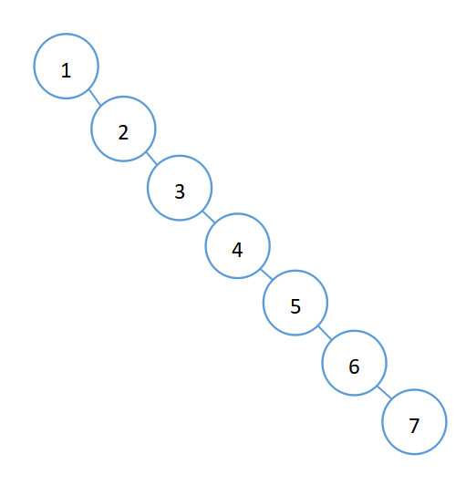
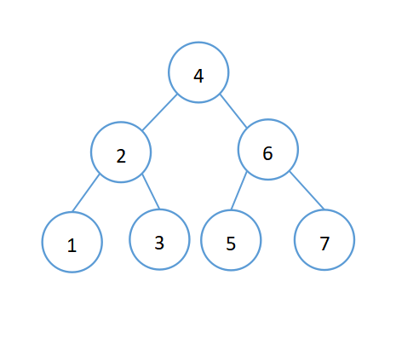
BST & AVL
BST
AVL

Slide 3
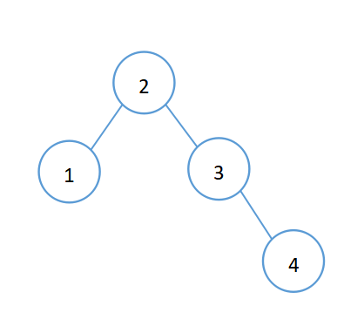
Features
AVL is a binary search tree
Balance factor : -1,0,1
BF = height(left_tree)-height(right_tree)
-1
3
-1
2
0
1
0
1

Slide 4
Rotate
Four unbalanced situations
LL: Rotate right
RR: Rotate left
LR: Rotate left first, then right
RL: Rotate right first, then left

Slide 5
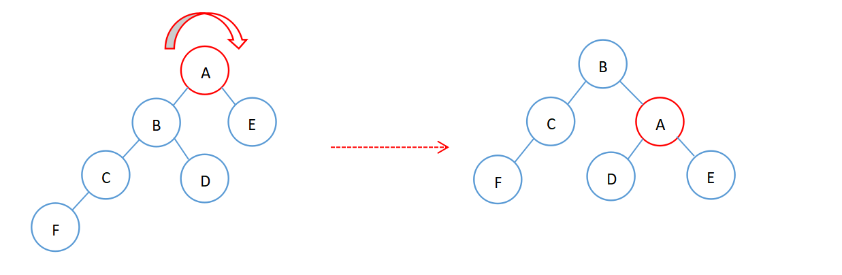
LL
Rotate right

Slide 6
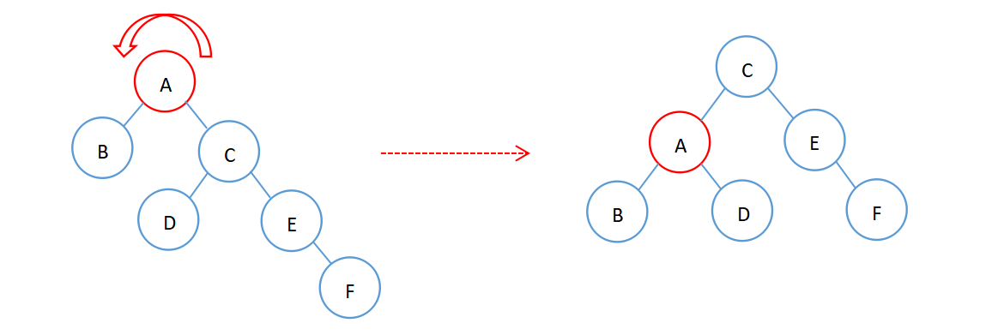
RR
Rotate left

Slide 7
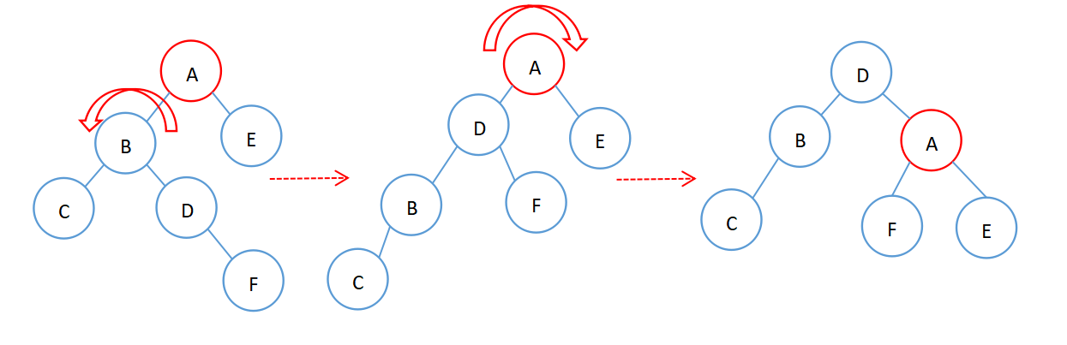
LR
Rotate left , then rotate right

Slide 8
LR
Rotate left , then rotate right
2
2
-1
1
LR
LL

Slide 9
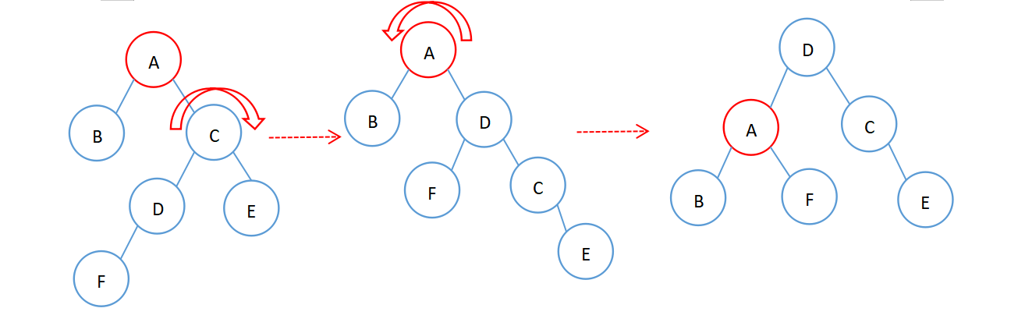
RL
Rotate right, then rotate left

Slide 10
RL
Rotate right, then rotate left
-2
-2
1
-1
RL
RR

Slide 11
Insert
Key steps
Traverse the tree from the root node to find the position to be inserted
Find unbalanced nodes, starting from the parent node of the inserted node
Determine the unbalanced type of the node and adjust the node to balance by rotating

Slide 12
Delete
Key steps
Traverse the tree from the root node to find the position to be deleted
Modify the value of the node to the value of its predecessor (or successor), and then delete its predecessor (or successor)
Adjust the balance of the tree

Slide 13
Result
Result Show

