Slide 1
More Focused, More Efficient Improvement Based on PointMLP

Slide 2
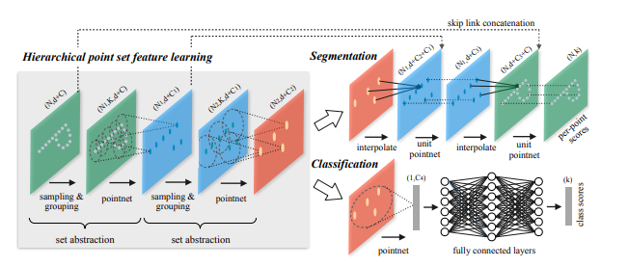
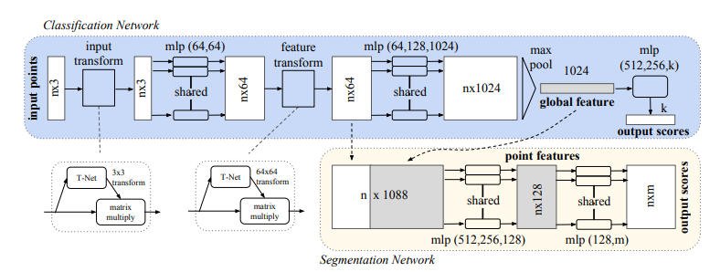

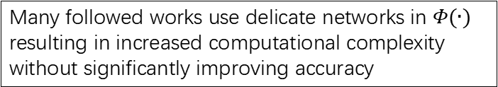
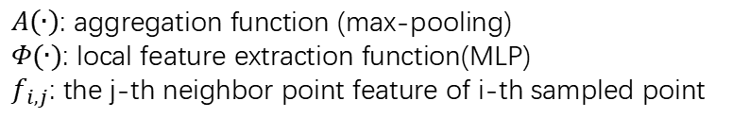
BackGround
Point Cloud:
Disorder
Invariant to some spatial transformer
Many followed works use delicate networks in $Φ(∙)$ resulting in increased computational complexity without significantly improving accuracy
Classical algorithm:
PointNet: Local features of points are not considered!
PointNet++:
$A\left(∙\right)$: aggregation function (max-pooling)
$Φ(∙)$: local feature extraction function(MLP)
$f_{i,j}$: the j-th neighbor point feature of i-th sampled point

Slide 3
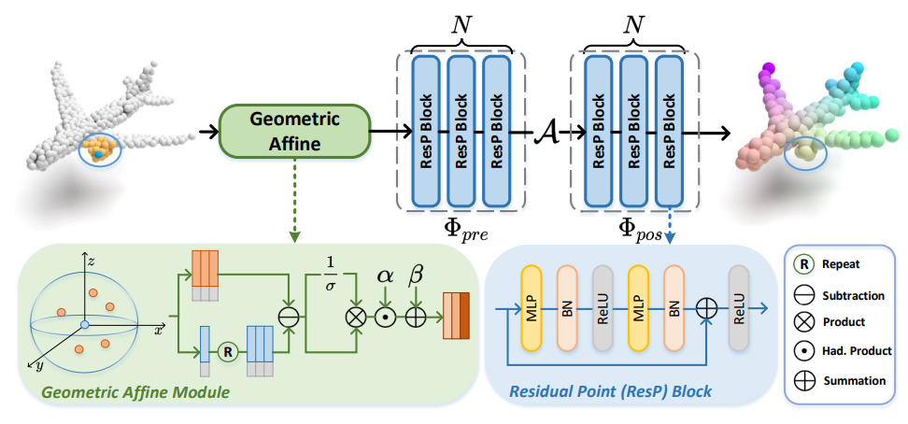
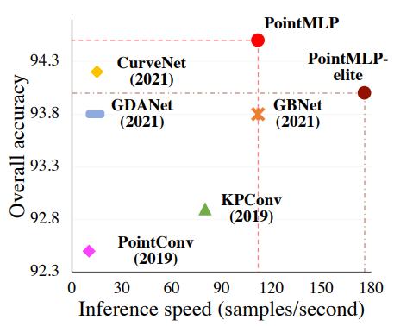
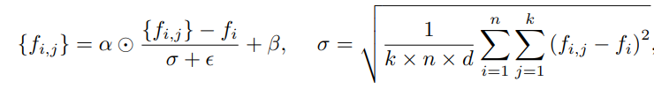

PointMLP
Framework:
Fast and Accurate!
$$g_{i}=Φ_{pos}(A(Φ_{pre}\left(f_{i,j}\right).|j=1,…,K))$$
$φ_{pre}$: learn shared weight from local region
$φ_{pos}$: extract deep aggregated features
Abandon sophisticated local geometric extractors
and introduce a simple residual MLP network.
Geometric Affine Module:
which solve the sparse and irregular geometric structures in local regions.

Slide 4
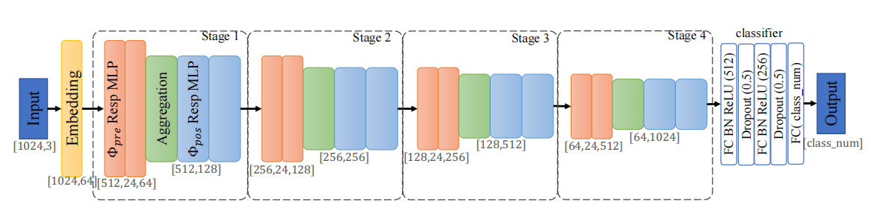
PointMLP
Loss function: cross entropy

Slide 5
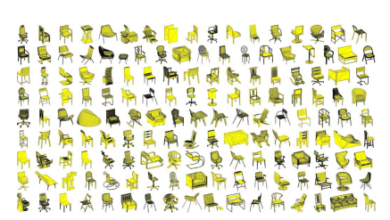
Dataset
ModelNet40
ScanObjectNN
1. CAD model
2. 40 categories
3. 9843 training data
4. 2468 test data

Slide 6
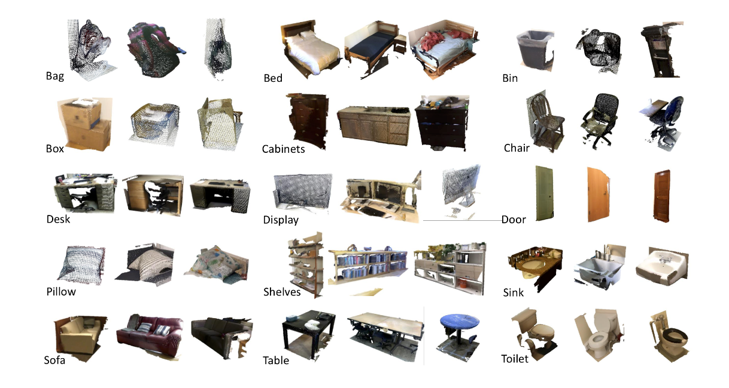
Dataset
ModelNet40
ScanObjectNN
1. RGBD scanned
2. 15 categories
3. 11408 training data
4. 2880 test data

Slide 7
Experiment
Sampling method
Weight neighbor point features
SE
Feature Concate
Cosine similarity loss

Slide 8
Sampling method
Sequential sampling of 1028 points(original method)
Sampling 1028 points by FPS
Randomly sample 1028 points
Train & Test | ModelNet40(acc/time) |  | ScanObjectNN(acc/time)
Seq & Seq(baseline) | 93.436% | 622s | 85.323% | 870s
Seq & FPS | 93.395% | 644s | 85.566% | 888s
Seq & Random | 92.383% | 625s | 84.559% | 868s
FPS & Seq | 93.517% | 607s | 84.49% | 923s
FPS & FPS | 93.112% | 617s | 85.357% | 891s
FPS & Random | 92.585% | 618s | 84.247% | 879s
Random & Seq | 92.95% | 677s | 84.663% | 867s
Random & Seq | 92.585% | 629s | 84.872% | 888s
Random & Random | 92.383% | 625s | 84.421% | 871s

Slide 9
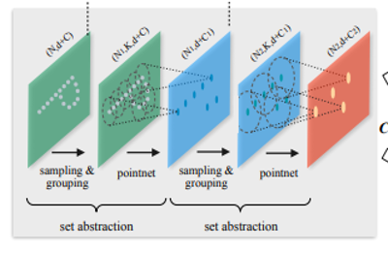

Weight neighbor point features
weight
weight
 | ModelNet40(acc/time) |  | ScanObjectNN(acc/time)
Baseline | 92.817% | 28s | 84.688% | 43s
Weight | 92.898% | 37s | 84.583% | 43s
d
$$w=e^{−d^{2}}$$

Slide 10
SE & Feature Concate
Different dimension feature concatenate
Different dimension feature concatenate
1.Add SE Block on different dimension features,
because there may many local groups, but not every group is important, so we need to foucs on the most important groups
2.The original model just forward all features, but we think forward features in this way may lost some information, so we concatenate all different features to do a better classification
SE Block

Slide 11
SE & Feature Concate
 | ModelNet40(acc/time) |  | ScanObjectNN(acc/time)
baseline | 93.963% | 30s | 85.432% | 21s
SE | 93.679% | 33s | 85.392% | 25s
Feature Concate | 93.679% | 33s | 85.808% | 25s
SE+Feature Concate | 92.707% | 37s | 85.635% | 25s

Slide 12
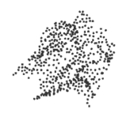
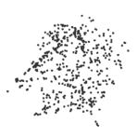
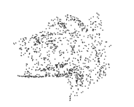
Cosine similarity loss
1024 points：
the FPS sampled 512 points：
the missing 512 points：
(a)
(b)
(c)
The global features of (b) and (c) are similar!

Slide 13
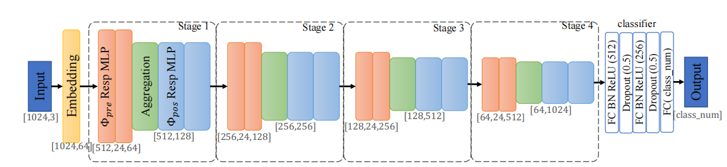
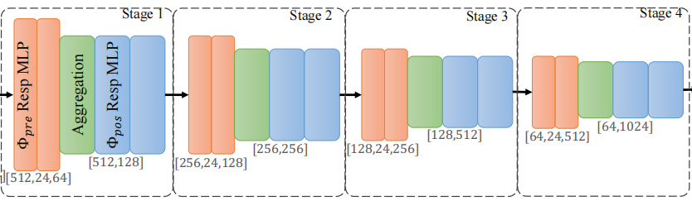
Cosine similarity loss
cross entropy loss
cosine similarity loss
missing 512 points
 | ScanObjectNN
Baseline | 84.688% | 43s
loss | 85.556% | 57s

