Slide 1


Slide 2
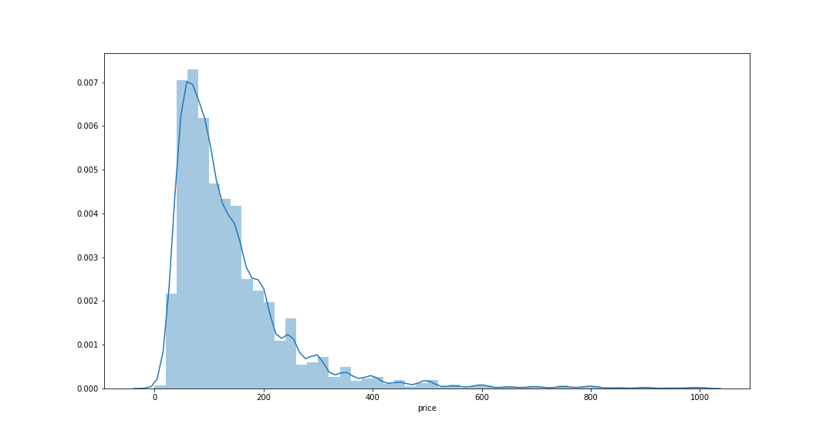
Listings price distribution

Slide 3
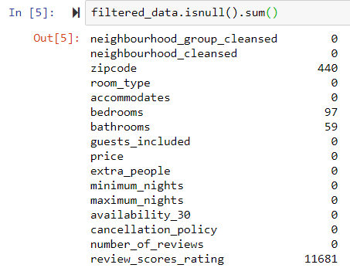
Listings price distribution

Slide 4
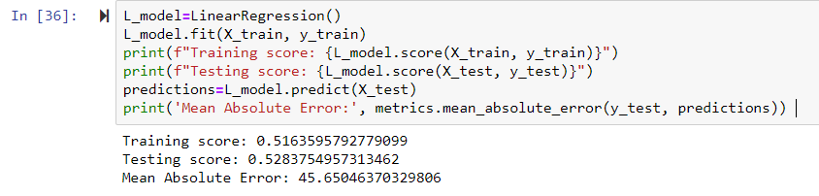
LINEAR Regression model

Slide 5
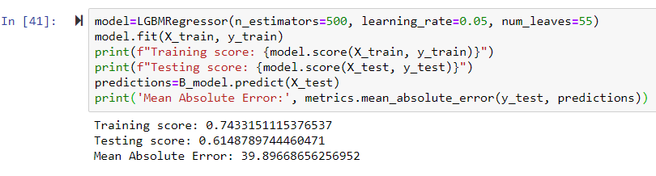
Light gbm regression model

