Slide 1
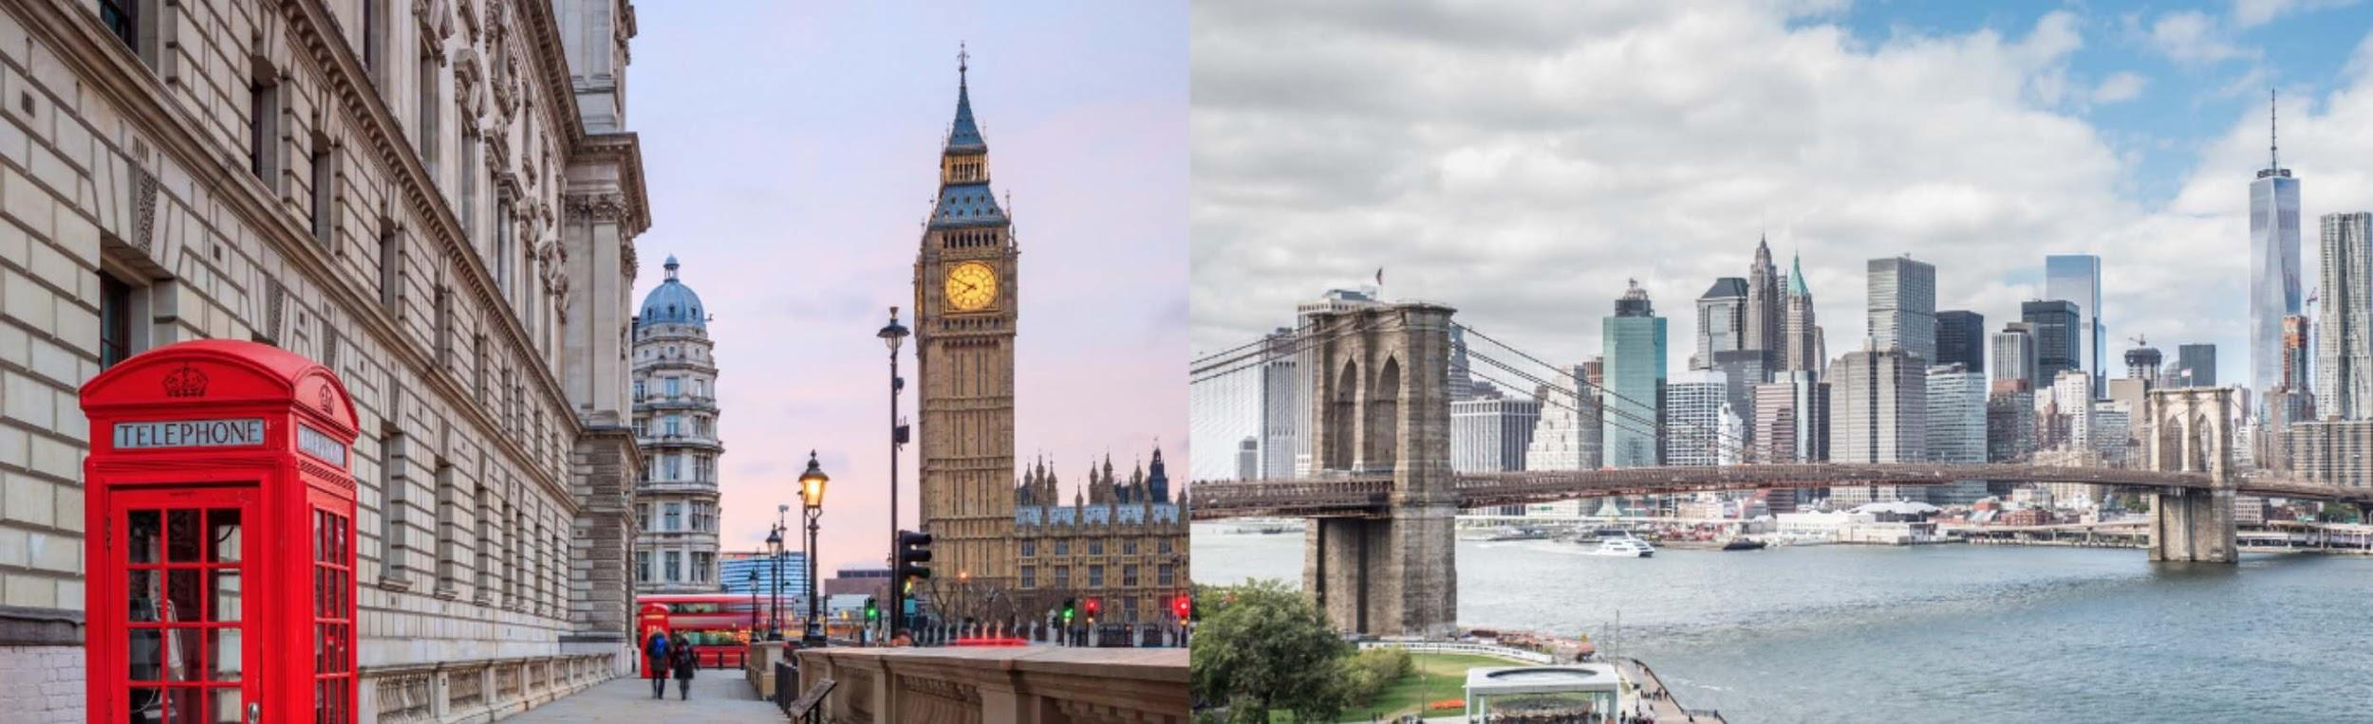
Capstone Project - The Battle of Neighborhoods

Slide 2
Introduction
New York City comprises 5 boroughs sitting where the Hudson River meets the Atlantic Ocean. At its core is Manhattan, a densely populated borough that’s among the world’s major commercial, financial and cultural centers. Its iconic sites include skyscrapers such as the Empire State Building and sprawling Central Park. Broadway theater is staged in neon-lit Times Square.
London, the capital of England and the United Kingdom, is a 21st-century city with history stretching back to Roman times. At its centre stand the imposing Houses of Parliament, the iconic ‘Big Ben’ clock tower and Westminster Abbey, site of British monarch coronations. Across the Thames River, the London Eye observation wheel provides panoramic views of the South Bank cultural complex, and the entire city.

Slide 3
Description of the problem
We will explored New York City and London and segmented and clustered their neighborhoods. Both cities are very diverse and are very similar. Both cities are a densely populated boroughs that’s among the world’s major commercial, financial and cultural centers. . We will to compare the neighborhoods of the two cities and determine how similar or dissimilar they are. We will define that people like to do more in the cities, which places are often visited. Knowing this information we can think of how to use this. For example, open a new restaurant or supermarket, entertainment center or gift shop. As we can see in the next task that although there are Mexican restaurants in London, but they are not popular, entertainment is centrally located and almost none in areas farther from the center. We may also use this information for advertising purposes, etc

Slide 4
Description of Data
This project will rely on public data from Wikipedia and Foursquare.
London is the capital of and largest city in England and the United Kingdom. It is administered by the City of London and 32 London boroughs.
We will get information about the areas of London https://en.wikipedia.org/wiki/List_of_areas_of_London
(https://en.wikipedia.org/wiki/List_of_areas_of_London)
I will use dataset https://geo.nyu.edu/catalog/nyu_2451_34572 (https://geo.nyu.edu/catalog/nyu_2451_34572) for information about boroughs of NYC

Slide 5
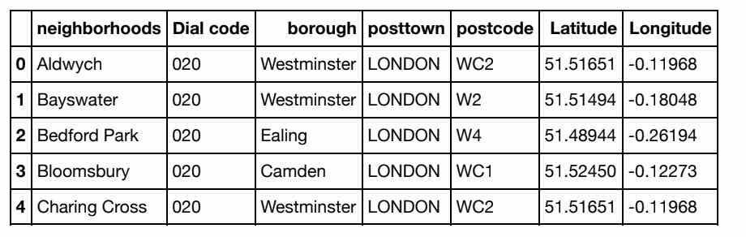
From https://en.wikipedia.org/wiki/List_of_areas_of_London we got Data (df_london) and then using Geocoder we got Data with Latitude and Longitude

Slide 6
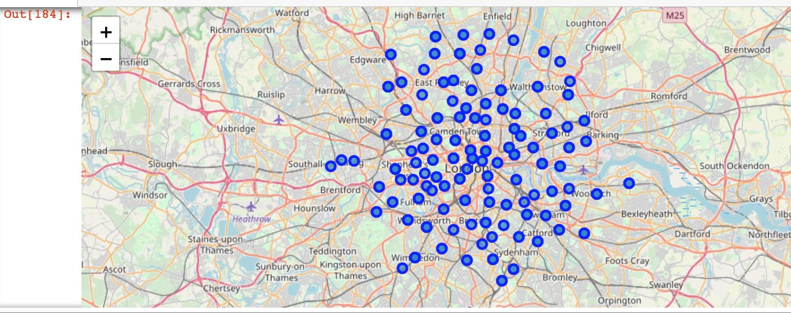
Create a map of London with borough superimposed on top.

Slide 7
Download and Explore Dataset NYC Neighborhood
The link to the dataset: https://geo.nyu.edu/catalog/nyu_2451_34572 (https://geo.nyu.edu/catalog/nyu_2451_34572)
 | Borough | Neighborhood | Latitude | Longitude
1 | Bronx | Wakefield | 40.894705 | -73.847201
2 | Bronx | Co-op City | 40.874294 | -73.829939
3 | Bronx | Eastchester | 40.887556 | -73.827806
4 | Bronx | Fieldston | 40.895437 | -73.905643
5 | Bronx | Riverdale | 40.890834 | -73.912585

Slide 8
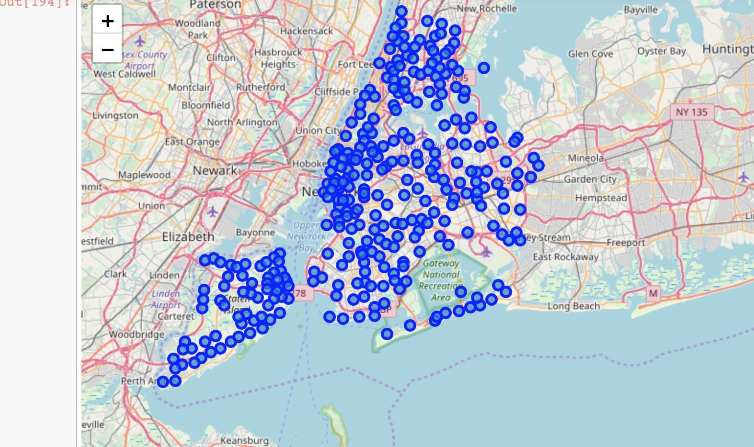
Create map of New York using latitude and longitude values

Slide 9
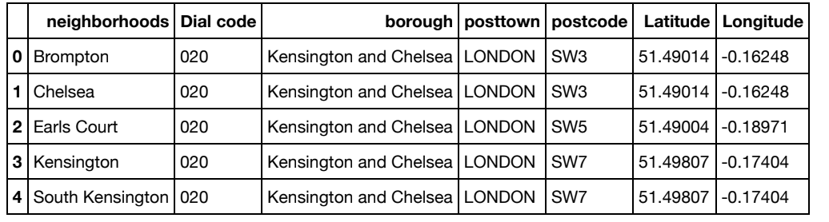
Methodology
Data Exploration
Create a new dataframe of the borough Kensington and Chelsea.

Slide 10
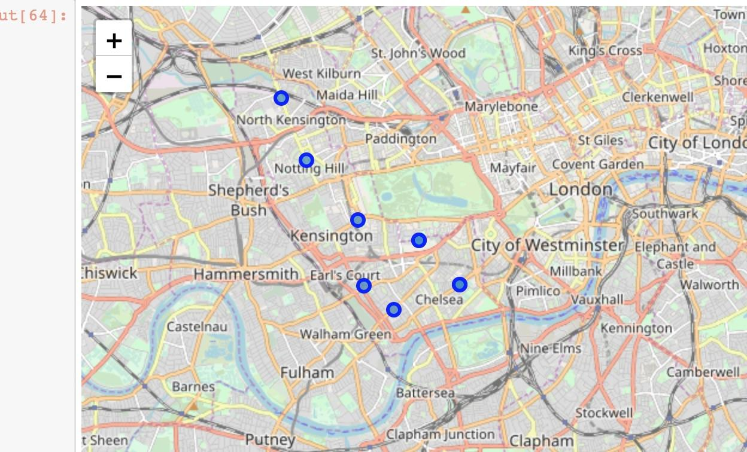
Create a map of the borough Kensington and Chelsea.

Slide 11
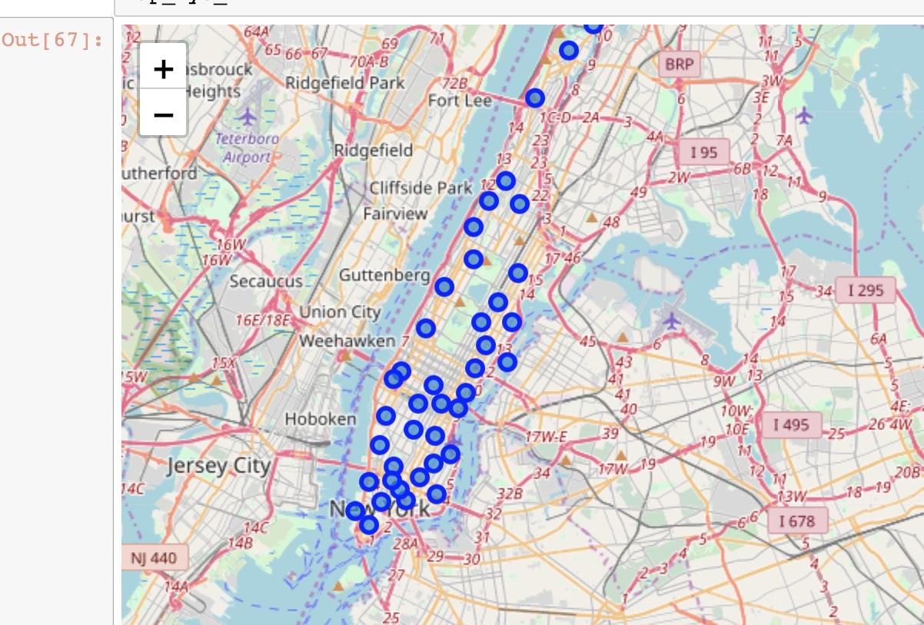
Create a map of the boroughs Manhattan

Slide 12
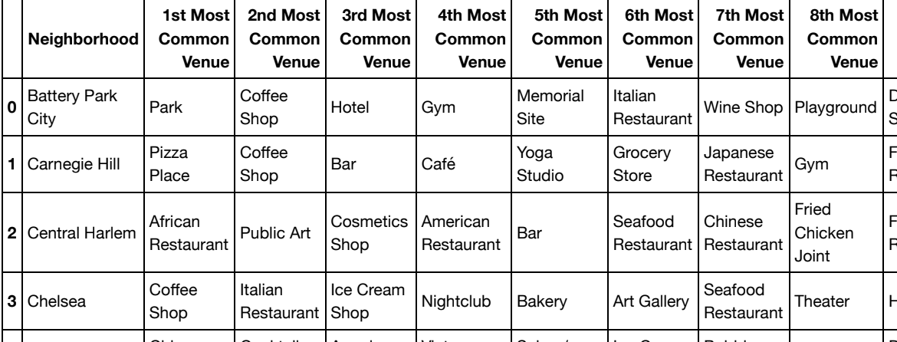
Using the Foursquare API we will to explore the neighborhoods and Analyze Each Neighborhood (Manhattan)
-

Slide 13
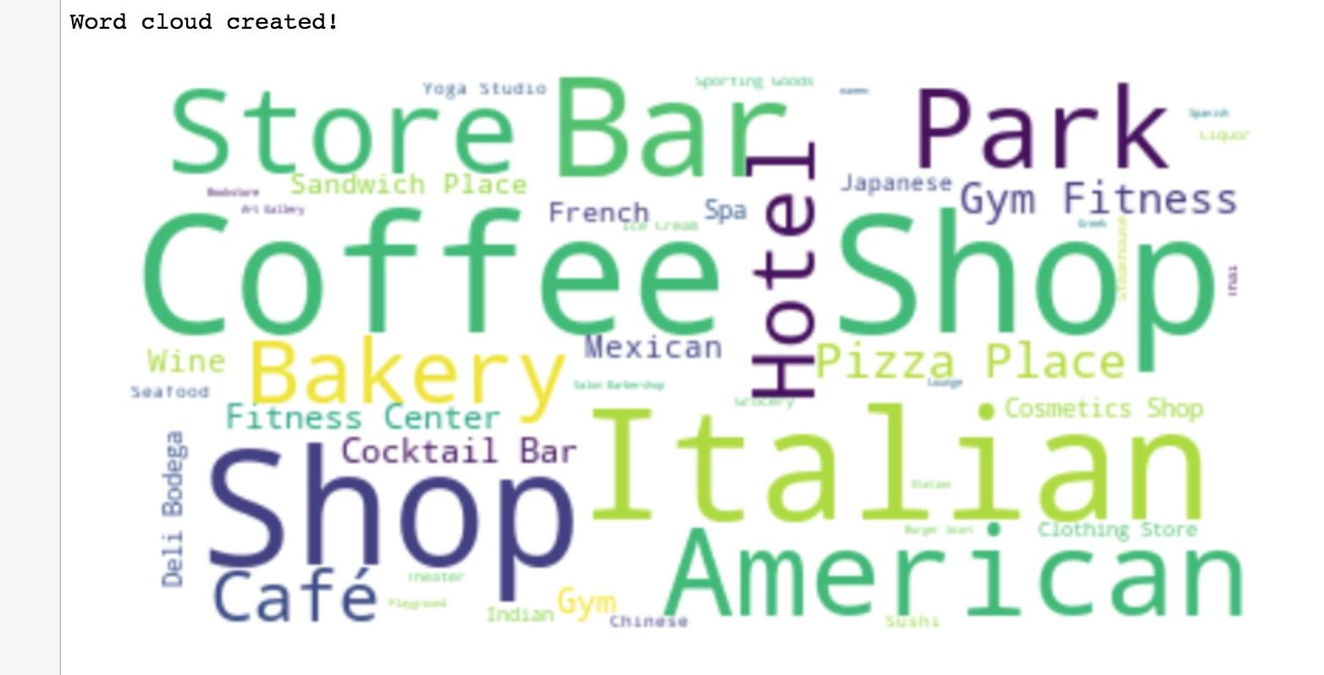
Visualization with word cloud for Manhattan (NYC)

Slide 14
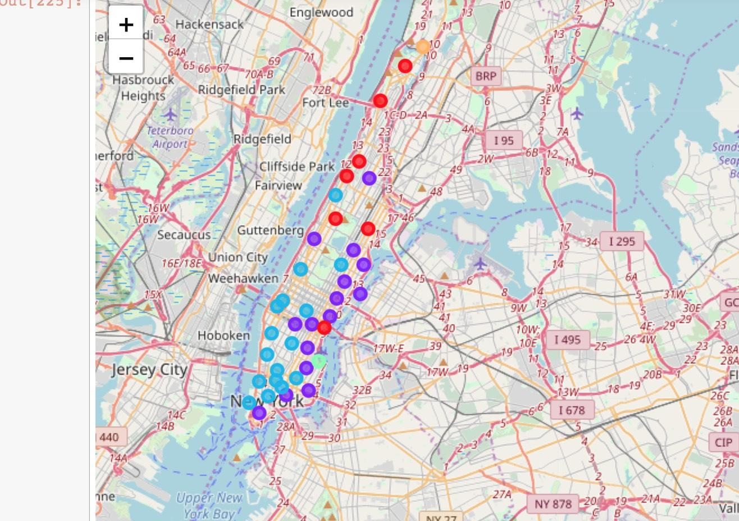
Cluster Neighborhoods of Manhattan

Slide 15
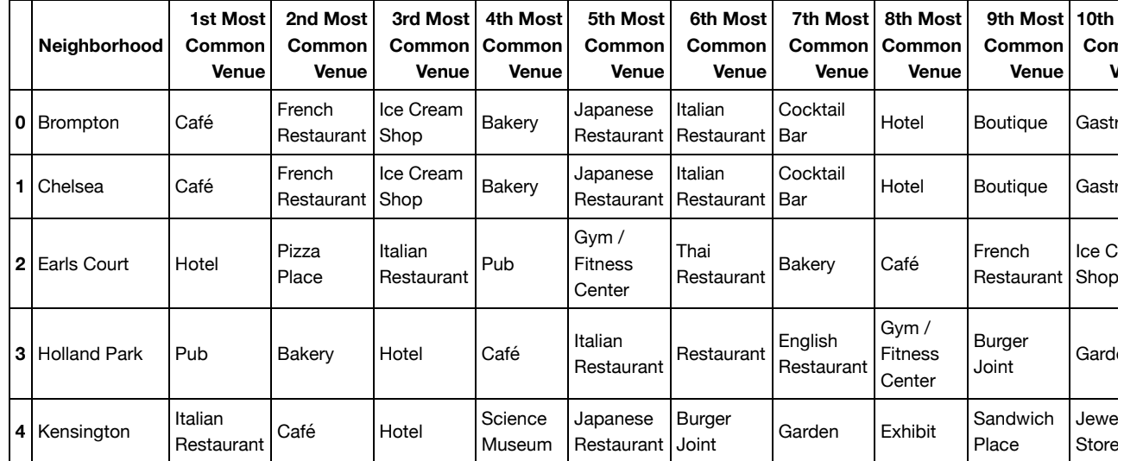
Analyze Each Neighborhood of Kensington and Chelsea

Slide 16
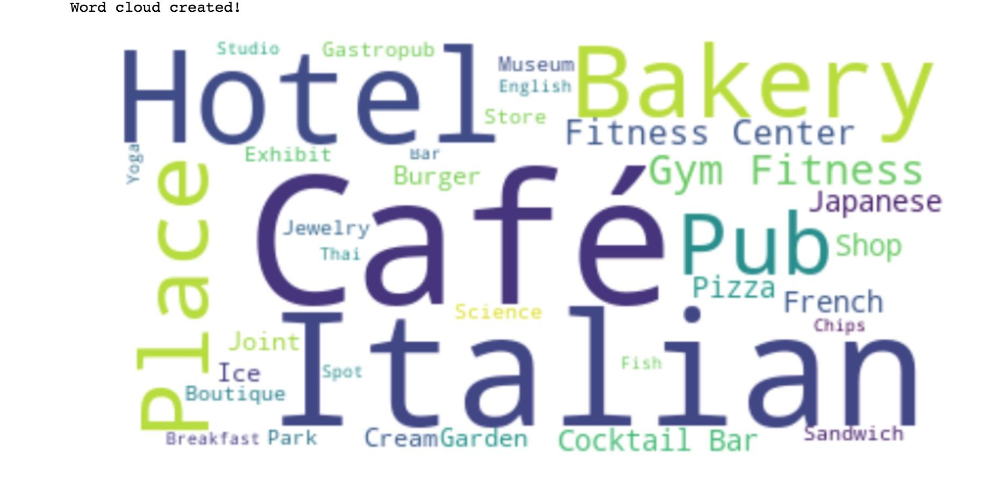
Visualization with word cloud for Kensington and Chelsea (London)

Slide 17
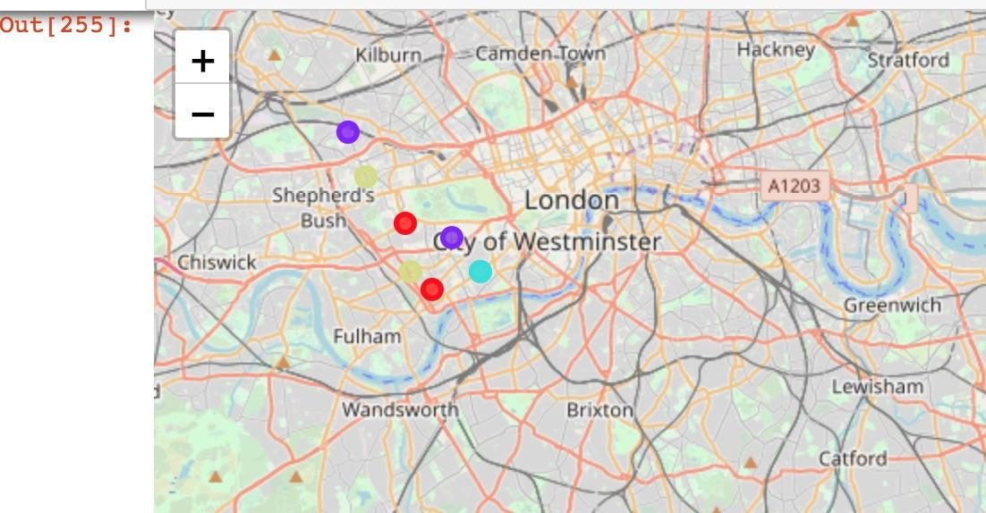
Cluster Neighborhoods of Kensington and Chelsea

Slide 18
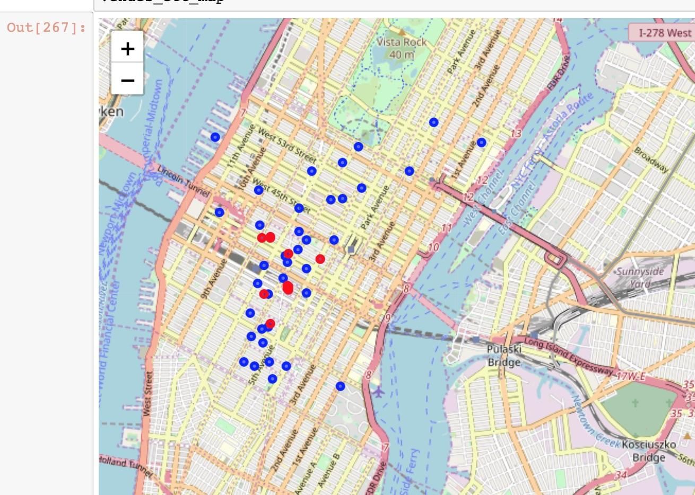
Entertainment in NYC
Escape rooms

Slide 19
Results
Analyzing the results we can see that people in different borough of London and NYC often visit identical places, such as Italian Restaurant, Coffee Shop, Park, Pizza Place, Hotel, Gym, Fitness Center. But there are also differences in preferences, such as French Restaurant, Pub, Japanese Restaurant, Cocktail Bar, Boutique for borough of London and for borough of NYC - American Restaurant, Wine Shop, Chinese Restaurant, Sushi Restaurant, Taco Place.
Also using Foursquare API and visualization we can easily see the information that we need, for example, the placement of Escape room. They are popular now, and how we can see on map there are only a few in Manhattan.

Slide 20
Discussion
Based on our result, we can conclude that there are few Escape rooms and if we want to open a Escape room then the best place in Manhattan is nearly the center and above. If to analyze Brooklyn we can see only 2 of them. That is a good decision and we are independed from choose a place at this moment.
Also analyzing area of London and New York, we see that the British prefer French Restaurant, Pub, Japanese Restaurant while the American prefer Mexican Restaurant, Chinese Restaurant, Sushi Restaurant, Taco Place.

Slide 21
Conclusion
Using Foursquare API, we can captured data of common places all around the world. Using it, we refer back to our main objectives, which is to determine; the similarity or dissimilarity of both cities classification of area located inside the city whether it is residential, tourism places, or others.
Using visualization libraries we can do different visualization for easy understanding of the material.

