Slide 1
Review: Supervised Learning

Slide 2
Previous lecture
A broad overview of structured prediction
The different aspects of the area
Basically the syllabus of the class
Questions?

Slide 3
Important dates
Date | Deadline
17-Jan | Start signing up for class presentations
24-Jan | Project team information due
5-Feb | Review 1 due
14-Feb | Project proposals due
9-Mar | Review 2 due
2-Apr | Project intermediate status report due
9-Apr | Review 3 due
23-Apr | Project final report due

Slide 4
Announcements
Office hours today at 2 PM
Reading for next lecture (Wednesday):
Erin L. Allwein, Robert E. Schapire, Yoram Singer, Reducing Multiclass to Binary: A Unifying Approach for Margin Classifiers, ICML 2000.

Slide 5
Supervised learning, Binary classification
Supervised learning: The general setting
Linear classifiers
The Perceptron algorithm
Learning as optimization
Support vector machines
Logistic Regression

Slide 6
Where are we?
Supervised learning: The general setting
Linear classifiers
The Perceptron algorithm
Learning as optimization
Support vector machines
Logistic Regression

Slide 7
Supervised learning: General setting
Given: Training examples of the form <x, f(x)>
The function f is an unknown function
The input x is represented in a feature space
Typically x 2 {0,1}^{n} or x 2 <^{n}
For a training example x, f(x) is called the label
Goal: Find a good approximation for f
Different kinds of problems
Binary classification: f(x) 2 {-1,1}
Multiclass classification: f(x) 2 {1, 2, 3, ☹, K}
Regression: f(x) 2 <

Slide 8
Nature of applications
There is no human expert
Eg: Identify DNA binding sites
Humans can perform a task, but can’t describe how they do it
Eg: Object detection in images
The desired function is hard to obtain in closed form
Eg: Stock market

Slide 9
Binary classification
Spam filtering
Is an email spam or not?
Recommendation systems
Given user’s movie preferences, will she like a new movie?
Malware detection
Is an Android app malicious?
Time series prediction
Will the future value of a stock increase or decrease with respect to its current value?
Spambot detection
Is a Twitter account a spam bot?

Slide 10
Where are we?
Supervised learning: The general setting
Linear classifiers
The Perceptron algorithm
Learning as optimization
Support vector machines
Logistic Regression

Slide 11
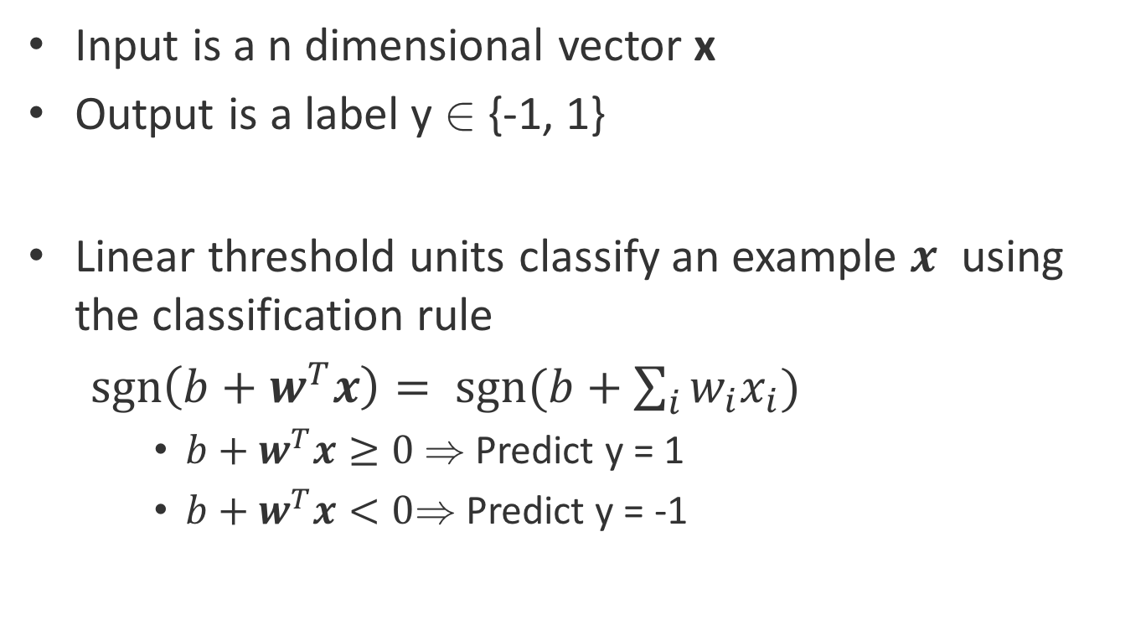
Linear Classifiers
Input is a n dimensional vector x
Output is a label y 2 {-1, 1}
Linear threshold units classify an example $x$ using the classification rule
$sgn\left(b+w^{T}x\right)= sgn(b+\sum_{i}{w_{i}x_{i}})$
$b+w^{T}x≥0$ ) Predict y = 1
$b+w^{T}x<0$) Predict y = -1
For now

Slide 12
The geometry of a linear classifier
sgn(b +w₁ x₁ + w₂x₂)
b +w₁ x₁ + w₂x₂=0
+
+
+
+
+
+
+
+
[w₁ w₂]
x₁
-
-
-
-
-
-
-
In n dimensions,
a linear classifier
represents a hyperplane that separates the space into two half-spaces
-
-
-
-
-
-
-
-
-
-
-
x₂

Slide 13
XOR is not linearly separable
No line can be drawn to separate the two classes
-
-
-
-
-
-
-
+
+
+
-
-
-
-
+
+
-
-
-
-
-
+
+
+
-
-
x₁
-
-
-
-
-
-
-
+
-
-
+
+
+
-
-
-
+
-
-
+
-
-
+
+
-
-
x₂

Slide 14
Even these functions can be made linear
Not all functions are linearly separable
The trick: Change the representation
These points are not separable in 1-dimension by a line
What is a one-dimensional line, by the way?

Slide 15
Even these functions can be made linear
Not all functions are linearly separable
The trick: Use feature conjunctions
Transform points: Represent each point x in 2 dimensions by (x, x²)
Now the data is linearly separable in this space!

Slide 16
Almost linearly separable data
sgn(b +w₁ x₁ + w₂x₂)
Training data is almost separable, except for some noise
How much noise do we allow for?
b +w₁ x₁ + w₂x₂=0
+
+
+
-
+
+
+
+
+
x₁
-
-
-
-
-
-
-
-
-
-
-
-
-
-
-
-
-
x₂

Slide 17
Linear classifiers are an expressive hypothesis class
Many functions are linear
Conjunctions, disjunctions
At least m-of-n functions
Often a good guess for a hypothesis space
Some functions are not linear
The XOR function
Non-trivial Boolean functions
We will see later in the class that many structured predictors are linear functions too

Slide 18
Where are we?
Supervised learning: The general setting
Linear classifiers
The Perceptron algorithm
Learning as optimization
Support vector machines
Logistic Regression

Slide 19
The Perceptron algorithm
Rosenblatt 1958
The goal is to find a separating hyperplane
For separable data, guaranteed to find one
An online algorithm
Processes one example at a time
Several variants exist

Slide 20
The algorithm
Given a training set D = {(x,y)}, x 2 <^{n}, y 2 {-1,1}
Initialize w = 0 2 <^{n}
For epoch = 1 … T:
For each training example (x, y) 2 D:
Predict y’ = sgn(w^{T}x)
If y ≠ y’, update w Ã w + y x
Return w
Prediction: sgn(w^{T}x)

Slide 21
The algorithm
Given a training set D = {(x,y)}
Initialize w = 0 2 <^{n}
For epoch = 1 … T:
For each training example (x, y) 2 D:
Predict y’ = sgn(w^{T}x)
If y ≠ y’, update w Ã w + y x
Return w
Prediction: sgn(w^{T}x)
T is a hyperparameter to the algorithm
In practice, good to shuffle D before the inner loop
Update only on an error.
Perceptron is an mistake-driven algorithm.

Slide 22
Convergence
Convergence theorem
If there exist a set of weights that are consistent with the data (i.e. the data is linearly separable), the perceptron algorithm will converge. [Novikoff 1962]
Cycling theorem
If the training data is not linearly separable, then the learning algorithm will eventually repeat the same set of weights and enter an infinite loop

Slide 23
Beyond the separable case
The good news
Perceptron makes no assumption about data distribution
Even adversarial
After a fixed number of mistakes, you are done. Don’t even need to see any more data
The bad news: Real world is not linearly separable
Can’t expect to never make mistakes again
What can we do: more features, try to be linearly separable if you can

Slide 24
Variants of the algorithm
The original version: Return the final weight vector
Averaged perceptron
Returns the average weight vector from the entire training time (i.e longer surviving weight vectors get more say)
Widely used
A practical approximation of the Voted Perceptron

Slide 25
Where are we?
Supervised learning: The general setting
Linear classifiers
The Perceptron algorithm
Learning as optimization
Support vector machines
Logistic Regression

Slide 26
Learning as loss minimization
Collect some annotated data. More is generally better
Pick a hypothesis class (also called model)
Eg: linear classifiers, deep neural networks
Also, decide on how to impose a preference over hypotheses
Choose a loss function
Eg: negative log-likelihood, hinge loss
Decide on how to penalize incorrect decisions
Minimize the expected loss
Eg: Set derivative to zero, more complex algorithm

Slide 27
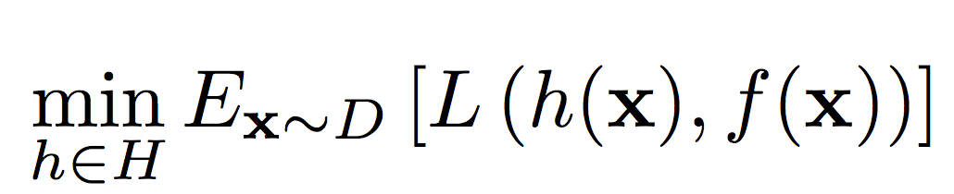
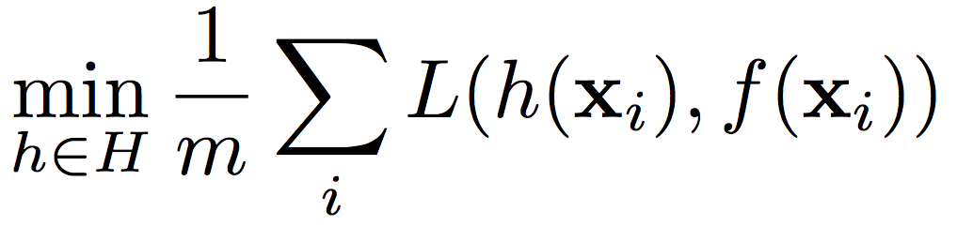
Learning as loss minimization
The setup
Examples x drawn from a fixed, unknown distribution D
Hidden oracle classifier f labels examples
We wish to find a hypothesis h that mimics f
The ideal situation
Define a function L that penalizes bad hypotheses
Learning: Pick a function h 2 H to minimize expected loss
Instead, minimize empirical loss on the training set
But distribution D is unknown

Slide 28
Learning as loss minimization
The setup
Examples x drawn from a fixed, unknown distribution D
Hidden oracle classifier f labels examples
We wish to find a hypothesis h that mimics f
The ideal situation
Define a function L that penalizes bad hypotheses
Learning: Pick a function h 2 H to minimize expected loss
Instead, minimize empirical loss on the training set
But distribution D is unknown

Slide 29
Learning as loss minimization
The setup
Examples x drawn from a fixed, unknown distribution D
Hidden oracle classifier f labels examples
We wish to find a hypothesis h that mimics f
The ideal situation
Define a function L that penalizes bad hypotheses
Learning: Pick a function h 2 H to minimize expected loss
Instead, minimize empirical loss on the training set
But distribution D is unknown

Slide 30
Empirical loss minimization
Learning = minimize empirical loss on the training set
We need something that biases the learner towards simpler hypotheses
Achieved using a regularizer, which penalizes complex hypotheses
Capacity control for better generalization
Is there a problem here?
Overfitting!

Slide 31
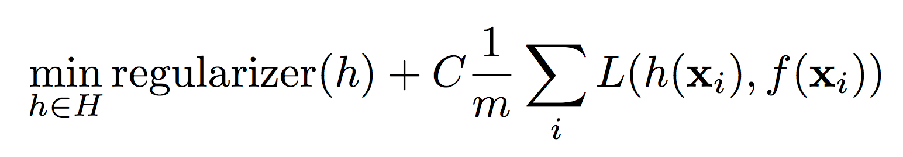
Regularized loss minimization
Learning:

Slide 32
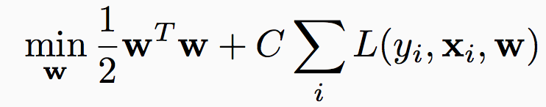
Regularized loss minimization
Learning:
With L2 regularization:

Slide 33
Regularized loss minimization
Learning:
With L2 regularization:
What is a loss function?
Loss functions should penalize mistakes
We are minimizing average loss over the training data
What is the ideal loss function for classification?

Slide 34
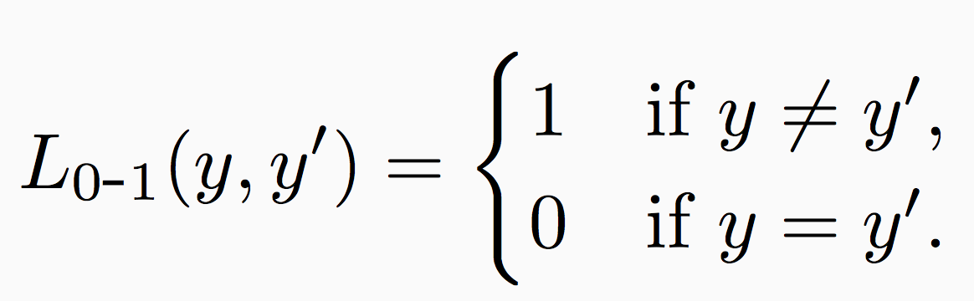
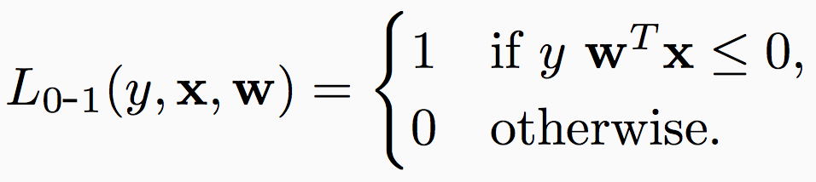
The 0-1 loss
Penalize classification mistakes between true label y and prediction y’
For linear classifiers, the prediction y’ = sgn(w^{T}x)
Mistake if y w^{T}x · 0
Minimizing 0-1 loss is intractable. Need surrogates

Slide 35
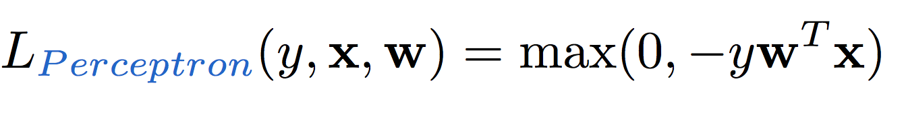
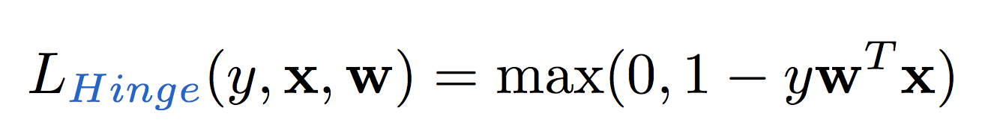
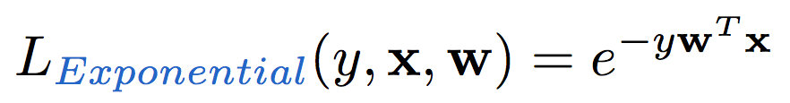
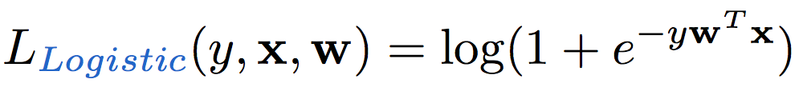
The loss function zoo
Many loss functions exist
Perceptron loss
Hinge loss (SVM)
Exponential loss (AdaBoost)
Logistic loss (logistic regression)

Slide 36
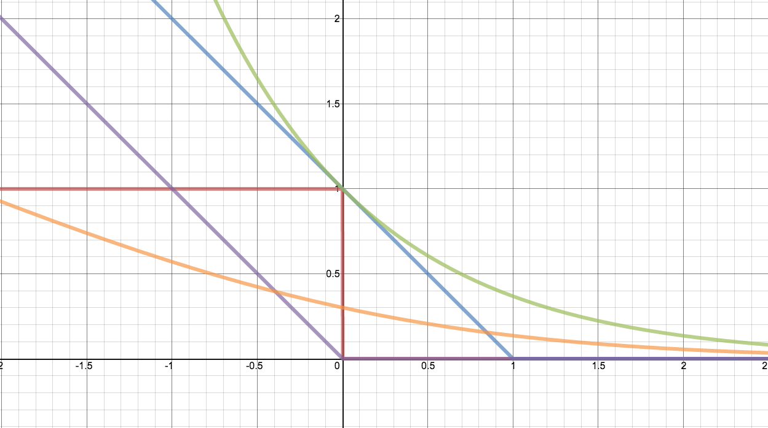
The loss function zoo
Loss
yw^{T}x

Slide 37
The loss function zoo
Loss
Zero-one
yw^{T}x

Slide 38
The loss function zoo
Loss
Hinge: SVM
Zero-one
yw^{T}x

Slide 39
The loss function zoo
Loss
Hinge: SVM
Perceptron
Zero-one
yw^{T}x

Slide 40
The loss function zoo
Loss
Hinge: SVM
Exponential: AdaBoost
Perceptron
Zero-one
yw^{T}x

Slide 41
The loss function zoo
Loss
Hinge: SVM
Exponential: AdaBoost
Perceptron
Zero-one
Logistic regression
yw^{T}x

Slide 42
Where are we?
Supervised learning: The general setting
Linear classifiers
The Perceptron algorithm
Learning as optimization
Support vector machines
Logistic Regression

Slide 43
Margin
The margin of a hyperplane for a dataset is the distance between the hyperplane and the data point nearest to it.
-
-
+
+
+
-
+
+
-
-
-
-
+
+
+
-
-
-
-
-
-
-
-
-
-
-

Slide 44
Learning strategy
Find the linear separator that maximizes the margin

Slide 45
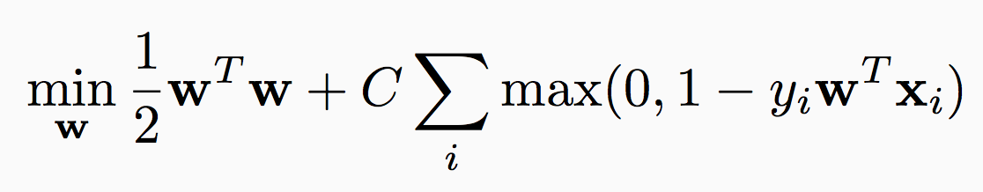
Maximizing margin and minimizing loss
Find the linear separator that maximizes the margin
Maximize margin
Penalty for the prediction: The Hinge loss

Slide 46
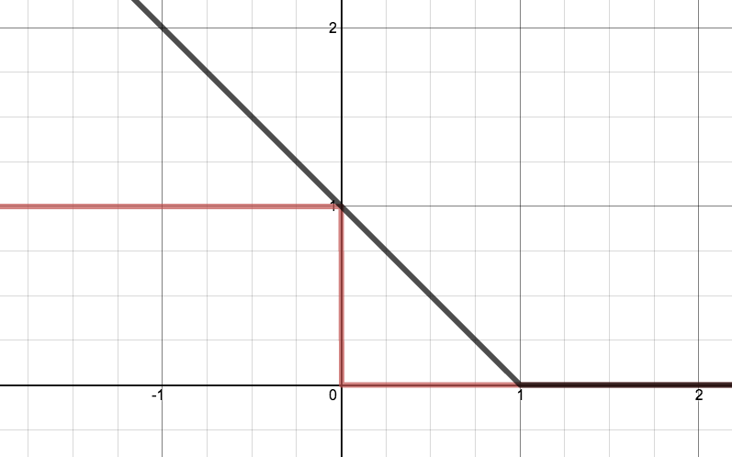
The Hinge Loss
Loss
yw^{T}x

Slide 47
The Hinge Loss
Loss
Hinge loss
0-1 loss
yw^{T}x

Slide 48
The Hinge Loss
Loss
0-1 loss: If the sign of y and w^{T}x are different, then penalty = 1
0-1 loss: If the sign of y and w^{T}x is the same, then no penalty
0-1 loss
yw^{T}x

Slide 49
The Hinge Loss
Loss
Hinge: Penalize predictions even if they are correct, but too close to the margin
Hinge: Incorrect predictions get a linearly increasing penalty with w^{T}x
Hinge: No penalty if w^{T}x is far away from 1 (-1 for negative examples)
yw^{T}x

Slide 50
SVM objective function
Regularization term:
Maximize the margin
Imposes a preference over the hypothesis space and pushes for better generalization
Can be replaced with other regularization terms which impose other preferences
Empirical Loss:
Hinge loss
Penalizes weight vectors that make mistakes
Can be replaced with other loss functions which impose other preferences

Slide 51
SVM objective function
Regularization term:
Maximize the margin
Imposes a preference over the hypothesis space and pushes for better generalization
Can be replaced with other regularization terms which impose other preferences
Empirical Loss:
Hinge loss
Penalizes weight vectors that make mistakes
Can be replaced with other loss functions which impose other preferences
A hyper-parameter that controls the tradeoff between a large margin and a small hinge-loss

Slide 52
Solving the SVM optimization problem
This function is convex in w

Slide 53
Stochastic sub-gradient descent for SVM
Given a training set S = {(x_{i}, y_{i})}, x 2 <^{n}, y 2 {-1,1}
Initialize w = 0 2 <^{n}
For epoch = 1 … T:
For each training example (x_{i}, y_{i})2 S:
If y_{i} w^{T}x_{i} · 1,
w Ã (1- °_{t}) w + °_{t} C y_{i} x_{i}
else
w Ã (1- °_{t}) w
Return w

Slide 54
Stochastic sub-gradient descent for SVM
Given a training set S = {(x_{i}, y_{i})}, x 2 <^{n}, y 2 {-1,1}
Initialize w = 0 2 <^{n}
For epoch = 1 … T:
For each training example (x_{i}, y_{i})2 S:
If y_{i} w^{T}x_{i} · 1,
w Ã (1- °_{t}) w + °_{t} C y_{i} x_{i}
else
w Ã (1- °_{t}) w
Return w

Slide 55
Stochastic sub-gradient descent for SVM
Given a training set S = {(x_{i}, y_{i})}, x 2 <^{n}, y 2 {-1,1}
Initialize w = 0 2 <^{n}
For epoch = 1 … T:
For each training example (x_{i}, y_{i})2 S:
If y_{i} w^{T}x_{i} · 1,
w Ã (1- °_{t}) w + °_{t} C y_{i} x_{i}
else
w Ã (1- °_{t}) w
Return w
Update w Ã w – °_{t} rJ^{t}

Slide 56
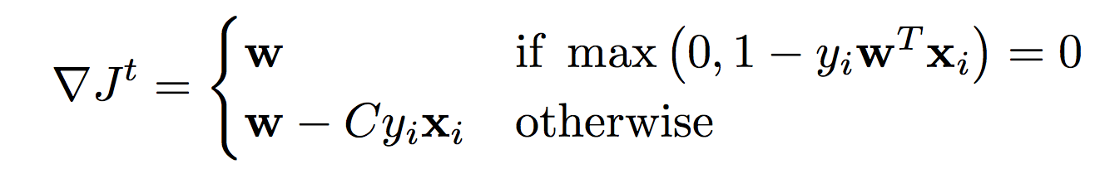
Stochastic sub-gradient descent for SVM
Given a training set S = {(x_{i}, y_{i})}, x 2 <^{n}, y 2 {-1,1}
Initialize w = 0 2 <^{n}
For epoch = 1 … T:
For each training example (x_{i}, y_{i})2 S:
If y_{i} w^{T}x_{i} · 1,
w Ã (1- °_{t}) w + °_{t} C y_{i} x_{i}
else
w Ã (1- °_{t}) w
Return w

Slide 57
Stochastic sub-gradient descent for SVM
Given a training set S = {(x_{i}, y_{i})}, x 2 <^{n}, y 2 {-1,1}
Initialize w = 0 2 <^{n}
For epoch = 1 … T:
For each training example (x_{i}, y_{i})2 S:
If y_{i} w^{T}x_{i} · 1,
w Ã (1- °_{t}) w + °_{t} C y_{i} x_{i}
else
w Ã (1- °_{t}) w
Return w
°_{t}: learning rate, many tweaks possible
Important to shuffle examples at the start of each epoch

Slide 58
Stochastic sub-gradient descent for SVM
Given a training set S = {(x_{i}, y_{i})}, x 2 <^{n}, y 2 {-1,1}
Initialize w = 0 2 <^{n}
For epoch = 1 … T:
Shuffle the training set
For each training example (x_{i}, y_{i})2 S:
If y_{i} w^{T}x_{i} · 1,
w Ã (1- °_{t}) w + °_{t} C y_{i} x_{i}
else
w Ã (1- °_{t}) w
Return w
°_{t}: learning rate, many tweaks possible

Slide 59
Where are we?
Supervised learning: The general setting
Linear classifiers
The Perceptron algorithm
Learning as optimization
Support vector machines
Logistic Regression

Slide 60
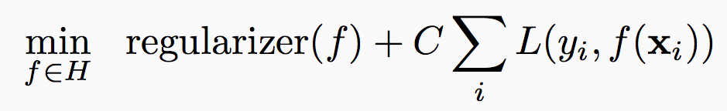
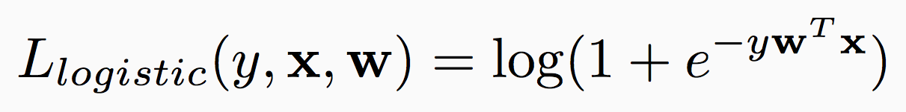
Regularized loss minimization: Logistic regression
Learning:
With linear classifiers:
SVM uses the hinge loss
Another loss function: The logistic loss

Slide 61
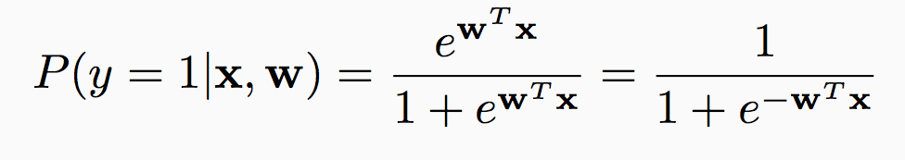
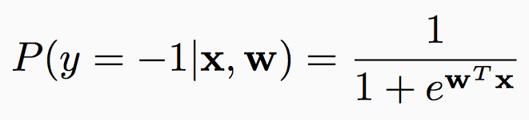
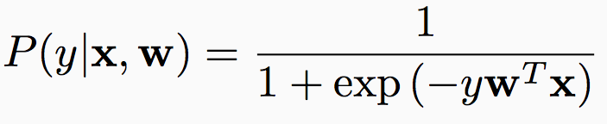
The probabilistic interpretation
Suppose we believe that the labels are distributed as follows given the input:
Predict label = 1 if P(1 | x, w) > P(-1 | x, w)
Equivalent to predicting 1 if w^{T}x ¸ 0

Slide 62
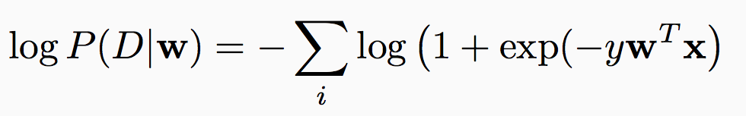
The probabilistic interpretation
Suppose we believe that the labels are distributed as follows given the input:
The log-likelihood of seeing a dataset D = {(x_{i}, y_{i})} if the true weight vector was w:

Slide 63
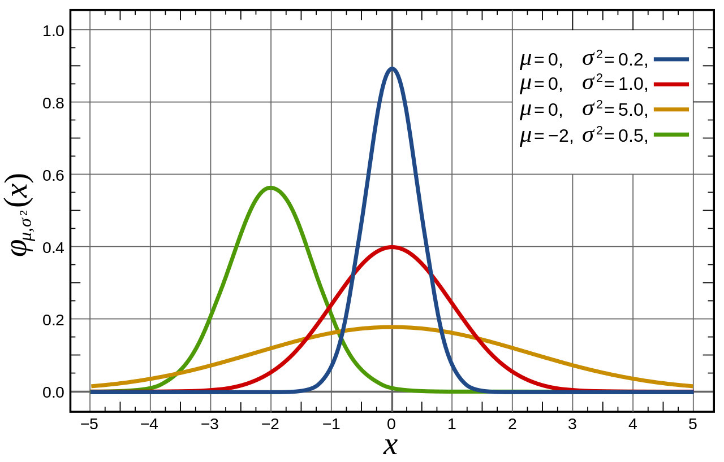
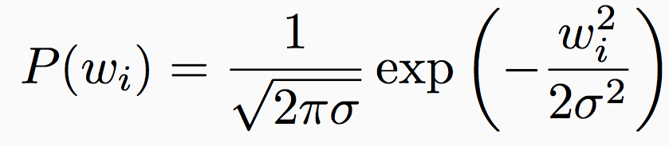
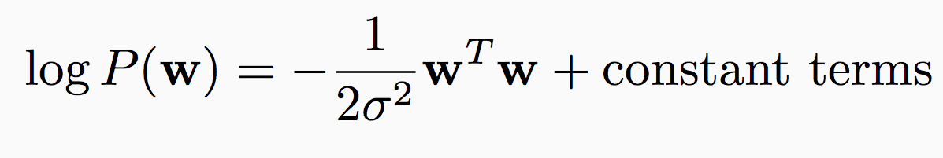
Prior distribution over the weight vectors
A prior balances the tradeoff between the likelihood of the data and existing belief about the parameters
Suppose each weight w_{i} is drawn independently from the normal distribution centered at zero with variance ¾²
Bias towards smaller weights
Probability of the entire weight vector:
Source: Wikipedia

Slide 64

Regularized logistic regression
What is the probability of a weight vector w being the true one for a dataset D = {<x_{i}, y_{i}>}?
$P\left(w \right| D)∝P\left(w, D\right)=P\left( D ∣ w\right)P( w)$

Slide 65
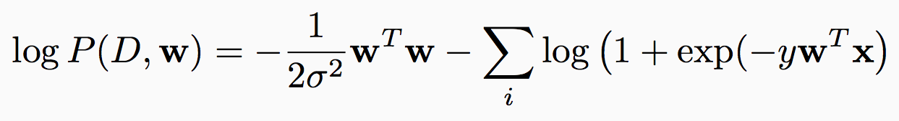
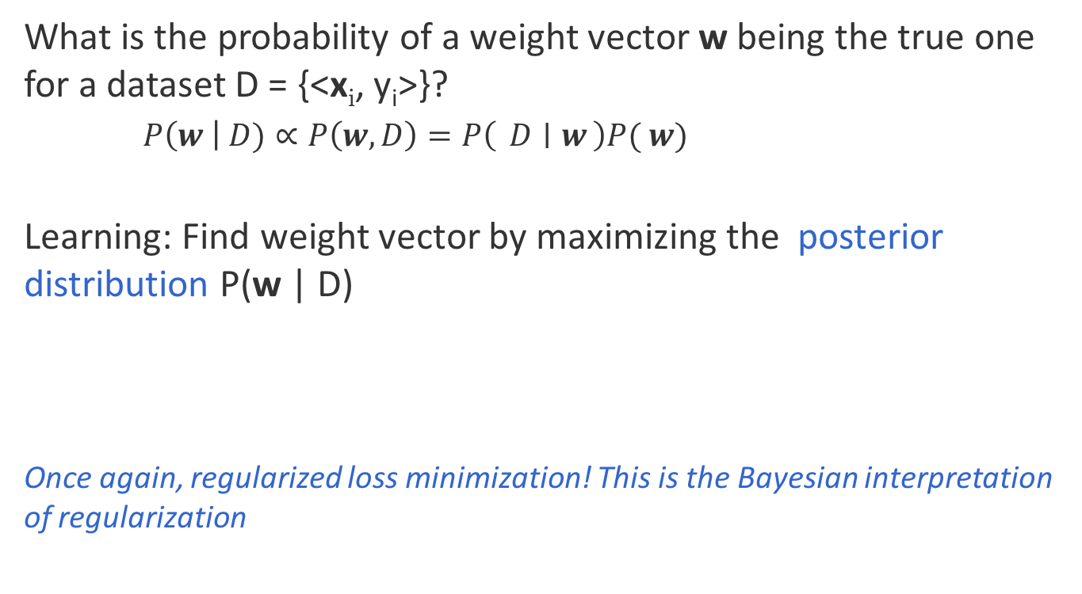
Regularized logistic regression
What is the probability of a weight vector w being the true one for a dataset D = {<x_{i}, y_{i}>}?
$P\left(w \right| D)∝P\left(w, D\right)=P\left( D ∣ w\right)P( w)$
Learning: Find weight vector by maximizing the posterior distribution P(w | D)
Once again, regularized loss minimization! This is the Bayesian interpretation of regularization

Slide 66
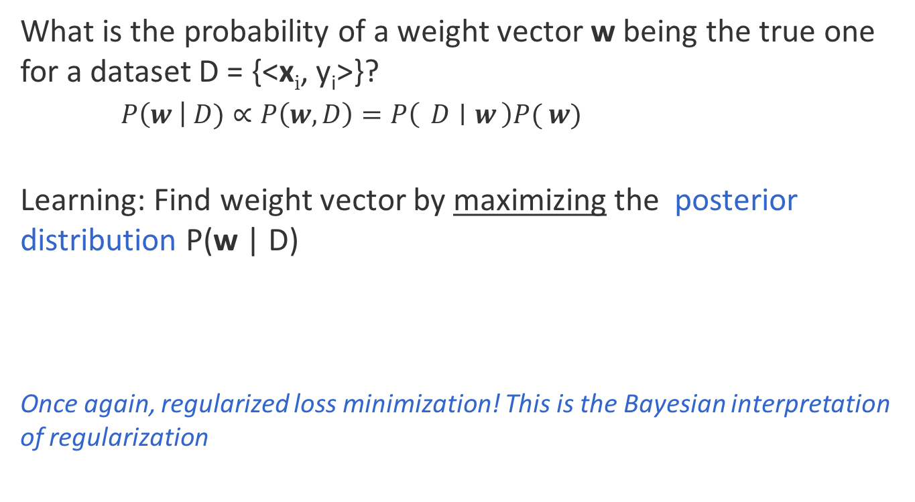
Regularized logistic regression
What is the probability of a weight vector w being the true one for a dataset D = {<x_{i}, y_{i}>}?
$P\left(w \right| D)∝P\left(w, D\right)=P\left( D ∣ w\right)P( w)$
Learning: Find weight vector by maximizing the posterior distribution P(w | D)
Once again, regularized loss minimization! This is the Bayesian interpretation of regularization
Exercise: Derive the stochastic gradient descent algorithm for logistic regression.

Slide 67
Regularized loss minimization
Learning objective for both SVM & logistic regression:
“loss over training data + regularizer”
Different loss functions
Hinge loss vs. logistic loss
Same regularizer, but different interpretation
Margin vs prior
Hyper-parameter controls tradeoff between the loss and regularizer
Other regularizers/loss functions also possible
Questions?

Slide 68
Review of supervised binary classification
Supervised learning: The general setting
Linear classifiers
The Perceptron algorithm
Support vector machine
Learning as optimization
Logistic Regression
Questions?

