Slide 1
Review: Supervised Learning

Slide 2
Previous lecture
A broad overview of structured prediction
The different aspects of the area
Basically the syllabus of the class
Questions?

Slide 3
Supervised learning, Binary classification
Supervised learning: The general setting
Linear classifiers
The Perceptron algorithm
Learning as optimization
Support vector machines
Logistic Regression

Slide 4
Where are we?
Supervised learning: The general setting
Linear classifiers
The Perceptron algorithm
Learning as optimization
Support vector machines
Logistic Regression

Slide 5
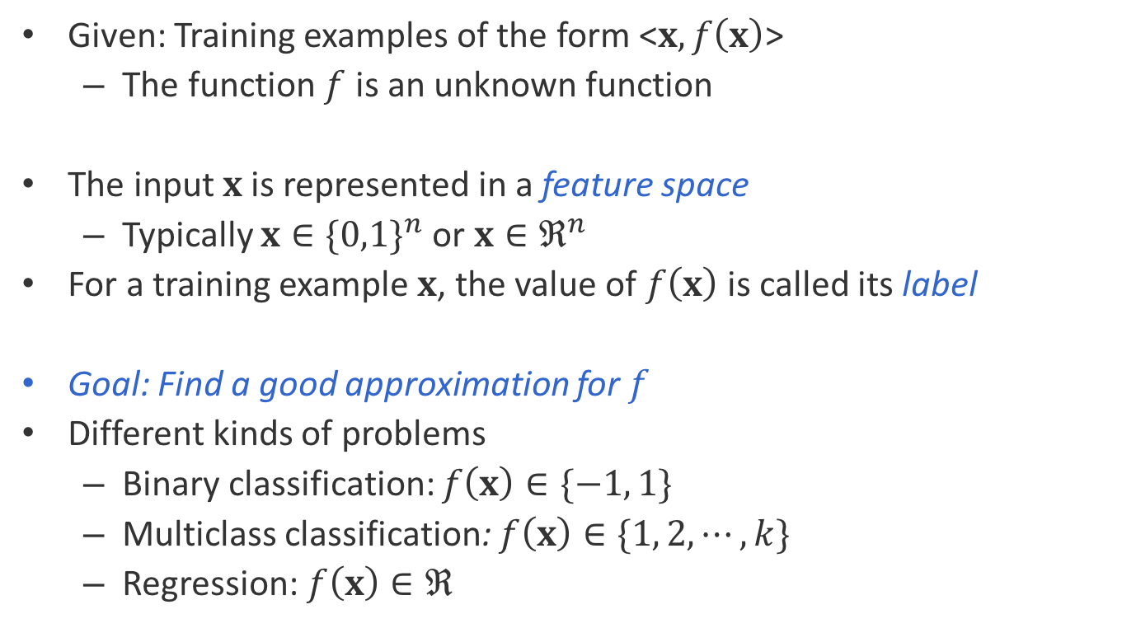
Supervised learning: General setting
Given: Training examples of the form <$x, f\left(x\right)$>
The function $f$ is an unknown function
The input $x$ is represented in a feature space
Typically $x∈{\{0,1\}}^{n}$or $x∈ℜ^{n}$
For a training example $x$, the value of $f\left(x\right)$ is called its label
Goal: Find a good approximation for $f$
Different kinds of problems
Binary classification: $f\left(x\right)∈\{−1, 1\}$
Multiclass classification: $f\left(x\right)∈\{1, 2,⋯,k\}$
Regression: $f\left(x\right)∈ℜ$

Slide 6
Nature of applications
There is no human expert
Eg: Identify DNA binding sites
Humans can perform a task, but can’t describe how they do it
Eg: Object detection in images
The desired function is hard to obtain in closed form
Eg: Stock market

Slide 7
Where are we?
Supervised learning: The general setting
Linear classifiers
The Perceptron algorithm
Learning as optimization
Support vector machines
Logistic Regression

Slide 8
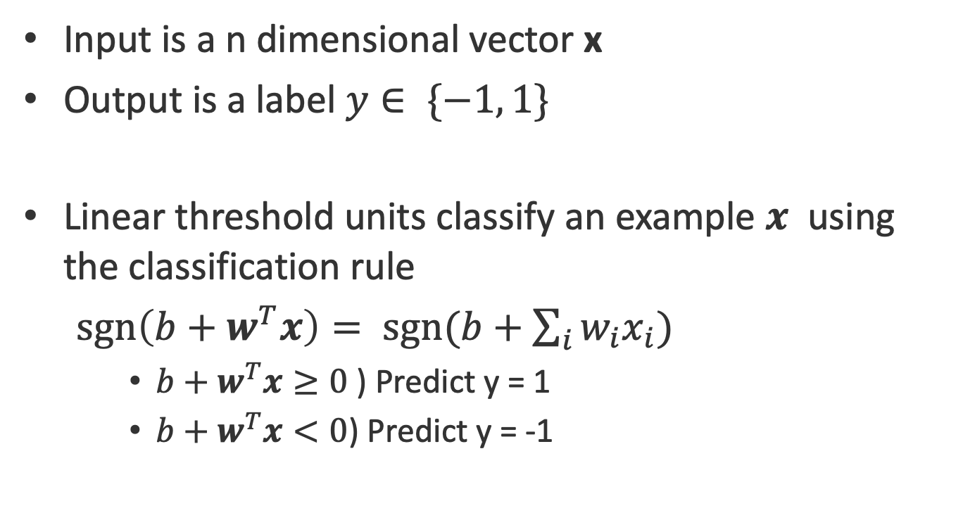
Linear Classifiers
Input is a n dimensional vector x
Output is a label $y∈ \{−1, 1\}$
Linear threshold units classify an example $x$ using the classification rule
$sgn\left(b+w^{T}x\right)= sgn(b+\sum_{i}{w_{i}x_{i}})$
$b+w^{T}x≥0$ ) Predict y = 1
$b+w^{T}x<0$) Predict y = -1
For now

Slide 9
The geometry of a linear classifier
sgn(b +w₁ x₁ + w₂x₂)
b +w₁ x₁ + w₂x₂=0
+
+
+
+
+
+
+
+
[w₁ w₂]
x₁
-
-
-
-
-
-
-
In n dimensions,
a linear classifier
represents a hyperplane that separates the space into two half-spaces
-
-
-
-
-
-
-
-
-
-
-
x₂

Slide 10
XOR is not linearly separable
No line can be drawn to separate the two classes
-
-
-
-
-
-
-
+
+
+
-
-
-
-
+
+
-
-
-
-
-
+
+
+
-
-
x₁
-
-
-
-
-
-
-
+
-
-
+
+
+
-
-
-
+
-
-
+
-
-
+
+
-
-
x₂

Slide 11
Even these functions can be made linear
Not all functions are linearly separable
The trick: Change the representation
These points are not separable in 1-dimension by a line
What is a one-dimensional line, by the way?

Slide 12
Even these functions can be made linear
Not all functions are linearly separable
The trick: Use feature conjunctions
Transform points: Represent each point x in 2 dimensions by (x, x²)
Now the data is linearly separable in this space!

Slide 13
Linear classifiers are an expressive hypothesis class
Many functions are linear
Conjunctions, disjunctions
At least m-of-n functions
Often a good guess for a hypothesis space
If we know a good feature representation
Some functions are not linear
The XOR function
Non-trivial Boolean functions
We will see in the coming weeks that structured predictors can also be defined via linear functions.

Slide 14
Where are we?
Supervised learning: The general setting
Linear classifiers
The Perceptron algorithm
Learning as optimization
Support vector machines
Logistic Regression

Slide 15
The Perceptron algorithm
Rosenblatt 1958
The goal is to find a separating hyperplane
For separable data, guaranteed to find one
An online algorithm
Processes one example at a time
Several variants exist

Slide 16
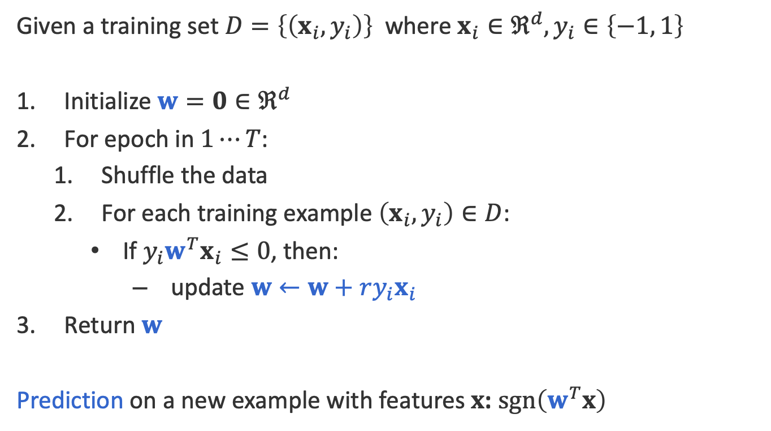
The algorithm
Given a training set $D=\left\{\left(x_{i},y_{i}\right)\right\}$ where $x_{i}∈ℜ^{d}, y_{i}∈\left\{−1, 1\right\}$
Initialize $w=0∈ℜ^{d}$
For epoch in $1⋯T$:
Shuffle the data
For each training example $\left(x_{i},y_{i}\right)∈D$:
If $y_{i}w^{T}x_{i}≤0$, then:
update $w←w+ry_{i}x_{i}$
Return $w$
Prediction on a new example with features $x$: $\operatorname{sgn}\left(w^{T}x\right)$

Slide 17
The algorithm
Given a training set $D=\left\{\left(x_{i},y_{i}\right)\right\}$ where $x_{i}∈ℜ^{d}, y_{i}∈\left\{−1, 1\right\}$
Initialize $w=0∈ℜ^{d}$
For epoch in $1⋯T$:
Shuffle the data
For each training example $\left(x_{i},y_{i}\right)∈D$:
If $y_{i}w^{T}x_{i}≤0$, then:
update $w←w+ry_{i}x_{i}$
Return $w$
Prediction on a new example with features $x$: $\operatorname{sgn}\left(w^{T}x\right)$
T is a hyper-parameter to the algorithm
Another way of writing that there is an error

Slide 18
Convergence theorem
If there exist a set of weights that are consistent with the data (i.e. the data is linearly separable), the perceptron algorithm will converge after a finite number of updates.
[Novikoff 1962]

Slide 19
Beyond the separable case
The good news
Perceptron makes no assumption about data distribution
Even adversarial
After a fixed number of mistakes, you are done. Don’t even need to see any more data
The bad news: Real world is not linearly separable
Can’t expect to never make mistakes again
What can we do: more features, try to be linearly separable if you can

Slide 20
Variants of the algorithm
The original version: Return the final weight vector
Averaged perceptron
Returns the average weight vector from the entire training time (i.e longer surviving weight vectors get more say)
Widely used
A practical approximation of the Voted Perceptron

Slide 21
Where are we?
Supervised learning: The general setting
Linear classifiers
The Perceptron algorithm
Learning as optimization
The general idea
Stochastic gradient descent
Loss functions
Support vector machines
Logistic Regression

Slide 22
Learning as loss minimization
Collect some annotated data. More is generally better
Pick a hypothesis class (also called model)
Eg: linear classifiers, deep neural networks
Also, decide on how to impose a preference over hypotheses
Choose a loss function
Eg: negative log-likelihood, hinge loss
Decide on how to penalize incorrect decisions
Minimize the expected loss
Eg: Set derivative to zero and solve on paper, typically a more complex algorithm

Slide 23
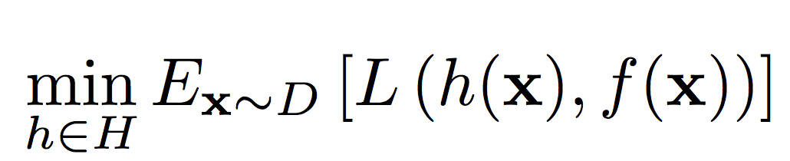
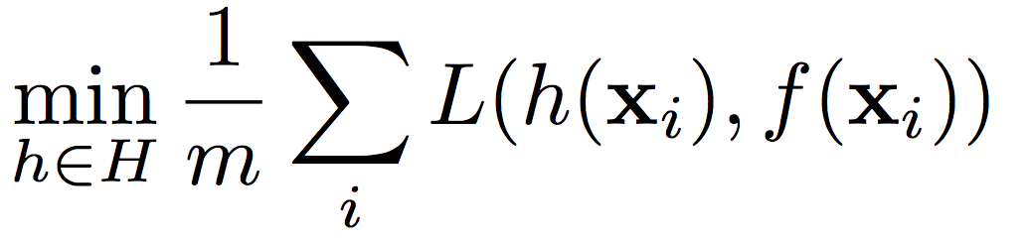
Learning as loss minimization
The setup
Examples x drawn from a fixed, unknown distribution D
Hidden oracle classifier f labels examples
We wish to find a hypothesis h that mimics f
The ideal situation
Define a function L that penalizes bad hypotheses
Learning: Pick a function h 2 H to minimize expected loss
Instead, minimize empirical loss on the training set
But distribution D is unknown

Slide 24
Learning as loss minimization
The setup
Examples x drawn from a fixed, unknown distribution D
Hidden oracle classifier f labels examples
We wish to find a hypothesis h that mimics f
The ideal situation
Define a function L that penalizes bad hypotheses
Learning: Pick a function h 2 H to minimize expected loss
Instead, minimize empirical loss on the training set
But distribution D is unknown

Slide 25
Learning as loss minimization
The setup
Examples x drawn from a fixed, unknown distribution D
Hidden oracle classifier f labels examples
We wish to find a hypothesis h that mimics f
The ideal situation
Define a function L that penalizes bad hypotheses
Learning: Pick a function h 2 H to minimize expected loss
Instead, minimize empirical loss on the training set
But distribution D is unknown

Slide 26
Empirical loss minimization
Learning = minimize empirical loss on the training set
We need something that biases the learner towards simpler hypotheses
Achieved using a regularizer, which penalizes complex hypotheses
Capacity control for better generalization
Is there a problem here?
Overfitting!

Slide 27

Regularized loss minimization
Learning: $\min_{h∈H}{\text{regularizer}\text{(}\text{w}\text{) + }\text{C}\frac{1}{m}\sum_{i}{L(h\left(x_{i}\right), y_{i})}}$
With L2 regularization: $\min_{w}\frac{1}{2} w^{T}w+C\sum_{i}{L(F\left(x_{i}, w\right), y_{i})}$

Slide 28
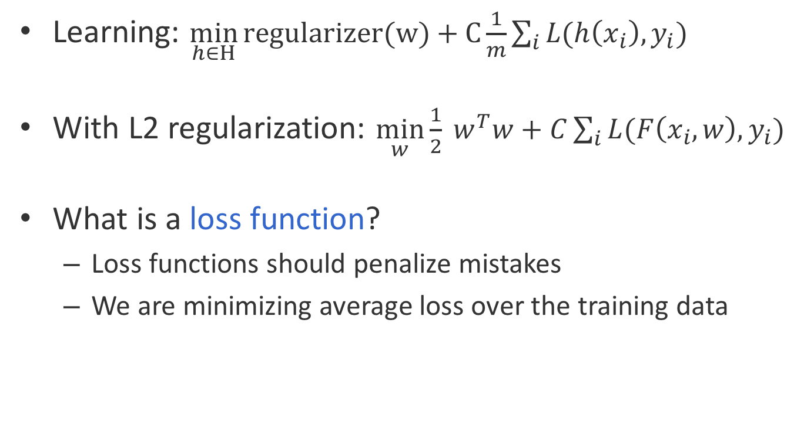
Regularized loss minimization
Learning: $\min_{h∈H}{\text{regularizer}\text{(}\text{w}\text{) + }\text{C}\frac{1}{m}\sum_{i}{L(h\left(x_{i}\right), y_{i})}}$
With L2 regularization: $\min_{w}\frac{1}{2} w^{T}w+C\sum_{i}{L(F\left(x_{i}, w\right), y_{i})}$
What is a loss function?
Loss functions should penalize mistakes
We are minimizing average loss over the training data

Slide 29
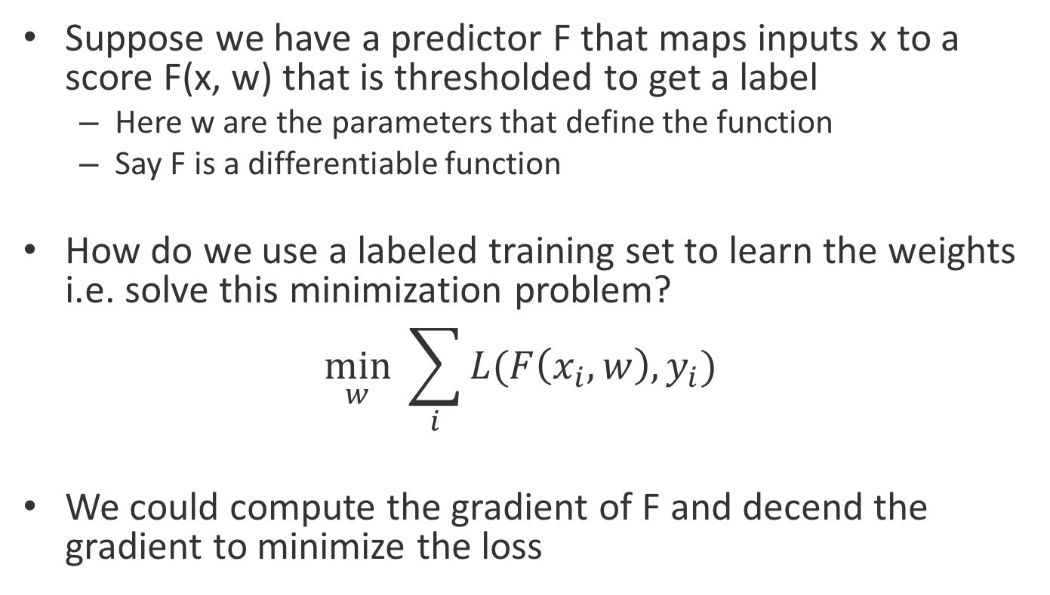
How do we train in such a regime?
Suppose we have a predictor F that maps inputs x to a score F(x, w) that is thresholded to get a label
Here w are the parameters that define the function
Say F is a differentiable function
How do we use a labeled training set to learn the weights i.e. solve this minimization problem?
$$\min_{w} \sum_{i}{L(F\left(x_{i}, w\right), y_{i})}$$
We could compute the gradient of F and decend the gradient to minimize the loss

Slide 30
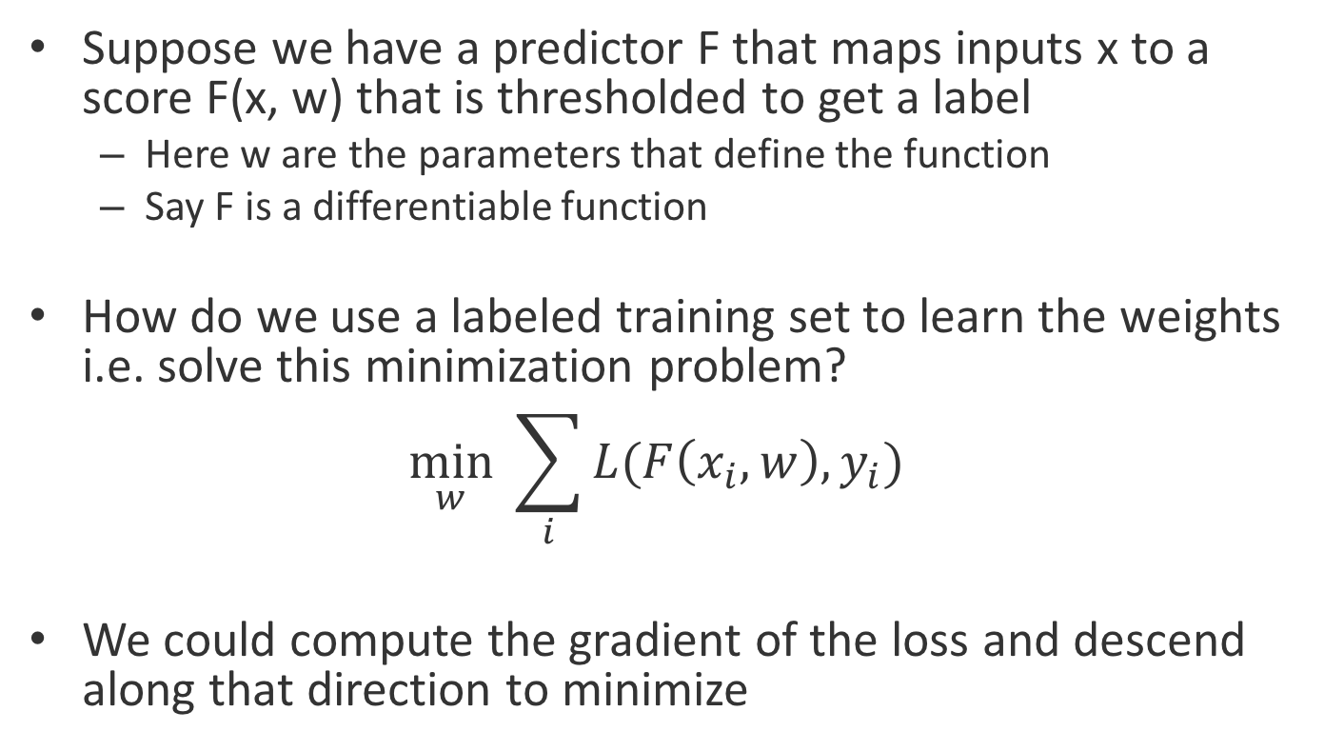
How do we train in such a regime?
Suppose we have a predictor F that maps inputs x to a score F(x, w) that is thresholded to get a label
Here w are the parameters that define the function
Say F is a differentiable function
How do we use a labeled training set to learn the weights i.e. solve this minimization problem?
$$\min_{w} \sum_{i}{L(F\left(x_{i}, w\right), y_{i})}$$
We could compute the gradient of the loss and descend along that direction to minimize

Slide 31
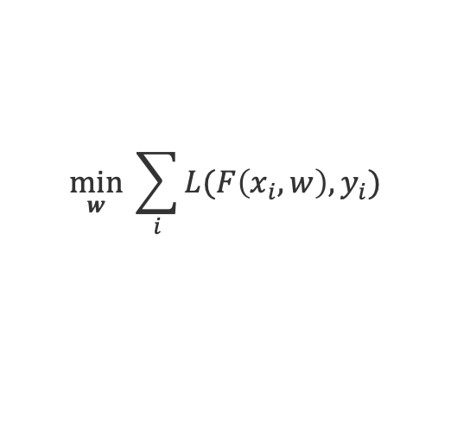

Stochastic gradient descent
$$\min_{w} \sum_{i}{L(F\left(x_{i}, w\right), y_{i})}$$
Given a training set $S=\left\{\left(xi, yi\right)\right\}, x∈ℜ^{d}$
Initialize parameters w
For epoch = 1 … T:
Shuffle the training set
For each training example $\left(xi, yi\right)∈S$:
Treat this example as the entire dataset
Compute the gradient of the loss $∇L(NN\left(x_{i}, w\right), y_{i})$
Update: $w←w−γ_{t}∇L(NN\left(x_{i}, w\right), y_{i}))$
Return w

Slide 32
Stochastic gradient descent
$$\min_{w} \sum_{i}{L(F\left(x_{i}, w\right), y_{i})}$$
Given a training set $S=\left\{\left(xi, yi\right)\right\}, x∈ℜ^{d}$
Initialize parameters w
For epoch = 1 … T:
Shuffle the training set
For each training example $\left(xi, yi\right)∈S$:
Treat this example as the entire dataset
Compute the gradient of the loss $∇L(NN\left(x_{i}, w\right), y_{i})$
Update: $w←w−γ_{t}∇L(NN\left(x_{i}, w\right), y_{i}))$
Return w

Slide 33
Stochastic gradient descent
$$\min_{w} \sum_{i}{L(F\left(x_{i}, w\right), y_{i})}$$
Given a training set $S=\left\{\left(xi, yi\right)\right\}, x∈ℜ^{d}$
Initialize parameters w
For epoch = 1 … T:
Shuffle the training set
For each training example $\left(xi, yi\right)∈S$:
Treat this example as the entire dataset
Compute the gradient of the loss $∇L(NN\left(x_{i}, w\right), y_{i})$
Update: $w←w−γ_{t}∇L(NN\left(x_{i}, w\right), y_{i}))$
Return w

Slide 34
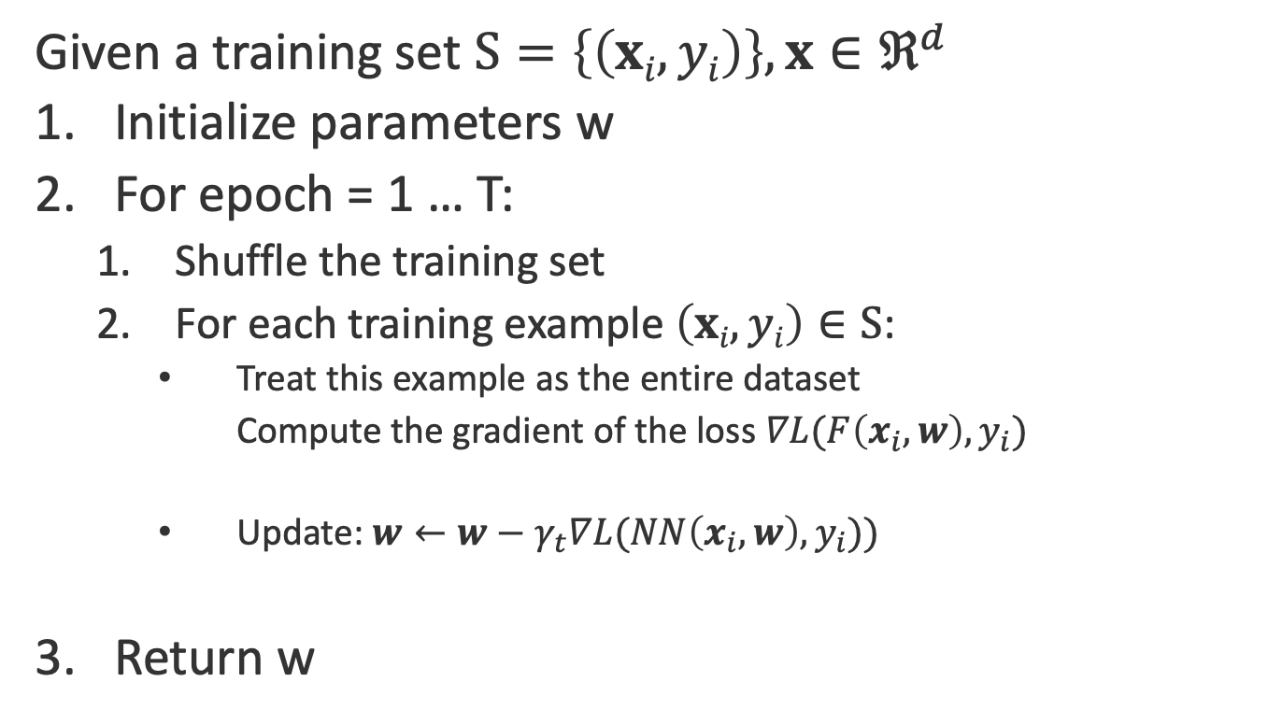
Stochastic gradient descent
$$\min_{w} \sum_{i}{L(F\left(x_{i}, w\right), y_{i})}$$
Given a training set $S=\left\{\left(xi, yi\right)\right\}, x∈ℜ^{d}$
Initialize parameters w
For epoch = 1 … T:
Shuffle the training set
For each training example $\left(xi, yi\right)∈S$:
Treat this example as the entire dataset
Compute the gradient of the loss $∇L(F\left(x_{i}, w\right), y_{i})$
Update: $w←w−γ_{t}∇L(NN\left(x_{i}, w\right), y_{i}))$
Return w

Slide 35
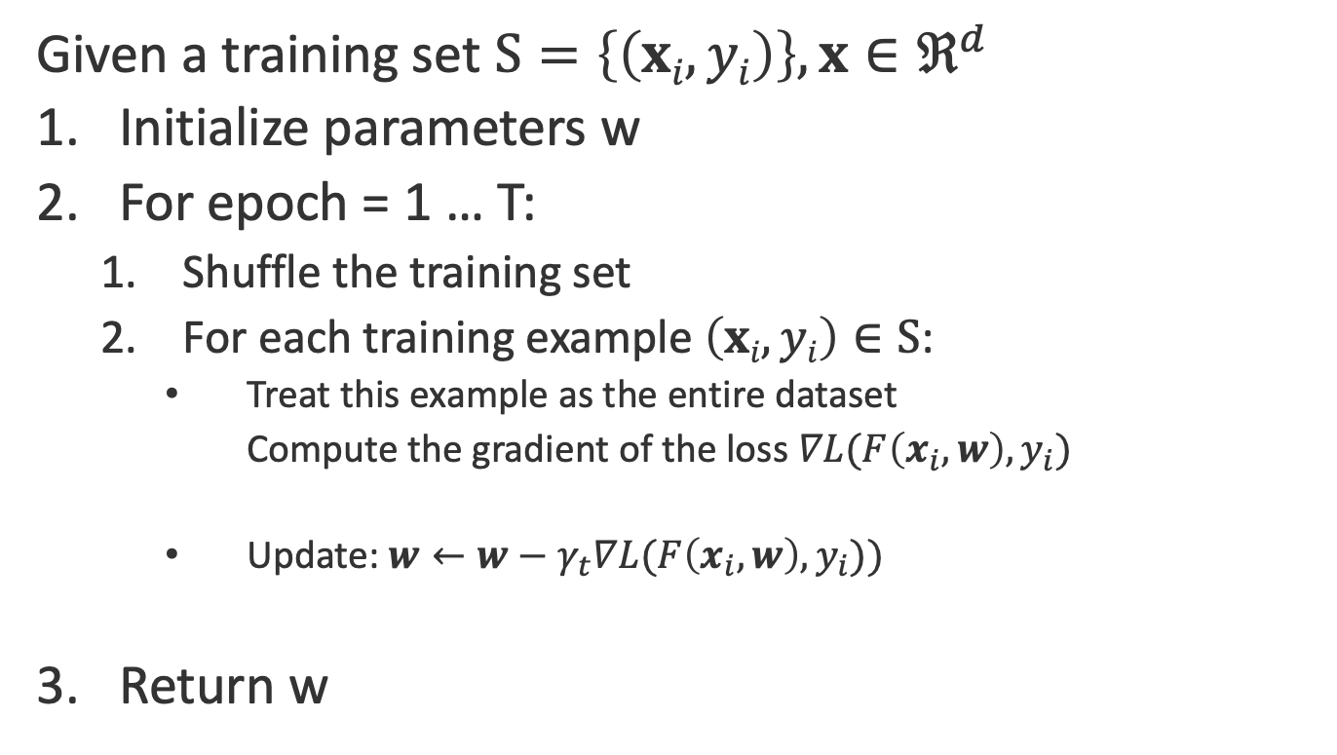
Stochastic gradient descent
$$\min_{w} \sum_{i}{L(F\left(x_{i}, w\right), y_{i})}$$
Given a training set $S=\left\{\left(xi, yi\right)\right\}, x∈ℜ^{d}$
Initialize parameters w
For epoch = 1 … T:
Shuffle the training set
For each training example $\left(xi, yi\right)∈S$:
Treat this example as the entire dataset
Compute the gradient of the loss $∇L(F\left(x_{i}, w\right), y_{i})$
Update: $w←w−γ_{t}∇L(F\left(x_{i}, w\right), y_{i}))$
Return w

Slide 36
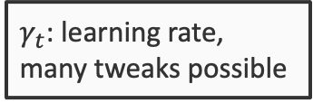
Stochastic gradient descent
$$\min_{w} \sum_{i}{L(F\left(x_{i}, w\right), y_{i})}$$
Given a training set $S=\left\{\left(xi, yi\right)\right\}, x∈ℜ^{d}$
Initialize parameters w
For epoch = 1 … T:
Shuffle the training set
For each training example $\left(xi, yi\right)∈S$:
Treat this example as the entire dataset
Compute the gradient of the loss $∇L(F\left(x_{i}, w\right), y_{i})$
Update: $w←w−γ_{t}∇L(F\left(x_{i}, w\right), y_{i}))$
Return w
$γ_{t}$: learning rate, many tweaks possible

Slide 37
Stochastic gradient descent
$$\min_{w} \sum_{i}{L(F\left(x_{i}, w\right), y_{i})}$$
Given a training set $S=\left\{\left(xi, yi\right)\right\}, x∈ℜ^{d}$
Initialize parameters w
For epoch = 1 … T:
Shuffle the training set
For each training example $\left(xi, yi\right)∈S$:
Treat this example as the entire dataset
Compute the gradient of the loss $∇L(F\left(x_{i}, w\right), y_{i})$
Update: $w←w−γ_{t}∇L(F\left(x_{i}, w\right), y_{i}))$
Return w
The objective is not convex. Initialization can be important
$γ_{t}$: learning rate, many tweaks possible

Slide 38
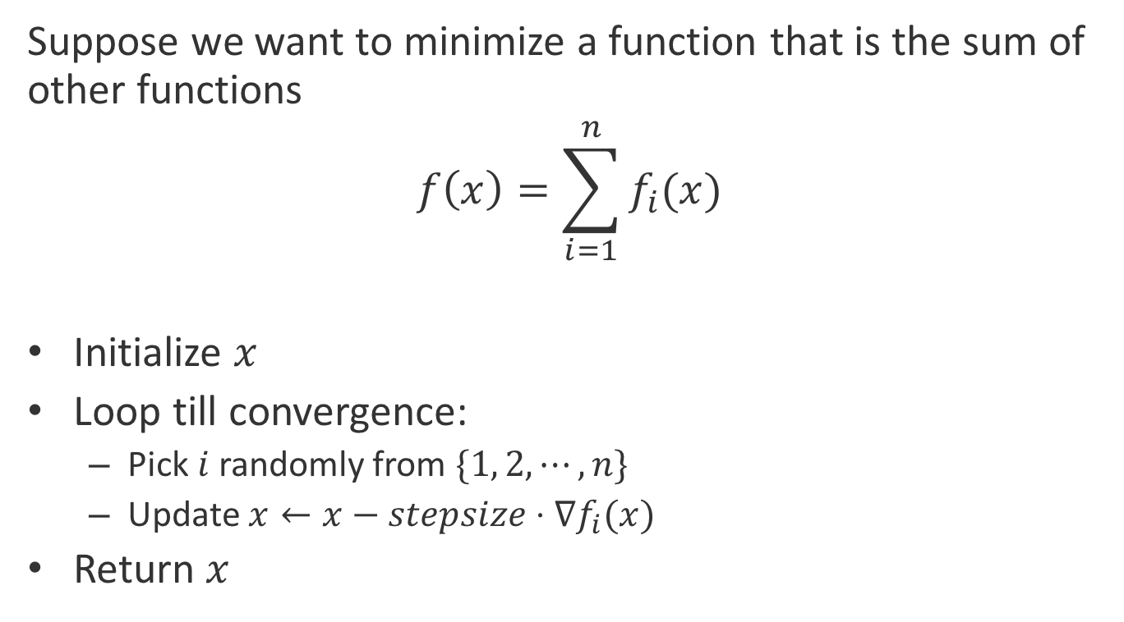
A more general form
Suppose we want to minimize a function that is the sum of other functions
$$f\left(x\right)=\sum_{i=1}^{n}{f_{i}(x)}$$
Initialize $x$
Loop till convergence:
Pick $i$ randomly from $\{1, 2,⋯,n\}$
Update $x←x−stepsize⋅∇f_{i}(x)$
Return $x$

Slide 39
In practice…
There are many variants of this idea
Several named learning algorithms
AdaGrad, AdaDelta, RMSProp, Adam
But the key components are the same. We need to…
…sample a tiny subset of the data at each step
…compute the gradient of the loss using this subset
…take a step in the negative direction of the gradient

Slide 40
Standard loss functions
We need to think about the problem we have at hand
Is it a…
Binary classification problem?
Regression problem?
Multi-class classification problem?
Or something else?
Each case is naturally paired with a different loss function

Slide 41
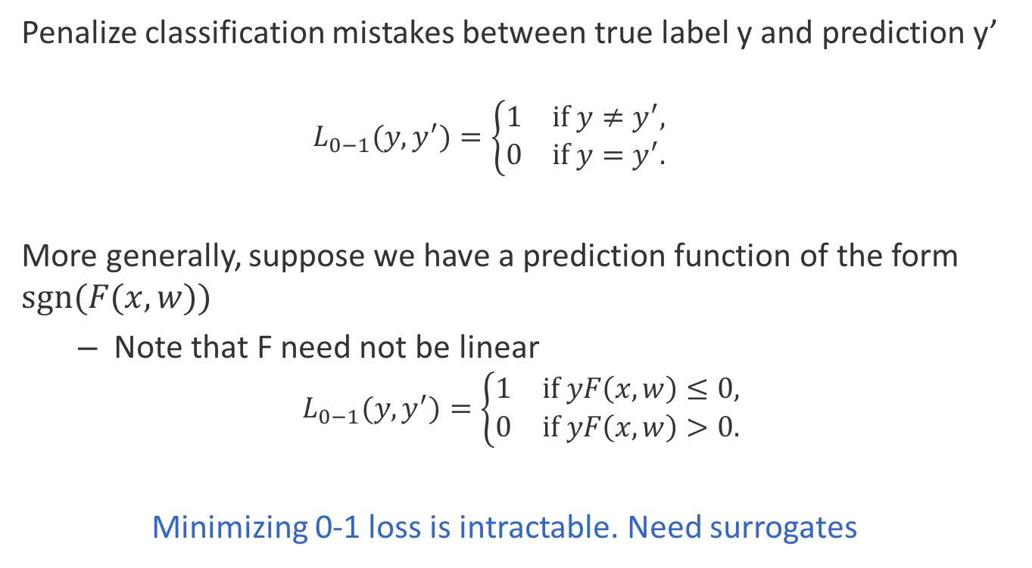
The ideal case for binary classification: The 0-1 loss
Penalize classification mistakes between true label y and prediction y’
$$L_{0−1}(y, y^{′})=\left\{\begin{matrix}1 & \text{if} y≠y^{′}, \\ 0 & \text{if} y=y^{′}.\end{matrix}\right.$$
More generally, suppose we have a prediction function of the form $sgn(F(x, w))$
Note that F need not be linear
$$L_{0−1}(y, y^{′})=\left\{\begin{matrix}1 & \text{if} yF\left(x,w\right)≤0, \\ 0 & \text{i}\text{f} yF\left(x,w\right)>0.\end{matrix}\right.$$
Minimizing 0-1 loss is intractable. Need surrogates

Slide 42
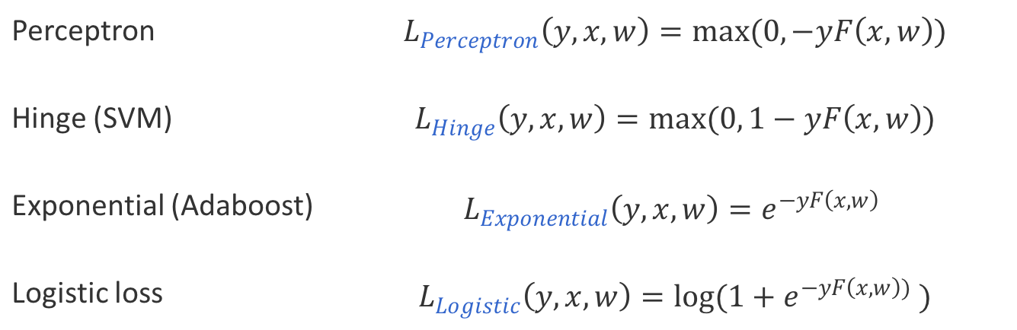
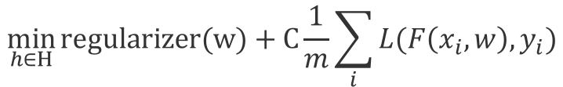
The loss function zoo
$$\min_{h∈H}{\text{regularizer}\text{(}\text{w}\text{) + }\text{C}\frac{1}{m}\sum_{i}{L(F\left(x_{i},w\right), y_{i})}}$$
For binary classification
Many loss functions exist
Perceptron | $$L_{Perceptron}\left(y, x, w\right)=max(0, −yF\left(x, w\right))$$
Hinge (SVM) | $$L_{Hinge}\left(y, x, w\right)=max(0, 1−yF\left(x, w\right))$$
Exponential (Adaboost) | $$L_{Exponential}\left(y, x, w\right)=e^{−yF\left(x, w\right) }$$
Logistic loss | $$L_{Logistic}\left(y, x, w\right)=log(1+e^{−yF\left(x, w\right)) })$$

Slide 43
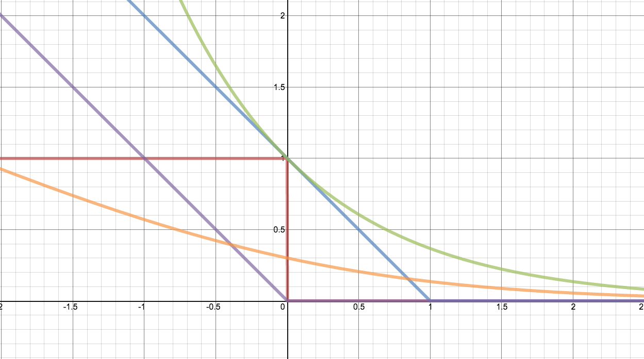

The loss function zoo
$$\min_{h∈H}{\text{regularizer}\text{(}\text{w}\text{) + }\text{C}\frac{1}{m}\sum_{i}{L(F\left(x_{i},w\right), y_{i})}}$$
Loss
$$yF(x,w)$$

Slide 44
The loss function zoo
$$\min_{h∈H}{\text{regularizer}\text{(}\text{w}\text{) + }\text{C}\frac{1}{m}\sum_{i}{L(F\left(x_{i},w\right), y_{i})}}$$
Loss
Zero-one
$$yF(x,w)$$

Slide 45

The loss function zoo
$$\min_{h∈H}{\text{regularizer}\text{(}\text{w}\text{) + }\text{C}\frac{1}{m}\sum_{i}{L(F\left(x_{i},w\right), y_{i})}}$$
$$L_{Hinge}\left(y, x, w\right)=max(0, 1−yF\left(x, w\right))$$
Loss
Hinge: SVM
Zero-one
$$yF(x,w)$$

Slide 46
The loss function zoo
$$\min_{h∈H}{\text{regularizer}\text{(}\text{w}\text{) + }\text{C}\frac{1}{m}\sum_{i}{L(F\left(x_{i},w\right), y_{i})}}$$
$$L_{Hinge}\left(y, x, w\right)=max(0, 1−yF\left(x, w\right))$$
Loss
Hinge: SVM
$$L_{Perceptron}\left(y, x, w\right)=max(0, −yF\left(x, w\right))$$
Perceptron
Zero-one
$$yF(x,w)$$

Slide 47

The loss function zoo
$$\min_{h∈H}{\text{regularizer}\text{(}\text{w}\text{) + }\text{C}\frac{1}{m}\sum_{i}{L(F\left(x_{i},w\right), y_{i})}}$$
$$L_{Hinge}\left(y, x, w\right)=max(0, 1−yF\left(x, w\right))$$
Loss
Hinge: SVM
$$L_{Perceptron}\left(y, x, w\right)=max(0, −yF\left(x, w\right))$$
Exponential: AdaBoost
$$L_{Exponential}\left(y, x, w\right)=e^{−yF\left(x, w\right) }$$
Perceptron
Zero-one
$$yF(x,w)$$

Slide 48

The loss function zoo
$$\min_{h∈H}{\text{regularizer}\text{(}\text{w}\text{) + }\text{C}\frac{1}{m}\sum_{i}{L(F\left(x_{i},w\right), y_{i})}}$$
$$L_{Hinge}\left(y, x, w\right)=max(0, 1−yF\left(x, w\right))$$
Loss
Hinge: SVM
$$L_{Perceptron}\left(y, x, w\right)=max(0, −yF\left(x, w\right))$$
Exponential: AdaBoost
$$L_{Exponential}\left(y, x, w\right)=e^{−yF\left(x, w\right) }$$
Perceptron
$$L_{Logistic}\left(y, x, w\right)=log(1+e^{−yF\left(x, w\right)) })$$
Zero-one
Logistic regression
$$yF(x,w)$$

Slide 49
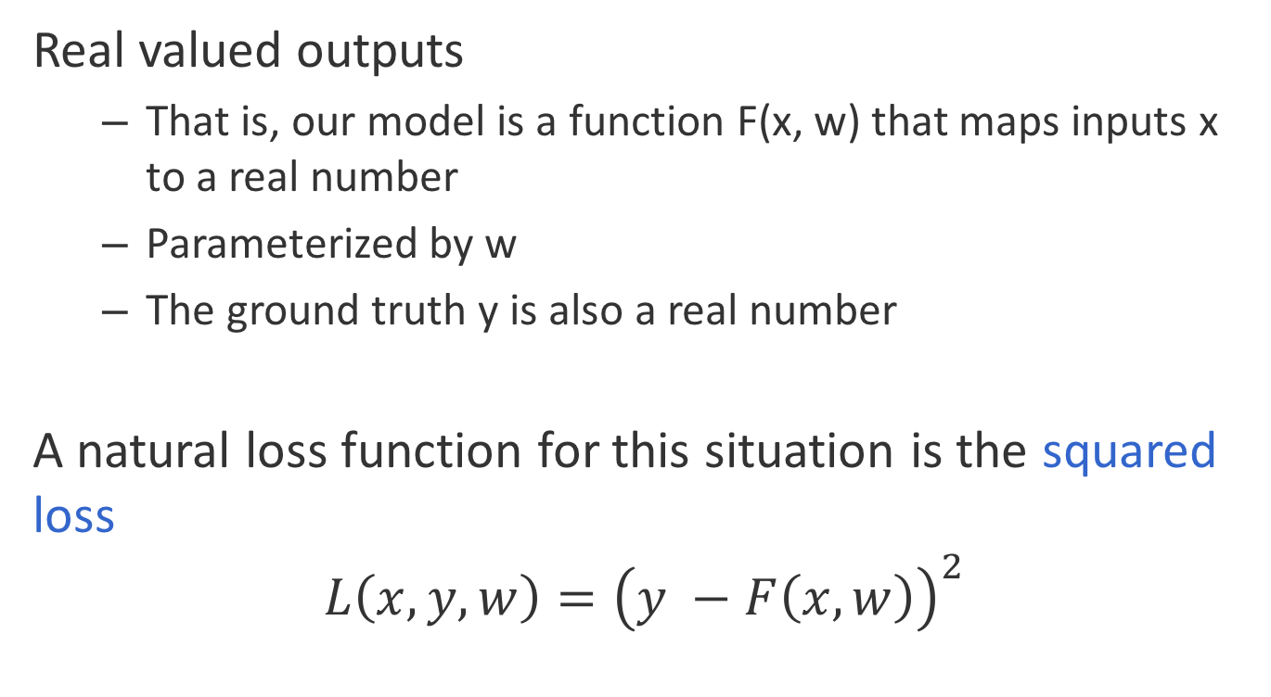
What if we have a regression task
Real valued outputs
That is, our model is a function F(x, w) that maps inputs x to a real number
Parameterized by w
The ground truth y is also a real number
A natural loss function for this situation is the squared loss
$$L\left(x,y,w\right)={\left(y −F\left(x, w\right)\right)}^{2}$$

Slide 50
Where are we?
Supervised learning: The general setting
Linear classifiers
The Perceptron algorithm
Learning as optimization
Support vector machines
Logistic Regression

Slide 51
Margin
The margin of a hyperplane for a dataset is the distance between the hyperplane and the data point nearest to it.
-
-
+
+
+
-
+
+
-
-
-
-
+
+
+
-
-
-
-
-
-
-
-
-
-
-

Slide 52
Learning strategy
Find the linear separator that maximizes the margin

Slide 53
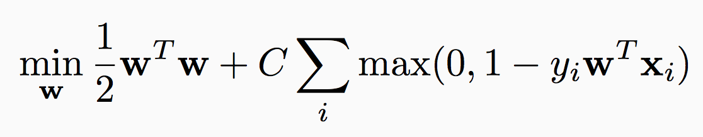
Maximizing margin and minimizing loss
Find the linear separator that maximizes the margin
Maximize margin
Penalty for the prediction: The Hinge loss

Slide 54
SVM objective function
Regularization term:
Maximize the margin
Imposes a preference over the hypothesis space and pushes for better generalization
Empirical Loss:
Hinge loss
Penalizes weight vectors that make mistakes
A hyper-parameter that controls the tradeoff between a large margin and a small hinge-loss

Slide 55
Where are we?
Supervised learning: The general setting
Linear classifiers
The Perceptron algorithm
Learning as optimization
Support vector machines
Logistic Regression

Slide 56
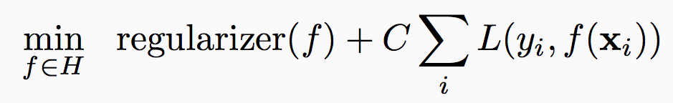
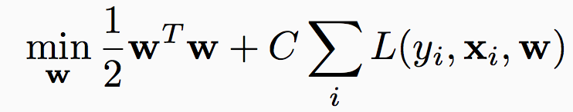
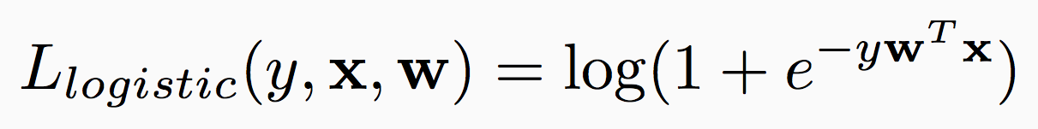
Regularized loss minimization: Logistic regression
Learning:
With linear classifiers:
SVM uses the hinge loss
Another loss function: The logistic loss

Slide 57
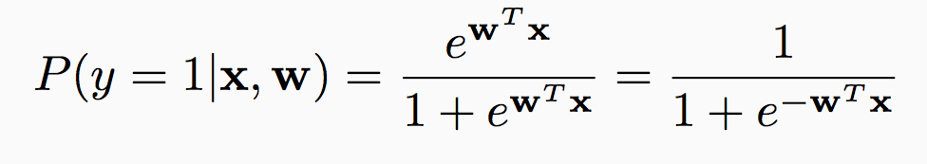
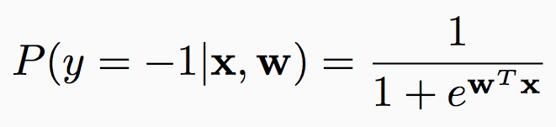
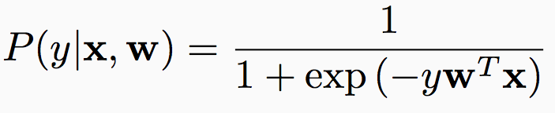
The probabilistic interpretation
Suppose we believe that the labels are distributed as follows given the input:
Predict label = 1 if P(1 | x, w) > P(-1 | x, w)
Equivalent to predicting 1 if w^{T}x ¸ 0

Slide 58
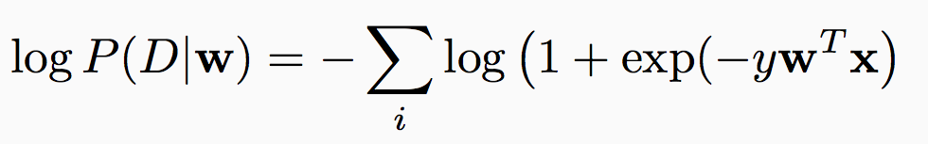
The probabilistic interpretation
Suppose we believe that the labels are distributed as follows given the input:
The log-likelihood of seeing a dataset D = {(x_{i}, y_{i})} if the true weight vector was w:

Slide 59

Regularized logistic regression
What is the probability of weights w being the true ones for a dataset D = {<x_{i}, y_{i}>}?
$$P\left(w \right| D)∝P\left(w, D\right)=P\left( D ∣ w\right)P( w)$$

Slide 60
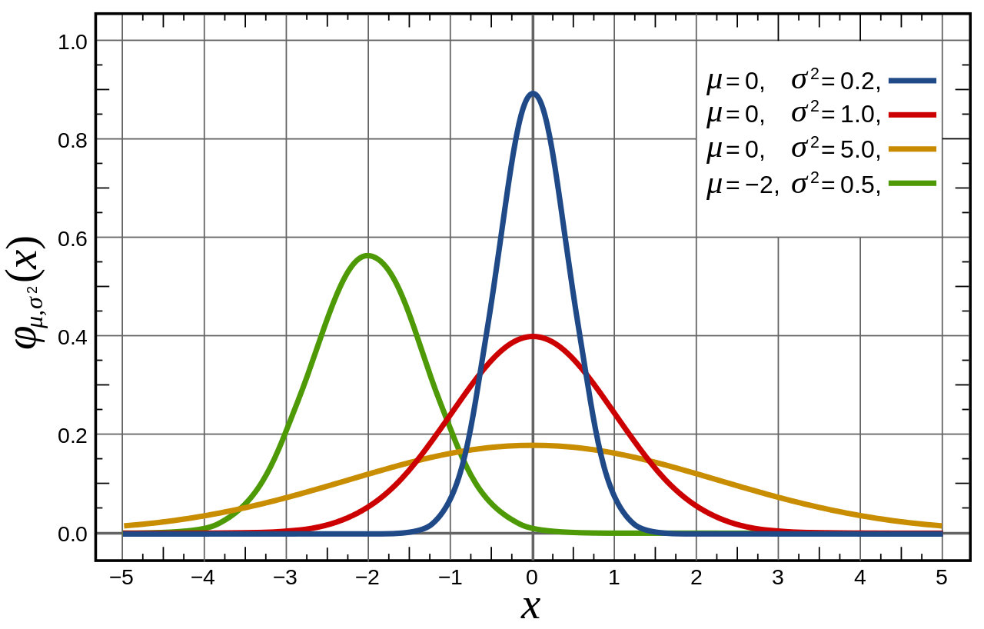
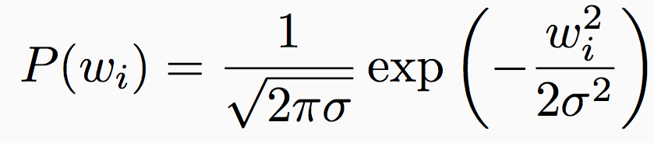
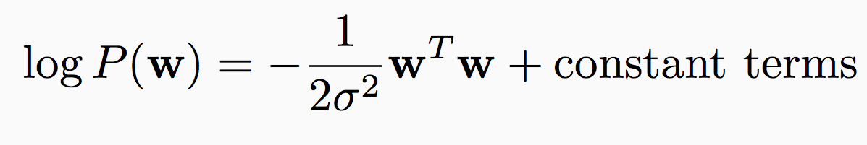
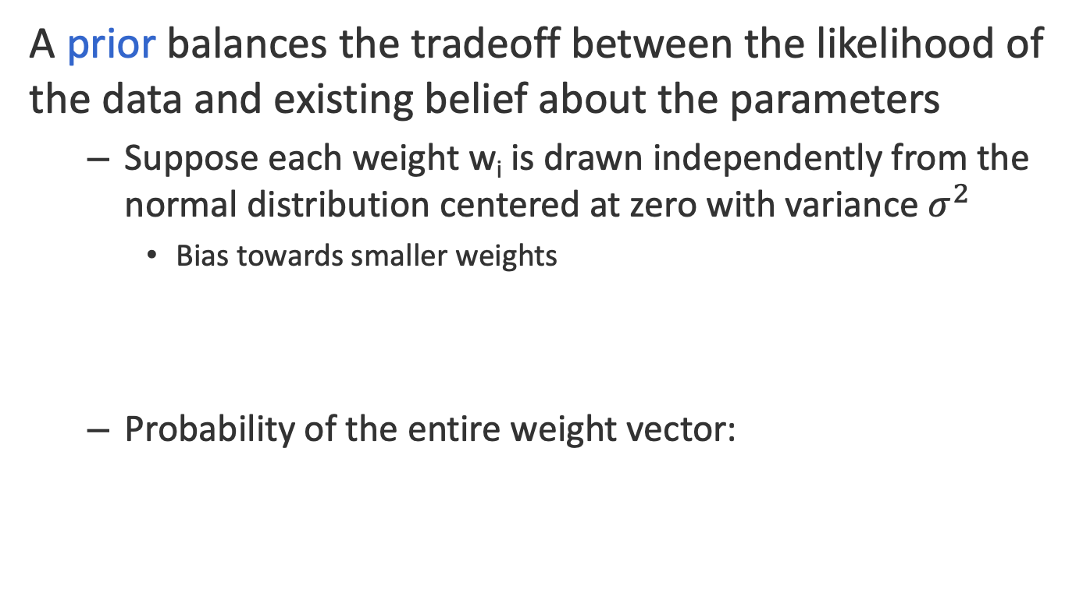
Prior distribution over the weight vectors
A prior balances the tradeoff between the likelihood of the data and existing belief about the parameters
Suppose each weight w_{i} is drawn independently from the normal distribution centered at zero with variance$σ^{2}$
Bias towards smaller weights
Probability of the entire weight vector:
Source: Wikipedia

Slide 61
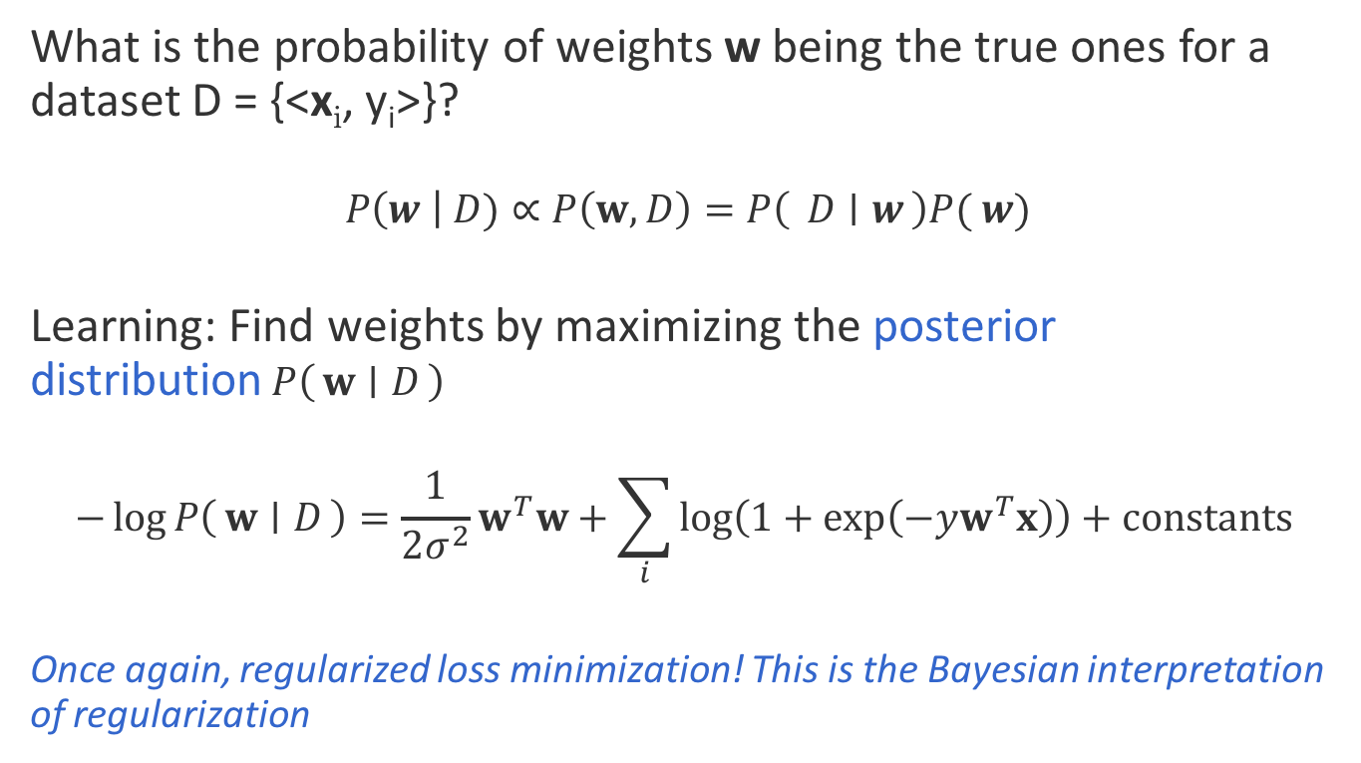
Regularized logistic regression
What is the probability of weights w being the true ones for a dataset D = {<x_{i}, y_{i}>}?
$$P\left(w \right| D)∝P\left(w, D\right)=P\left( D ∣ w\right)P( w)$$
Learning: Find weights by maximizing the posterior distribution$P\left(w ∣ D\right)$
$$−\log{P\left(w ∣ D\right)=\frac{1}{2σ^{2}}w^{T}w+\sum_{i}{\log\left(1+\exp\left(−yw^{T}x\right)\right)}+constants }$$
Once again, regularized loss minimization! This is the Bayesian interpretation of regularization

Slide 62
Regularized loss minimization
Learning objective for both SVM & logistic regression:
“loss over training data + regularizer”
Different loss functions
Hinge loss vs. logistic loss
Same regularizer, but different interpretation
Margin vs prior
Hyper-parameter controls tradeoff between the loss and regularizer
Other regularizers/loss functions also possible
Questions?

Slide 63
Review of supervised binary classification
Supervised learning: The general setting
Linear classifiers
The Perceptron algorithm
Support vector machine
Learning as optimization
Logistic Regression

Slide 64
What if we have more than two labels?

Slide 65
Reading for next lecture:
Erin L. Allwein, Robert E. Schapire, Yoram Singer, Reducing Multiclass to Binary: A Unifying Approach for Margin Classifiers, ICML 2000.

