Slide 1
Module 1
Application Architecture Patterns in Azure
Notes:
Presentation: 45 minutes
After completing this module, students will be able to:
Locate and reference the Cloud Design Patterns documentation.
Locate and reference the Azure Architecture Center.
Describe various patterns pulled from the Cloud Design Patterns.
Required materials
To teach this module, you need the Microsoft PowerPoint file: 20535A_01.pptx.
Preparation tasks
To prepare for this module, you should:
Read all of this module’s materials.
Practice performing the demonstrations and labs.
Work through the Module Review and Takeaways section to determine how you will use the information to reinforce student learning and promote knowledge transfer to on-the-job performance.
As you prepare for this class, it is imperative that you complete the labs yourself. This gives you an understanding of how the labs work and the concepts that each covers, so that you can provide meaningful hints to students who might have issues. Furthermore, it will help guide your lecture to ensure that you discuss the concepts that the lab covers.
The Azure portal is continually being improved, and the user interface might have updated since this module was written. Therefore, before teaching this module, familiarize yourself with the latest version of the Azure portal.
20535A
1: Application Architecture Patterns in Azure

Slide 2
Module Overview
Design Pattern Resources Performance Patterns Resiliency Patterns Scalability Patterns Data Patterns
Notes:
20535A
1: Application Architecture Patterns in Azure

Slide 3
Lesson 1: Design Pattern Resources
Why Patterns? Microsoft Patterns & Practices Azure Architecture Center
Notes:
20535A
1: Application Architecture Patterns in Azure

Slide 4
Why Patterns?
Most problems are already solved by other professionals in the industry
Years of experience and research have defined best practices and the “best practice” when developing new solutions
Most patterns are platform-agnostic
Notes:
20535A
1: Application Architecture Patterns in Azure

Slide 5
Microsoft Patterns & Practices
Engineering focused group at Microsoft
Collects real-world scenarios from customers
Engineers solutions using best-practices
Analyze trends and services used by the community
Shares findings using
GitHub
Whitepapers
Conference Sessions
http://docs.microsoft.com
Notes:
20535A
1: Application Architecture Patterns in Azure

Slide 6
Cloud Design Patterns
The Cloud Design Patterns is a collection developer-oriented prescriptive architecture guidance
Includes topics and patterns that help you design your cloud solutions
Patterns are platform and framework-agnostic
Examples are provided in the context of Azure and C#
Notes:
20535A
1: Application Architecture Patterns in Azure

Slide 7
Patterns & Practices on GitHub
Microsoft Patterns & Practices shares much of their documentation, projects and findings today on GitHub:
https://github.com/mspnp
For example, the Microservices Reference Implementation shares best practices when designing a microservices solution running on Azure using Kubernetes:
https://github.com/mspnp/microservices-reference-implementation
Notes:
Navigate to the Microservices page and scroll down to show the reference architecture diagram.
The reference solution using Azure Container Service.
20535A
1: Application Architecture Patterns in Azure

Slide 8
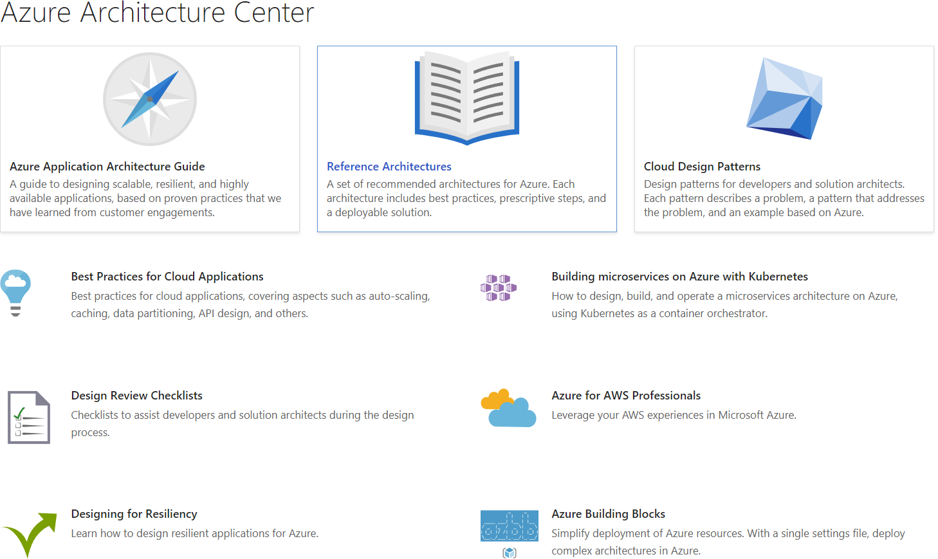
Azure Architecture Center
Landing page for reference architectures, patterns and guidance for solutions on the Azure Platform
https://docs.microsoft.com/azure/architecture/
Notes:
20535A
1: Application Architecture Patterns in Azure

Slide 9
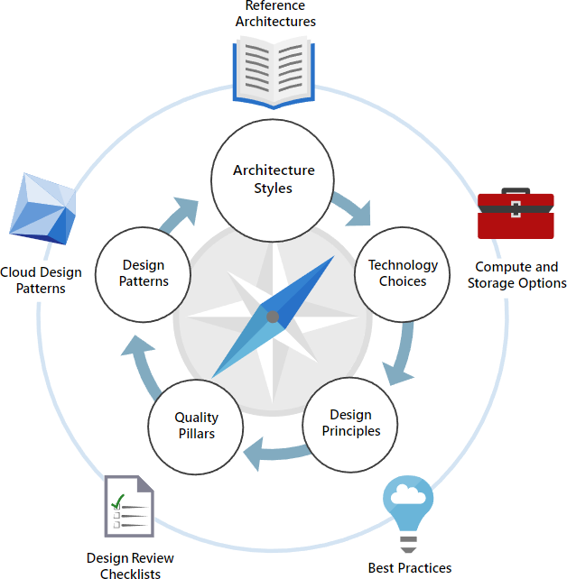
Azure Architecture Center Guide
The Architecture Center features an all-up guide to creating solutions that are scalable, resilient and highly available
https://docs.microsoft.com/azure/architecture/guide/
Notes:
Show the students the webpage for the guide.
20535A
1: Application Architecture Patterns in Azure

Slide 10
Lesson 2: Performance Patterns
Stateless Applications The Valet Key Pattern
Notes:
20535A
1: Application Architecture Patterns in Azure

Slide 11
Stateless Applications
When designing web applications, split your business processes into Partitioning Workloads
Partitioning Workloads:
Can be handled in modular websites, cloud services, or virtual machines
Provides the ability to scale the different components of your application in isolation
Notes:
This topic contains a very simple example to illustrate the concepts.
Examples of Issues Related to scaling with Suggested Solutions
Example 1: Many users visit your site but few register.
Solution: Scale out the web front-end and scale down the instances that host your authenticated web pages.
Example 2: Your music processing website experiences heavy traffic whenever new albums release thereby preventing other users for viewing the recently uploaded music.
Solution: Scale out or scale up the worker instance that processes music. Separate that instance from the website that allows people to view recently uploaded music.
20535A
1: Application Architecture Patterns in Azure

Slide 12
Partitioning Workloads
Example Photo Sharing Application
Web Front-End
SignalR Hub
Image Processor
Virtual Machine
Thumbnail Storage
Notes:
Everything is hosted on a single virtual machine.
20535A
1: Application Architecture Patterns in Azure

Slide 13
Partitioning Workloads
Example Photo Sharing Application
The Web Front-End shows thumbnails of images users have uploaded today
The application code takes an image that a user uploads, processes it into a thumbnail and then stores the thumbnail
The SignalR hub notifies the client web browser that the image is finished processing
Notes:
20535A
1: Application Architecture Patterns in Azure

Slide 14
Partitioning Workloads
Example Photo Sharing Application
Each component of the application can be scaled in isolation to meet its specific demand
Signal-R Hub
Virtual Machine
Storage Service
Thumbnail Storage and Retrieval
Web App
Web Front-End
Background Worker
Image Processing
Notes:
20535A
1: Application Architecture Patterns in Azure

Slide 15
The Valet Key Pattern
If your application access a resource on behalf of your clients, your servers take on additional load
You do not want to make your resources publicly available so you are typically forced to have your application validate a client
The Valet Key pattern dictates that your application simply validates the client and then returns a token to the client. The client can then retrieves the resource directly using its own hardware and bandwidth
Notes:
Valet Key pattern:
https://docs.microsoft.com/azure/architecture/patterns/valet-key
20535A
1: Application Architecture Patterns in Azure

Slide 16
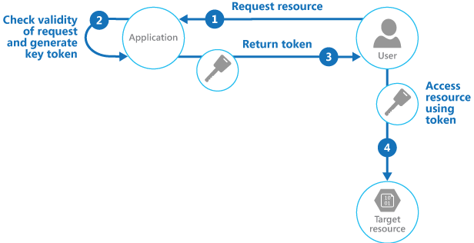
The Valet Key Pattern
The client requests a resource from your application
Your application validates the client and then returns an access token
The client then directly accesses the resource by using the provided token
Notes:
Discussion Question: What type of resources can you access by using the Valet Key pattern?
20535A
1: Application Architecture Patterns in Azure

Slide 17
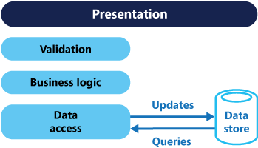
CQRS Pattern
The Problem
Potential mismatch between read and write
Data Access layer contains largest amount of requests (for database, identity and security)
Notes:
CQRS Pattern:
https://docs.microsoft.com/azure/architecture/patterns/cqrs
Your data tier will be hit “the most” out of all of the tiers.
There is also the potential for a mismatch between read and write representations of data. For example, your read queries may return “too much data” because it is all needed to write data back to the data access tier. This is a problem that won’t surface until production.
20535A
1: Application Architecture Patterns in Azure

Slide 18
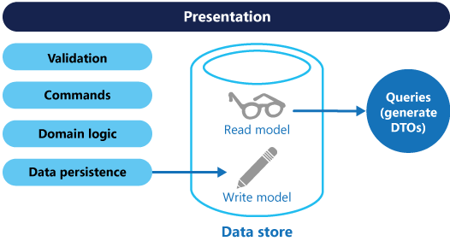
CQRS Pattern
Solves problem by separating read and write models
Each model can be managed in isolation
Models can be deployed to separate compute instances
Example: A write-heavy workload will need more write instances
Notes:
20535A
1: Application Architecture Patterns in Azure

Slide 19
Throttling Pattern
The Problem:
Load on a cloud application varies:
By Time
By Quantity of Users
By Specific User Activities
By Performance of Actual Underlying Hardware
Handling load correctly for one user/client may “starve” other clients of resources
Solutions must be able to handle sudden bursts of usage
Notes:
Throttling Pattern:
https://docs.microsoft.com/azure/architecture/patterns/throttling
Responsiveness is king even when dealing with the unknown. It is important to always set a theoretical ceiling or usage (or a throttle) before clients or usages can abuse your services or APIs.
20535A
1: Application Architecture Patterns in Azure

Slide 20
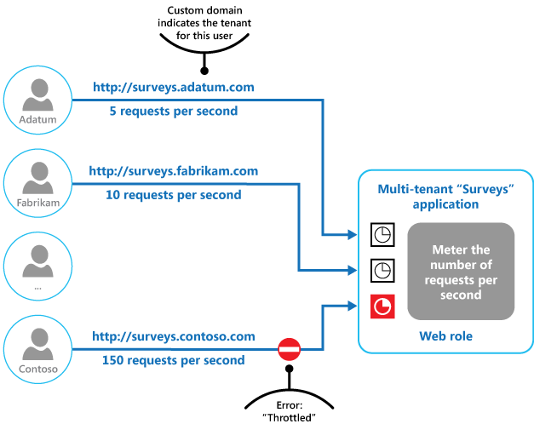
Throttling Pattern
Solves problem by creating a “ceiling” on usage
Notes:
20535A
1: Application Architecture Patterns in Azure

Slide 21

Discussion
Which Azure services implement SAS token features that you can use in the Valet Key pattern?
Notes:
20535A
1: Application Architecture Patterns in Azure

Slide 22
Lesson 3: Resiliency Patterns
Transient Errors The Retry Pattern Queues
Notes:
20535A
1: Application Architecture Patterns in Azure

Slide 23
Transient Errors
Transient faults can occur because of a temporary condition
Service is unavailable
Network connectivity issue
Service is under heavy load
Retrying your request can resolve temporary issues that normally would crash an application
You can retry using different strategies
Retry after a fixed time period
Exponentially wait longer to retry
Retry in timed increments
Notes:
20535A
1: Application Architecture Patterns in Azure

Slide 24
Transient Fault Handling
The Transient Fault Handling application block is a part of the Enterprise Library
The Enterprise library contains a lot of code that is necessary to implement the pattern and the retry strategies
Retry strategies are prebuilt for common scenarios including accessing Azure services
You can build custom strategies and extend the library for the unique needs of your application
Notes:
You can show a custom demonstration here if it is appropriate for your audience.
20535A
1: Application Architecture Patterns in Azure

Slide 25
Circuit Breaker Pattern
Prevents applications from repeatedly retrying an operation that will most like fail
Acts as a proxy between application and service
Prevents waste of CPU cycles on long-lasting faults
Notes:
Circuit Breaker Pattern:
https://docs.microsoft.com/azure/architecture/patterns/circuit-breaker
20535A
1: Application Architecture Patterns in Azure

Slide 26
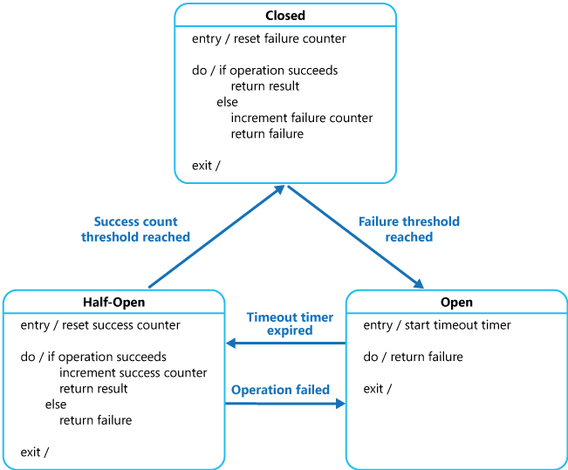
Circuit Breaker Pattern
Notes:
Three states:
Closed: All is fine and requests are proceeding normally. Failed requests are tracked. If a threshold is reached, state changes to Half-Open.
Half-Open: A limited subset of requests are sent to determine if failure is long-lasting (permanent) or transient. If the failure is permanent, state transitions to Open.
Open: All request immediately fail.
20535A
1: Application Architecture Patterns in Azure

Slide 27
The Retry Pattern
The Retry pattern is designed to handle temporary failures
Failures are assumed to be transient until they exceed the retry policy
The Transient Fault Handling Block is an example of a library that is designed to implement the Retry pattern (and more)
Entity Framework provides a built-in retry policy implementation
Implemented in version 6.0
Notes:
Retry pattern:
https://docs.microsoft.com/azure/architecture/patterns/retry
20535A
1: Application Architecture Patterns in Azure

Slide 28
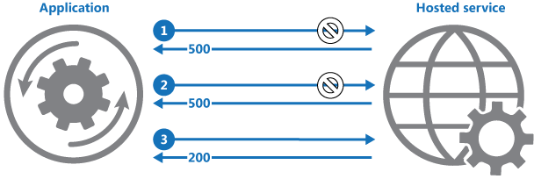
The Retry Pattern
The application sends a request to a hosted service
The hosted service responds with a HTTP 500 (Internal Server Error) code
The application retries until it exceeds the retry count for its policy or is met with an acceptable status code such as HTTP 200 (OK)
Notes:
Discussion Question: Why would Entity Framework implement the Retry pattern?
20535A
1: Application Architecture Patterns in Azure

Slide 29
Queues
A modular web application can behave like a monolithic application if each component relies on a direct two-way communication with a persistent connection
Persistent queue messages allow your application to handle requests if one of your application components fail or is temporary unavailable
An external queue allows your application to audit requests or measure your load without adding any overhead to the code of your primary application
Notes:
20535A
1: Application Architecture Patterns in Azure

Slide 30
Queues
Queues can be used to communicate in a disconnected manner between the different components of your application
If an instance of your application module fails, another instance can process the queue messages
Messages that fail to be processed can either be reinserted into the queue or not marked as complete by the client module
Messages can be measured or audited in isolation from your application
Queues become very important when dealing with background processing (Worker roles and WebJobs)
Notes:
You might not want to spend a lot of time here. This will be covered in Module 9 – Designing a Communication Strategy by Using Queues and Service Bus.
20535A
1: Application Architecture Patterns in Azure

Slide 31
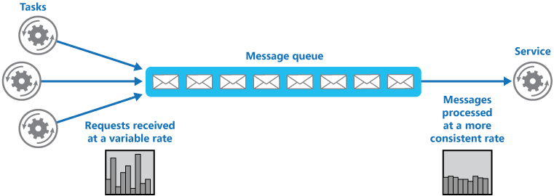
Queue-Based Load Leveling Pattern
Use a queue to act as a “buffer” between requestor generators and request services
Queue decouples the tasks from the service
Service can work at it’s own pace
Notes:
Queue-Based Load Leveling:
https://docs.microsoft.com/azure/architecture/patterns/queue-based-load-leveling
Service can truly work at its own pace. For example, a service can spin up thousands of instances to clear the queue quickly or spin down to no instances (maybe for an update) and resume processing messages off the queue when it’s ready.
This decoupling prevents situations where there’s a message but no listener.
20535A
1: Application Architecture Patterns in Azure

Slide 32
Discussion
If you were to design a retry policy to connect to an instance of Azure SQL Database, what parameters (cool-off time, max retry count) would you use?
Notes:
20535A
1: Application Architecture Patterns in Azure

Slide 33
Lesson 4: Scalability Patterns
Asynchronous Messaging Cached Data Consistency Load Balancing
Notes:
20535A
1: Application Architecture Patterns in Azure

Slide 34
Asynchronous Messaging
With synchronous messaging, the service processing some logic must run immediately when requested
This becomes a problem with large, varying quantities of request
This can prevent an application from scaling both up or down
Scaling down can drop requests “in flight”
Notes:
20535A
1: Application Architecture Patterns in Azure

Slide 35
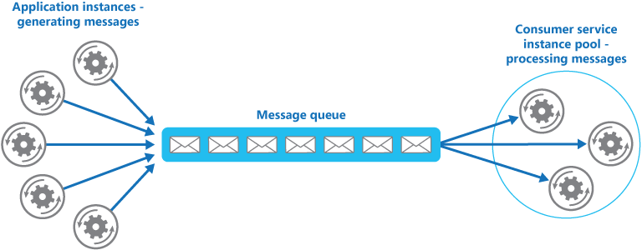
Competing Consumers Pattern
Application instances (producers) generate messages to be placed in the queue
Service instances (consumers) poll the queue to see if any messages are waiting to be processed
The service instance that receives the message will process the message and then flag the message as processed in the queue
If the service instance fails to process the message, the queue will eventually make the message available to other instances after a period of time
Notes:
Competing Consumers Pattern:
https://docs.microsoft.com/azure/architecture/patterns/competing-consumers
Decouples the message generators from the message consumers.
Identify similarities to Queue-Based Load Leveling Pattern.
20535A
1: Application Architecture Patterns in Azure

Slide 36
Cached Data Consistency
Cache data can quickly become stale
Example:
Application caches a list of the 10 latest records
Whenever a new record is added, the list is officially stale
Do you re-query the database constantly?
Do you skip using a cache to have real-time data?
Notes:
20535A
1: Application Architecture Patterns in Azure

Slide 37
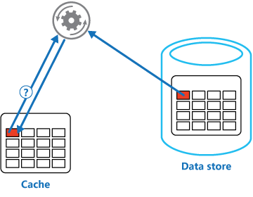
Cache-Aside Pattern
Treats cache as a read/write store
Ensures synced data between cache and data store
Notes:
Cache-Aside Pattern:
https://docs.microsoft.com/azure/architecture/patterns/cache-aside
20535A
1: Application Architecture Patterns in Azure

Slide 38
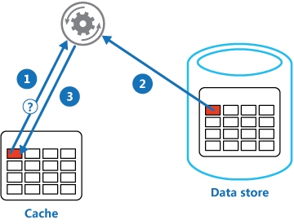
Cache-Aside Pattern
Determine whether the item is currently stored in cache
If the item is not currently stored in ache, retrieve the item from the source data store
Store a copy of the item in the cache
Notes:
20535A
1: Application Architecture Patterns in Azure

Slide 39
Static Content
Static content is often hosted in a CDN to deliver content directly to clients in the most efficient manner possible
Web servers can serve static content, but they are often not the right choice
Developers often serve multiple CSS, JS and HTML files as part of a single web page “visit”
Serving static content from a CDN can save on compute and memory utilization of web servers
Notes:
Developers can be undisciplined in the amount of images, CSS, JS and HTML they serve to each user.
CDNs can help offset some of the compute utilization around static content.
20535A
1: Application Architecture Patterns in Azure

Slide 40
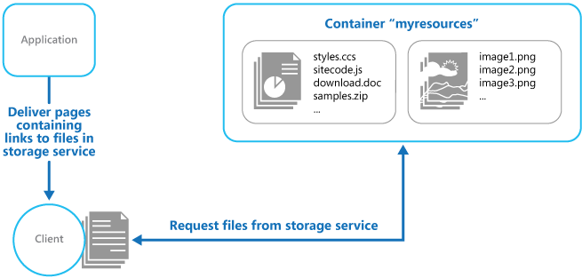
Static Content Hosting Pattern
Minimizes web hosting compute costs
Especially so for web sites that consist only of static content
Improves end-user content performance
Notes:
Static Content Hosting Pattern:
https://docs.microsoft.com/azure/architecture/patterns/static-content-hosting
Compare to the Valet-Key Pattern.
Can the Valet-Key Pattern be used for Static Content Hosting?
20535A
1: Application Architecture Patterns in Azure

Slide 41
Load Balancing
Provide the same service from multiple instances and use a load balancer to distribute requests across all of the instances
Considerations for selecting a load balancing strategy:
Hardware or software load balancers
Load balancing algorithms (round robin)
Load balancer stickiness
Load balancing becomes critical even if you have a single service instance as it offers the capability to scale seamlessly
Notes:
20535A
1: Application Architecture Patterns in Azure

Slide 42
Load Balancing and Geographic Resiliency
Load balancing can be combined with geographic redundancy to help achieve high availability
You can use a load balancer to direct client requests to their closest data center
Traffic Manager is often used for this task
A load balancer can be used to implement a failover scenario
When a data center or compute instance is down, clients can be directed to the next desirable instance that is available
Designing a load balancing strategy along with distributing your application across data centers is key to high availability across the globe
Notes:
20535A
1: Application Architecture Patterns in Azure

Slide 43
Discussion
How could you implement the cache-aside pattern using in-memory caching mechanisms?
Notes:
20535A
1: Application Architecture Patterns in Azure

Slide 44
Lesson 5: Data Patterns
Redis Cache Database Partitioning
Notes:
20535A
1: Application Architecture Patterns in Azure

Slide 45
Redis Cache
Based on the open-source Redis platform
Multiple tiers are available that offer different numbers of nodes
Supports transactions
Supports message aggregation using a publish subscribe model
Considered a key-value store where the keys can be simple or complex values
Massive Redis ecosystem already exists with many different clients
Notes:
Redis Cache: https://docs.microsoft.com/azure/redis-cache/
If you have an audience who is strong with open source tooling, you should consider visiting Redis’ site and discussing the tool more in depth here.
20535A
1: Application Architecture Patterns in Azure

Slide 46
Database Partitioning
Most cloud applications and services store and retrieve data as part of their operations
The design of the data stores that an application uses can have a significant bearing on the performance, throughput, and scalability of a system
One technique that is commonly applied in large-scale systems is to divide the data into separate partitions
Partitioning refers to the physical separation of data for scale
Modern data stores understand that data may be spread across many different instances
Notes:
20535A
1: Application Architecture Patterns in Azure

Slide 47
Sharding Pattern
A map is implemented that contains lookup data mapped by shard key. With a multi-tenant application, data using the same shard key will be stored in an identical shard. In this example, the tenant ID is the shard key.
An application instance will make a request to the map for the shard which contains tenant #55. The map will return "Shard A".
The application instance will then make a request directly to the database at "Shard A" for records related to tenant #55.
A new application instance will make a request to the map for tenant #227 and will receive a response of "Shard C".
The new application instance makes a request directly to the database at "Shard C" for records related to tenant #227.
As new tenants are added and more space is necessary, new shards can be added to the map. Tenant IDs can than be associated with the new shards.
Notes:
Sharding Pattern:
https://docs.microsoft.com/azure/architecture/patterns/sharding
20535A
1: Application Architecture Patterns in Azure

Slide 48
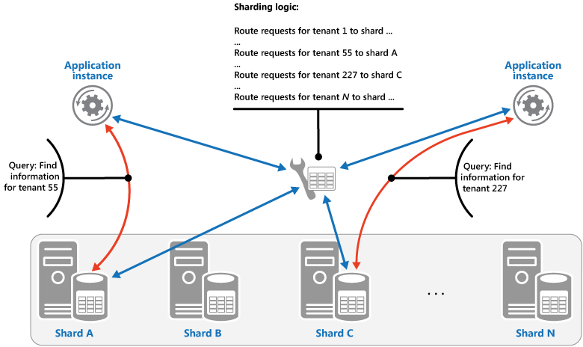
Sharding Pattern - Lookup
Notes:
A map is implemented that contains lookup data mapped by shard key. With a multi-tenant application, data using the same shard key will be stored in an identical shard. In this example, the tenant ID is the shard key.
An application instance will make a request to the map for the shard which contains tenant #55. The map will return "Shard A".
The application instance will then make a request directly to the database at "Shard A" for records related to tenant #55.
A new application instance will make a request to the map for tenant #227 and will receive a response of "Shard C".
The new application instance makes a request directly to the database at "Shard C" for records related to tenant #227.
As new tenants are added and more space is necessary, new shards can be added to the map. Tenant IDs can than be associated with the new shards.
20535A
1: Application Architecture Patterns in Azure

Slide 49
Database Query Performance
Database Administrators and Developers focus on how data is stored not read
Database systems are designed for fast data writes
Reading data can require complex queries that uses relationships between multiple collections
RDBMS systems are notorious for having 3+ JOINs in a single query
NoSQL systems make require cross-partition querying to find relevant data for a record
Notes:
In most database systems, it’s easy to write but very expensive to read.
There are plenty of examples of read-inefficient databases
Relational databases requiring multiple joined tables
NoSQL databases requiring cross-partition queries
Cache systems requiring reads from more than one cache key negating any caching performance advantage
20535A
1: Application Architecture Patterns in Azure

Slide 50
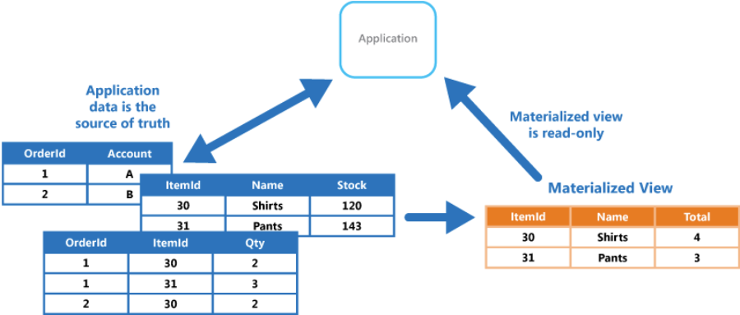
Materialized View Pattern
Pre-built view of most queried data
Automatically updated when source data is changed
Functions as a specialized cache
Notes:
Materialized View Pattern:
https://docs.microsoft.com/azure/architecture/patterns/materialized-view
Build the “greatest hits” of requests in advance, have users query this view instead of tables directly.
Perform the JOINs and cross-partition queries in advanced when usage is low and CPU is cheap.
20535A
1: Application Architecture Patterns in Azure

Slide 51
Discussion
For a new application and database design, how would you select a partition key?
Notes:
20535A
1: Application Architecture Patterns in Azure

Slide 52
Module Review and Takeaways
Review Questions
Notes:
Review Questions
Question
Why would you want a periodic check or heartbeat of your Azure Website’s availability across geographic regions?
Answer
Without a periodic diagnostic health check, you may not know for sure if your application is fully functional or not. A health check can quickly inform you if your Azure platform service instance is running or not. Even if the Azure platform service instance is running, a health check can inform you if there is a fatal exception in your running workloads.
Question
How could you implement the Valet Key pattern by using Azure services?
Answer
The valet key pattern can be implemented using any Azure service that utilizes SAS (shared-access signature) tokens. The academic example would be to create a SAS token for an Azure Storage blob that grants least-permissive access to the blob resource from a client application.
20535A
1: Application Architecture Patterns in Azure

