Slide 1
Module 3
Building Azure IaaS-Based Server Applications
Notes:
Presentation: 60 minutes
Lab: 60 minutes
After completing this module, students will be able to:
Design an availability set for one or more virtual machines
Describe the differences between fault and update domains.
Author a VM Scale Set ARM template.
Join a virtualized machine to a domain either in Azure or on a hybrid network.
Required materials
To teach this module, you need the Microsoft PowerPoint file: 20535A_03.pptx.
Preparation tasks
To prepare for this module, you should:
Read all of this module’s materials.
Practice performing the demonstrations and labs.
Work through the Module Review and Takeaways section to determine how you will use the information to reinforce student learning and promote knowledge transfer to on-the-job performance.
As you prepare for this class, it is imperative that you complete the labs yourself. This gives you an understanding of how the labs work and the concepts that each covers, so that you can provide meaningful hints to students who might have issues. Furthermore, it will help guide your lecture to ensure that you discuss the concepts that the lab covers.
The Azure portal is continually being improved, and the user interface might have updated since this module was written. Therefore, before teaching this module, familiarize yourself with the latest version of the Azure portal.
20535A
3: Building Azure IaaS-Based Server Applications

Slide 2
Module Overview
High Availability Templated Infrastructure Domain-Joined Virtual Machines
Notes:
20535A
3: Building Azure IaaS-Based Server Applications

Slide 3
Lesson 1: High Availability
Azure Availability Availability Sets Availability Zones
Notes:
20535A
3: Building Azure IaaS-Based Server Applications

Slide 4
Azure Availability
Azure provides money-backed SLAs for IaaS services:
Two Instances or more in an Availability Set = 99.95%
Single Instance VM using Premium Storage = 99.9%
Decisions should based on cost and availability requirements
Notes:
Introduce availability.
Reflect on What an Azure region is.
Many datacenters sometimes a fair distance apart.
Also discuss the reason for requirements to achieve the SLA.
20535A
3: Building Azure IaaS-Based Server Applications

Slide 5
Stand-Alone VMs
Single instance VM would gain 99.9% SLA if it complies with:
Premium Storage for all Operating System Disks and Data Disks
Any single instance VM without Premium storage receives no SLA
Notes:
20535A
3: Building Azure IaaS-Based Server Applications

Slide 6
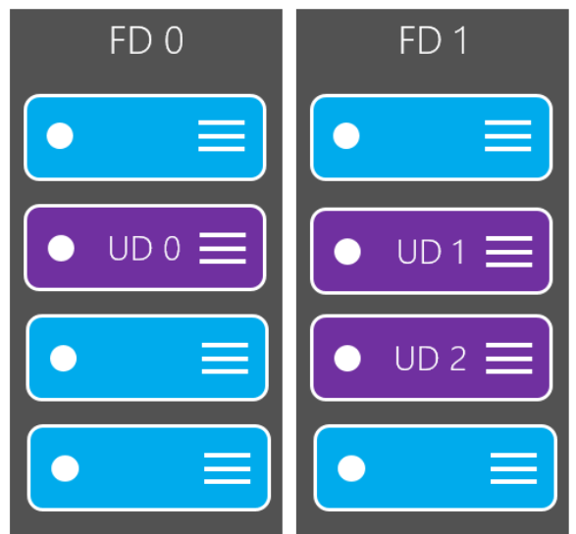
Availability Sets
Availability Sets provide assurance that any multiple instance VM will be available 99.95% of the time
Availability Sets cater for planned and unplanned maintenance using Update Domains and Fault Domains
Notes:
Discuss what it is.
How it works for azure fabric updates.
What about VM updates?
How faults are dealt with – look at maximum update and fault domains within regions – they differ.
20535A
3: Building Azure IaaS-Based Server Applications

Slide 7
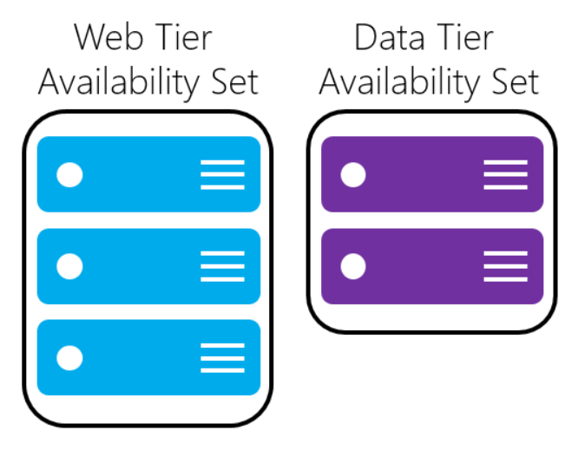
Availability Sets
When planning multiple tier applications use multiple Availability sets, one per tier
Notes:
Discuss multiple tier apps, including those with multiple services IaaS, PaaS etc.
Worth whiteboarding the architecture and implications of each approach.
20535A
3: Building Azure IaaS-Based Server Applications

Slide 8
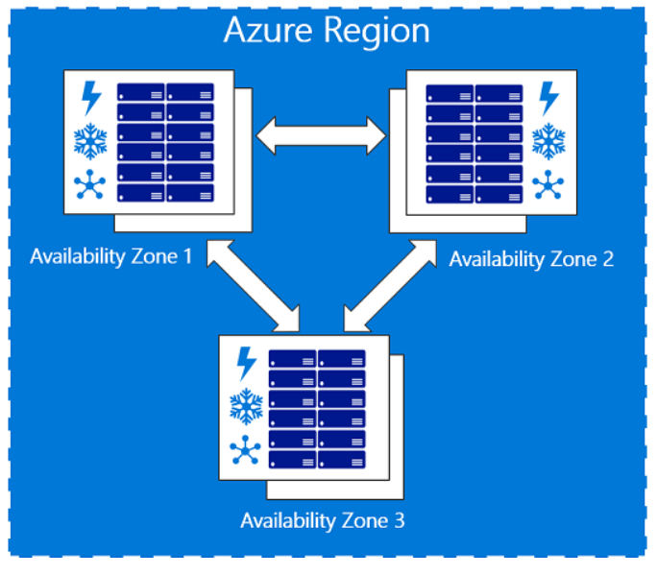
Availability Zones
Service helps to protect resources from datacenter level failures
Provides the ability to place VMs with resilience to the loss of an entire Datacenter building. These are all located within the same Azure region
Notes:
Discuss Azure AV Zones.
Mention the limits to its locations, resources and machine sizes.
Start a discussion around how this new feature will impact the design of multi tier applications.
20535A
3: Building Azure IaaS-Based Server Applications

Slide 9

Discussion
When would you use multiple Azure Availability Sets in the same application?
Notes:
20535A
3: Building Azure IaaS-Based Server Applications

Slide 10
Lesson 2: Templated Infrastructure
Templated Infrastructure Virtual Machine Scale Sets Virtual Machines vs. Virtual Machine Scale Sets Virtual Machine Scale Set Considerations
Notes:
20535A
3: Building Azure IaaS-Based Server Applications

Slide 11
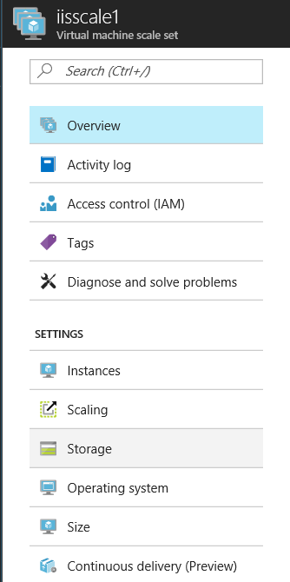
Templated Infrastructure
While ARM templates are an excellent resource, for large scale deployments, other solutions are available:
VM Scale Sets allow true auto scaling to deploy big compute and big data solutions
Notes:
VM Scale Sets:
Intro into scaling, and other benefits of VM Scale sets.
Reliable rapid deployment at very large scale.
Automatically scale without pre provisioning.
Simple networking adds load balancers and application gateways, NAT etc.
Scale sets provide hyper scale support for containers, web front ends micros services.
20535A
3: Building Azure IaaS-Based Server Applications

Slide 12
Virtual Machine Scale Sets
Scale sets have a number of features:
Deployable with JSON templates just like VMs
Can use Azure Autoscale
No requirement to pre-provision
Load balancer creation
NAT included
Notes:
Can deploy a Scale set by any standard deployment method:
PowerShell
Azure CLI
Azure Portal
Networking is built in at creation.
Azure Autoscale is available.
20535A
3: Building Azure IaaS-Based Server Applications

Slide 13
Virtual Machines vs. Virtual Machine Scale Sets
Scale Sets:
Easy to grow and shrink on demand
Easy to reimage
Easy to overprovision
Upgrade policies
VMs:
Attach disks to VMs
Attach non-empty disks
Snapshot a VM
Capture a VM Image
Migrate from native to managed disks
Assign IPv6 public IP addresses to individual VM NICs
Notes:
Design differences VM and Scale Sets
Scale Sets:
Once you specify the scale set configuration, you can simply update the "capacity" property to deploy more VMs in parallel. This is much simpler than writing a script to orchestrate deploying many individual VMs in parallel.
You can use Azure Autoscale to automatically scale a scale set but not individual VMs.
You can reimage scale set VMs but not individual VMs.
You can overprovision scale set VMs for increased reliability and quicker deployment times. You cannot do this with individual VMs unless you write custom code to do this.
You can specify an upgrade policy to make it easy to roll out upgrades across VMs in your scale set. With individual VMs, you must orchestrate updates yourself.
VMs:
You can attach data disks to specific individual VMs, but attached data disks are configured for all VMs in a scale set.
You can attach non-empty data disks to individual VMs but not VMs in a scale set.
You can snapshot an individual VM but not a VM in a scale set.
You can capture an image from an individual VM but not from a VM in a scale set.
You can migrate an individual VM from native disks to managed disks, but you cannot do this for VMs in a scale set.
You can assign IPv6 public IP addresses to individual VM nics but cannot do so for VMs in a scale set. Note that you can assign IPv6 public IP addresses to load balancers in front of either individual VMs or scale set VMs.
20535A
3: Building Azure IaaS-Based Server Applications

Slide 14
Virtual Machine Scale Sets
Connect to an Instance of a VM using RDP through the load balancer
Use Continuous delivery to maintain an application in a VMSS with Visual Studio Team Services
Using managed disks removes storage account considerations from Scale Set creation
Notes:
Connection to Scale Set VMs.
Either use Loadbalancer RDp or a separate Vm jump box on the same subnet.
Deploying apps to Vmscale sets can be automated using VSTS for continuous delivery.
(github repository supported)
Managed disks – discuss storage account ,limitations and requirements then recommend managed disks in all or almost all situations.
20535A
3: Building Azure IaaS-Based Server Applications

Slide 15
Virtual Machine Scale Set Considerations
Custom Extensions can be used to configure new VM instances when scaling – this can add time to the deployment
Custom Images can be used to deploy all images to the scale set – this scales VMs in a ready to use state
Notes:
Checklist for using large scale sets
To decide whether your application can make effective use of large scale sets, consider the following requirements:
Large scale sets require Azure Managed Disks. Scale sets that are not created with Managed Disks require multiple storage accounts (one for every 20 VMs). Large scale sets are designed to work exclusively with Managed Disks to reduce your storage management overhead, and to avoid the risk of running into subscription limits for storage accounts. If you do not use Managed Disks, your scale set is limited to 100 VMs.
Scale sets created from Azure Marketplace images can scale up to 1,000 VMs.
Scale sets created from custom images (VM images you create and upload yourself) can currently scale up to 300 VMs.
Layer-4 load balancing with scale sets composed of multiple placement groups requires Azure Load Balancer Standard SKU. The Load Balancer Standard SKU provides additional benefits, such as the ability to load balance between multiple scale sets. Standard SKU also requires that the scale set has a Network Security Group associated with it, otherwise NAT pools will not work correctly. If you need to use the Azure Load Balancer Basic SKU, make sure the scale set is configured to use a single placement group, which is the default setting.
Layer-7 load balancing with the Azure Application Gateway is supported for all scale sets.
A scale set is defined with a single subnet - make sure your subnet has an address space large enough for all the VMs you need. By default a scale set overprovisions (creates extra VMs at deployment time or when scaling out, which you are not charged for) to improve deployment reliability and performance. Allow for an address space 20% greater than the number of VMs you plan to scale to.
If you are planning to deploy many VMs, your Compute vCPU quota limits may need to be increased.
Fault domains and upgrade domains are only consistent within a placement group. This architecture does not change the overall availability of a scale set, as VMs are evenly distributed across distinct physical hardware, but it does means that if you need to guarantee two VMs are on different hardware, make sure they are in different fault domains in the same placement group. Fault domain and placement group ID are shown in the instance view of a scale set VM. You can view the instance view of a scale set VM in the Azure Resource Explorer.
20535A
3: Building Azure IaaS-Based Server Applications

Slide 16
Considerations for “Large” VMSS
Large scale sets over 100 VMs use placement groups – these change load balancing and fault domain characteristics:
Managed Disks
Marketplace images scale to 1,000 VMs
Custom images scale to 300 VMs
Ensure available IP addresses in subnet
Ensure your compute limits are high enough
Fault Domains relate to a single placement group
Notes:
Checklist for using large scale sets
To decide whether your application can make effective use of large scale sets, consider the following requirements:
Large scale sets require Azure Managed Disks.
Scale sets created from Azure Marketplace images scale up to 1,000 VMs.
Scale sets created from custom images scale up to 300 VMs.
Layer-4 load balancing with scale sets composed of multiple placement groups requires Azure Load Balancer Standard SKU.
Layer-7 load balancing with the Azure Application Gateway is supported for all scale sets.
Scale sets are defined with a single subnet – ensure subnet is large enough.
Ensure your compute limits are high enough (run out of cores).
FD and UD relate to a single placement group.
20535A
3: Building Azure IaaS-Based Server Applications

Slide 17
Discussion
What are the benefits and drawbacks of VMSS for different types of application and services?
Notes:
20535A
3: Building Azure IaaS-Based Server Applications

Slide 18
Lesson 3: Domain-Joined Virtual Machines
Domain and IaaS Applications Hybrid Connectivity Azure AD Domain Services
Notes:
20535A
3: Building Azure IaaS-Based Server Applications

Slide 19
Domain and IaaS Applications
Azure provides a number of options for Domains:
Azure AD (and B2B, B2C)
Hybrid ADDS And Azure AD
Azure AD Domain Services
Notes:
Overview of all Azure AD hybrid options:
Hybrid
Azure AD DS
AAD B2C, AAD B2B
Whiteboard all options for authentication and authorization.
20535A
3: Building Azure IaaS-Based Server Applications

Slide 20
Hybrid Connectivity
Azure AD Connect
Active Directory Federation Services
AD Connect Passthrough
Deploy AD DS to an Azure VM
Notes:
Detailed option walkthrough.
Install and configure Azure AD connect.
Discuss AD FS options.
Discuss differences with AD connect Passthrough.
20535A
3: Building Azure IaaS-Based Server Applications

Slide 21
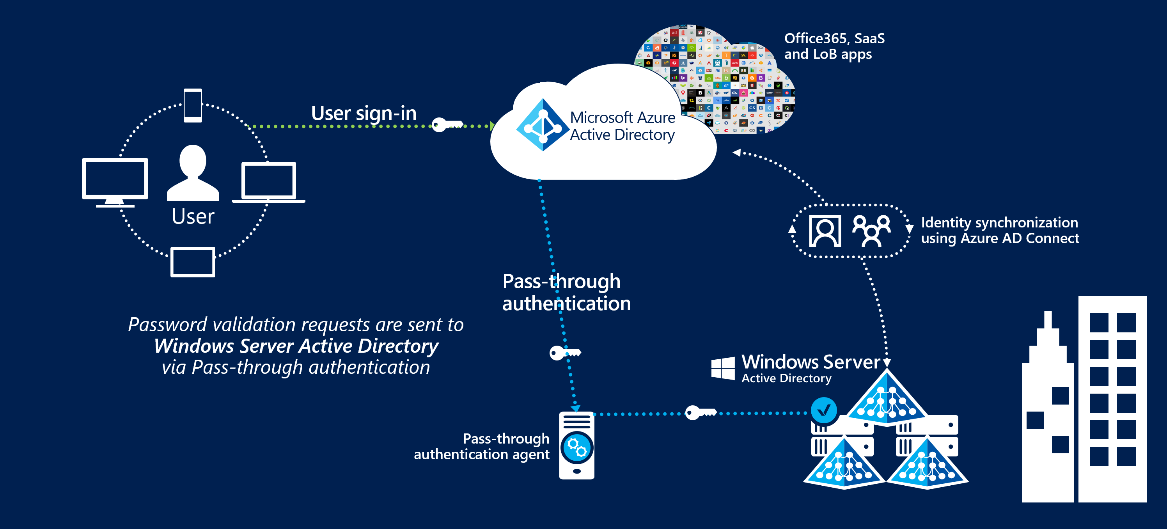
Azure AD Hybrid
Passthrough vs. ADFS
Notes:
Key benefits of using Azure AD Pass-through Authentication:
Great user experience.
Same passwords to sign into both on-premises and cloud-based applications.
Easy to deploy and administer.
No need for complex on-premises ADFS deployment.
A lightweight agent to be installed on-premises.
No management overhead. Automatic bug fixes.
Secure.
On-premises passwords never stored in the cloud in any form.
The agent only makes outbound connections from within your network. No perimeter required.
20535A
3: Building Azure IaaS-Based Server Applications

Slide 22
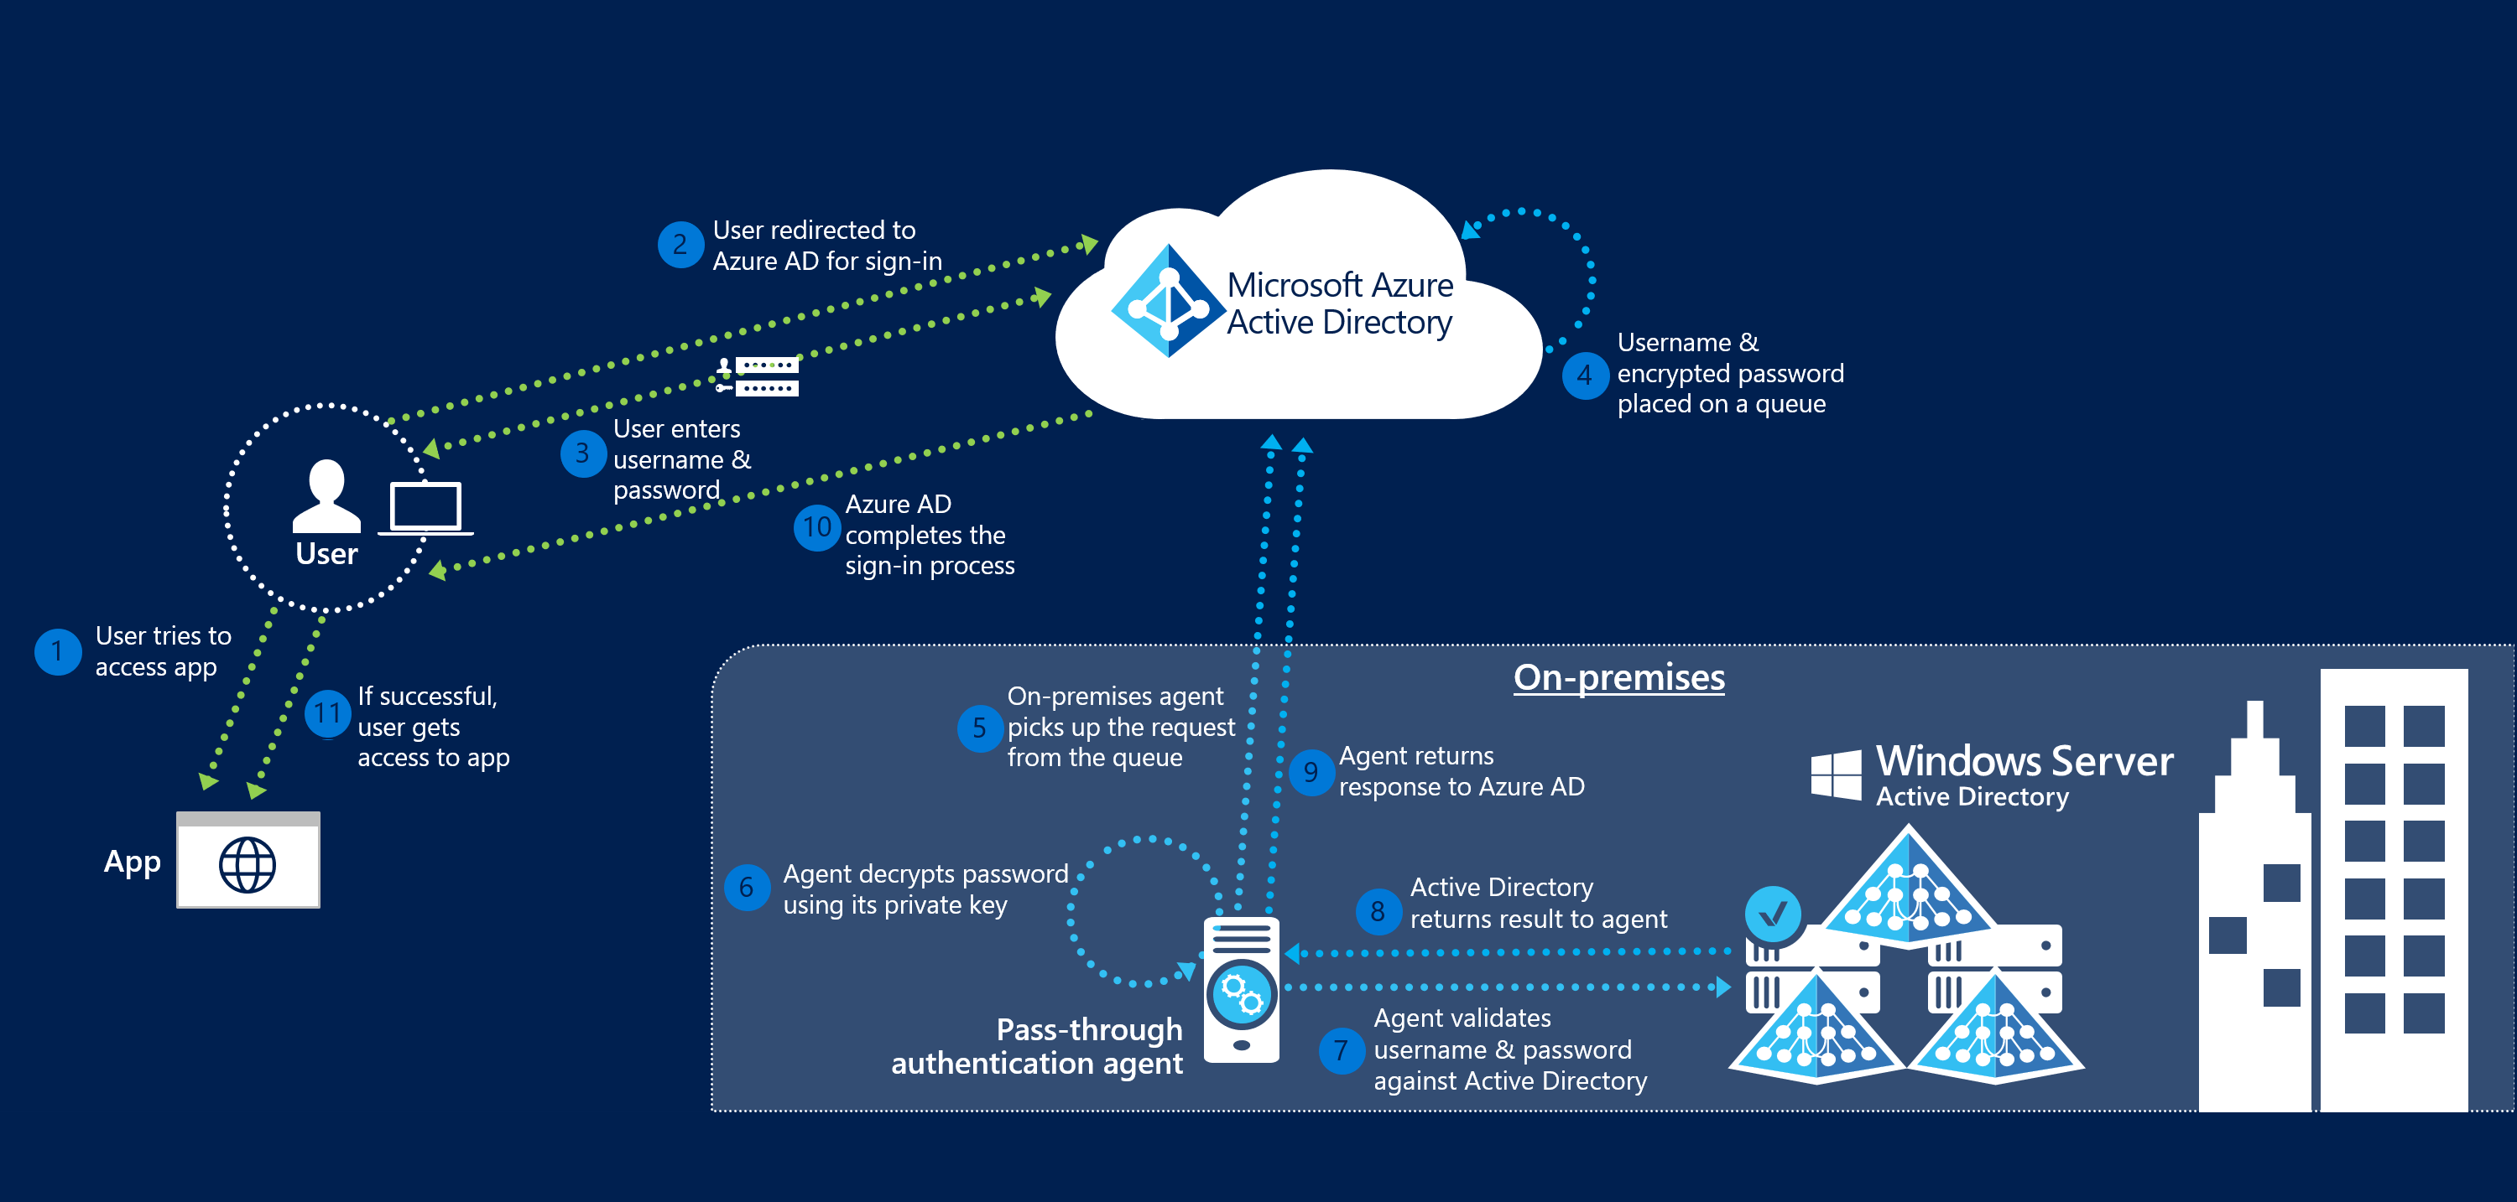
Azure AD Hybrid
Passthrough vs. ADFS
Notes:
Key benefits of using Azure AD Pass-through Authentication:
Great user experience.
Same passwords to sign into both on-premises and cloud-based applications.
Easy to deploy and administer.
No need for complex on-premises ADFS deployment.
A lightweight agent to be installed on-premises.
No management overhead. Automatic bug fixes.
Secure.
On-premises passwords never stored in the cloud in any form.
The agent only makes outbound connections from within your network. No perimeter required.
20535A
3: Building Azure IaaS-Based Server Applications

Slide 23
Azure AD Domain Services
Azure AD Domain Services integrates previously created Hybrid scenarios or works as a cloud only solution. The benefits are:
Simplicity – few clicks to setup
Integrated – deep Azure AD integration
Compatible – Windows Server AD
Cost-effective – no infrastructure burden
Notes:
Benefits:
Simple – You can satisfy the identity needs of virtual machines deployed to Azure Infrastructure services with a few simple clicks. You do not need to deploy and manage identity infrastructure in Azure or setup connectivity back to your on-premises identity infrastructure.
Integrated – Azure AD Domain Services is deeply integrated with your Azure AD tenant. You can now use Azure AD as an integrated cloud-based enterprise directory that caters to the needs of both your modern applications and traditional directory-aware applications.
Compatible – Azure AD Domain Services is built on the proven enterprise grade infrastructure of Windows Server Active Directory. Therefore, your applications can rely on a greater degree of compatibility with Windows Server Active Directory features. Not all features available in Windows Server AD are currently available in Azure AD Domain Services. However, available features are compatible with the corresponding Windows Server AD features you rely on in your on-premises infrastructure. The LDAP, Kerberos, NTLM, Group Policy, and domain join capabilities constitute a mature offering that has been tested and refined over various Windows Server releases.
Cost-effective – With Azure AD Domain Services, you can avoid the infrastructure and management burden that is associated with managing identity infrastructure to support traditional directory-aware applications. You can move these applications to Azure Infrastructure Services and benefit from greater savings on operational expenses.
20535A
3: Building Azure IaaS-Based Server Applications

Slide 24
Discussion
What business scenarios would dictate the use of Azure AD Domain Services over a DC box hosted on Azure IaaS or existing metal?
Notes:
20535A
3: Building Azure IaaS-Based Server Applications

Slide 25
Lab: Deploying Infrastructure Workloads to Azure
Exercise 1: Deploying a Virtual Machine using PowerShell DSC Exercise 2: Deploying a Virtual Machine Scale Set using PowerShell DSC Exercise 3: Cleanup Subscription
Logon Information
Virtual machine: 20535A-SEA-ARCH
User name: Admin
Password: Pa55w.rd
Estimated Time: 60 minutes
Notes:
This lab assumes that students have their own Azure subscriptions that do not contain any existing cloud services, storage accounts, or Azure SQL Database servers.
Azure is continually improving, so the user interface might have been updated since this lab was written. Before students start the lab, make them aware of any differences between the steps described in the lab and the current user interface.
Exercise 1: Deploying a Virtual Machine using PowerShell DSC
Exercise 2: Deploying a Virtual Machine Scale Set using PowerShell DSC
Exercise 3: Cleanup Subscription
20535A
3: Building Azure IaaS-Based Server Applications

Slide 26
Lab Scenario
One of your clients wants to build a web application hosted on Internet Information Services (IIS) that will scale in response to increases and decreases in usage. The solution should minimize the amount of manual setup and maintenance work necessary for each virtual machine running IIS.
Notes:
20535A
3: Building Azure IaaS-Based Server Applications

Slide 27
Lab Review
If you are deploying a farm of web servers Virtual Machines using ARM, when would you use VMSS as opposed to traditional VMs?
Notes:
Question
If you are deploying a farm of web servers Virtual Machines using ARM, when would you use VMSS as opposed to traditional VMs?
Answer
Answers can include:
If all VMs are identical, VMSS is ideal.
If there are differences between VMs, it would be easier to implement them as regular VMs.
20535A
3: Building Azure IaaS-Based Server Applications

Slide 28
Module Review and Takeaways
Review Questions
Notes:
Review Questions
Question
You need to deploy VMs with high availability. You need to ensure that datacenter level failures are protected. How should you deploy your VMs?
( ) Option 1: Availability Zones
( ) Option 2: VNet Peering
( ) Option 3: Azure ASR
( ) Option 4: Availability Set
Answer
( √) Option 1: Availability Zones
( ) Option 2: VNet Peering
( ) Option 3: Azure ASR
( ) Option 4: Availability Set
Question
Which of the following VM Scale Set features is required to build a “large” VM Scale Set instance.
( ) Option 1: Custom Image
( ) Option 2: Managed Disks
( ) Option 3: Static IP Addresses
( ) Option 4: Windows Operating System
( ) Option 5: Storage Accounts
Answer
( ) Option 1: Custom Image
( √) Option 2: Managed Disks
( ) Option 3: Static IP Addresses
( ) Option 4: Windows Operating System
( ) Option 5: Storage Accounts
20535A
3: Building Azure IaaS-Based Server Applications
(More notes on the next slide)

Slide 29
Notes:
Question
You need to ensure that you can apply full Group Policy functionality to multiple OUs in your Azure IaaS Virtual Machines with the least amount of configuration and maintenance effort. All of your Virtual Machines are hosted in your Azure subscription. Which Active Directory Solution should you deploy?
( ) Option 1: Azure AD only
( ) Option 2: Active Directory Domain Services with DC on-premises
( ) Option 3: Active Directory Domain Services deployed to an Azure IaaS VM
( ) Option 4: Azure AD Connect
( ) Option 5: Azure AD Domain Services, Managed Domain
Answer
( ) Option 1: Azure AD only
( ) Option 2: Active Directory Domain Services with DC on-premises
( √) Option 3: Active Directory Domain Services deployed to an Azure IaaS VM
( ) Option 4: Azure AD Connect
( ) Option 5: Azure AD Domain Services, Managed Domain
20535A
3: Building Azure IaaS-Based Server Applications

