Slide 1
Module 4
Creating Managed Server Applications in Azure
Notes:
Presentation: 60 minutes
Lab: 60 minutes
After completing this module, students will be able to:
Describe the differences between App Service Environments, Service Fabric and Container Service.
Use Azure Batch to manage an HPC workload.
Migrate to an Infrastructure-backed PaaS service from another IaaS service or a legacy Cloud Service.
Required materials
To teach this module, you need the Microsoft PowerPoint file: 20535A_04.pptx.
Preparation tasks
To prepare for this module, you should:
Read all of this module’s materials.
Practice performing the demonstrations and labs.
Work through the Module Review and Takeaways section to determine how you will use the information to reinforce student learning and promote knowledge transfer to on-the-job performance.
As you prepare for this class, it is imperative that you complete the labs yourself. This gives you an understanding of how the labs work and the concepts that each covers, so that you can provide meaningful hints to students who might have issues. Furthermore, it will help guide your lecture to ensure that you discuss the concepts that the lab covers.
The Azure portal is continually being improved, and the user interface might have updated since this module was written. Therefore, before teaching this module, familiarize yourself with the latest version of the Azure portal.
20535A
4: Creating Managed Server Applications in Azure

Slide 2
Module Overview
Infrastructure-Backed Platform-as-a-Service (PaaS) High-Performance Compute (HPC) Migration
Notes:
20535A
4: Creating Managed Server Applications in Azure

Slide 3
Lesson 1: Infrastructure-Backed Platform-as-a-Service (PaaS)
Infrastructure Backed PaaS App Service Environments Azure Service Fabric Azure Container Service
Notes:
20535A
4: Creating Managed Server Applications in Azure

Slide 4
Infrastructure Backed PaaS
Azure provides several services to cater for highly scaled isolated applications:
App Service Environments
Azure Service Fabric
Azure Container Service
Notes:
Outline all three options and potential use cases.
Very high scale.
Isolation and secure network access.
High memory utilization.
20535A
4: Creating Managed Server Applications in Azure

Slide 5
App Service Environments
Dedicated environment for high scale, secure Apps:
Very high scale
Isolation with secure network access
High memory utilization
Single or Multi region
Deployed to a Virtual Network
An ASE is dedicated exclusively to a single subscription (Max 100 instances)
Notes:
App Service apps at high scale. For web apps, mobile apps, API apps, and functions.
Multiple ASEs within a single Azure region or across multiple Azure regions.
ASEs are isolated to running only a single customer's applications and are always deployed into a virtual network.
Fine-grained control over inbound and outbound network traffic.
High speed secure VPN connections to corp resources.
Web application firewalls (WAFs) can be used.
Dedicated environment 1 sub 100 instances of a single App service plan or 100 different plans.
Front ends and workers.
Front ends are automatically added as the App Service plans in the ASE are scaled out.
Workers host customer apps.
Three fixed sizes:
One vCPU/3.5 GB RAM
Two vCPU/7 GB RAM
Four vCPU/14 GB RAM
No need to manage front ends and workers.
Expensive options – discuss pricing.
Describe the ASE v1 and ASE v2.
App Service Environment has two versions: ASEv1 and ASEv2.
In ASEv1, you need to manage all of the resources manually.
That includes the front ends, workers, and IP addresses used for IP-based SSL.
20535A
4: Creating Managed Server Applications in Azure
(More notes on the next slide)

Slide 6
Notes:
ASEv1 uses a different pricing model from ASEv2. In ASEv1, you pay for each vCPU allocated.
One advantage to ASEv1 is that it can be deployed in a classic virtual network and a Resource Manager virtual network.
20535A
4: Creating Managed Server Applications in Azure

Slide 7
Azure Service Fabric
Distributed systems platform to package, deploy and manage microservices and containers
Avoids complex infrastructure problems
High density microservice applications running on a shared cluster of machines
Container deployment and orchestration
Stateless and stateful services
Notes:
Applications composed of microservices.
Container deployment and orchestration.
Any OS, any cloud.
Service Fabric runs everywhere.
For Windows development, the Service Fabric .NET SDK is integrated with Visual Studio and Powershell.
Stateless and stateful microservices for Service Fabric using microservices or containers.
Application lifecycle management – support for full ALM Ci/CD.
Service Fabric is integrated with CI/CD tools such as Visual Studio Team Services, Jenkins, and Octopus Deploy.
20535A
4: Creating Managed Server Applications in Azure

Slide 8
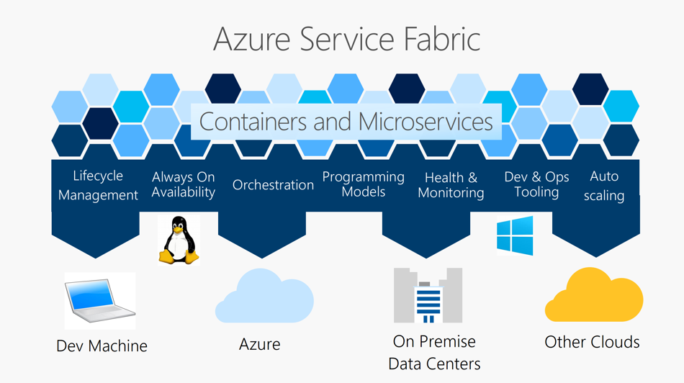
Azure Service Fabric
Notes:
Key capabilities:
Deploy to Azure or to on-premises datacenters that run Windows or Linux with zero code changes.
Develop scalable applications that are composed of microservices by using the Service Fabric programming models, containers, or any code.
Develop highly reliable stateless and stateful microservices.
Use the novel Reliable Actors programming model to create cloud objects with self contained code and state.
Deploy and orchestrate containers that include Windows containers and Linux containers.
Manage the lifecycle of your applications without any downtime, including breaking and nonbreaking upgrades.
Monitor and diagnose the health of your applications with auto repair.
20535A
4: Creating Managed Server Applications in Azure

Slide 9
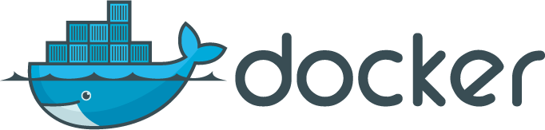
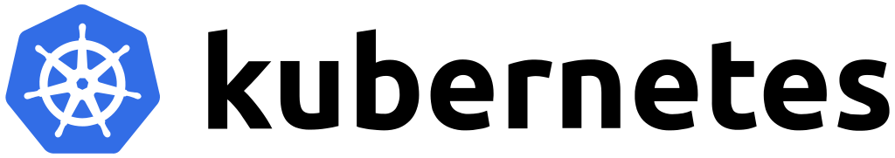
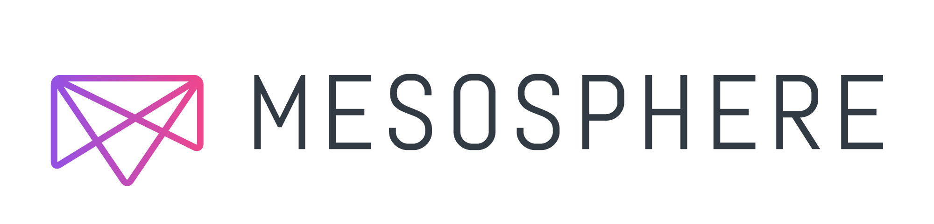
Azure Container Service
Simple management of Cluster of VMs using either Docker, Mesosphere DC/OS or Kubernetes
Removes infrastructure complication and planning
No cluster charges, just used resources
Secure, reliable, highly scalable
Notes:
Creation, configuration, and management of a cluster of virtual machines that are preconfigured to run containerized applications.
Using an optimized configuration of popular open-source scheduling and orchestration tools.
ACS enables you to use your existing skills or draw upon a large and growing body of community expertise to deploy and manage container-based applications on Microsoft Azure.
ACS leverages Docker images to ensure that your application containers are fully portable.
Supports your choice of Kubernetes, DC/OS (powered by Apache Mesos), or Docker Swarm for orchestration.
Enterprise grade features of Azure while still maintaining application portability.
There are no fees for any of the software installed by default as part of ACS.
ACS is available for Standard A, D, DS, G, GS, F, and FS series Linux virtual machines.
You are only charged for the compute instances you choose, as well as the other underlying infrastructure resources consumed such as storage and networking.
20535A
4: Creating Managed Server Applications in Azure

Slide 10

Discussion
What are some of the benefits and drawbacks of ASE, Service Fabric and ACS?
Notes:
20535A
4: Creating Managed Server Applications in Azure

Slide 11
Lesson 2: High-Performance Compute (HPC)
High Performance Computing (HPC) Azure Batch Stateless Component Workloads
Notes:
20535A
4: Creating Managed Server Applications in Azure

Slide 12
High Performance Computing (HPC)
HPC is commonly defined as the use of super computers and parallel processing techniques for solving complex computational problems
Azure provides solutions to manage this function:
Custom Workloads on IaaS
Azure Batch
Notes:
Cover off the need for massively scalable parallel solutions.
Discuss the workloads they might be used for.
Identify those stateless components.
20535A
4: Creating Managed Server Applications in Azure

Slide 13
Custom Workloads on IaaS
HPC Pack using Azure Virtual Machines:
HPC Pack is Microsoft’s HPC cluster and job management solution for Windows
Uses Head Nodes and compute nodes – Suggested as A8 and A9 VM sizes
HPC Pack can also be used in hybrid scenarios to “burst to Azure” with A8 or A9 instances to obtain more processing power
Notes:
HPC using Azure Virtual Machines
HPC Pack is Microsoft’s HPC cluster and job management solution for Windows.
HPC Pack is not required for you to use the A8, A9, A10, and A11 instances with Windows Server.
It is a recommended tool to create Windows HPC clusters in Azure.
In the case of A8 and A9 instances, HPC Pack is the most efficient way to run Windows MPI applications that access the RDMA network in Azure.
HPC Pack includes a runtime environment for the Microsoft implementation of the Message Passing Interface for Windows.
HPC Pack can also be used in hybrid scenarios where you want to "burst to Azure" with A8 or A9 instances to obtain more processing power.
Discuss RDMA in Azure and the benefits.
Also that Several Linux HPC clusters are available.
20535A
4: Creating Managed Server Applications in Azure

Slide 14
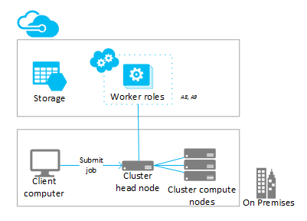
Custom Workloads on IaaS
HPC Pack can also “burst to Azure” with A8 or A9 instances to obtain more processing power through a hybrid solution
Notes:
Remote Direct Memory Access
Why, what, and how.
This technology is essential for engineering simulations and other compute applications that are too large to fit in the memory of a single machine.
From a developer perspective, RDMA is implemented in a way to make it seem that the machines are "sharing memory”.
RDMA is efficient because it copies data from the network adapter directly to memory and avoids wasting CPU cycles.
The A8 and A9 VM sizes in Azure use the InfiniBand network to provide RDMA virtualized through Hyper-V with near “bare metal” performance of less than 3 microsecond latency and greater than 3.5 Gbps bandwidth.
HPC Pack can also be used in hybrid scenarios where you want to "burst to Azure” with A8 or A9 instances to obtain more processing power.
RDMA on Linux Virtual Machines in Azure.
20535A
4: Creating Managed Server Applications in Azure

Slide 15
Azure Batch
A free service designed for large data set manipulation and transform workloads:
Job Scheduling
Compute resource management
Large-scale parallel workloads
Batch API to enable scaling to thousand of compute nodes
Notes:
Discuss the architecture on next slide in advance.
Talk about the workloads suitable and the options for deploying jobs to batch.
Financial risk modeling
Climate and hydrology data analysis
Image rendering, analysis, and processing
Media encoding and transcoding
Genetic sequence analysis
Engineering stress analysis
Software testing
Use of Message Passing Interface (MPI).
20535A
4: Creating Managed Server Applications in Azure

Slide 16
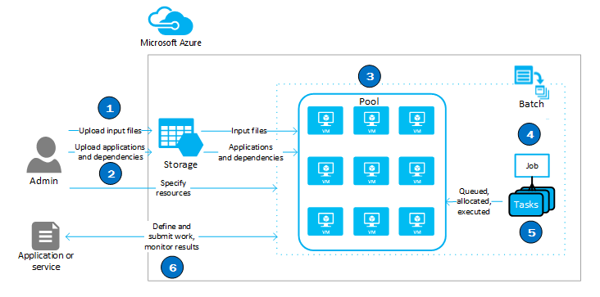
Azure Batch
Notes:
Work through the batch process.
Discuss:
Sizing
Costs
Workloads likely to be used
20535A
4: Creating Managed Server Applications in Azure

Slide 17
Stateless Component Workloads
In addition there are several services that are the foundations for HPC Solutions in Azure:
Virtual Machines (VMs)
VM Scale Sets
Azure Container Services
HDInsight
Machine Learning
Notes:
General discussion on related services that help to build HPC solutions:
https://docs.microsoft.com/azure/virtual-machines/linux/high-performance-computing#related-azure-services
20535A
4: Creating Managed Server Applications in Azure

Slide 18
Discussion
How would you implement HPC using large VM instances?
Notes:
20535A
4: Creating Managed Server Applications in Azure

Slide 19
Discussion
How would you implement HPC using VMSS with varying quantities of VMs based on queue length?
Notes:
How would you implement VMSS to manage a HPC workload with a variable amount of VMs based on queue length?
This would effectively combine auto-scale based on a custom metric, HPC and templated infrastructure.
20535A
4: Creating Managed Server Applications in Azure

Slide 20
Lesson 3: Migration
Migration On-Premises Lift and Shift Migration from Classic IaaS Migration from Cloud Services
Notes:
20535A
4: Creating Managed Server Applications in Azure

Slide 21
Migration
Several options exist when migrating workloads from on-premises to Azure and from Azure IaaS to PaaS:
Migrate on-premises to Azure
Migrate from IaaS to PaaS
Migrate from Cloud Services to PaaS
Native app or Migration
Notes:
List the methods available to lift and shift on-premises apps.
Briefly discuss and describe Azure Migrate.
20535A
4: Creating Managed Server Applications in Azure

Slide 22
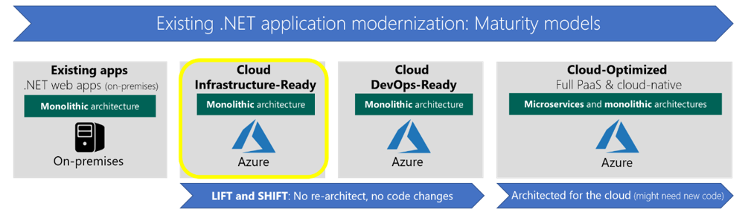
On-Premises Lift and Shift
First stage of a migration may be move the workload direct to IaaS in Azure, having completed this the potential is to follow the modernization maturity model
Notes:
The first step would be to lift and shift on-premises VM workloads to Azure IaaS.
Drivers could be cost reductions.
Scalable IaaS not possible on premises.
Some apps are easier to re-architect to and modernize once they have been migrated, perhaps data used by the application has already been migrated to a PaaS platform.
Azure Migrate will help assess this migration.
Discovery and assessment for on-premises VMs.
Inbuilt dependency mapping for high-confidence discovery of multi-tier applications.
Intelligent sizing to Azure virtual machines.
Compatibility reporting with guidelines for remediating potential issues.
Integration with Azure Database Management Service for database discovery and migration.
Azure Site recovery can be used to migrate with a Lift and Shift.
20535A
4: Creating Managed Server Applications in Azure

Slide 23
On-Premises Migration
Two options:
To IaaS – little code changes – need to manage the OS
To PaaS – rewrite the code but no OS management required
In either case the data can be hosted in either IaaS or PaaS SQL databases
Notes:
20535A
4: Creating Managed Server Applications in Azure

Slide 24
Migration from Classic IaaS
For IaaS migration from Classic to Azure Resource Manager the following can be migrated:
Check carefully for unsupported configurations, which could affect successful migration
Virtual Machines
Availability Sets
Cloud Services
Storage Accounts
Virtual Networks
VPN Gateways
Express Route Gateways
Network Security Groups
Route Tables
Reserved IPs
Notes:
IaaS Classic to ARM.
Discuss methods and options and benefits.
20535A
4: Creating Managed Server Applications in Azure

Slide 25
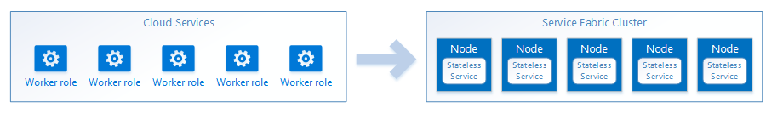
Migration from Cloud Services
Migrating Web and Worker roles in a cloud service to Azure Fabric stateless services is the simplest method of migration to Service Fabric
Notes:
A worker role represents a stateless workload.
This means all are identical and can receive requests from a web role on any instance at any time.
External state stores such as table storage can maintain system states.
Web roles are similar but Service fabric does not support IIS, so a conversion to a self-hosted web framework is needed, such as ASP.NET Core.
20535A
4: Creating Managed Server Applications in Azure

Slide 26
Discussion
What should you consider when migrating on-premises container applications to Azure?
Notes:
20535A
4: Creating Managed Server Applications in Azure

Slide 27
Lab: Deploying Managed Server Workloads to Azure
Exercise 1: Creating Azure Container Service Cluster Exercise 2: Docker Image Exercise 3: Cleanup Subscription
Logon Information
Virtual machine: 20535A-SEA-ARCH
User name: Admin
Password: Pa55w.rd
Estimated Time: 60 minutes
Notes:
This lab assumes that students have their own Azure subscriptions that do not contain any existing cloud services, storage accounts, or Azure SQL Database servers.
Azure is continually improving, so the user interface might have been updated since this lab was written. Before students start the lab, make them aware of any differences between the steps described in the lab and the current user interface.
Exercise 1: Creating Azure Container Service Cluster
Exercise 2: Docker Image
Exercise 3: Cleanup Subscription
20535A
4: Creating Managed Server Applications in Azure

Slide 28
Lab Scenario
The latest client has internally developed their new web application using Docker. The developers on the team have created a Docker container image as their build output and wished to host this image in Azure.
Notes:
20535A
4: Creating Managed Server Applications in Azure

Slide 29
Lab Review
What type of solutions would benefit from the use of Azure Container Service and Docker containers?
Notes:
Question
What type of solutions would benefit from the use of Azure Container Service and Docker containers?
Answer
Answers could include:
Containers that are isolated environments with scripting tools and packages pre-installed to run configuration or build scripts.
Containers running stateless instances of a web application.
20535A
4: Creating Managed Server Applications in Azure

Slide 30
Module Review and Takeaways
Review Questions
Notes:
Review Questions
Question
Which of the following Azure solutions could you use to deploy a Docker Swarm to Azure?
( ) Option 1: Azure Web App
( ) Option 2: Azure Service Fabric
( ) Option 3: App Service Environment
( ) Option 4: Azure Container Service
Answer
( ) Option 1: Azure Web App
( ) Option 2: Azure Service Fabric
( ) Option 3: App Service Environment
( √) Option 4: Azure Container Service
Question
Your organization needs to carry out massive parallel computing tasks once a month, this task will take upwards of 1000 compute cores to complete. Which service could complete this task with the least amount of deployment, configuration, and maintenance?
( ) Option 1: Azure IaaS G series VMs running custom software
( ) Option 2: Azure Batch running a pre-defined workload
( ) Option 3: Azure HPC Pack deployed to Azure IaaS VMs
( ) Option 4: Azure Container Service with pre-built images
Answer
( ) Option 1: Azure IaaS G series VMs running custom software
( √) Option 2: Azure Batch running a pre-defined workload
( ) Option 3: Azure HPC Pack deployed to Azure IaaS VMs
( ) Option 4: Azure Container Service with pre-built images
20535A
4: Creating Managed Server Applications in Azure
(More notes on the next slide)

Slide 31
Notes:
Question
Having used Azure Migrate to plan and assess your on-premises workloads, you are now ready to lift and shift several VMs into Azure. Which method would be the easiest and quickest way to migrate your existing Hyper-V virtual machines to Azure?
( ) Option 1: Create identical Azure VMs in Azure
( ) Option 2: Upload the VHDs to an Azure Storage account
( ) Option 3: Azure Site Recovery
( ) Option 4: Azure Migrate
Answer
( ) Option 1: Create identical Azure VMs in Azure
( ) Option 2: Upload the VHDs to an Azure Storage account
( √) Option 3: Azure Site Recovery
( ) Option 4: Azure Migrate
20535A
4: Creating Managed Server Applications in Azure

