Slide 1
Module 6
Backing Azure Solutions with Azure Storage
Notes:
Presentation: 75 minutes
Lab: 60 minutes
After completing this module, students will be able to:
Determine the ideal pricing option for Azure Storage based on a solution’s requirements.
Identify performance thresholds for the Azure Storage service.
Determine the type of Storage blobs to use for specific solution components.
Use the Azure Files service for SMB operations.
Identify solutions that could benefit from the use of StorSimple physical or virtual devices.
Required materials
To teach this module, you need the Microsoft PowerPoint file: 20535A_06.pptx.
Preparation tasks
To prepare for this module, you should:
Read all of this module’s materials.
Practice performing the demonstrations and labs.
Work through the Module Review and Takeaways section to determine how you will use the information to reinforce student learning and promote knowledge transfer to on-the-job performance.
As you prepare for this class, it is imperative that you complete the labs yourself. This gives you an understanding of how the labs work and the concepts that each covers, so that you can provide meaningful hints to students who might have issues. Furthermore, it will help guide your lecture to ensure that you discuss the concepts that the lab covers.
The Azure portal is continually being improved, and the user interface might have updated since this module was written. Therefore, before teaching this module, familiarize yourself with the latest version of the Azure portal.
20535A
6: Backing Azure Solutions with Azure Storage

Slide 2
Module Overview
Pricing Blob Storage Files StorSimple
Notes:
20535A
6: Backing Azure Solutions with Azure Storage

Slide 3
Lesson 1: Pricing
Azure Storage Storage Account Security Storage Account Replication Storage Performance & Pricing
Notes:
20535A
6: Backing Azure Solutions with Azure Storage

Slide 4
Azure Storage
Azure provides a variety of storage features
Storage, like other services is provided in differing performance and cost levels. In addition, storage is broken down into four discrete services provided within Storage Accounts:
Blobs
Tables
Queues
Files
Notes:
Introduce storage concepts and the storage account.
Good place to discuss managed disks and mention next lesson.
20535A
6: Backing Azure Solutions with Azure Storage

Slide 5
Azure Storage Accounts
Storage accounts are further split into General Purpose and Blob Storage
Type of Account | General Purpose Standard | General Purpose Premium | Blob Storage (hot and cool access tiers)
Services Supported | Blob, File, Queue services | Blob service | Blob service
Types of Blobs supported | Block blobs, Page blobs and Append blobs | Page blobs | Block blobs and Append blobs
Notes:
Highlight the breakdown and purposes of each account type.
Talk about blobs queues tables etc.
Mention file storage and new features for hybrid scenarios life azure file sync.
Distinction between block and page blobs.
Explain blob account access tiers.
Hot – for active data.
Cool – short term backup or dr data.
Archive (blob level only) (preview).
While a blob is in archive storage, it cannot be read, copied, overwritten, or modified. No snapshots of a blob in archive storage.
Designed for long term backup.
20535A
6: Backing Azure Solutions with Azure Storage

Slide 6
Storage Account Security
Storage accounts can be secured by Azure AD or by Shared Access Signatures:
Azure AD RBAC controls management functions when applied to a Storage Account
Azure AD RBAC can be used to read data objects when applied to storage account keys
Shared Access Signatures and Stored Access Polices further secures data objects to dates times and permissions
Azure Storage can be accessed by any HTTP/HTTPS requests and has multiple storage libraries for popular languages
Notes:
Cover security aspects.
Encryption at rest and movement.
Revise sas and sap as well as rbac.
Cover storage apis and libraries.
Azure Storage resources can be accessed by any language that can make HTTP/HTTPS requests.
Additionally, Azure Storage offers programming libraries for several languages. These libraries simplify many aspects of working with Azure Storage.
Libraries are currently available for the following languages and platforms, with others in the pipeline:
Storage Services REST API https://docs.microsoft.com/rest/api/storageservices/
Storage Client Library for .NET https://docs.microsoft.com/azure/storage/blobs/storage-dotnet-how-to-use-blobs
Storage Cmdlets for PowerShell https://docs.microsoft.com/powershell/module/azure.storage/
Storage Commands for CLI 2.0 https://docs.microsoft.com/cli/azure/storage
20535A
6: Backing Azure Solutions with Azure Storage

Slide 7
Storage Account Replication
Storage account replication can be changed after creation except for Zone Redundant Storage (ZRS)
Data transfer costs my be incurred if you change from Locally redundant storage (LRS) to Geo redundant storage (GRS) - this would be a one time cost
Replication | LRS | ZRS | GRS | RA-GRS
Data stored in multiple datacenters | No | Yes | Yes | Yes
Data read from secondary & primary location | No | No | No | Yes
No of copies of data stored in separate nodes | 3 | 3 | 6 | 6
Notes:
Talk about LRS,GRS,R-GRS and ZRS.
Costs, performance.
20535A
6: Backing Azure Solutions with Azure Storage

Slide 8
Storage Performance & Pricing
Premium Storage is:
For page blobs and VM Disks
Only available as a Locally Redundant storage account
Only available for certain VM series
Notes:
Cover Premium storage creation and use.
Show which disks / vms can use premium. Do a sizing and pricing exercise to show difference.
Discuss what apps / solutions might benefit from premium disks.
SQL server, etc.
20535A
6: Backing Azure Solutions with Azure Storage

Slide 9

Discussion
When would storage performance become an issue over storage replication?
Notes:
20535A
6: Backing Azure Solutions with Azure Storage

Slide 10
Lesson 2: Blob Storage
Blob Storage Un-Managed Disks Managed Disks Deployment Considerations
Notes:
20535A
6: Backing Azure Solutions with Azure Storage

Slide 11
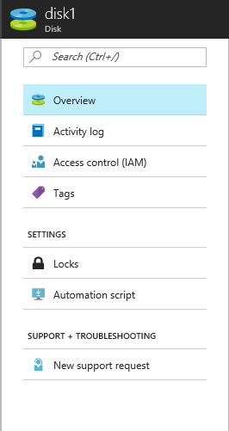
Blob Storage
All VM Disks are stored within the Azure Blob Service:
Unmanaged disks require the user to provision Storage Accounts and manage throughput
Managed disks allow Azure to handle all storage and provisioning jobs and IOPs is not a consideration
Notes:
Recap previous lesson for storage accounts containers and blob storage services.
Cover page and block blobs and the need to understand Storage account limitations.
Good chance for revision from previous topic and covering the required azure limits for storage.
There are two ways to create standard disks for Azure VMs:
Unmanaged disks:
Original method – requires storage account
Page blobs in SA can be attached to any Azure VM.
Max 256 TB per VM.
Azure Managed Disks:
Azure creates and manages storage accounts.
You choose standard or premium per disk (and can change).
Recommended option.
20535A
6: Backing Azure Solutions with Azure Storage

Slide 12
Un-Managed Disks
Require a storage account
Management overhead
Storage account IOPS limits
Choose between Standard and Premium account at creation
Notes:
Original method – requires storage account.
Page blobs in SA can be attached to any Azure VM.
Max 256 TB per VM.
20000 iops per Storage account.
Can be standard or premium disks but not in the same storage account – choose at creation for storage account performance.
20535A
6: Backing Azure Solutions with Azure Storage

Slide 13
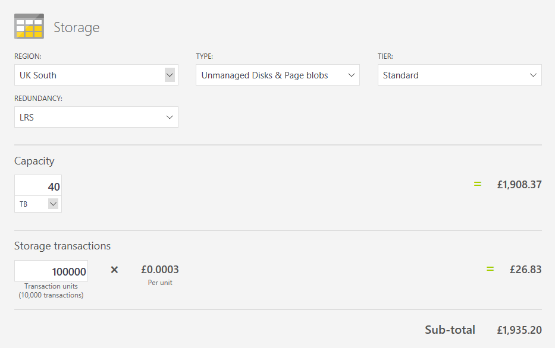
Un-Managed Disk Pricing
Notes:
20535A
6: Backing Azure Solutions with Azure Storage

Slide 14
Managed Disks
Standard and Premium disks at a disk level
Azure handles storage account and limits
Transaction billing (standard only)
Snapshots
Images
Notes:
Standard and Premium disks at a disk level – not storage account level can change at will (when unattached).
Azure handles storage account and limits – no need to spread multiple disks over a number of storage accounts for above 20000 iops performance level.
Transaction billing (standard only) – be aware for standard disks there are disk transaction costs for managed storage – see comparison slides.
Snapshots – portal based snapshot blades and management – creation of disks from snapshots.
Images – create an managed OS disk image from the portal or PowerShell or from a snapshot. (note this is also possible from a VHD in a storage account).
20535A
6: Backing Azure Solutions with Azure Storage

Slide 15
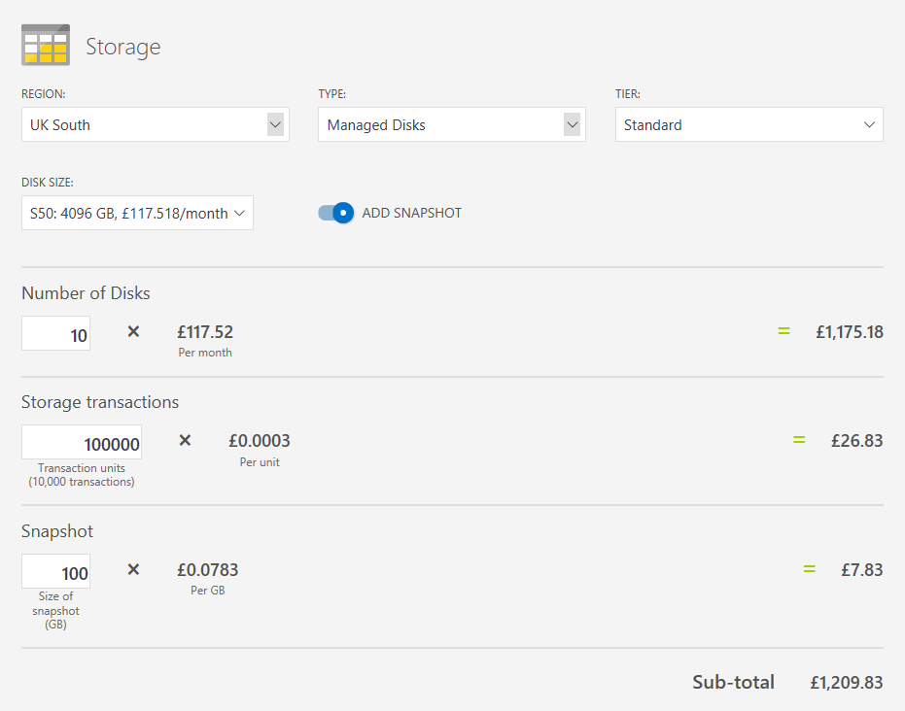
Managed Disk Pricing
Notes:
20535A
6: Backing Azure Solutions with Azure Storage

Slide 16
Deployment Considerations
Managed disks removes complexity from multiple disk VM deployments:
Can deploy with templates
Can manage with:
PowerShell
Azure CLI
Portal
Easy snapshot creation and management
Rapid performance changes
Notes:
Summary slide prior to the discussion on choices and options for deployment:
JSON template deployment so can automate full deployment.
Easy management by any method.
Snapshots and imaging from portal.
Fast and easy swap from standard to premium and back.
20535A
6: Backing Azure Solutions with Azure Storage

Slide 17
Discussion
What are the benefits and drawbacks of IaaS un-managed disk deployments?
Notes:
20535A
6: Backing Azure Solutions with Azure Storage

Slide 18
Discussion
What are the benefits and drawbacks of IaaS managed disk deployments?
Notes:
20535A
6: Backing Azure Solutions with Azure Storage

Slide 19
Lesson 3: Files
Azure Files Azure File Sync
Notes:
20535A
6: Backing Azure Solutions with Azure Storage

Slide 20
Azure Files
An SMB 3.0 file service providing reliable network file shares without infrastructure:
File Shares
File Sync
IaaS File Shares
Notes:
File Shares
File Sync
IaaS File Shares
Describe the history, needed IaaS and the drawbacks.
Describe File Share and AFS very high level.
20535A
6: Backing Azure Solutions with Azure Storage

Slide 21
Sharing Files in Cloud Infrastructure
Azure Files
Azure IaaS VM File Share
Azure File Sync for Hybrid and DR
Notes:
Detailed run through:
Azure Files
File storage offers shared storage for applications and Virtual Machines using the standard SMB 3.0 protocol.
Azure IaaS VM File Share
Standard Windows Server Files hares mounted on an IaaS VM – requires updates, maintenance and authentication of VM etc.
Azure File Sync
New preview service – allows on premises or IaaS Vms to replicate file shares using an Azure file share (cloud endpoint).
Multi server multis share with cloud tiering and dr.
20535A
6: Backing Azure Solutions with Azure Storage

Slide 22
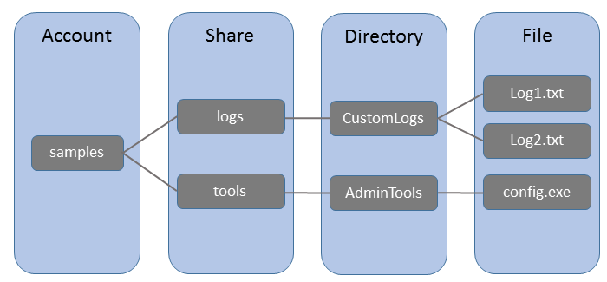
Azure File Shares
Components
URL or server / application file share access
Notes:
Azure Files:
File storage offers shared storage for applications using the standard SMB 3.0 protocol.
Storage Account: All access to Azure Storage is done through a storage account.
Share: A File storage share is an SMB 3.0 file share in Azure.
Directory: An optional hierarchy of directories.
File: A file in the share. A file may be up to 1 TB in size.
URL format: Files are addressable using the following URL format:
https://[account].file.core.windows.net/<share>/<directory/directories>/<file>
The following example URL could be used to address one of the files in the diagram above:
http://[account].file.core.windows.net/logs/CustomLogs/Log1.txt
20535A
6: Backing Azure Solutions with Azure Storage

Slide 23
Azure File Sync
File Sync Service:
NTFS volumes only
Dedupe supported (not with Cloud Tiering)
Cloud Tiering for cold files
DR feature for failed servers
Notes:
Azure File Sync terminology
Storage Sync Service – The Storage Sync Service is the top-level Azure resource for Azure File Sync.
Sync Group – A Sync Group defines the sync topology for a set of files.
Registered Server – The Registered Server object represents a trust relationship between your server (or cluster) and the Storage Sync Service.
Azure File Sync agent – The Azure File Sync agent is a download MSI that enables Windows Server to be synced with an Azure file share. Contains FileSyncSvc.exe, StorageSync.sys, PowerShell management cmdlets.
Server Endpoint – A Server Endpoint represents a specific location on a Registered Server.
Cloud Endpoint – A Cloud Endpoint is an Azure file share that is part of a Sync Group.
You can add files to servers or Azure files. Servers sync <5mins Azure files only syncs every 24 hours.
Cloud tiering – Cloud tiering is an feature of Azure File Sync in which cold files can be tiered to Azure Files. This frees space on the server. The whole namespace is still visible.
Azure File Sync compatibility 2012 R2 or 2016 with a GUI standard or datacenter.
20535A
6: Backing Azure Solutions with Azure Storage

Slide 24
Azure IaaS File Sharing
Azure AD Domain Services integrates previously created Hybrid scenarios or works as a cloud only solution. The benefits are:
Simplicity – few clicks to setup
Integrated – deep Azure AD integration
Compatible – Windows Server AD
Cost-effective – no infrastructure burden
Notes:
20535A
6: Backing Azure Solutions with Azure Storage

Slide 25
Discussion
When creating a file sharing solution, how do you decide between Azure Files, a IaaS File Server or a third-party file sharing solution?
Notes:
20535A
6: Backing Azure Solutions with Azure Storage

Slide 26
Lesson 4: StorSimple
StorSimple Data Tiering
Notes:
20535A
6: Backing Azure Solutions with Azure Storage

Slide 27
StorSimple
Hybrid file storage solution:
Cost saving solution
Accelerate Disaster Recovery
Automate Data Management
Notes:
Cost saving solution
Accelerate Disaster Recovery
Automate Data Management
20535A
6: Backing Azure Solutions with Azure Storage

Slide 28
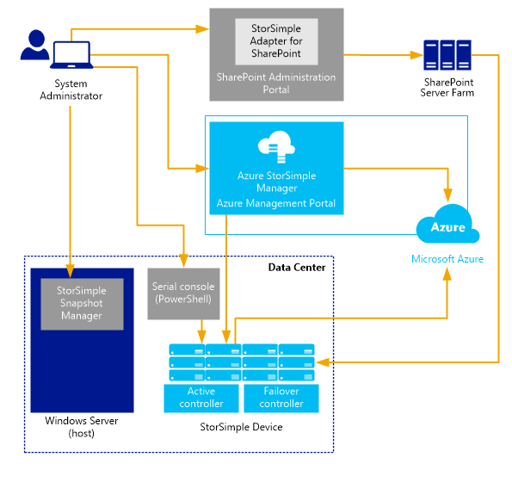
Architecture
Notes:
StorSimple is the combination of a service, device and management tools that can create workflows for migrating data to a cloud storage center or back on premise.
The StorSimple device is an on-premises hybrid storage array that provides primary storage and iSCSI access to data stored on it. It manages communication with cloud storage, and helps to ensure the security and confidentiality of all data that is stored on the StorSimple solution. The StorSimple device includes solid state drives (SSDs) and hard disk drives (HDDs), as well as support for clustering and automatic failover. It contains a shared processor, shared storage, and two mirrored controllers.
You can alternatively use StorSimple to create a virtual device that replicates the architecture and capabilities of the actual hybrid storage device. The StorSimple virtual device (also known as the StorSimple Virtual Appliance) runs on a single node in an Azure virtual machine.
StorSimple provides a web-based user interface (the StorSimple Manager service) that enables you to centrally manage datacenter and cloud storage. You can also use a Windows PowerShell–based, command-line interface that includes dedicated cmdlets for managing your StorSimple device. Finally, you can interact with StorSimple using a Microsoft Management Console (MMC) snap-in that's used to configure create consistent, point-in-time backup copies of local and cloud data.
20535A
6: Backing Azure Solutions with Azure Storage

Slide 29
Features
Transparent integration – iSCSI protocol to invisibly link data storage facilities
Reduced storage costs – Allocates sufficient local or cloud storage to meet demands, extends cloud storage when necessary
Simplified storage management – standard tools
Improved disaster recovery and compliance – Restores data as it is needed
Data mobility – Can be accessed from other sites for recovery and migration purposes
Notes:
Transparent integration – Microsoft Azure StorSimple uses the Internet Small Computer System Interface (iSCSI) protocol to invisibly link data storage facilities. This ensures that data stored in the cloud, at the datacenter, or on remote servers appears to be stored at a single location.
Reduced storage costs – Microsoft Azure StorSimple allocates sufficient local or cloud storage to meet current demands and extends cloud storage only when necessary. It further reduces storage requirements and expense by eliminating redundant versions of the same data (deduplication) and by using compression.
Simplified storage management – Microsoft Azure StorSimple provides system administration tools that you can use to configure and manage data stored on-premises, on a remote server, and in the cloud. Additionally, you can manage backup and restore functions from a Microsoft Management Console (MMC) snap-in. StorSimple provides a separate, optional interface that you can use to extend StorSimple management and data protection services to content stored on SharePoint servers.
Improved disaster recovery and compliance – Microsoft Azure StorSimple does not require extended recovery time. Instead, it restores data as it is needed. This means normal operations can continue with minimal disruption. Additionally, you can configure policies to specify backup schedules and data retention.
Data mobility – Data uploaded to Microsoft Azure cloud services can be accessed from other sites for recovery and migration purposes. Additionally, you can use StorSimple to configure StorSimple virtual devices on virtual machines (VMs) running in Microsoft Azure. The VMs can then use virtual devices to access stored data for test or recovery purposes.
20535A
6: Backing Azure Solutions with Azure Storage

Slide 30
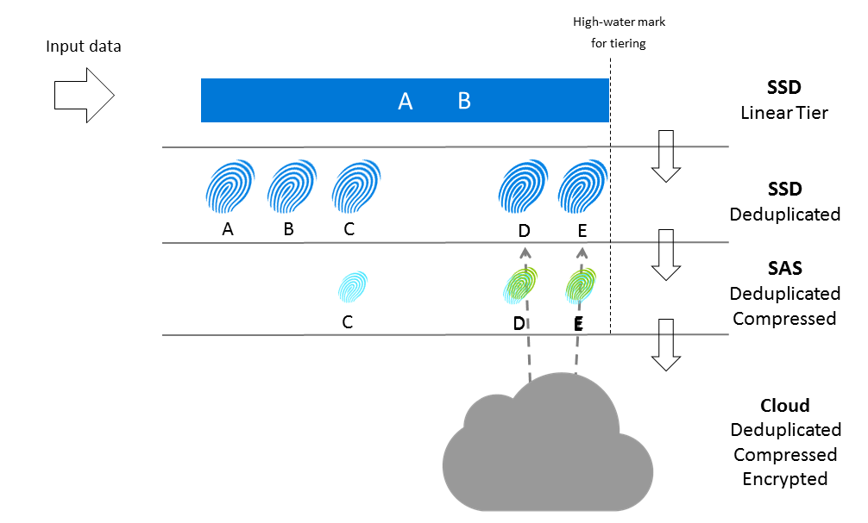
Data Tiering
Notes:
Data that is most active is stored locally, while less active and inactive data is automatically migrated to the cloud.
To enable quick access, StorSimple stores very active data (hot data) on SSDs in the StorSimple device. It stores data that is used occasionally (warm data) on HDDs in the device or on servers at the datacenter.
It moves inactive data, backup data, and data retained for archival or compliance purposes to the cloud. StorSimple adjusts and rearranges data and storage assignments as usage patterns change.
For example, some information might become less active over time.
As it becomes progressively less active, it is migrated from SSD to HDD and then to the cloud. If that same data becomes active again, it is migrated back to the storage device.
20535A
6: Backing Azure Solutions with Azure Storage

Slide 31
Discussion
Your organization has a content-management solution that stores documents. How can you implement StorSimple in your organization to reduce costs and improve document access performance?
Notes:
20535A
6: Backing Azure Solutions with Azure Storage

Slide 32
Lab: Deploying Azure Storage to Support Other Workloads in Azure
Exercise 1: Creating Required Resources for a Virtual Machine Exercise 2: Creating a VM With a Storage Account Exercise 3: Creating a VM With a Managed Disk Exercise 4: Cleanup Subscription
Logon Information
Virtual machine: 20535A-SEA-ARCH
User name: Admin
Password: Pa55w.rd
Estimated Time: 60 minutes
Notes:
This lab assumes that students have their own Azure subscriptions that do not contain any existing cloud services, storage accounts, or Azure SQL Database servers.
Azure is continually improving, so the user interface might have been updated since this lab was written. Before students start the lab, make them aware of any differences between the steps described in the lab and the current user interface.
Exercise 1: Creating Required Resources for a Virtual Machine
Exercise 2: Creating a VM With a Storage Account
Exercise 3: Creating a VM With a Managed Disk
Exercise 4: Cleanup Subscription
20535A
6: Backing Azure Solutions with Azure Storage

Slide 33
Lab Scenario
An established business has hired your company to help it transition from using Storage Accounts and blobs to managed disks in Azure.
Notes:
20535A
6: Backing Azure Solutions with Azure Storage

Slide 34
Lab Review
If you are reusing VHDs across different VMs created by various ARM templates, should you use managed or un-managed disks?
Notes:
Question
If you are reusing VHDs across different VMs created by various ARM templates, should you use managed or un-managed disks?
Answer
Answers can include:
A managed disk is a separately defined resource in an ARM template and it’s easier to author and reuse them directly in ARM templates.
Un-managed disks are not defined explicitly in ARM templates but they can be re-used if you reference the Storage account in another ARM template.
20535A
6: Backing Azure Solutions with Azure Storage

Slide 35
Module Review and Takeaways
Review Questions
Notes:
Review Questions
Question
You need to create a Storage account that supports uploading streaming data for auditing in files without overwriting already present data in those files. Which type of blobs should you use to store this data in Azure Storage?
( ) Option 1: Append blobs
( ) Option 2: Tables entities
( ) Option 3: Block blobs
( ) Option 4: File shares
( ) Option 5: Page blobs
Answer
( √) Option 1: Append blobs
( ) Option 2: Tables entities
( ) Option 3: Block blobs
( ) Option 4: File shares
( ) Option 5: Page blobs
20535A
6: Backing Azure Solutions with Azure Storage
(More notes on the next slide)

Slide 36
Notes:
Question
You have deployed an Azure VM with five attached data disks. The data disks are striped within the VM for Performance. The Azure VM uses managed disks. You need to copy the VM disks for backup and potential later reuse. What task should you perform to backup the disks?
( ) Option 1: Use Azure Backup service
( ) Option 2: Use Azure Site Recovery service
( ) Option 3: Create snapshots of individual VM disks
( ) Option 4: Detach individual VM disks and export them
( ) Option 5: Create an image of the Azure VM
Answer
( ) Option 1: Use Azure Backup service
( ) Option 2: Use Azure Site Recovery service
( ) Option 3: Create snapshots of individual VM disks
( ) Option 4: Detach individual VM disks and export them
( √) Option 5: Create an image of the Azure VM
20535A
6: Backing Azure Solutions with Azure Storage
(More notes on the next slide)

Slide 37
Notes:
Question
You need to deploy a file share to several on-premises and cloud-based IaaS Virtual Machines. Which Azure service would provide Disaster Recovery functionality for your file shares with the lowest management overhead?
( ) Option 1: Azure Site Recovery
( ) Option 2: Azure Storage File Shares
( ) Option 3: Distributed File System Replication
( ) Option 4: Azure File Sync
( ) Option 5: Azure Backup
Answer
( ) Option 1: Azure Site Recovery
( ) Option 2: Azure Storage File Shares
( ) Option 3: Distributed File System Replication
( √) Option 4: Azure File Sync
( ) Option 5: Azure Backup
20535A
6: Backing Azure Solutions with Azure Storage

