Slide 1
Module 8
Networking Azure Application Components
Notes:
Presentation: 75 minutes
Case Study: 60 minutes
Lab: 60 minutes
After completing this module, students will be able to:
Describe DNS and IP strategies for VNETs in Azure.
Compare connectivity options for ad-hoc and hybrid connectivity.
Distribute network traffic across multiple loads using load balancers.
Design a hybrid connectivity scenario between cloud and on-premise.
Required materials
To teach this module, you need the Microsoft PowerPoint file: 20535A_00.pptx.
Preparation tasks
To prepare for this module, you should:
Read all of this module’s materials.
Practice performing the demonstrations and labs.
Work through the Module Review and Takeaways section to determine how you will use the information to reinforce student learning and promote knowledge transfer to on-the-job performance.
As you prepare for this class, it is imperative that you complete the labs yourself. This gives you an understanding of how the labs work and the concepts that each covers, so that you can provide meaningful hints to students who might have issues. Furthermore, it will help guide your lecture to ensure that you discuss the concepts that the lab covers.
The Azure portal is continually being improved, and the user interface might have updated since this module was written. Therefore, before teaching this module, familiarize yourself with the latest version of the Azure portal.
20535A
8: Networking Azure Application Components

Slide 2
Module Overview
Virtual Networks Load Balancing External Connectivity Secure Connectivity Networking Case Study
Notes:
20535A
8: Networking Azure Application Components

Slide 3
Lesson 1: Virtual Networks
Azure Virtual Network (VNET) Architecture Multi-Region Virtual Network Architecture VNETs & Subnets
Notes:
20535A
8: Networking Azure Application Components

Slide 4


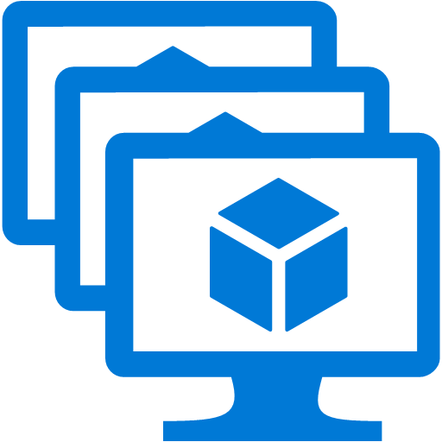
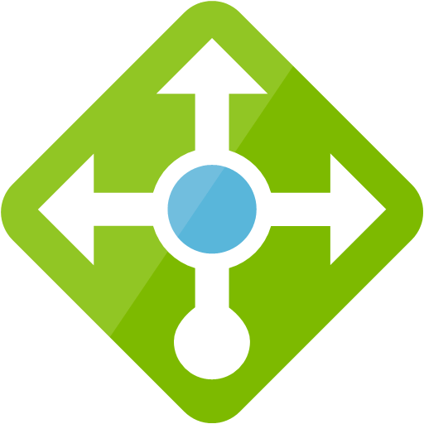
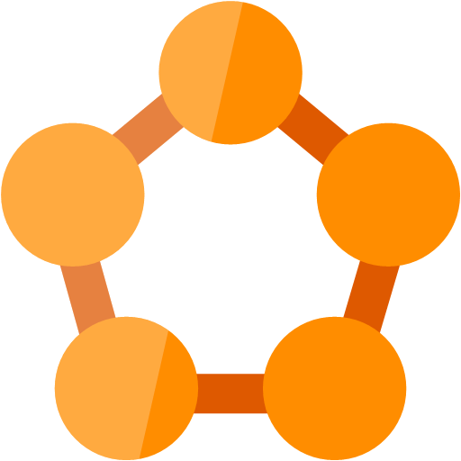
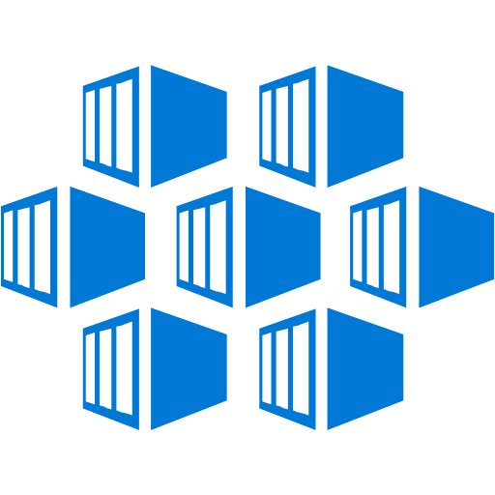






Azure Virtual Network (VNET) Architecture
Virtual Network
Azure Region 1
Public Internet
Cross premises Connectivity
Notes:
Use this slide to briefly discuss the “big” Azure Network Picture.
Front-End = all incoming traffic from the public internet.
Azure Virtual Network = all network related traffic starts and lives within a VNET, where Azure resources like VMs, Scale Sets, Service Fabric, Load Balancers, Traffic Manager, App Services, Web Jobs,… attach to.
Back-End Services = Cross-Premises connectivity using S2S VPN or ExpressRoute.
Emphasize the Azure Region is the boundary for VNET communication.
20535A
8: Networking Azure Application Components

Slide 5

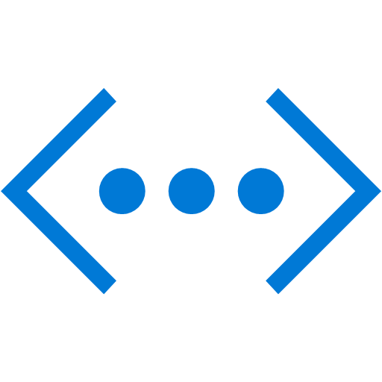
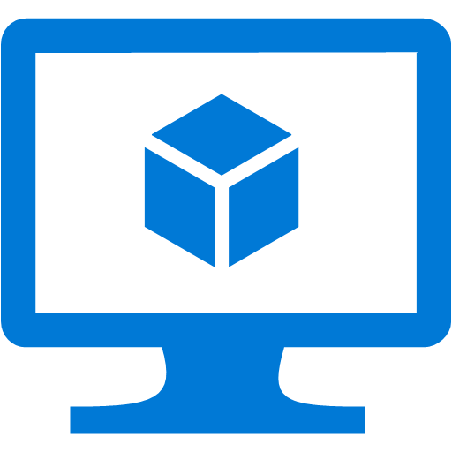

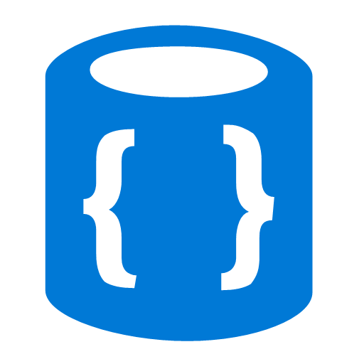
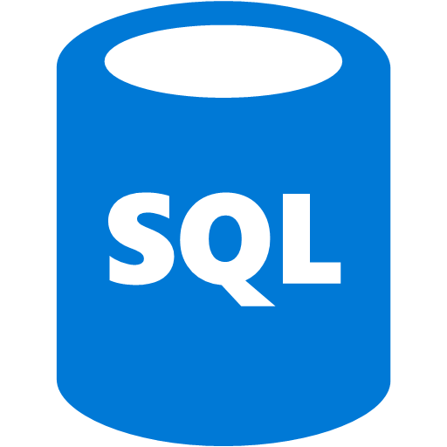
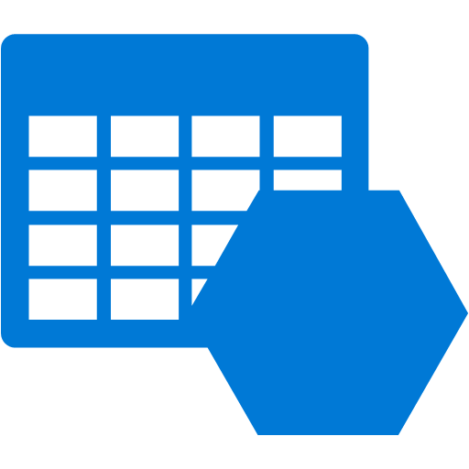

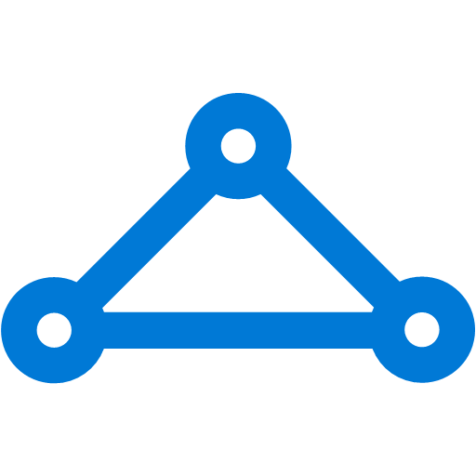
Multi-Region Virtual Network Architecture
Azure Region 1
Azure Region 2
Azure
Azure
VNET Peering
Vnet-to-VNet Tunnel
S2S VPN
S2S VPN
P2S VPN
ExpressRoute
From Internet
CorpNet
Notes:
This slide is an extension to the previous one, where all IAAS and PAAS services are allocated within one or more VNETs, within an Azure Region.
Cross-premise connectivity is made possible using ExpressRoute or Site-to-Site VPN.
While we touch on differences on interconnecting Azure VNETs across multiple regions, you can already briefly describe this can be made possible using Site-to-Site VPN tunnel or using VNET peering.
20535A
8: Networking Azure Application Components

Slide 6
Multi-Region Virtual Network Architecture
Traffic Manager provides DNS based traffic distribution & failover across Azure Regions
IAAS & PAAS VNet inter-communication
Isolate VM workloads in SubNets/Vnet
ExpressRoute and/or S2S VPN for CorpNet connectivity or Azure-to-Azure Region traffic
NSGs secure the in/outgoing traffic on VNet or NIC level
Notes:
20535A
8: Networking Azure Application Components

Slide 7
VNETs & Subnets
Networking Topology:
Define 1 or more VNets within an Azure Region, and configure an address space for each
Define 1 or more SubNets within a VNet, and configure address space within the VNet range
VNets and SubNets are using CIDR notation (x.x.x.x/24, x.x.x.x/16,…)
Configure Network Security Group settings on VNet level
Attach a NIC to a SubNet
SubNet IP Addressing:
IP-address gets allocated to a NIC during provisioning of the NIC
First available IP-address in a SubNet range is x.x.x.4
Azure SubNets support dynamic (=default) and static IP addressing
Notes:
Walk the users through the high-level hierarchy of VNets and SubNets, clearly explaining how they are related to each other.
Next to that, focus on the configuration aspects, CIDR notation, and how IP-addresses get allocated.
20535A
8: Networking Azure Application Components

Slide 8
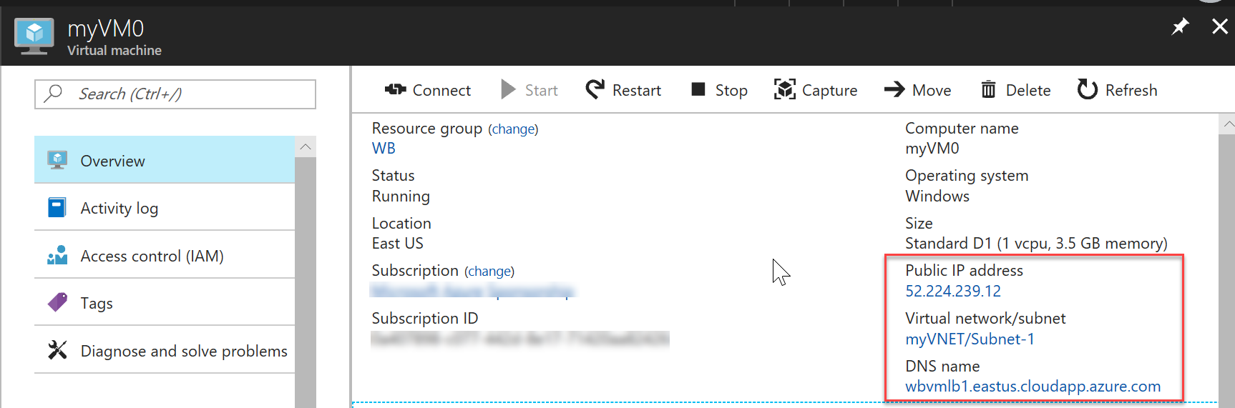
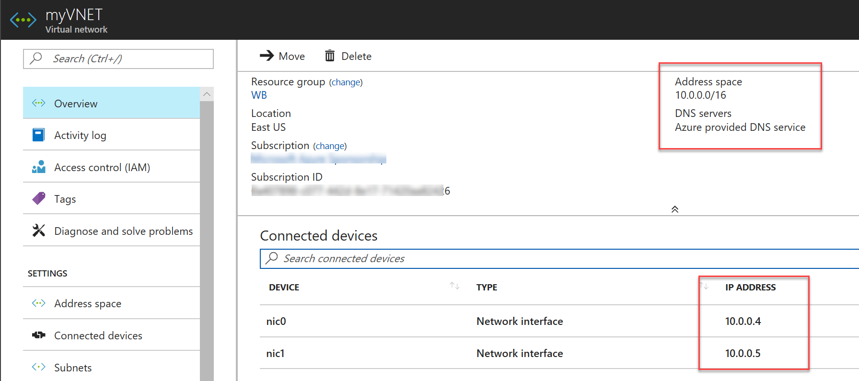
Public & Private IP-addressing
Public IP-addressing:
Used for all public internet-facing communication
Required parameter when creating a VM from the portal
Private IP-addressing:
Used for all inter-VNet communication
Used for all communication between an Azure VNet and an on-premises VNet
Notes:
20535A
8: Networking Azure Application Components

Slide 9
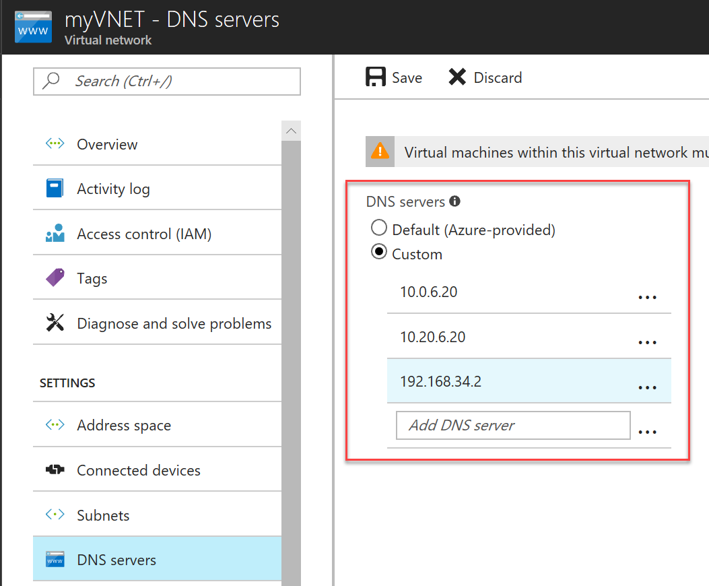
Azure DNS Resolving
DNS Server settings are configured on VNET level
Use Azure DNS (Default)
Or use your custom DNS configuration:
Azure DNS Appliance (from Azure MarketPlace)
Azure VM (e.g. Windows ADDS with DNS)
On-premises DNS solution (requires connectivity)
Public DNS names (available for VMs and App Services) must be unique across Azure regions:
<host.region.cloudapp.azure.com>
Notes:
Virtual Networks provide the ability to specify your own DNS Servers, if you do not want to use the Azure-provided ones. These could point to IP addresses of on-premises servers, such as an Active Directory Domain Controller or network appliance, a DNS service running in an Azure Virtual Machine, or anywhere else on the internet.
If you make changes to the DNS pointers in a virtual network, after Virtual Machines have already been deployed into it, then the Virtual Machines must reboot before the change will be detected.
20535A
8: Networking Azure Application Components

Slide 10

Discussion
What business scenarios would dictate the use of a multi-region VNET architecture?
Notes:
20535A
8: Networking Azure Application Components

Slide 11
Lesson 2: Load Balancing
Load Balancing Solutions Azure Load Balancer Azure Application Gateway Azure Load Balancing Marketplace Appliances Azure Traffic Manager
Notes:
20535A
8: Networking Azure Application Components

Slide 12
Load Balancing Solutions
Azure Load Balancer (layer 4)
Azure Application Gateway (layer 7)
Azure MarketPlace Load Balancing Appliance (layer 7)
Azure Traffic Manager (DNS-based)
Notes:
20535A
8: Networking Azure Application Components

Slide 13
Azure Load Balancer
Load balancer with a Public IP-address, sending traffic along to the back-end pool servers
TCP, UDP traffic
Azure Platform management
Support for Availability Sets
Internet
External LB
LB Standard
10X
1-1000
Notes:
20535A
8: Networking Azure Application Components

Slide 14
Load Balancer Basic
Load Balancer Basic can be used for most load balancing scenarios:
Basic
Up to 100 backend instances
Non-zonal frontend
Availability Set (single)
Basic NAT and Probe health status
-
NSG optional
Free
Notes:
20535A
8: Networking Azure Application Components

Slide 15
Load Balancer Standard
You can use Load Balancer Standard for TCP & UDP scenarios with:
Larger scale
Greater flexibility
HA Ports
New metrics
Availability zones
Standard
Up to 1000 backend instances
Zone-redundant frontend Zonal frontend
Availability Sets not required and Availability Zones
Integrated Frontend and Backend health metrics
Supports HA Ports
NSG required
Notes:
20535A
8: Networking Azure Application Components

Slide 16
Internal Load Balancer
Load balancer with a Private IP-address, sending traffic along to the back-end pool servers
TCP, UDP traffic
Azure Platform management
An Azure Load Balancer cannot both be external and internal
Internet
External LB
WebAVSet1
Internal LB
DBAVSet1
Notes:
20535A
8: Networking Azure Application Components

Slide 17
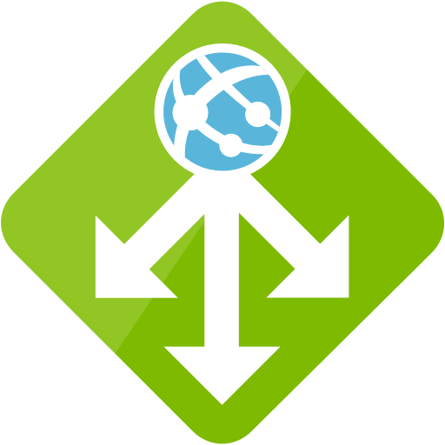
Azure Application Gateway
Internet
Application GW
Notes:
Load balancer with a Public IP-address, sending traffic along to the back-end pool servers
HTTP/HTTPS only
SSL Offloading
Cookie Affinity
Web Application Firewall (WAF)
URL Based Routing
20535A
8: Networking Azure Application Components

Slide 18
URL-based Routing
Internet (www.domain1.com) (www.domain2.com)
Application GW
www.domain1.com
www.domain2.com/finance
www.domain2.com/sales
Notes:
Load balancer with a Public IP-address, sending traffic along to the back-end pool servers
HTTP/HTTPS only
SSL Offloading
Cookie Affinity
Web Application Firewall (WAF)
URL Based Routing
20535A
8: Networking Azure Application Components

Slide 19
SSL Termination
Internet (www.domain1.com) (www.domain2.com)
Application GW
http://www.domain1.com
https://www.domain2.com
http://www.domain2.com => https://www.domain2.com
Notes:
Load balancer with a Public IP-address, sending traffic along to the back-end pool servers
HTTP/HTTPS only
SSL Offloading
Cookie Affinity
Web Application Firewall (WAF)
URL Based Routing
20535A
8: Networking Azure Application Components

Slide 20
Web Application Firewall (WAF)
Internet (www.domain1.com) (www.domain2.com)
Application GW with WAF
XSS Attack
SQL Injection
Valid Requests
Notes:
Load balancer with a Public IP-address, sending traffic along to the back-end pool servers
Web Application Firewall (WAF)
20535A
8: Networking Azure Application Components

Slide 21
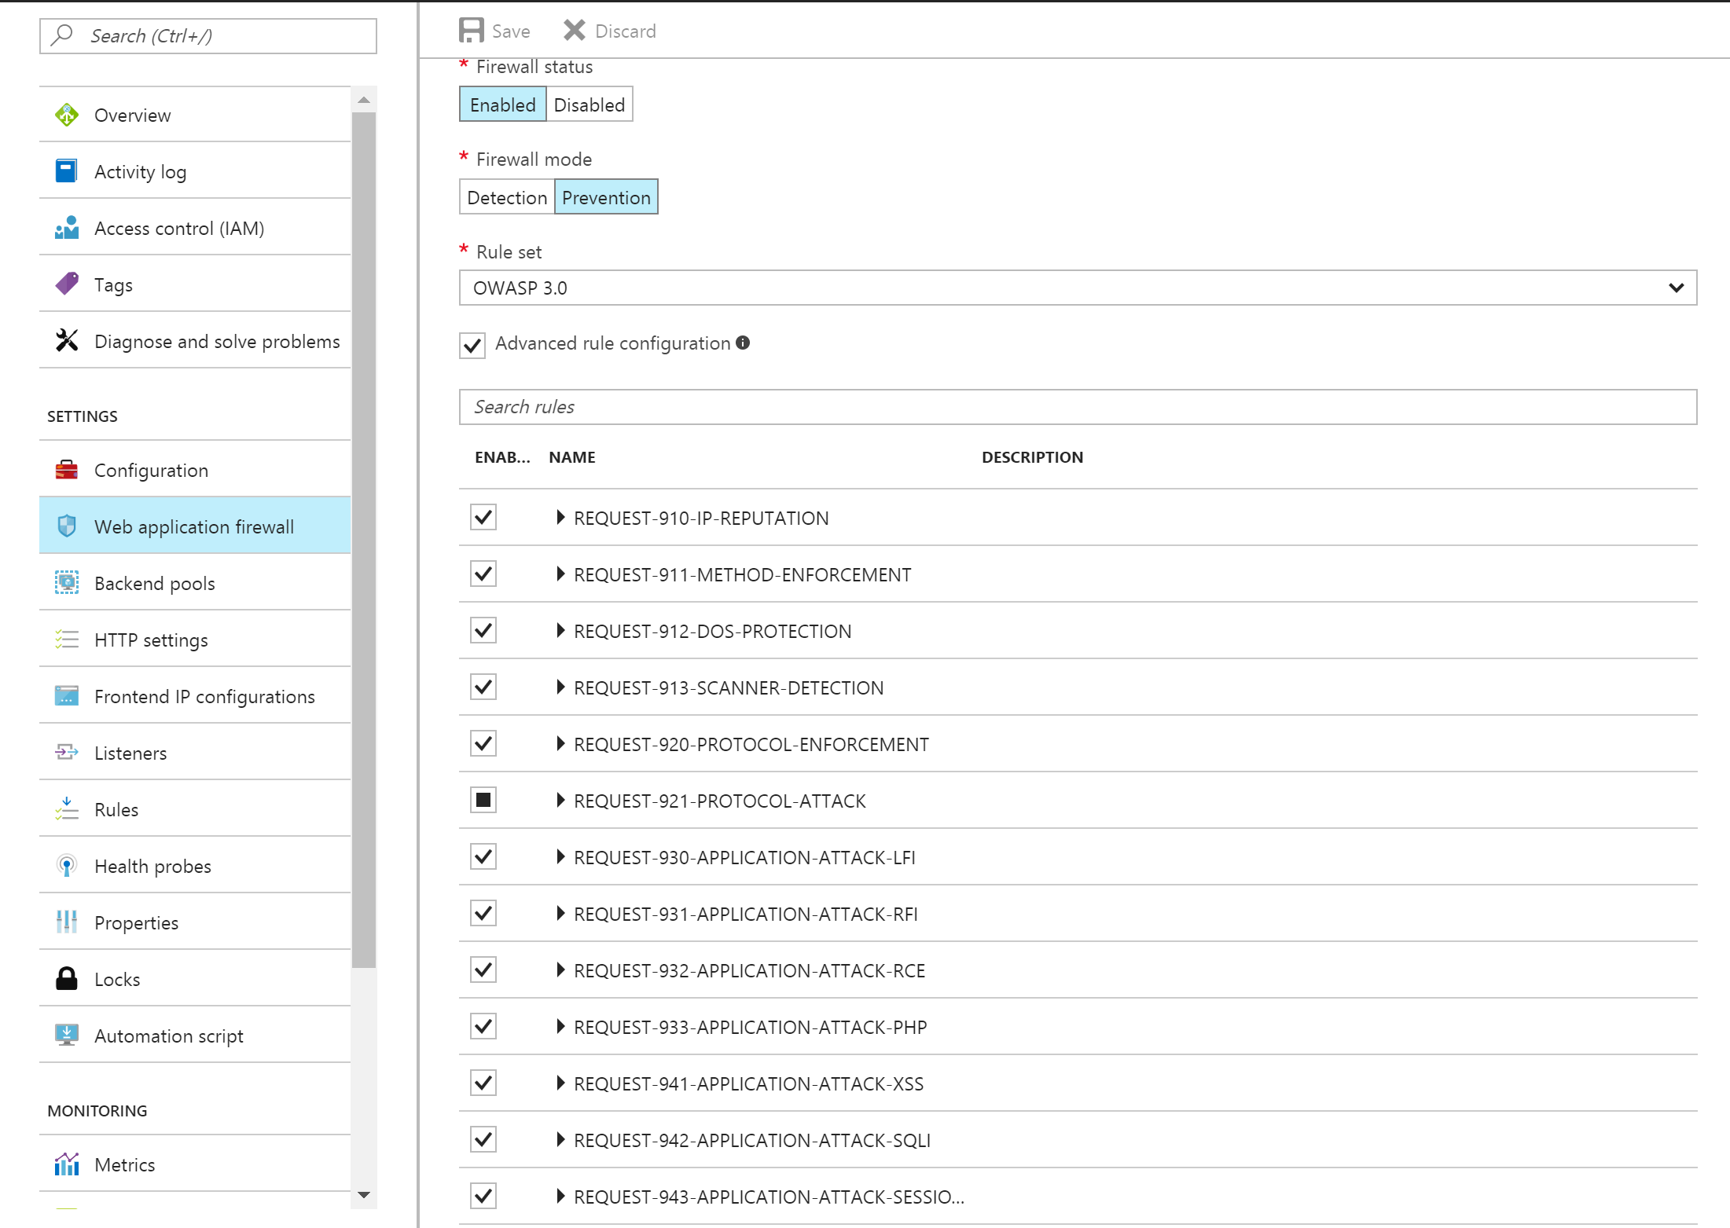
Web Application Firewall
Pre-configured WAF Rules
Notes:
RuleSet offered:
CRS 2.2.9
CRS 3.0
Protect from:
SQL Injection
Cross site scripting
Protocol violations
Generic attacks
HTTP rate limiting
Scanner detection
Session fixation
LFI/RFI
20535A
8: Networking Azure Application Components

Slide 22
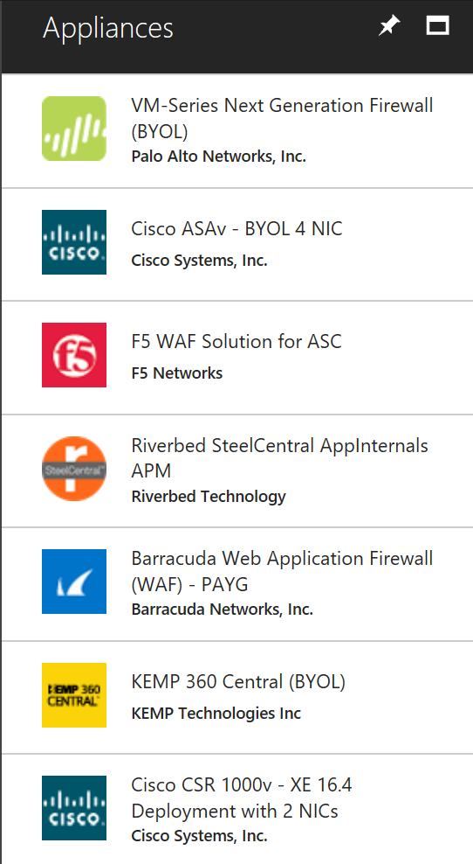
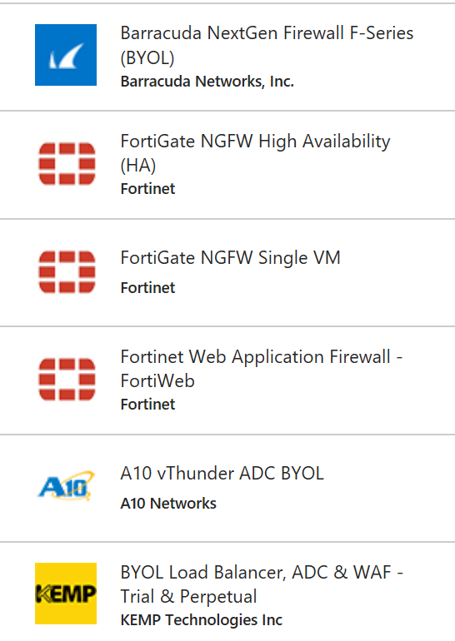
Azure Load Balancing Marketplace Appliances
Preconfigured vendor VM appliances, supported by Azure
BYOL or Pay-per-use
Can be an alternative for Azure Platform provided options
Notes:
20535A
8: Networking Azure Application Components

Slide 23

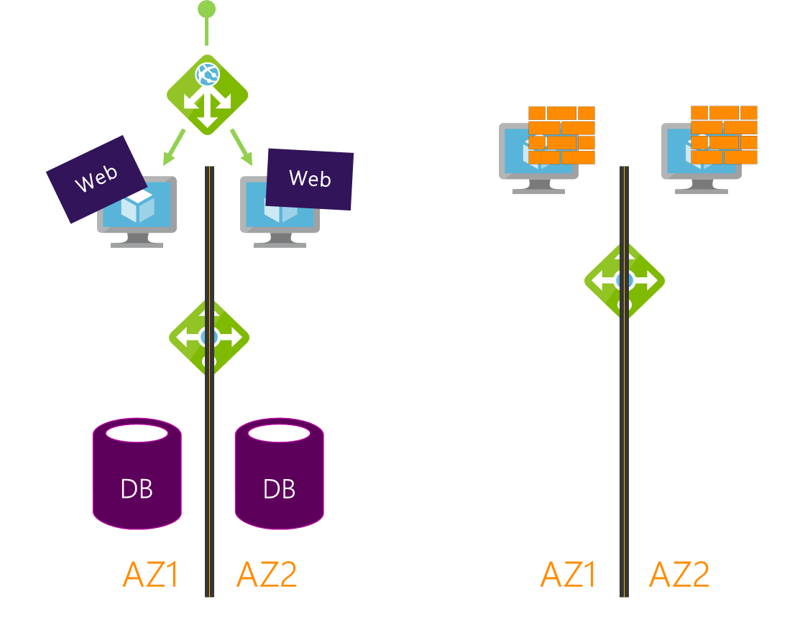
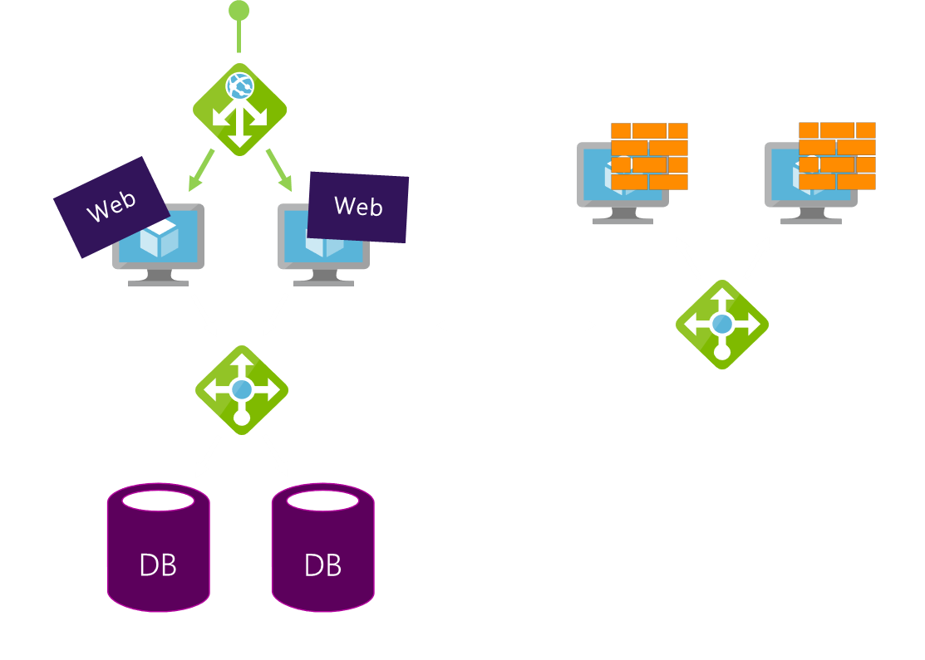
Azure Traffic Manager
Global Resiliency and Performance, based on DNS
4 Load Balancing options:
Priority
Weighted Round Robin
Geographical
Performance
Traffic Manager
Notes:
Global Resiliency and Performance, based on DNS.
4 Load Balancing options:
Priority
Weighted Round Robin
Geographical
Performance
20535A
8: Networking Azure Application Components

Slide 24
Lesson 3: External Connectivity
On-Premises to Azure Connectivity VNET Peering Multi-Region VPN Connectivity
Notes:
20535A
8: Networking Azure Application Components

Slide 25
On-Premises to Azure Connectivity
Azure Region 1
Azure Region 2
Azure
Azure
S2S VPN
S2S VPN
P2S VPN
ExpressRoute
Notes:
This slide focuses around establishing an on-premises to Azure Region connectivity, which is made possible in 3 different ways:
ExpressRoute
Site-to-Site VPN
Point-to-Site VPN
20535A
8: Networking Azure Application Components

Slide 26
Connectivity Options
Connectivity | Benefits
ExpressRoute | ExpressRoute as primary cross-premises connectivity Multiple circuits for redundancy & better routing ExpressRoute-VPN co-existence for highly available, redundant paths
Site-to-Site VPN | S2S VPN over Internet for remote branch locations BGP & active-active configuration for HA and transit
Point-to-Site VPN | P2S VPN for mobile users & developers to connect from anywhere with macOS & Windows AD/radius authentication for enterprise grade security
Notes:
This should be a refresher for most students.
20535A
8: Networking Azure Application Components

Slide 27
High-Performance VPN Gateway SKUs
Scenarios:
High throughput, hybrid workload over VPN tunnels
Failover from ExpressRoute circuits to S2S VPN tunnels
P2S for dev/test connectivity from anywhere
SKU | Workload | Throughput | S2S/V2V | P2S | SLA
VpnGw1 | Production | 650 Mbps | Max. 30 | 128 | 99.95%
VpnGw2 | Production | 1 Gbps | Max. 30 | 128 | 99.95%
VpnGw3 | Production | 1.25 Gbps | Max. 30 | 128 | 99.95%
Basic | Dev/Test | 100 Mbps | Max. 10 | 128 | 99.9%
Notes:
20535A
8: Networking Azure Application Components

Slide 28
VNET Peering
VNET Peering allows you to interconnect 2 Azure VNETs, as if they are 1 large VNET
VNET Peering is possible within the same Azure region, or across Azure regions (using MS Backbone, no public internet)
VNET Peering is supported to interconnect an Azure Classic VNET with an ARM VNET (e.g., for migrating workloads)
Notes:
20535A
8: Networking Azure Application Components

Slide 29
VNet Peering
Azure Region 1
Azure Region 2
Azure
Azure
VNET Peering
Notes:
VNET peering allows you to interconnect 2 Azure Regions with each other, using the Microsoft Backbone (not the public internet). Communication relies on internal IP addressing.
20535A
8: Networking Azure Application Components

Slide 30
Multi-Region VPN Connectivity
Before Vnet Peering, the only possible way to interconnect 2 Azure Regions, was Site-to-Site VPN Gateway tunneling
This is still a valid option, if your traffic between both Azure regions must be encrypted (outside of the already encrypted Microsoft Backbone, no public internet)
Notes:
If VNet peering is not an option, because you might want to encrypt your traffic within the VNET tunnel, one can still deploy a VPN Gateway on both Azure Regional VNETs, and creating a Site-to-Site VPN tunnel across those regions.
20535A
8: Networking Azure Application Components

Slide 31
Multi-Region VPN Connectivity
Azure Region 1
Azure Region 2
Azure
Azure
Vnet-to-VNet Tunnel
Notes:
20535A
8: Networking Azure Application Components

Slide 32
Forced Tunneling
Challenges:
IaaS services accessible through internet
Customers may require their VMs to be only accessed from on-premises VNET
Solution—Forced Tunneling:
IaaS services only accessible from a VNET
Site-to-Site VPN
Or ExpressRoute
Notes:
20535A
8: Networking Azure Application Components

Slide 33



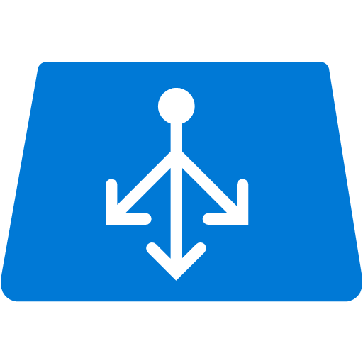
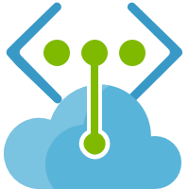
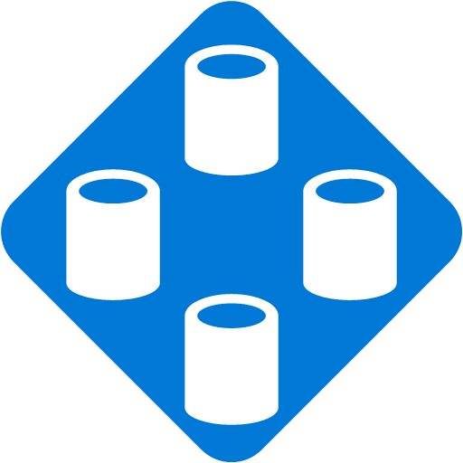
Forced Tunneling
S2S VPN
ExpressRoute
Notes:
20535A
8: Networking Azure Application Components

Slide 34
Securing Access to PaaS Services
Challenges:
PaaS services accessible through internet
Customers may require their services endpoints to be only accessed from their VNETs
Solution—VNEt Service Endpoints:
PaaS services only accessible from a VNET
Available now for Storage and SQL DB
Will roll out to other PaaS services in the future
Notes:
20535A
8: Networking Azure Application Components

Slide 35
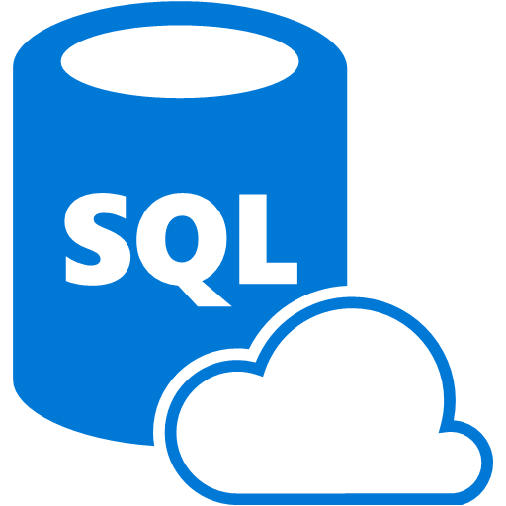

Securing Access to PaaS Services
Notes:
20535A
8: Networking Azure Application Components

Slide 36
Discussion
Why would you want to secure a PaaS service using VNET Service Endpoints?
Notes:
Azure SQL Database is a common example of this feature.
20535A
8: Networking Azure Application Components

Slide 37
Lesson 4: Secure Connectivity
Network Security Groups
Notes:
20535A
8: Networking Azure Application Components

Slide 38
Network Security Groups
A network security group (NSG) is a top level object that is associated to your subscription:
It can be used to control traffic to one or more virtual machine (VM) instances in your virtual network
An NSG contains access control rules that allow or deny traffic to VM instances
The rules of an NSG can be changed at any time, and changes are applied to all associated instances
Notes:
20535A
8: Networking Azure Application Components

Slide 39
Default Inbound Rules
NAME | PRIORITY | SOURCE IP | SOURCE PORT | DESTINATION IP | DESTINATION PORT | PROTOCOL | ACCESS
ALLOW VNET INBOUND | 65000 | VIRTUAL_ NETWORK | * | VIRTUAL_ NETWORK | * | * | ALLOW
ALLOW AZURE LOAD BALANCER INBOUND | 65001 | AZURE_ LOADBALANCER | * | * | * | * | ALLOW
DENY ALL INBOUND | 65500 | * | * | * | * | * | DENY
Notes:
An NSG contains default rules. The default rules cannot be deleted, but because they are assigned the lowest priority, they can be overridden by the rules that you create. The default rules describe the default settings recommended by the platform.
There is a default rule to allow Azure’s load balancer (LB) to probe the health of the VM. You can override this rule if the VM or set of VMs under the NSG does not participate in the load balanced set.
20535A
8: Networking Azure Application Components

Slide 40
Default Outbound Rules
NAME | PRIORITY | SOURCE IP | SOURCE PORT | DESTINATION IP | DESTINATION PORT | PROTOCOL | ACCESS
ALLOW VNET OUTBOUND | 65000 | VIRTUAL_ NETWORK | * | VIRTUAL_ NETWORK | * | * | ALLOW
ALLOW INTERNET OUTBOUND | 65001 | * | * | INTERNET | * | * | ALLOW
DENY ALL OUTBOUND | 65500 | * | * | * | * | * | DENY
Notes:
While connectivity to the Internet is allowed for Outbound direction, it is by default blocked for Inbound direction.
20535A
8: Networking Azure Application Components

Slide 41
Lesson 5: Networking Case Study
Case Study Overview Case Study Solution
Notes:
20535A
8: Networking Azure Application Components

Slide 42
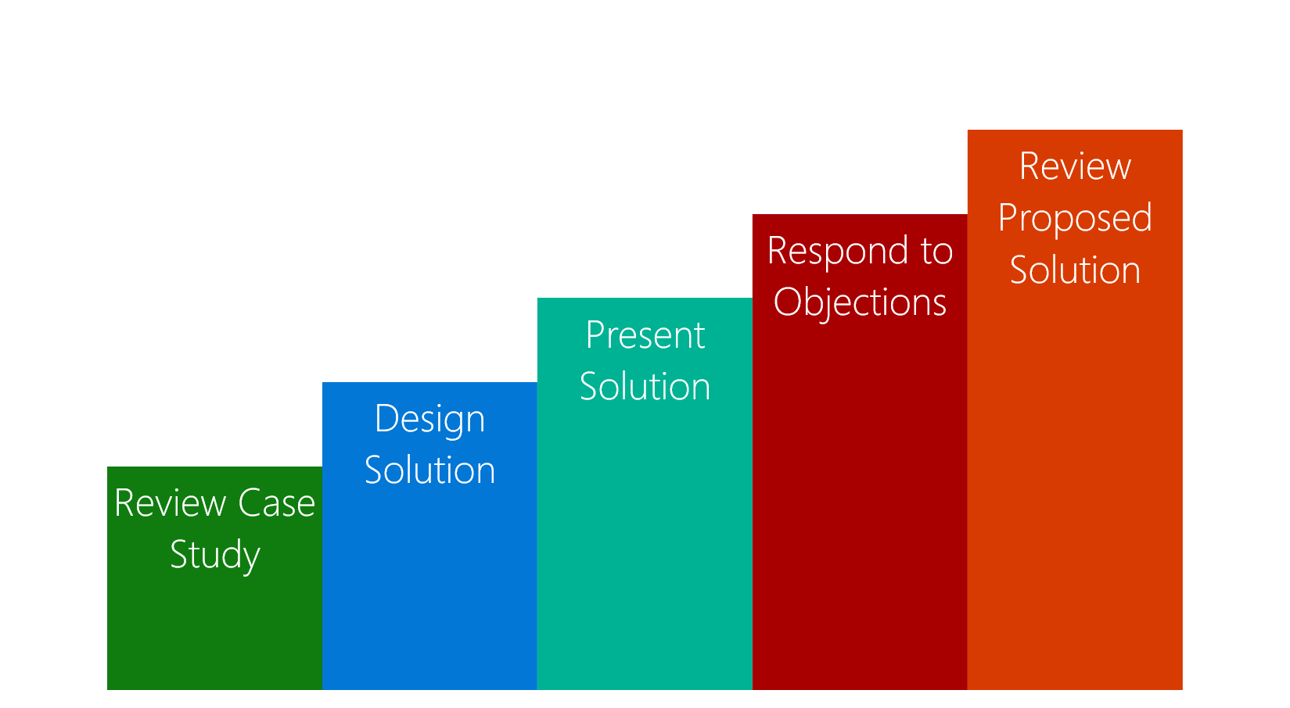
Case Study Overview
Review the case study requirements
Design a solution to the customer business problem
Present your solution
Respond to questions and objections
Review a potential solution
Notes:
Review the “Case Study Flow.”
20535A
8: Networking Azure Application Components

Slide 43
Customer Business Problem
Fabrikam Residences:
National Real Estate Services Group:
Rapid growth slowed by expensive and unresponsive datacenter infrastructure
“We are a national real estate firm, we want to make investments that support our core business, and buying and managing servers is not our core business.”
-Craig Jones, CIO
DOS Strategy:
“Don’t own stuff”
Focus on investments directly relevant to core business
Avoid being an asset-intensive organization
Notes:
Fabrikam Residences is a national real estate services group whose rapid growth was being slowed by an expensive and unresponsive datacenter infrastructure.
Fabrikam has two data centers in the United States, but it really doesn’t want to be in the datacenter business. “We are a national real estate firm,” says Craig Jones, Chief Information Officer for Fabrikam. “We want to make investments that support our core business, and buying and managing servers is not our core business. In fact, we have what we call a DOS strategy—‘don’t own stuff.’ We were not an asset-intensive organization in any area but IT, where we had many underutilized assets.”
20535A
8: Networking Azure Application Components

Slide 44
Customer Inventory
Existing Applications
California Datacenter
250 servers
Virginia Datacenter
110 servers
Misc. servers distributed geographically
Est. hundreds
Notes:
Fabrikam has about 250 servers in its datacenter in California, and another 110 in its Virginia datacenter, and hundreds of servers scattered across several branch offices throughout the United States. Fabrikam ended up overprovisioning servers each time it deployed an application to ensure that capacity would be there at peak times. This meant that millions of dollars’ worth of hardware and software was sitting idle much of the time.
In addition to the primary data centers, Fabrikam also has several branch offices scattered across the United States that have connectivity to the primary data center through an MPLS based wide area network. Their partner is a Microsoft Azure ExpressRoute partner. To reduce costs, Fabrikam has made the decision to move its West coast datacenter to a colocation site in Silicon Valley and to virtualize the remainder of the servers in its branch offices and Virginia data center into the cloud. Fabrikam’s current virtualization and management solution is based on System Center so a solution that integrates well with these known tools is ideal.
20535A
8: Networking Azure Application Components

Slide 45
Customer Goals
Migration: Migrate majority of their workloads to Azure
CRM: Migrate custom web application that runs on IIS 8 and SQL Server 2012
Scale to usage: Application should perform well at peak usage while not being overprovisioned
Notes:
Fabrikam Residences would like to eventually migrate the majority of their workloads to Azure. There are several workloads that will be migrated, but the most critical for Fabrikam is their CRM application.
The CRM application is a custom web application that runs on IIS 8 and SQL Server 2012 that stores sensitive documents for all of their customer’s transactions. This application needs to perform well at peak time while mitigating the problem of overprovisioned capacity. The centralized nature of the application means that any downtime will block the activity of a significant portion of the company so the solution must be highly available. Due to the sensitive nature of this application security is key so access to the application is restricted to only authorized users from the corporate network including branch offices.
20535A
8: Networking Azure Application Components

Slide 46
Customer Needs
Reduce on-premise server presence through public cloud consolidation
Migrated servers should be located in closest Azure region
Maintain security and privacy of their infrastructure connect-throughs
CRM application must be able to scale to meet peak demand while not being overprovisioned during liger usage periods
The CRM application must be highly available and only accessible from the corporate intranet
Notes:
Reduce the number of existing on-premises servers through public cloud consolidation to reduce the costs of their current overprovisioned deployments. Servers running in the Virginia data center and remote branch offices will be moved to the closest Azure region. Due the sheer amount of servers being virtualized latency and performance of the network is a big concern.
Because of the sensitive nature of the data that Fabrikam Real Estate works with ensuring the security and privacy of their infrastructure connects through is critical.
As part of the migration efforts the CRM application must be deployed in a way that mitigates their current problem of overprovisioning capacity when not needed but able to scale to meet peak demand. The CRM application must be highly available and only accessible from the corporate intranet.
20535A
8: Networking Azure Application Components

Slide 47
Customer Objections
We have a national business and we need connectivity that can accommodate connectivity from coast-to-coast
Our workloads are very seasonal. I do not want to pay for more resources than I need
The data that crosses our network is very confidential. Is Azure secure?
I need to deploy an intranet-based solutions and I have heard that Azure requires an on-premises load-balancer for internal facing workloads
Notes:
20535A
8: Networking Azure Application Components

Slide 48
Customer Objections
I have heard that the public IP address of an Azure deployment can change and break my application
My workloads require static IP addresses. I have heard Azure does not support this scenario
I have some workloads that require multiple network interfaces on my virtual machines
Some deployments require the segmenting of network traffic. Does Azure support this?
Notes:
20535A
8: Networking Azure Application Components

Slide 49
Call to Action
Case Study Timing: 60 Minutes
Who are the business decision makers and stakeholders?
What customer business needs do you need to address with your solution?
Diagram your proposed solution
Notes:
Not only are all the servers expensive to acquire and maintain, but scaling the infrastructure takes significant time. “During and after a high-profile race, there’s a great deal of interest in our product, and our websites receive a lot of hits,” says Hayley Leigh, Manager of Solution Development for Adventure Works Cycles. “It is difficult to scale our web hosting environment fast enough, and consumers and resellers could experience slow response times and even downtime.” Another challenge: Adventure Works conducts weekly server hardware maintenance, which causes downtime for some of its global offices.
Adventure Works wants to move many consumer-facing websites, enterprise databases, and enterprise web services to Azure. “By using Microsoft global datacenters, we’re able to move infrastructure for key applications and websites closer to the people who use them,” Leigh says. A big problem for Adventure Works is resellers and consumers in Japan and China have to use applications that run in a Utah datacenter, and because of the distance, encounter performance problems. Adventure Works would like to resolve this without the difficulty, expense and time requirements incurred by setting up infrastructure on the other side of the world using Adventure Works-owned servers.
20535A
8: Networking Azure Application Components

Slide 50
Case Study Solution
Target Audience
Potential Solution
Benefits
Customer Quote
Notes:
20535A
8: Networking Azure Application Components

Slide 51
Target Audience
Craig Jones, CIO
IT Directory
Network Administrator
Security Lead
Business Decision Makers
Technology Decision Makers
Notes:
Craig Jones, Chief Information Officer for Fabrikam
The primary audience is the business decision makers and technology decision makers. From the case study scenario, this would include the IT Director, Network Administrator and Security Lead.
20535A
8: Networking Azure Application Components

Slide 52
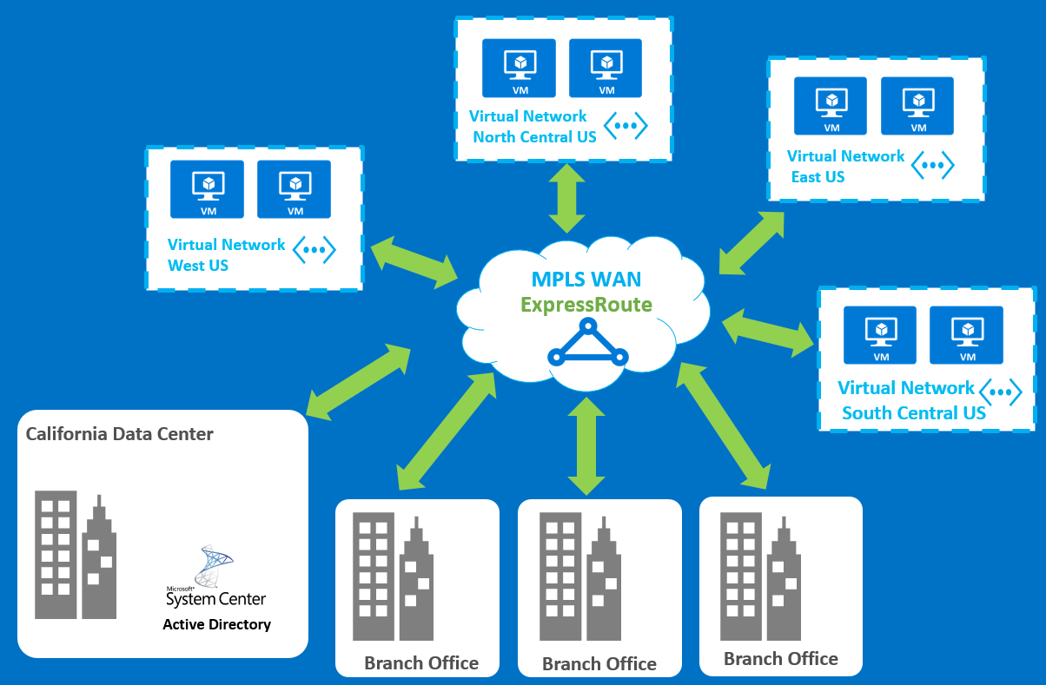
Potential Solution
Deploying ExpressRoute Over an Existing MPLS Network
Notes:
Fabrikam Residences went with Azure ExpressRoute. They already had a relationship with a Network Service Provider and their MPLS WAN was already in place so it made logical sense to extend their network with Azure. ExpressRoute provides the secure and private connection they need to ensure the privacy of their customer records along with the high speed and low latency connectivity their workloads require.
The first step was to configure ExpressRoute by first contacting AT&T and start the onboarding process for ExpressRoute.
After a circuit was in place with their provider, the next step was to implement Azure Virtual Networks in each of the regions where they would be migrating workloads to the cloud.
They connected the virtual networks across several regions where their branch offices are located to the ExpressRoute circuit using the PowerShell New-AzureDedicatedCircuitLink cmdlet.
20535A
8: Networking Azure Application Components

Slide 53
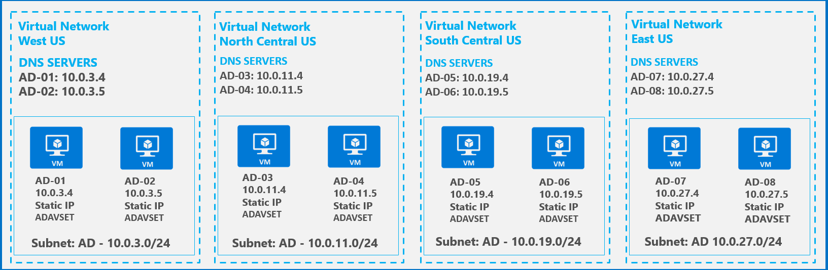
Potential Solution
Active Directory Deployment
Notes:
The next step was to deploy Active Directory in each of the regions. Each Active Directory DC should be deployed with a static IP into a subnet that does not contain non-static IP based VMs. There should be at least two DCs for redundancy and deployed into an availability set. An Active Directory site should be configured so authentication requests stay local.
20535A
8: Networking Azure Application Components

Slide 54
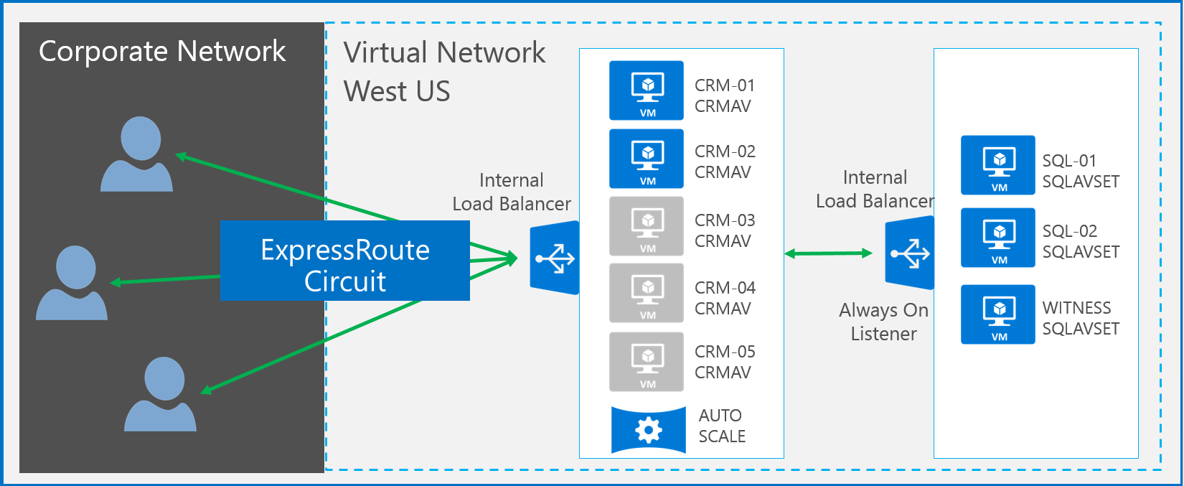
Potential Solution
CRM Webservers deployment
Notes:
The final step was to architect the solution for their CRM solution to ensure it met the requirements of being secure, highly available, and easily scalable for peak demand. The CRM web servers are deployed into an availability set and auto scale is configured to avoid over provisioning. Access to CRM is through an internally load-balanced endpoint and the SQL Server deployment uses AlwaysOn availability groups as well as an internal load balanced IP for the listener.
20535A
8: Networking Azure Application Components

Slide 55
Benefits
Security/Privacy:
Request are isolated using industry-standard VLANs. Requests do not traverse the public internet
Network Performance:
Predictable network performance since you are not competing with other traffic
Public Peering:
Private connectivity between Azure services
Cross-Region Connectivity:
Connect multiple virtual networks using the same ExpressRoute circuit
Notes:
Increased Security/Privacy and Network Performance for Enterprise Connectivity
Azure ExpressRoute provides a dedicated connection between an organizations network to Microsoft Azure through an ExpressRoute partner. Your connection is dedicated bandwidth between your infrastructure and Microsoft Azure. This committed bandwidth and additional control gives you predictable network performance.
Your connection is private. Traffic that flows between your on-premises network and Microsoft Azure does not traverse the public Internet and is isolated using industry standard VLANs. ExpressRoute connections support high throughput and low latency for some of the most bandwidth hungry applications and workloads.
For workloads where large amounts of data are leaving the Microsoft Azure data center ExpressRoute can save significant amounts of money due to the included bandwidth and lower bandwidth costs that come with an ExpressRoute circuit.
Public Peering
In addition to providing private connectivity between your on-premises network and your Azure virtual networks you can enable public peering which provides private connectivity to a number of Azure public services.
Cross Region Connectivity
Azure ExpressRoute makes it simple to connect multiple virtual networks to the same ExpressRoute circuit as long as the virtual networks are on the same continent. This allows you to extend your on-premises network to multiple Azure regions.
20535A
8: Networking Azure Application Components

Slide 56
Benefits
Network Service Provider Model:
Existing provider is responsible for establishing connectivity to Azure
Notes:
Network Service Provider Model of ExpressRoute Provides a Simple Integration Point
Fabrikam already has an existing MPLS VPN with a Network Service Provider. With ExpressRoute choosing the Network Service Provider model the provider is responsible for onboarding your network into Azure. They take care of the routing configuration and ensuring everything works. You are still responsible for choosing your service tier and creating the circuit in Azure that they will setup. Bandwidth options for a Network Service Provider range from 10 Mbps all the way up to 1 Gbps. With a network service provider bandwidth is unlimited and not separately charged.
When a virtual network in Azure is configured in this manner the virtual network will be accessible to you just like any other site on your wide area network.
20535A
8: Networking Azure Application Components

Slide 57
Customer Quote
“With our Microsoft cloud infrastructure, we have reduced our IT costs by 75 percent and gotten out of the business of owning so much IT stuff” Craig Jones, CIO Fabrikam Residences
Notes:
20535A
8: Networking Azure Application Components

Slide 58
Lab: Deploying Network Components for Use in Azure Solutions
Exercise 1: Creating an ARM Template for a Linux VM Exercise 2: Duplicating the VM Resources Exercise 3: Creating a Load Balancer Resource Exercise 4: Cleanup Subscription
Logon Information
Virtual machine: 20535A-SEA-ARCH
User name: Admin
Password: Pa55w.rd
Estimated Time: 60 minutes
Notes:
This lab assumes that students have their own Azure subscriptions that do not contain any existing cloud services, storage accounts, or Azure SQL Database servers.
Azure is continually improving, so the user interface might have been updated since this lab was written. Before students start the lab, make them aware of any differences between the steps described in the lab and the current user interface.
Exercise 1: Creating an ARM Template for a Linux VM
Exercise 2: Duplicating the VM Resources
Exercise 3: Creating a Load Balancer Resource
Exercise 4: Cleanup Subscription
20535A
8: Networking Azure Application Components

Slide 59
Lab Scenario
Your newest client has purchased a third-party web application that they have been custom branded and is ready for deployment. The web application is hosted on Linux servers using nginx as the web server. The CTO of your client’s company has specifically requested that the solution is triple-redundant at a minimum with three load-balanced machines hosting the web application.
Notes:
20535A
8: Networking Azure Application Components

Slide 60
Lab Review
When you create a load balancer, how should you probe your servers to ensure they are available?
Notes:
Question
When you create a load balancer, how should you probe your servers to ensure they are available?
Answer
The answer depends on whether or not you are talking about an application server, web server or other third-party solution. A web server could respond to a simple HTTP ping while other servers will have different ports open and available.
20535A
8: Networking Azure Application Components

Slide 61
Module Review and Takeaways
Review Questions
Notes:
Review Questions
Question
What one of these choices correctly lists the hierarchical topology of an Azure Virtual Network?
( ) Option 1: Azure Region -> VNet -> Subnet -> Azure VM NIC
( ) Option 2: VNet -> across Azure Regions - > Azure VM NIC ->Subnet
( ) Option 3: VNet -> across Azure Regions -> Subnet -> Azure VM NIC
( ) Option 4: Azure VM NIC -> Subnet -> VNet -> Azure Region
Answer
( √) Option 1: Azure Region -> VNet -> Subnet -> Azure VM NIC
( ) Option 2: VNet -> across Azure Regions -> Subnet -> Azure VM NIC
( ) Option 3: VNet -> across Azure Regions -> Subnet -> Azure VM NIC
( ) Option 4: Azure VM NIC -> Subnet -> VNet -> Azure Region
Question
Which of features listed below is NOT a feature of Azure Application Gateway?
( ) Option 1: Azure Application Gateway provides a Web Application Firewall
( ) Option 2: Azure Application Gateway provides HTTP to HTTPS redirection
( ) Option 3: Azure Application Gateway handles all TCP and UDP connections
( ) Option 4: Azure Application Gateway allows for URL redirection capabilities
( ) Option 5: Azure Application Gateway handles SSL offloading capabilities
Answer
( ) Option 1: Azure Application Gateway provides a Web Application Firewall
( ) Option 2: Azure Application Gateway provides HTTP to HTTPS redirection
( √) Option 3: Azure Application Gateway handles all TCP and UDP connections
( ) Option 4: Azure Application Gateway allows for URL redirection capabilities
( ) Option 5: Azure Application Gateway handles SSL offloading capabilities
20535A
8: Networking Azure Application Components
(More notes on the next slide)

Slide 62
Notes:
Question
If your Azure application workload requires a hybrid network connectivity, with guaranteed SLAs, high performance, and high bandwidth capabilities, what would be the best connectivity solution to use in Azure?
( ) Option 1: Site-to-Site VPN
( ) Option 2: VNET Peering
( ) Option 3: Point-to-Site VPN
( ) Option 4: ExpressRoute
Answer
( ) Option 1: Site-to-Site VPN
( ) Option 2: VNET Peering
( ) Option 3: Point-to-Site VPN
( √) Option 4: ExpressRoute
20535A
8: Networking Azure Application Components

