Slide 1
Module 9
Managing Security & Identity for Azure Solutions
Notes:
Presentation: 75 minutes
Lab: 60 minutes
After completing this module, students will be able to:
Integrate their existing solutions with external identity providers using Azure AD B2B or B2C.
Design a hybrid identity solution.
Determine when to use advanced features of Azure AD such as Managed Service Identity, MFA and Privileged Identity Management.
Secure application secrets using Key Vault.
Secure application data using SQL Database and Azure Storage features.
Required materials
To teach this module, you need the Microsoft PowerPoint file: 20535A_00.pptx.
Preparation tasks
To prepare for this module, you should:
Read all of this module’s materials.
Practice performing the demonstrations and labs.
Work through the Module Review and Takeaways section to determine how you will use the information to reinforce student learning and promote knowledge transfer to on-the-job performance.
As you prepare for this class, it is imperative that you complete the labs yourself. This gives you an understanding of how the labs work and the concepts that each covers, so that you can provide meaningful hints to students who might have issues. Furthermore, it will help guide your lecture to ensure that you discuss the concepts that the lab covers.
The Azure portal is continually being improved, and the user interface might have updated since this module was written. Therefore, before teaching this module, familiarize yourself with the latest version of the Azure portal.
20535A
9: Managing Security & Identity for Azure Solutions

Slide 2
Module Overview
Security Identity
Notes:
20535A
9: Managing Security & Identity for Azure Solutions

Slide 3
Lesson 1: Security
Platform Security Securing the Azure Platform
Notes:
20535A
9: Managing Security & Identity for Azure Solutions

Slide 4

Platform Security
Security Responsibility is SHARED
Microsoft Azure is built with end-to-end security in mind, besides trust. Microsoft gives you a secure foundation, as well as the tooling to control your environment
Customers own responsibility of their subscription governance, data, identities, and how to protect those. In IAAS, customer owns more control than in PAAS or SAAS
Notes:
20535A
9: Managing Security & Identity for Azure Solutions

Slide 5
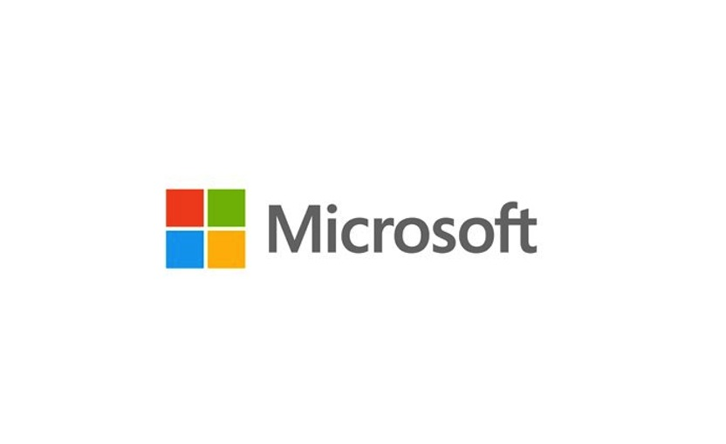

Public Cloud Security
Customer’s PAAS Workloads (Azure Apps, ML, SQL, Functions, Data,…)
Customer’s IAAS Workloads (Networking, Storage, VMs, Backup, ASR,…)
Physical Hypervisor layer
Physical Datacenter Access Security (=the buildings)
Notes:
20535A
9: Managing Security & Identity for Azure Solutions

Slide 6
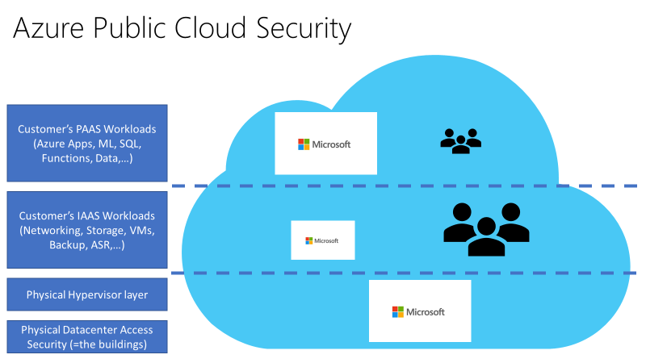
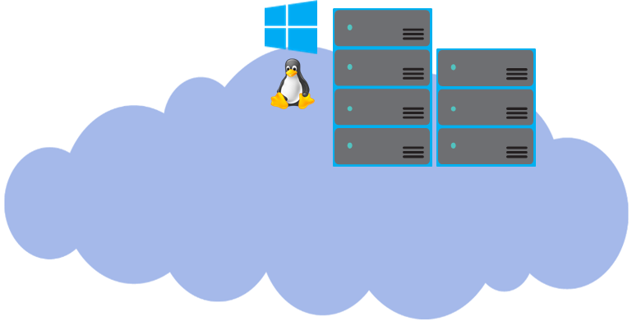
Cloud Platform Security
- Each Azure Tenant is isolated from all other tenants, using “Azure Fabric Controller”
- Azure datacenters are mainly based on Microsoft proprietary hardware, running an Azure-host-specific version of Hyper-V
Customer A
Customer B
Notes:
20535A
9: Managing Security & Identity for Azure Solutions

Slide 7







Platform Encryption Scenarios
Microsoft Azure
Admin operational sessions to the Azure platform are encrypted
All communication between Azure Regions is encrypted
Hybrid connectivity (Site-to-Site VPN or ExpressRoute) is encrypted
Microsoft Azure
Notes:
This is a basic diagram, detailing the Architecture and required Azure Backup components, when you want to backup Files & Folders only:
Deploy the Azure Backup Agent (Azure Recovery Services Agent) on the VM guests running on-premises Hyper-V / SCVMM / Vmware / Physical infrastructure
Configure Azure Backup from within the VM guest
Configure the integration with Azure Backup Vault
Run the Backup job from within the VM guest
Files & Folders backup will be stored in Azure Backup Vault, and can be restored from there.
20535A
9: Managing Security & Identity for Azure Solutions

Slide 8
Data Encryption Scenarios
On top of the Azure Platform provided encryption, customers have additional levels of encryption techniques available, depending on the Azure Resource or Data type:
Offline disk shipment: only encrypted disks are accepted
SQL Azure provides database content encryption (SQL DB TDE)
Azure Storage Accounts can be encrypted
Azure VMs (guests) allow Bitlocker encryption
Azure Backup, Azure Recovery Vault data is stored encrypted
Archive Data (data at rest) allows encryption
Notes:
20535A
9: Managing Security & Identity for Azure Solutions

Slide 9
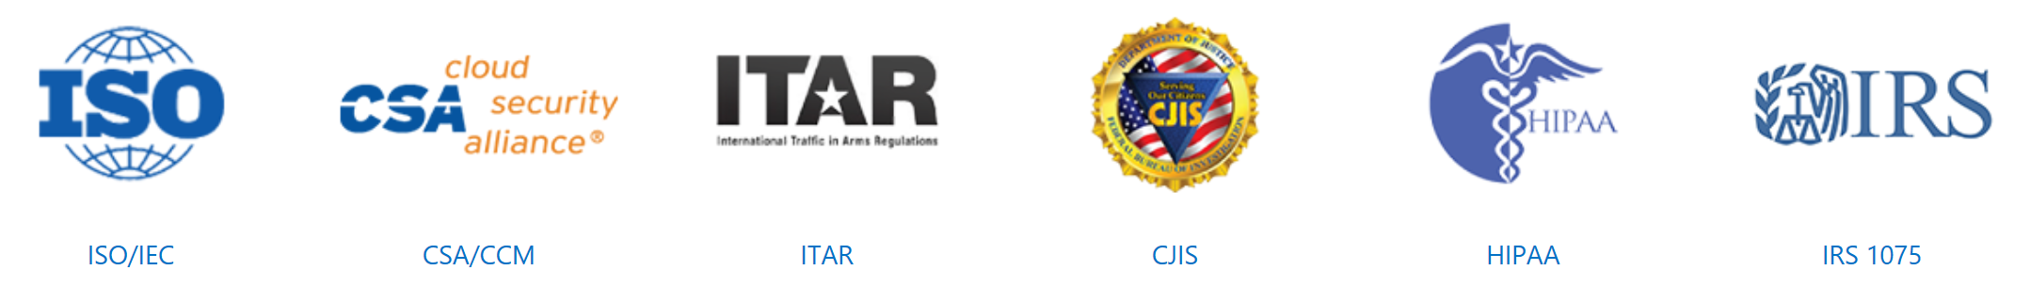
Compliance & Certifications
Security
Services are built from the ground up, to help safeguard customer data
Privacy
Compliance
Policies and processes help keep customer data private and in their control
Industry-verified compliance conformity and certifications
Transparency
Azure practices, policies and guidelines are public, clear and accessible
Notes:
Broad set of international and industry-specific compliance standards, such as ISO 27001, HIPAA, FedRAMP, SOC 1 and SOC 2, as well as country/region-specific standards like Australia IRAP, UK G-Cloud, and Singapore MTCS. Rigorous third-party audits, such as by the British Standards Institute, verify Azure’s adherence to the strict security controls these standards mandate.
20535A
9: Managing Security & Identity for Azure Solutions

Slide 10
Securing the Azure Platform
Azure Subscription Governance
Limit Admin Access using RBAC (Role Based Access Control)
Limit VM Admin Access using JIT (Just in Time) Access
Enable (force) Multi-factor Authentication for Azure Admin Accounts
Customize RBAC roles where needed for your organizational compliance
Notes:
20535A
9: Managing Security & Identity for Azure Solutions

Slide 11
Securing the Azure Platform
Azure Storage Accounts:
Enable Storage Account Encryption:
using your encryption keys
Access Keys:
key1/key2 -> regenerate periodically
Shared Access Signatures (SAS) to narrow Application service access to the storage object and data
Storage Access Policies:
timestamp
permissions
Notes:
20535A
9: Managing Security & Identity for Azure Solutions

Slide 12
Securing the Azure Platform
Azure SQL-as-a-Service:
Apply RBAC to limit SQL Resources Admin-level access
Be cautious with the “Allow Azure Services” access
Features:
SQL Database Encryption At Rest (TDE)
SQL Database Encryption In Transit
SQL Auditing & Threat Detection
SQL Dynamic Data Masking
SQL Row Level Security
SQL Vulnerability Assessment
Notes:
20535A
9: Managing Security & Identity for Azure Solutions

Slide 13
Securing the Azure Platform
Azure Networking:
Isolate VM traffic by deploying multiple VNETs and separate Subnets within
Use Network Security Groups to limit traffic allow/deny
Integrate Forced Tunneling, User Defined Routing to control traffic outside from the default Azure Routes
Explore Azure Marketplace Virtual Appliances:
Load Balancers
Firewalls
Notes:
20535A
9: Managing Security & Identity for Azure Solutions

Slide 14
Securing the Azure Platform
Azure Key Vault:
Security Keys are stored in a vault and invoked by URI when needed
Keys are safeguarded by Azure, using industry-standard algorithms, key lengths, and hardware security modules (HSMs)
Keys are processed in HSMs that reside in the same Azure datacenters as the applications.
Notes:
20535A
9: Managing Security & Identity for Azure Solutions

Slide 15





Azure Key Vault
Developer accesses the Keys using URI request
Microsoft Azure
Azure Admin manages Azure Key Vault and generates keys
Keys are securely stored in Azure Key Vault
Security Officer inspects where Keys are being used
Notes:
20535A
9: Managing Security & Identity for Azure Solutions

Slide 16
Lesson 2: Identity
Azure Active Directory Azure AD Authentication Strategies Azure AD B2B & B2C Azure AD Identity Protection Azure AD Domain Services
Notes:
20535A
9: Managing Security & Identity for Azure Solutions

Slide 17
Azure Active Directory
Long gone is the time where all/most applications were “only” AD integrated
Microsoft Azure
Active Directory
=>
Windows Server Active Directory
User identities from multiple repositories
Hybrid
identity
LOB App Servers
On-Premises ADDS
LDAP v3
Windows PowerShell
Windows Server Active Directory
LOB Web Servers
File Shares, Printers,…
Web services
(SOAP, Java, REST)
Generic SQL via ODBC
Notes:
Get STS Token from Azure AD.
Return STS Token to Client/Application.
Request resource using trusted STS Token.
SSO Can be implemented in your custom applications too.
20535A
9: Managing Security & Identity for Azure Solutions

Slide 18
Cloud Authentication
The “cloud way of authenticating:
Azure ADConnect using Password Hash Sync
Azure ADConnect using Federation (ADFS)
Azure ADConnect using Azure AD Passthrough Authentication Agent
Notes:
20535A
9: Managing Security & Identity for Azure Solutions

Slide 19



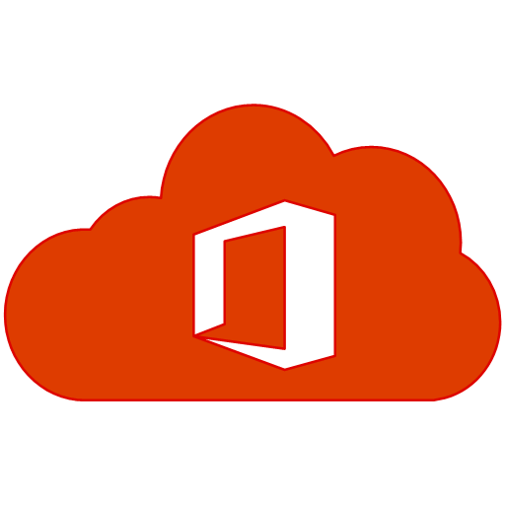



Single Sign-On
3rd Party Web Applications
Implement SSO Everywhere
Intranet Applications
Windows 10 Desktop
IoT Devices
Mobile Applications
Cloud Applications
Azure AD
Directory Sync
STS (Trust)
Security Token
Notes:
20535A
9: Managing Security & Identity for Azure Solutions

Slide 20



Azure AD Application Proxy
Microsoft Azure
Active Directory
Application
Proxy
https://appX-mydomain.msappproxy.net/
connector
Azure or 3rd Party IaaS
DMZ
connector
connector
connector
app
app
app
app
Notes:
Azure AD app proxy is a cloud service that allows users to access on-premises apps securely.
Users connect to the cloud service that routes traffic to the applications via “connectors.”
Connectors are usually deployed inside the corporate network, next to the applications.
Users connect to the cloud service that routes their traffic to application resources via the connectors.
20535A
9: Managing Security & Identity for Azure Solutions

Slide 21
Azure AD Authentication Strategies
In any of the “cloud” scenarios, AD Connect User/Group object sync is required
Replaces legacy tools:
DirSync, ADSync, FIM with AD Connector
Benefits:
Allows for write-back (passwords, devices, groups) to on-premises AD
Built-in deployment wizard for on-premises ADFS infrastructure
Azure AD Connect Synchronization Services dashboard
Managed user sign-in options
Notes:
In any of the “cloud” scenarios, ADConnect User/Group object sync is required.
Replaces legacy tools (DirSync, ADSync, FIM with AD Connector).
Additional benefits:
• Allows for Write-Back (passwords, devices, groups) to on-premises AD.
• Built-in deployment wizard for on-premises ADFS infrastructure (custom deploy).
• Azure ADConnect Synchronization Services dashboard for logging & troubleshooting.
• Manages User Sign-in options.
20535A
9: Managing Security & Identity for Azure Solutions

Slide 22
Azure AD Connect
1st option: Identity + Password (Hash) synchronization
Microsoft Azure
Active Directory
User
Identity +
Password Hash synchronization
Azure Active Directory authenticates user
Notes:
20535A
9: Managing Security & Identity for Azure Solutions

Slide 23
Azure AD Connect
2nd option: Identity synchronization + ADFS
Microsoft Azure
Active Directory
User
Identity synchronization
Authentication passed to Windows Server Active Directory via ADFS
ADFS
Notes:
20535A
9: Managing Security & Identity for Azure Solutions

Slide 24
Azure AD Connect
New option: Identity synchronization + Pass-through authentication with Seamless SSO
Microsoft Azure
Active Directory
User
Identity synchronization
Pass-through
authentication
Seamless SSO
Authentication passed to Windows Server Active Directory via Pass-through authentication
Pass-through authentication agent
Notes:
20535A
9: Managing Security & Identity for Azure Solutions

Slide 25
Azure AD Connect
Seamless SSO is now enabled for the 1st option, too: Identity + Password (Hash) synchronization
Microsoft Azure
Active Directory
User
Identity +
Password Hash synchronization
Azure Active Directory authenticates user
Seamless SSO
Notes:
20535A
9: Managing Security & Identity for Azure Solutions

Slide 26
Azure AD Connect
More options than ever!
Identity Synchronization + Password Hash Synchronization+
Seamless SSO
Identity Synchronization + ADFS
Identity Synchronization + Pass-through Authentication + Seamless SSO
Microsoft Azure
Active Directory
User
Seamless SSO
ADFS
Seamless SSO
Identity synchronization
Identity +
Password Hash synchronization
Identity synchronization
Pass-through
Authentication
Notes:
20535A
9: Managing Security & Identity for Azure Solutions

Slide 27

Hybrid Identity
Consolidated deployment assistant for your identity bridge components
All currently available sync engines will be replaced by the sync engine included in the Connect tool
Assisted deployment of ADFS will be available through Azure Active Directory Connect
ADFS is an optional component for authentication in hybrid implementation. Password sync can replace ADFS for more scenarios
DirSync
Azure Active Directory Connect
Azure Active Directory Sync
Sync engine
FIM+Azure Active Directory Connector
ADFS
ADFS
Notes:
20535A
9: Managing Security & Identity for Azure Solutions

Slide 28
Azure AD B2B & B2C
B2B (Business to Business):
Collaborate between organizations
Avoid federation and extra servers
B2C (Business to Customer):
Use their existing identities
Avoid creating additional identities
MFA (Multi-Factor Authentication):
Further authenticate users
Avoid compromises due to simple password constraints
Notes:
20535A
9: Managing Security & Identity for Azure Solutions

Slide 29
Azure AD B2B
Inviting users from other Azure AD Tenants into your own organization tenant
User provisioning is done by the invited party
You as an organization are in control to invite the other side’s user
Notes:
Your employees need to collaborate with partners:
Easily share data and applications with the right people in the right companies.
Your Partners want simplicity:
No new accounts to manage, no federation to configure, No servers to install.
Admins want security control and oversight:
Granular auditing and monitoring of partner access.
20535A
9: Managing Security & Identity for Azure Solutions

Slide 30



Azure AD B2C
Inviting users from other social media Identity Tenants (e.g. Facebook, Twitter, Google, LinkedIn, Microsoft Account) into your own organization tenant
User provisioning is done by the invited party
You as an organization are in control to invite the other side’s user
Notes:
20535A
9: Managing Security & Identity for Azure Solutions

Slide 31
Multi-Factor Authentication
What is it?:
An authentication method, which requires an additional validation item, besides your username and password combination:
Text message
Azure Authentication App
How does MFA work?
Requires 2 or more (configurable) account validation options:
Something you know (typically user/password combination)
Something you have (Mobile authenticator app)
Notes:
20535A
9: Managing Security & Identity for Azure Solutions

Slide 32
Azure AD Identity Protection
Automatic detection of vulnerabilities in your organization’s identity objects (e.g., compromised user accounts)
Define configuration alerts and automatic responses (runbooks), to detected suspicious and malicious actions that occur in your organization’s identity solution
Recognize, audit and inspect suspicious activity, and take appropriate action to resolve them
Notes:
20535A
9: Managing Security & Identity for Azure Solutions

Slide 33
Azure AD Privileged Identity Management
Detect privileged users in Azure Active Directory
Enable “Just-in-time” administrative level access to Microsoft Cloud Services
Detailed reporting related to who got what administrative access level
Automatically give users permission to have permanent admin-level right access, or allow for self-service group membership
Notes:
20535A
9: Managing Security & Identity for Azure Solutions

Slide 34
Azure AD Domain Services
Some (non-cloud native) applications don’t “speak” cloud:
The application relies on Active Directory protocols (LDAP, Kerberos,…)
Azure AD doesn’t provide Group Policies
Azure AD doesn’t provide Organizational Units
You cannot “join” servers into an Azure AD Tenant
Notes:
20535A
9: Managing Security & Identity for Azure Solutions

Slide 35
Azure AD Domain Services
Key Characteristics:
Provides a compatibility layer for Active Directory integrated applications, on top of Azure AD
Takes resources from Azure AD to “emulate” an Active Directory domain (users, groups, memberships, passwords, limited GPOs)
One AAD DS per Azure AD
High Availability built-in
Notes:
20535A
9: Managing Security & Identity for Azure Solutions

Slide 36

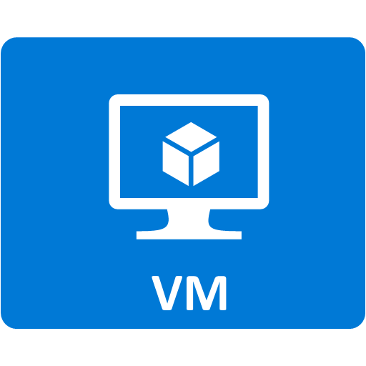

Azure AD Domain Services
Azure
Azure AD Domain Services
Azure AD
Azure AD Connect
Azure ADDS domain joined
Notes:
On the left side, we have our typical, trusted On-Premises Active Directory Domain Controllers.
These DCs sync user/group objects to Azure AD, using Azure AD Connect sync tool .
Within Azure, we define a specific VNet in Classic Azure; here, we also configure AAD Domain Services, and link it to this Classic Vnet.
AAD Domain Services user/group objects can be created manually, but preferably synced from Azure AD.
VMs in Azure can be “domain joined” to the AAD Domain Services domain, in the exact same way as it occurs on-premises.
20535A
9: Managing Security & Identity for Azure Solutions

Slide 37
Lab: Deploying Services to Secure Secrets in Azure
Exercise 1: Deploying Key Vault using ARM Template Exercise 2: Deploying Virtual Machine using Key Vault Secret Exercise 3: Cleanup Subscription
Logon Information
Virtual machine: 20535A-SEA-ARCH
User name: Admin
Password: Pa55w.rd
Estimated Time: 60 minutes
Notes:
This lab assumes that students have their own Azure subscriptions that do not contain any existing cloud services, storage accounts, or Azure SQL Database servers.
Azure is continually improving, so the user interface might have been updated since this lab was written. Before students start the lab, make them aware of any differences between the steps described in the lab and the current user interface.
Exercise 1: Deploying Key Vault using ARM Template
Exercise 2: Deploying Virtual Machine using Key Vault Secret
Exercise 3: Cleanup Subscription
20535A
9: Managing Security & Identity for Azure Solutions

Slide 38
Lab Scenario
A local credit union client has been excitedly using Azure Resource Manager to deploy virtual machines to the cloud with ARM templates. Unfortunately, they quickly discovered that sending virtual machine passwords as part of the JSON object in an HTTP request body violates some of their industry’s best practices. While they already use SSL for in-flight request security, they would like to use the Azure Key Vault to store their virtual machine passwords moving forward. The client has hired you to put together a prototype showing them how to accomplish this task.
Notes:
20535A
9: Managing Security & Identity for Azure Solutions

Slide 39
Lab Review
What type of secrets could you store for container-based VMs in an Azure Key Vault?
Notes:
Question
What type of secrets could you store for container-based VMs in an Azure Key Vault?
Answer
You can store:
Application secrets
Authentication information
Third-party service keys
Azure service connection strings and keys
Many others…
20535A
9: Managing Security & Identity for Azure Solutions

Slide 40
Module Review and Takeaways
Review Question
Notes:
Review Question
Question
What are some scenarios where you would prefer natively authenticating to Azure AD over using federation or hybrid identity?
Answer
Cloud-native applications is typically the example cited most often when discussing native Azure AD authentication.
20535A
9: Managing Security & Identity for Azure Solutions

