Slide 1
Module 11
Integrating Azure Solution Components Using Messaging Services
Notes:
Presentation: 60 minutes
Lab: 60 minutes
After completing this module, students will be able to:
Compare Storage Queues to Service Bus Queues.
Identify when to use Azure Functions or Logic Apps for integration components in a solution.
Describe the differences between IoT Hubs, Event Hubs and Time Series Insights.
Required materials
To teach this module, you need the Microsoft PowerPoint file: 20535A_10.pptx.
Preparation tasks
To prepare for this module, you should:
Read all of this module’s materials.
Practice performing the demonstrations and labs.
Work through the Module Review and Takeaways section to determine how you will use the information to reinforce student learning and promote knowledge transfer to on-the-job performance.
As you prepare for this class, it is imperative that you complete the labs yourself. This gives you an understanding of how the labs work and the concepts that each covers, so that you can provide meaningful hints to students who might have issues. Furthermore, it will help guide your lecture to ensure that you discuss the concepts that the lab covers.
The Azure portal is continually being improved, and the user interface might have updated since this module was written. Therefore, before teaching this module, familiarize yourself with the latest version of the Azure portal.
20535A
11: Integrating Azure Solution Components using Messaging Services

Slide 2
Module Overview
Event Messaging Integration Internet of Things (IoT)
Notes:
20535A
11: Integrating Azure Solution Components using Messaging Services

Slide 3
Lesson 1: Event Messaging
Storage Queues Service Bus Event Grid
Notes:
20535A
11: Integrating Azure Solution Components using Messaging Services

Slide 4
Storage Queues
devqueue
QueueClient
account
SAS TOKEN
message
queue
account
Notes:
20535A
11: Integrating Azure Solution Components using Messaging Services

Slide 5
Queue Message Handling
Create/Delete Queue
Measure Queue Length
Insert Message into Queue
Retrieve the Next Message
Extend Message Lease
Peek at the Next Message
Update a Message
Delete a Message
Notes:
Create/Delete Queue
Create a new queue instance or remove an existing one.
Measure Queue Length
Get an estimate of the number of messages in the queue.
Insert Message into Queue
New messages added to the queue.
Retrieve the Next Message
A copy of the next available message is retrieved and the message is made invisible for a specific duration.
Extend Message Lease
More time to process a retrieved queue message.
Peek at the Next Message
Retrieve a copy of the next available message in the queue without making the message invisible.
Update a Message
Contents of a retrieved message can be updated in the queue.
Delete a Message
Delete the message from the queue.
20535A
11: Integrating Azure Solution Components using Messaging Services

Slide 6
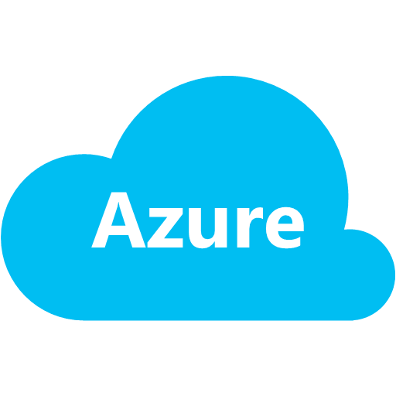
Storage Access Control
Application
1. Request SAS Token
2.Generated SAS Token
3. Storage request with SAS Token.
SAS Token Service
4. Response
Storage
Notes:
Reference valet-key pattern here.
20535A
11: Integrating Azure Solution Components using Messaging Services

Slide 7
Service Bus
Service Bus is a managed messaging infrastructure:
Massive in scale and completely managed
Allows you to scale out your applications and consumers knowing that the messaging platform will scale out with your application
Allows decoupled components to communicate asynchronously and synchronously
Notes:
20535A
11: Integrating Azure Solution Components using Messaging Services

Slide 8
Service Bus Queues
Service Bus queues offer a brokered messaging communication model:
Distributed applications can share messages in a First In First Out (FIFO) pattern
Individual messages are only received by one message consumer
Service Or Application
Queue
Web App
Mobile App
Service
Message Receiver
Service Bus Namespace
Message Sender
Notes:
The Service Bus queues are tailored to be general-purpose for different types of distributed applications.
20535A
11: Integrating Azure Solution Components using Messaging Services

Slide 9
Service Bus Relay
Relays provide a mechanism to connect distributed client applications or cloud services to a projected on-premises endpoint:
It allows for unidirectional or bi-directional communication
It relays messages directly to an endpoint without any brokering of the message
Applications establish an outbound connection to the relay and the relay manages the transport of the messages
Notes:
Emphasize that relays pass messages around and are not intended for message storage.
Although most examples show relays being used to create public endpoints for on-premises services, relays can be used with cloud services.
20535A
11: Integrating Azure Solution Components using Messaging Services

Slide 10
Service Bus Relay
Service Bus Relay
Service Application
Send/Receive
Client Application
Client Application
Notes:
The service application creates an outbound connection with the Service Bus Relay using the binding, their Service Bus namespace, and a relative name for the relay. The Service Bus creates a relay at this point and then one or more client applications create an outbound connection to the relay using the same connection details. The relay is disposed when all of the clients and the service applications are disconnected from the endpoint.
20535A
11: Integrating Azure Solution Components using Messaging Services

Slide 11

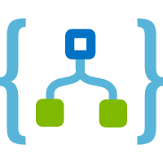
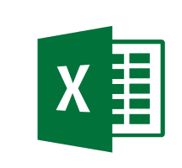



Event Grid
Notes:
Event Grid integrates data sources with client applications that intend to consume events from those sources.
This example shows an application that has an operation (or request), it then publishes an event that is subscribed to by a Logic App, Function App, custom application server and an Excel instance. Each client processes the message in a unique manner.
20535A
11: Integrating Azure Solution Components using Messaging Services

Slide 12
Event Grid and ARM Integration
Automate Operations:
Event Grid can publish ARM events including:
Resource creation
Resource modification/deletion
Deployment of multiple resources to a resource group
Creation or deletion of a resource group
Azure services can respond to an Event Grid resource-based event by performing automation actions:
A Logic App can modify a newly created database
Azure Automation can manage a new VM
Metadata about a resource deployment can be stored in Azure Storage using an Azure Function
Notes:
20535A
11: Integrating Azure Solution Components using Messaging Services

Slide 13

Discussion
What types of application scenarios would require you to send messages from many producers to a single consumer?
Notes:
20535A
11: Integrating Azure Solution Components using Messaging Services

Slide 14
Lesson 2: Integration
Serverless Integration Notification Hubs
Notes:
20535A
11: Integrating Azure Solution Components using Messaging Services

Slide 15


Serverless Integration
Development
Platform
IDE support
Functions
Logic apps
Developer tooling
Bindings and triggers
Open source
Visual designer
100+ connectors
Functions orchestration
Visual debug history
Local development
Data/storage
Messaging
Gateway Connectors
Intelligence
Bots
Verbose debugging
Notes:
20535A
11: Integrating Azure Solution Components using Messaging Services

Slide 16
Logic Apps
Cloud APIs and platform:
Supports over 125 built-in connectors
Scales to meet your needs
Enables rapid development
Extends with custom APIs and Functions
API connections:
Authenticate once and reuse
Notes:
20535A
11: Integrating Azure Solution Components using Messaging Services

Slide 17
Logic App Connectors
SaaS
Protocols/Native
appFigures
Asana
Azure API Management
Azure App Services
Azure Automation
Azure Cognitive Face API
Azure Cognitive LUIS
Azure Cognitive Text Analytics
Azure Cognitive Vision
Azure Data Lake Store
Azure Document DB
Azure Event Hub
Azure Functions
Azure Machine Learning
Azure Resource Manager
Azure Service Bus
Azure SQL
Azure Storage Blob
Azure Storage Queues
Basecamp
Bing Search
BitBucket
Bitly
Blogger
Box
Buffer
Campfire
Chatter
Common Data Service
Disqus
DocuSign
Dropbox
Dynamics AX Online
Dynamics CRM Online
Dynamics CRM Service Bus
Dynamics Financials
Dynamics Operations
Easy Redmine
Eventbrite
Facebook
FreshBooks
Freshdesk
GitHub
Gmail
Google Calendar
Google Contacts
Google Drive
Google Sheets
Google Tasks
GoTo Meeting
GoTo Training
GoTo Webinar
Harvest
HelloSign
Infusionsoft
JIRA
Insightly
Instagram
Instapaper
MailChimp
Mandrill
Medium
Microsoft Project Online
Microsoft Translator
MSN Weather
Muhimbi PDF
Office 365
Office 365 Users
Office 365 Video
OneDrive
OneDrive for Business
OneNote
Outlook.com
Outlook Tasks
PagerDuty
Pinterest
Pipedrive
Pivotal Tracker
Power BI
Project Online
Redmine
Salesforce
Salesforce Chatter
SendGrid
SharePoint Online
Slack
SmartSheet
SparkPost
Stripe
Survey Monkey
Todoist
Toodledo
Trello
Twilio
Twitter
Typeform
UserVoice
VS Team Services
Webmerge
Wordpress
Wunderlist
Yammer
YouTube
Zendesk
HTTP, HTTPS
HTTP Webhook
FTP, SFTP
SMTP
RSS
Compose, Query, Parse JSON
Wait
Terminate
Workflow
XML Validation
Transform XML (+Mapper)
Flat File Encode
Flat File Decode
X12
EDIFACT
AS2
Integration Account Artifact Lookup
Hybrid
BizTalk Server
File System
IBM DB2
Informix
Oracle DB
SharePoint Server
SQL Server
SAP
Websphere MQ
Notes:
This is just a subset of all of the connectors available in Logic Apps.
20535A
11: Integrating Azure Solution Components using Messaging Services

Slide 18






Azure Functions
Apps
eCommerce
Digital Global Presence
Custom Apps
LOB
API / Services / ISV
App Service
Web Apps
Mobile Apps
API Apps
Functions
Fully Managed Platform
Development
Enterprise Grade
Limitless/Auto
OS and Framework
Load balance
Something else
Languages and Framework
Superior DevOps
Self served
Something else
Enterprise grade SLA
Secure and Compliance
On-Premise Connectivity
Something else
Notes:
20535A
11: Integrating Azure Solution Components using Messaging Services

Slide 19
Azure Functions
Methods of Execution:
Triggers
WebHooks
Language of Choice:
C#, F#, Node.js, Python, PHP, batch, bash, Java
Pricing Options:
Dynamic (pay-per-use)
App Service Plan
Integrations:
DocumentDB, Event Hubs, Mobile Apps (tables), Notification Hubs, Service Bus, Storage
GitHub (webhooks), On-premises (using Service Bus)
Notes:
There are more execution methods, languages and integrations not listed.
20535A
11: Integrating Azure Solution Components using Messaging Services

Slide 20

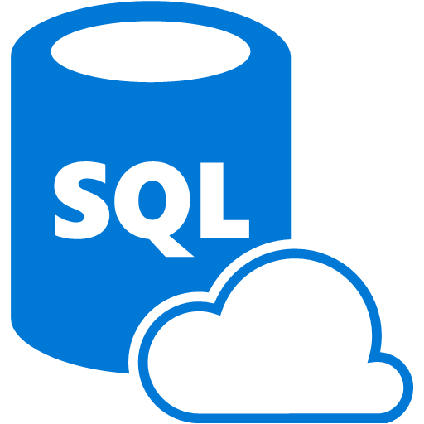

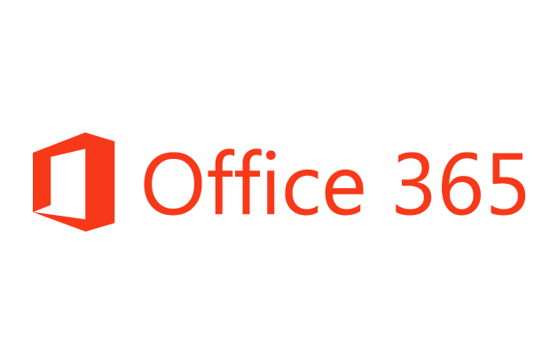
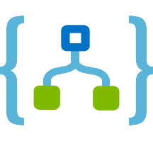
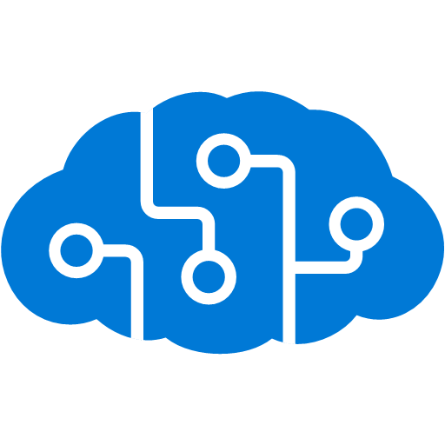
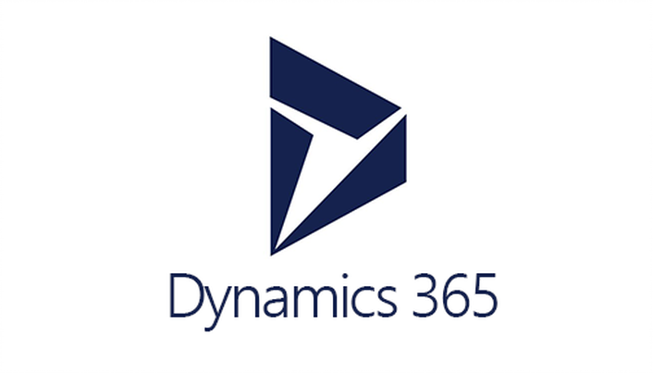


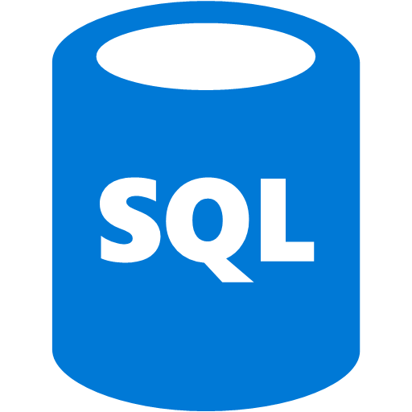
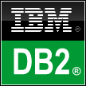


Connecting Serverless Components
Azure Functions
Service bus
Cognitive services
Logic Apps
Machine learning
On-premises data gateway
BizTalk server
Notes:
Logic Apps can serve as the central connecting point of a full integration solution.
20535A
11: Integrating Azure Solution Components using Messaging Services

Slide 21
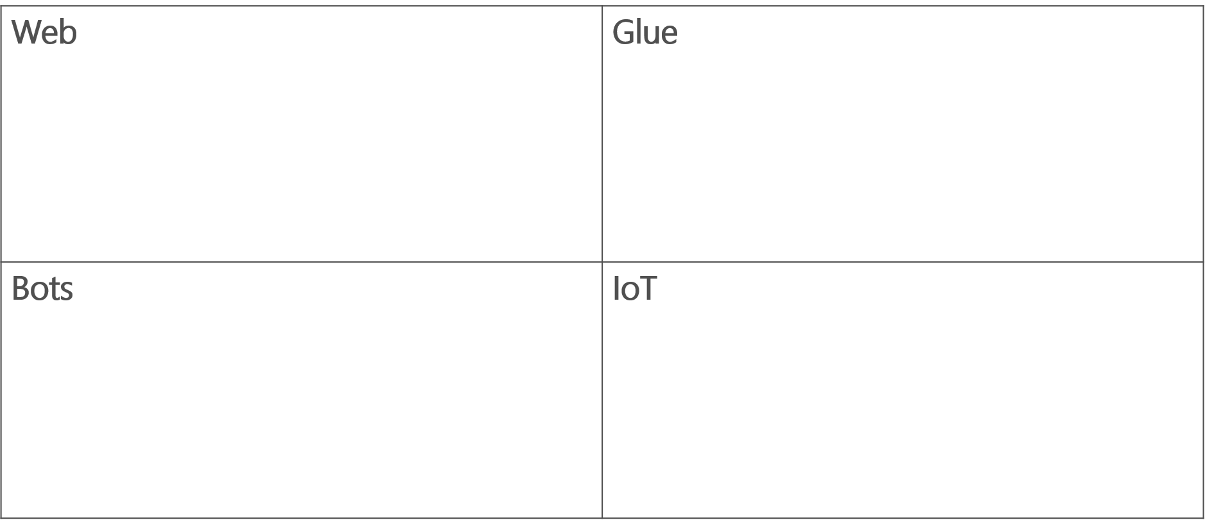
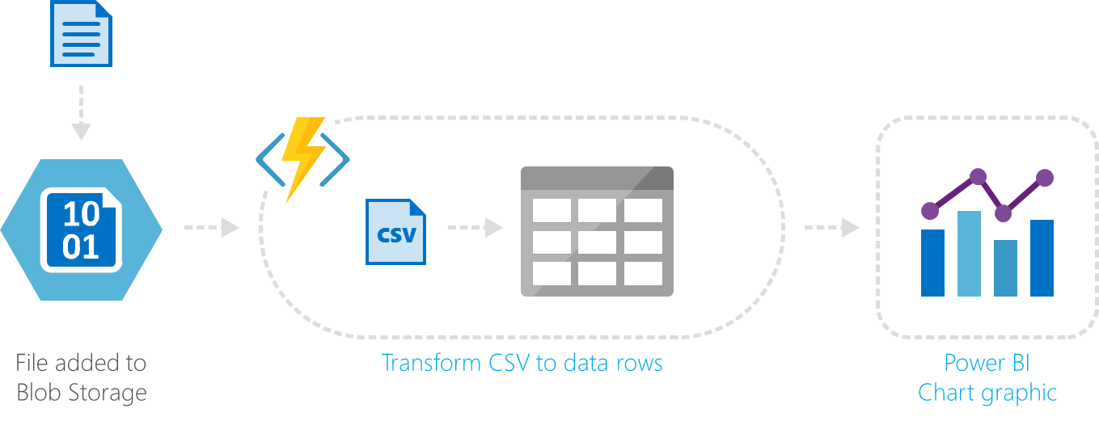
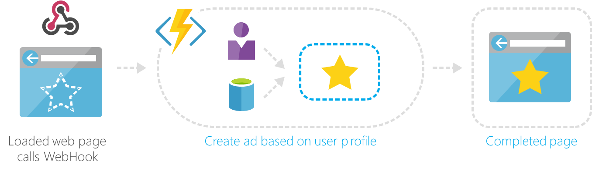
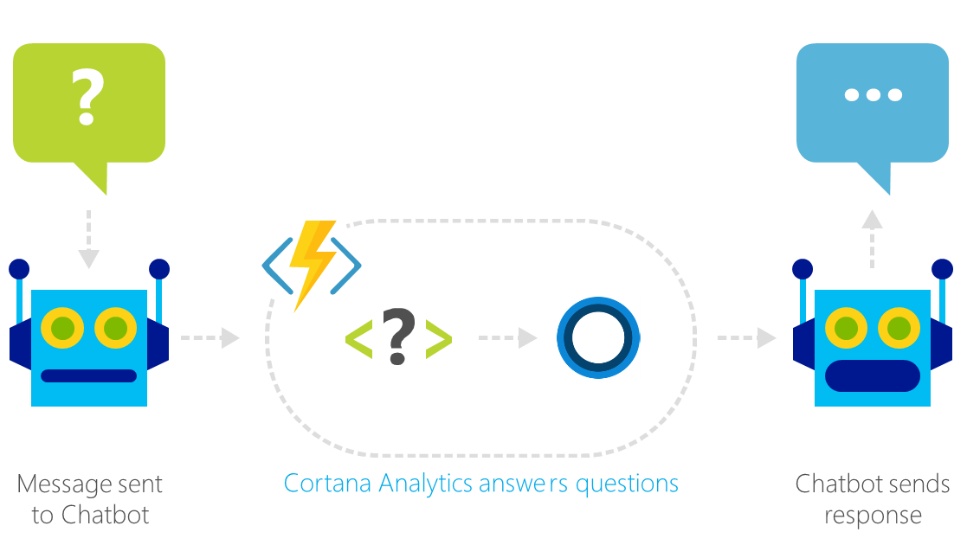
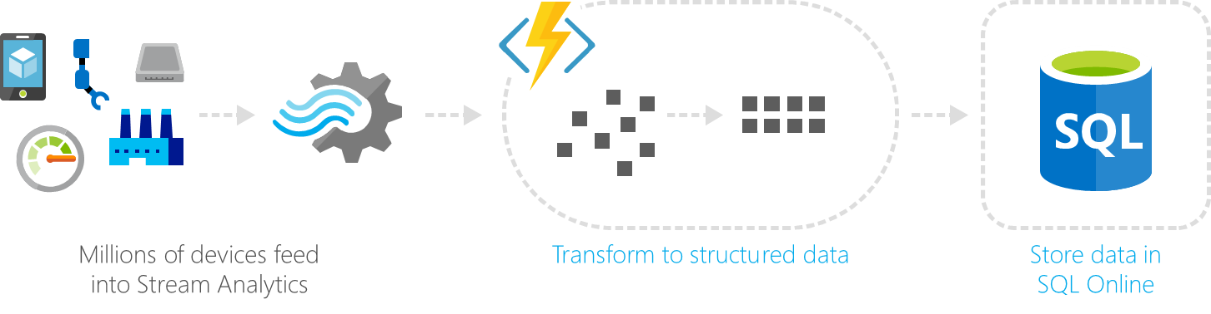
Serverless Business Scenarios
Notes:
Ask students “why” they would use serverless in some of these scenarios.
20535A
11: Integrating Azure Solution Components using Messaging Services

Slide 22
Notification Hubs
Managed infrastructure for sending push notifications to mobile devices:
Multiplatform
Scalable
Simple SDK:
Available on many major mobile platforms
Broadcast to many users or target specific users
Notes:
You can broadcast a message to a large group of users, send a message to a targeted subset of users or even notify a specific user. The platform handles the batching, transport and management of the messages.
Mention how this service is a SaaS solution.
20535A
11: Integrating Azure Solution Components using Messaging Services

Slide 23
Benefits
Managed Infrastructure:
You don’t have to worry about scaling your application yourself
You can focus on messages and templates, not the mechanics of your service
SDKs available for major platforms
Template support
Support for filtering recipients by tag
Notes:
On this slide, you should focus on the fact that the SDKs provide a very simple way to subscribe to a notification hub. The SDK code handles the different toast/notification logic for each platform.
Templates allow you to send the same message to multiple clients and have it display differently for each platform.
20535A
11: Integrating Azure Solution Components using Messaging Services

Slide 24






Platform
Register Client
Send Message
Retrieve Handle
Register Client
Send Message
Send Message
Notes:
Client devices register their PNS-handle with the application back-end. The Application back-end registers the client with the Notification Hub.
Whenever a client starts, the client retrieves its handle directly from the Platform Notification Service.
The application back-end then sends a message to the Notification Hub. The Notification Hub handles passing the message to the Platform Notification Service which in turn notifies the appropriate clients using their handles.
20535A
11: Integrating Azure Solution Components using Messaging Services

Slide 25
Discussion
How can you enhance an off-the-shelf software solution using both Logic Apps and Notification Hubs?
Notes:
Example answer:
Logic App is triggered by database (likely SQL) change.
Logic App gets metadata about transaction from database, CMS (likely SharePoint) and other sources.
Logic App persists data somewhere (Cosmos is a good fit here).
Logic App final step is to send a notification using Notification Hubs.
20535A
11: Integrating Azure Solution Components using Messaging Services

Slide 26
Lesson 3: Internet of Things (IoT)
Event Hubs
Notes:
20535A
11: Integrating Azure Solution Components using Messaging Services

Slide 27
Event Hubs
Event Hubs is a partitioned consumer messaging services:
Publish and subscribe to streams of records:
Similar to a message queue or enterprise messaging system
Store streams of records in a fault-tolerant manner
Process streams of records “as they occur”
Ideal for building applications that transform or react to streams of data
Notes:
20535A
11: Integrating Azure Solution Components using Messaging Services

Slide 28
Event Hubs
Input Streaming:
Receives high-velocity message streams in a multi-consumer group
Isolated Read:
Stores “pointers” for each reader so they can resume at a specific point-in-time in reading time-based messages from the queue
Open Protocols:
Supports AMQP 1.0
REST API for management
Notes:
With respect to Stream Input, we can use Event Hubs to receive binary message streams.
Event Hubs provide a high velocity multi-consumer queue.
20535A
11: Integrating Azure Solution Components using Messaging Services

Slide 29
Event Hubs Conceptual Diagram
Azure Event Hub
Consumer Group
Partition 1
HTTP
AMQP
Partition 2
Event Receivers
Partition 3
Consumer Group 2
Event Producers
Partition 4
Notes:
20535A
11: Integrating Azure Solution Components using Messaging Services

Slide 30
IoT Hubs
IoT Hubs builds on the features in Event Hubs by adding additional functionality that is commonly needed in IoT applicatons:
Support across a wider variety of platforms and SDKs:
Ex. JavaScript and Java Support, RTOS and ARM Platform support
Device-facing and Service-facing SDKs for registration and management
Identity and access management across all devices connected to Hub
Notes:
20535A
11: Integrating Azure Solution Components using Messaging Services

Slide 31
IoT Hubs
1
IoT Hub
(Cloud Gateway)
2
Protocol Adaptation
Direct connection (HTTP, AMQP)
Cloud Protocol Adaptation (e.g. MQTT)
Field Protocol Adaptation (e.g. DDS)
Gateway-assisted (e.g. Bluetooth LE)
Field Gateway
Protocol Adaptation
3
Devices
RTOS, Linux, Windows, Android, iOS
Field Gateway
4
Device
Connectivity & Management
Notes:
20535A
11: Integrating Azure Solution Components using Messaging Services

Slide 32
Azure IoT Device SDK
Enable simple, secure device <-> cloud connectivity & management
Client “agent” software for devices and gateways
Libraries that OEMs/SIs/ISVs can use in new and existing systems
Open source software framework
Notes:
20535A
11: Integrating Azure Solution Components using Messaging Services

Slide 33
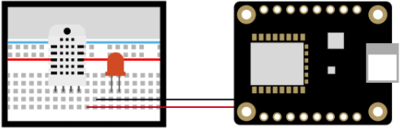

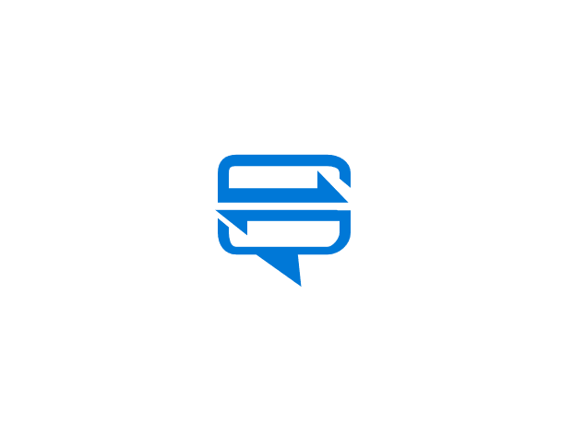
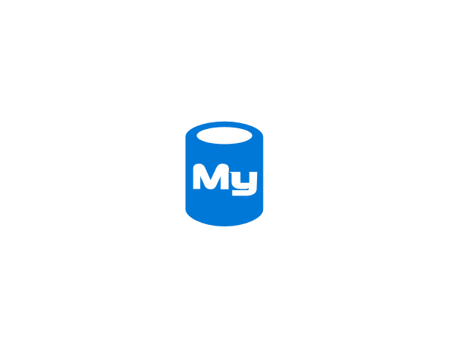

IoT Remote Monitoring
Iot Hub
Device
Notification Hub
Logic App
MySQL DB
Notes:
This diagram shows an example where messages are processed by Logic Apps and stored in long-term storage. The serverless compute can also send notifications using a PNS service.
20535A
11: Integrating Azure Solution Components using Messaging Services

Slide 34
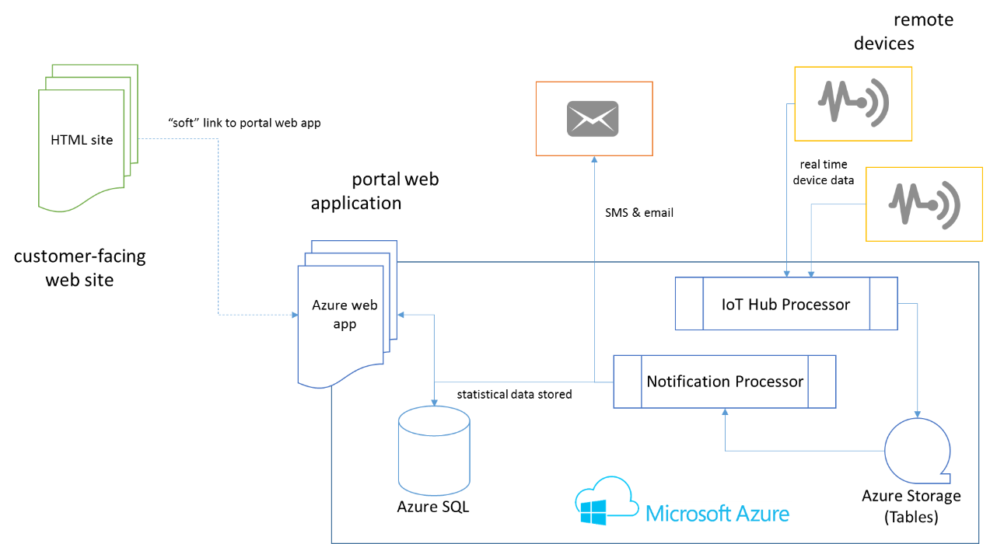
Example IoT Solution
Notes:
20535A
11: Integrating Azure Solution Components using Messaging Services

Slide 35
Lab: Deploying Messaging Components to Facilitate Communication Between Azure Resources
Exercise 1: Deploying Service Bus Namespace Exercise 2: Deploying Logic App Exercise 3: Cleanup Subscription
Logon Information
Virtual machine: 20535A-SEA-ARCH
User name: Admin
Password: Pa55w.rd
Estimated Time: 60 minutes
Notes:
This lab assumes that students have their own Azure subscriptions that do not contain any existing cloud services, storage accounts, or Azure SQL Database servers.
Azure is continually improving, so the user interface might have been updated since this lab was written. Before students start the lab, make them aware of any differences between the steps described in the lab and the current user interface.
Exercise 1: Deploying Service Bus Namespace
Exercise 2: Deploying Logic App
Exercise 3: Cleanup Subscription
20535A
11: Integrating Azure Solution Components using Messaging Services

Slide 36
Lab Scenario
An established healthcare client has used Service Bus extensively throughout the years to manage communication between their custom software components. After learning about Logic Apps, the client would like to create Logic Apps that can consume Service Bus queue messages so that they can minimize the amount of code that their team needs to write and maintain annually.
Notes:
20535A
11: Integrating Azure Solution Components using Messaging Services

Slide 37
Lab Review
What are some scenarios where non-developers in your company can gain value from using Logic Apps?
Notes:
Question
What are some scenarios where non-developers in your company can gain value from using Logic Apps?
Answer
A simple integration scenario that pulls data from a SaaS application (SharePoint, Salesforce, etc.) and acts on that data in some way will work (send an SMS message, add to SharePoint list, add to database, e-mail a listserv).
20535A
11: Integrating Azure Solution Components using Messaging Services

Slide 38
Module Review and Takeaways
Review Question
Notes:
Review Question
Question
What are some examples of B2B business scenarios where a messaging component can help facilitate communication between the two companies and their application solutions?
Answer
Answers may vary but they should include some messaging component that needs to operate in an asynchronous manner. An example could be an image gallery application that offloads the most complex image processing tasks asynchronously to a background job processing engine.
20535A
11: Integrating Azure Solution Components using Messaging Services

