Slide 1

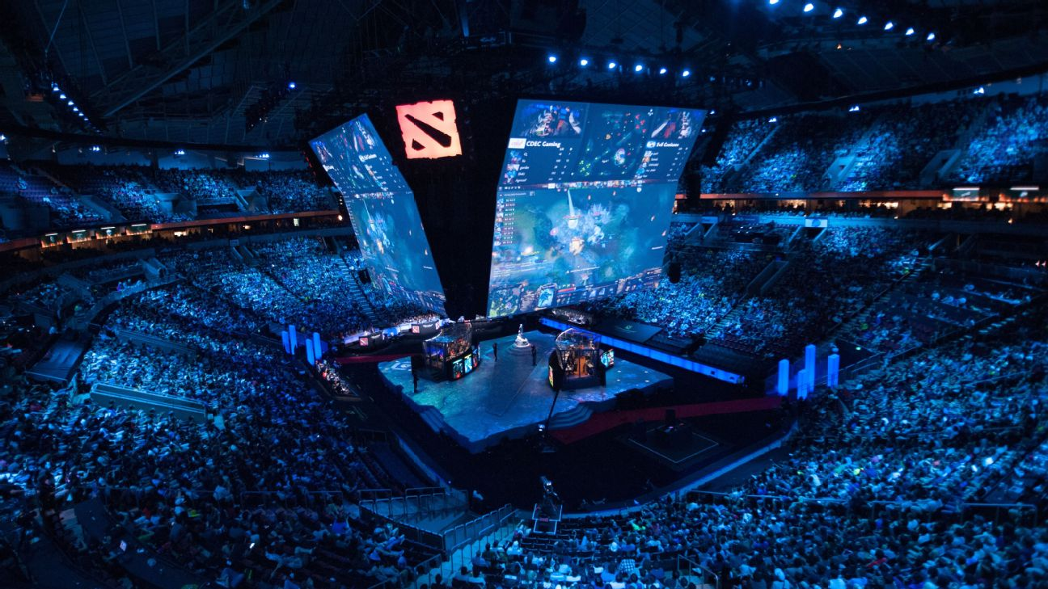
BookNest: Navigate Your Next Read

Slide 2
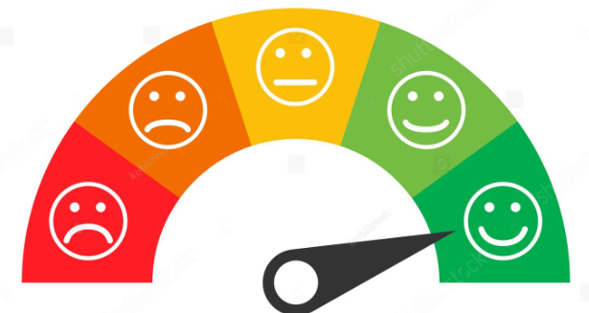

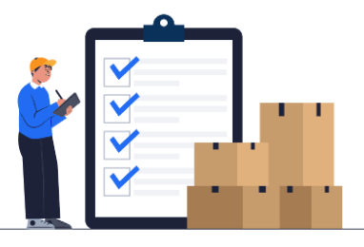
Problem we are trying to solve
In today's vast sea of literature, readers often struggle to find books that match their interests and preferences. With countless titles available, discovering new books that align with individual tastes can be a daunting task. Additionally, readers may not always have access to personalized recommendations tailored to their specific reading habits. This poses a challenge for both avid readers seeking new content and businesses looking to connect readers with relevant books.
How can we generate value from it
Value to different actors of the community:
Enhances user engagement and satisfaction by providing personalized book recommendations.
Increases book sales by connecting users with relevant titles and driving purchases.
Optimizes inventory and marketing strategies for book retailers by identifying popular titles.
Our Goal
The goal is to enhance user satisfaction, increase book sales, and foster a thriving community of readers by leveraging recommendation.

Slide 3
Dataset

Slide 4
Pre-processing

Slide 5
Models

Slide 6
“BookNest” hosted on Streamlit

Slide 7
References
Thank you!

