Slide 1
Cheese Presentation
We love rotten milk!

Slide 2
Hard Cheeses
Abertam
Acorn
Aged British Cheddar
Aged Gouda
Aggiano
Allguer Emmentaler
Almanas Tegel
Amish Frolic
Anari
Anthotyro
Appenzeller

Slide 3
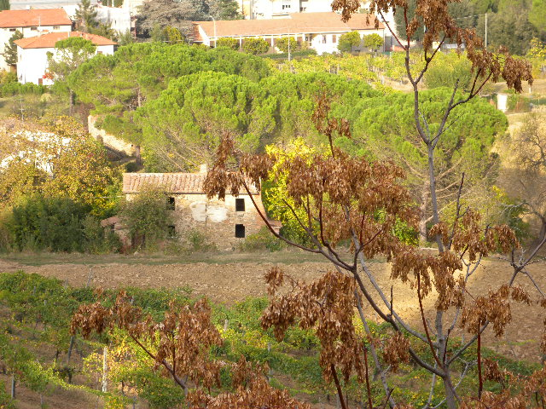
Image with GPS data

