Slide 1

SMART FRIDGE · L1–L4 RECOGNITION DATA
Fridge Intelligence
Data Platform
A production-grade, cost-effective pipeline on Google Cloud — turning raw recognition events into governed, monetizable household intelligence.
Data Platform Architecture · July 2026

Slide 2






FOUNDATIONS
Six design principles that drive cost and reliability
Batch-first ingestion
Diffs, not snapshots
Medallion lakehouse
BigQuery load jobs are free. No Pub/Sub, no Dataflow on the main path — fridge data has zero real-time need.
Devices emit only item changes (add / remove / level). 10–20x volume reduction before a single rupee is spent.
Bronze → silver → gold in BigQuery. Raw is immutable and replayable from a GCS archive at Coldline prices.
Serverless, scale-to-zero
Privacy by design
SLO-driven observability
Cloud Scheduler + Workflows + Cloud Run Jobs. Per-second billing, retries built in, nothing idles.
DPDP / GDPR erasure jobs, policy-tagged sensitive columns, retention defined as code in Terraform.
Three SLOs, a handful of high-signal alerts. Cloud Monitoring + Managed Prometheus, Grafana-compatible.
Fridge Intelligence Data Platform · 02

Slide 3

SIZING
The volume math — why this platform stays cheap
1M
~18 GB
~550 GB
10–20x
connected fridges
raw data per day
per month into bronze
saved by diff-only events
4 captures / day, ~3 changed items each
gzip JSONL diffs at ~1.5 KB per event
small by BigQuery standards
vs. shipping full fridge snapshots
~$350 – 1,100 / month, all-in (1M devices)
Headroom: 10M devices
GCS + BigQuery + Cloud Run + LLM enrichment + monitoring.
The same platform built on Pub/Sub + Dataflow + Composer: $3–5K / month — and more code to operate.
≈ 5.5 TB / month — still comfortably in on-demand BigQuery territory before slot commitments make sense.
Fridge Intelligence Data Platform · 03

Slide 4
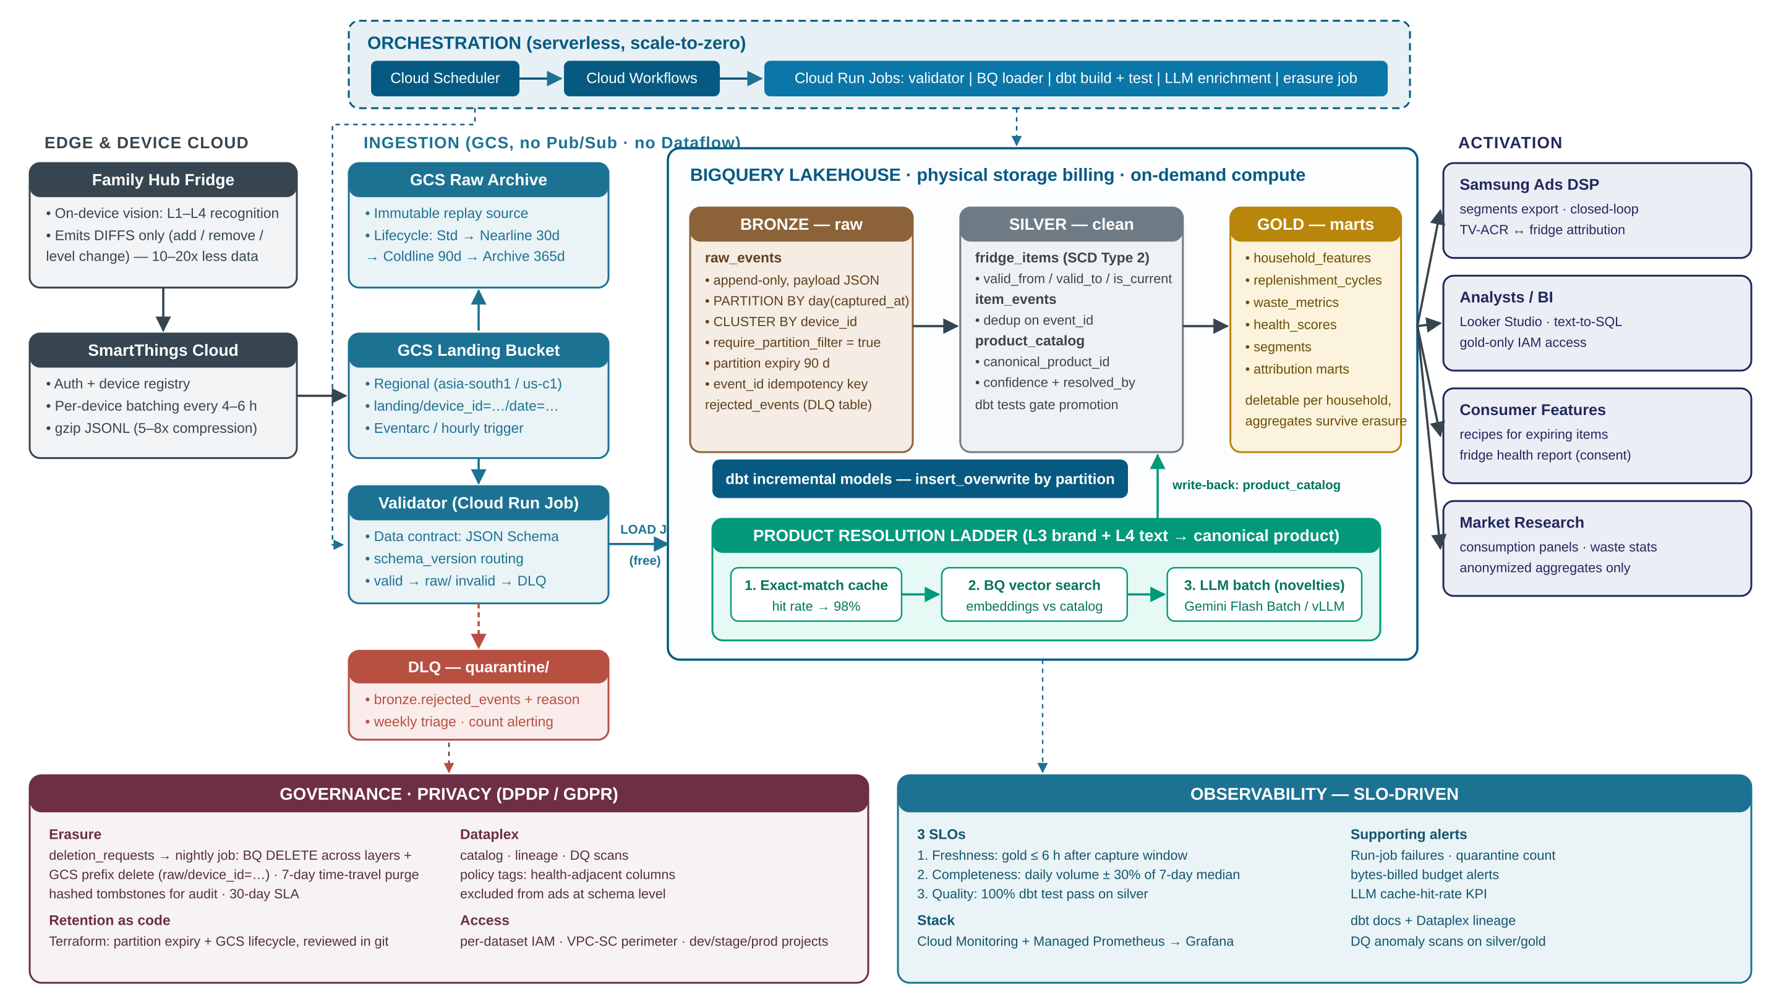
END-TO-END ARCHITECTURE
Batch lakehouse on GCS + BigQuery, orchestrated by Cloud Run Jobs

Slide 5
LAYER 1
Ingestion — GCS landing + free BigQuery load jobs
1
Fridge emits diffs
On-device vision detects L1–L4; only add / remove / level-change events leave the device.
Key decisions
No Pub/Sub, no Dataflow on the main path — fridge events have no real-time requirement.
Regional bucket (asia-south1 / us-central1); multi-region costs ~2x for no benefit here.
Per-device GCS prefixes make GDPR/DPDP erasure a simple prefix delete.
Data contract at the door: unknown schema_version is quarantined and alerted — never silently dropped.
DLQ = quarantine/ prefix + bronze.rejected_events with rejection reason; weekly triage.
Optional later: a narrow Pub/Sub → BigQuery subscription path only for real-time features.
2
SmartThings batches
Auth + registry; per-device gzip JSONL batches every 4–6 h (5–8x compression).
3
GCS landing (regional)
landing/device_id=…/date=… prefixes; Eventarc or hourly trigger picks up new files.
4
Validator enforces the contract
Cloud Run Job checks JSON Schema per schema_version; valid → raw/, invalid → quarantine/.
5
Load job into bronze
BigQuery LOAD JOB — zero ingestion cost. Raw archive kept on GCS lifecycle for replay.
Fridge Intelligence Data Platform · 05

Slide 6

LAYER 2
BigQuery lakehouse — medallion table design
BRONZE — raw
SILVER — cleaned
GOLD — marts
raw_events: append-only, full payload as JSON
PARTITION BY day(captured_at), CLUSTER BY device_id
require_partition_filter = true (blocks runaway scans)
Partition expiry 90 d — GCS archive is the long-term copy
event_id = hash(device, time, item) → idempotent replay
fridge_items as SCD Type 2: valid_from / valid_to / is_current — full appear/disappear history
item_events deduped on event_id
product_catalog: canonical_product_id, confidence, resolved_by provenance
dbt tests gate every promotion
household_features, replenishment_cycles, waste_metrics, health_scores, segments
Attribution marts joinable to TV-ACR exposure
Household rows deletable; anonymized aggregates survive erasure legally
Analysts get gold-only IAM access
Schema evolution without migrations: new firmware fields land in bronze's JSON payload automatically; promotion to typed silver columns is a reviewed dbt PR. BigQuery ALTER TABLE ADD COLUMN is online and free.
Fridge Intelligence Data Platform · 06

Slide 7




LAYER 3
Transformation & orchestration — dbt on Cloud Run Jobs
No Cloud Composer
Saves $400+/month of idle Airflow. Workflows + Scheduler cost ~nothing and cover retries + chaining.
Cloud Scheduler
Cloud Workflows
Cloud Run Jobs
cron triggers
DAG chaining + retries
dbt build · enrichment · erasure
Everything in Terraform
dbt project rules
Buckets, datasets, jobs, alerts, retention policies — dev / stage / prod as separate GCP projects.
All models incremental with insert_overwrite on daily partitions — history is never rebuilt in routine runs.
Tests: uniqueness on event_id, not-null keys, accepted L1 values, resolution-confidence drift.
Full refresh is a deliberate, flagged backfill runbook — never an accident.
CI on PR: dbt build --select state:modified+ against a stage dataset; merge is blocked on test failures.
Idempotent by design: any GCS file can be re-loaded, any partition range re-run, safely.
Fridge Intelligence Data Platform · 07

Slide 8


LAYER 4
LLM enrichment — the product resolution ladder
Messy L3/L4 text (“AMUL BUTTR 500g”) must resolve to a canonical product. The string space converges fast — so almost nothing should ever reach the LLM.
1. Exact-match cache
2. Vector similarity
3. LLM batch — novelties only
Previously resolved strings hit a lookup table. Target: ~98% of daily volume within months.
BigQuery vector search: embed the string, match against the resolved catalog + Open Food Facts.
Nightly batch: Gemini Flash Batch API (−50% cost) or self-hosted vLLM if it must stay in-house.
98%
Provenance on every row
Write-back loop
product_catalog stores confidence + resolved_by (cache / vector / LLM / human). Low-confidence rows route to review, never silently into gold.
Nightly job writes resolutions to silver.product_catalog; tomorrow's identical string is a cache hit. Estimated vs. verified nutrition is flagged in-schema.
cache-hit rate is a first-class KPI — it is the lever that keeps LLM spend at $50–200/month.
Fridge Intelligence Data Platform · 08

Slide 9




TRUST
Governance & privacy — DPDP / GDPR built into the schema
Right to erasure
Retention as code
deletion_requests table drives a nightly Cloud Run job
BQ DELETE across bronze / silver / gold by device_id
GCS prefix delete (raw/device_id=…)
Time-travel purges in 7 d → comfortable 30-day SLA
Hashed tombstones retained as audit proof
Partition expiry + GCS lifecycle set in Terraform
Std → Nearline 30 d → Coldline 90 d → Archive 365 d
Every retention change is a reviewed git PR
No console-clicked policies, ever
Sensitive-data controls
Access & environments
Dataplex policy tags on health-adjacent columns
Excluded from ad products at schema level, not policy level
Column-level security from day one
Aggregates designed to survive individual erasure
Per-dataset IAM: analysts see gold only
Only the pipeline service account touches bronze
dev / stage / prod as separate GCP projects
VPC-SC perimeter once real user data lands
Fridge Intelligence Data Platform · 09

Slide 10
OPERATIONS
Observability — three SLOs, not a dashboard zoo
≤ 6 h
± 30%
100%
Freshness
Completeness
Quality
Gold tables updated within 6 hours of each capture window. Dataplex freshness scans + dbt source_freshness feed Cloud Monitoring.
Daily event volume per region stays within ±30% of the trailing 7-day median. This is the alarm that catches fleet-side breakage.
All dbt tests pass on silver: event_id uniqueness, not-null keys, accepted L1 values, resolution-confidence drift.
Supporting signals (alert-worthy, not SLOs)
Cloud Run job failures · quarantine / rejected-event counts · BigQuery bytes-billed budget alerts · LLM cache-hit-rate KPI
Lineage: automatic via Dataplex for BigQuery jobs + dbt docs. Metrics export to Cloud Monitoring; Managed Prometheus (GMP) keeps it Grafana-compatible with the existing stack.
Fridge Intelligence Data Platform · 10

Slide 11
ECONOMICS
Monthly cost at 1M devices — order of magnitude
$350–1,100
total per month — roughly the cost of a single idle Composer environment, for the entire platform.
Cost levers
Physical storage billing: 3–5x cheaper for compressed JSON
require_partition_filter: kills accidental full scans
Move to autoscaling slots only past ~$1.5–2K/mo scan spend
Fridge Intelligence Data Platform · 11

Slide 12



EXECUTION
Rollout in three phases
Phase 1 — MVP
Phase 2 — Hardened
Phase 3 — Scale & productize
Weeks 1–2
Months 1–3
Month 3+
GCS landing → load job → dbt bronze/silver/gold
Cloud Workflows + Scheduler orchestration
dbt tests + 3 alerts: backlog, job failure, volume anomaly
Terraform baseline, dev/stage/prod projects
Dataplex DQ scans, lineage, policy tags
Vector cache + LLM batch enrichment loop
Automated erasure job + tombstone audit
CI/CD gates: state:modified+ builds on PR
Slot commitments when scan spend justifies it
Narrow streaming path for real-time features only
Household feature marts → segments & panels
TV-ACR join for closed-loop attribution pilots
Immediate next step: stand up the Terraform + dbt starter repo and load one week of synthetic diff events end-to-end.

