Slide 1
American Hospitals Information Management System
Abhin Gude - ag8556
S. Venkata Krishna - vs2539

Slide 2
Tables:
Hospital
Department
Doctors
Staff
Ambulance
Medicines
Patients
Payments
Reports
Appointments
Reports_has_Medicines

Slide 3
ER Diagram

Slide 4
Data:
Some of the data we used in the project is the data we created for the purpose of the project.
Some of the data like the names of doctors , patients name, department name, the whole hospital data, their addresses, the names of the medicines, their costs. The values of these respective attributes are extracted from the internet from various sources(listed below)
Other Attributes like the date of birth, degree, success rate are generated at random, using python.
Some of the attributes like experience are written in python, experience is generally current age – 24years.
Attributed like h_id(hospital id), p_id(patient id) and other attributes which determine a table are given in an increasing order from 1.

Slide 5
Queries:
Hospitals in a particular state which have rating >4 and having doctors from a specific department.
Count of number of Hospitals in a state which do not have ambulance facility in that particular state.
Appointments made by specific departments during different years.
Medicines received by a patient during a particular appointment date and their cost.
Doctors with a MBBS degree working in a particular department and having a minimum year of experience.
Hospitals from a particular state and their revenue from the years 2020, 2021
Hospital’s and their patient’s conditions in a state.

Slide 6
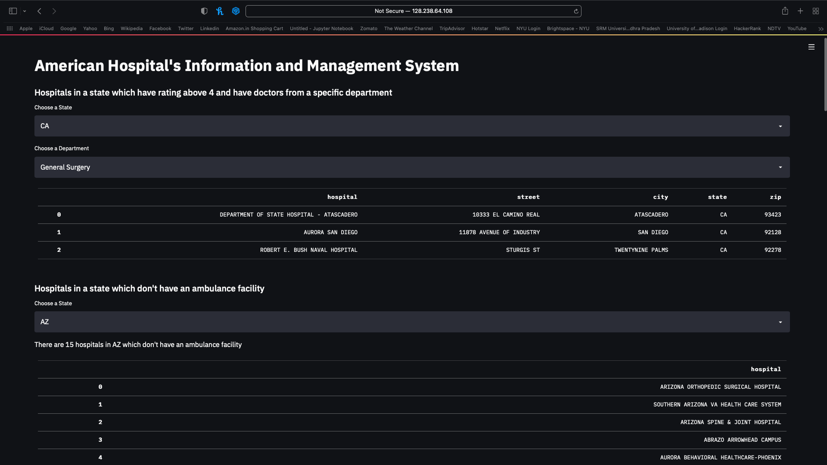
Query 1

Slide 7
Query 2

Slide 8
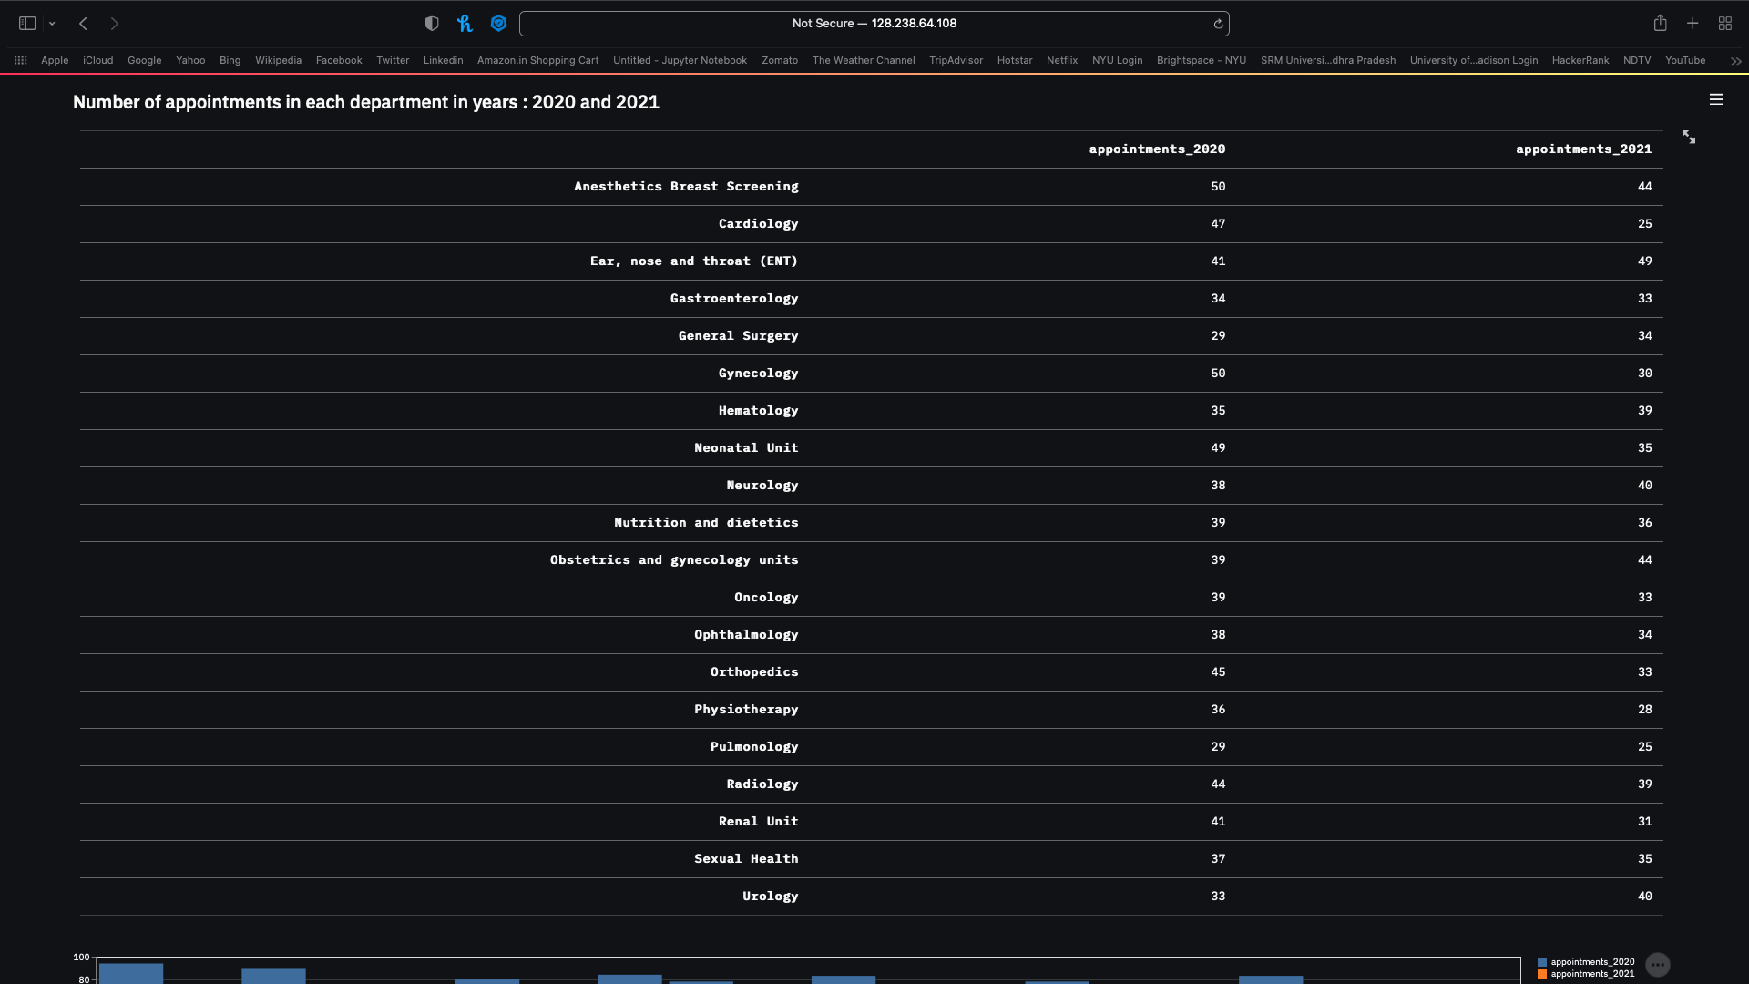
Query 3

Slide 9
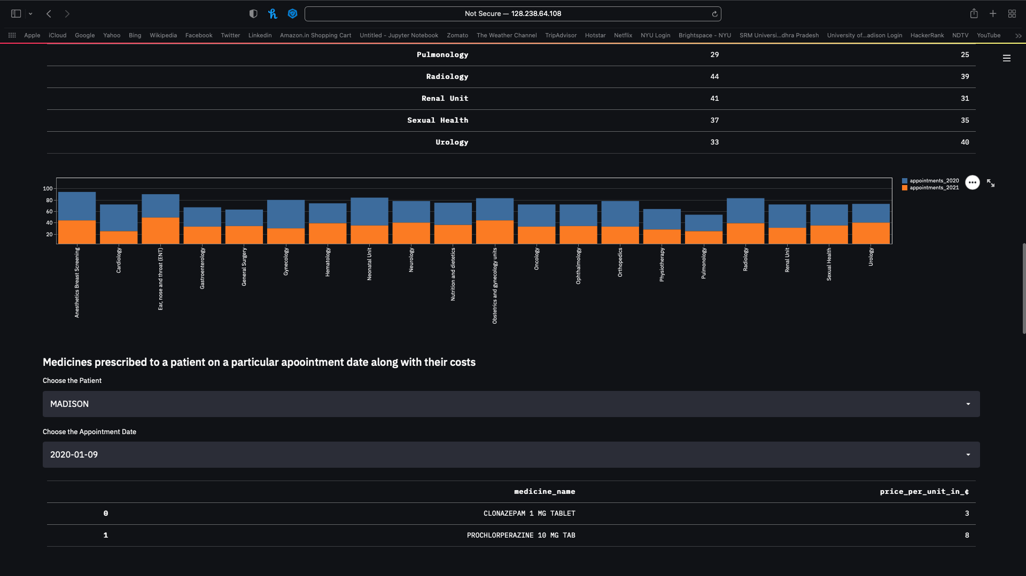
Query 4

Slide 10
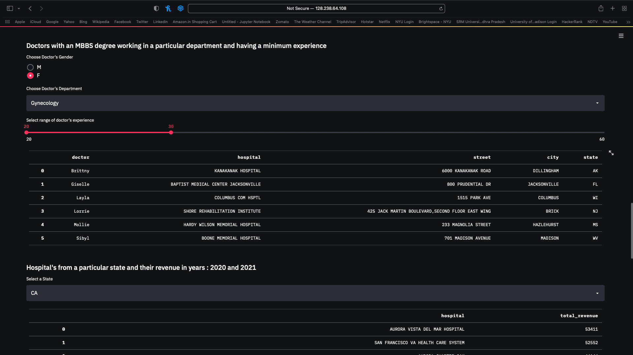
Query 5

Slide 11
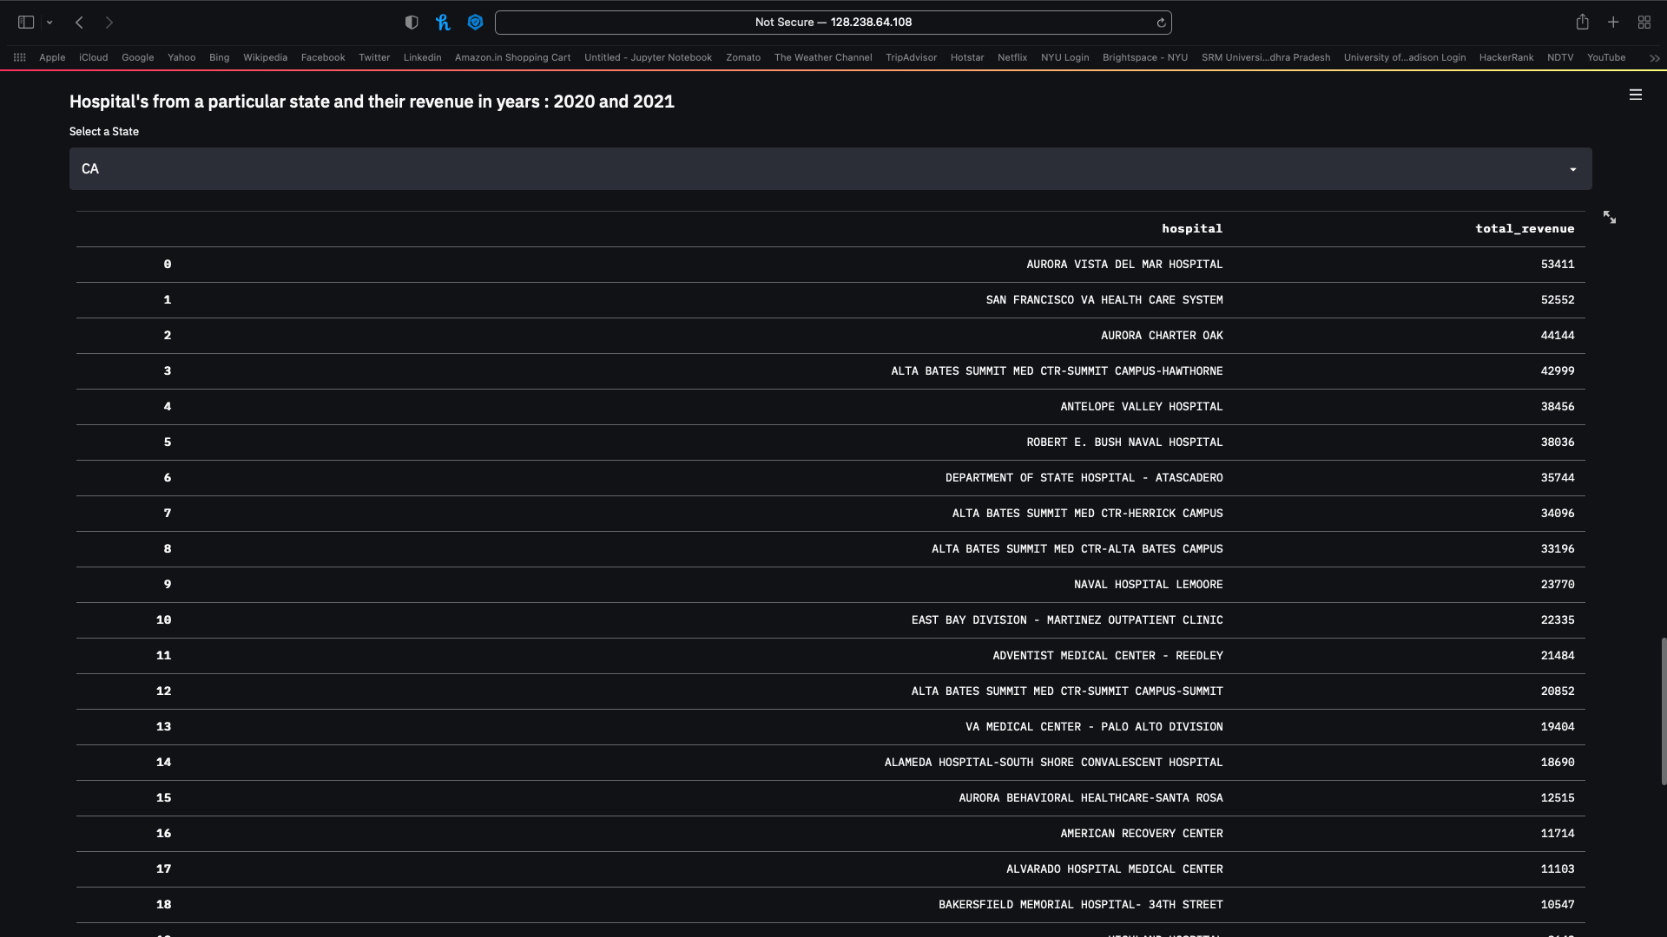
Query 6

Slide 12
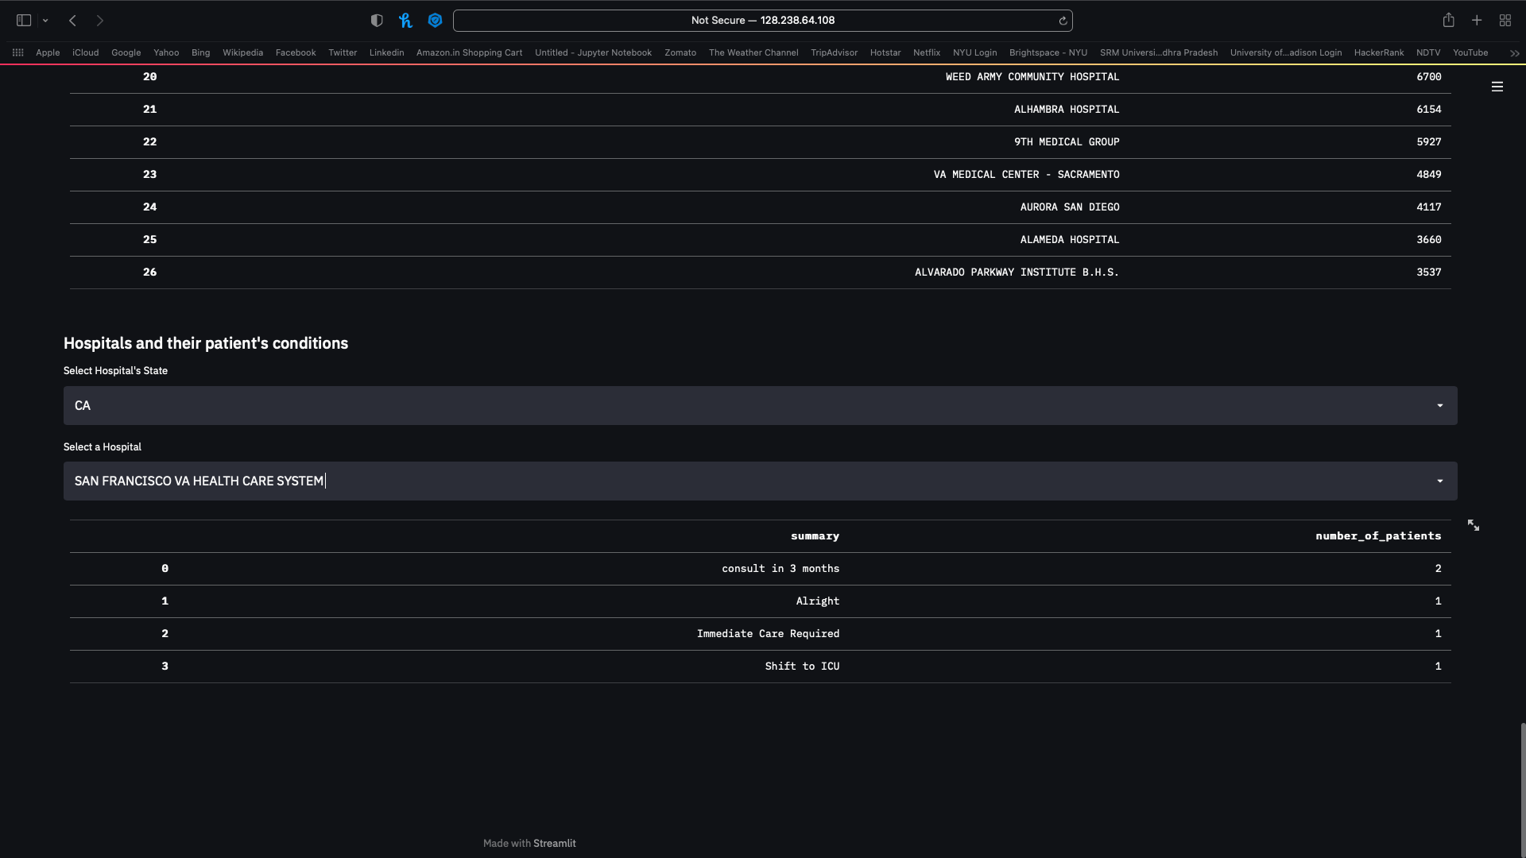
Query 7

