Slide 1
A Hybrid Machine Learning Approach for Order Priority Prediction
GROUP-7

Slide 2
PROBLEM STATEMENT
Existing machine learning techniques cannot accurately predict order priority due to inability to learn complex patterns and adapt to real-time factors. This leads to inefficient prioritization and suboptimal fulfillment in complex retail supply chains. There is a need for an optimized machine learning approach integrating deep learning and reinforcement learning to enable accurate and efficient order prioritization.

Slide 3
AGENDA
Introduction
Objectives
Methodology
Results
Conclusions
References

Slide 4
Introduction
Order priority prediction is critical for supply chain efficiency and customer satisfaction
Manual prediction is challenging due to complexity of omni-channel order systems
Investments in AI-driven predictive analytics solutions are accelerating
This research develops an optimized machine learning approach using a retail dataset

Slide 5
Objectives
Perform statistical analysis to identify factors influencing order priority based on domain knowledge.
Implement and compare performance of machine learning models like SVM, neural networks and ensemble methods for priority prediction.
Analyze impact of techniques like feature engineering, hyperparameter tuning and cross-validation on model effectiveness.

Slide 6
METHODOLGY
Data preprocessing steps like handling missing values and converting formats prepared the retail dataset for modeling. This enabled high quality input data.
Feature engineering derived informative attributes like order age and customer type based on domain knowledge. This helped capture patterns related to priority.
Design of Experiments systematically evaluated factors influencing priority response. It provided insights into key drivers.
Various models were developed including SVM, neural networks, random forests. This enabled benchmarking diverse techniques.
Hyperparameter tuning optimized each model's parameters to tailor them for the prediction task. It improved performance.
Rigorous experimental evaluation using train/test splits, cross-validation and multiple performance metrics facilitated unbiased model comparisons. This identified the best approach.

Slide 7
Design of experiments
DOE helpful in Providing statistically significant insights into factors influencing order priority response variable. For example, identifying ship mode, region, and customer segment as significant effects.
Quantified interaction effects between factors like Region and Ship Mode on order priority.
Guided selection of predictive modeling techniques capable of capturing these interaction effects through decision trees and ensemble methods.
Enabled fine-tuning of model parameters based on the relative importance of factors identified. For example, tuning depth and number of estimators in line with impacts of ship mode, region etc.
Helped identify shipping cost, order value, customer type as key drivers of priority through subsequent feature importance analysis.
Pointed out challenges in predicting priority for mid-value orders, suggesting areas for model improvement.

Slide 8
DOE 27 Runs
SET 1 Feature Selection 7
SET 2 Feature Selection 9
SET 3 Feature Selection 5

Slide 9
Results
Ensemble methods achieved highest F1-score, balancing precision and recall
Neural networks had top accuracy but lower interpretability
Shipping cost and order value emerged as major drivers of priority
Limited data and class imbalance remain challenging
Simpler models like SVM and regression had lower training times
Ensemble approaches moderately impacted by smaller training data
Hyperparameter tuning critical for complex models like SVM and neural networks

Slide 10
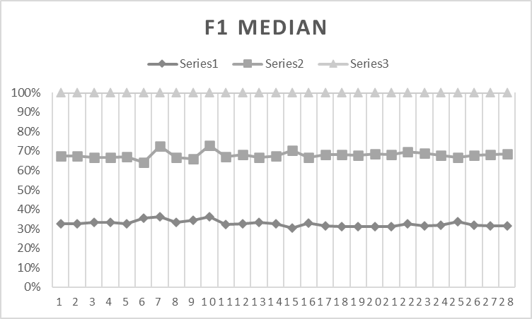
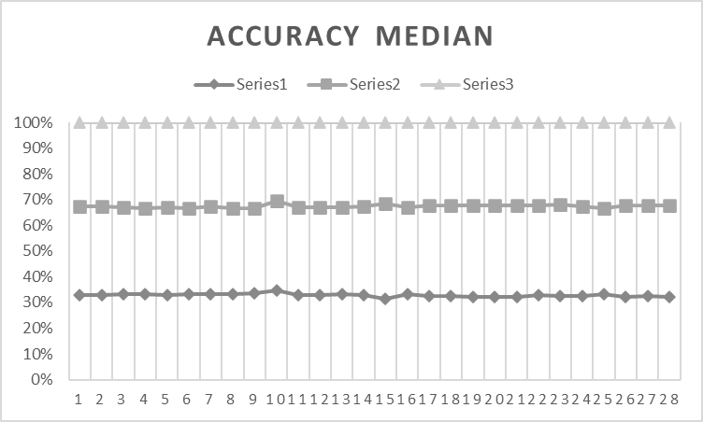
GRAPHS

Slide 11
Metric | Highest Value | Model with Highest Value | Lowest Value | Model with Lowest Value
F1 Score | 75.55% | Optimizable Ensemble | 41.47% | Kernel Naive Bayes
PPV | 82.32% | Efficient Logistic Regression | 54.92% | Bagged Trees Ensemble
Accuracy | 79.49% | Neural Network Tri-layered | 62.69% | SVM Linear
Testing Time | 4493.30 secs | Optimizable SVM | 1.40 secs | Efficient Logistic Regression
Table 1. Showing Median Highest and Lowest Values of F1, PPV, Accuracy, Testing Time
Metric | Model with Lowest IQR | Lowest IQR Value | Model with Highest IQR | Highest IQR Value
F1 Score | Neural Network Bilayered | 0.18% | SVM Linear | 35.59%
PPV | SVM Linear Efficient Linear SVM SVM Coarse Gussian | 0.16% | SVM Linear | 35.26%
Accuracy | Tree Tree Fine Tree | 0.10% | SVM Linear | 27.19%
Testing Time | Naive Bayes Gaussian Naïve Bayes | 0.23 | Optimizable SVM | 2278.60-4493.30
Table. 2. Showing IQR Highest and Lowest Values of F1, PPV, Accuracy, Testing Time

Slide 12
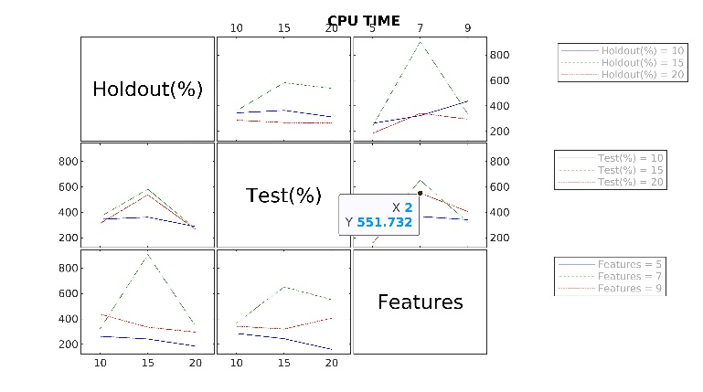
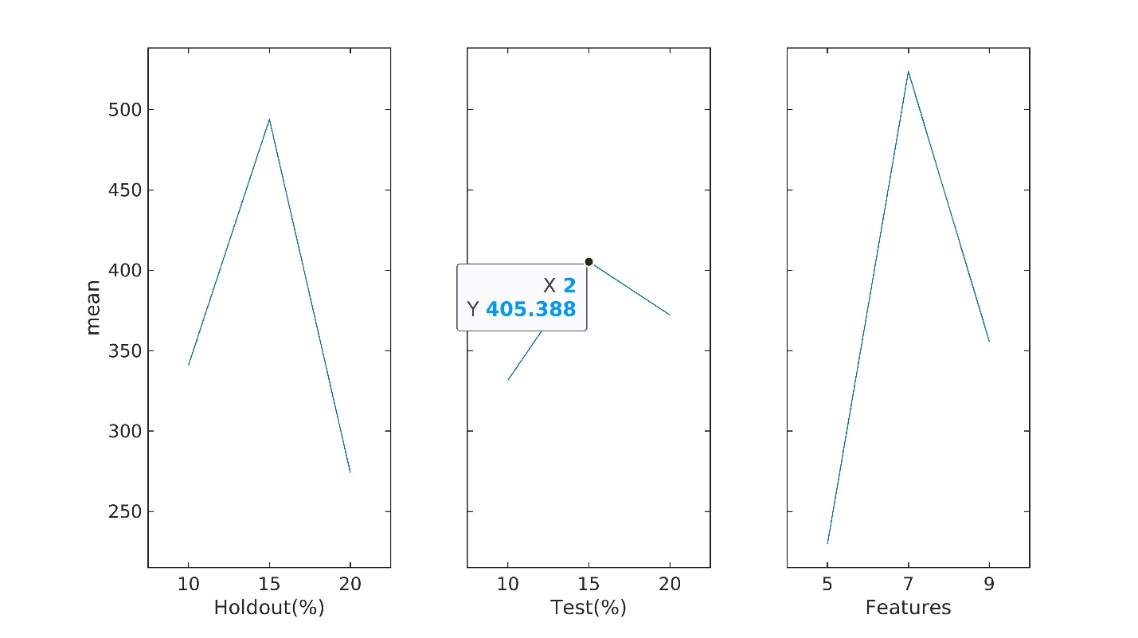
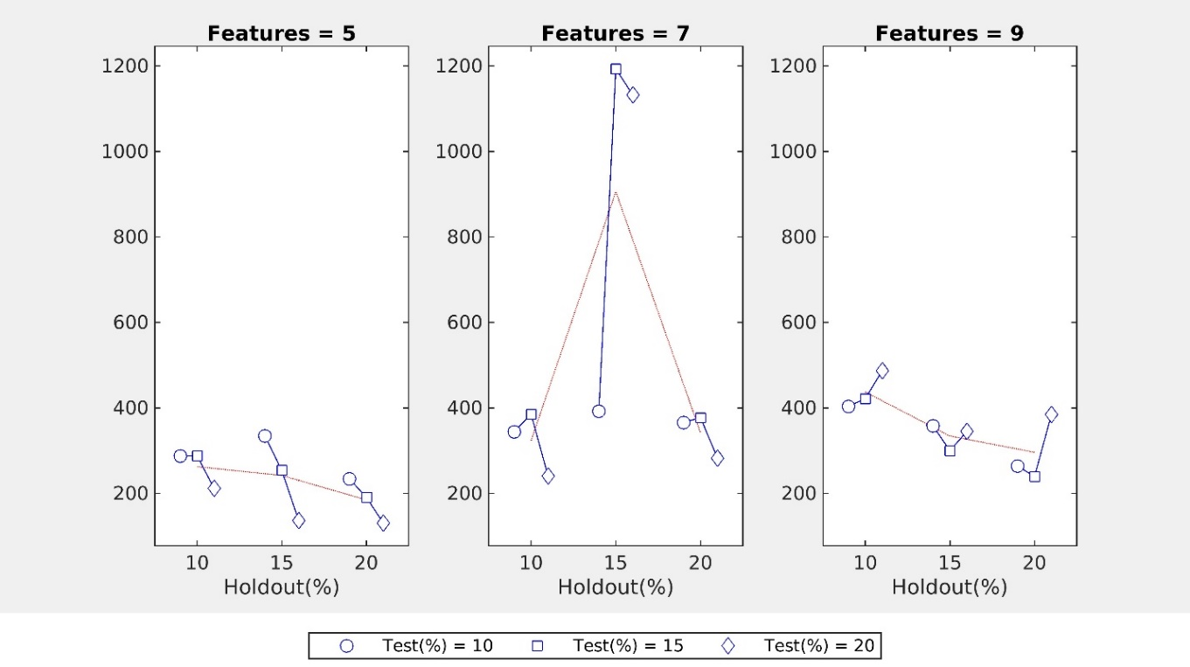
CPU TIME MULTIVARIANT CHART

Slide 13
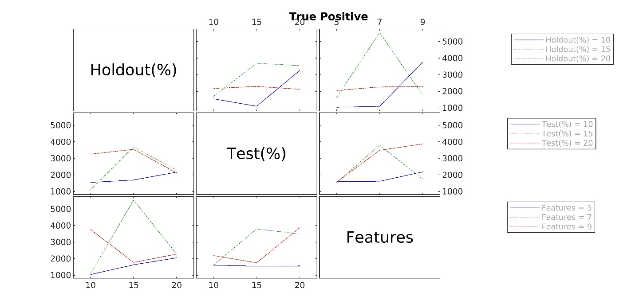
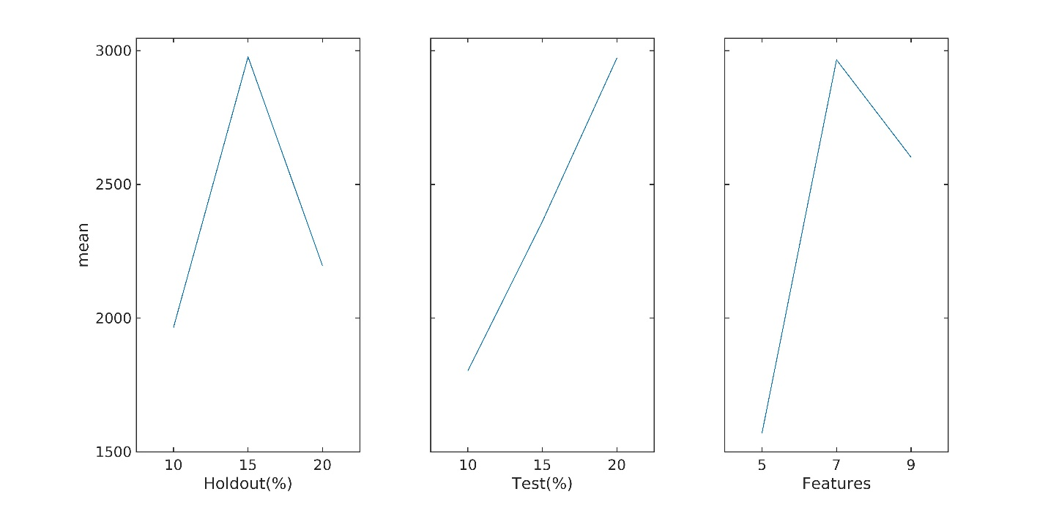
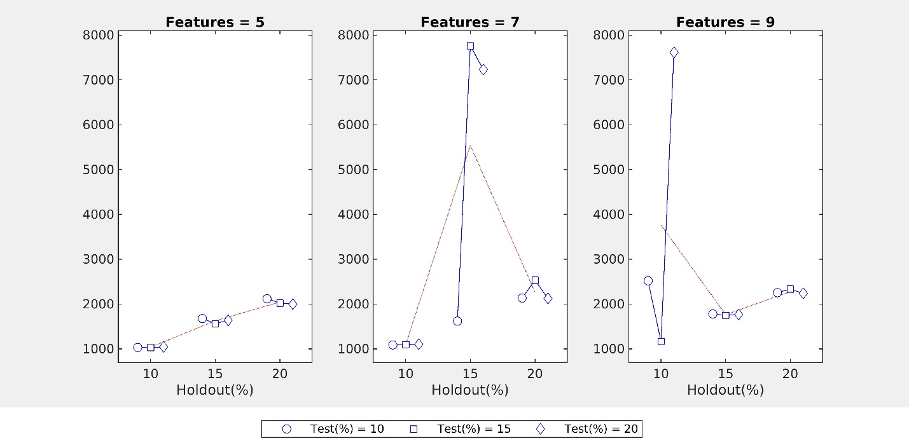
True positive multivariate charts

Slide 14
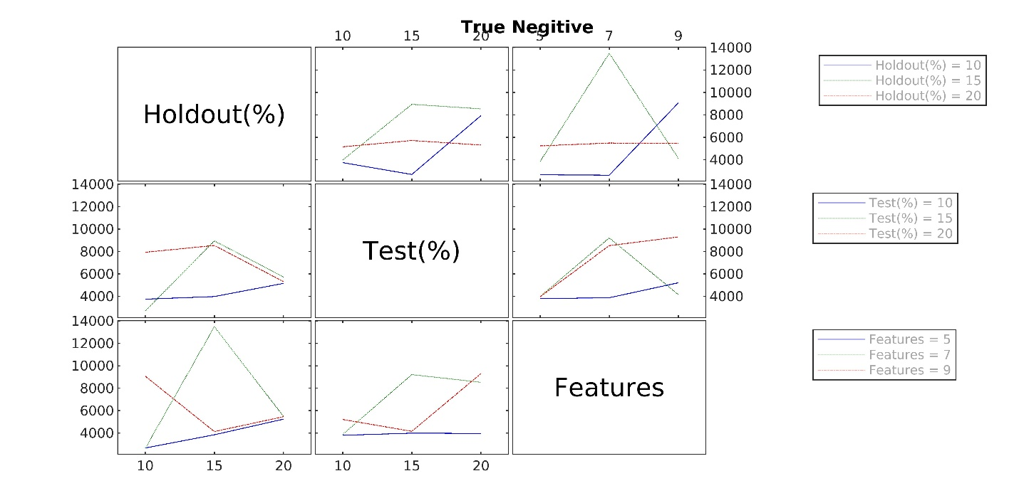
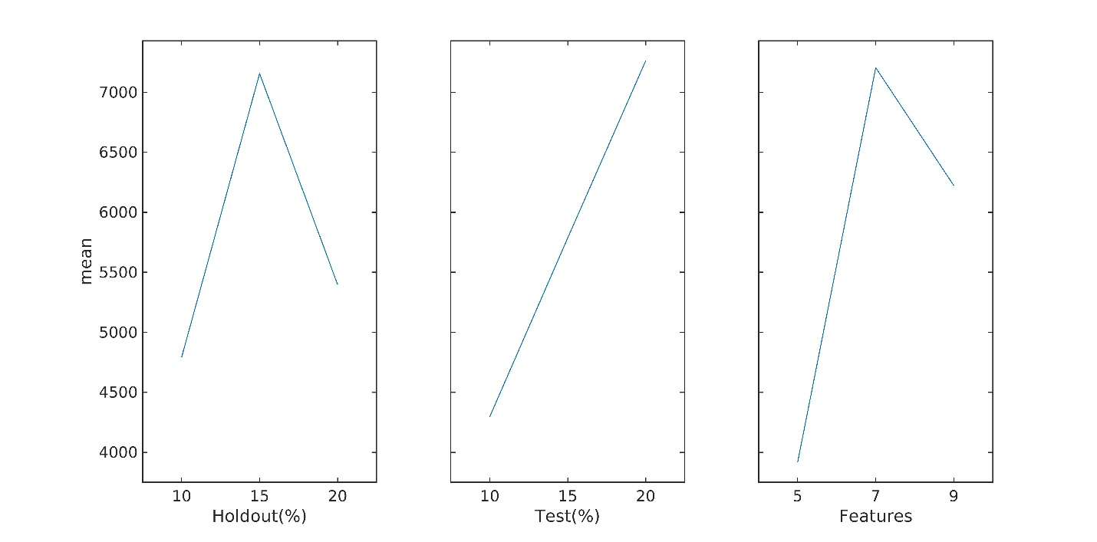
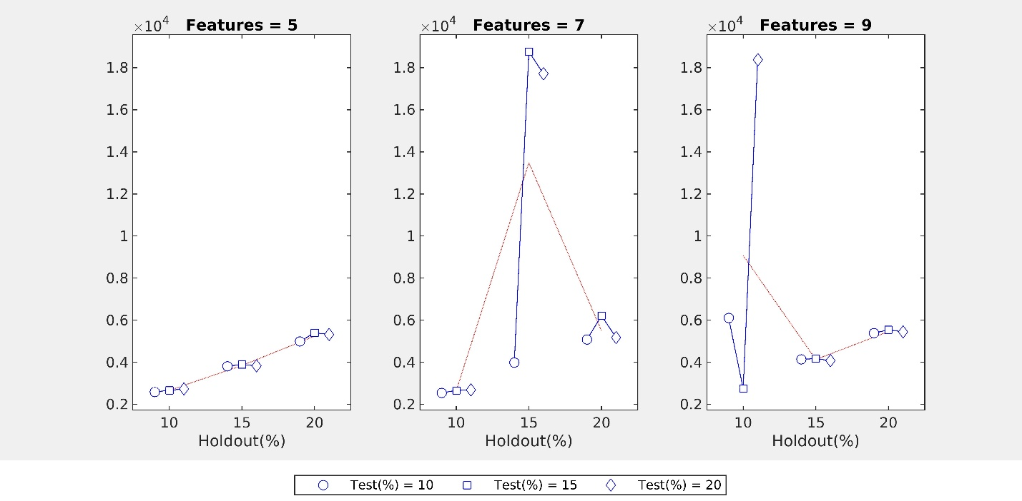
True Negative multivariate charts

Slide 15
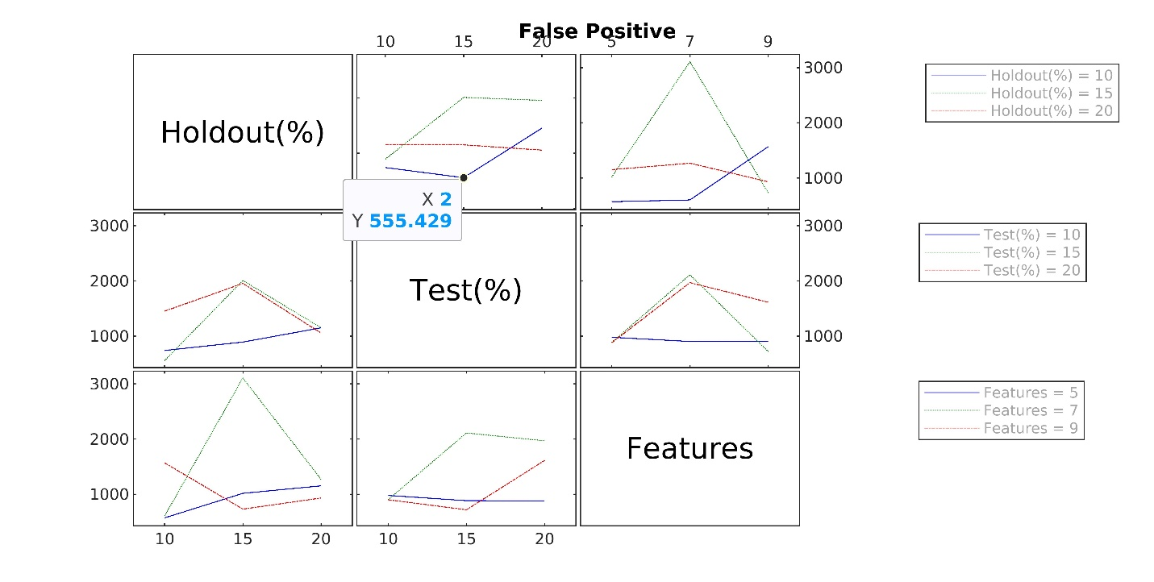
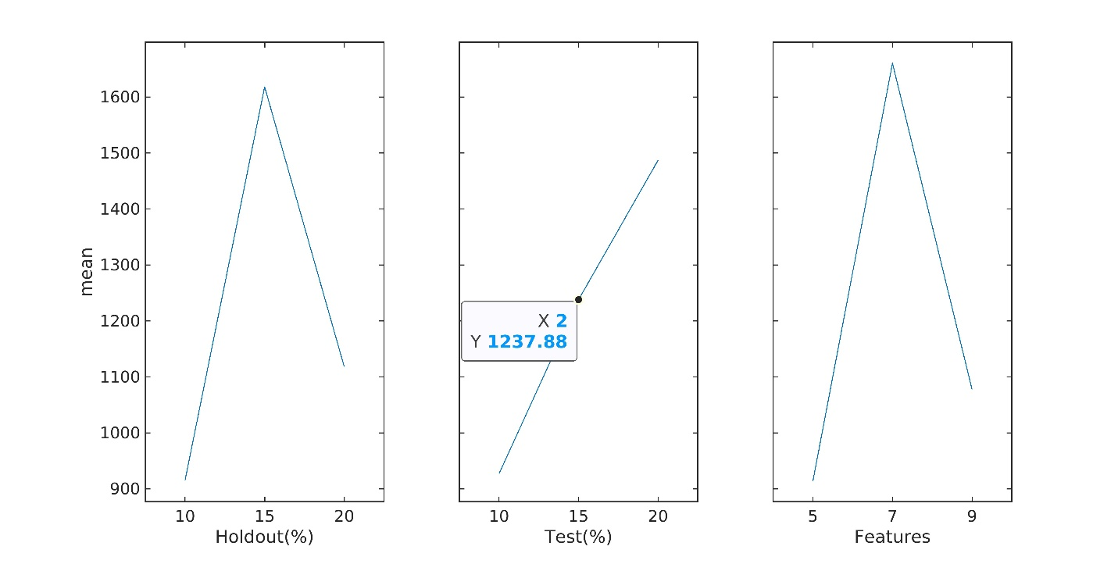
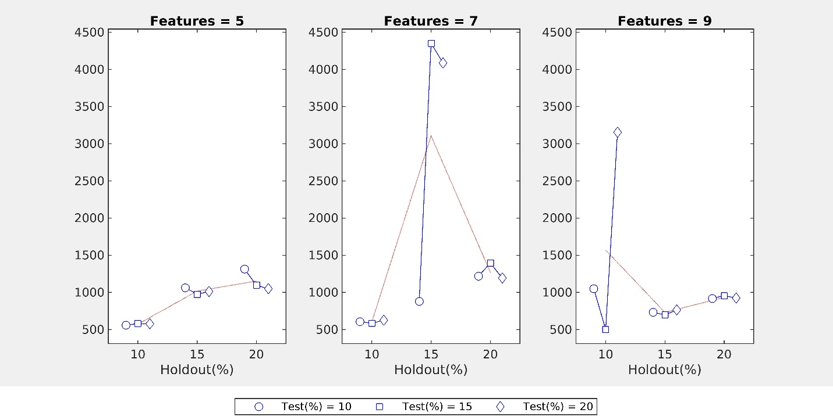
False Positive multivariate charts

Slide 16
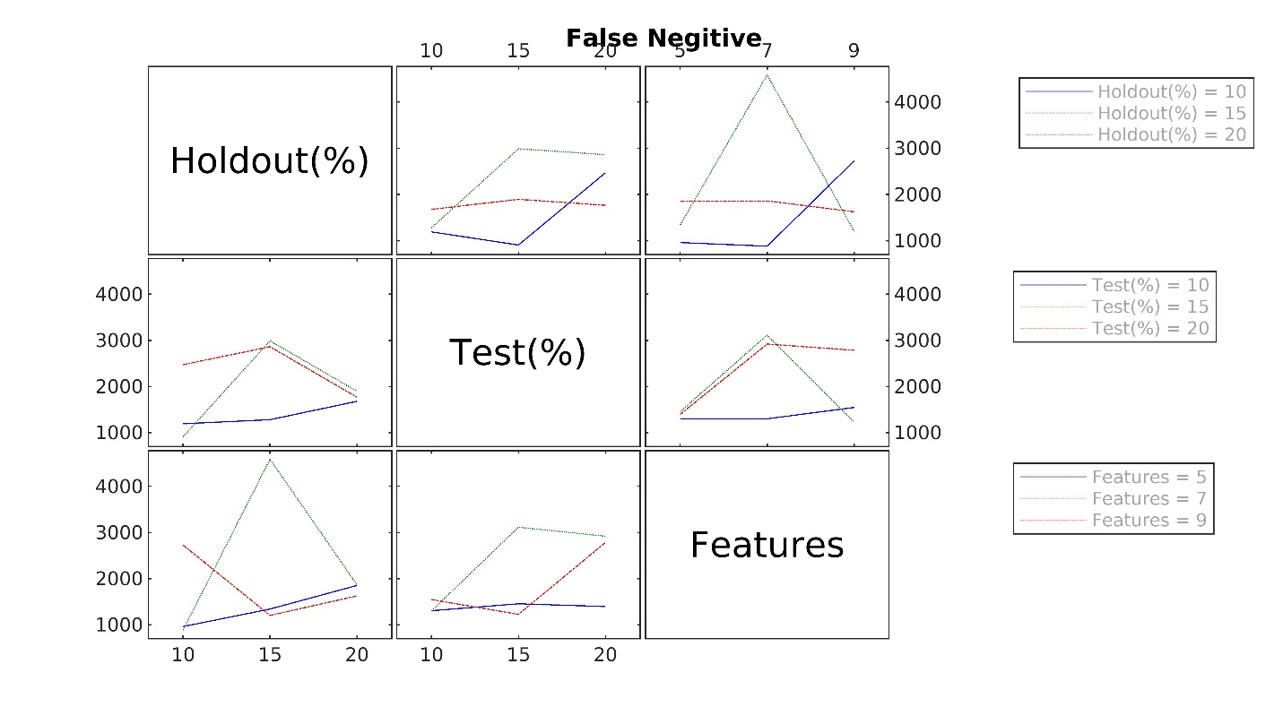
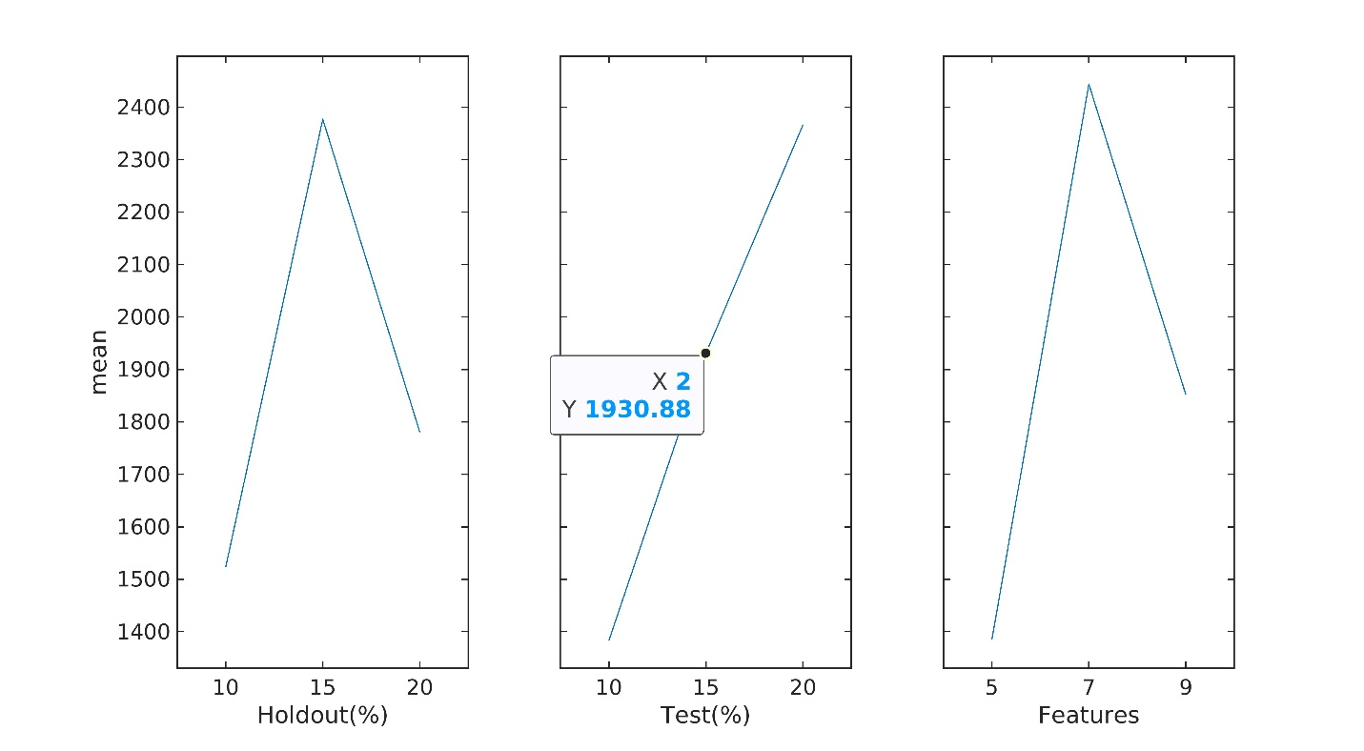
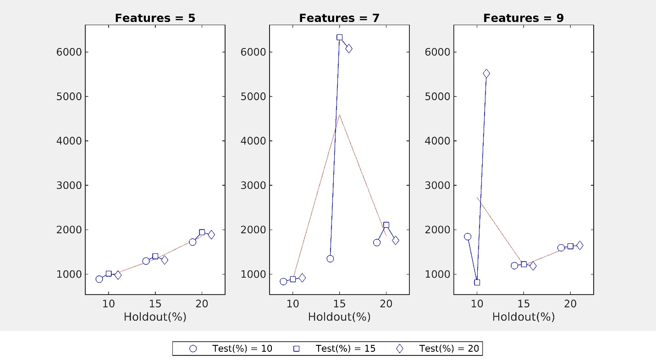
False Negative multivariant charts

Slide 17
conclusion
The study benchmarked modern machine learning techniques for order priority prediction using a retail dataset.
Ensemble methods were most effective, balancing precision and recall. Neural networks had top accuracy but lower interpretability.
Analysis identified important factors driving priority like shipping cost and order value.
Limitations around data size and class imbalance remain. Further research on mitigation techniques needed.
Provided insights into model behaviors regarding training time, complexity, hyperparameter sensitivity.
Quantified performance trade-offs between techniques to guide selection based on use case priorities.
Overall, laying a strong foundation for developing optimized AI-driven order management and supply chain capabilities.

Slide 18
Summary
The presentation concludes by highlighting the key findings, limitations, model insights, trade-off quantifications, practical implications for order management, and future research directions. It demonstrates how the study delivered a data-driven, thorough benchmarking of machine learning techniques for order priority prediction.

Slide 19
THANK YOU
Vamshikrishna Sunnam, Vineeth Rudraksha, Akanksha Nadukula, Gunadheep Sakthivel
vsunnam@kent.edu, vrudraks@kent.edu, anadukul@kent.edu, gsakthiv@kent.edu.

