Slide 1


Big Data Technologies REVIEW – 1 Social Media Sentiment Analysis on Twitter
Team No- 14
Roll No Name
SV Karthikeya 2320030501
P Rahul Varma 2320030258
K Manjith Reddy 2320030003
Department of Computer Science and Engineering
KONERU LAKSHMAIAH EDUCATION FOUNDATION

Slide 2
OUTLINE
• Abstract
• Introduction
• Objectives
• Literature Survey
• Implementation
• Conclusion
• References

Slide 3
Abstract
Social media platforms generate a massive amount of data every day, and Twitter is one of the most popular platforms where users share their opinions through short messages called tweets. These tweets contain valuable information about public emotions, reactions, and views on different topics. However, Twitter data is unstructured and available in very large volumes, which makes manual analysis difficult and inefficient.
This project focuses on performing sentiment analysis on Twitter data using exploratory data analysis techniques and big data technologies. Tweets are classified into positive, negative, and neutral categories to understand overall sentiment trends. Tools such as Apache Spark and Hadoop are used to process large-scale data efficiently. The results are visualized using charts and graphs to provide meaningful insights into public opinion and demonstrate the importance of big data technologies in social media analysis.

Slide 4
Introduction
In today’s digital era, social media plays a significant role in communication and information sharing. Millions of users express their thoughts, opinions, and experiences on platforms like Twitter every day. These posts generate a huge amount of data that can be analyzed to understand public sentiment on various topics such as products, events, and social issues.
Due to the high volume, velocity, and variety of social media data, traditional data processing systems are not sufficient. Big data technologies such as Hadoop and Apache Spark help in storing and processing large datasets efficiently. Sentiment analysis is used to determine whether a tweet expresses a positive, negative, or neutral opinion. In this project, we combine sentiment analysis with big data tools to analyze Twitter data and extract useful insights for decision-making and trend analysis.

Slide 5
Objectives
• To collect and analyze Twitter dataset.
• To classify tweets into Positive, Negative, and Neutral sentiments.
• To perform Exploratory Data Analysis (EDA).
• To use Big Data tools like Hadoop and Spark for processing.

Slide 6
Literature Survey
Paper Link | Author Name | Journal/Conference | Drawbacks / Future Scope
Link | Badran et al. | ResearchGate (Conference) | Focuses on Spark scalability; doesn’t include Hadoop integration or real-time streaming.
Link | V. Kharde & S. Sonawane | arXiv (Survey) | Older survey; needs updates with deep learning and big data frameworks
Link | M. Rodríguez-Ibánez | ScienceDirect (Survey) | General sentiment review; lacks specific Twitter big data tool implementation.
Link | S. Das et al. | Elsevier Procedia (2018) | Focuses on streaming for prediction, not Hadoop storage or classification accuracy.
Link | A. Sharma | Elsevier (2020) | Uses R for sentiment analysis; doesn’t cover big data frameworks like Spark/Hadoop.

Slide 7
Proposed Method
Workflow:
• Data Collection (Twitter Dataset)
• Data Preprocessing (Cleaning text, removing stop words)
• Sentiment Classification (Positive/Negative/Neutral)
• Big Data Processing using Spark/Hadoop
• Result Visualization using graphs

Slide 8
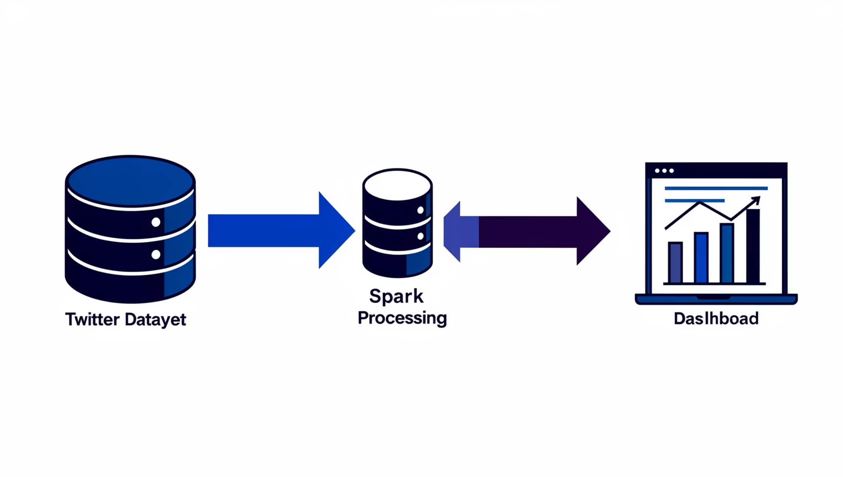
System Architecture (Block Diagram)
Twitter Dataset
Hadoop
(Storage)
Spark (Processing)
Sentiment Output
Visualization

Slide 9
Implementation
Tools Used:
• Python
• Apache Spark
• Hadoop
Platform: Visual Studio Code
Dataset: Twitter Sentiment Dataset (Kaggle)

Slide 10
Conclusion
• Twitter data contains valuable public opinions.
• Big Data tools help process large-scale data efficiently.
• Sentiment analysis helps in decision making and trend analysis.
• Future work: Real-time streaming sentiment analysis.

Slide 11
References
• Big Data Sentiment Analysis of Twitter Data (Base Paper)
• Research articles from Google Scholar
• Kaggle Twitter Sentiment Dataset
• Apache Spark and Hadoop documentation

Slide 12
THANK YOU

