Slide 1
Skin texture change detection for clinical trials
NAGA KALYAN C S SARMA V
2018AH04042

Slide 2
Abstract
In most of the clinical trials, specifically in cosmetic industry, a substantial amount of images are generated such that, the research scientists have an opportunity to analyze and document the efficacy of a chemical/product that is going to be introduced into the consumer market.
This poses 2 major problems:
The industries are bound by confidentiality agreements with the participants, hence each of these images are to be masked in order to protect PII from the internal and external technicians/approvers/stakeholders who view these images.
The research scientists are needed to analyze huge number of images that are generated over a period of time to understand good and bad effects of the product used in the trial, which is a cumbersome task and prone to human error
By leveraging Computer Vision algorithms in this solution, the facial parts of the participants which are not helpful for research (such as eyes) are automatically masked and also the skin texture changes can be compared from one image to another.

Slide 3
Uniqueness
This is an end-to-end solution rather just a portion of what is expected by the industry. The following modules form the entire solution:
Data engineering: Gathering, storing and masking of data
Data Science: Applying Deep Learning and Computer Vision algorithms to generate insights from image which are helpful for research
Operationalization: Leveraging cloud services to host the entire solution in order to generate repeated value

Slide 4
Work Accomplished
Masking of PII data:
Trained a multi-layer Convolutional Neural Network from scratch by leveraging a training dataset available on public domain
Masked specific coordinates of facial parts such that there is no data loss (for eg: dark circles below the eyes), which should enable better data (skin texture) analysis
With no loss of data, can therefore proceed with current architecture (masking image as soon as it is uploaded -> skin texture analysis)
Masked mouth along with eyes
Texture Analysis:
Compared various python libraries to pick the best suitable implementation of LBP algorithm
Preprocessed the image to extract just the face, convert to gray scale and modify dimensions to fit into LBP algorithm
Experimented with hyper parameters (eg: number of points, radius) to generate best possible results for texture analysis
Based on the feature vectors generated by LBP algorithm, generated overlay images to show rough, smooth and medium areas of the skin texture
Generated Histograms and saved the reports in PDF format in S3 to seamlessly distribute the output to the end users

Slide 5
Technology
Cloud Platform: Amazon Web Services
Services: S3 (storage); Lambda (server less “function as code”); SageMaker (fully managed ML service)
Programming Language: Python 3.7
Libraries: Keras, OpenCV, boto3, numpy, pandas, matplotlib, scikit-image
Multi layer Convolutional Neural Network
Training data: 2000+ labelled images (source: https://www.kaggle.com/c/facial-keypoints-detection/data)

Slide 6






Solution Architecture
AWS Cloud
(Invoke Masking)
2
(trigger)
3
AWS Lambda
(read raw image)
4
Amazon SageMaker
Notebook Instance
(Masking)
5
(write masked image)
1
(upload raw images)
(write PDF Report
with texture
changes)
7
Users
(Scientists & other stakeholders)
Amazon S3
6
(read masked image)
Amazon SageMaker
Notebook Instance
(Texture Identification)
Research Lab Personnel
(trigger)
8
(stop the instance)
9
AWS Lambda
(read PDF Report
with texture
changes)
10

Slide 7
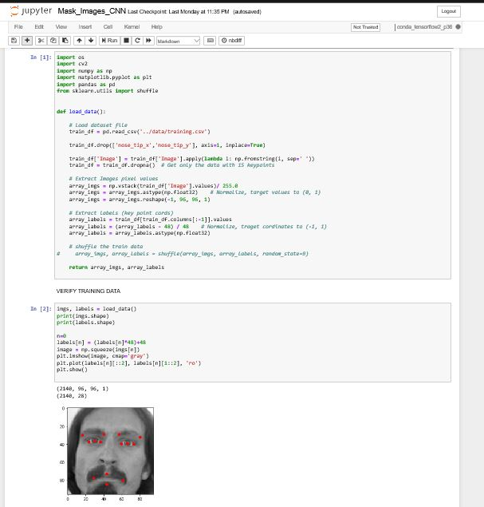
Code: Load & Transform Training Data

Slide 8
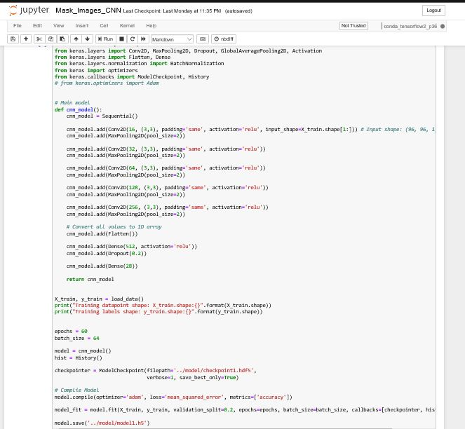
Code: CNN Model

Slide 9
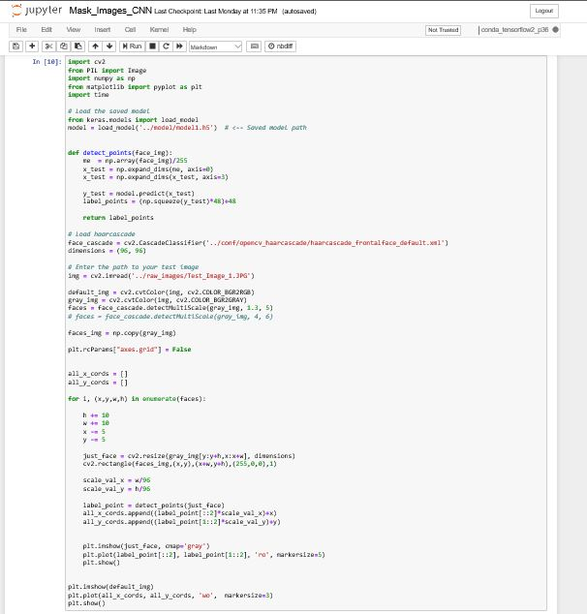
Code: Model Validation

Slide 10
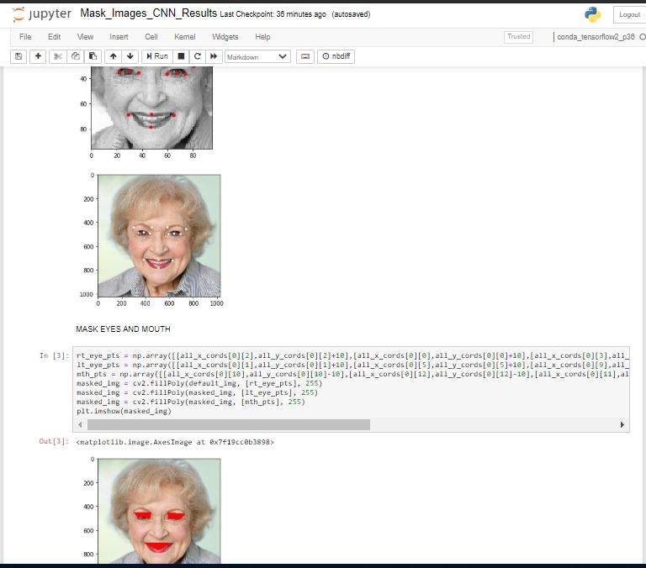
Result: Masked Image Example 1

Slide 11
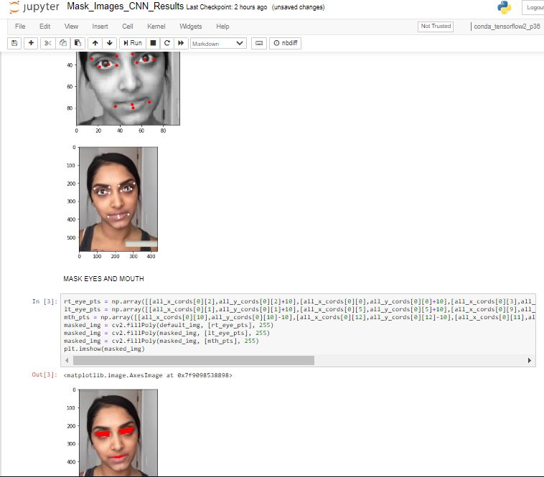
Result: Masked Image Example 2 (Different Ethnicity/Age)

Slide 12
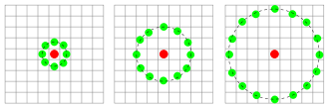
Local Binary Patterns
The LBP feature vector, in its simplest form, is created in the following manner:
Divide the examined window into cells (e.g. 16x16 pixels for each cell).
For each pixel in a cell, compare the pixel to each of its 8 neighbors (on its left-top, left-middle, left-bottom, right-top, etc.). Follow the pixels along a circle, i.e. clockwise or counter-clockwise.
Where the center pixel's value is greater than the neighbor's value, write "0". Otherwise, write "1". This gives an 8-digit binary number (which is usually converted to decimal for convenience).
Compute the histogram, over the cell, of the frequency of each "number" occurring (i.e., each combination of which pixels are smaller and which are greater than the center). This histogram can be seen as a 256-dimensional feature vector.
Optionally normalize the histogram.
Concatenate (normalized) histograms of all cells. This gives a feature vector for the entire window.
Three neighborhood examples used to define
a texture and calculate a local binary pattern (LBP)

Slide 13
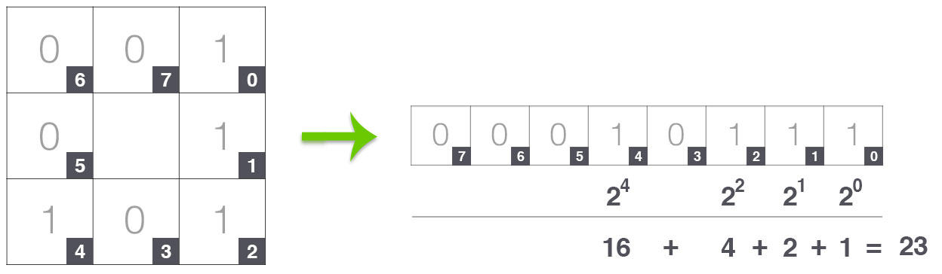
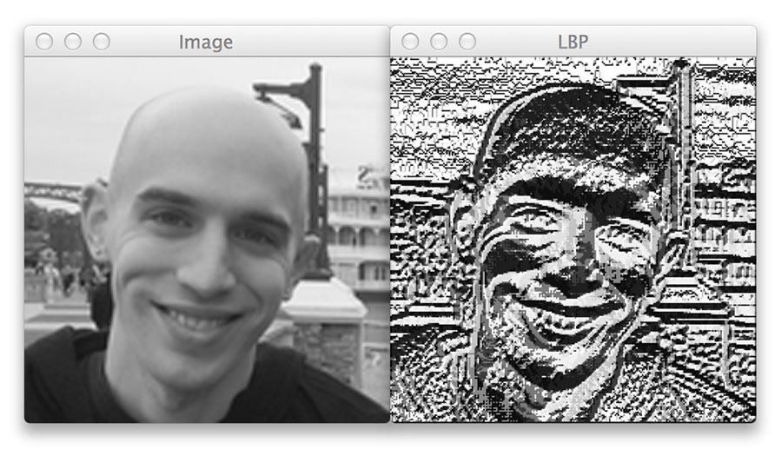
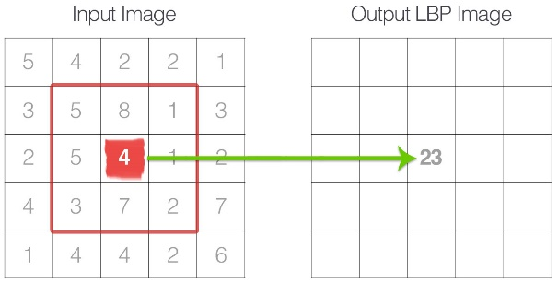
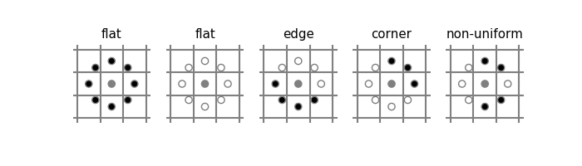
Local Binary Patterns
Uniform combinations: Considering p=8, there are 9 unique uniform combinations:
00000000
00000001
00000011
00000111
00001111
00011111
00111111
01111111
11111111

Slide 14
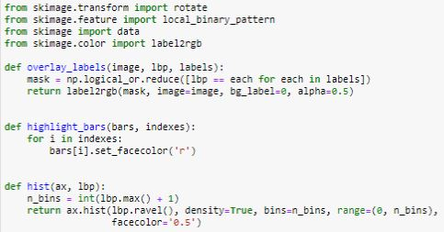
Code: Libraries & Helper Functions

Slide 15
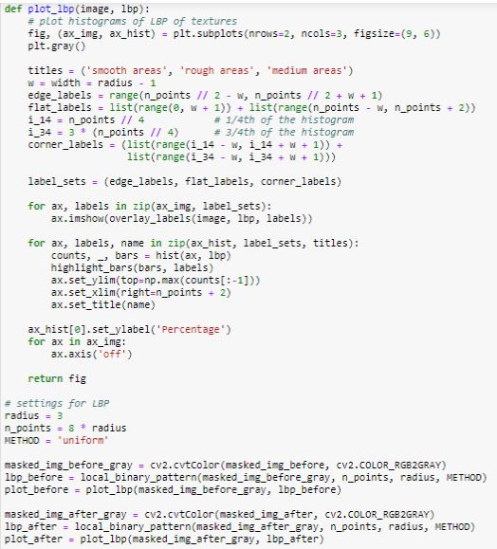
Code: Implement LBP and Plot Histograms

Slide 16
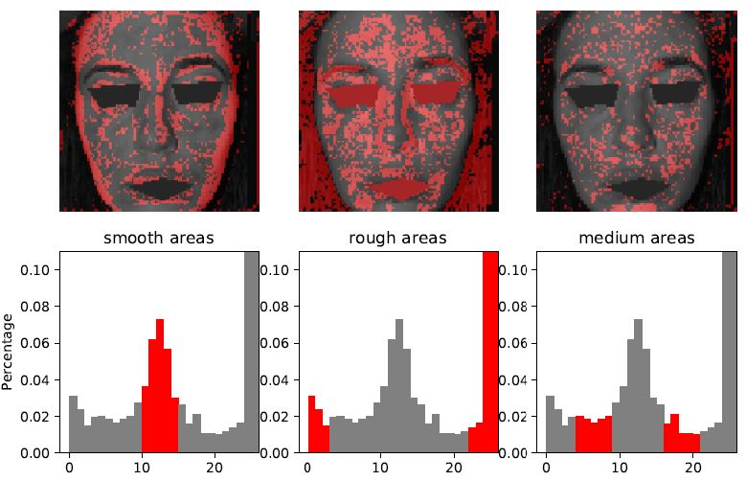
Result: Before using a facial cream (Participant 1)

Slide 17
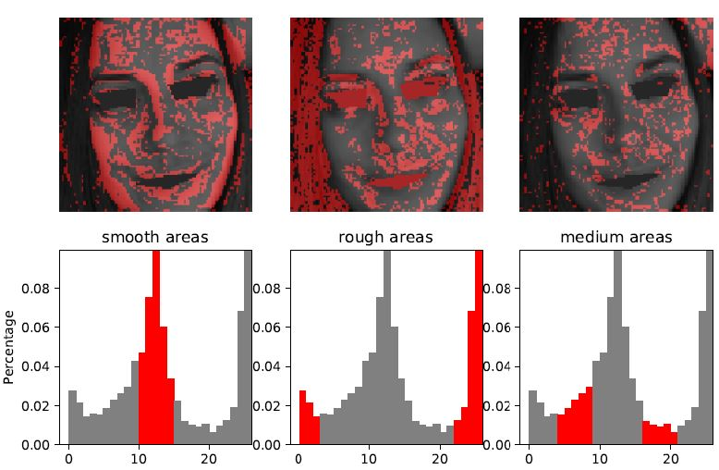
Result: After using a facial cream (Participant 1)

Slide 18
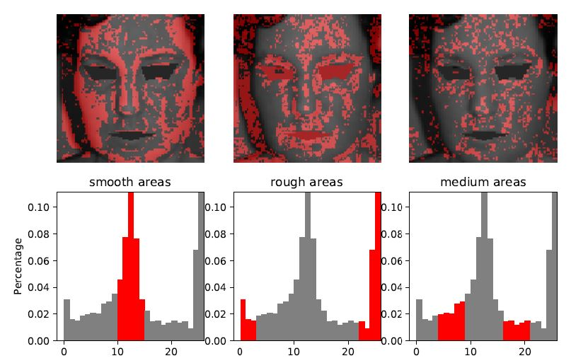
Result: Before using a facial cream (Participant 2)

Slide 19
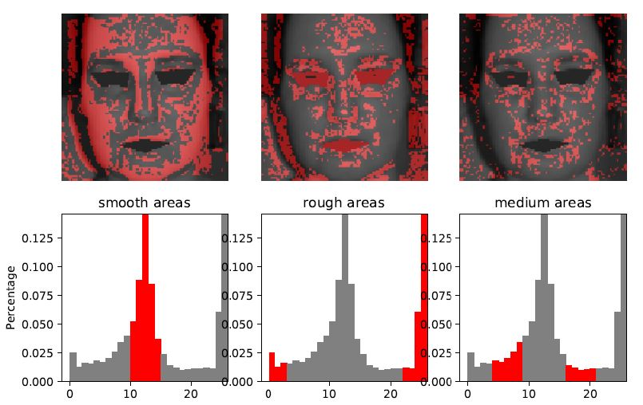
Result: After using a facial cream (Participant 2)

Slide 20
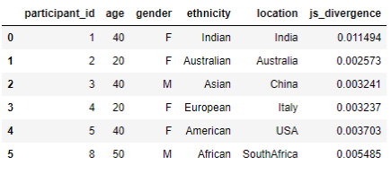
Sample Output Dataframe

Slide 21
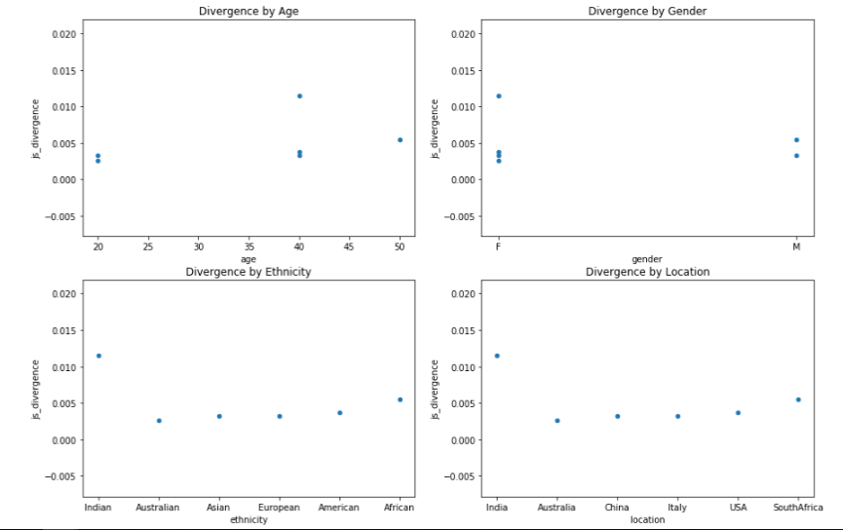
Sample Output Plots - Divergence comparison

