Slide 1
Skin texture change detection for clinical trials
NAGA KALYAN C S SARMA V
2018AH04042

Slide 2
Abstract
In most of the clinical trials, specifically in cosmetic industry, a substantial amount of images are generated such that, the research scientists have an opportunity to analyze and document the efficacy of a chemical/product that is going to be introduced into the consumer market.
This poses 2 major problems:
The industries are bound by confidentiality agreements with the participants, hence each of these images are to be masked in order to protect PII from the internal and external technicians/approvers/stakeholders who view these images.
The research scientists are needed to analyze huge number of images that are generated over a period of time to understand good and bad effects of the product used in the trial, which is a cumbersome task and prone to human error
By leveraging Computer Vision algorithms in this solution, the facial parts of the participants which are not helpful for research (such as eyes) are automatically masked and also the skin texture changes can be compared from one image to another.

Slide 3
Uniqueness
This is an end-to-end solution rather just a portion of what is expected by the industry. The following modules form the entire solution:
Data engineering: Gathering, storing and masking of data
Data Science: Applying Deep Learning and Computer Vision algorithms to generate insights from image which are helpful for research
Operationalization: Leveraging cloud services to host the entire solution in order to generate repeated value

Slide 4
Enhancements
Trained a multi-layer Convolutional Neural Network from scratch by leveraging a training dataset available on public domain
Masked specific coordinates of facial parts such that there is no data loss (for eg: dark circles below the eyes), which should enable better data (skin texture) analysis
With no loss of data, can therefore proceed with current architecture (masking image as soon as it is uploaded -> skin texture analysis)
Masked mouth along with eyes

Slide 5
Technology
Cloud Platform: Amazon Web Services
Services: S3 (storage); Lambda (server less “function as code”); SageMaker (fully managed ML service)
Programming Language: Python 3.7
Libraries: Keras, OpenCV, boto3, numpy, pandas, matplotlib
Multi layer Convolutional Neural Network
Training data: 2000+ labelled images (source: https://www.kaggle.com/c/facial-keypoints-detection/data)

Slide 6









Solution Architecture
AWS Cloud
(Invoke Masking)
2
(trigger)
3
AWS Lambda
(read raw image)
4
Amazon SageMaker
Model Endpoint
(Masking)
5
(write masked image)
1
(upload raw images)
(write texture info)
9
Users
(Scientists & other stakeholders)
Amazon S3
8
(read masked image)
Amazon SageMaker
Model Endpoint
(Texture Identification)
Research Lab Personnel
10
(trigger)
(invoke texture identification)
6
7
(structure)
AWS Lambda
(Data Catalogue)
(Query)
(Reports)
11
12
13
AWS Glue
Amazon Athena
Amazon QuickSight

Slide 7
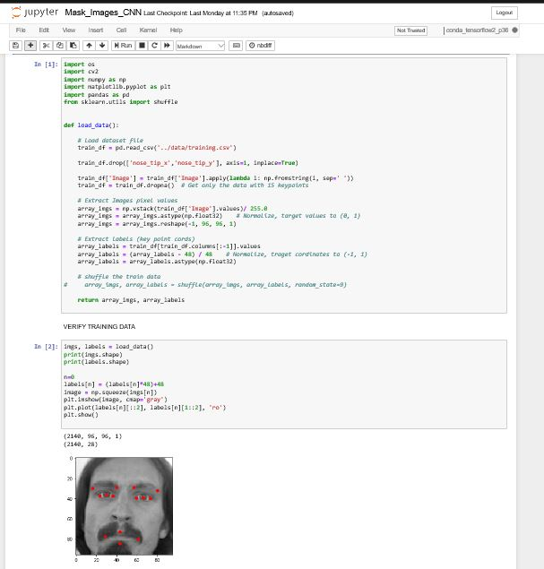
Code: Load & Transform Training Data

Slide 8
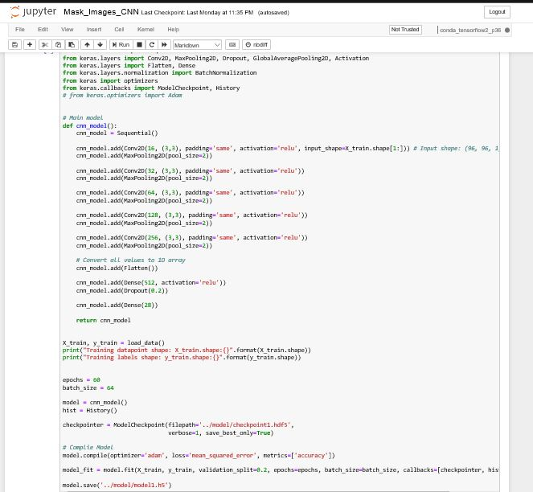
Code: CNN Model

Slide 9
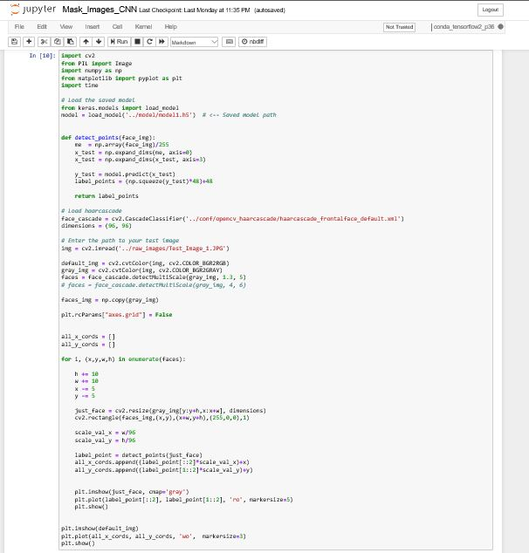
Code: Model Validation

Slide 10
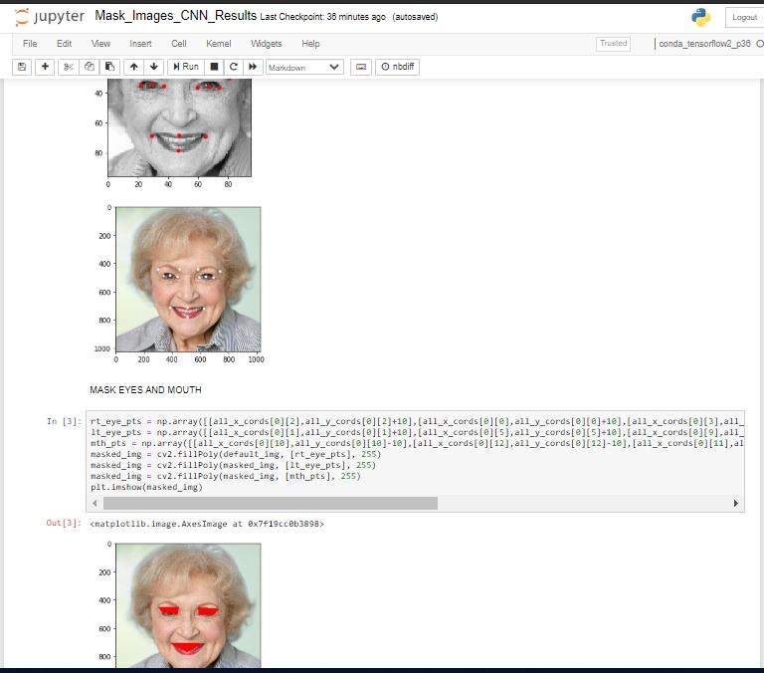
Result: Masked Image Example 1

Slide 11
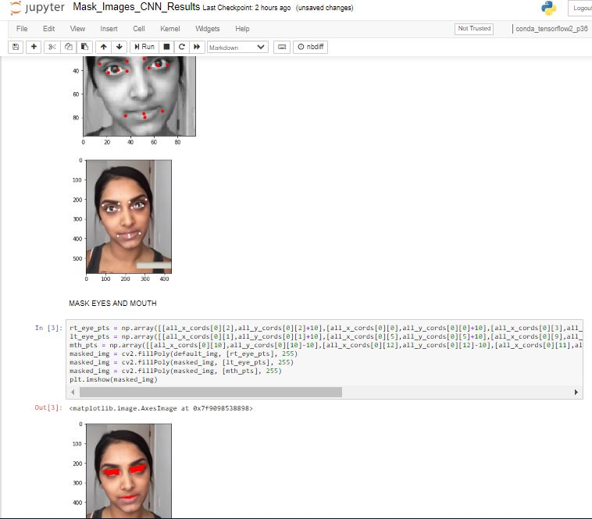
Result: Masked Image Example 2 (Different Ethnicity/Age)

