Slide 1


Course survey: what has been done, and what should be done
Alexey Pomerantsev
forecast@chph.ras.ru
Semenov
Institute
of Chemical
Physics
Russian
Chemometrics
Society

Slide 2
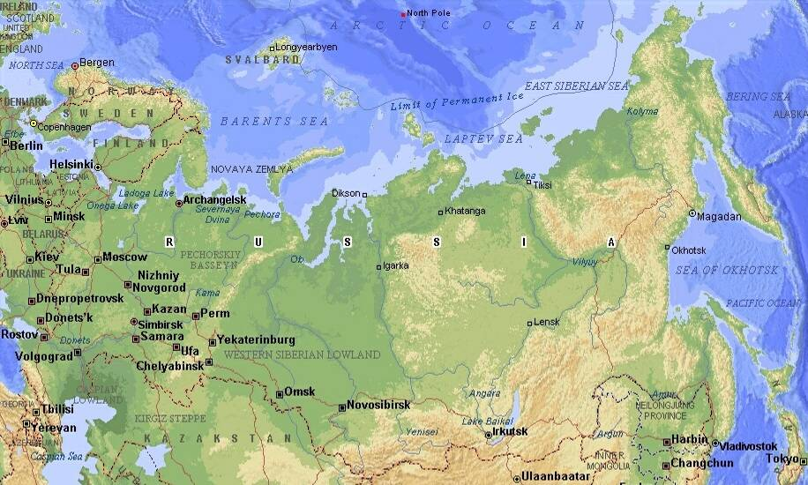
Introduction
Unfulfilled need in chemometric education in Russia
Low number of qualified specialists in chemometrics
Large distances, e.g. Moscow – Barnaul is about 3000 km
No modern chemometrics books in Russian
No available chemometric software
No support from officials: government, Academy, etc
Easy available everywhere => INTERNET
Interactive layout: all calculations should be clear and repeatable
Web friendly environment for the calculations => EXCEL
Necessity to make and use our own (free) software => EXCEL Add-In
3000 km
4000 km
Barnaul

Slide 3
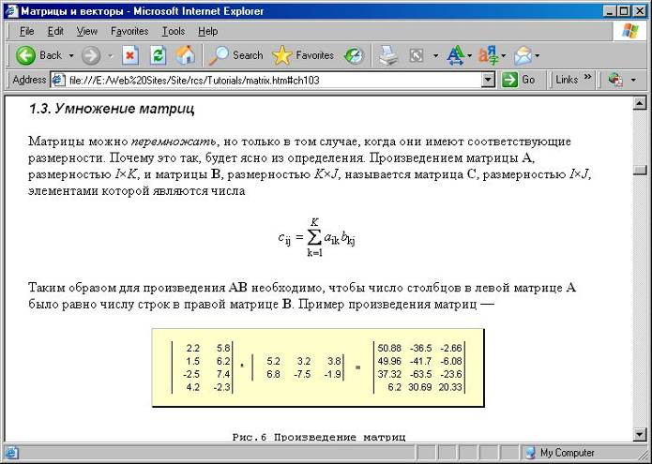
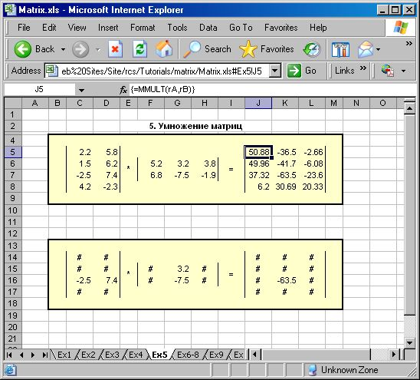
Interactivity in practice

Slide 4
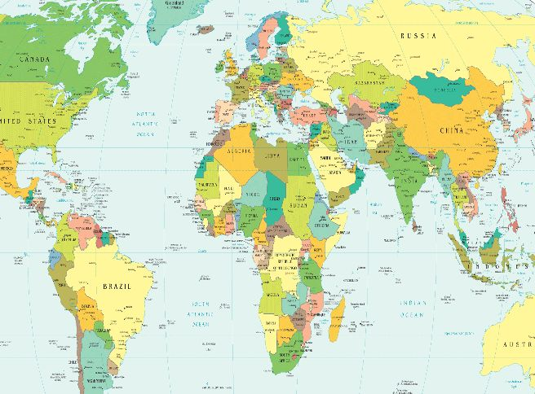
International View
Free in Russian
Charged in English
elsewhere
Free in Afrikaans –
Sylvia Paul initiative

Slide 5
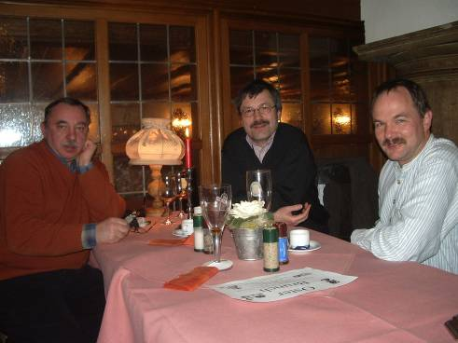
Dream about profits
In 2005 Braunschweig Univ.
announced an Internet based
Master course in hydrogeology
Some 1000 applicants (mostly
from China) have applied
Only 3 persons (as planned)
have been accepted
Each Master student brings
some 1000 EUR per year
Braunschweig 2007
Our need is a world famous university that can support our
initiative
It should confirm the Master of Chemometrics degree obtained
at the distance education

Slide 6
Course Levels
Basics
Chemometrics
Advanced

Slide 7
Course Layout
Tutorials
Exercises
Basics
Basics
Chemometrics
Chemometrics
Advanced
Advanced
Projects
Tests
Chemometrics
Chemometrics
Advanced
Advanced

Slide 8
Course Contents
Basics
Matrices
Statistics
Excel
XLA
Matlab
Instruments
Chemometrics
Introduction
PCA
Calibration
Classification
MCR
Advanced
MSPC
MIA
Preprocessing
Multi Way
Spectroscopy
DoE

Slide 9
Ready in Russian
Basics
Matrices
XLA
Matlab
Chemometrics
Introduction
PCA
Calibration
Advanced

Slide 10
To be created
Basics
Statistics
Excel
Instruments
Chemometrics
Classification
MCR
Advanced
MSPC
MIA
Preprocessing
Multi Way
Spectroscopy
DoE

Slide 11
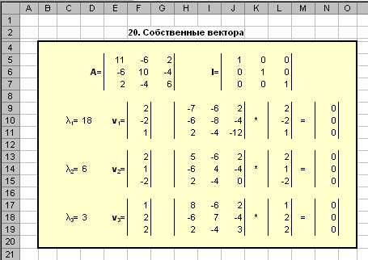
Basic. Matrices. Ready
Minimum
  Matrix & vector
  Operations
  Rank, determinant
  Inverse & psedoinverse
Additional
  Linear equations
  Quadratic forms
  Decompositions
  Eigenvectors
  SVD
  Linear space and basis
  Subspace and projection
Illustration: Excel workbook

Slide 12
Basic. Matlab. Ready
Framework
  Workspace
  Calculations
  MAT files
Matrices
  Data and data access
  Matrix operations
MatLab & Excel
Programming
  M-files
  Functions & subroutines
  Plotting
Examples
  Preprocessing
  SVD & NIPALS
  PLS1 & PLS2
Illustration: Functions
function [T, P] = pcasvd(X)
% pcasvd: calculates PCA components.
% The output matrices are T and P.
% T contains scores
% P contains loadings
[U,D,V] = svd(X);
T = U * D;
P = V;
%end of pcasvd

Slide 13
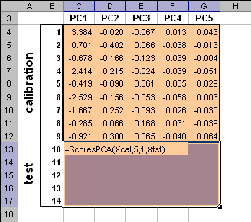
Basic. XLA. Ready
Projection methods
  PCA & PLS
  Simulated example
Chemometrics xla
  Installation
  General
PCA
  ScoresPCA
  LoadingsPCA
PLS
  ScoresPLS
  ....
PLS2
  ScoresPLS 2
  ....
Simulated illustration

Slide 14
Basic. Excel. To be created
?
Illustration: Excel workbook

Slide 15
Basic. Statistics. To be created
?
Illustration: Excel workbook

Slide 16
Basic. Instruments. To be created
Introduction
Spectroscopy (IR, UV, NIR, Raman)
Chromatography
Hyphenated techniques
Etc ...

Slide 17
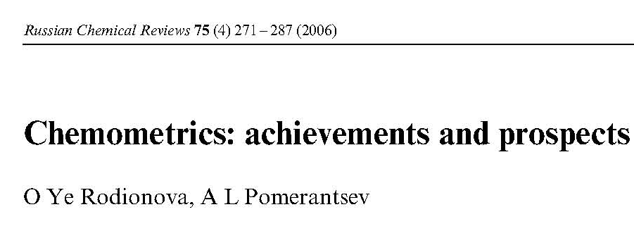
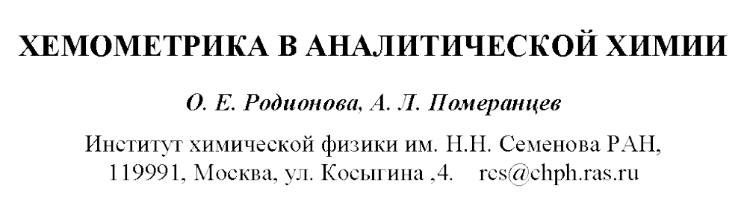
Chemometrics. Introduction. Ready
Introduction
Data and models used in chemical analysis
Qualitative analysis
methods. Exploration, classification and discrimination
Quantitative analysis methods. Calibration
Data preprocessing and signal processing
Conclusions

Slide 18
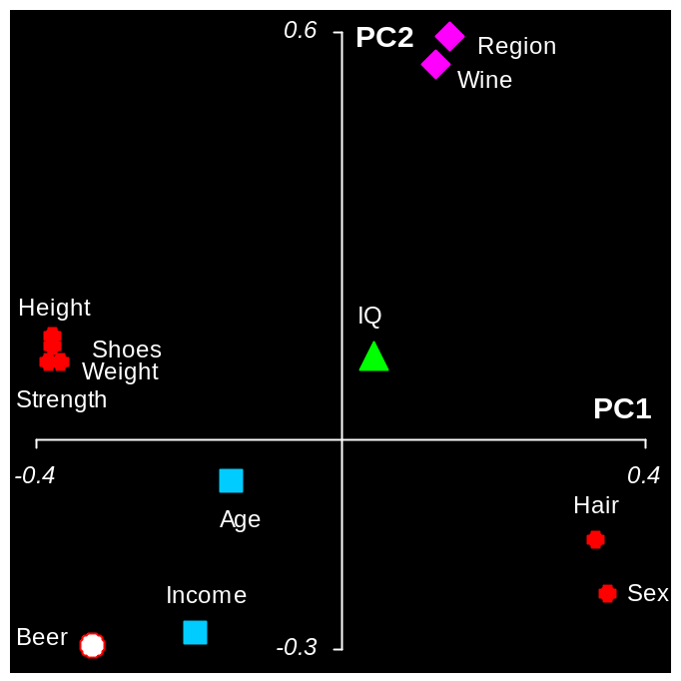
Chemometrics. PCA. Ready
Introduction
  Data reduction
  Intuitive approach
PCA
  Algorithm
  Scores
  Loadings
  Residuals
  Number of PC
Example. People
  Data exploration
  Score plots
  Loading plots
  Residuals
Illustration: People

Slide 19
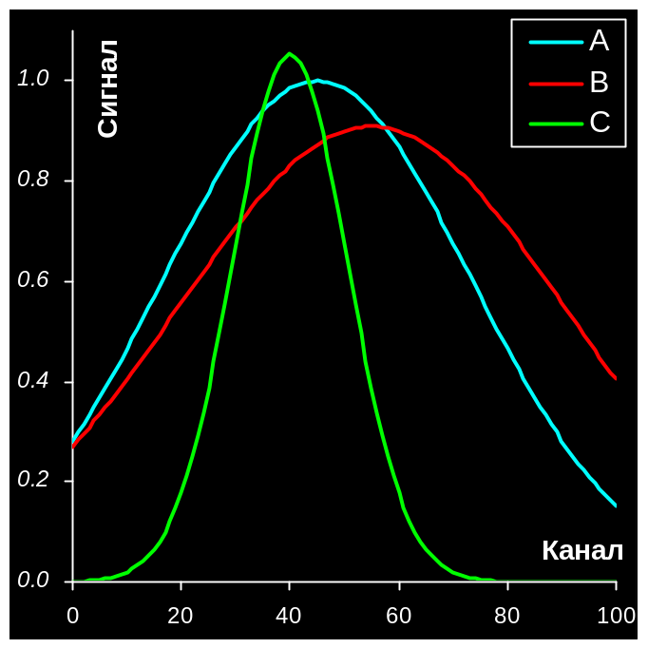
Chemometrics. Calibration. Ready
Introduction
  Validation and quality
  Over – and underfitting
  Multicolinearity
Classic
  Direct calibration
  Univariate calibration
  Multiply calibration
  Step wise calibration
Multivariate
  Projections
  PCR
  PLS
  PLS2
Simulated illustration

Slide 20
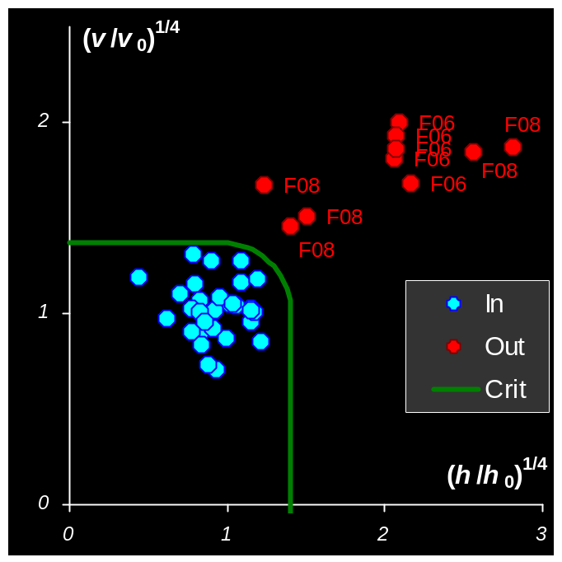
Chemometrics. Classification. To be done
Introduction
  Supervised PR
  Unsupervised PR
SIMCA
  PCA
  Scores and orthog. distances
  Example
PLS discrimination
  PLS
  Example
Illustration: Drugs

Slide 21
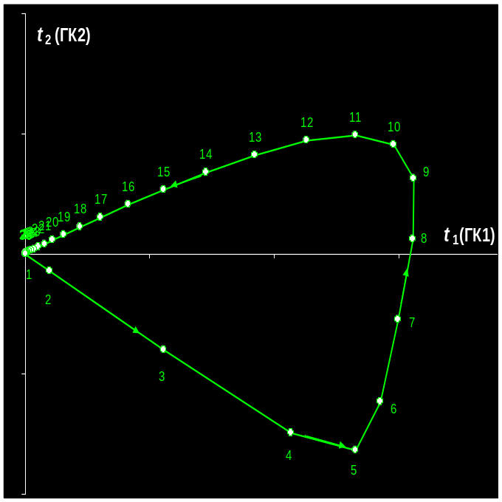
Chemometrics. MCR. To be created
Introduction
  Data reduction
  Intuitive approach
Example. HPLC-DAD
  Data
  Elution profiles
  Pure Spectra
Resolution
  PCA
  EFA
  WFA
  Procrustean rotation
  ALS
Illustration: HPLC-DAD

Slide 22
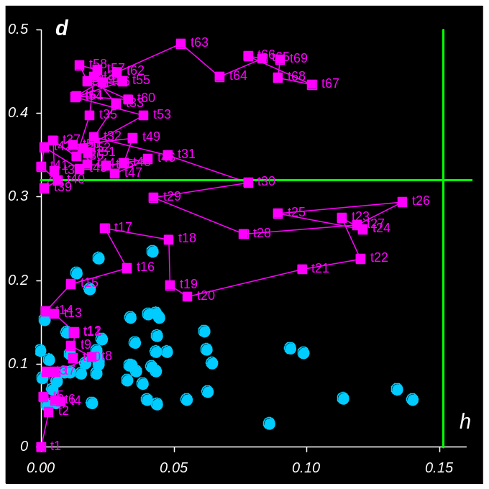
Advanced. MSPC. To be created
Introduction
  Process control
  Shewart cards
Multivariate approach
  PCA & SIMCA
  Batch process
  PLS
Illustration: Simulated

Slide 23
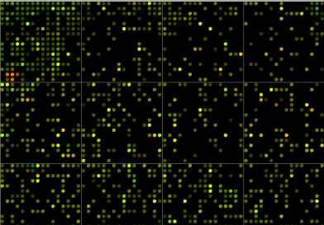
Advanced. MIA. To be created
Introduction
  Imaging
  Digitalization
Example. Microarrays
  Unfolding
  PCA
Multivariate approach
  PCA
Illustration: Microarray

Slide 24
Advanced. Preprocessing. To be created
?
Illustration: ???

Slide 25
Advanced. Multi Way. To be created
?
Illustration: ???

Slide 26
Advanced. Spectroscopy. To be created
?
Illustration: ???

Slide 27
Advanced. DoE. To be created
?
Illustration: ???

Slide 28
Team work
Nadezhda is the project coordinator
Alexey is responsible for tutorials preparation (in Russian)
Oxana is responsible for Chemometrics.xla software, exercises, projects, and tests
Oleg and Tatiana are the exemplars of a student. They are also responsible for the English translation
Satu-Pia is working to legalize the course inside the LUT
Jarno is responsible for validation. He will also contribute with projects
Sergei is responsible for the Internet medium

Slide 29
Conclusions and tasks
We have a good groundwork for start
There is a lot of future activities though
Besides the conceptual, a legalization efforts are needed
Topical problem is allocation of responsibilities
Just now I am waiting for your comments, proposals, etc

